Slide 1
PRISHU

Slide 2
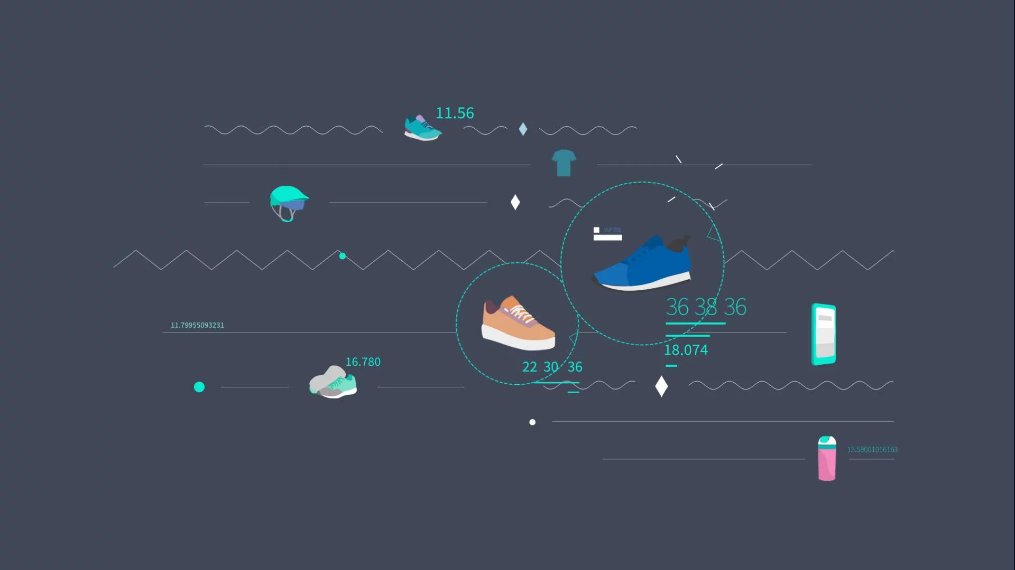
Our brains
Meet our awesome members
Premalatha D
Roshini S
Saloni Raj

Slide 3
Contents
Problem Statement
5
1
Execution
2
Existing
Problems
6
Challenges
3
Benefits of Project
Vision
7
4
Technologies
8
Future scope
5

Slide 4
Problem Statement
To build a conversational solution that enables customers to discover and order products.

Slide 5
Existing
Problems
Making a secure chatbot.
Choosing between voice activated and text based chatbots.
Managing the availability of chatbot.
Improve customer experience and satisfaction.
Should provide accurate and useful information.
Usage of better algorithms to make search efficient.

Slide 6
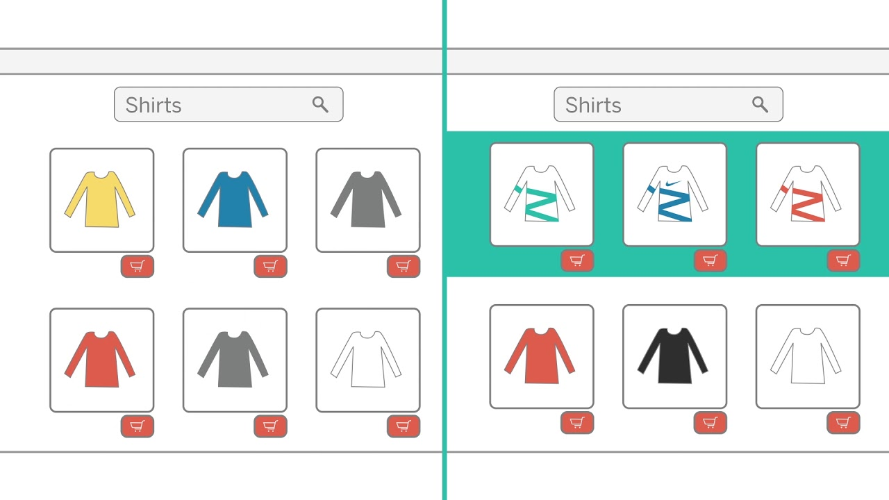
Our vision
With minimal data or human intervention, our project will accept only verbal commands, to give visitors one-to-one personalization of ordering products so each visitor experiences relevant response. It will intuitively anticipate according to the customer needs, exactly when they need it.

Slide 7

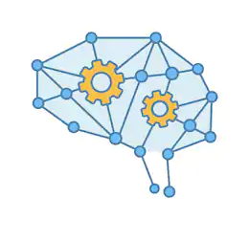

Technologies
Python
Machine Learning
Natural Language Processing

Slide 8
Execution
Start
Listen command
Chatbot
replies
Display Most expected required products
Add product to the cart
Invalid input
True
True
True
False
Is command== convo.
Is command == Product
pattern
Is command == Product
Is command == “Bye” or “Thank You”
End
False
False
False
True

Slide 9
Benefits of our project
Self-learning technology
Also works with small data sets
Predictive personalization
Hands free experience
Content search
Automated ranking & sorting
Understands user-product relationships

Slide 10

Challenges !
Performing ordering and ranking of products
Performing sound recognitions
Creating a chatbot

Slide 11
FUTURE SCOPE
The opportunity to enhance the conversation with the ability to be available and interact remotely.
We can add more dataset and make it more conventional.
The clearest use of chatbots right now is in customer service and online ordering.By incorporating it with Deep learning concepts we can make it efficient in services to automate customer issues or complete orders.
In the coming future Chatbot will be able to perform cognitive service function such as Language recognition and translation,Text analytics etc.

Slide 12

The future starts today, not tomorrow.
Thank you !!!
Team - Prishu

