Slide 2
Minor Project – 1 Data Link Layer (L2 Routing) Implementation (TCP/ IP Stack Functionality)
Synopsis Presentation
In partial fulfillment of the requirements
For the course of
Minor Project-1
Under the guidance of
Ms. Avita Katal
By
Kshitiz Saini | 500067035 | R171218058
Saloni Saxena | 500067409 | R110218131
Pratyusha Agarwal | 500068293 | R110218107

Slide 3
ABSTRACT
In today’s world, fast and efficient communication on the network between the sender and receiver is very important. For this communication, data is converted into packets and sent over the network using various routing algorithms. In a network or over multiple networks, routing refers to the process of determining a path for a packet to travel from. L2 Routing is based on the concept of Data Link layer and happens when data is to be transferred between the same subnet. In this project, we aim to implement the functionality of Data Link Layer like creating ARP tables, L2 Routing, MAC learning, L2 Switching & implementing VLAN forwarding.
Keywords : Network Routing, TCP/IP, Network Graph, ARP, L2 Routing, L2 Switching, Packet, Socket Programming, Topology, VLAN, MAC Learning

Slide 4
PROBLEM STATEMENT
The transmission of data from one device to another without the help of TCP/IP stack is only feasible for a geographically small area but when it comes to worldwide solutions, it is not very appropriate. The problem without the TCP/IP Layer is to transmit data through the shortest path using features like creating ARP Tables and MAC Learning for an optimal resolution. Another problem is to create a network to share the data and a new medium has to be used for transmission every time.

Slide 5
OBJECTIVES
The main objective is to implement the data link layer. The project focuses on the practical implementation of L2 Routing, L2 Switching and VLAN based forwarding where the concepts of ARP Resolution, MAC Learning and Forwarding will be used. Alongside, implementing the concept of Routing and Switching Algorithms, GL Threads, Timers, CLI Integration will also be in consideration.
Sub-objectives for the project are:
Developing a generic graph topology
Tackling the issues of thrashing, collision and reducing broadcast domain
Implementing ARP, L2 routing, MAC learning and L2 switching

Slide 6
DATA LINK LAYER
The data link layer is the protocol layer in a program that handles the moving of data into and out of a physical link in a network. The data link layer is Layer 2 in the Open Systems Interconnection (OSI) architecture model for a set of telecommunication protocols. Data bits are encoded, decoded and organized in the data link layer, before they are transported as frames between two adjacent nodes on the same LAN or WAN. The data link layer also determines how devices recover from collisions that may occur when nodes attempt to send frames at the same time.
Functionality of Data Link Layer :
Framing : The data link layer divides the stream of bits received from the network layer into manageable data units called frames.
Physical Addressing : If frames are to be distributed to different systems on the network, the data link layer adds a header to the frame to define the sender and/or receiver of the frame.
Flow Control : The data rate must be constant on both sides else the data may get corrupted.
Error control : Error control is normally achieved through a trailer added to the end of the frame and to detect and retransmit damaged or lost frames.
Access control : When two or more devices are connected to the same link, data link layer protocols are necessary to determine which device has control over the link at any given time.

Slide 7
NETWORK ABSTRACTION
Networks are treated as graphs G (V, E) consisting of V vertices/nodes and E edges.
➔ The graphs are bi-directional (undirected) because data can flow on both sides.
➔ Weighted graphs are used where weight indicates distance/cost etc.
➔ Connected graph is used as all nodes in a network are connected with each other.
Given figure depicts a graph containing 5 vertices and 5 edges. It is a connected and undirected graph that can be used to represent a network.
Network G (V, E) with V = 5 and E =5

Slide 8
ARP Resolution
The Address Resolution Protocol (ARP) is a communication protocol used for discovering the link layer address, such as a MAC address, associated with a given internet layer address. This mapping is a critical function in the Internet protocol suite.
Algorithm for ARP Resolution
ARP Request message is broadcasted to all devices on the network.
Nodes determine if they are the intended target.
If nodes are the intended target, they proceed to STEP 3
If they are not the intended target, they discard the request and proceed to STEP 4
Intended device sends ARP Response to the sender in unicast mode.
END

Slide 9
L2 Switching
Layer 2 switching (also known as the Data Link layer switching) is the process of using devices MAC addresses to decide where to forward frames in a LAN. Layer 2 switching is efficient because there is no modification to the data packet, only to the frame encapsulation of the packet.
Algorithm for L2 Switching
When the frame reaches the L2 switch, it updates its table with the MAC address of the source machine corresponding to the port number at which the frame is received.
L2 switch forwards the packet.
If it does not contain the MAC address of the destination machine corresponding to any port, it floods the packet.
If it contains the MAC address of the destination machine, step 3 is followed.
Frame is received only to the intended machine.
END

Slide 10
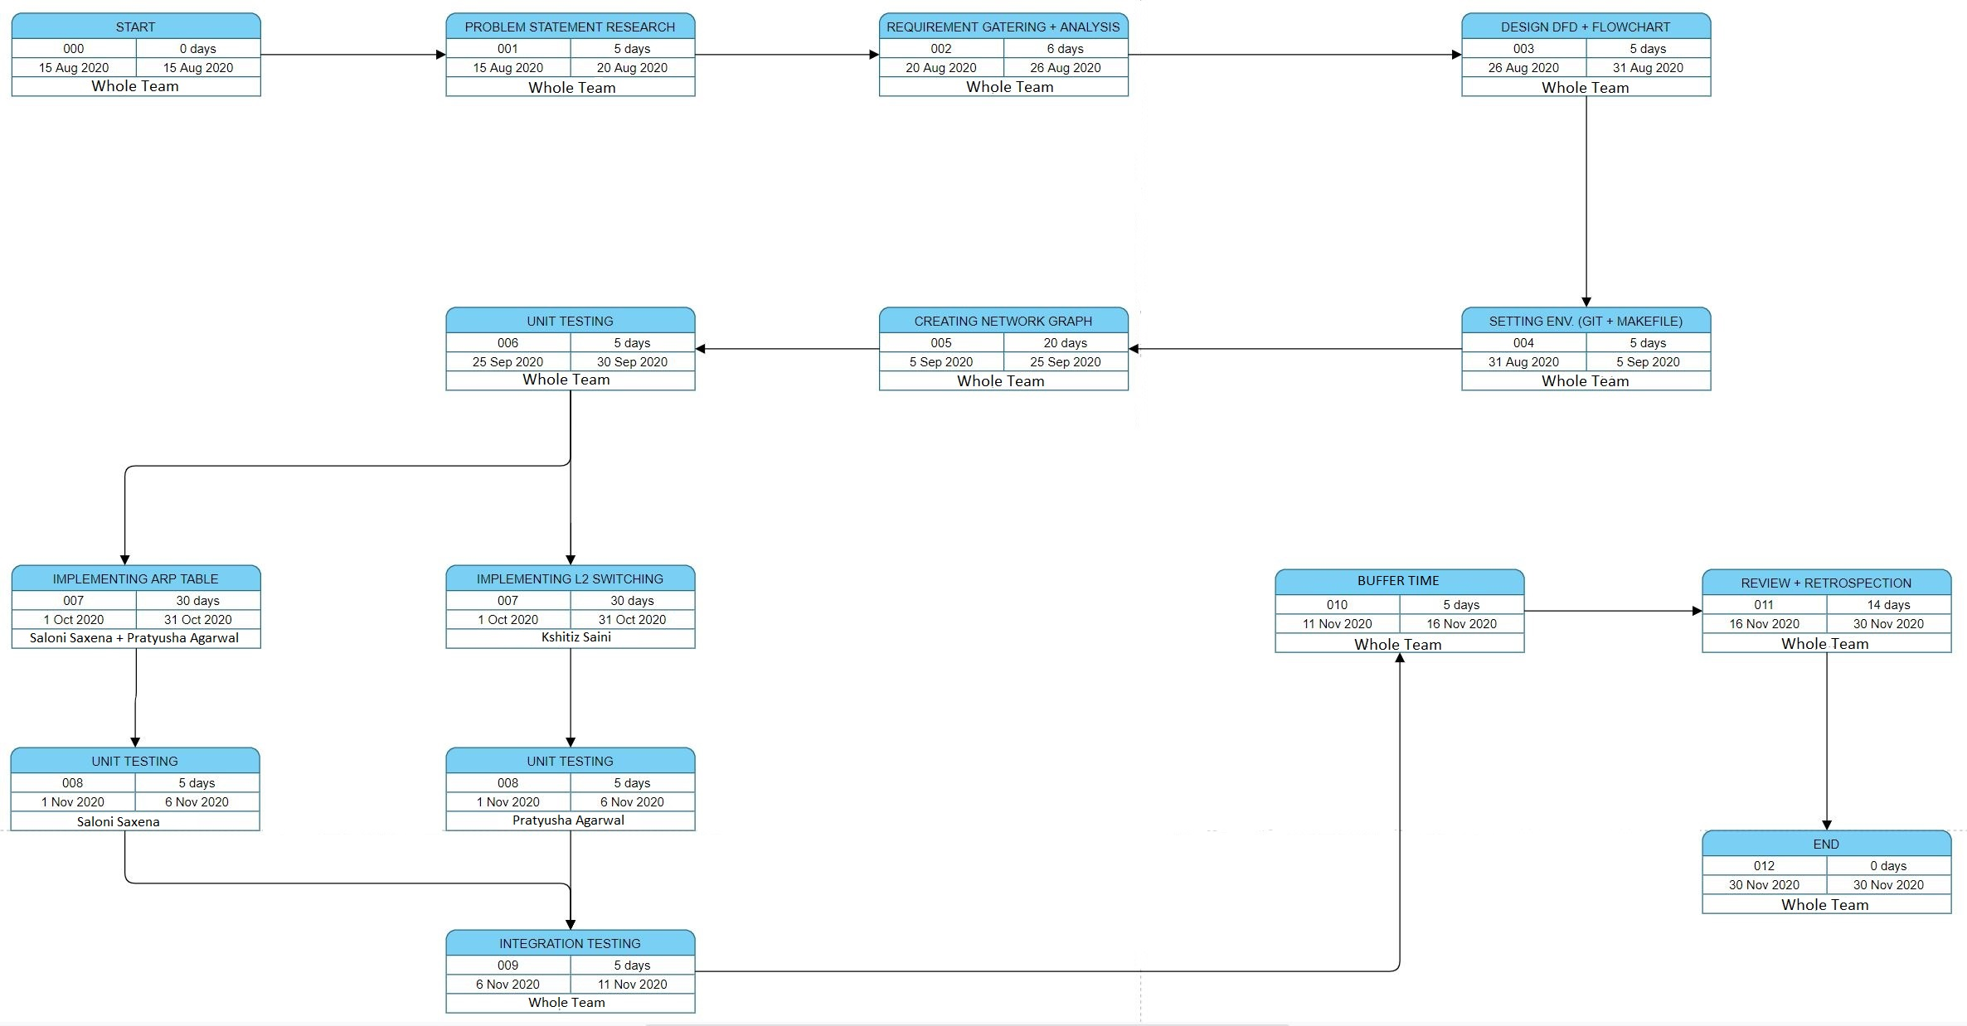
PERT CHART

Slide 11
