Slide 1
Implementing, testing and experimental analysis of centrality concepts
Mohit Jeste
Saloni Shah
Team 5
CSE 6331, Spring 2020
mohitsandeep.jeste@mavs.uta.edu
saloni.shah2@mavs.uta.edu

Slide 2
References
Bader, David A., Shiva Kintali, Kamesh Madduri, and Milena Mihail. "Approximating betweenness centrality." In International Workshop on Algorithms and Models for the Web-Graph, pp. 124-137. Springer, Berlin, Heidelberg, 2007.
Sariyüce, Ahmet Erdem, Kamer Kaya, Erik Saule, and Ümit V. Çatalyiirek. "Incremental algorithms for closeness centrality." In 2013 IEEE International Conference on Big Data, pp. 487-492. IEEE, 2013.
Gago, S., J. Hurajová, and T. Madaras. "Notes on the betweenness centrality of a graph." Mathematica Slovaca 62, no. 1 (2012): 1-12.
Networkx documentation https://networkx.github.io/documentation/stable/
Santra, Abhishek, Sanjukta Bhowmick, and Sharma Chakravarthy. "Hubify: Efficient estimation of central entities across multiplex layer compositions." 2017 IEEE International Conference on Data Mining Workshops (ICDMW). IEEE, 2017.

Slide 3
Problem description
Find hubs on a given dataset based on different centrality measures.
For datasets consisting of different layers, we need to find hubs in the ‘AND’ composition of 2 or more layers.
Find a heuristic which does the above task in lesser time and find the hubs.
Study the effects of different graph characteristics on the four centrality measures.

Slide 4
Details of our Approach
Recap of midway presentation
Taking the AND of 2 or more layers and then finding the hubs for the AND composition is computationally intensive.
We tried the Naïve AND approach where we find the hubs for each individual layer and then take the intersections of all these hubs across various layers.
This gives a large percent of false negatives and low Jaccard index.

Slide 5
Details of our Approach
We tried 4 heuristics. Naïve AND was explained in the midway presentation. I will be explaining the other 3.
These three are min betweenness heuristic, average betweenness heuristic and Mohit's heuristic.

Slide 6
Packages used
networkx
betweenness_centrality
closeness_centrality
degree_centrality
eigenvector_centrality
shortest_path_length
density
diameter
eccentricity
average_clustering
sys, subprocess, os
time
statistics
layerComposerv2(AND composition code by Abhishek)

Slide 7
Details of our Approach
Min betweenness heuristic
Intuition:
Betweenness directly proportional to number of shortest paths passing through a node.
Taking the AND composition eliminates edges.
This in turn causes the number of shortest paths to decrease.
So take the minimum of the number of shortest paths passing through a node across both layers.

Slide 8
Details of our Approach
Min betweenness heuristic
Algorithm(consider 2 layers):
Find betweenness values for all nodes for layer 1.
Find betweenness values for all nodes for layer 2.
Calculate the betweenness of a node as min(betweennes in layer 1,betweennes in layer 2)
Calculate the mean of all these mins.
Hubs are the ones whose min value across 2 layers is greater than mean.

Slide 9
Details of our Approach
Min heuristic gives a high precision but not low recall.
To increase the recall we needed to increase mean betweenness calculated. So the need for average heuristic.

Slide 10
Details of our Approach
Average betweenness heuristic
Algorithm(consider 2 layers):
Find betweenness values for layer 1.
Find betweenness values for layer 2.
Calculate the betweenness of a node as average(betweenness in layer 1,betweennes in layer 2)
Calculate the mean of all these averages.
Hubs are the ones whose average value across 2 layers is greater than mean.

Slide 11
Details of our Approach
This leads to high recall but comes at the cost of low precision.

Slide 12
Details of our Approach
Mohit's heuristic:
Intuition:
AND composition eliminates edges. Since we have HoMLN, it won't eliminate nodes.
So consider betweenness centrality for edges rather than nodes.

Slide 13
Details of our Approach
Details:
Find the edge betweenness centrality and find the edges which are hubs rather than nodes.
To go from edge hubs to node hubs we find the count for each node from these edge hubs.
Consider the node which have a count greater than 1 to be our final predicted hubs.

Slide 14
Datasets Used
All datasets used are homogenous MLNs.
Datasets used:
Airline dataset:
6 layers
All layers have 290 nodes. Nodes are cities.
If there exists a flight of an airline between 2 cities there is an edge.
Layers are as follows:
Alligent #Edges 379
American #Edges 745
Delta #Edges 682
Frontier #Edges 338
Southwest #Edges 711
Spirit #Edges 187

Slide 15
Datasets Used
DBLP dataset
3 layers
Nodes represent authors.
There are 17204 nodes in every layer.
Edges represent if 2 authors have co-authored a paper.
Layers are as follows:
ICDM #Edges 12986
SIGMOD #Edges 17737
VLDB #Edges 5831

Slide 16
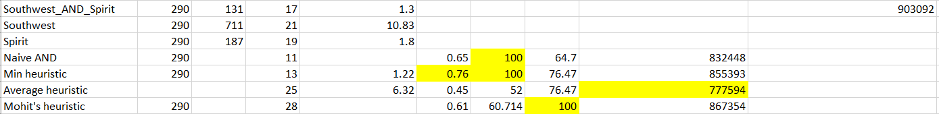
Experimental Results
Naïve AND shows best precision and low recall.
Min heuristic traded some precision for recall resulting in higher Jaccard.
Average heuristic resulted in high recall but low precision. Results in lower Jaccard than min heuristic.
My heuristic shows best Jaccard for AND compositions that have edges < 100
Min heuristic shows best Jaccard for AND compositions that have edges > 100
Average heuristic calculates hubs the fastest.

Slide 17
Analysis of graph characteristics and centrality measures
Centrality measure:
Closeness centrality
Graph characteristics:
Graph average distance
Density
Centrality measure:
Eigen centrality
Graph characteristics:
Degree assortivity
Density
Ratio of hubs

Slide 18
Datasets used
Homogenous datasets:
Airline Dataset
DBLP Dataset
Heterogenous datasets:
Facebook and Gplus Dataset:
Ego networks: network of a user's immediate friends
9 layers
Nodes represent user profiles
Edges represent friendship between 2 users
300 – 900 nodes in a layer

Slide 19
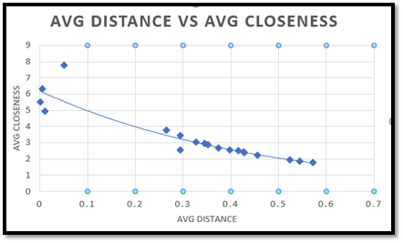
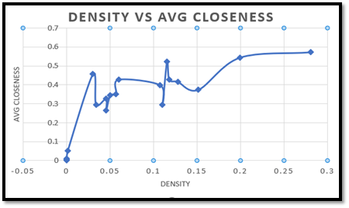
Closeness centrality
Average Distance: average shortest distance between 2 nodes in the graph
Density: Number of edges/number of nodes
Results:

Slide 20
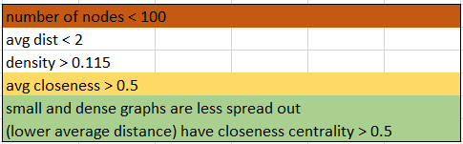
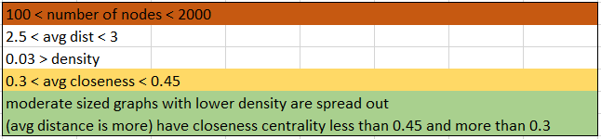
Results
Graphs with nodes > 2000, are less dense than all the smaller graphs listed and naturally have larger average distance. Hence, they lie in the lowest average closeness bracket

Slide 21
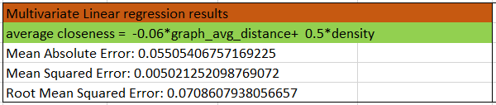
Relation between average closeness and graph characteristics for the given dataset

Slide 22
Eigen centrality
Degree assortivity coefficient: A number between −1 and 1, just as are correlation coefficients. A large positive value means that connected nodes have similar degree value.
Hub ratio: number of hubs/ total nodes
Density: Number of edges/number of nodes

Slide 23
Assortivity is positive for Facebook and Gplus graphs: because of homophily. Whereas for airlines, the hubs need to be spread out and be reachable to small cities too so assortivity is negative.
Expectation: High assortivity would result in high eigen value.

Slide 24
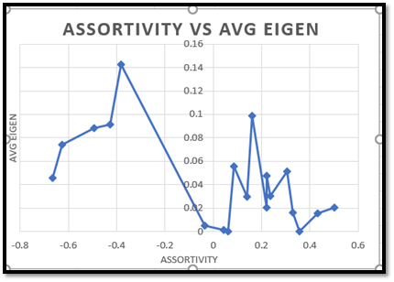
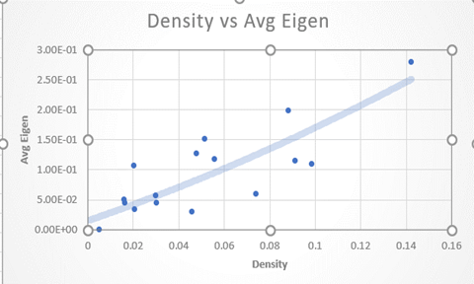
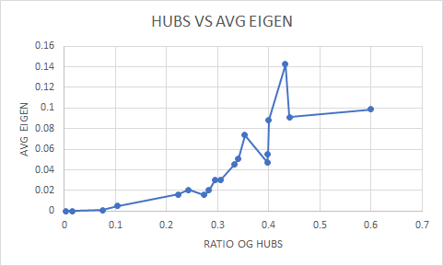

Slide 25
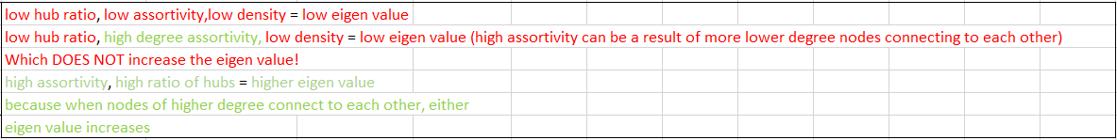
Results
Results:

Slide 26
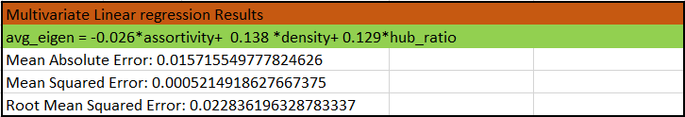
Relation between average eigen centrality and graph characteristics for the given dataset

Slide 27
Conclusions
Due to lack of experiments on controlled settings we are not able to convincingly establish any meaningful conclusions on characteristics and centrality analysis.
Though certain heuristics worked well on precision or recall we were not able to find a good heuristic which will satisfy a high Jaccard index.

Slide 28
Tasks completed
Implement the two measures (in Python or other language), test for correctness.
Done
Integrate it into the driver that we already have (in Python) to make running experiments and management of results easy.
Done
Run at least two data sets on each of the measures and compare it with other measures.
Done
Experimental analysis of other identified data sets and comparative analysis of all work.
Done

Slide 29
Evaluation
Have you finished the project as per initial description and milestones?
Yes
Did you encounter any problems?
We could not perform our analysis on datasets having more than 17000 #nodes and #edges since they didn't run in limited time.
Couldn't find a trade-off to minimize the false positives and false negatives.
Takeaway from this project experience
Deep understanding of centrality measures and how they are related to graph characteristics.
Experimental analysis of real-world data.

Slide 30
Conclusions
What do you think you learned from this effort?
Coming up with a hypothesis via intuition.
Learnt how to perform in depth analysis of any hypothesis proposed.
Reasoning for expected and unexpected results.
Do you think there is a paper from this project?
Not yet.
If not, Can you extend this to make a decent conference paper?
With more experiments in controlled settings it may be possible.

Slide 31
Discussion

Slide 32


Thank You !!!
For more information visit:
http://itlab.uta.edu

