Slide 1
Greater Houston Market Evaluation
Greater Houston Metro
Market Evaluation
Grease Trap Waste Disposal Demand & Competitive Landscape
Saloni Subhash Shahi
MS Business Analytics, Northeastern University
May 2026
Notes:
looked at where the restaurant demand is, who the current competitors are, where the gaps are, and what the regulatory picture looks like. I think I found some interesting things

Slide 2
AGENDA
Greater Houston Market Evaluation
01
The Infrastructure Gap
Market size and the core problem
02
Demand Analysis
14,532 establishments across 9 counties
03
Restaurant Density Map
Where demand is concentrated
04
Competitive Landscape
Who operates, who dominates, market sizing
05
Gap Analysis
Quantifying the disposal infrastructure deficit
06
Regulatory Tailwinds
FOG limits, surcharges, EPA Consent Decree
07
Opportunity Zones
Fort Bend, Montgomery, Harris suburban ring
08
Recommendation
Where to enter first and why

Slide 3
THE INFRASTRUCTURE GAP
Houston has the demand.
It doesn't have the disposal.
14,532
6 of 10
8 of 9
Food Service
Establishments
Actively Operating GTW Facilities
Counties with
ZERO Facilities
9 of 10 registered 5GG facilities are in Harris County, 1 is pending in Austin County. Only 6 are actively operating. 8 counties with 4,494 establishments have no disposal infrastructure.
Notes:
Houston has over 14,500 food service establishments across 9 counties. Every one of them has a grease trap generating waste.
Now here's the problem. The TCEQ registry shows 10 5GG grease trap processing entries across the entire MSA. But when you look closer — 9 are in Harris County and 1 is in Austin County still pending approval.
So the real picture — 10 registered entries in TCEQ but only 6 are actually built and running. Three got permits years ago but were never constructed. And one in Austin County is still pending. So it's 6 operating facilities for over 14,000 restaurants. That's roughly 2,400 restaurants per operating facility. And 8 out of 9 counties have absolutely nothing

Slide 4
DEMAND ANALYSIS
Restaurant density is concentrated but disposal is not
County | Establishments | % MSA | 5GG Facilities | Gap
Harris | 10,038 | 69.1% | 9 | Overloaded
Fort Bend | 1,522 | 10.5% | 0 | UNSERVED
Montgomery | 1,199 | 8.2% | 0 | UNSERVED
Galveston | 780 | 5.4% | 0 | UNSERVED
Brazoria | 689 | 4.7% | 0 | UNSERVED
Chambers | 80 | 0.6% | 0 | UNSERVED
Liberty | 102 | 0.7% | 0 | UNSERVED
Waller | 65 | 0.4% | 0 | UNSERVED
Austin | 57 | 0.4% | 1 (pending) | Pending
Source: U.S. Census Bureau, County Business Patterns 2023 (NAICS 722). TCEQ MSW Facility Registry.
Notes:
Here's the county breakdown. Harris is the giant — 10,038 restaurants, about 69% of the entire MSA. But look at the other columns. Fort Bend has 1,522. Montgomery nearly 1,200. Galveston 780. Brazoria 689. These aren't small markets.
Now look at the facilities column. Harris has 9 registered, but like I mentioned only 5 are actually running. Every other county — zero. Fort Bend, zero. Montgomery, zero. Galveston, zero. It just keeps going.
And here's the thing — this market is growing fast. Houston led the entire country in population growth last year. Fort Bend alone added 24,000 people and is on track to hit one million residents by 2030. Montgomery added 30,000. More people means more restaurants means more grease trap waste. The gap is getting wider, not smaller.

Slide 5
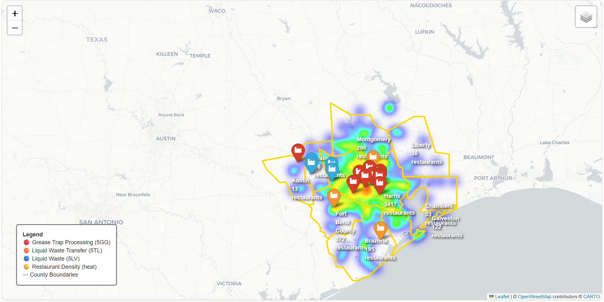
RESTAURANT DENSITY MAP
Demand is distributed. Disposal infrastructure is not.
Interactive map: Houston_Market_Map.html| 4,502 geocoded locations | 16 competitor facilities
Notes:
This is an interactive heat map I built using 4,502 geocoded restaurant locations. You can open the HTML file in your browser and zoom in, click on facilities, explore it yourself.
The yellow and red areas are where restaurants are most concentrated. You can see the core is central Houston — downtown, Galleria, Chinatown. But look at the secondary clusters. The Woodlands up here. Sugar Land over here. The Katy corridor. Humble. Even Pearland down south.
Now the pins — the red ones are the 5GG processing facilities. They're all clustered together in central Harris. See the problem? The heat spreads across the entire MSA but the pins only cover a small area. Sugar Land is glowing but the nearest pin is 10 miles away. The Woodlands has a clear hot spot but the nearest facility is 22 miles south.
That disconnect between where the demand is and where the disposal is — that's what this entire presentation is about.

Slide 6
COMPETITIVE LANDSCAPE
One county. All facilities. 1,004 restaurants per facility.
Top 5GG Facilities (Harris County Only)
MARKET SIZING
Southwaste Hurst (est. 1948)
275M+
1,393 zones | Dominant operator
Downstream Facility
852 zones | SW Houston
gallons processed by Southwaste in 2025
Vexara Pharmaceuticals
302.5M
328 zones | Operating, expansion Pending
TAP Inc / Big K Environmental
2026 target (+10% YoY growth)
260 zones | North Houston
Genesyst International
$13.75M-$41.25M
230 zones | East Houston | Not built
estimated annual tip fee revenue
(single dominant operator)
Notes:
Now let's look at who's in this market. Southwaste Hurst is the dominant player — established in 1948, nearest option for nearly 1,400 restaurant zones. Downstream is second at 852 — and interestingly, Southwaste lists that address as one of their own Houston locations on their website. If that's the case, one company may control over 2,200 restaurant zones.
Vexara is operating but has a pending application to expand to 50,000 gallons per day — which tells you even existing operators see demand growing. TAP Inc covers north Houston. And Genesyst has had a permit since 1989 but the facility was never built. Same with Schalker Street and Ley Road — permitted, never constructed. So three facilities that were supposed to add capacity never materialized.
On the financial side — Southwaste publicly reports processing 275 million gallons in 2025 with a target of 302.5 million for 2026. That's 10% year-over-year growth. At industry tip fee rates of 5 to 15 cents per gallon, that's 13.75 to 41.25 million in annual revenue from one operator. The market is real and it's growing.

Slide 7
GAP ANALYSIS
50% of restaurant hot spots are 10+ miles from disposal
UNDERSERVED
MODERATE GAP
SLIGHT GAP
SERVED
13
14
13
14
zones | 301 restaurants
zones | 700 restaurants
zones | 661 restaurants
zones | 1,945 restaurants
>15 miles
10-15 miles
5-10 miles
<5 miles
County-Level Pattern
Montgomery County: All zones UNDERSERVED (avg 26 mi). The Woodlands = 83 restaurants, 22.2 mi from nearest facility.
Fort Bend County: 1,522 establishments, zero 5GG facilities. Haulers drive 10-17 mi into Harris.
Galveston County: 39.4 mi from nearest facility. Most isolated market in the MSA.
Notes:
I automated the gap analysis to get real numbers. Divided the MSA into 2-kilometer grid squares, found the 54 densest restaurant zones, and calculated the distance from each to the nearest operating 5GG facility.
Half of all zones — 27 out of 54 — are more than 10 miles from any disposal option. 13 zones are over 15 miles.
At the county level — Montgomery is the worst. Every zone is underserved, averaging 26 miles. Fort Bend haulers drive 10 to 17 miles into Harris. Galveston is nearly 40 miles from anything. And some of these distances are actually understated because the analysis includes facilities like Genesyst that were never built.

Slide 8
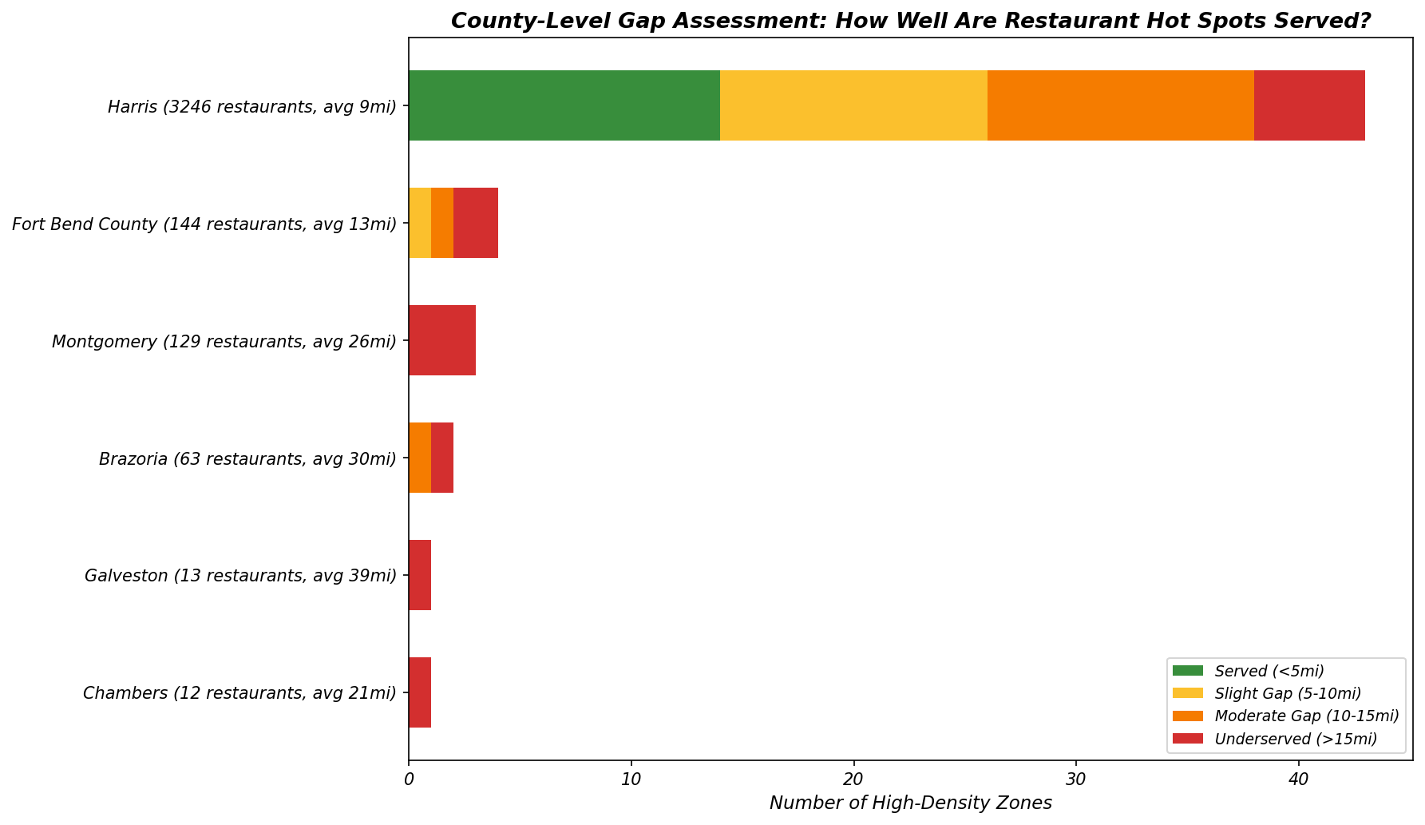
GAP ANALYSIS
.
Notes:
This chart shows it by county. Green is served, red is underserved. Harris has some green in the center but the suburban ring is mostly orange and red. Every other county is almost entirely red. The pattern is clear.

Slide 9
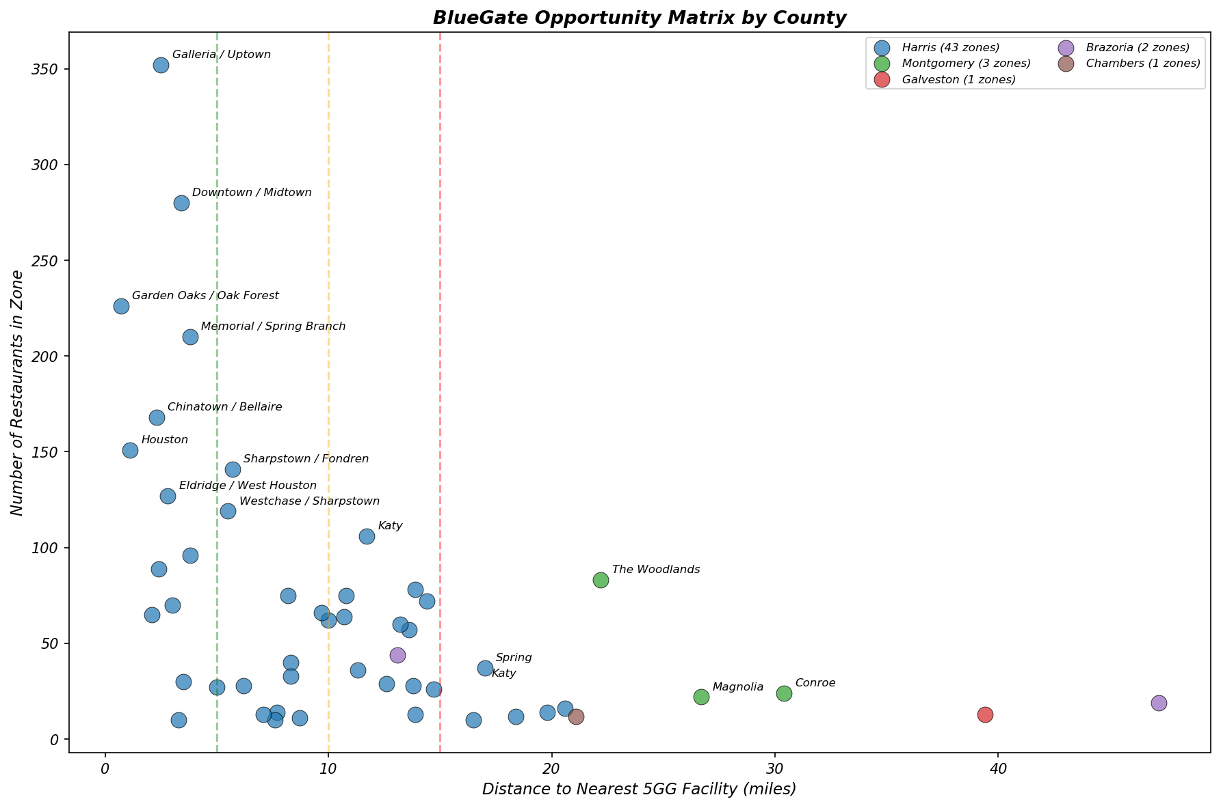
OPPORTUNITY MATRIX
High demand + far from facilities = the primary entry point
.
Upper-right quadrant = high demand, underserved = primary targets
Notes:
This chart answers one simple question — where should the platform look first?
Think of it this way. The dots on the left are markets where competitors already have a foothold — central Houston, well-served, hard to break in. The dots on the right are markets where haulers are driving long distances because nothing exists nearby. The higher the dot, the bigger the revenue potential because more restaurants mean more waste volume.
So the upper right corner is where the money is — strong demand, no competition. The Woodlands sits right there — 83 restaurants generating waste with the nearest facility 22 miles away. Katy is another one — 106 restaurants, nearly 12 miles from disposal. These aren't just data points — these are haulers making that round trip every single day, burning fuel, losing time, and looking for a closer option.
the platform doesn't need to compete with Southwaste in central Houston. The opportunity is out here on the right — markets that existing operators simply don't reach.

Slide 10
REGULATORY TAILWINDS
Regulations are tightening. Demand is rising.
FOG Limit Tightened
Surcharge Pressure
EPA Consent Decree
400 → 200 mg/L
$2.50-$5.00/kgal
$3-5 Billion
Houston cut discharge limits in half (Dec 2023). Restaurants previously compliant are now in violation.
Harris County formula-based surcharges are the highest in the MSA. Pretreatment is cheaper.
Houston committed to fix CWA violations over 22 years. City welcomes pretreatment partners.
Doubles surcharge exposure
Direct economic incentive
Regulatory alignment
Notes:
Three regulatory drivers making the timing right.
First — Houston cut FOG discharge limits from 400 to 200 milligrams per liter in December 2023. Restaurants that were fine at 350 are now in violation. That roughly doubled the number of businesses needing pretreatment. And for 2026, Houston is also tightening hauler enforcement — stricter inspections, waste must be disposed within 4 days of pickup, fines up to $2,000.
Second — surcharges. Harris County charges $2.50 to $5.00 per thousand gallons above baseline. At that rate, pretreatment is simply cheaper than the penalty.
Third — Houston's EPA Consent Decree. The city committed 3 to 5 billion over 22 years to fix their sewer system. They want partners that reduce system load. the platform's pretreatment model is exactly that.

Slide 11
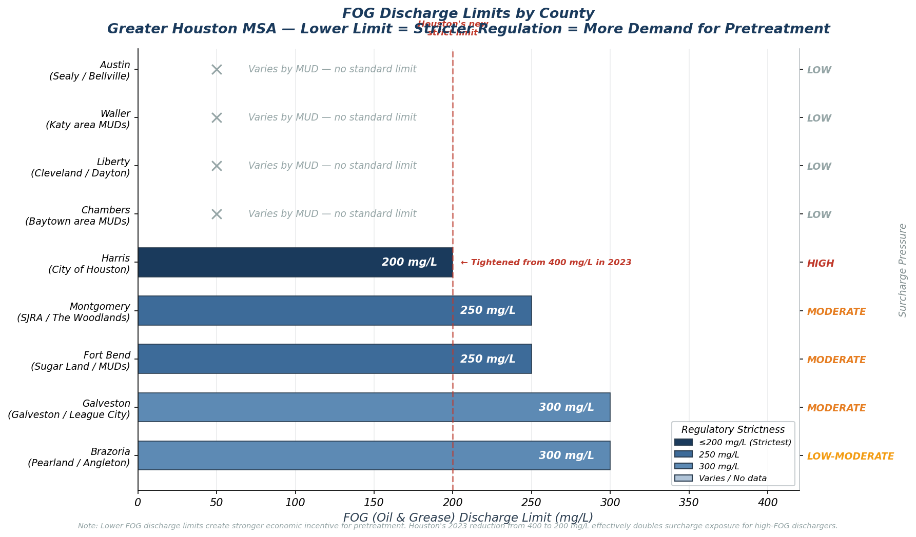
FOG Chart
.
Notes:
This chart shows how much grease each county allows in their sewer before penalties kick in. Think of it like a speed limit — the lower the number, the stricter the rule, the easier it is to get fined.
Houston is the strictest at 200. A year ago it was 400 — they cut it in half. Fort Bend and Montgomery are at 250. Galveston and Brazoria at 300.
Now here's what's interesting nationally. EPA's 2026 draft guidance says if you're using chemicals or bacteria to break down grease inside your trap — that doesn't count as removing it. The grease still ends up in the sewer, just in liquid form. The only thing that counts as real removal is physically taking it out and pretreating it. That's literally what the platform does. So the federal direction is moving toward the platform's exact model.

Slide 12
PRIMARY OPPORTUNITY
Fort Bend County: Highest immediate ROI
1,522
870K
0
10-17mi
Food
Establishments
Population
5GG
Facilities
Disposal
Distance
Why Fort Bend First
Zero 5GG competitors
— only a single 5TL transfer station exists. No pretreatment processing. Surcharge pressure building
— $2.00-$4.00/kgal with 250 mg/L FOG limit. Moderate but growing. Rapid population growth
— Sugar Land, Missouri City, Rosenberg expanding. More restaurants coming. Haulers already driving into Harris
— 10-17 miles each way. A local pretreatment facility saves fuel, time, and money.
Notes:
Based on everything — Fort Bend is the strongest first move.
1,522 establishments. Zero 5GG facilities. Population 870,000 — added 24,000 people just last year and projected to hit one million by 2030. Haulers are already driving 10 to 17 miles into Harris for every load. A facility near Sugar Land captures that immediately.
The only thing in Fort Bend right now is one liquid waste transfer station — no pretreatment. The surcharge structure is moderate at $2 to $4 with a 250 FOG limit. When that limit tightens — and it will, following Houston's lead — the economics get even stronger.

Slide 13
SECONDARY & EMERGING OPPORTUNITIES
Three additional markets with zero competitors
Montgomery County (The Woodlands / Conroe)
1,199 establishments | 650K+ population | Zero 5GG | Avg 26 mi to disposal | $2.00-$4.50/kgal | 250 mg/L FOG
Fastest-growing county in the MSA. All zones UNDERSERVED. The Woodlands alone is 22.2 mi from the nearest 5GG facility.
Harris County Suburban Ring (Katy / Humble / Cypress)
Katy: 106 rest, 11.7 mi | Humble: 57 rest, 13.6 mi | Cypress: 13.9 mi | FOG tightened to 200 mg/L
Southwaste dominates central Houston but suburban corridors are 10-20 mi from any facility. FOG limit change creates new demand.
Emerging: Brazoria County (Pearland / Lake Jackson)
689 establishments | 419K population (growing) | Zero 5GG | 5TL exists but no pretreatment | $1.50-$3.00/kgal
Small but uncontested. Builds operational track record alongside larger market entries.
Notes:
Three more markets after Fort Bend — each at a different stage but all with the same story: demand exists, disposal doesn't.
Montgomery County is the biggest untapped opportunity after Fort Bend. Nearly 1,200 restaurants, population just crossed 780,000, and they added 30,000 people last year alone — that's the fourth highest numeric growth of any county in the entire country. Every single restaurant zone here is classified as underserved. There is no 5GG facility within 22 miles. The addressable market is large, growing, and completely uncontested.
Harris County suburban ring — Katy, Humble, Cypress. Now this is interesting because technically there are facilities in Harris County, but they're all in central Houston. A hauler in Katy is still driving 12 miles each way. With the FOG limit now at 200, the volume of waste that needs pretreatment just increased across the entire county. The suburban corridors are where that new demand is showing up, and the existing central facilities aren't positioned to capture it. There's room for a new entrant without going head to head with Southwaste.
And Brazoria — 689 establishments, population 419,000 and growing. Smaller revenue pool today, yes. But zero competition means zero customer acquisition cost. For a platform that's building out its first few facilities, an uncontested market where you can establish operations, build hauler relationships, and generate steady cash flow while scaling into larger markets — that has real strategic value beyond just the top-line number.

Slide 14
RECOMMENDATION
Houston is ready for a new pretreatment platform.
The greater Houston MSA has 14,532 food service establishments generating grease trap waste across 9 counties, but only 10 processing facilities exist — all in one county. 8 counties with 4,494 establishments have zero disposal infrastructure. Haulers in these markets drive 15-47 miles for disposal.
Enter Fort Bend County first.
1,522 establishments. Zero competitors. Growing population. Haulers already driving 10-17 miles into Harris County. A pretreatment facility near Sugar Land captures immediate demand from an entirely unserved market.
Expand to Montgomery County second — then the Harris suburban ring as FOG regulations tighten.
Notes:
Houston is ready for the platform.
14,532 restaurants. 6 operating facilities — one company controlling over 60% of capacity. Three more that were supposed to be built never were. 8 counties with nothing. FOG regulations tightening. Population growing faster than any metro in the country.
Enter Fort Bend first. 1,522 establishments, zero competitors, a million people by 2030, haulers already driving into Harris. A facility near Sugar Land captures immediate demand.
Then Montgomery. Then the Harris suburban ring as regulations push demand outward.
The market is there. The infrastructure is not. That's the opportunity.

Slide 15
DATA SOURCES & METHODOLOGY
Source | Dataset | Application
U.S. Census Bureau | County Business Patterns 2023 | 14,532 food establishments (NAICS 722) — demand baseline
OpenStreetMap | Overpass Turbo API | 4,502 geocoded restaurant locations — spatial density mapping
TCEQ Registry | MSW Facility Database | 22 liquid waste facilities (10 x 5GG) — competitive landscape
EPA ECHO | NPDES Permit Database | WWTP capacity and compliance data
Southwaste.com | Public volume reporting | 275M+ gallon throughput — market sizing benchmark
Tools: Python (pandas, folium, matplotlib) | Power BI | OpenStreetMap Overpass Turbo
Methodology: Automated spatial gap analysis — 2km grid, top 15% density threshold, haversine distance calculation, 4-tier classification (Underserved/Moderate Gap/Slight Gap/Served)
Limitations: OSM captures ~31% of Census total. Surcharge rates approximate. Tip fee data requires primary research. Production analysis would supplement with official county health dept licensing data.
Notes:
Happy to walk through the data sources and methodology. It's all detailed in the written report I shared.

Slide 16
Thank you!
Notes:
That's what I found. I'd love to hear how it compares to your own diligence — and I'm happy to dig into any area

