Slide 1
Employee Feedback Analytics
Sentiment, Topics & Workforce Segmentation

Slide 2
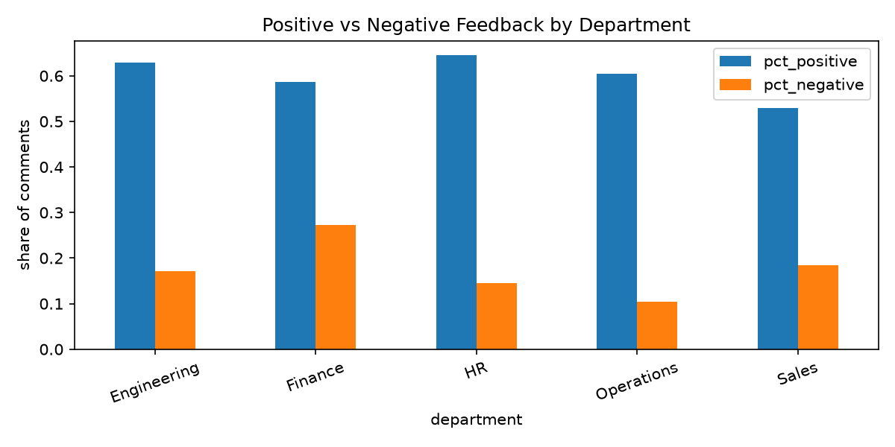
Sentiment by Department

Slide 3
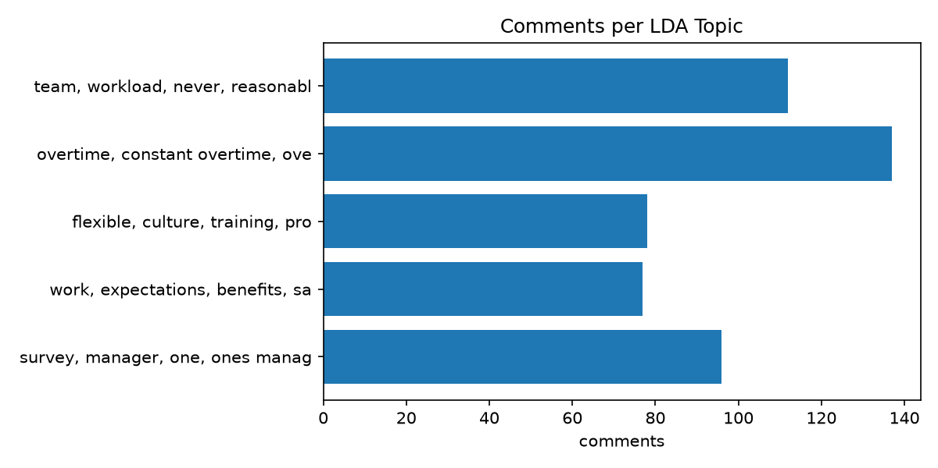
Key Themes (LDA Topics)

Slide 4
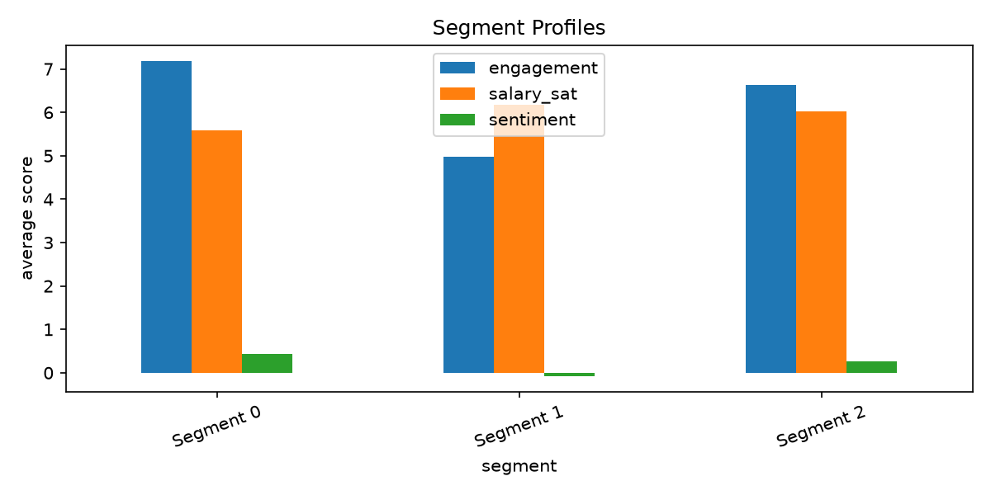
Employee Segments (k=3, silhouette=0.181)

Slide 5
Recommendations
Lowest sentiment department: Finance
Review workload for segments with high workload and low engagement
Prioritize themes with high volume and negative sentiment

