Slide 1
MAP Day Update
Carbon Intelligence
Investor Pitch
Confidential

Slide 2
The Story
Data → Action → Finance for MSMEs and Banks

Slide 3
One-liner
Carbon Intelligence helps MSMEs measure emissions, reduce costs, and prove progress—then uses that verified data to unlock better-priced green finance for banks.

Slide 4
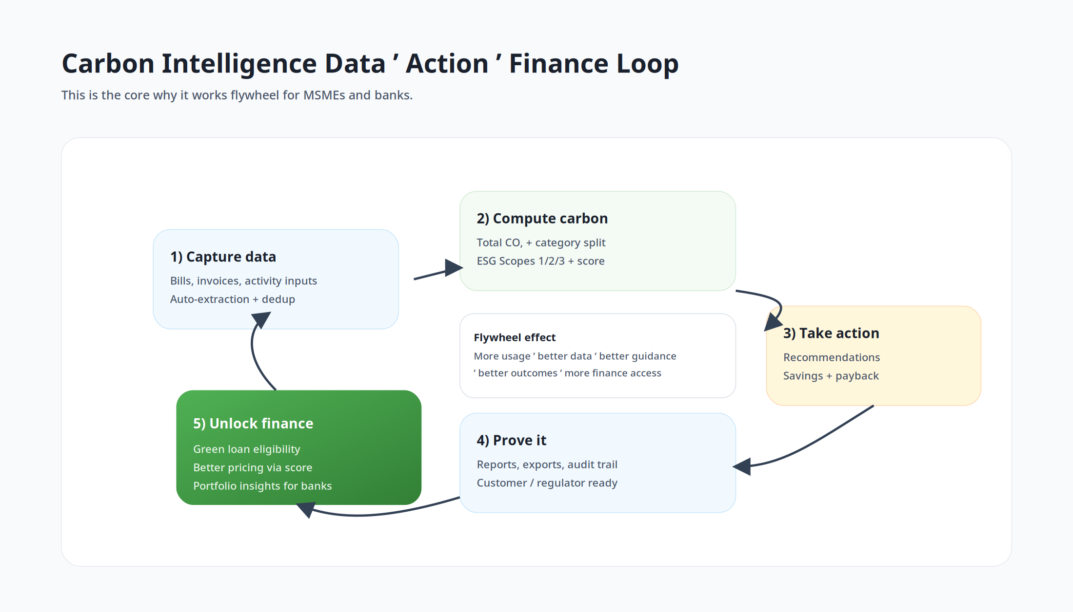
The problem (why now)
MSMEs face rising sustainability requests from buyers and lenders.
Operational data is fragmented (emails, folders, spreadsheets).
Banks have an ESG data gap: inconsistent SME data, expensive verification.
Result: compliance is painful, decarbonization is slow, finance is mispriced.
We compound: measure → improve → prove → finance

Slide 5
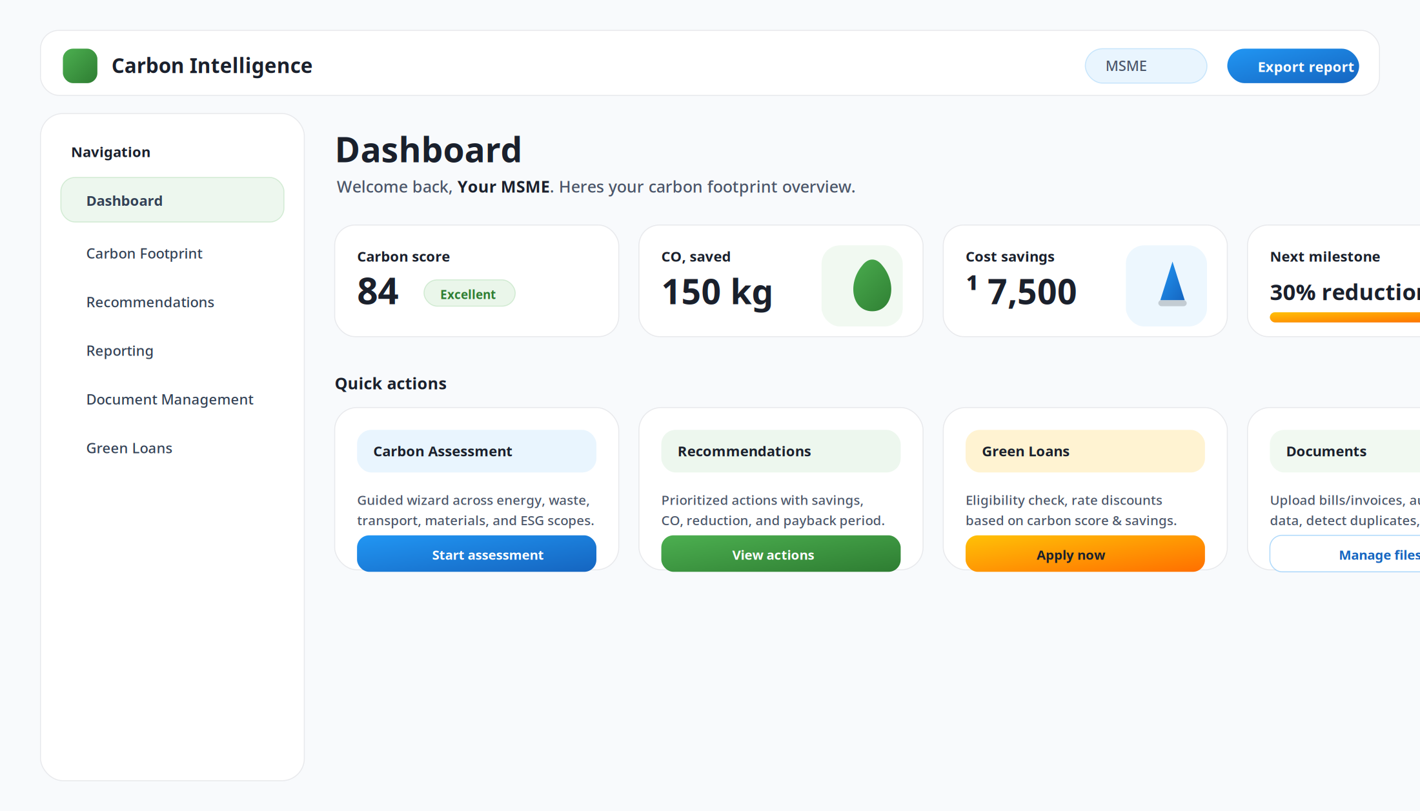
Product overview (web experience)
Card-based dashboard: score, quick stats, trends, and actions

Slide 6
Product Proof
What exists in the UI today

Slide 7
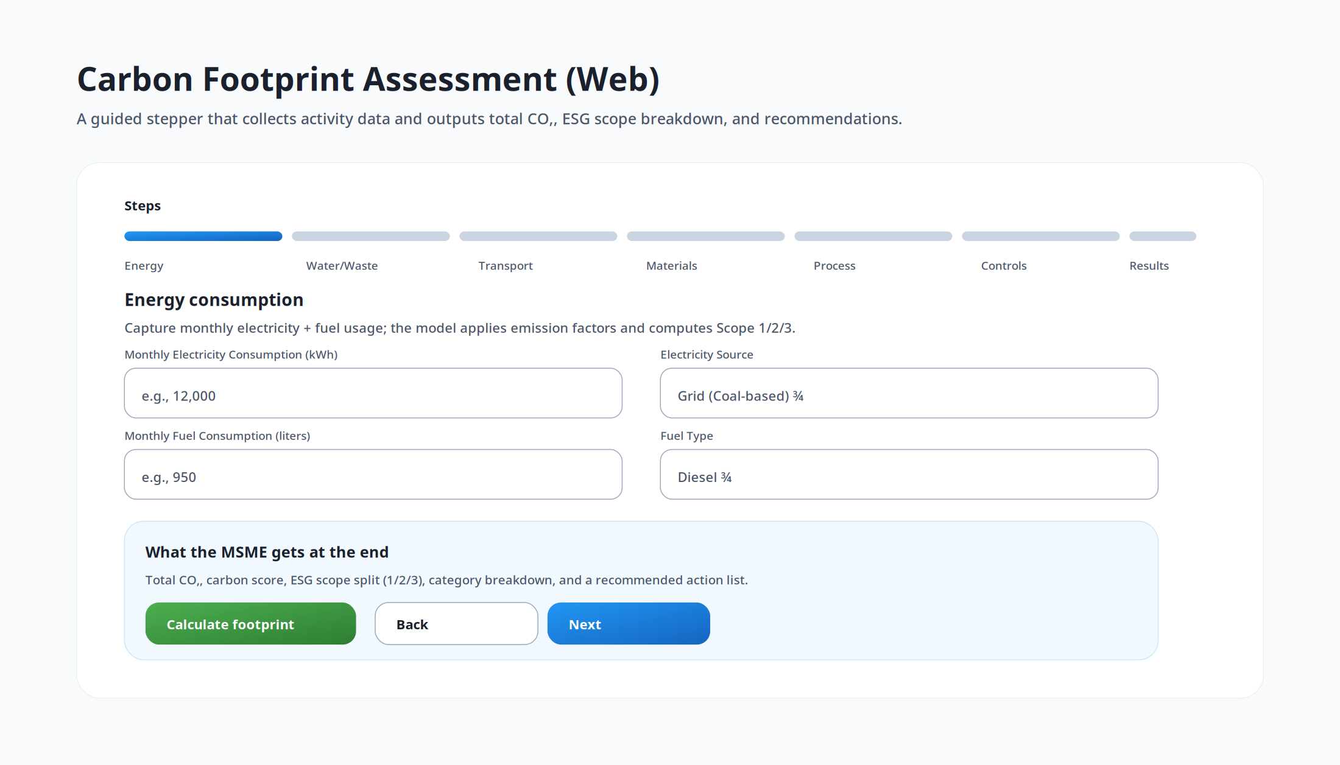
Guided carbon assessment

Slide 8
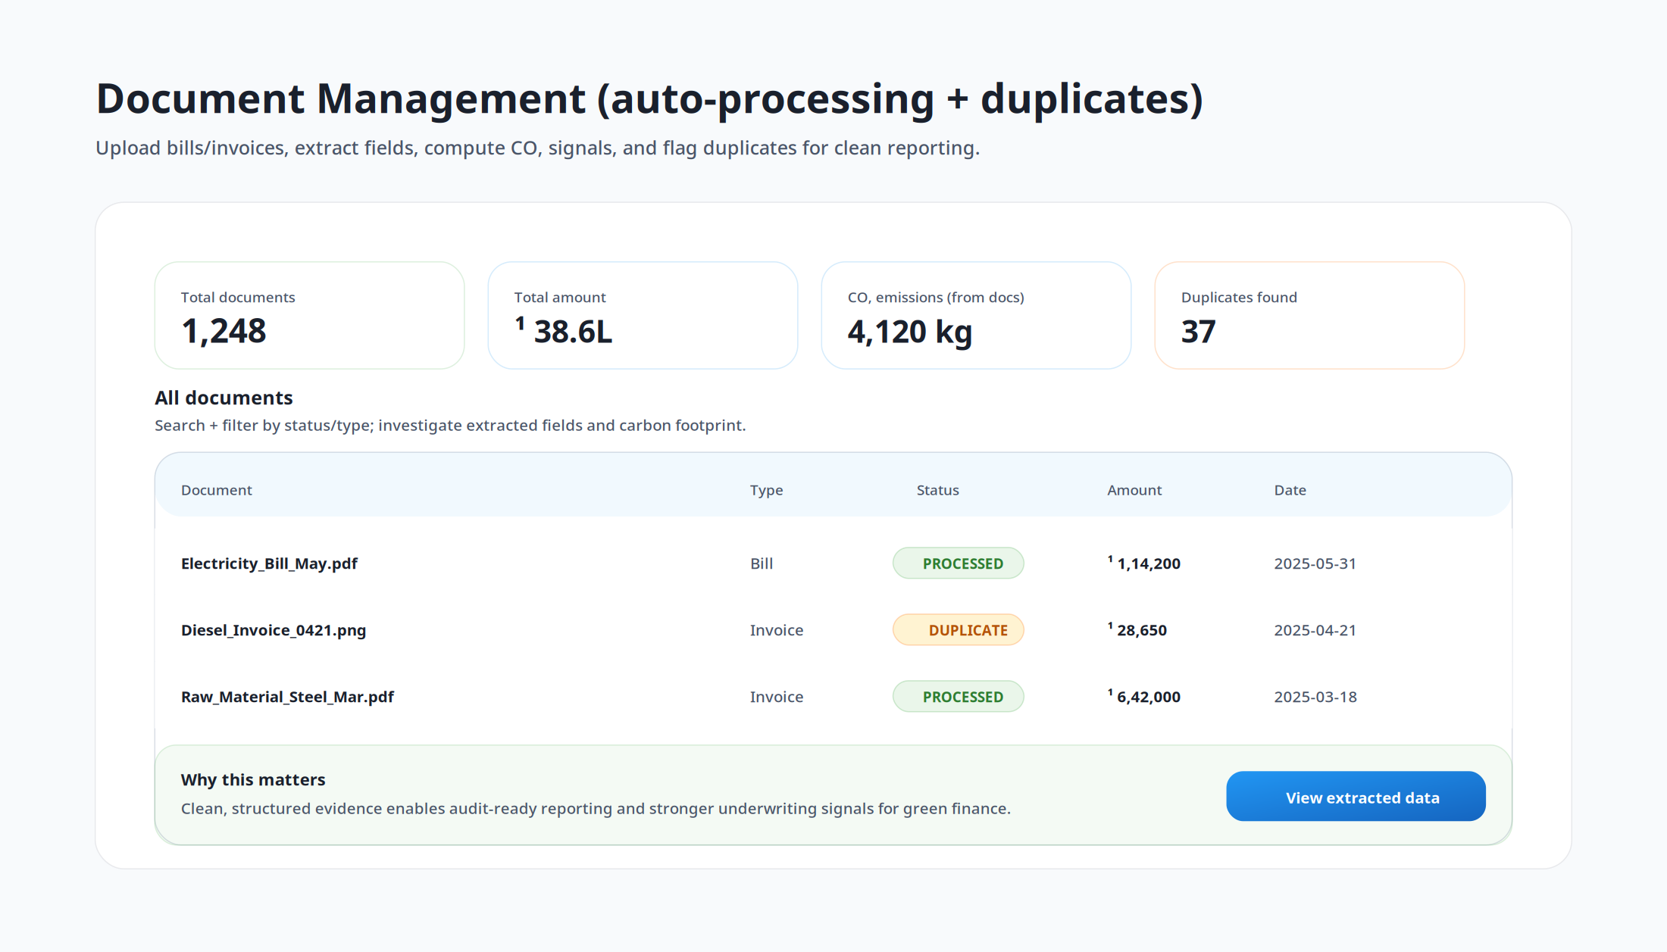
Document intelligence (evidence layer)

Slide 9
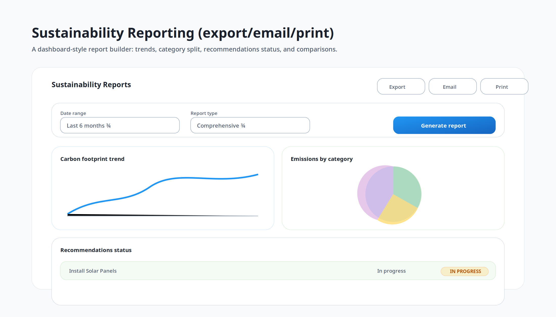
Reporting (shareable outcomes)

Slide 10
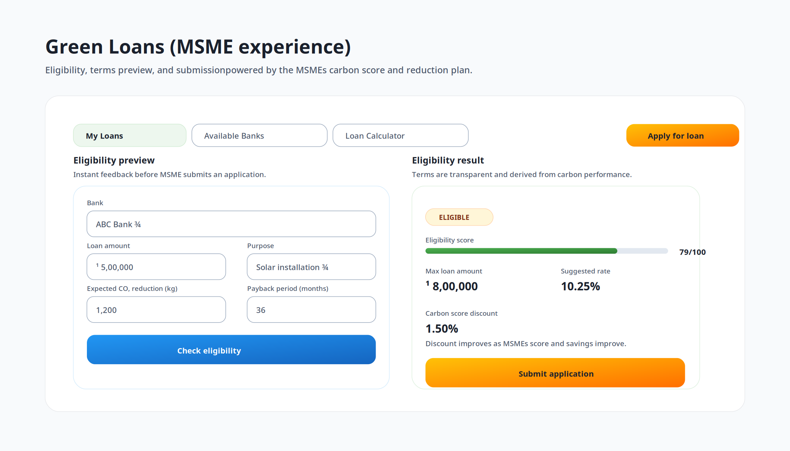
Green loans (conversion into finance)

Slide 11
Go-to-market + Model
Wedge now, expand into finance workflows

Slide 12
Market wedge and expansion
Wedge: MSME carbon assessment + reporting + ROI-based recommendations (fast time-to-value).
Expand: evidence/audit packs, supplier requests, benchmarking, continuous monitoring.
Integrate: bank/fintech green products (eligibility, pricing, monitoring).

Slide 13
Business model
SaaS (MSME): subscription per company/site, tiered by features.
Usage: per report export, per processed document, per audit pack.
Bank revenue: platform fee for origination enablement + monitoring (or referral/origination economics).
Future: services marketplace + carbon credit rails.

Slide 14
Defensibility
Workflow lock-in: once reporting + documents + recommendations are embedded, switching costs rise.
Data moat: labeled activity + document data improves benchmarks and underwriting signals over time.
Distribution: banks and anchor enterprises can onboard MSMEs via portfolio/supply-chain programs.

Slide 15
Milestones to prove next (fundraising-ready)
Repeatable acquisition via bank or supply-chain onboarding channel.
Retention/expansion: documents processed, reports exported, actions implemented.
Outcome metrics: ₹ cost savings and kg CO₂ reduction per MSME cohort.
Bank proof: faster credit files and improved portfolio coverage/monitoring.

Slide 16
The ask
Capital to accelerate distribution partnerships and product depth in evidence + green lending workflows.
Warm intros to banks/anchor enterprises to run portfolio or supply-chain pilots.
Replace this slide with your specific raise amount, runway, and milestones.

