Slide 1
MAP Day Update
Carbon Intelligence
Key Employees / Partners / Channels
Internal + partner deck

Slide 2
Why this exists
Build the data → action → finance loop at scale

Slide 3
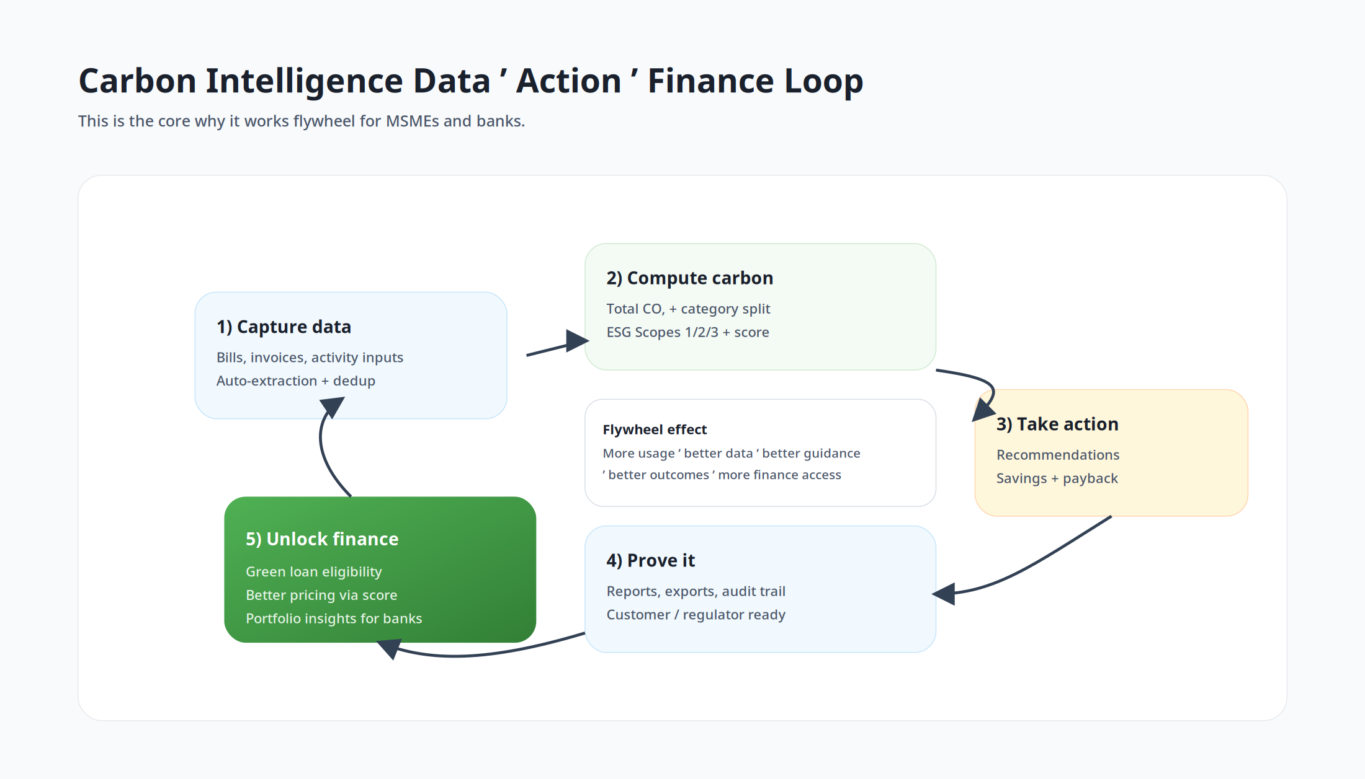
The mission
Help MSMEs measure emissions, reduce costs, and prove progress with audit-ready evidence.
Turn verified sustainability data into a financial primitive for green lending and portfolio reporting.
Make sustainability adoption practical: ROI-first recommendations, simple workflows, fast time-to-value.
Our compounding loop: measure → improve → prove → finance

Slide 4
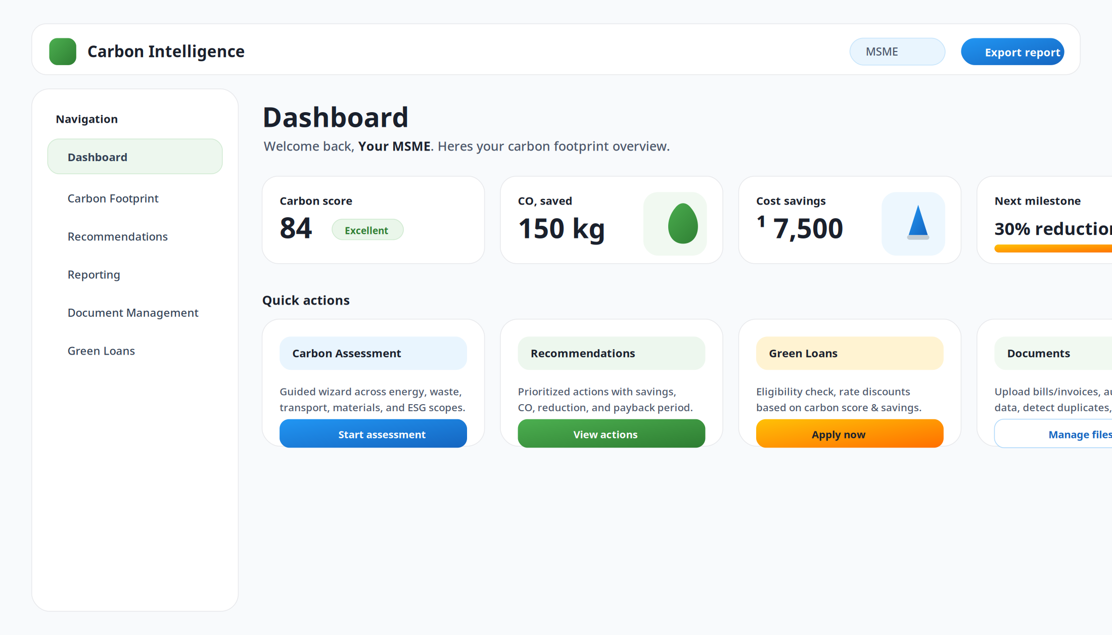
What we’ve built (product snapshot)
Web dashboard: score, trends, documents, reporting, and green finance workflows

Slide 5
Who this deck is for
Three audiences; one coherent program

Slide 6
Audience and outcomes
Key Employees: join the team and own core product + distribution outcomes.
Partners: embed/extend the platform (consultancies, auditors, implementers, industry bodies).
Channels: drive repeatable MSME onboarding via banks, anchor enterprises, or ecosystem partners.

Slide 7
Where we win
Reliable evidence + simple UX + finance conversion

Slide 8
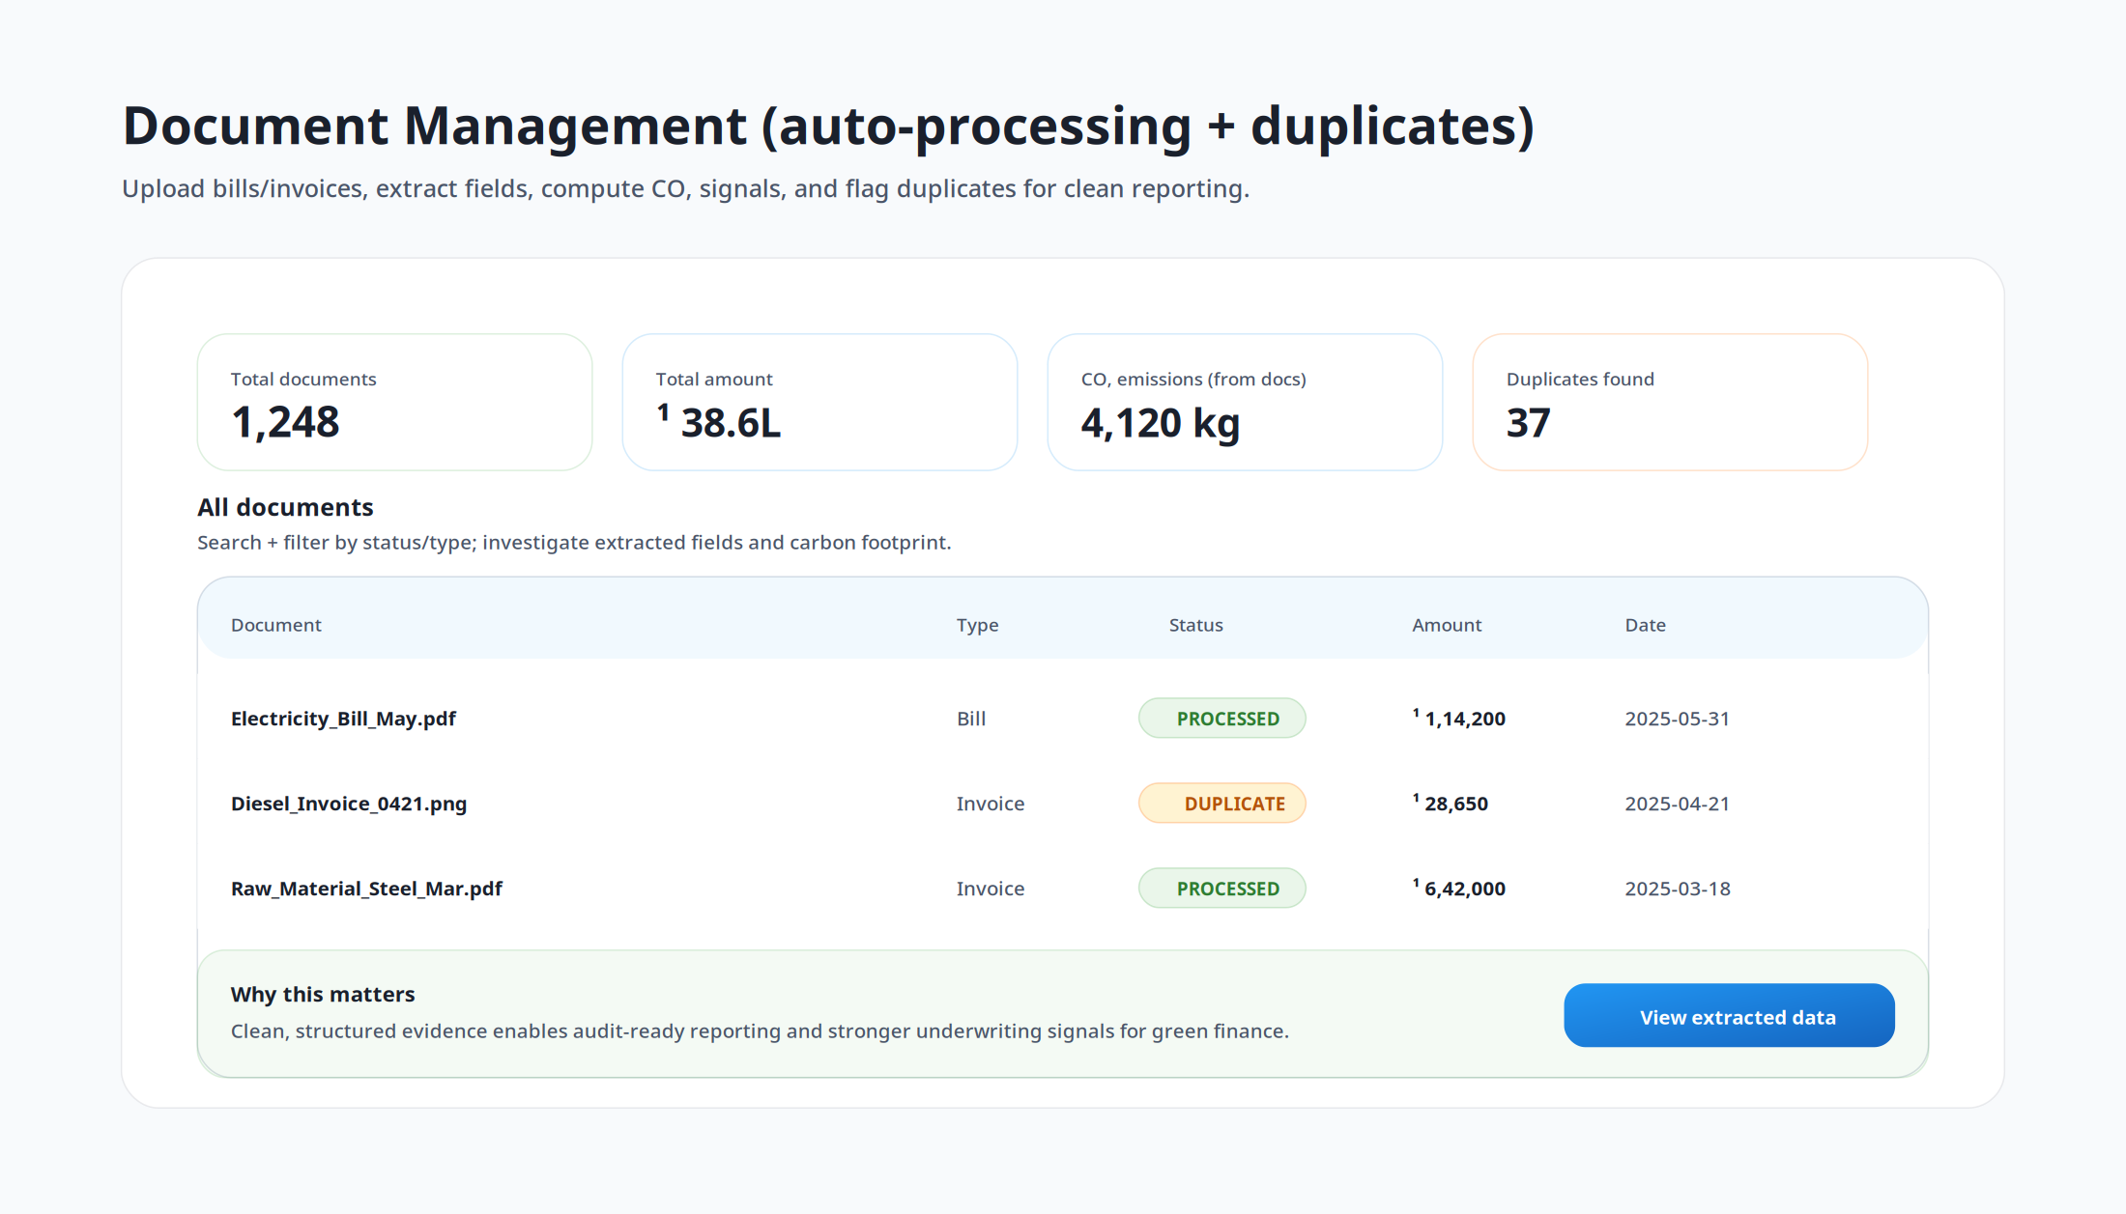
Evidence layer (documents) = defensibility
Bills/invoices become structured data with audit trail.
Duplicate detection reduces errors and strengthens trust.
Creates repeatable ‘evidence packs’ for buyers, auditors, and lenders.

Slide 9
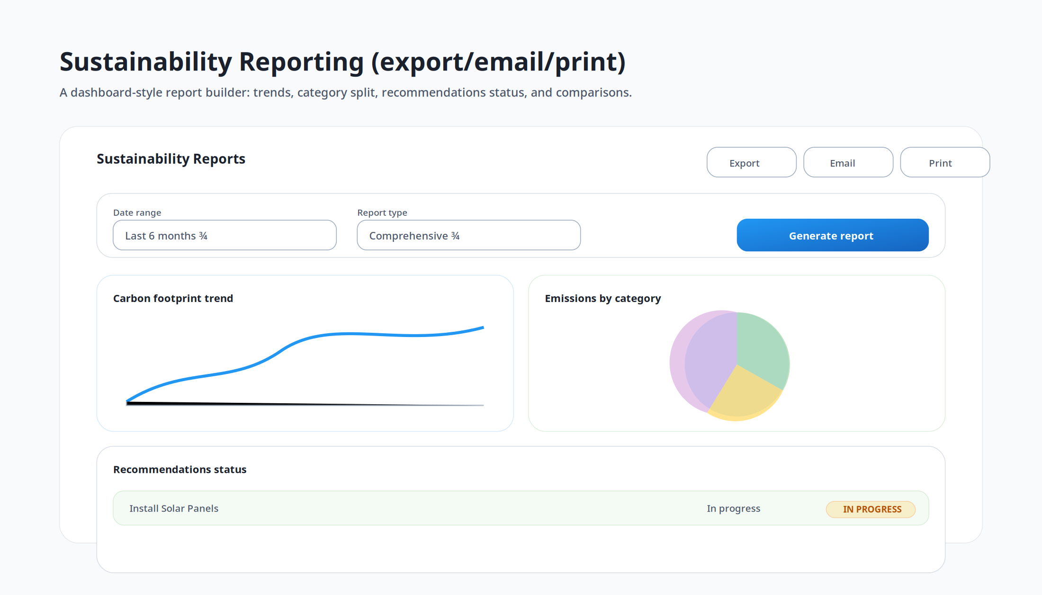
Reporting that stakeholders actually consume
Standardized outputs: total CO₂, category split, scope 1/2/3, score and trend.
Exports for buyers, internal teams, and bank/portfolio reporting.
Action adoption tracked over time (progress, payback, impact).

Slide 10
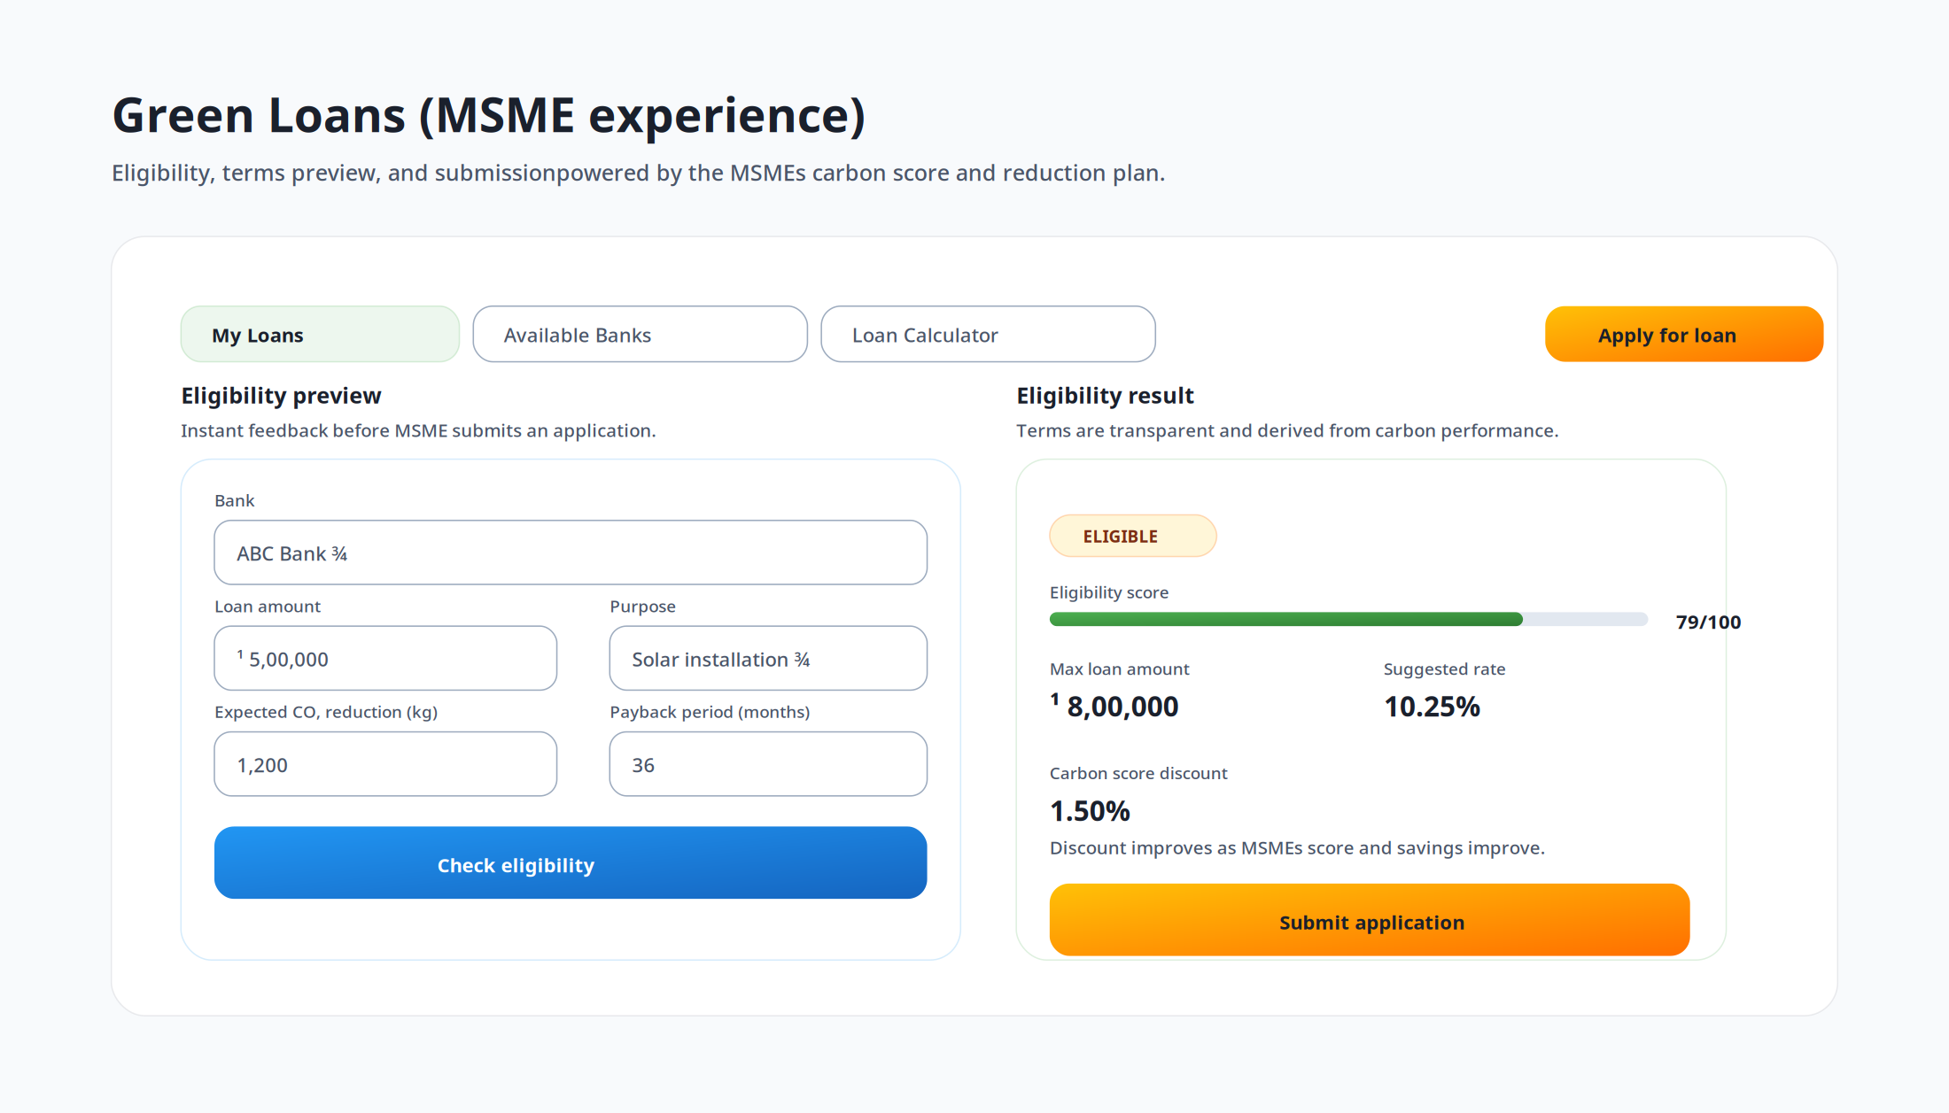
Finance conversion (green lending workflow)
Eligibility and term preview driven by policy rules + verified data.
Cleaner files reduce back-and-forth and speed approvals.
Monitoring ties capital deployment to measurable reduction outcomes.

Slide 11
Key employees
What we’re hiring for (and why it’s exciting)

Slide 12
Roles we typically need (adapt as needed)
Product + Engineering: workflows, evidence layer, integrations, reporting/export.
Data/ML: extraction quality, dedup, carbon estimation models, benchmarks.
Growth + Partnerships: bank/anchor programs, onboarding playbooks, channel enablement.
Customer Success: repeatable onboarding, retention/expansion, outcome reporting (₹ savings + CO₂).
Replace this slide with your exact open roles and seniority.

Slide 13
Why a key employee should join
Mission + measurable outcomes: help MSMEs cut costs while meeting compliance pressure.
Real product in place: ship on a working workflow system (not a concept).
Distribution leverage: banks and anchor enterprises can onboard thousands via programs.
Compounding advantage: better evidence → better data → better decisions → better finance conversion.

Slide 14
Partners
Who we work with and what they gain

Slide 15
Partner types (examples)
Sustainability consultants / implementers (baseline → roadmap → execution).
Auditors / verifiers (evidence packs + standardized outputs).
Industry associations (member onboarding programs).
Solution providers (solar/efficiency/waste) who need qualified demand + proof.

Slide 16
Partner value proposition
Faster delivery: standardized workflows and reporting reduce manual effort.
Higher trust: document-backed evidence improves auditability and buyer/lender confidence.
More revenue: partners can bundle services around recommendations and implementation.
Clear packaging: tiered engagement templates (assessment → action plan → monitoring).

Slide 17
Channels
Repeatable acquisition and onboarding

Slide 18
Channel models (how leads come in)
Bank channel: RMs / digital journeys for green lending and portfolio monitoring.
Anchor enterprise channel: supply-chain compliance programs (vendor onboarding).
Ecosystem channel: associations, platforms, and service providers referring MSMEs.

Slide 19
Channel motion (recommended)
Step 1: MSME invite → lightweight onboarding + baseline assessment.
Step 2: Document upload → evidence pack + data cleanliness checks.
Step 3: Report export → buyer/bank-ready output (shareable).
Step 4: Action plan → track ROI + implementation status.
Step 5: Finance conversion (optional) → eligibility + application workflow.

Slide 20
What channels need from us (enablement kit)
Co-branded landing + onboarding journey.
Sector-specific templates (inputs, recommended actions, ROI assumptions).
Partner portal: cohort tracking, export packs, and progress dashboards.
Training: talk track, demo script, objection handling, and ROI calculator.

Slide 21
How we measure success
Simple KPIs per audience

Slide 22
KPIs
Acquisition: invited → activated MSMEs; CAC by channel; time-to-first-report.
Engagement: documents processed; exports; action adoption rate.
Outcomes: ₹ savings realized; kg CO₂ reduced; score improvement.
Finance: eligibility rate; application completion; approval speed; portfolio coverage.

Slide 23
Next steps (choose your path)
Key employees: share your role fit + a 30/60/90 plan you’d execute.
Partners: propose 1–2 packaged offerings you can deliver using the platform.
Channels: select a pilot cohort size and define the onboarding + reporting workflow.
This deck is designed to be customized per audience and partner type.

