Slide 1
MAP Day Update
Carbon Intelligence
Pitch for MSMEs
Customer deck

Slide 2
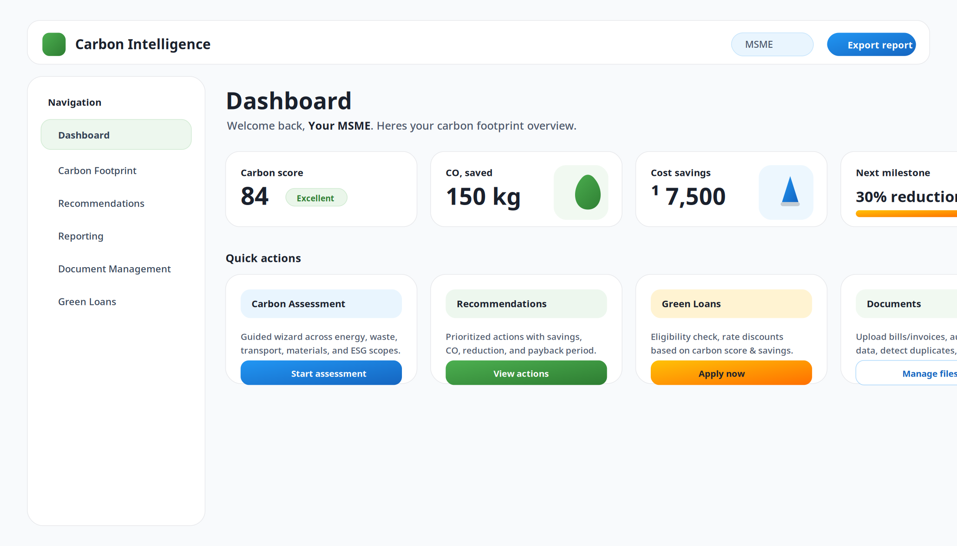
The promise
Measure footprint, cut costs, and generate reports—without spreadsheets

Slide 3
What you get (clear benefits)
Win more customers: share sustainability reports + evidence when asked.
Reduce waste: recommendations prioritized by impact, savings, and payback.
Get audit-ready faster: organize bills/invoices with a clean evidence trail.
Access green finance: convert performance into eligibility and better pricing.

Slide 4
How it works
A simple 4-step flow

Slide 5
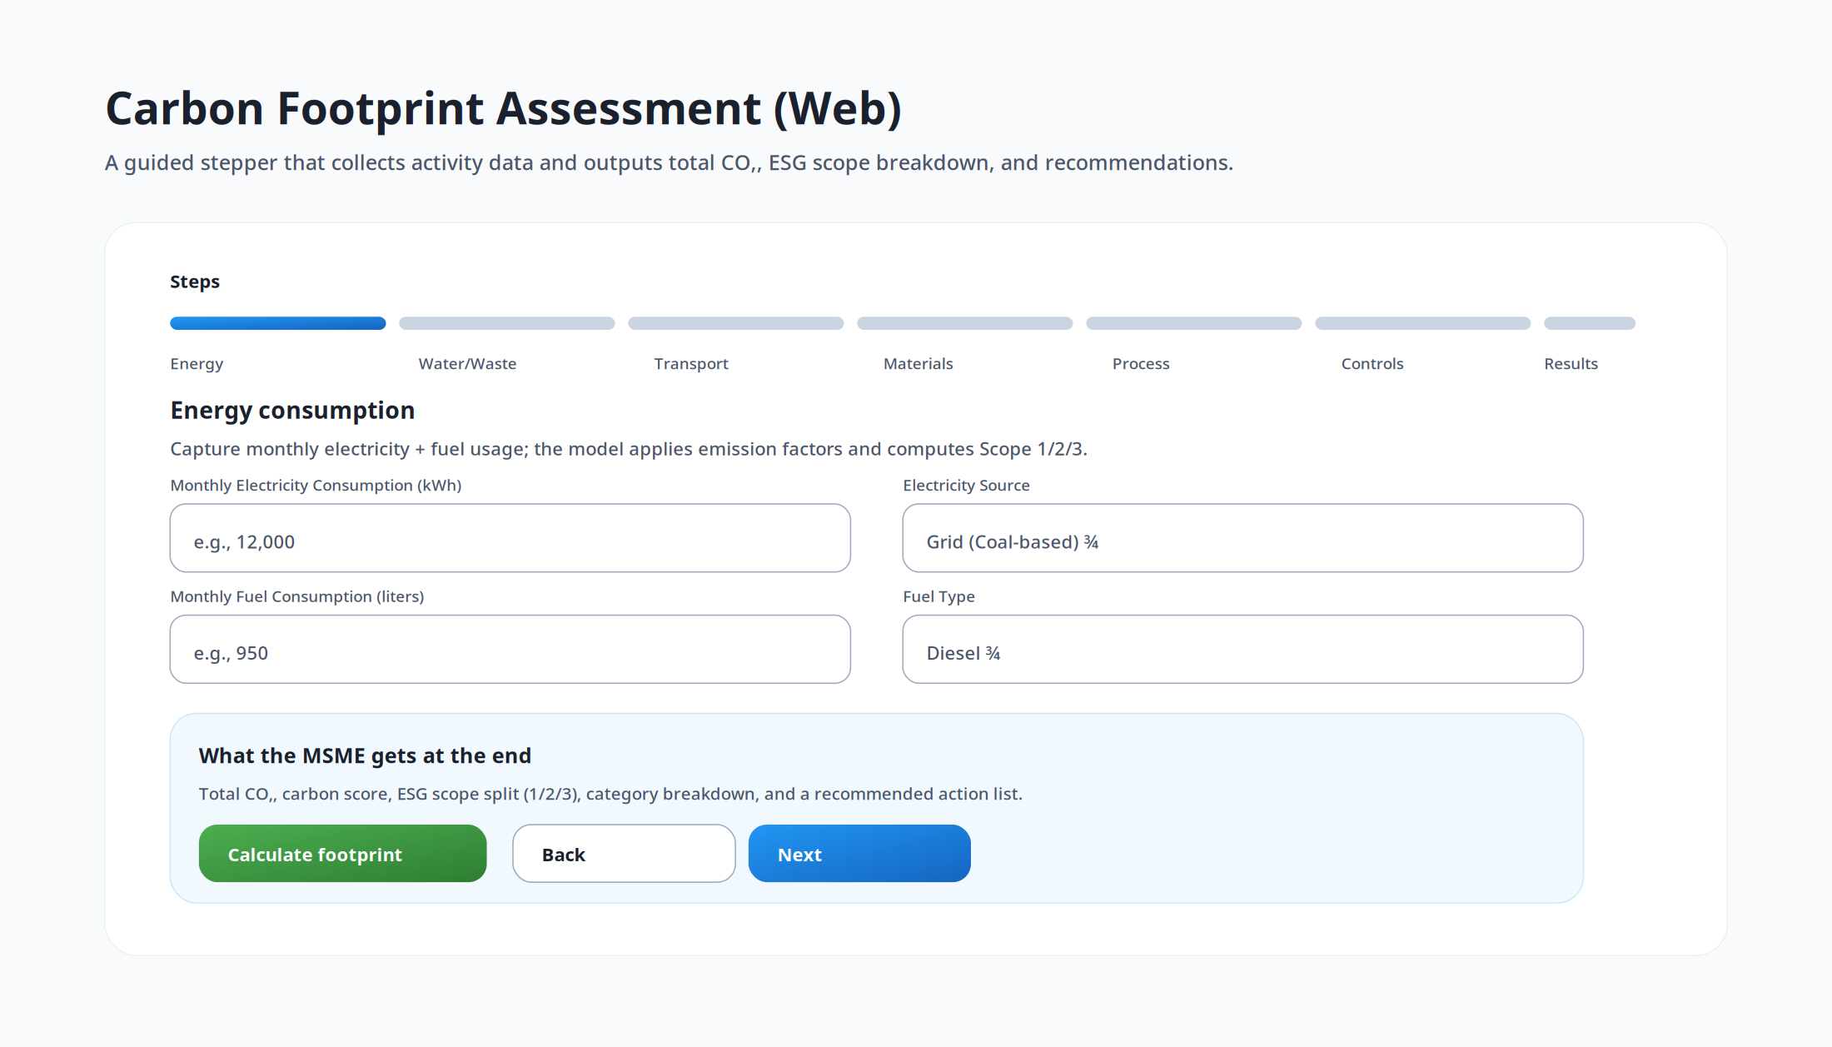
1) Guided carbon assessment
Answer a short step-by-step questionnaire across energy, transport, materials, water/waste, and processes.
Receive total CO₂, category split, scopes (1/2/3), and a carbon score.

Slide 6
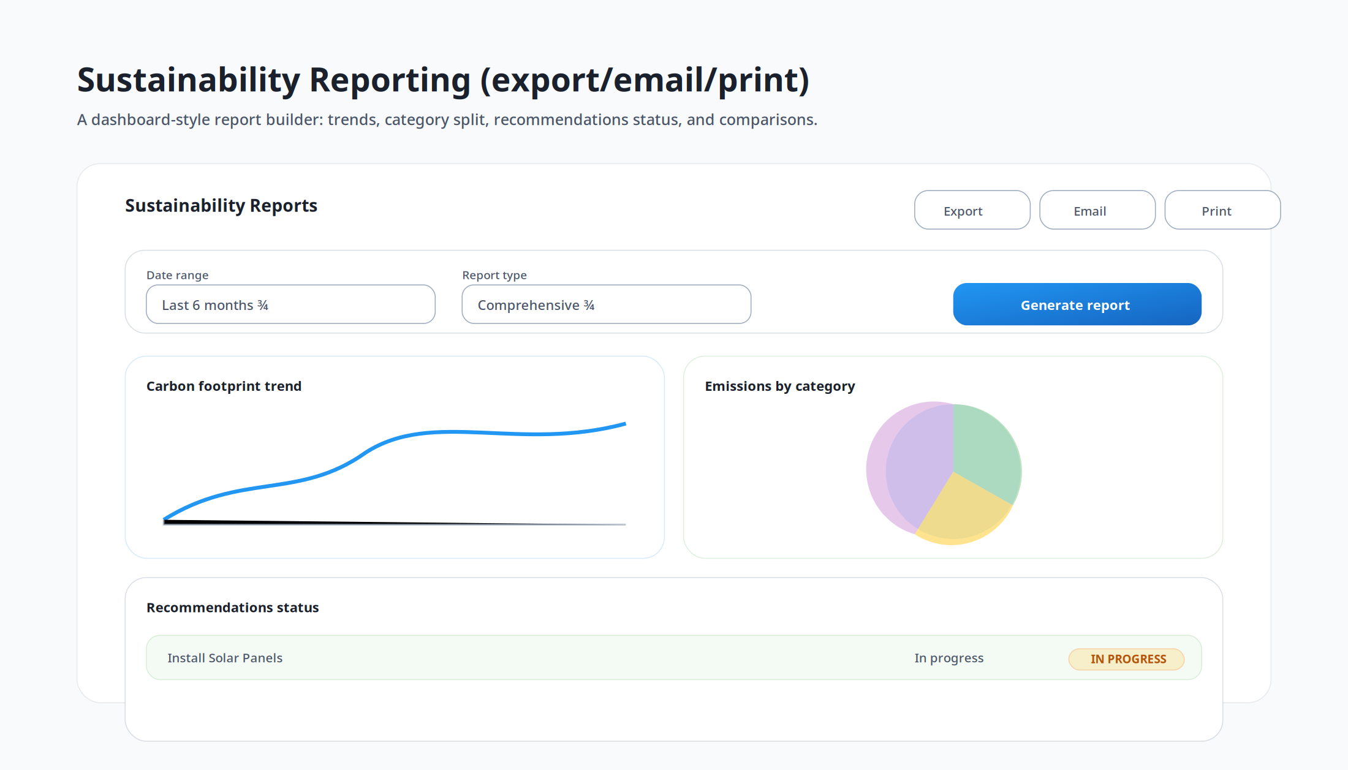
2) Recommendations with ROI
Not generic tips: each action includes priority, estimated savings (₹), payback (months), and CO₂ reduction.
Pick quick wins first, plan upgrades next (solar, efficiency, process improvements).
Track actions and results in reporting

Slide 7
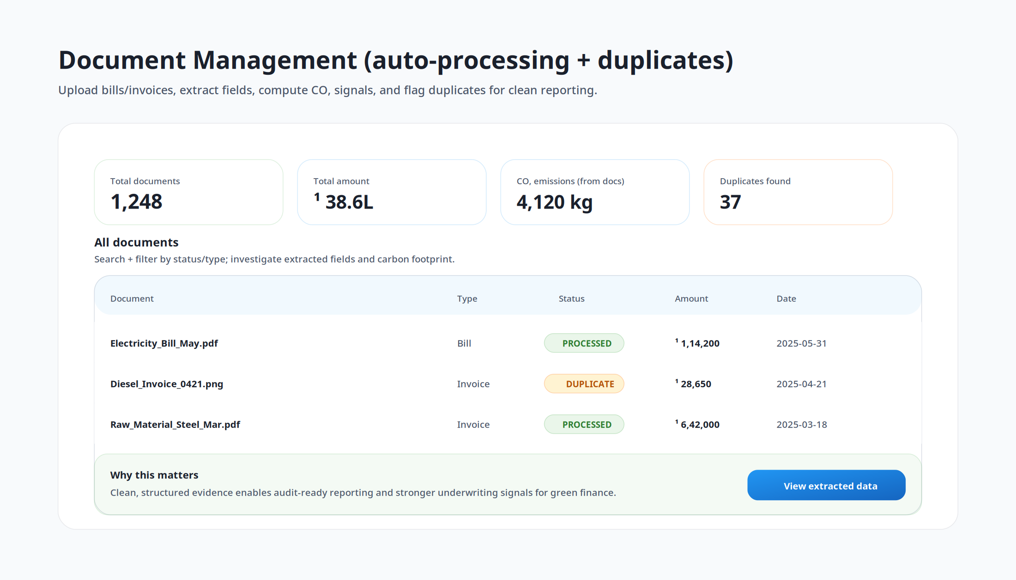
3) Keep documents report-ready
Upload bills/invoices once; auto-extract key fields and compute carbon signals.
Detect duplicates to reduce errors and create an audit-friendly evidence pack.
Stop hunting for files when customers or auditors request proof.

Slide 8
4) Generate reports you can share
Export reports for customers, internal reviews, tenders, and compliance.
Show progress over time: footprint trend + actions implemented.

Slide 9
Green finance
Convert sustainability into capital

Slide 10
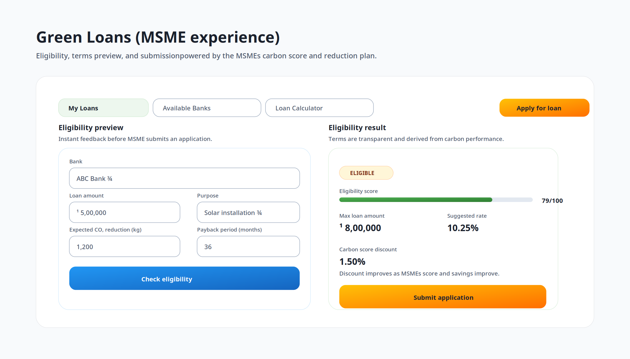
Green loan enablement
Plan a reduction project (solar, machinery upgrade, waste systems).
Check eligibility up front and see transparent terms.
Submit a cleaner application using verified activity + plan data.

Slide 11
MSME ROI framing
Time saved: less manual reporting and document hunting.
Cost savings: energy/fuel/process improvements with clear payback.
Revenue enablement: meet buyer requirements and improve trust.
Better financing access: qualify for green loans and incentives.

Slide 12
Next steps
Pick your sector and baseline period (last 3–12 months).
Upload your latest bills/invoices and complete the assessment.
Review prioritized actions and export your first customer-ready report.

