Slide 1
MAP Day Update
Carbon Intelligence
Pitch for Banks
Customer deck

Slide 2
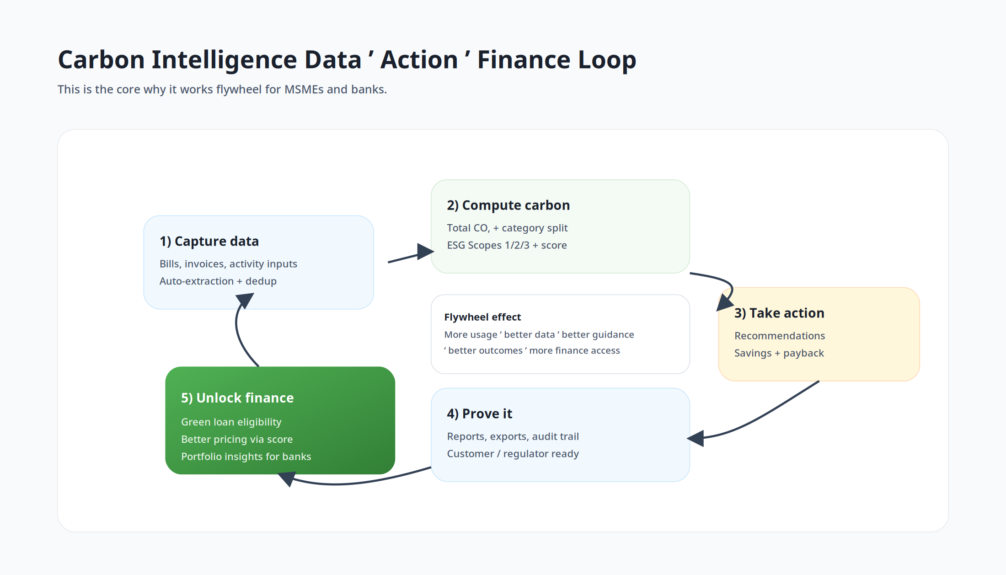
The promise
Turn SME sustainability data into underwriting + reporting advantage

Slide 3
Why banks use this (value drivers)
Grow green lending efficiently: guided onboarding + evidence pack reduces friction.
Better risk signals: score, emissions trajectory, action adoption, document-backed activity data.
Portfolio visibility: standardized outputs across MSMEs for dashboards and disclosures.
Lower cost-to-serve: fewer document chases, fewer data quality issues, faster files.

Slide 4
Bank-ready outputs
Standardized, comparable, defensible

Slide 5
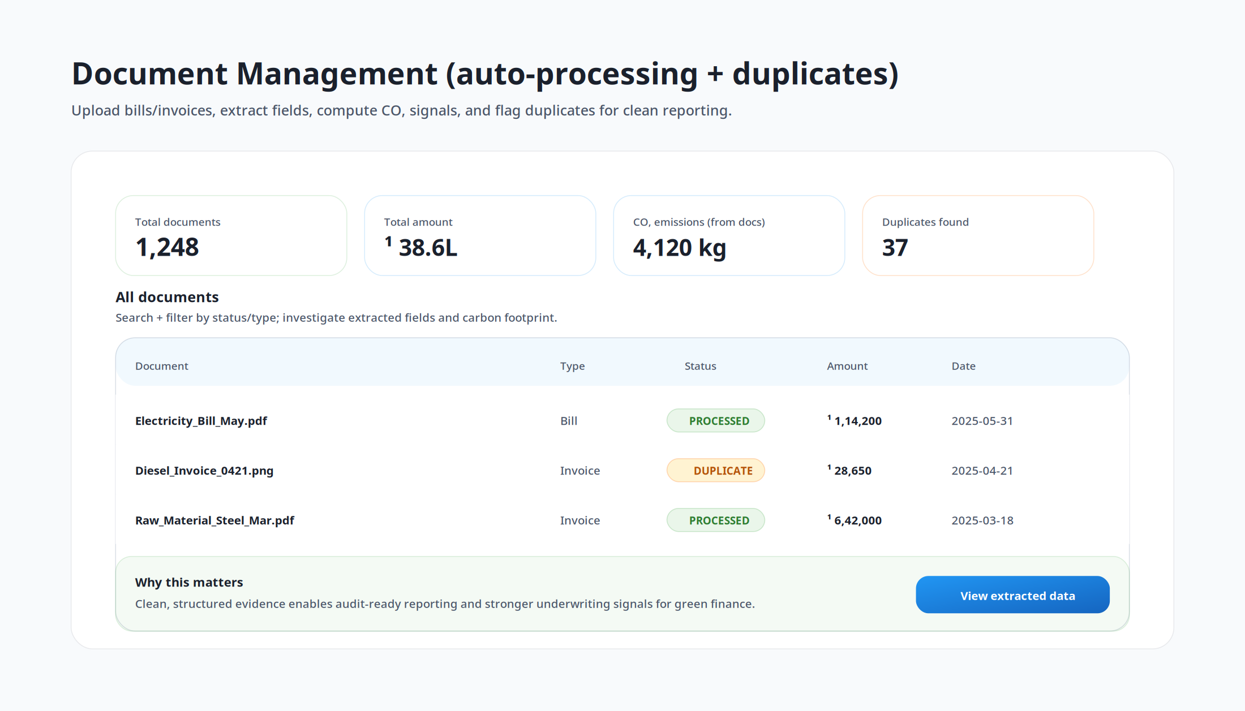
1) Verified evidence layer (documents)
MSMEs upload bills/invoices; we structure fields and maintain an audit trail.
Duplicate detection improves cleanliness and reduces fraud/over-claim risk.
Creates a reusable sustainability evidence pack per borrower.

Slide 6
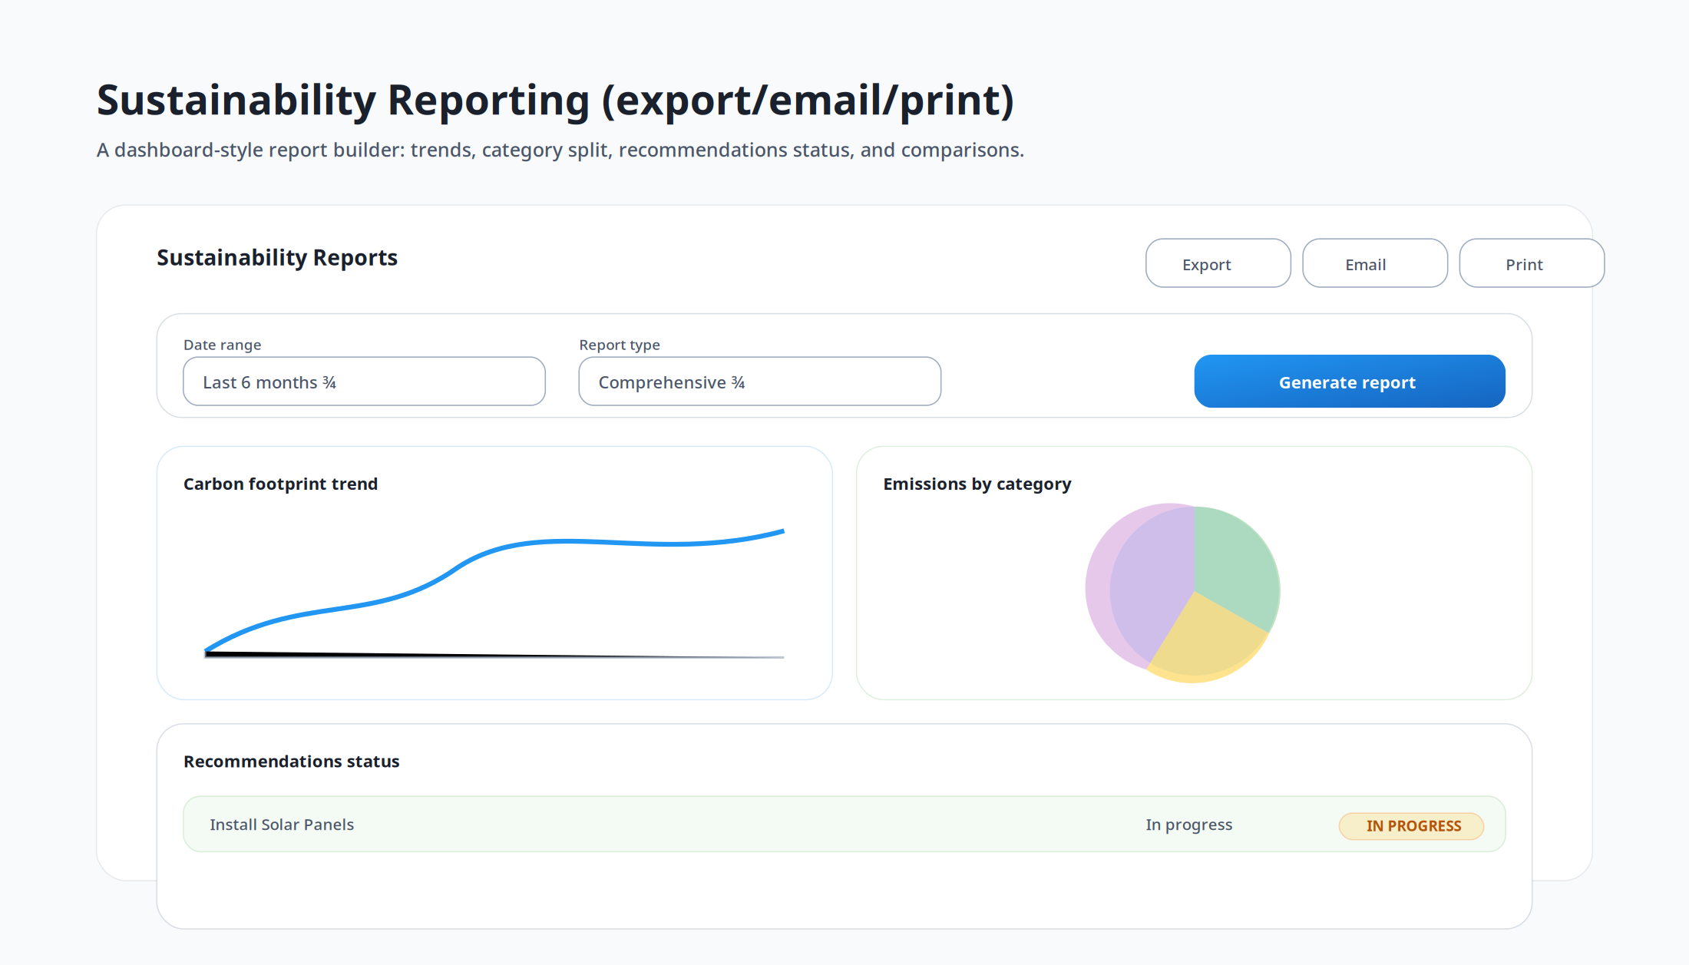
2) Carbon + ESG outputs (comparable across customers)
Total CO₂ + category breakdown; scopes 1/2/3 split.
Carbon score + trend over time; recommended actions with payback.
Consistent schema enables portfolio rollups and benchmarking.

Slide 7
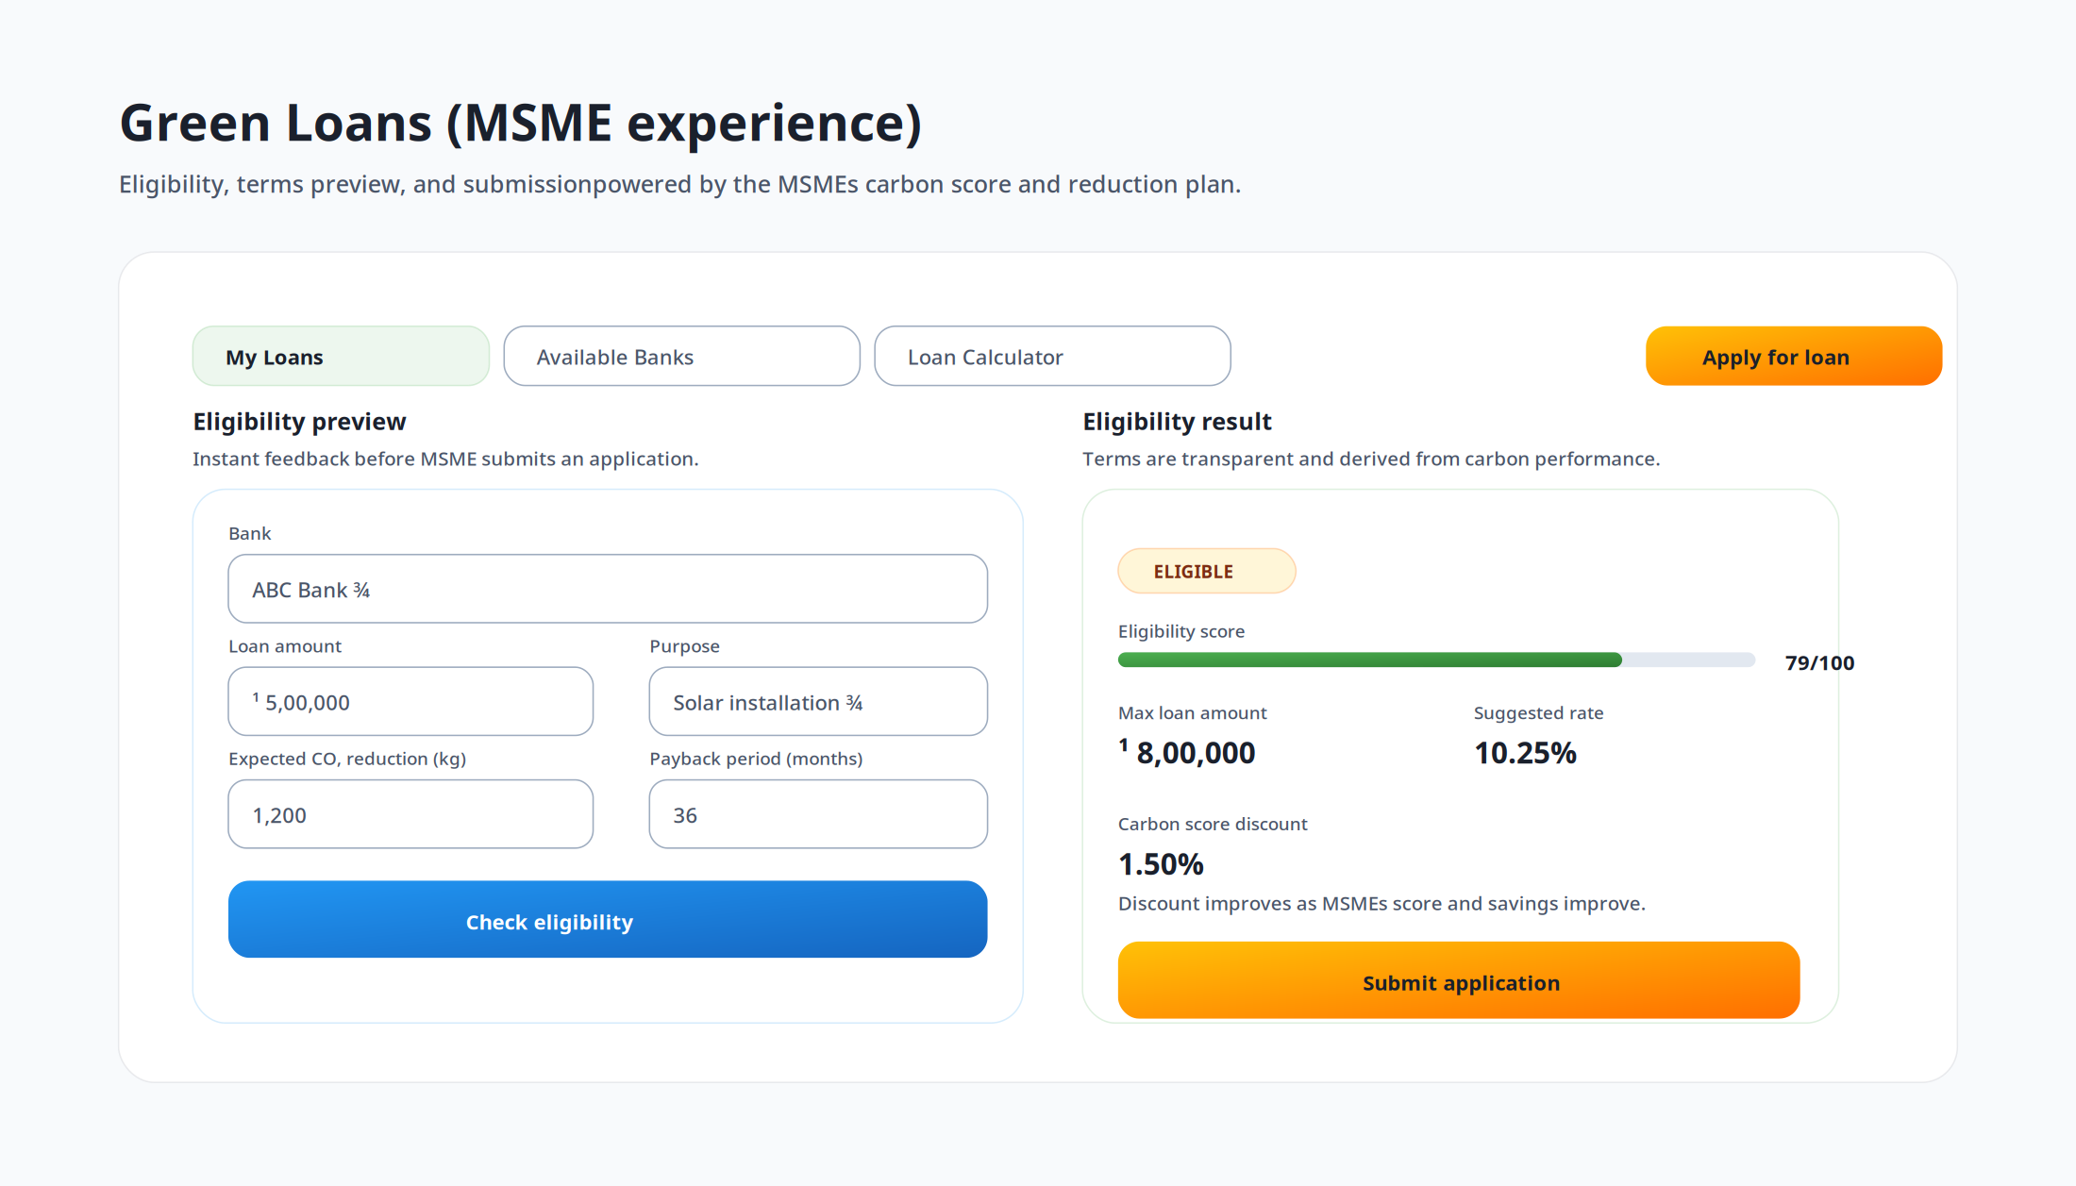
3) Green loan enablement (origination workflow)
Eligibility checks + transparent term preview based on policy rules and carbon score.
Cleaner application files reduce back-and-forth and speed approvals.
Ongoing monitoring ties disbursement impact to measurable reductions.

Slide 8
Deployment models
3 common ways banks roll this out

Slide 9
Rollout options
Model A — Bank-led onboarding: offer to MSME customers to prepare green-loan-ready profiles.
Model B — Co-lending / partner channel: embed into partner program and share standardized outputs.
Model C — Portfolio monitoring: enroll existing borrowers for ongoing capture and early-warning signals.

Slide 10
KPIs this can improve
Acquisition: more qualified green loan leads per RM/branch.
Approval speed: fewer document gaps; cleaner eligibility checks.
Portfolio coverage: % of MSME book with standardized sustainability data.
Monitoring: emissions trend + action adoption as engagement/risk signals.

Slide 11
Pilot proposal (suggested)
Select 50–200 MSMEs across 2–3 sectors; onboard via RM-led or digital journey.
Collect baseline assessment + documents; generate standardized outputs and evidence packs.
Measure time-to-file improvement, coverage, and eligibility conversion for green products.
This slide is designed to be customized with your bank’s target segment and product policy rules.

