Slide 1

Optimizing Student Entry Efficiency: A Simulation Study of Implementing Yondr Pouches at McKinley, IS259
By Saloua Daouki

Slide 2
The problem:
Using SimPy, write a process simulation that includes waiting time (discrete event simulation). You may use any topic of interest to you. Write the simulation and all of the following in Jupyter.
Each element is worth 5 points and will be graded using the rubric shown here.
1. State the problem and its significance.
2. Provide a flow-chart model.
3. Simulate the process for the appropriate number of iterations (justify)
4. Justify the validity of the model and discuss how you verified it.
5. State your conclusions/ findings from the model.
6. Generate appropriate graphs (more than one) to illustrate the results and provide a PowerPoint presentation to share with your colleagues. Post this to the discussion.

Slide 3
Introduction:
JHS 259 William McKinley, with nearly 2,000 students, is one of the largest and most sought-after middle schools in New York City. Despite its size and crowding, it is known for its orderliness and success, offering district-wide honors and selective programs like VE (Virtual Enterprise) and Independent Investigative Method classes. To maintain this success and improve student engagement, behavior, and academic performance, McKinley is implementing the Yondr Pouch System next year. This implementation may create an issue with student entry efficiency in the morning. To address this potential challenge, I will use SimPy to simulate the process and optimize student entry efficiency.

Slide 4
Problem statement and its significant
Problem:
The problem is to simulate the flow of 1600 students in the morning as they use Yondr Pouches to store their cell phones, and to have them checked by school aids to ensure that they are locked at 4 school entrances to optimize efficiency and identify potential issues.
Its significance:
Efficiently managing the morning flow of students is crucial to ensure a smooth start to the school day. Delays at the entrance due to the Yondr pouch system can lead to late arrivals in classrooms and a chaotic start to the day. By simulating the process, we can identify potential issues, optimize resource allocation, and propose strategies to improve the flow of students. The goal is to ensuring smooth student entry without delays.

Slide 5
Flow-chart Model
# Create a new directed graph
dot = Digraph()
# Define the nodes
dot.node('A', 'Students Arrive at School')
dot.node('B', 'Place Phones and EarPods in Yondr Pouches')
dot.node('C', 'Manually Lock Yondr Pouches')
dot.node('D', 'School Aides Check Pouches')
dot.node('E', 'Enter School Building')
# Define the edges
dot.edges(['AB', 'BC', 'CD', 'DE'])
# Render the graph
dot.render('student_entry_process', format='png', view=True)
# Display the graph in the notebook
dot
Here is the code I used to create the flow chart in python:

Slide 6
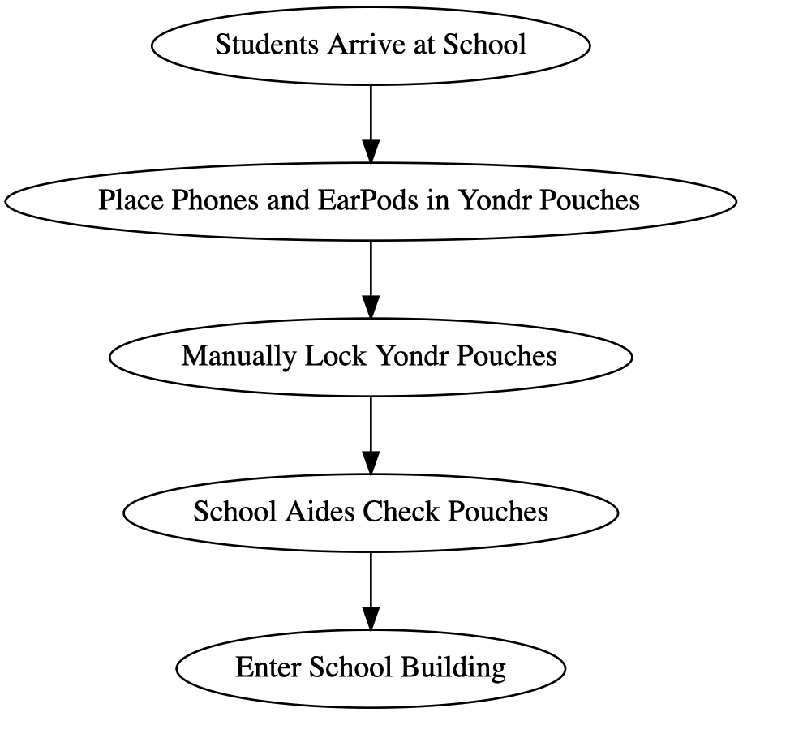
Flow-chart Model
The flow-chart visually represents the steps involved in the student entry process:

Slide 7
Simulation Details: Parameters
I think we need to increase the number of iterations to capture more variability. In other words, we need to simulate several weeks to observe different days and conditions. I will explain the parameters in the next slide, for now here is the code I used to define them in Python:
import simpy
import random
import matplotlib.pyplot as plt
# Parameters
arrival_rate = 10 # Average arrival rate of students per minute
lock_time = 1/2 # Average time for students to lock pouches manually (minutes)
simulation_time = 30 # Total simulation time in minutes (1/2 hours)
num_students = 1600 # Total number of students
num_entrances = 4 # Number of entrances used in the morning
num_aids_per_entrance = 2 # Number of school aides per entrance checking pouches

Slide 8
Simulation Details:
Parameters:
arrival rate: I assumed that 10 students will be arriving every minute considering the size of the school and its population that consists of 1600 students.
lock time: The Yondr pouches are new for everyone including students, so I assumed it will take them about 30 seconds to lock it manually.
simulation time: the simulation will run over a period of 1/2 hours; longer period allows for multiple iterations to simulate different days or scenarios, for better insights. However, in my school, students start lining up around 8:20, then the doors open at 8:30 so students can get to the advisory/homeroom at 8:35.
Number of students: the population of the school can reach 2000 students. During the last couple of years, the population had an average of 1600, so I am using that number for my simulation.
number of entrances: in total, there are 13 entrances/exits at the school. During dismissal, all 13 entrances are used to facilitate the flow of students leaving. However, in the morning, only 4 entrances are open to efficiently manage the entry process with adequate staff supervision.
and aides per entrance: there will be at least 2 school aides stationed at each entrance to check the pouches.

Slide 9
Simulation Details: Students Process
# Student process
def student(env, name, school):
arrival_time = env.now
print(f"{name} arrives at school at {arrival_time:.2f}")
# Place cell phone and EarPods in Yondr pouch
yield env.timeout(random.uniform(0.5, 1)) # Random time to place items in pouch
# Lock Yondr pouch manually
yield env.timeout(random.expovariate(1 / lock_time))
# Security check by school aides
yield env.timeout(random.uniform(0.5, 1)) # Random check time
entry_time = env.now
print(f"{name} enters school at {entry_time:.2f}")
school.entry_times.append(entry_time)
this code models the entry process of students, including waiting times for placing items in pouches, locking the pouches, and security checks.

Slide 10
Simulation Details: School Resources
# School resources
class School:
def __init__(self, env):
self.env = env
self.entry_times = []
To manage the resources and data related to the school simulation, I defined the class `school`:

Slide 11
Simulation Details: set up the simulation
# Generate time series plot outside the simulation loop
time_points = range(0, simulation_time + 1) # Adjusted to include all minutes
# Aggregate entry times across all iterations for plotting
entry_counts = [0] * (simulation_time + 1)
for time in all_entry_times:
entry_counts[int(time)] += 1
plt.figure(figsize=(10, 6))
plt.plot(time_points, entry_counts, marker='o', linestyle='-', color='b')
plt.title('Student Entries Over Time')
plt.xlabel('Time (minutes)')
plt.ylabel('Number of Students Entered')
plt.grid(True)
plt.show()
# Return all entry times collected across all iterations
return all_entry_times
# Simulation setup
def run_simulation(num_iterations):
all_entry_times = [] # List to store all entry times across iterations
for i in range(num_iterations):
random.seed(i)
env = simpy.Environment()
school = School(env)
env.process(student_generator(env, school))
env.run(until=simulation_time)
all_entry_times.extend(school.entry_times) # Collect all entry times
➥

Slide 12
Simulation Details: Student Generator
The following function is responsible for creating and scheduling student arrivals at the school.
# Student generator
def student_generator(env, school):
for i in range(num_students):
yield env.timeout(random.expovariate(1 / arrival_rate)) # Adjusted arrival rate
env.process(student(env, f"Student {i+1}", school))

Slide 13
Simulation Details:
My simulation employed parameters reflecting an average arrival rate, typical pouch locking times, and realistic simulation time. I verified the model through logical consistency in student entry patterns and sensitivity analysis of parameters like arrival rate. To capture variability and different scenarios, 5 iterations (representing weeks) were simulated. This allows for observing patterns across multiple instances and validating the model's robustness.
The line graph is in the next slide:
# Run the simulation
num_iterations = 5 # Number of iterations (weeks)
all_entry_times = run_simulation(num_iterations)

Slide 14
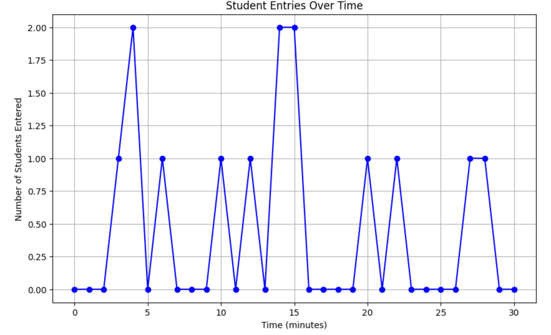

Slide 15
Histogram of students entry time
Average entry time across all iterations: 14.31 minutes. To visualize the students entry time, I am going to plot a histogram:
# Generate histogram of student entry times
plt.figure(figsize=(10, 6))
plt.hist(all_entry_times, bins=20, edgecolor='black')
plt.title('Distribution of Student Entry Times')
plt.xlabel('Entry Time (minutes)')
plt.ylabel('Frequency')
plt.grid(True)
plt.show()

Slide 16
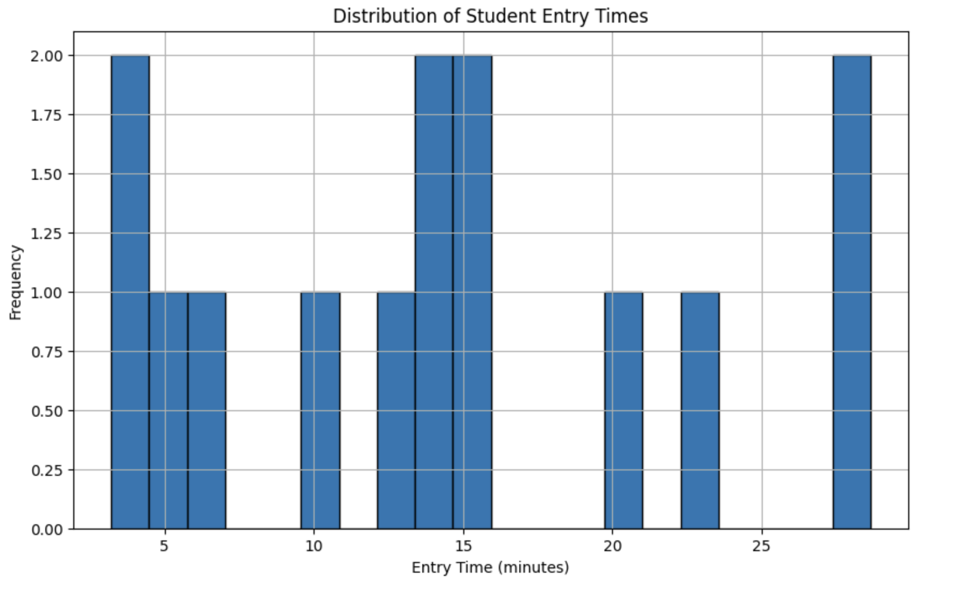

Slide 17
The validity of the model:
The model's validity is ensured through realistic parameters and logical flow representation of the entry process. SimPy's discrete event simulation accurately reflects the stochastic nature of student arrivals, pouch locking, and security checks.
Verification was achieved by comparing simulated outcomes with expected behaviors and conducting sensitivity analysis on key parameters (e.g., arrival rate). Patterns observed in simulations align with expected school entry dynamics. Given that the Yondr pouch system is scheduled for implementation next year at our school, verification is based on simulated outcomes rather than direct comparisons with real-world data.

Slide 18
Conclusion and findings
Based on the simulation and resulting graphs, there are peaks around 4, 14, and 15 minutes which indicate clusters of student entries, possibly reflecting rush periods during entry. In addition, majority of entries occur during specific periods, with smaller peaks indicating subsequent student arrivals. In other words, there are consistent patterns of entry indicate a structured flow, while variability highlights potential points of congestion or efficiency improvements.

Slide 19
Next steps:
Based on those findings, we can improve the flow of students by the following:
Optimization strategies: Place more school aides at entrances during the busiest times to help students get through the line faster.
Improve the process: I am not sure how to refine the process of locking the pouches to make students enter faster, because the pouches can be locked with one click. However, we can make the steps of checking the pouches quicker, maybe by stationing more school staff by the entrances so the flow of the students can be faster.
Try different simulations: maybe we can test different scenarios by changing the parameters (like arrival rates or check times) to see how the entry process holds up under different conditions and to predict long-term effects.
Please find the link to the colab notebook is here

