Slide 1

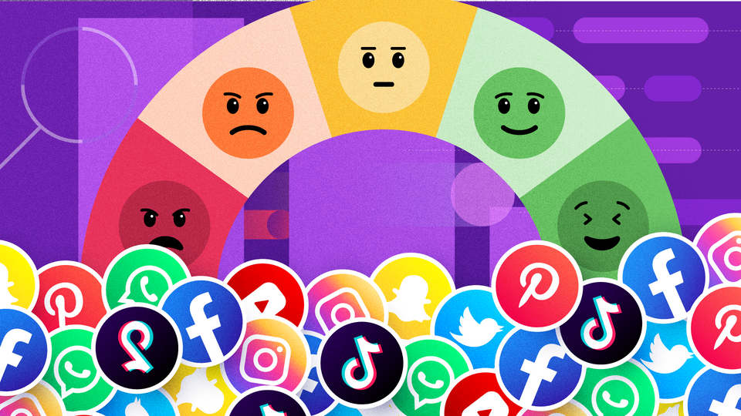

Authors:
i. Ibrahim Salim
ii. Abond Mwangi
iii. Abigail Muthenya
iv. Nelson Kamau
Social Media Sentiment Analysis
Institution: Moringa school
Date: 16th July, 2025
Automated Sentiment Tracking on Twitter

Slide 2
Introduction
Social media platforms generate massive unstructured data.
Monitoring sentiment helps protect brand reputation.
Manual analysis is impractical due to volume and velocity.
This project uses Natural Language Processing (NLP) and machine learning for automated sentiment detection.

Slide 3
Project Overview
Goal: Classify tweet sentiment towards brands (e.g., Amazon, Facebook, Borderlands).
Sentiments: Positive, Negative, Neutral, Irrelevant.
Helps brand managers and marketing teams:
Monitor sentiment trends.
Detect spikes in negative sentiment.
Evaluate marketing impacts.
Benchmark competition.
✅ Positive
⚖️ Neutral
❌ Negative
🚫 Irrelevant

Slide 4


Tools and Techniques
TF-IDF
Random Forest
XGBoost
Term Frequency - Inverse Document Frequency(TF-IDF) simply converts text into numbers
The Smart Voting System Behind the Model
Think of it like asking many decision-makers instead of just one.
Each "decision-maker" (tree) looks at the tweet and makes a guess (Positive, Negative, etc.)
Then they vote, and the majority wins.
for comparison
XGBoost is like a supercharged decision-maker that learns from its past mistakes—fast and aggressively.
It builds decisions step by step, each time fixing what went wrong in the last step

Slide 5

The Sentiment Analysis Process Explained
Step 1: Data Collection
Step 2: Data Processing
Step 3: Analysis
Step 4: Reporting
Dataset sourced from Kaggle: Twitter Entity Sentiment Analysis.
75,000 labeled tweets mentioning brands.
Making Tweets Readable by Machines
Removed spam,duplicates, missingtext
Filtered noise like @mentions, links
Utilize algorithms to detect sentiment trends and patterns.
Present findings through charts and visualizations for clarity

Slide 6
Exploring Key Aspects of Sentiment Analysis
Sentiment Modeling
Performance Snapshot
Impact on Business
What Insights This Unlocks
How the System Understands Sentiment:
We used machine learning (like training a smart assistant)
Turned words into numbers (TF-IDF: word importance score)
Trained models to recognize sentiment patterns
How Well Did It Work?:
89% accuracy with Random Forest model
Strong at detecting Positive & Negative sentiments
Still improving Neutral and Irrelevant detection
Identify trends and sentiment shifts
Compare brands side-by-side
Tailor messaging based on public feedback

Slide 7
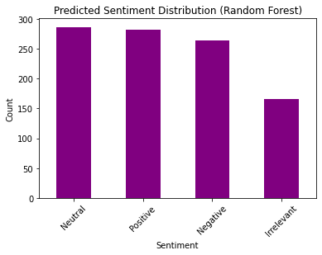
Visual of the distribution

Slide 8
Real Use on New Tweets
What Happens When You Feed It Tweets:
We tested on unseen tweets from the validation set
Predictions matched real-world expectations

Slide 9
Example use cases
When this matters
Launch day: Monitor public reaction instantly
PR incidents: Catch and respond to complaints
Campaign tracking: Measure tone over time

Slide 10
The Future of Sentiment Analysis
As social media continues to evolve, understanding sentiment becomes crucial for businesses. In the future, leveraging advanced algorithms and AI tools will enhance our ability to interpret public opinion, leading to more informed decision-making processes.

Slide 11
Insights Summary
What the System Found:
Balanced feedback among sentiment types
Irrelevant content is hardest to classify
Real-time insights without human effort

Slide 12
Benefits and Limitations of Sentiment Analysis
Key benefits of sentiment analysis:
Key limitations of sentiment analysis:
Provides real-time feedback on opinions
Helps identify trends in consumer behavior
Enables targeted marketing strategies
Improves customer service and engagement
May misinterpret sarcasm or irony
Language nuances can create inaccuracies
Limited context understanding of phrases
Reliant on quality and quantity of data

Slide 13
Recommendations and Conclusion
Key Recommendations:
Conclusion
Periodic model evaluation to maintain relevance.
Expand to multilingual support for wider markets.
Integrate with real-time dashboards for monitoring.
Use insights for marketing, customer support, product feedback.
Explore advanced models (e.g., transformers) for deeper analysis.
Automated sentiment analysis supports scalable, real-time monitoring.
Enables brands to track sentiment trends, detect issues, and inform strategy.
Demonstrates how NLP and ML drive proactive brand management.
Positions Interbrand for data-driven insights and competitive advantage.

Slide 14
Thank You
Questions & Feedback
We’re ready to demo or discuss further

