Slide 1
SALS3 MASTER ARCHITECTURE & LAUNCH PLAN
Master Architecture & 3 to 5-Month Transition Blueprint
Month 1 Shopify Cash Flow + Custom B2C Website & Seller Center Build
Lead Architects & Operators: AJ & Bogs (The Sals3 Engineering & Operations Team)

Slide 2
MASTER ARCHITECTURE OVERVIEW
The 3 Core Pillars of Sals3
🏬 Pillar 1: Shopify Pop-Up Store (Month 1)
Active for 30 days. Generates immediate sales & cash flow while we build our custom platform in the background.
🛍️ Pillar 2: Customer Website (Months 2-3)
WHERE BUYERS SHOP! Shopee/Lazada-style website (sals3.com) where shoppers browse, add to cart, pay & track parcels.
⚙️ Pillar 3: Sals3 Seller Center (Months 3-4)
WHERE SELLERS WORK! Shopee/Lazada-style seller portal where vendors upload SKUs, process orders, print waybills & get paid.

Slide 3
SYSTEM OPERATIONAL FLOWCHART
Detailed 10-Step Item Lifecycle (Connected Flowchart)
1. Supplier Feed
CJ API / Local Stock
2. Quality Gate
4.5+ Stars & >100 Sold
3. Dynamic Pricing
Auto Sals3 Price & Margin
4. Customer Order
Checkout & Payment
5. Stock Sync
Real-Time Stock Check
➔
➔
➔
➔
⬇
6. Auto Order PO
API Dispatch to CJ
7. White-Label
Branded Sals3 Label
8. Live Tracking
Webhook Status Portal
9. Delivery & Review
Parcel Delivered SLA
10. Profit Settlement
Net Profit to Bank
➔
➔
➔
➔

Slide 4
CATALOG FILTRATION PIPELINE
Curated High-Quality Catalog Gate & Media Queue
🛡️ Automated Quality Gate Rules
Products fetched from CJ Dropshipping must pass strict algorithmic filters before entering the publishing queue: • 4.5+ Star Rating Guard: Keeps out low-rated items. • >100+ Sales Volume Guard: Accepts only proven best-sellers. • Verified Supplier Guard: Accepts items from Gold suppliers only.
🖼️ Media Review Queue & Photo Touchups
Approved items enter the Sals3 Media Queue for photo cleanup and text formatting. ⚠️ NOTE: Photo cleanup, watermark removal, and custom graphic touchups will be handled as an ADDITIONAL FEATURE / SEPARATE WORKFLOW by a dedicated Content/Media Specialist (to be discussed separately).

Slide 5
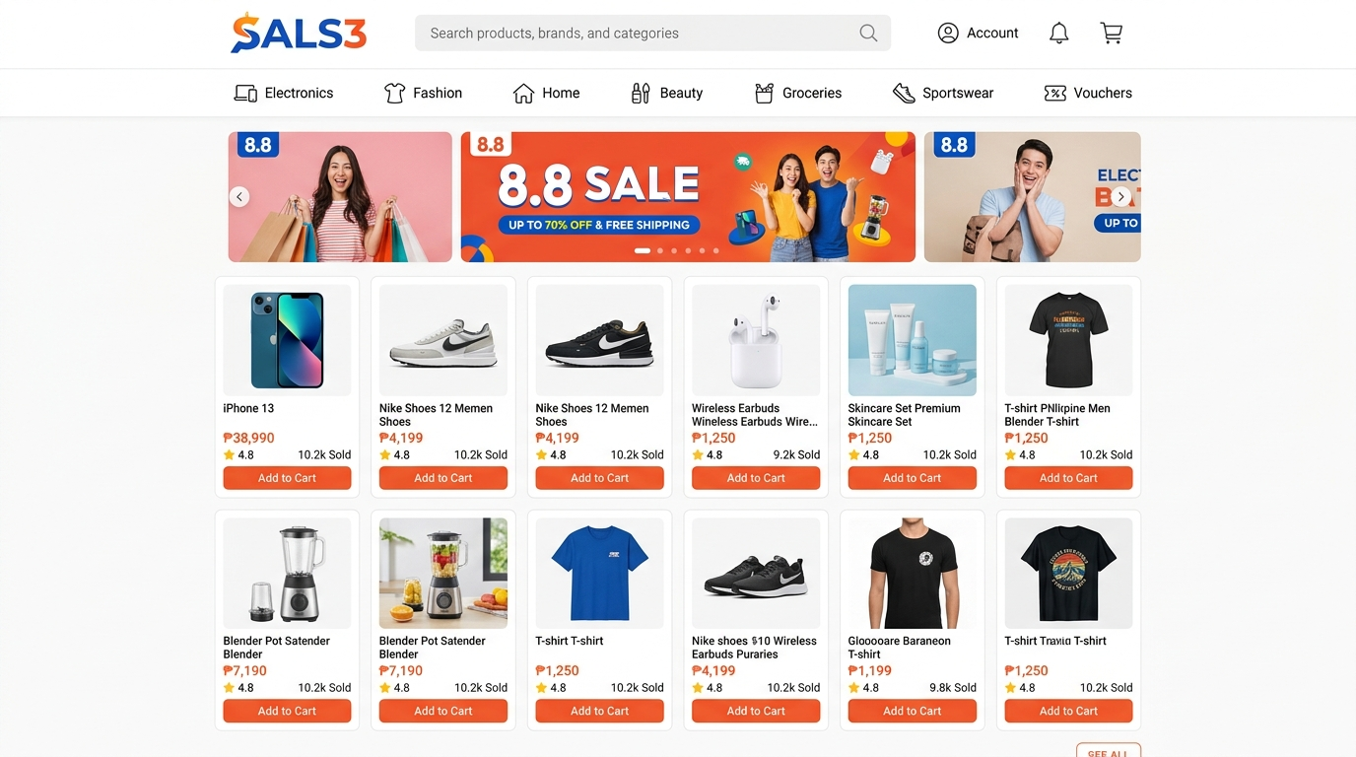
PILLAR 2: CUSTOMER SHOPPING STOREFRONT
Sals3 Customer Shopping Website UI (Where Buyers Shop)
💡 DISCLAIMER: This UI mockup, visual layout, and payment options are sample representations for demonstration only. All detailed functionalities, payment gateways, and business logic will undergo further alignment discussion with Sals3 Leadership.
🛍️ WHAT HAPPENS ON THIS SCREEN:
• 1. Public Storefront (sals3.com): The main shopping site where customers browse and buy.
• 2. Shopee/Lazada Style UX: Intuitive categories, promo banners, and high-converting product grid.
• 3. Only High-Quality Items: Only products passing our 4.5+ Star & >100 Sales filter appear here.
• 4. Real-Time Stock Lock: Out-of-stock items automatically hide or disable checkout in real time.
• 5. Further Discussion: Final UI layout & category structure subject to owner alignment.

Slide 6
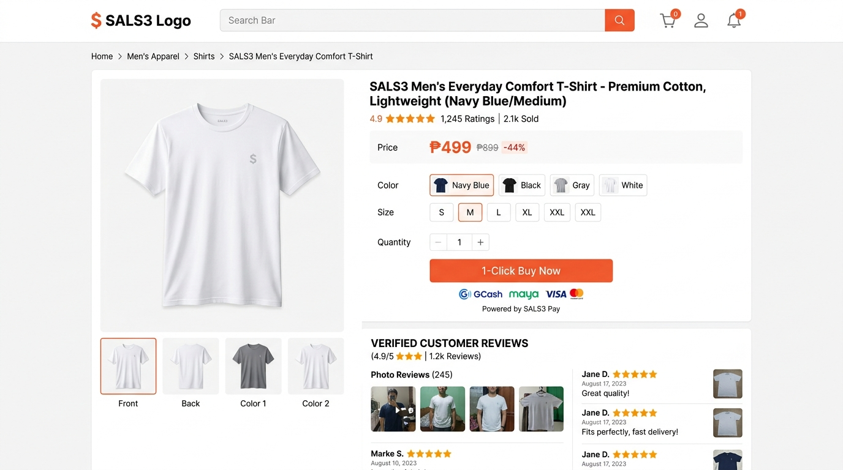
PILLAR 2: PRODUCT DETAIL & CHECKOUT
Sals3 Product Page & 1-Click Checkout UI Mockup
💡 DISCLAIMER: This UI mockup, visual layout, and payment options are sample representations for demonstration only. All detailed functionalities, payment gateways, and business logic will undergo further alignment discussion with Sals3 Leadership.
💳 WHAT HAPPENS ON THIS SCREEN:
• 1. Product Collateral: Photo gallery, size/color selectors, and verified buyer photo reviews.
• 2. Payment Options (Sample Mockup): Buy button showing sample payment options (GCash/Cards).
• 3. Dynamic Shipping Calculator: Auto-calculates courier delivery fees based on address.
• 4. Auto Receipt: Triggers instant email/SMS confirmation and enters order into database.
• 5. Further Discussion: Payment gateway partners & checkout logic to be aligned with owner.

Slide 7
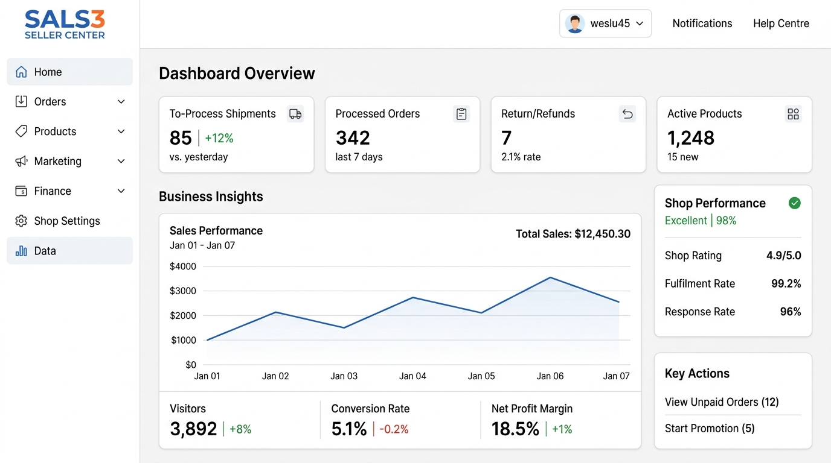
PILLAR 3: SELLER PORTAL MODULE 1
Main Seller Center Dashboard (Where Sellers Work)
💡 DISCLAIMER: This UI mockup, visual layout, and payment options are sample representations for demonstration only. All detailed functionalities, payment gateways, and business logic will undergo further alignment discussion with Sals3 Leadership.
⚙️ WHAT HAPPENS ON THIS SCREEN:
• 1. Seller Command Center: Private portal for our product listers • 2. Top Action KPI Bar: Real-time counters for To-Process Orders, Processed Shipments, & Returns.
• 3. Business Insights: Live sales analytics (GMV), visitor traffic, conversion %, and net profit.
• 4. Shop Health Audit: Monitors seller shipping SLA compliance and customer chat response rate.
• 5. Further Discussion: Specific analytics widgets & dashboard metrics to be finalized with owner.

Slide 8
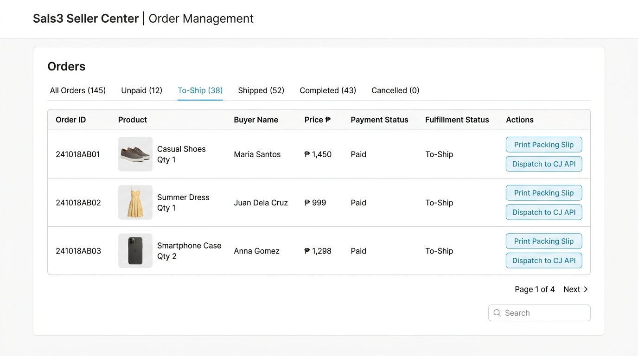
PILLAR 3: SELLER PORTAL MODULE 2
Order Management & Auto-Fulfillment UI
💡 DISCLAIMER: This UI mockup, visual layout, and payment options are sample representations for demonstration only. All detailed functionalities, payment gateways, and business logic will undergo further alignment discussion with Sals3 Leadership.
📦 WHAT HAPPENS ON THIS SCREEN:
• 1. Order Lifecycle Tracking: Centralized status tabs (UNPAID -> TO-SHIP -> SHIPPED -> COMPLETED).
• 2. 1-Click Mass Waybill Print: Prints official 'Sold & Fulfilled by Sals3' shipping labels & slips.
• 3. Auto CJ API PO Trigger: Automatically orders item from CJ Dropshipping via API with 1 click.
• 4. Live Tracking Sync: Automatically pushes courier tracking ID to customer portal.
• 5. Further Discussion: Order status rules & cancellation policies to be aligned with owner.

Slide 9
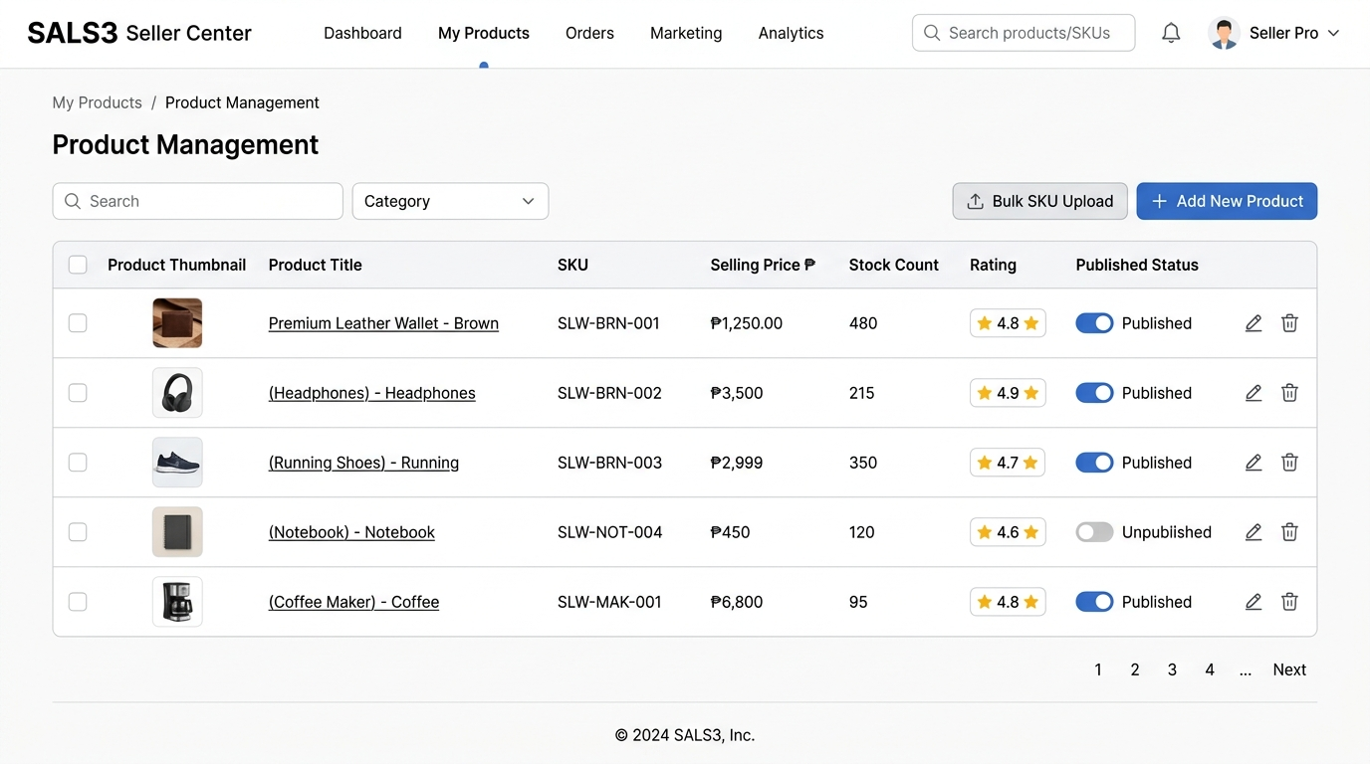
PILLAR 3: SELLER PORTAL MODULE 3
Product Management & Bulk SKU Upload UI
💡 DISCLAIMER: This UI mockup, visual layout, and payment options are sample representations for demonstration only. All detailed functionalities, payment gateways, and business logic will undergo further alignment discussion with Sals3 Leadership.
📝 WHAT HAPPENS ON THIS SCREEN:
• 1. Catalog Grid View: Manage published products, prices, stock levels, and quality badges.
• 2. Bulk SKU Excel Import: Direct upload workbook for local brand sellers holding warehouse stock.
• 3. Multi-Variation Matrix: Easily configure size, color, weight, and price per variation.
• 4. Quality Gate Status: Displays 4.5+ star rating score and flags low-performing items.
• 5. Further Discussion: Product categories & bulk import template logic to be aligned with owner.

Slide 10
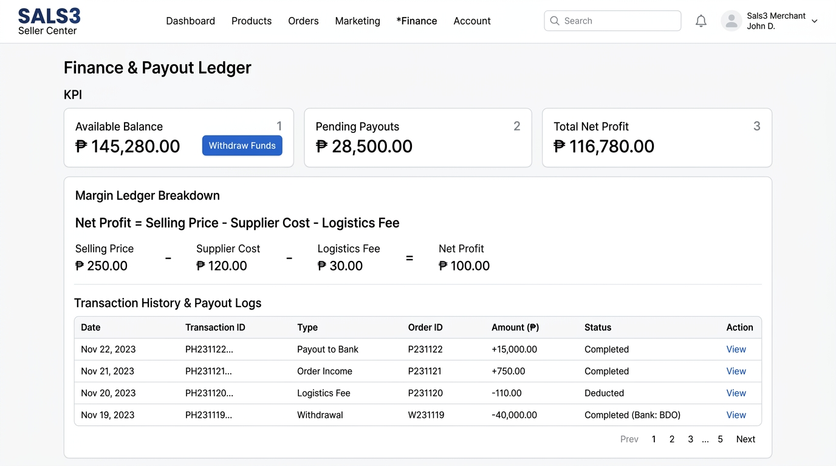
PILLAR 3: SELLER PORTAL MODULE 4
Finance & Net Margin Payout Ledger UI
💡 DISCLAIMER: This UI mockup, visual layout, and payment options are sample representations for demonstration only. All detailed functionalities, payment gateways, and business logic will undergo further alignment discussion with Sals3 Leadership.
💰 WHAT HAPPENS ON THIS SCREEN:
• 1. Dynamic Margin Ledger: Automatically calculates Net Payout = Selling Price - Supplier Cost - Sals3 Fee.
• 2. Automated Bank Withdrawal: Sellers securely request payout deposits to bank accounts or e-wallets.
• 3. Full Audit Transparency: Detailed financial breakdown per order.
• 4. Further Discussion: Platform commission rates & payout schedule rules to be aligned with owner.

Slide 11
3 TO 4-MONTH TRANSITION PLAN
Executive Summary & Cutover Strategy
🚀 Month 1: Shopify Launch
Launch temporary Shopify Storefront for 30 days to generate immediate cash flow and test CJ demand. Database schema & Quality Gate built in parallel.
🏗️ Months 2–3: Custom Build
Develop custom B2C Customer Website (Shopee/Lazada style) and Enterprise Sals3 Seller Center in parallel.
⚡ Month 3-5: Zero-Downtime Cutover
Perform QA load testing, migrate Shopify customer & SKU CSV records, and execute zero-downtime DNS cutover to sals3.com.

