Slide 1
CSS preprocessor-Sass

Slide 2
Contents
1
What is Sass?
5
Importing SASS
2
6
Selector inheritance
Sass features
Sass Variables
SASS - Mixins
3
7
4
Sass Nesting
8
Working with Sass

Slide 3
00
What are CSS Preprocessors ?

Slide 4




SASS
What are CSS Preprocessors ?
Scripting language for writing CSS.
Write CSS more efficiently.
A few of most popular CSS preprocessors:
Sass
LESS
Stylus
PostCSS

Slide 5
01
What is sass?
Syntactically Awesome Style sheets

Slide 6
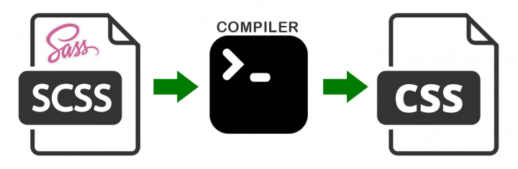
SASS
What is
SASS
Super Awesome Stylesheets OR Syntactically Awesome Stylesheets
SASS a style sheet extension language because it extends the standard CSS characteristics by introducing the benefits of a basic programming language. So SASS will compile your code and generate the CSS output a browser can understand.

Slide 7
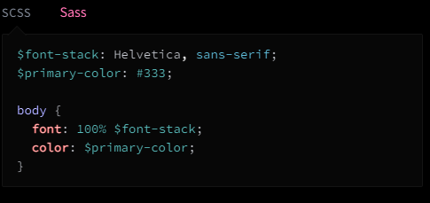
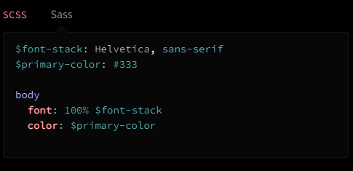
SASS
What is
SASS
SASS comes with two different syntaxes: SASS itself and SCSS, the most used one. SCSS syntax is CSS compatible, so you just have to rename your .css file to .scss .
scss extension is exactly the same. sass extension uses next line instead of {} and tab instead of ;.

Slide 8

SASS
Why?? What's wrong with CSS ??
Nothing , CSS is awesome
Without it , all websites would look the same

Slide 9


SASS
Why?? What's wrong with CSS ??
BUT ......
1- Developing CSS is slow
2- CSS is repetitive
So CSS needs external tools for optimization
3- CSS isn't really reusable

Slide 10
02
Sass features

Slide 11
Sass features
What can Sass do for us?
Variables
Mixins
Selector inheritance
Nesting
Import

Slide 12
03
SASS Variables

Slide 13
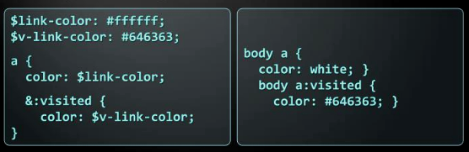
SASS Variables
.scss .css
Using the $ (dollar) symbol
Can be used to store colors , fonts , size , etc …

Slide 14
04
SASS Nesting

Slide 15
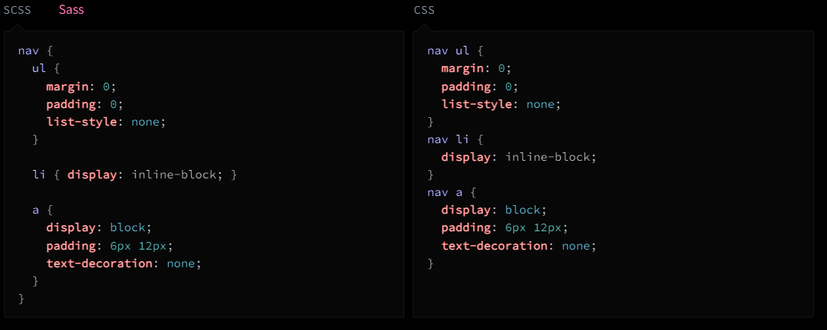
SASS Nesting
1
All selectors inside a selector are translated to nested selectors .
PPT模板 http://www.1ppt.com/moban/

Slide 16
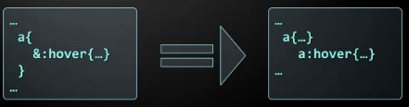
SASS Nesting
2
Selectors can also reference themselves inside their selector using the symbol → “&”.
PPT模板 http://www.1ppt.com/moban/

Slide 17
05
Importing SASS

Slide 18
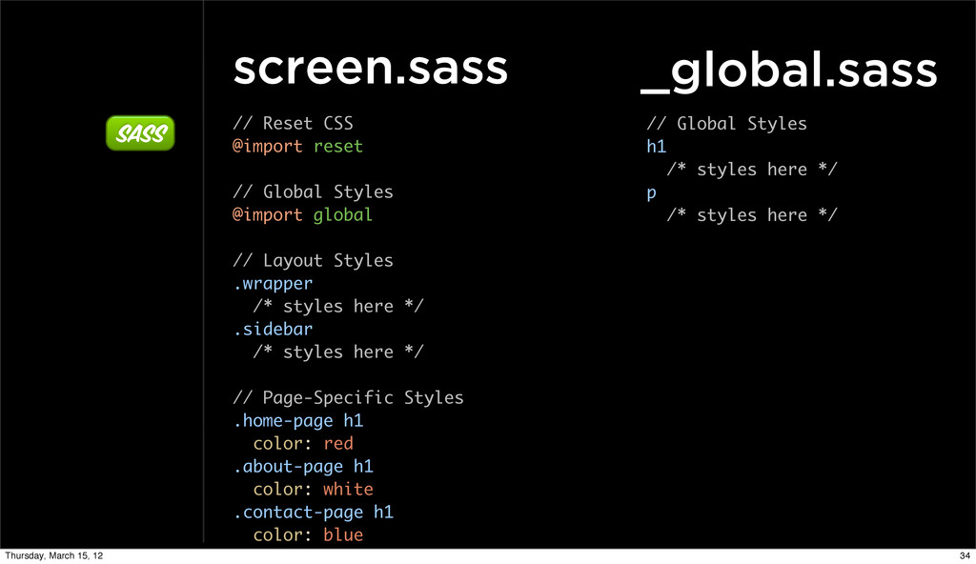
Importing Sass

Slide 19
Importing Sass
CSS import VS SASS import
CSS | SASS
CSS import makes multiple HTTP request. | Sass import makes only one HTTP request.
Poor performance | Good performance
CSS import happens at runtime. | Sass import happens at compile time.

Slide 20
06
Selector inheritance

Slide 21
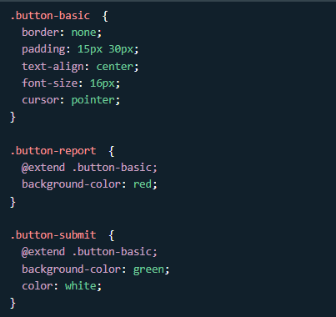
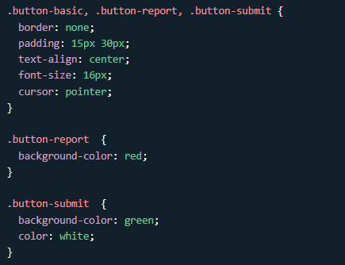
Selector inheritance
The @extend directive lets you share a set of CSS properties from one selector to another.
.scss
.css

Slide 22
07
SASS - Mixins

Slide 23
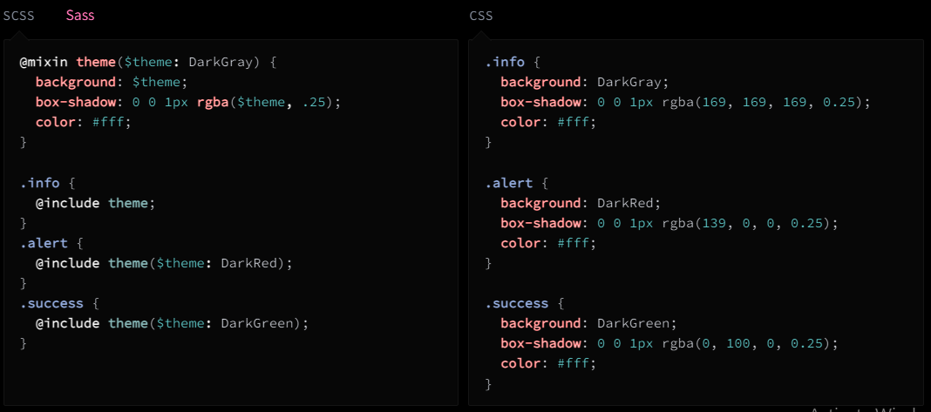
Sass - Mixins
A mixin lets you make groups of CSS declarations that you want to reuse throughout your site. It helps keep your Sass very DRY. You can even pass in values to make your mixin more flexible. Here's an example for theme:-

Slide 24
08
Working with Sass – in VSC

Slide 25
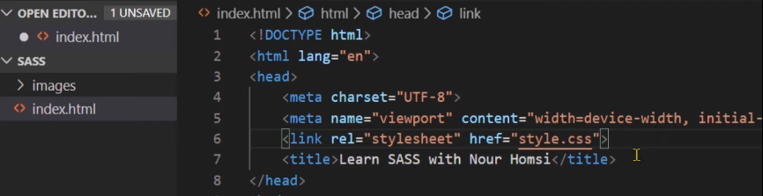
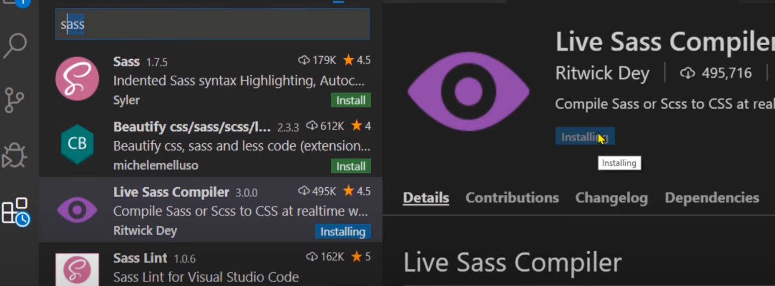
SASS
1
2

Slide 26
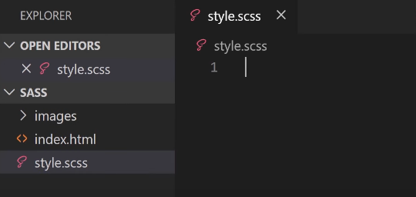
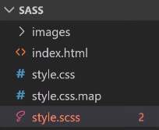
SASS
3
4
5

Slide 27
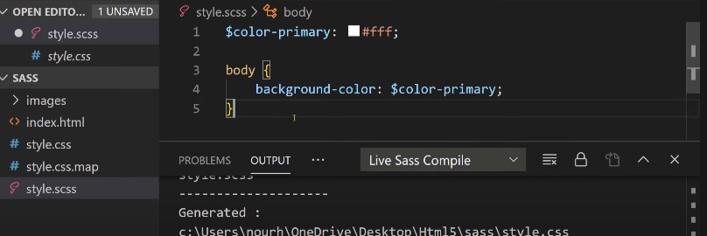
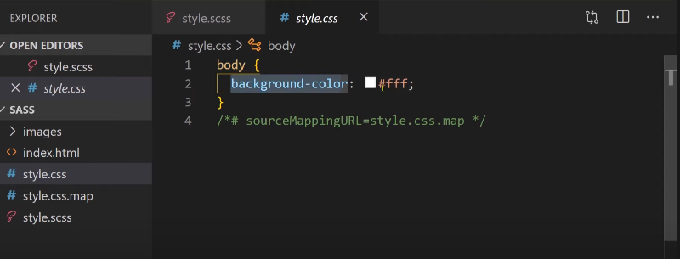
SASS
6
7

Slide 28
SASS
Resources
https://sass-lang.com/guide
https://developer.mozilla.org/en-US/docs/Glossary/CSS_preprocessor
https://codersera.com/blog/difference-between-css-and-scss/
https://www.slideserve.com/chandler-lambert/sass
https://www.geeksforgeeks.org/include-vs-extend-in-sass/
https://www.youtube.com/watch?v=zmotal8b5Qc&list=PLPTNqXpQ2tbgJPXA07MUI3A2oxnOfB6z4&index=1
https://www.youtube.com/watch?v=3zE1s_WCgVM&list=PLPTNqXpQ2tbgJPXA07MUI3A2oxnOfB6z4&index=9
https://sass-lang.com/documentation/at-rules/import
https://stackoverflow.com/questions/40976874/what-is-the-difference-between-css-import-and-sass-scss-import
https://sass-lang.com/documentation/at-rules/mixin

Slide 29
THANKS

