Slide 1

Intro to Airflow

Slide 2
Agenda
Agenda
Objective
Workflow Concept
What is Airflow
DAG
Task, Operator, Dependencies
Workflow Airflow
User Interface

Slide 3
Workflow Concept
a sequence of tasks
started on a schedule or triggered by an event
frequently used to handle data / big data processing pipeline
Typical Workflow
download data from source
send data somewhere else to process
Monitor when the process is completed
Get the result and generate the report
Send the report out by email

Slide 4
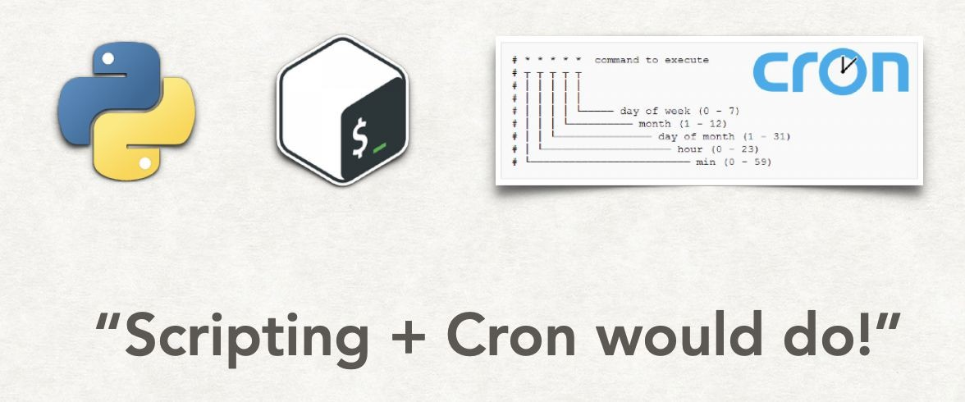
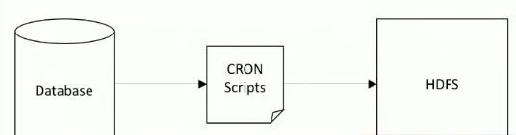
Traditional Workflow
Writing a script to pull data from database and send it to HDFS to process.
Schedule the script as a cronjob.

Slide 5


Traditional Workflow

Slide 6
Then Become Problem
Scalability in terms of managing → How do you manually manage scripts & Cron expressions for hundreds of workflows?
Scalability in terms of execution → For the consideration of performance, you may want to run your jobs on multiple worker nodes, how do you manage them?
Environment Dependencies → Different jobs may have different dependencies, e.g., Spark, or network proxy, etc.
Connections to different systems → like RDBMS, AWS, Hive, HDFS, etc. All of them come together with configurations like host address, port, id, password, schema, etc. How to manage them in a centralised fashion?
Monitoring → How do we monitor the status of each step? Which batch job failed? Due to which step? For what reason?
Re-running → How can we re-run a specific step? Manually do it or make ad-hoc change on the script? Neither is ideal.

Slide 7


History Airflow
History Airflow
The project joined the Apache Software Foundation’s incubation
A workflow (data-pipeline) management system developed by Airbnb
A framework to define tasks & dependencies in python
Executing, scheduling, distributing tasks accross worker nodes.
 | program in 2016.
Written in Python
View of present and past runs, logging feature
Extensible through plugins
Nice UI, possibility to define REST interface
Interact well with database
Used by more than 200+ companies: Airbnb, Yahoo, Paypal, Intel, Stripe,…
●
500+ contributors (according to GitHub history)

Slide 8


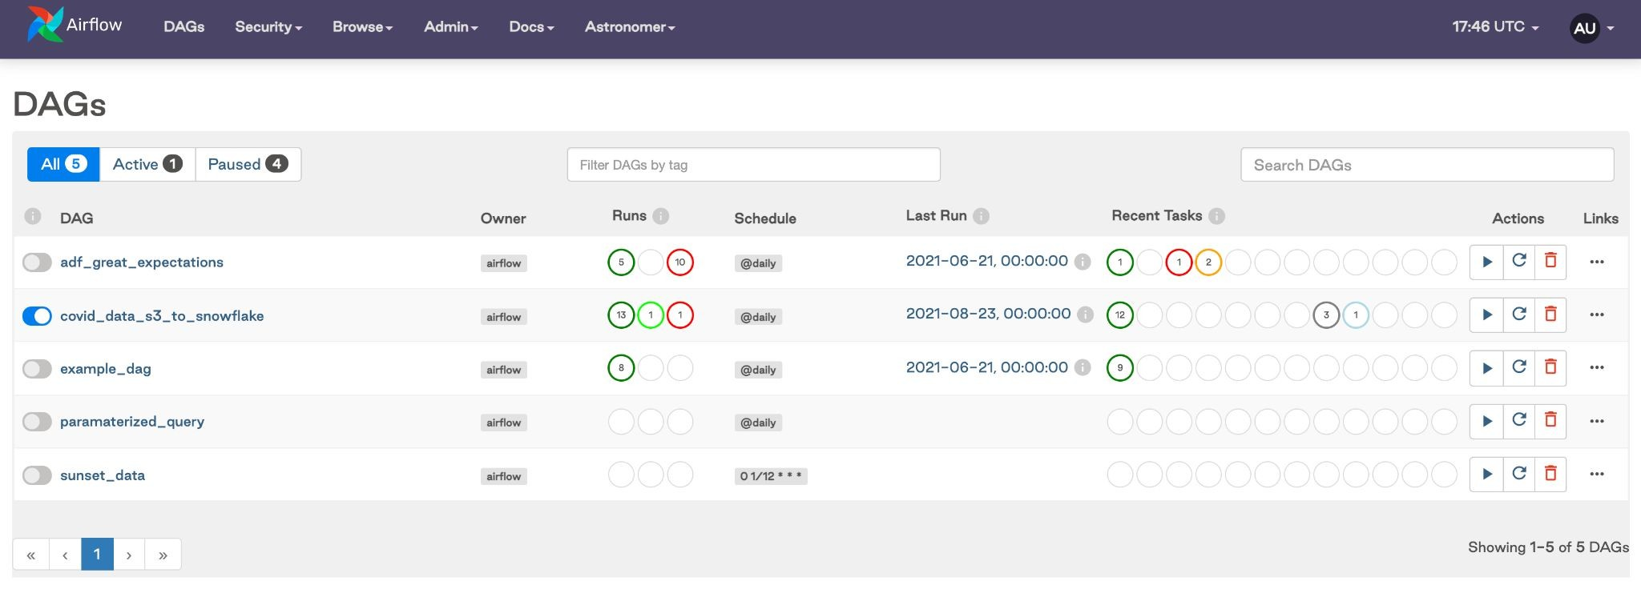
Why Airflow
What if? there are tools to manage collection of all the tasks/workflow that you want to run which is organized and shows the relationship between different tasks and also show the status running

Slide 9
Airflow Use Case Implementation
Data warehousing: cleanse, organize, data quality check, and publish data into our growing data warehouse
Machine Learning: automate machine learning workflows
Growth analytics: compute metrics around guest and host engagement as well as growth accounting
Experimentation: compute A/B testing experimentation frameworks logic and aggregates
Email targeting: apply rules to target and engage users through email campaigns
Sessionization: compute clickstream and time spent datasets
Search: compute search ranking related metrics
Data infrastructure maintenance: database scrapes, folder cleanup, applying data retention policies, …

Slide 10
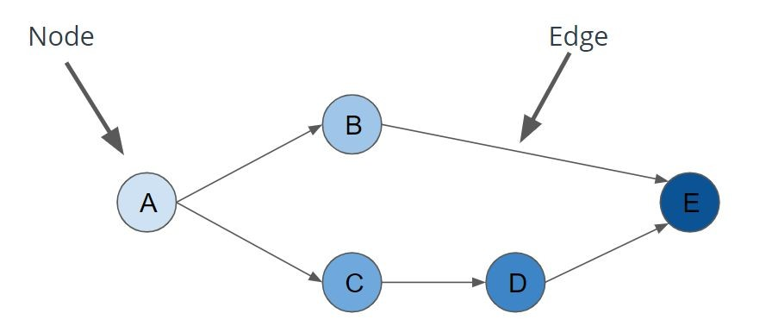
DAG (Directed Acyclic Graph)
Workflows in Airflow are collections of tasks that have directional dependencies.
Airflow uses DAG to represent a workflow.
The graph is enforced to be acyclic so that there are no circular dependencies that can cause infinite execution loops
Each DAG has a set of properties:
○
○
○
dag_id
, a unique identifier amongst all DAGs
start_date
, the point in time at which the DAG’s tasks are to begin executing
schedule_interval
, how often the tasks are to be executed.
Nodes: A step in the data pipeline process/Task.
Edges: The dependencies or relationships other between nodes.

Slide 11
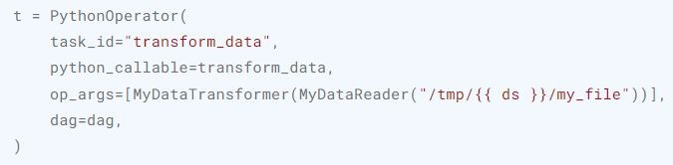
Task Operator
An Operator is conceptually a template for a predefined Task, that you can just define declaratively inside your DAG
BashOperator - executes a bash command
PythonOperator - calls an arbitrary Python function
EmailOperator - sends an email
SimpleHttpOperator
MySqlOperator
PostgresOperator
MsSqlOperator
OracleOperator
JdbcOperator
DockerOperator
HiveOperator
S3FileTransformOperator
PrestoToMySqlOperator
SlackAPIOperator
Airflow has a very extensive set of operators available, with some built-in to the core or pre-installed providers. Some popular operators from core include:

Slide 12
Task Instances
none: The Task has not yet been queued for execution (its dependencies are not yet met)
scheduled: The scheduler has determined the Task’s dependencies are met and it should run
queued: The task has been assigned to an Executor and is awaiting a worker
running: The task is running on a worker (or on a local/synchronous executor)
success: The task finished running without errors
shutdown: The task was externally requested to shut down when it was running
restarting: The task was externally requested to restart when it was running
failed: The task had an error during execution and failed to run
skipped: The task was skipped due to branching, LatestOnly, or similar.
upstream_failed: An upstream task failed and the Trigger Rule says we needed it
up_for_retry: The task failed, but has retry attempts left and will be rescheduled.
up_for_reschedule: The task is a Sensor that is in reschedule
mode
sensing: The task is a Smart Sensor
deferred: The task has been deferred to a trigger
removed: The task has vanished from the DAG since the run started

Slide 13
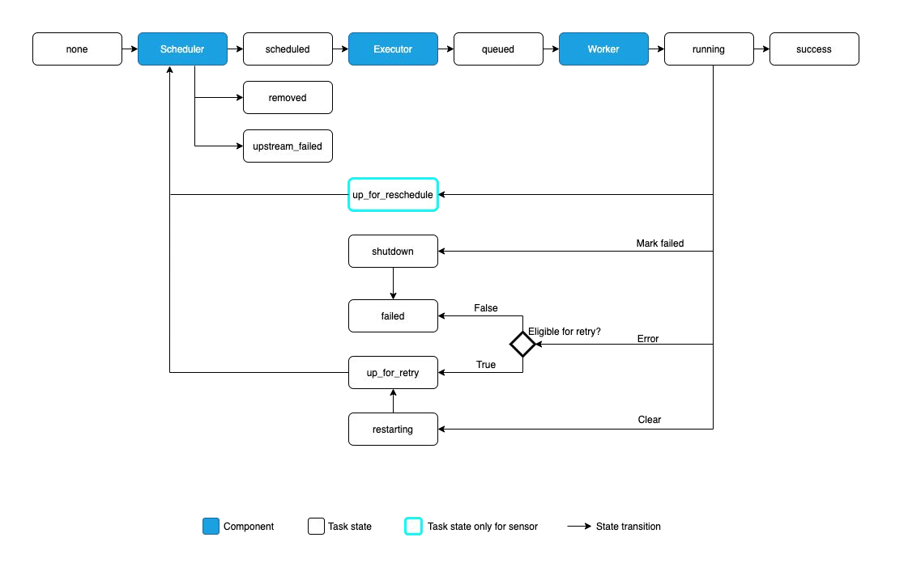
Task Instances

Slide 14
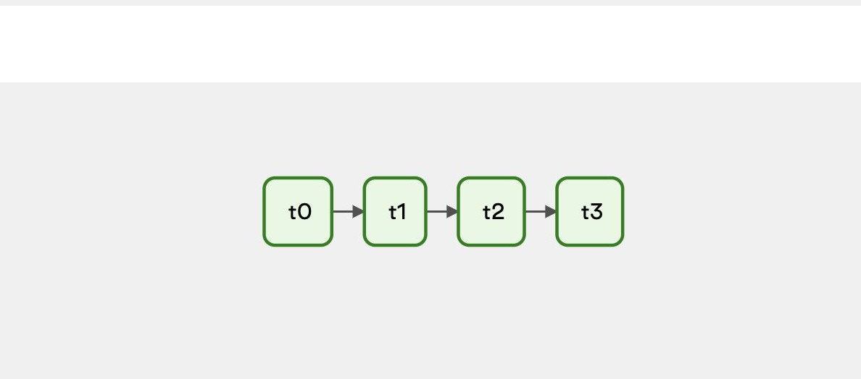
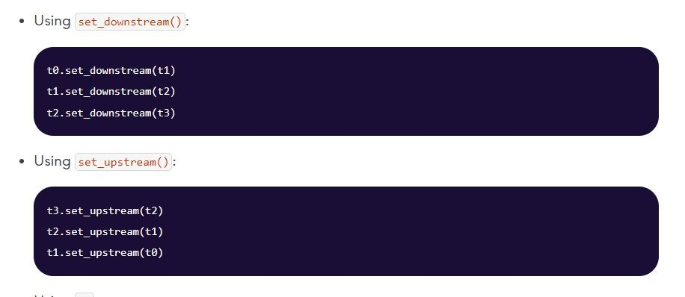
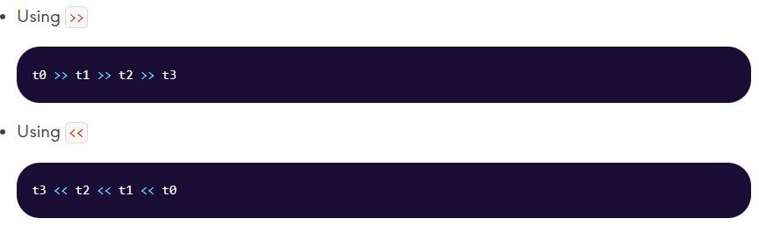
Task Dependencies
Upstream task: A task that must reach a specified state before a dependent task can run
Downstream task: A dependent task that cannot run until an upstream task reaches a specified state
Basic dependencies between Airflow tasks can be set in two ways:
Using bitshift operators (<< and >>)
Using the and
methods
set_upstream
set_downstream

Slide 15
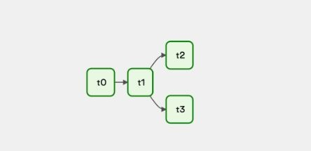
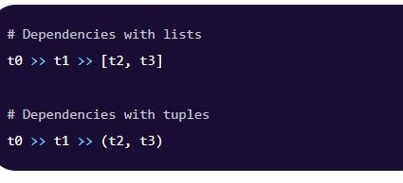
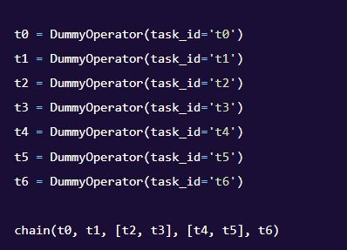
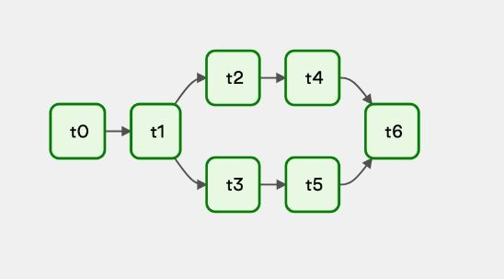
Task Dependencies
Dependencies with tuples & list

Slide 16
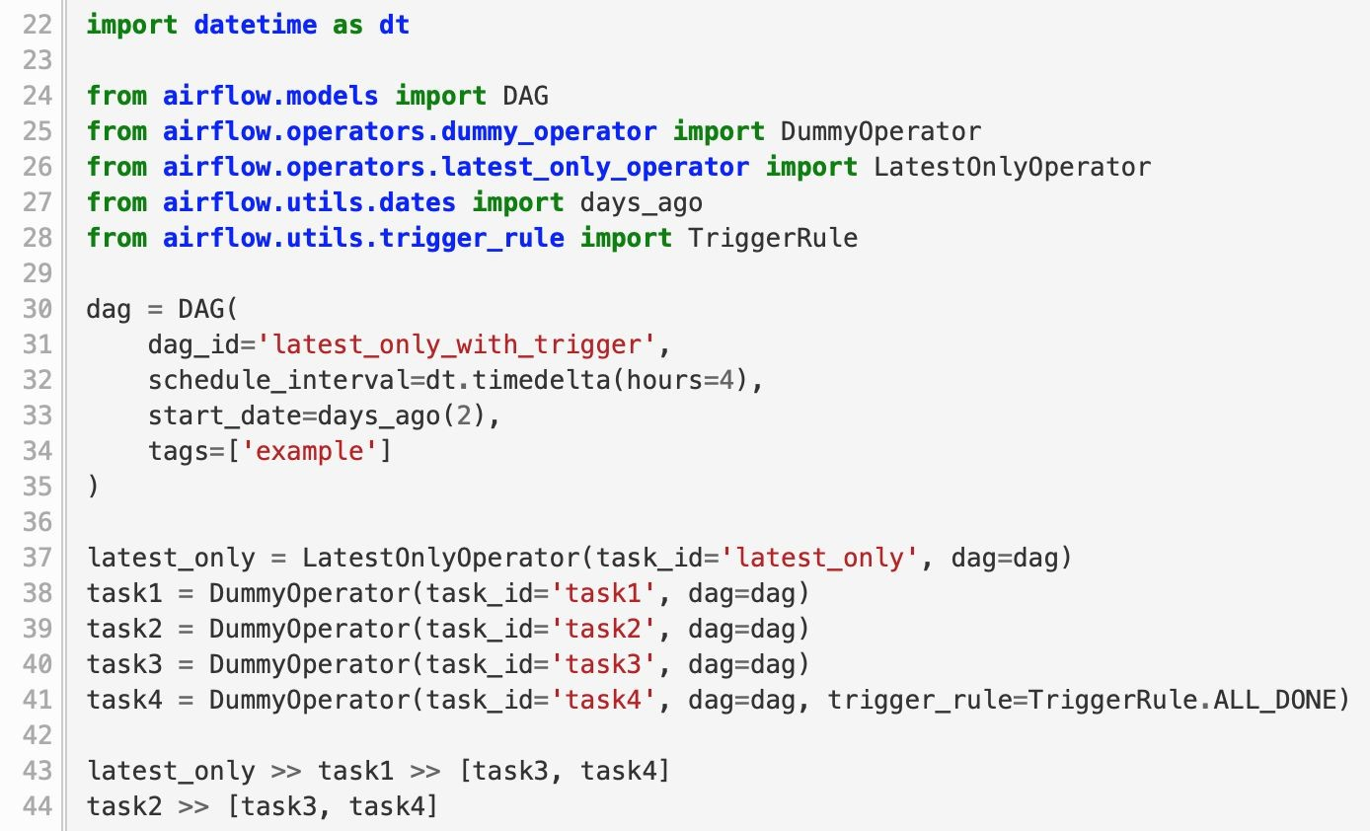
DAG (Example)

Slide 17
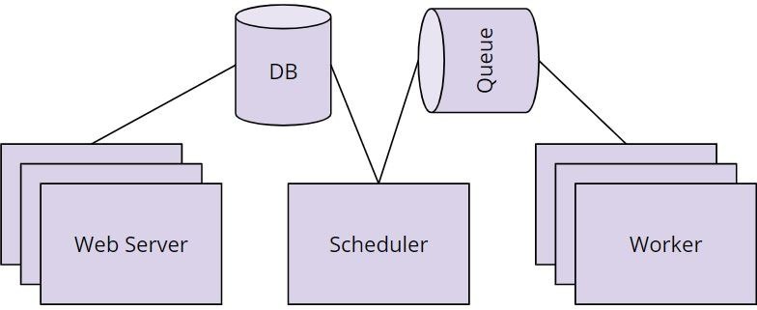
Airflow Core & Components
Scheduler orchestrates the execution of jobs on a trigger or schedule. The Scheduler chooses how to prioritize the running and execution of tasks within the system.
Work Queue is used by the scheduler in most Airflow installations to deliver tasks that need to be run to the Workers.
Worker processes execute the operations defined in each DAG. In most Airflow installations, workers pull from the work queue when it is ready to process a task. When the worker completes the execution of the task, it will attempt to process more work from the work queue until there is no further work remaining. When work in the queue arrives, the worker will begin to process it.
Database saves credentials, connections, history, and configuration. The database, often referred to as the metadata database, also stores the state of all tasks in the system. Airflow components interact with the database with the Python ORM, SQLAlchemy.
Web Interface provides a control dashboard for users and maintainers. Throughout this course you will see how the web interface allows users to perform tasks such as stopping and starting DAGs, retrying failed tasks, configuring credentials, The web interface
is built using the Flask web-development microframework.
20

Slide 18
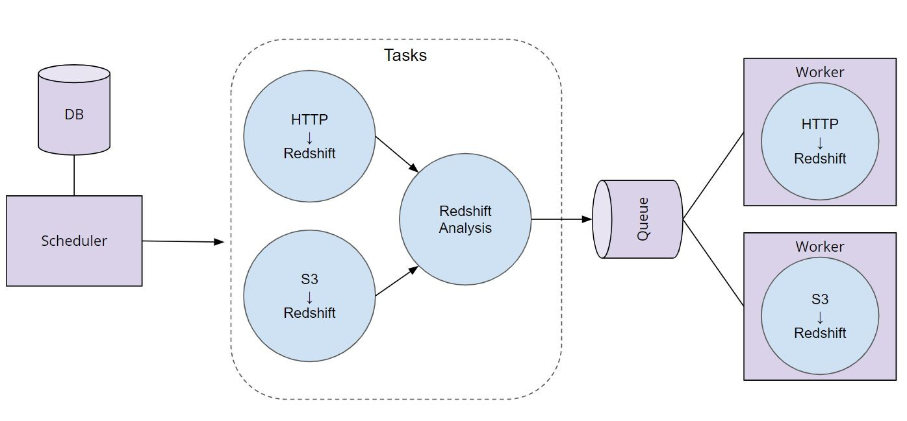
Airflow Workflow

Slide 19

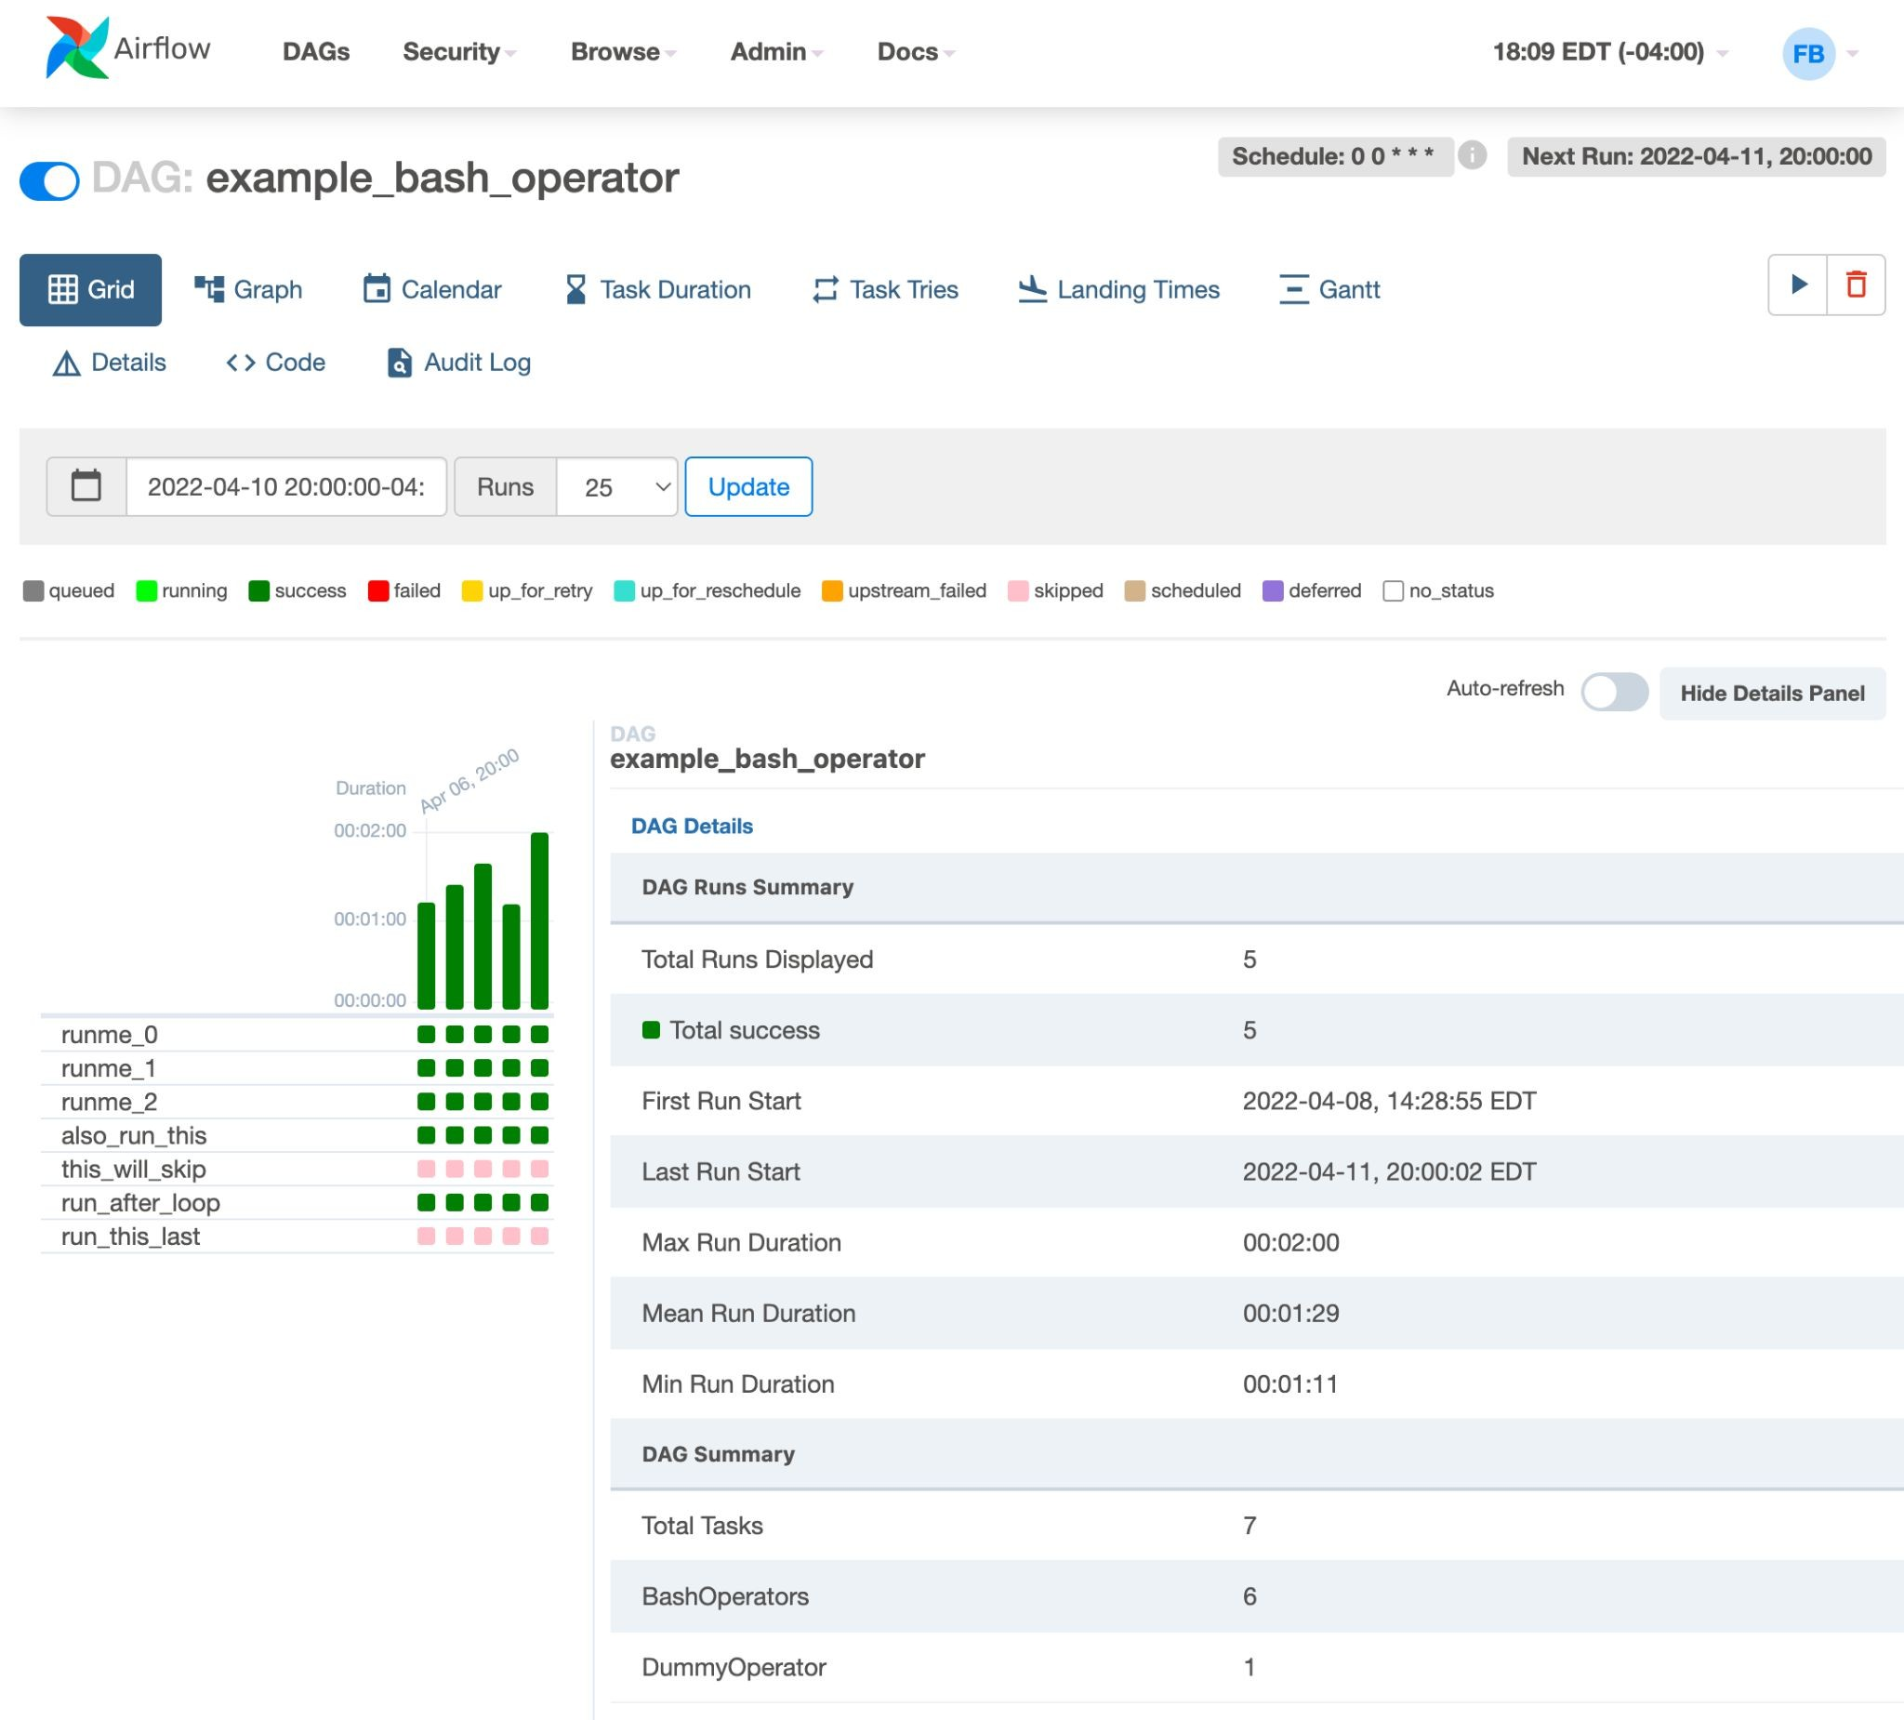

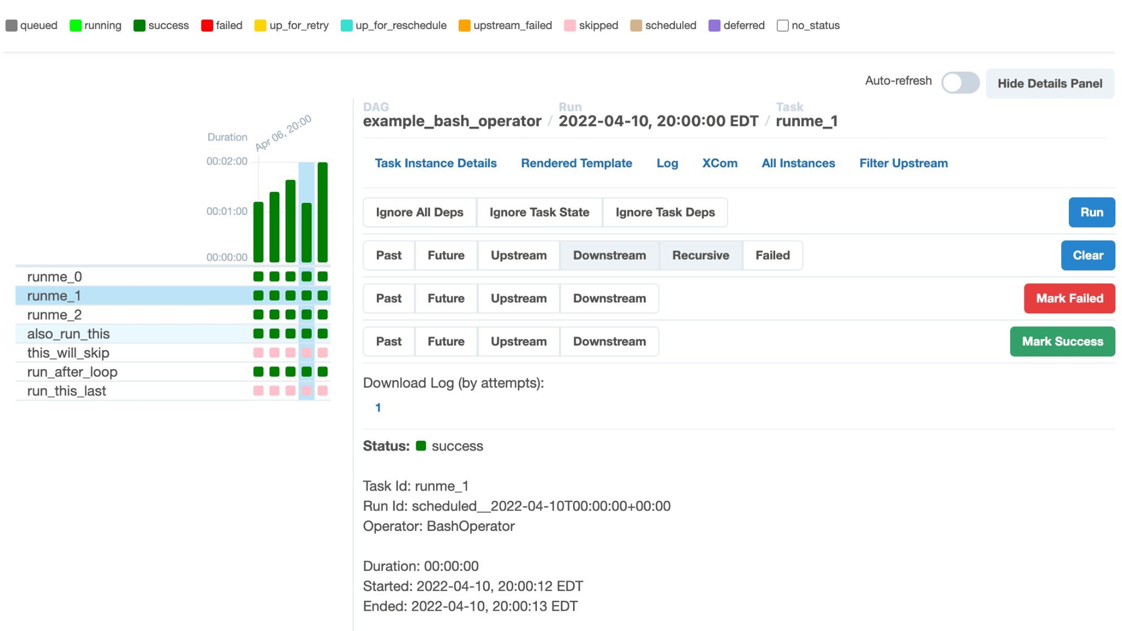
UI Grid View
A bar chart and grid representation of the DAG that spans across time. The top row is a chart of DAG Runs by duration, and below, task instances. If a pipeline is late, you can quickly see where the different steps are and identify the blocking ones.
The details panel wlil update when selecting a DAG Run by clicking on a duration bar:

Slide 20

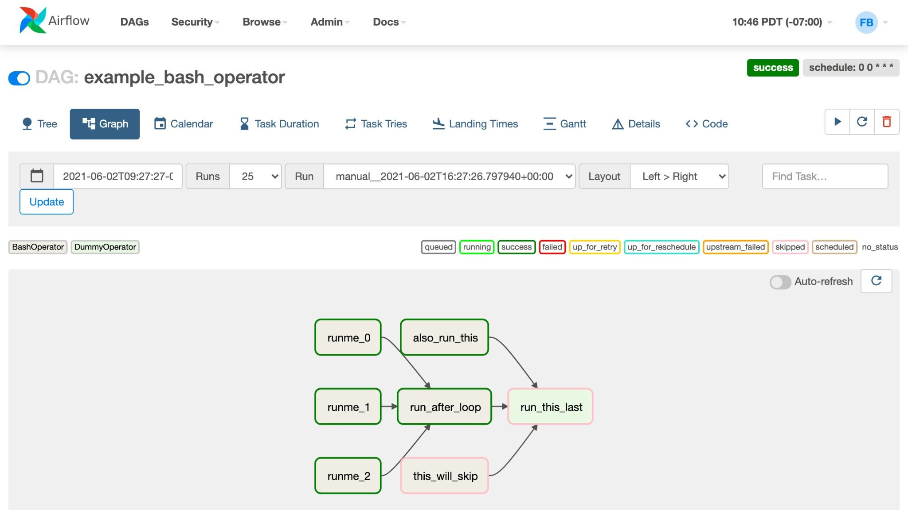
UI Graph View
The graph view is perhaps the most comprehensive. Visualize your DAG’s dependencies and their current status for a specific run.

Slide 21
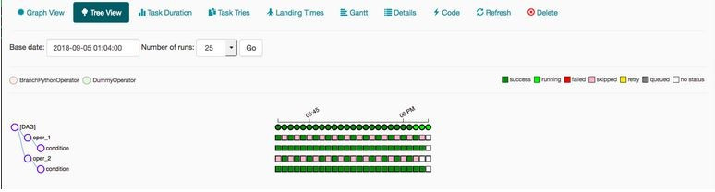
UI Tree View
The tree view also represents the DAG. If you think your pipeline took a longer time to execute than expected then you can check which part is taking a long time to execute and then you can work on it.

Slide 22

Any Questions?

Slide 23

Let's Code!

Slide 24
Thanks

