Slide 1

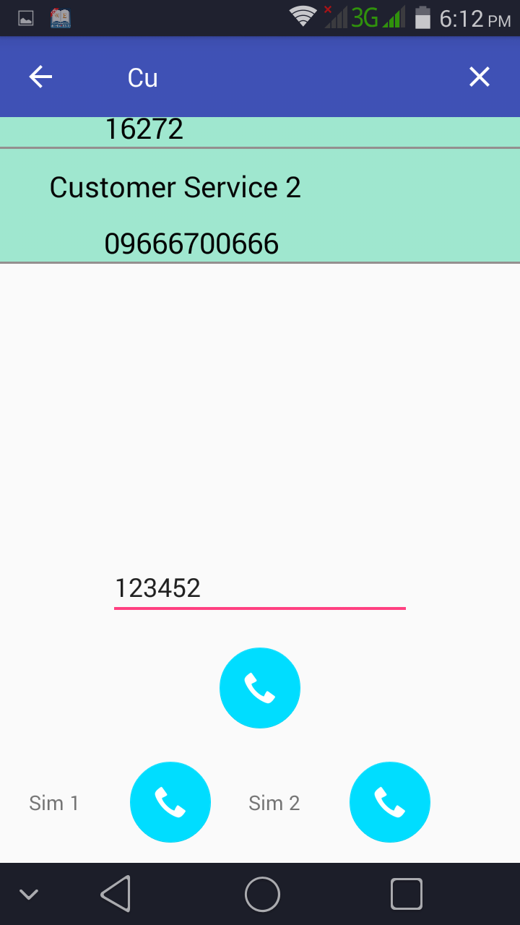
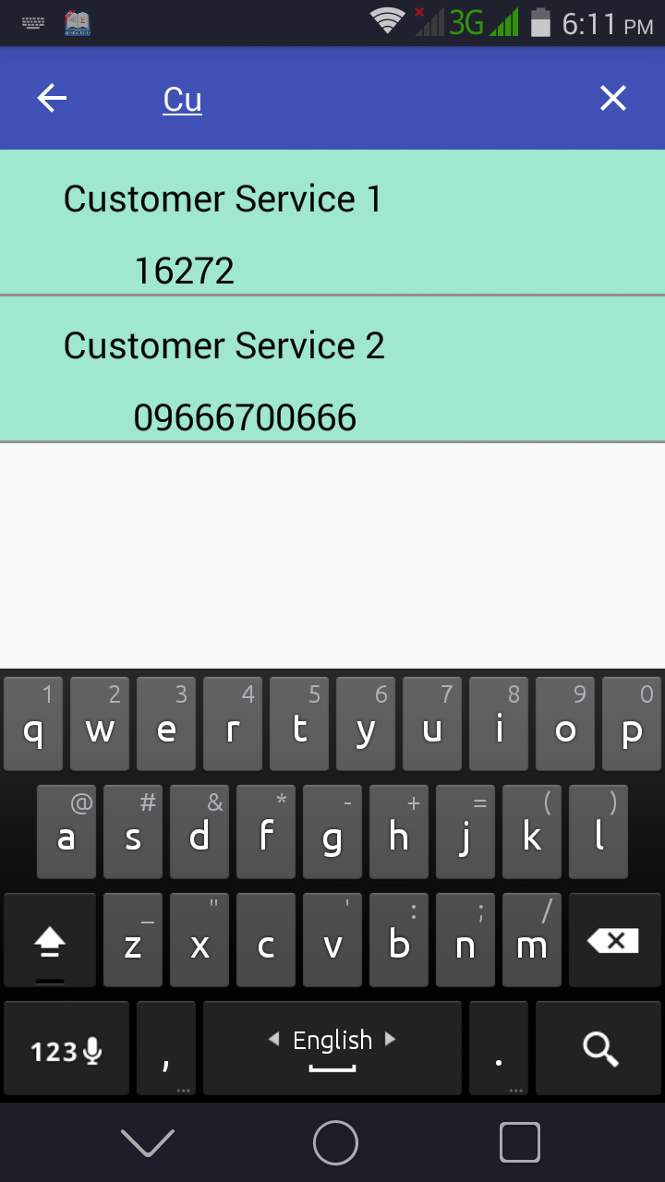
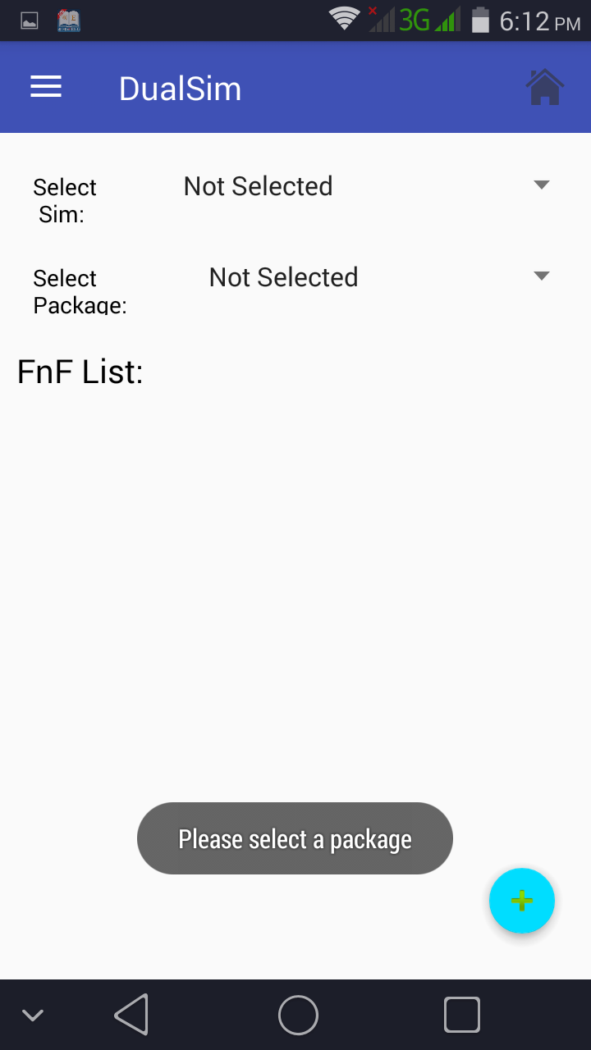
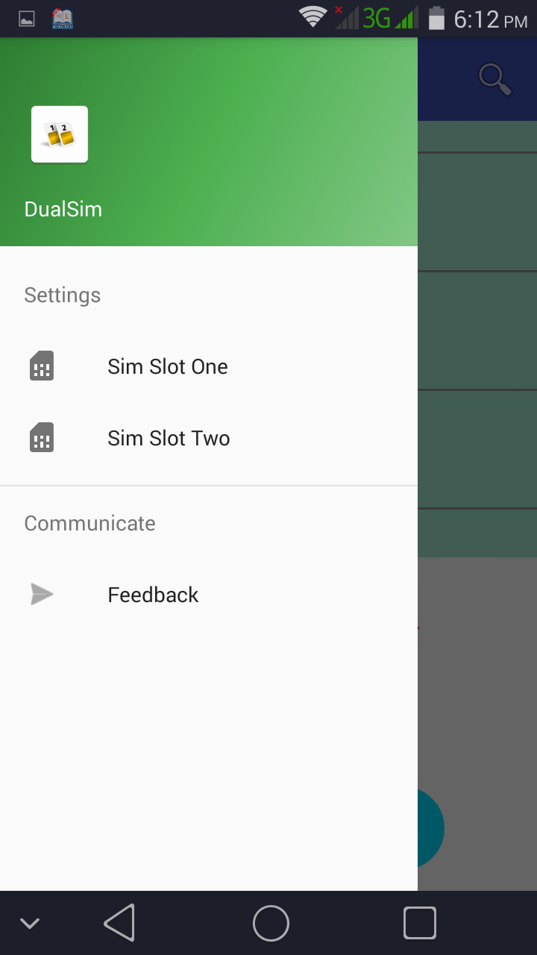
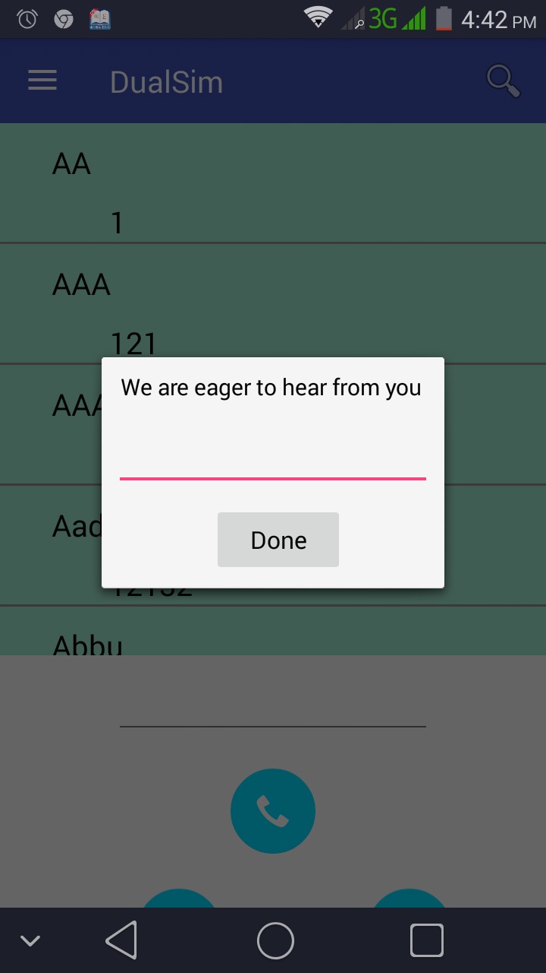
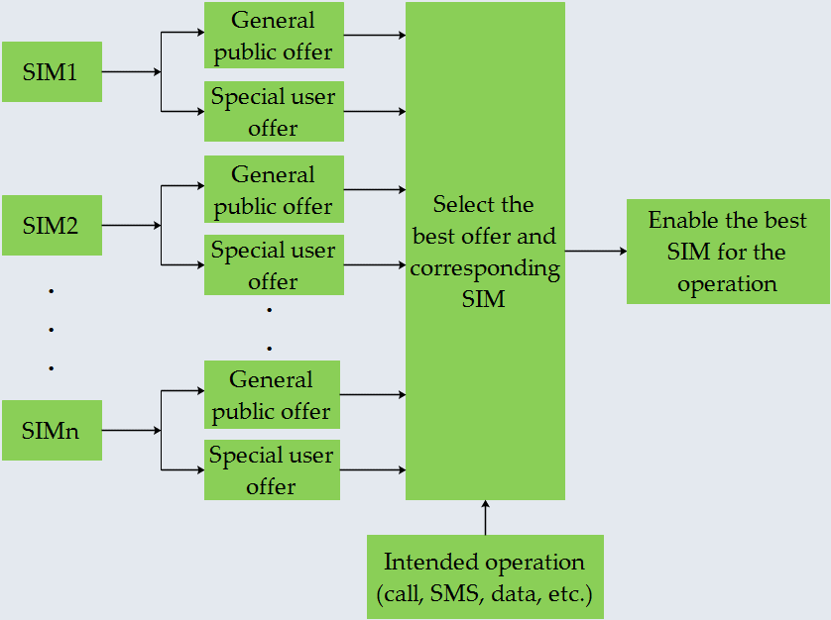
Automated Cost Reduction while Using
Multiple SIMs in a Single Mobile Device
Partha Chakraborty¹, Salsabil Arabi², Ayesha Siddiqua³, Tahrina Tasnim⁴, Md. Sazzad Hossain⁵, Ishtiaque Ahmed⁶, Shantanu Dutta⁷, Alvi Md. Ishmam⁸, Tarik Reza Toha⁹ and A. B. M. Alim Al Islam⁴
Department of CSE, Bangladesh University of Engineering and Technology, Dhaka-1000, Bangladesh
Email:{¹1305117.pc, ²1405108.sa, ³1405049.as, ⁶1205094.ia, ⁷1405092.sd, ⁸1305092.am, ⁹1205082.trt}@ugrad.cse.buet.ac.bd, {⁴tazreentasnim, ⁵sazzad.cse.88}@gmail.com and ¹⁰alim_razi@cse.buet.ac.bd
Background
Although many mobile phone users use dual sim supported mobile phones, it is often difficult to remember and choose the cheapest rate of mobile packages for calling, messaging, etc.
The number of mobile phone users is increasing day by day all over the world including developing countries
According to BTRC, the total number of Mobile Phone subscriptions has reached 117.758 million at the end of August, 2016 in Bangladesh [1]
System Implementation and Findings
Motivation
Very few apps have been developed and researches have been done especially for dual sim supported mobile phones, which mostly focus on adding extra features and avoiding call failures
PixelPhone Dialer & Contacts [2] provides a provision for selecting preferred SIM only for custom groups
For example, saving 0.25 BDT per minute saves 4 BDT after 10 minutes. Thus, 10 million users will save 40 million BDT!
Reducing cost by selecting the best available SIM is yet to be addresses in the literature
Dual SIM Control [3] provides an option for selecting preferred SIM for phone calls and sending SMSs
“Systems and methods for avoiding call failures in dual-sim devices”
Figure: Our implemented app interface
User Review
After a partial implementation of our system, some people used it and here is their valuable review:
Proposed Methodology
When a call is made, our proposed solution will select the cheapest rate offered by the available SIMs and performs operations through the selected SIM
It uses package information and FnF numbers of users for the SIM selection process
User | Used SIM1 | Used SIM2 | Dialed SIM | Average Save/Min
User 1 | GP | TELETALK | TELETALK | 3 BDT
User 2 | ROBI | GP | GP ( FnF ) | 0.5 BDT
User 3 | GP | ROBI | ROBI | 2.4 BDT
Conclusion and Future Work
We develop a cost reducing application for dual SIM supported mobile phones, which enables common people to save their money and time
We will parse data from the live websites of the network operator and add updating facility to the app
We will add sms cost reduction and will define specific cost calculation algorithms for both calls and sms
We will take user review and add crash analytics for tracking device compatibilities
Figure: Block diagram of our proposed solution
References
Google Glass Snoopers Can Steal Your Passcode With a Glance, March, 2015. Available: http://www.wired.com/2014/06/google-glass-snoopers-can-steal-your-passcode-with-a-glance/
B. Hoanca and K. Mock. Password Entry Scheme Resistant to Eavesdropping, Security and Management, Las Vegas, Nevada, 2008, pp. 119-125.
L. Sobrado, J. C. Birget, "Graphical passwords", The Rutgers Scholar, An Electronic Bulletin for Undergraduate Research, vol. 4 (2002).
N. Hopper and M. Blum. A Secure Human-Computer Authentication Scheme. Technical Re- port CMU-CS-00-139, Carnegie Mellon University, 2000.
Bangladesh Telecommunication Regulatory Commission. See: http://www.btrc.gov.bd/content/mobile-phone-subscribers-bangladesh-august-2016/ Last accessed: Nov. 21, 2017.
Dorado apps. PixelPhone Dialer & Contacts. See: http://www.doradoapps.com/pixelphone-dialer-contacts/ Last accessed: Nov. 21, 2017.
Mobius apps. Dual SIM Control. See: http://mobius-apps.appspot.com/apps/dual_sim_control.jsp Last accessed: Nov. 21, 2017
Subbarayudu Mutya, Jayavarapu Venkata, Krishna MURTHY, Shivank Nayak, “System and methods for avoiding call failures in dual-sim devices”, Sep. 18, 2014, uS Patent 20140274006.

