Slide 1

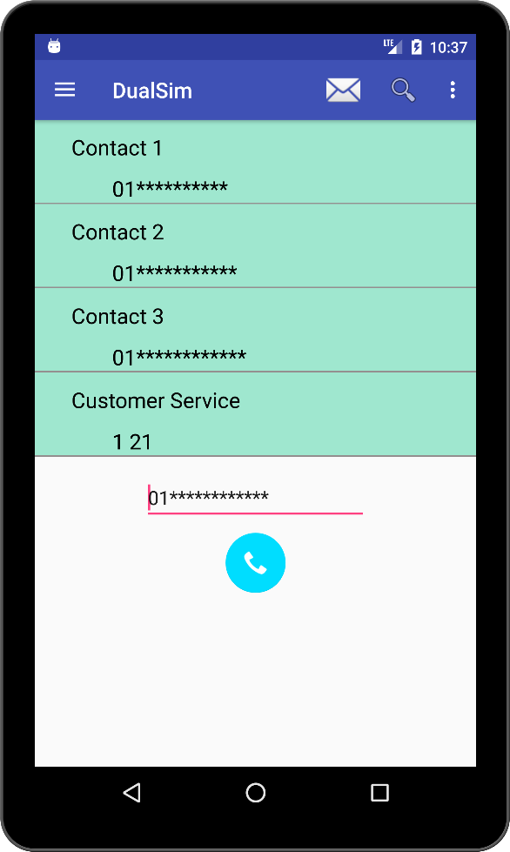
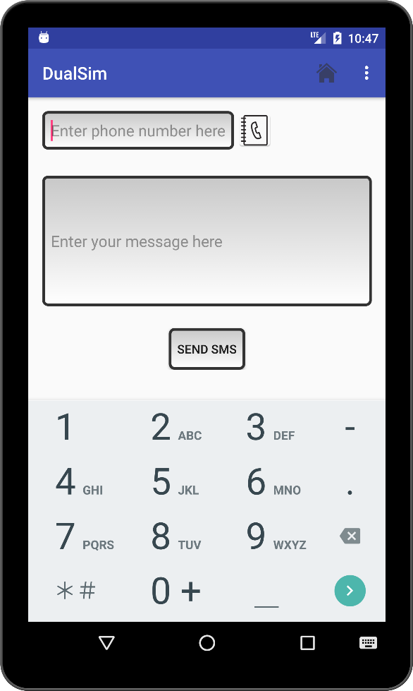
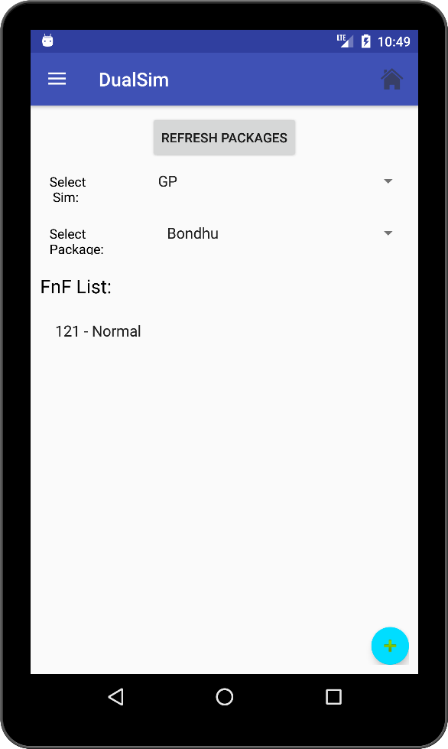
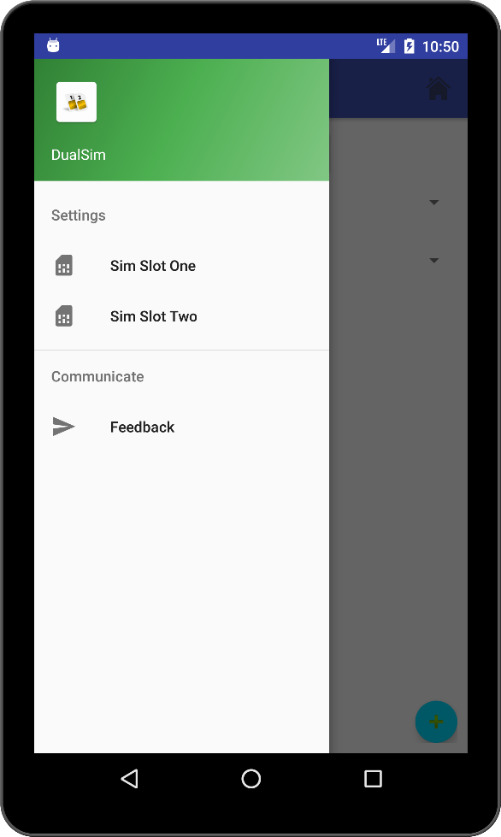
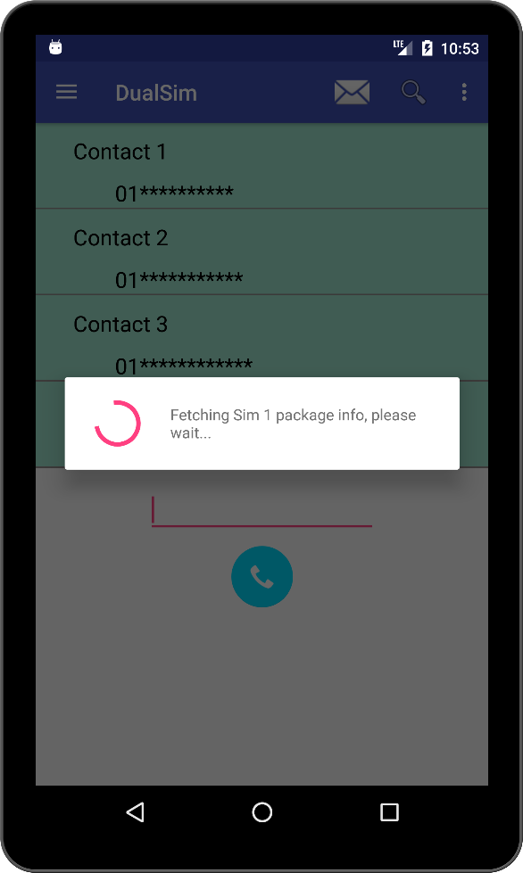
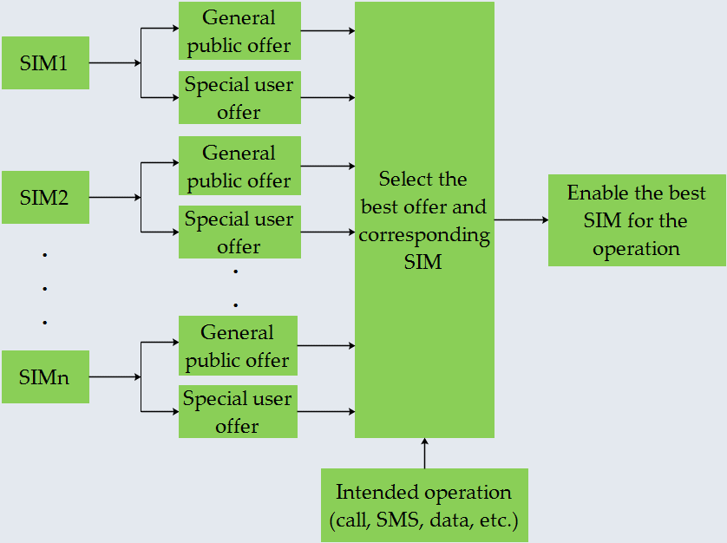
novia@cse.uiu.ac.bd
Automated Cost Reduction while Using
Multiple SIMs in a Single Mobile Device
novia@cse.uiu.ac.bd
novia@cse.uiu.ac.bd
novia@cse.uiu.ac.bd
novia@cse.uiu.ac.bd
Ajoy Das¹, Shusmoy Chowdhury², Salsabil Arabi³, Ayesha Siddiqua⁴, Tarik Reza Toha⁵, Novia Nurain⁶ and A. B. M. Alim Al Islam⁷
Department of CSE, Bangladesh University of Engineering and Technology, Dhaka-1000, Bangladesh
Email:{¹1405079.ad, ²1305108.sc, ³1405108.sa, ⁴1405049.as, ⁵1205082.trt}@ugrad.cse.buet.ac.bd, ⁶novia@cse.uiu.ac.bd and ⁷alim_razi@cse.buet.ac.bd
Background
Although many mobile phone users use dual sim supported mobile phones, it is often difficult to remember and choose the cheapest rate of mobile packages for calling, messaging, etc.
The number of mobile phone users is increasing day by day all over the world including developing countries
According to BTRC, the total number of Mobile Phone subscriptions has reached 117.758 million at the end of August, 2016 in Bangladesh [1]
System Implementation
Workflow of the app’s data collection:
Launch the app 1st time.
Register a service that will send a request to the server every hour(can be changed) for sending new data if available even if the app is not running/ being used a while.
If server returns non empty feedback update the Local database table in android.
Workflow of the server’s data collection:
Crawl the sim providers website (except from Teletalk) using programs.
Manually run the crawler once a week (can be changed)
Upload crawled the data to the server manually.
Motivation
Very few apps have been developed and researches have been done especially for dual sim supported mobile phones, which mostly focus on adding extra features and avoiding call failures
PixelPhone Dialer & Contacts [2] provides a provision for selecting preferred SIM only for custom groups
For example, saving 0.25 BDT per minute saves 4 BDT after 10 minutes. Thus, 10 million users will save 40 million BDT!
Reducing cost by selecting the best available SIM is yet to be addresses in the literature
Dual SIM Control [3] provides an option for selecting preferred SIM for phone calls and sending SMSs
“Systems and methods for avoiding call failures in dual-sim devices”
Proposed Methodology
When a call is made, our proposed solution will select the cheapest rate offered by the available SIMs and performs operations through the selected SIM
It uses package information and FnF numbers of users for the SIM selection process
Figure: Our implemented app interface
User Review
After a partial implementation of our system, some people used it and here is their valuable review:
User | Used SIM1 | Used SIM2 | Dialed SIM | Average Save/Min
User 1 | GP | TELETALK | TELETALK | 3 BDT
User 2 | ROBI | GP | GP ( FnF ) | 0.5 BDT
User 3 | GP | ROBI | ROBI | 2.4 BDT
Conclusion and Future Work
We develop a cost reducing application for dual SIM supported mobile phones, which enables common people to save their money and time
We will take user statistics for our full implementation and take power/ energy usages statistics.
Figure: Block diagram of our proposed solution
References
Bangladesh Telecommunication Regulatory Commission. See: http://www.btrc.gov.bd/content/mobile-phone-subscribers-bangladesh-august-2016/ Last accessed: Nov. 21, 2017.
Dorado apps. PixelPhone Dialer & Contacts. See: http://www.doradoapps.com/pixelphone-dialer-contacts/ Last accessed: Nov. 21, 2017.
Mobius apps. Dual SIM Control. See: http://mobius-apps.appspot.com/apps/dual_sim_control.jsp Last accessed: Nov. 21, 2017
Subbarayudu Mutya, Jayavarapu Venkata, Krishna MURTHY, Shivank Nayak, “System and methods for avoiding call failures in dual-sim devices”, Sep. 18, 2014, uS Patent 20140274006.

