Slide 1

CSE 604 Artificial Intelligence
Chapter 2: Intelligent Agents
Dr. Ahmedul Kabir
Adapted from slides available in Russell & Norvig’s textbook webpage

Slide 2
Outline
Agents and environments
Rationality
PEAS (Performance measure, Environment, Actuators, Sensors)
Environment types
Agent types

Slide 3
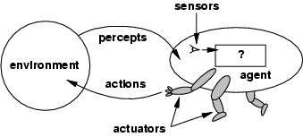
Agents
An agent is anything that can be viewed as perceiving its environment through sensors and acting upon that environment through actuators

Slide 4
Examples of Agents
Human agent: eyes, ears, and other organs for sensors; hands, legs, mouth, and other body parts for actuators
Robotic agent: cameras and infrared range finders for sensors; various motors for actuators
Software agent: receives keystrokes, file contents, network packets as sensory inputs; acts by displaying on screen, writing files etc.

Slide 5
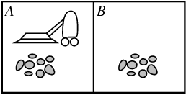
Vacuum-cleaner world
Percepts: location and contents, e.g., [A, Dirty]
Actions: Left, Right, Suck, NoOp

Slide 6
Rational Agent
A rational agent chooses whichever action maximizes the expected value of the performance measure given the percept sequence to date
Rational ≠ omniscient
percepts may not supply all relevant information
Rational ≠ clairvoyant
action outcomes may not be as expected
Hence, rational ≠ successful
Rational ⇒ exploration, learning, autonomy

Slide 7
Rational agents
An agent should strive to "do the right thing", based on what it can perceive and the actions it can perform.
Performance measure: An objective criterion for success of an agent's behavior
E.g., performance measure of a vacuum-cleaner agent could be :
amount of dirt cleaned up
amount of time taken
amount of electricity consumed

Slide 8
PEAS
Specifying the task environment:
Performance measure
Environment
Actuators
Sensors

Slide 9
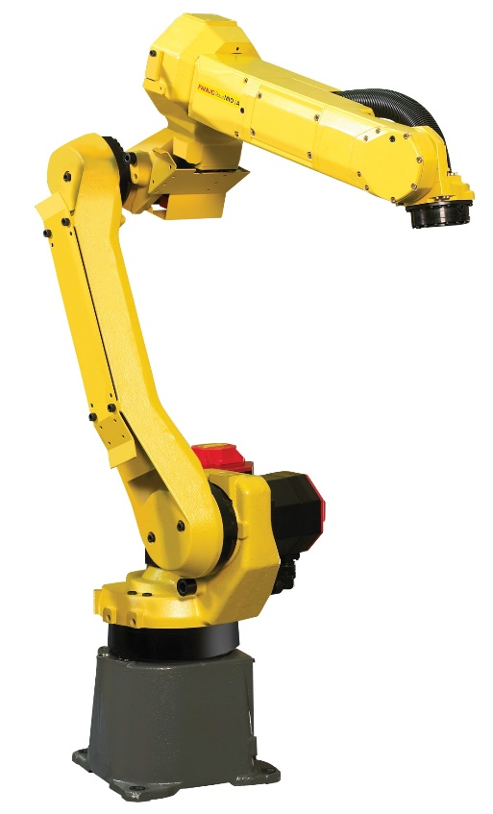
PEAS
Agent: Part-picking robot
Performance measure: % of parts in correct bins
Environment: Conveyor belt, parts, bins
Actuators: Jointed arm and hand
Sensors: Camera, joint angle sensors

Slide 10
PEAS
Agent: Automated car
Performance measure: Safe, fast, legal, comfortable trip
Environment: Roads, other traffic, pedestrians
Actuators: Steering wheel, accelerator, brake
Sensors: Camera, GPS, Speedometer, engine sensor

Slide 11
Environment types
Fully observable vs. partially observable
Single agent vs. multiagent
Deterministic vs. stochastic
Episodic vs. sequential
Static vs dynamic
Discrete vs continuous

Slide 12

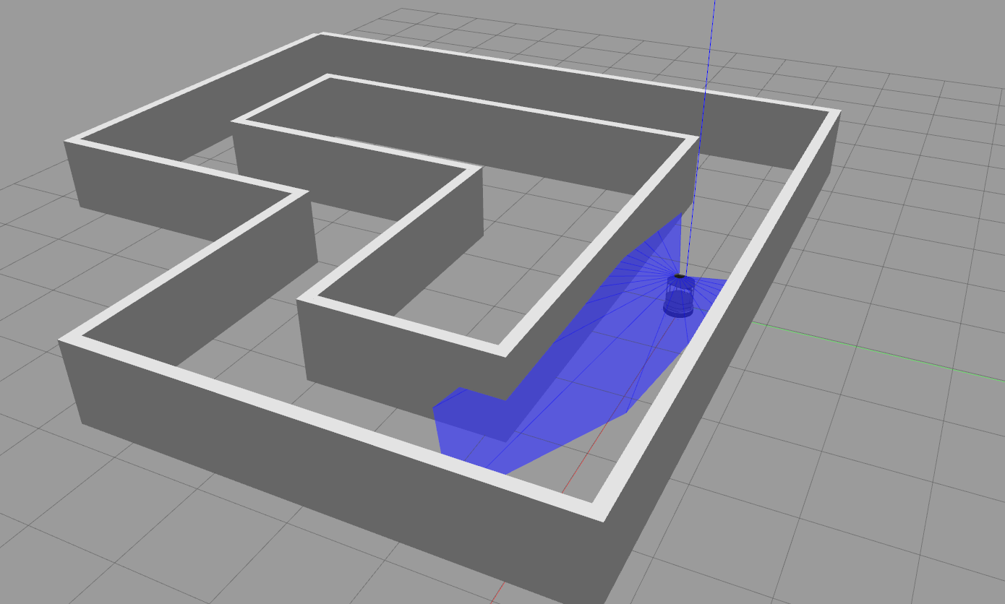
Fully Observable | Partially Observable
Agent can observe (see/hear/perceive) all relevant information from the environment | Agent can observe only partial information from the environment

Slide 13

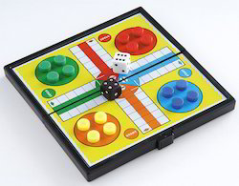
Single Agent | Multiagent
Our agent is the only intelligent agent in the environment | There are multiple intelligent agents which can be either cooperative or competitive

Slide 14
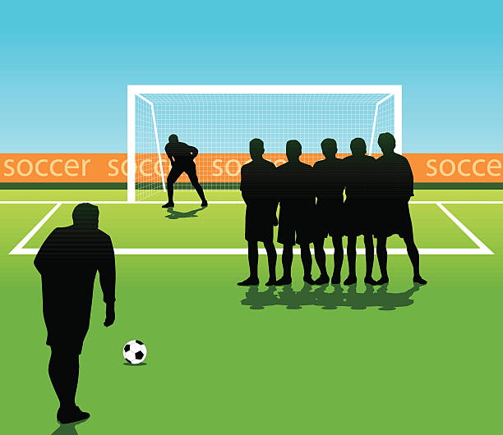
Deterministic | Stochastic
Agent can fully determine the outcome of it’s action (next step, not necessarily the full task) | Agent is uncertain of the outcome of it’s action

Slide 15

Episodic | Sequential
Agent’s actions are completely independent of each other, not linked to past or future actions | Agent’s actions are dependent on it’s past/future actions. The actions form a sequence.

Slide 16
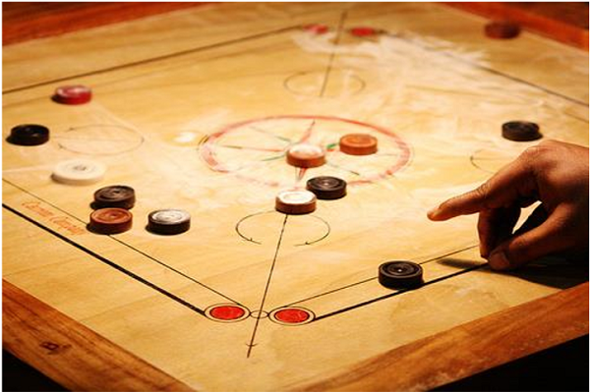
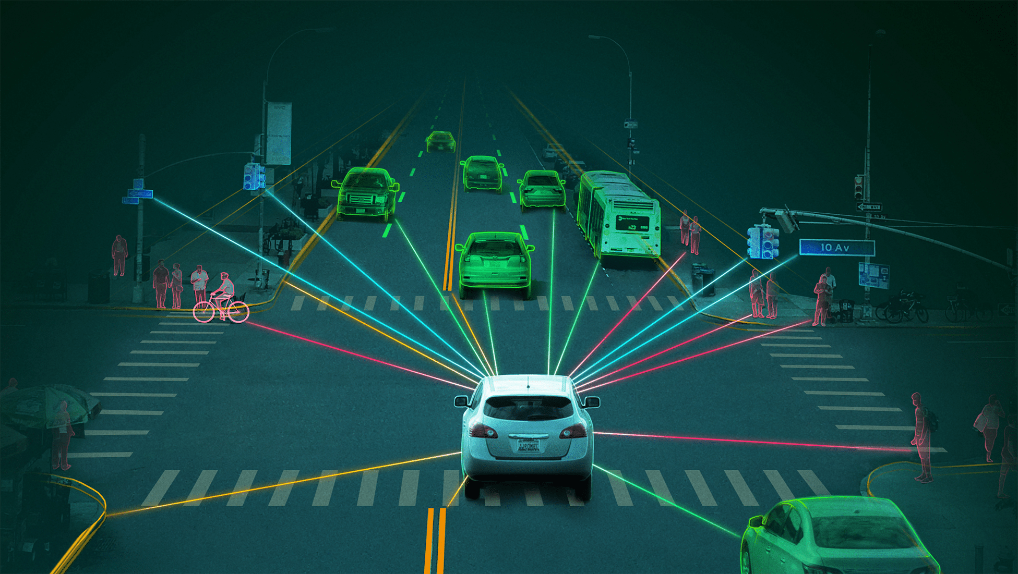
Static | Dynamic
While the agent is in the process of taking it’s action, the environment doesn’t change | The environment is constantly changing even when the agent is taking an action

Slide 17

Discrete | Continuous
Agent’s task can be broken down into discrete set of actions (you can make a list of agent’s actions A₁, A₂, ..., A_{n}) | Actions are happening continuously and can not be listed, i.e., you cannot say where one action ends and the other begins

Slide 18
Environment types
Chess with Chess without Taxi driving
a clock a clock
Fully observable Yes Yes No
Deterministic Strategic Strategic No
Episodic No No No
Static Semi Yes No
Discrete Yes Yes No
Single agent No No No
The environment type largely determines the agent design
The real world is (of course) partially observable, stochastic, sequential, dynamic, continuous, multi-agent

Slide 19
Agent types
Four basic types in order of increasing generality:
Simple reflex agents
Model-based reflex agents
Goal-based agents
Utility-based agents

Slide 20
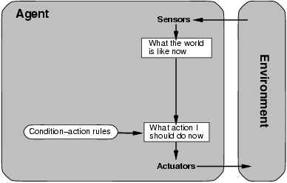
Simple reflex agents

Slide 21
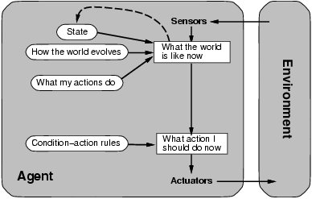
Model-based reflex agents

Slide 22
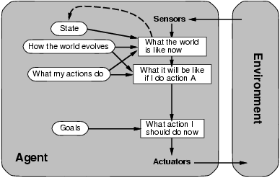
Goal-based agents

Slide 23
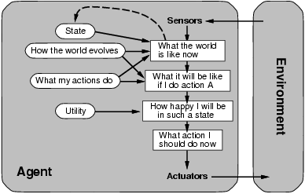
Utility-based agents

