Slide 1

CSE 604 Artificial Intelligence
Introduction to Machine Learning
Dr. Ahmedul Kabir
Adapted from slides by Prof. Eric Eaton (Universiy of Pennsylvania)

Slide 2
What is Machine Learning?
“Learning is any process by which a system improves performance from experience.”
- Herbert Simon
Definition by Tom Mitchell (1998):
Machine Learning is the study of algorithms that
improve their performance P
at some task T
with experience E.
A well-defined learning task is given by <P, T, E>.
3

Slide 3
Traditional Programming
Data Program
Computer
Output
Machine Learning
Data Output
Computer
Program
4
Slide credit: Pedro Domingos

Slide 4
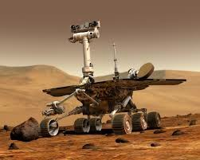
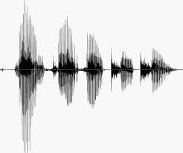
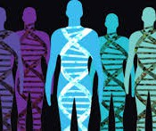
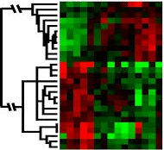
When Do We Use Machine Learning?
ML is used when:
Human expertise does not exist (navigating on Mars)
Humans can’t explain their expertise (speech recognition)
Models must be customized (personalized medicine)
Models are based on huge amounts of data (genomics)
Learning isn’t always useful:
There is no need to “learn” to calculate payroll
Based on slide by E. Alpaydin
5

Slide 5
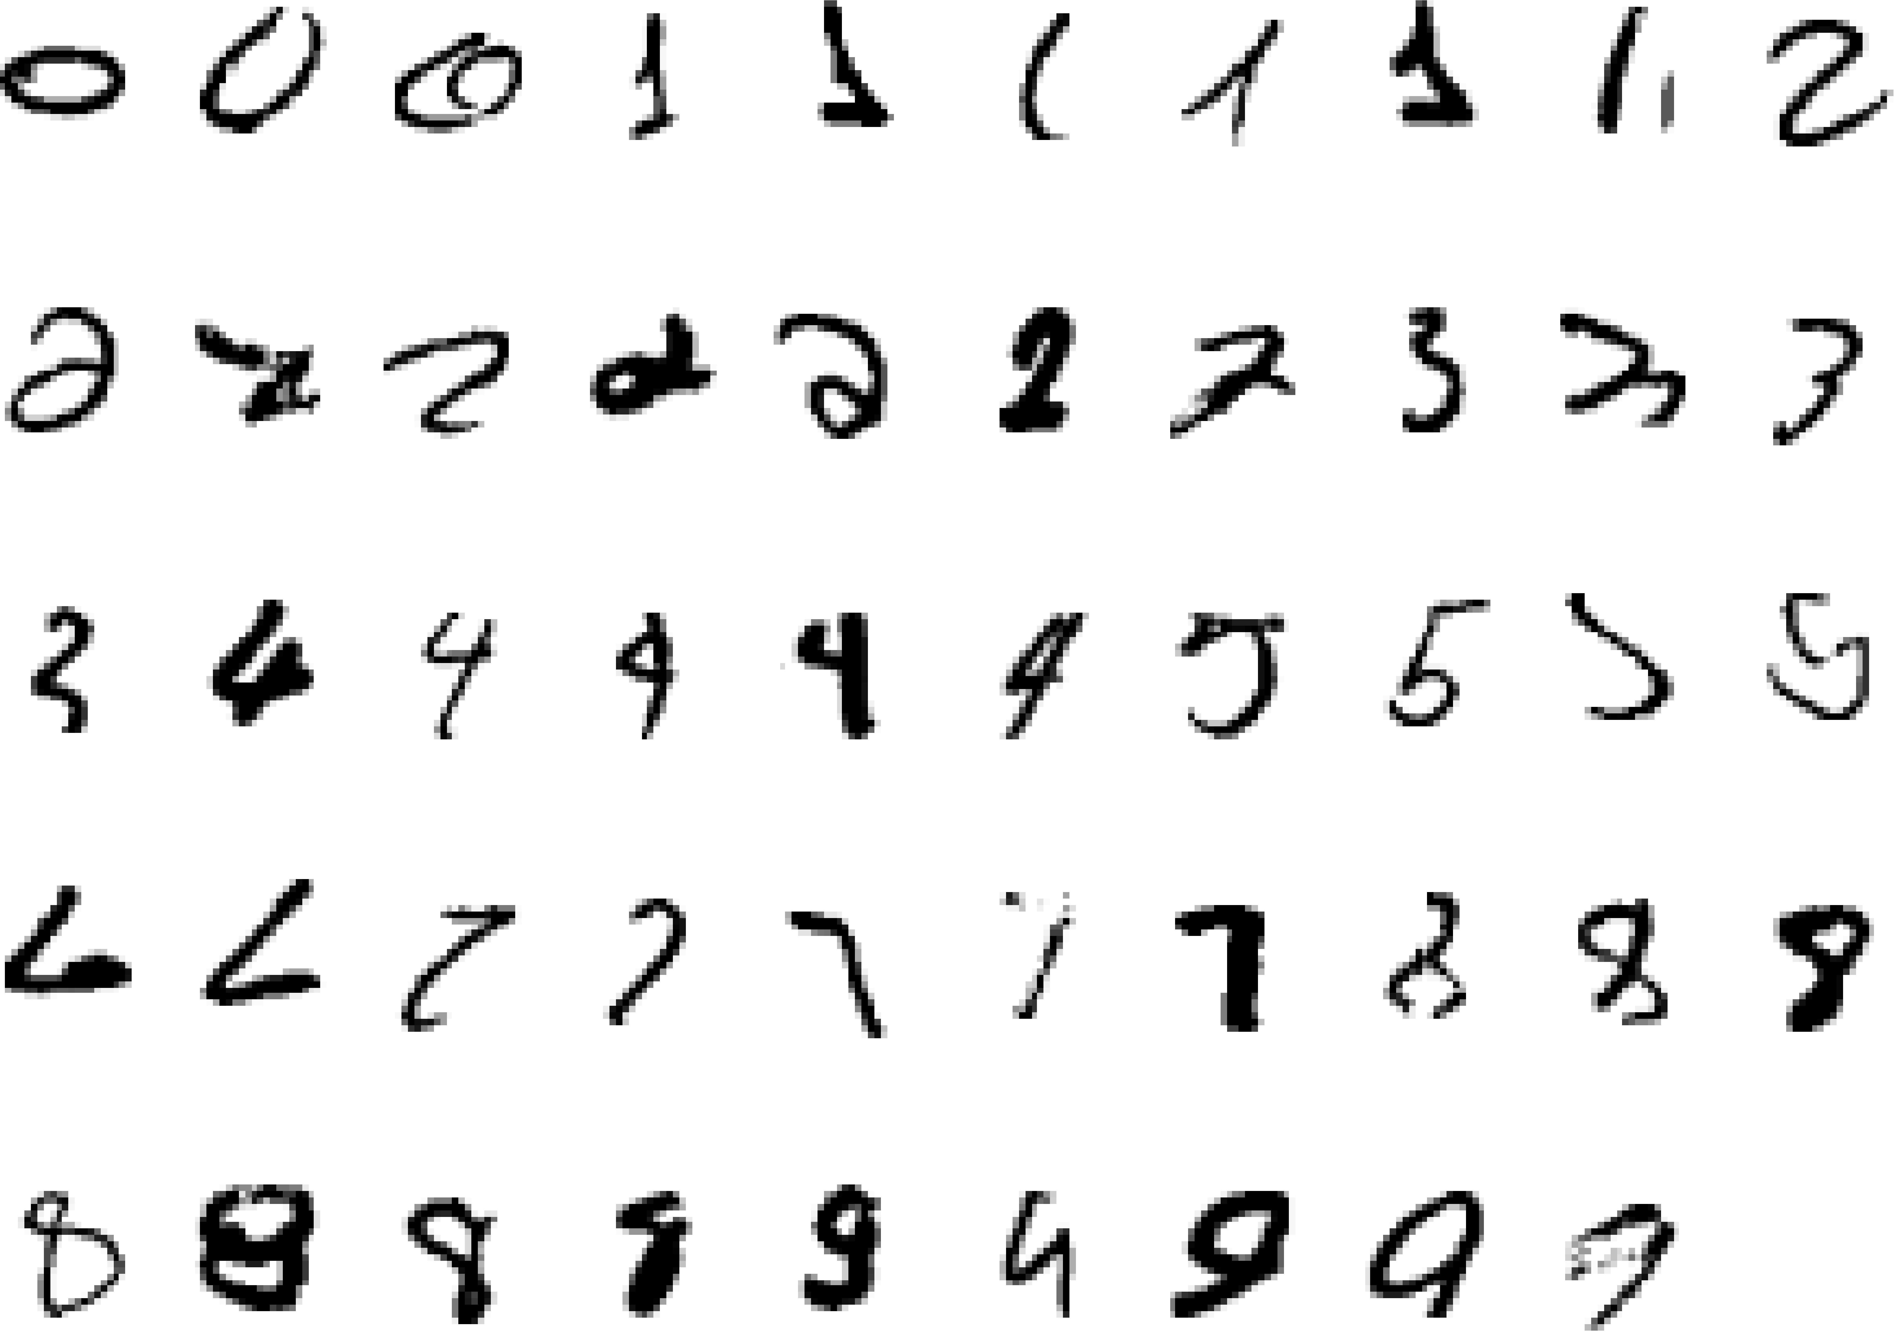
A classic example of a task that requires machine learning: It is very hard to say what makes a 2
Slide credit: Geoffrey Hinton

Slide 6
Some more examples of tasks that are best solved by using a learning algorithm
Recognizing patterns:
Facial identities or facial expressions
Handwritten or spoken words
Medical images
Generating patterns:
Generating images or motion sequences
Recognizing anomalies:
Unusual credit card transactions
Unusual patterns of sensor readings in a nuclear power plant
Prediction:
Future stock prices or currency exchange rates
Slide credit: Geoffrey Hinton

Slide 7
Sample Applications
Web search
Computational biology
Finance
E-commerce
Space exploration
Robotics
Information extraction
Social networks
Debugging software
[Your favorite area]
Slide credit: Pedro Domingos

Slide 8
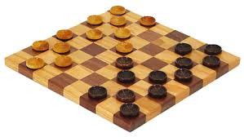
Samuel’s Checkers-Player
“Machine Learning: Field of study that gives computers the ability to learn without being explicitly programmed.” -Arthur Samuel (1959)
9

Slide 9
Defining the Learning Task
Improve on task T, with respect to performance metric P, based on experience E
T: Playing checkers
P: Percentage of games won against an arbitrary opponent E: Playing practice games against itself
T: Recognizing hand-written words
P: Percentage of words correctly classified
E: Database of human-labeled images of handwritten words
T: Driving on four-lane highways using vision sensors
P: Average distance traveled before a human-judged error
E: A sequence of images and steering commands recorded while observing a human driver.
T: Categorize email messages as spam or legitimate. P: Percentage of email messages correctly classified. E: Database of emails, some with human-given labels
10
Slide credit: Ray Mooney

Slide 10
State of the Art Applications of Machine Learning
11

Slide 11
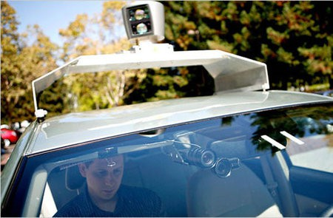
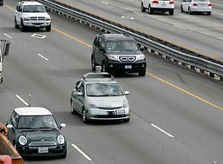
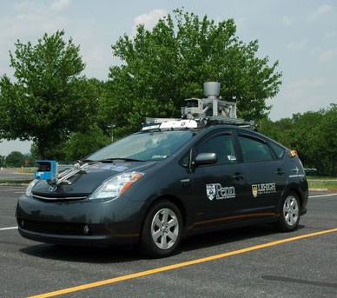
Autonomous Cars
Nevada made it legal for autonomous cars to drive on roads in June 2011
As of 2025, Most US states + many other countries have legalized autonomous cars
12

Slide 12
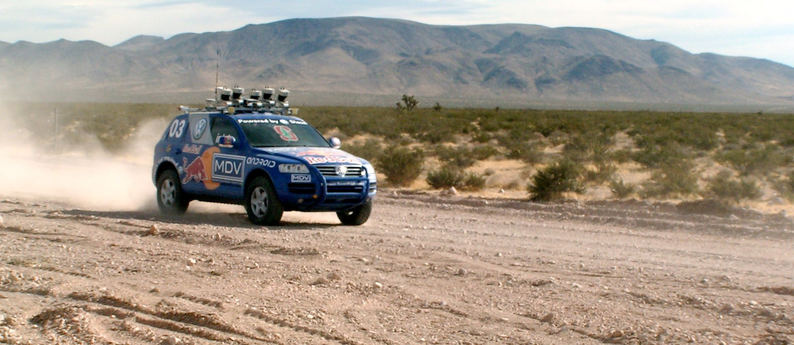
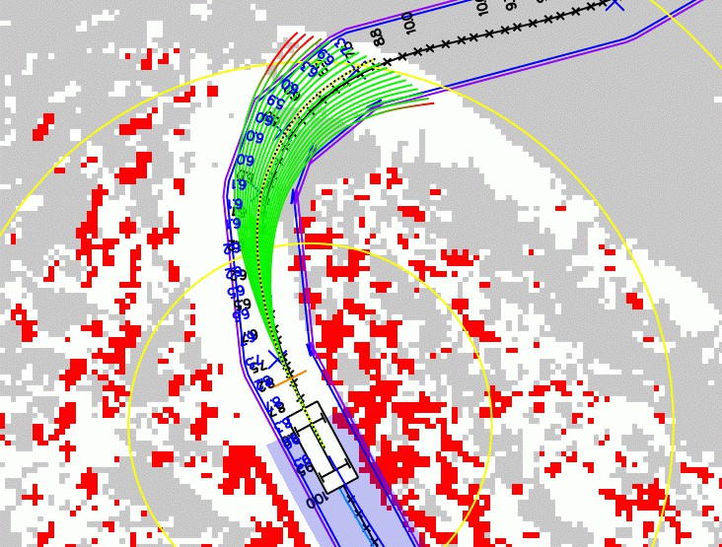
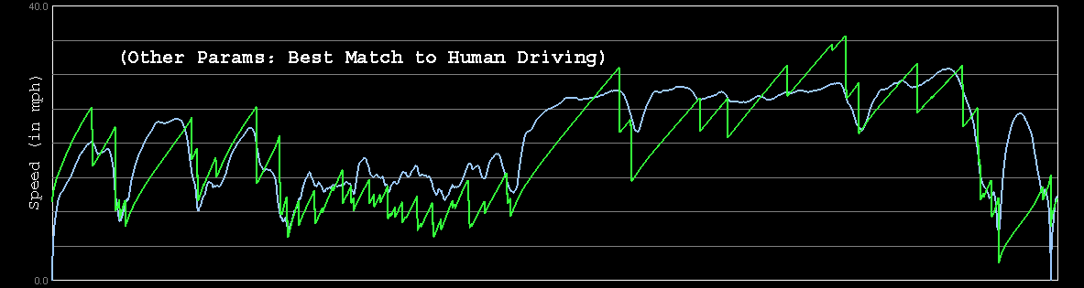
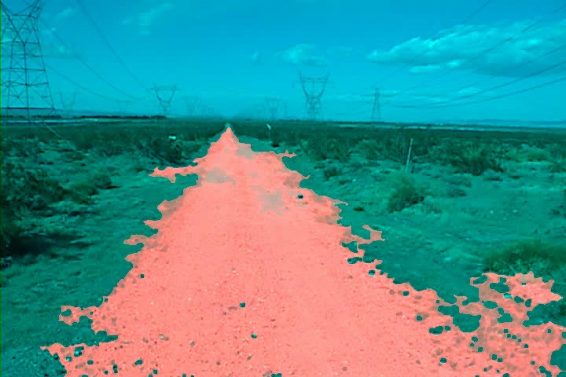
Autonomous Car Technology
Path Planning
Laser Terrain Mapping
Learning from Human Drivers
Sebastian
Adaptive Vision
Stanley
Images and movies taken from Sebastian Thrun’s multimedia w¹e⁴bsite.

Slide 13


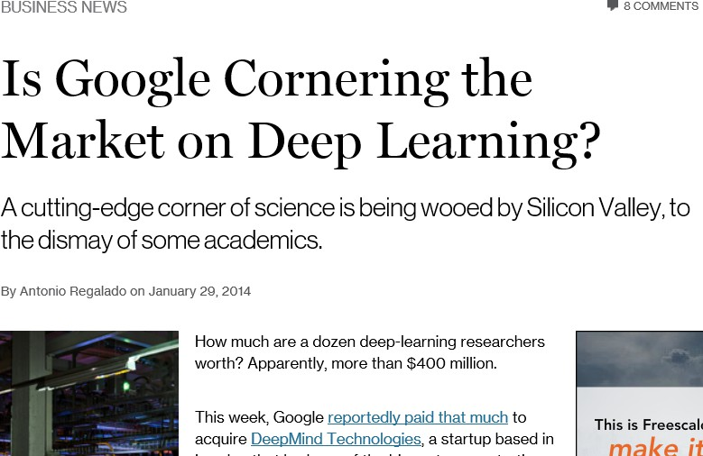
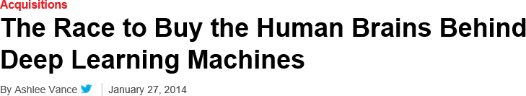
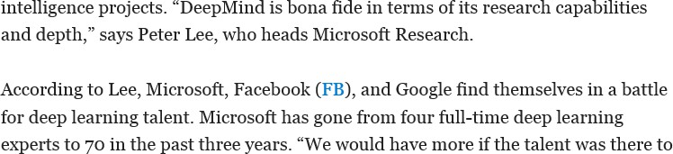
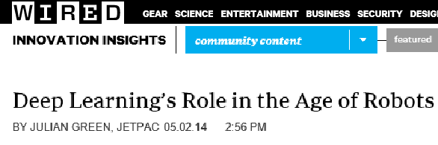
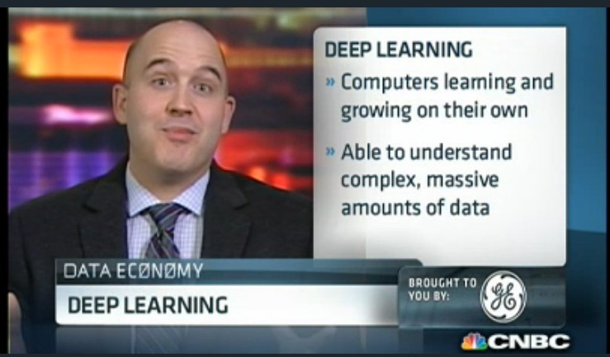
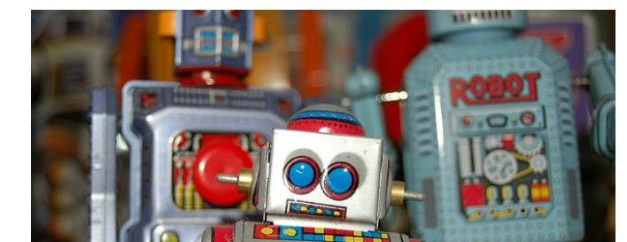
Deep Learning in the Headlines
15

Slide 14
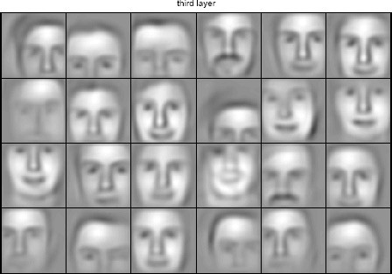
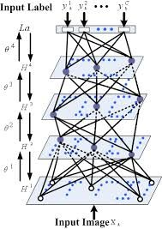

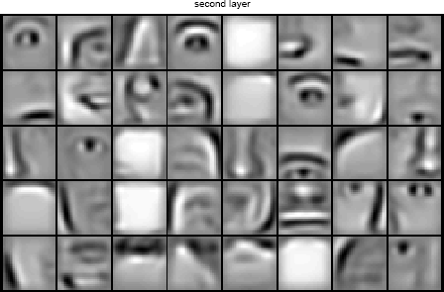


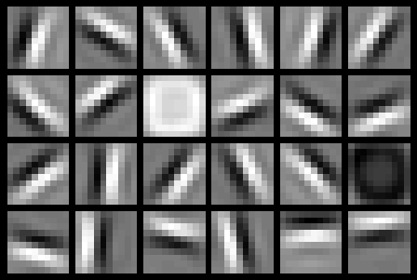
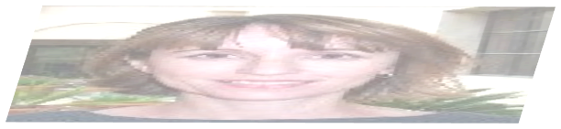

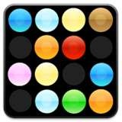

Deep Belief Net on Face Images
object models
object parts (combination of edges)
edges
pixels
Based on materials by Andrew Ng
16

Slide 15
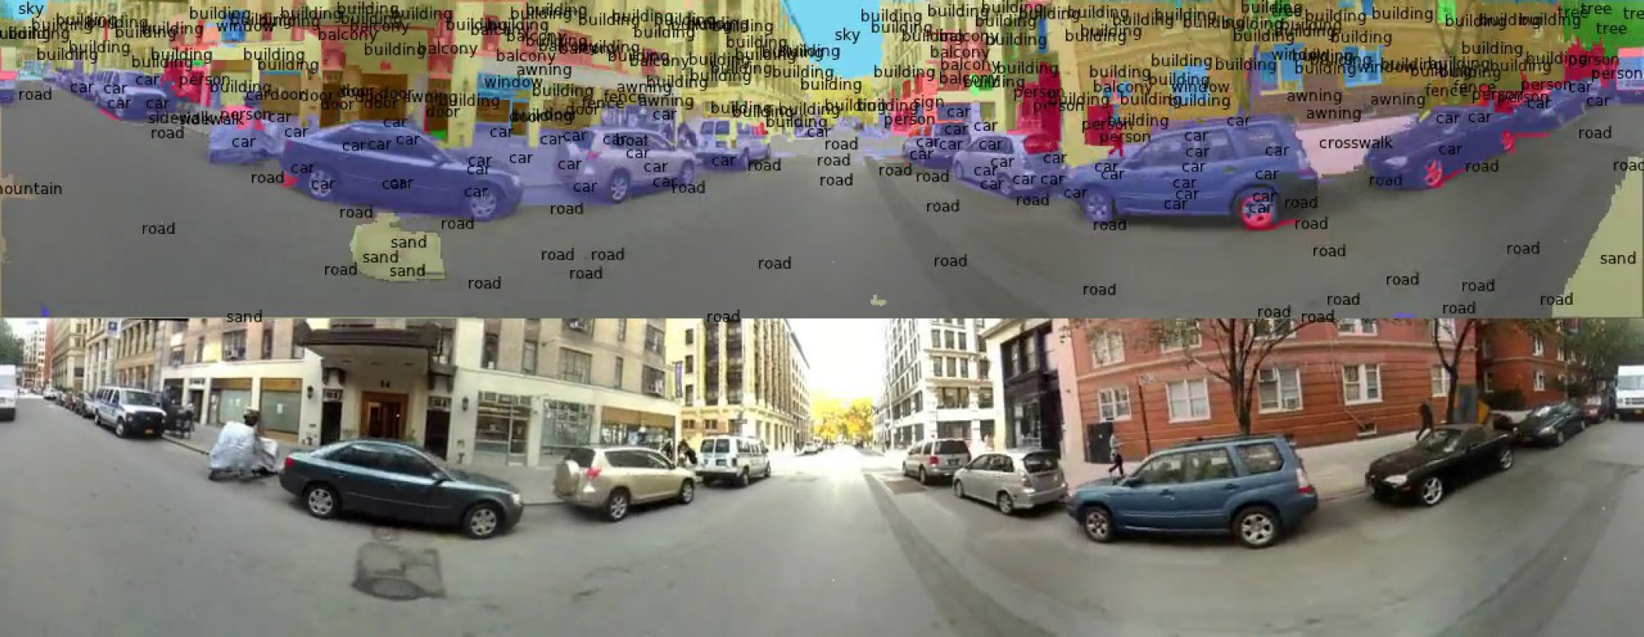
Scene Labeling via Deep Learning
[Farabet et al. ICML 2012, PAMI 2013]
19

Slide 16
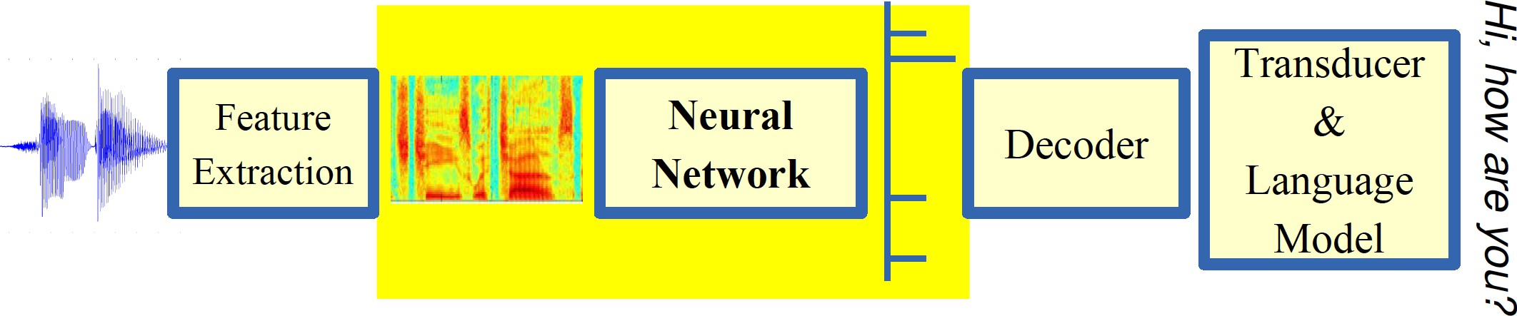
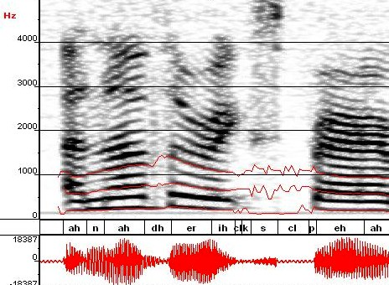
Machine Learning in Automatic Speech Recognition
A Typical Speech Recognition System
ML used to predict of phone states from the sound spectrogram
Deep learning has state-of-the-art results
# Hidden Layers | 1 | 2 | 4 | 8 | 10 | 12
Word Error Rate % | 16.0 | 12.8 | 11.4 | 10.9 | 11.0 | 11.1
Baseline GMM performance = 15.4%
[Zeiler et al. “On rectified linear units for speech recognition” ICASSP 2013]
21

Slide 17
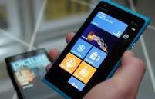
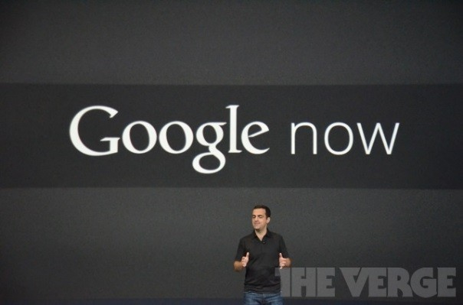
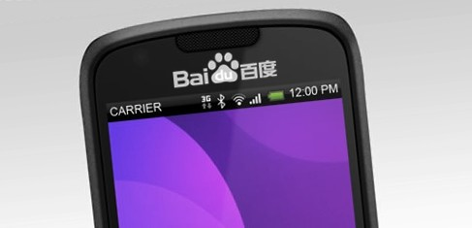
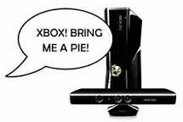



Impact of Deep Learning in Speech Technology
22
Slide credit: Li Deng, MS Research

Slide 18
Types of Learning
23

Slide 19
Types of Learning
Supervised (inductive) learning
Given: training data + desired outputs (labels)
Unsupervised learning
Given: training data (without desired outputs)
Semi-supervised learning
Given: training data + a few desired outputs
Reinforcement learning
Rewards from sequence of actions
24
Based on slide by Pedro Domingos

Slide 20



Supervised Learning: Regression
Given (x₁, y₁), (x₂, y₂), ..., (x_{n}, y_{n})
Learn a function f(x) to predict y given x
– y is real-valued == regression
9
8
7
6
5
4
3
2
1
0
1970 1980
September Arctic Sea Ice Extent (1,000,000 sq km)
1990 2000
2010
2020
Year
Data from G. Witt. Journal of Statistics Education, Volume 21, Number 1 (2013)
26

Slide 21










Supervised Learning: Classification
Given (x₁, y₁), (x₂, y₂), ..., (x_{n}, y_{n})
Learn a function f(x) to predict y given x
– y is categorical == classification
Breast Cancer (Malignant / Benign)
1(Malignant)
0(Benign)
Tumor Size
27
Based on example by Andrew Ng

Slide 22







Supervised Learning: Classification
Given (x₁, y₁), (x₂, y₂), ..., (x_{n}, y_{n})
Learn a function f(x) to predict y given x
– y is categorical == classification
Breast Cancer (Malignant / Benign)
1(Malignant)
0(Benign)
Tumor Size
Tumor Size
Based on example by Andrew Ng

Slide 23






Supervised Learning: Classification
Given (x₁, y₁), (x₂, y₂), ..., (x_{n}, y_{n})
Learn a function f(x) to predict y given x
– y is categorical == classification
Breast Cancer (Malignant / Benign)
1(Malignant)
0(Benign)
Tumor Size
Predict Benign Predict Malignant
Tumor Size
Based on example by Andrew Ng

Slide 24










Supervised Learning
x can be multi-dimensional
– Each dimension corresponds to an attribute
Clump Thickness
Uniformity of Cell Size
Uniformity of Cell Shape
…
Age
Tumor Size
30
Based on example by Andrew Ng

Slide 25
















Unsupervised Learning
Given x₁, x₂, ..., x_{n} (without labels)
Output hidden structure behind the x’s
– E.g., clustering
31

Slide 26
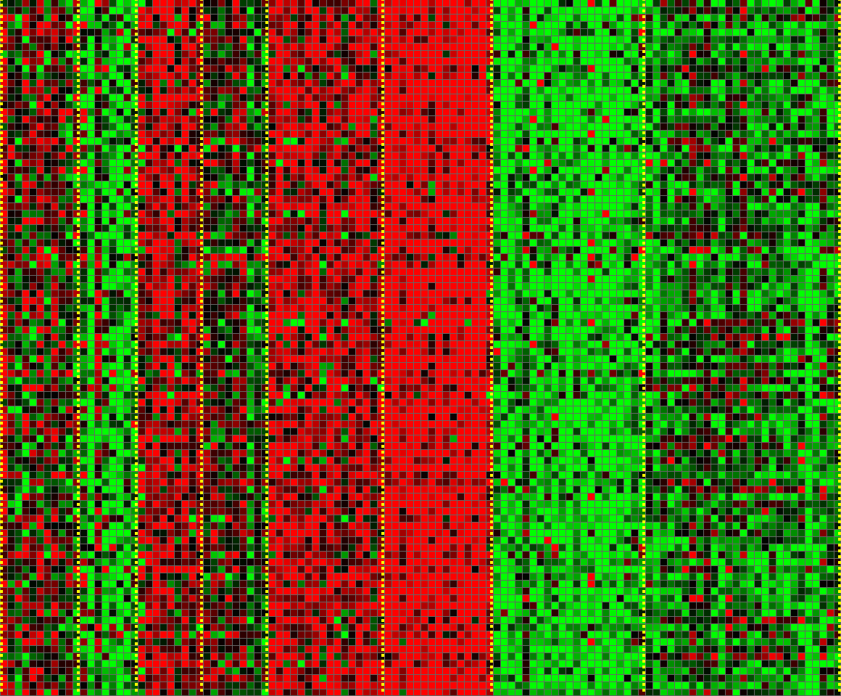
Unsupervised Learning
Genomics application: group individuals by genetic similarity
Genes
Individuals
32
[Source: Daphne Koller]

Slide 27

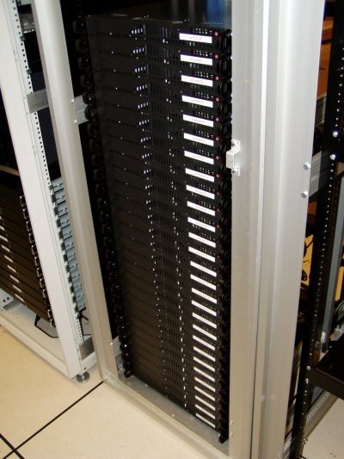
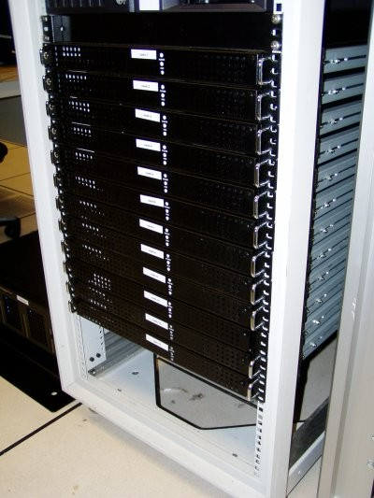




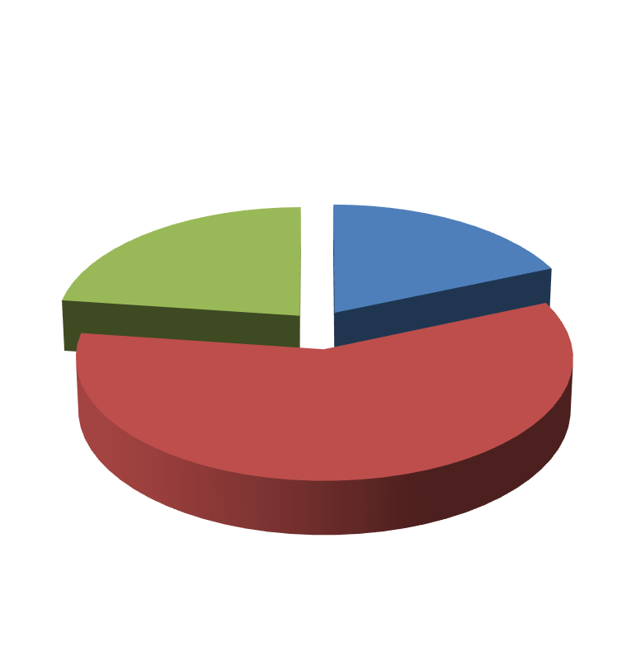

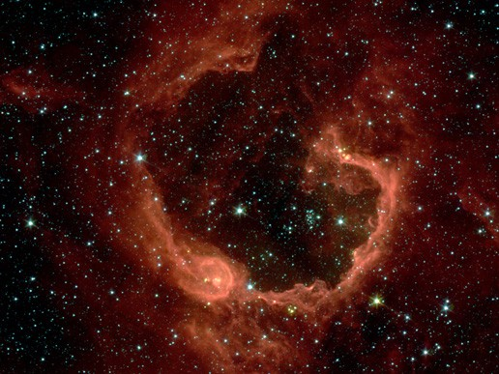


Unsupervised Learning
Organize computing clusters
Social network analysis
Market segmentation
Slide credit: Andrew Ng
Image credit: NASA/JPL-Caltech/E. Churchwell (Univ. of Wisconsin, Madison)
Astronomical data analysis
33

Slide 28
Reinforcement Learning
Given a sequence of states and actions with (delayed) rewards, output a policy
Policy is a mapping from states → actions that tells you what to do in a given state
Examples:
Credit assignment problem
Game playing
Robot in a maze
Balance a pole on your hand
36

Slide 29
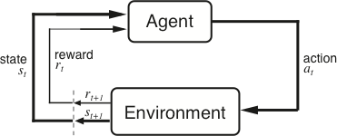
The Agent-Environment Interface
Agent and environment interact at discrete time steps Agent observes state at step t : s_{t} ∈S
: t = 0, 1, 2, K
produces action at step t : a_{t} ∈ A(s_{t} )
gets resulting reward : and resulting next state :
r_{t +1} ∈ℜ
^{s}t +1
. . .
^{r}t +1 _{st +1}
^{r}t +2 _{st +2}
^{r}t +3
. . .
s
t
a_{t}
^{s}t +3
ªt +1
ªt +2
ªt +3
37
Slide credit: Sutton & Barto

Slide 30
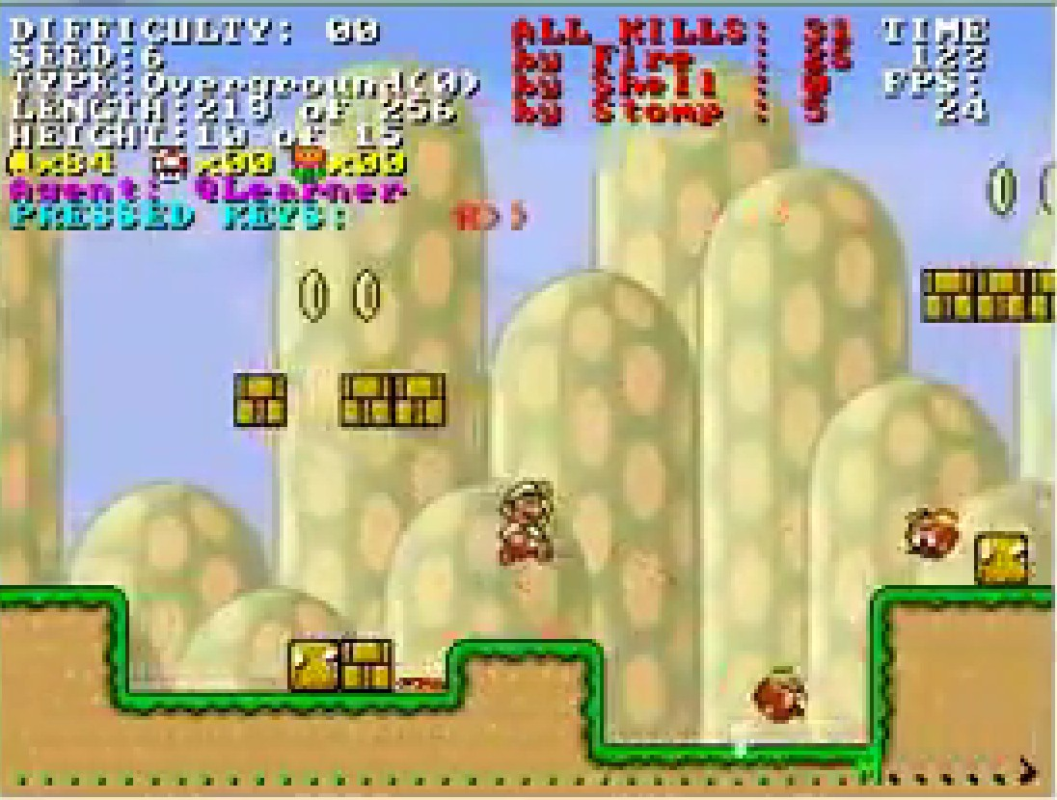
Reinforcement Learning
https://www.youtube.com/watch?v=4cgWya-wjgY

Slide 31

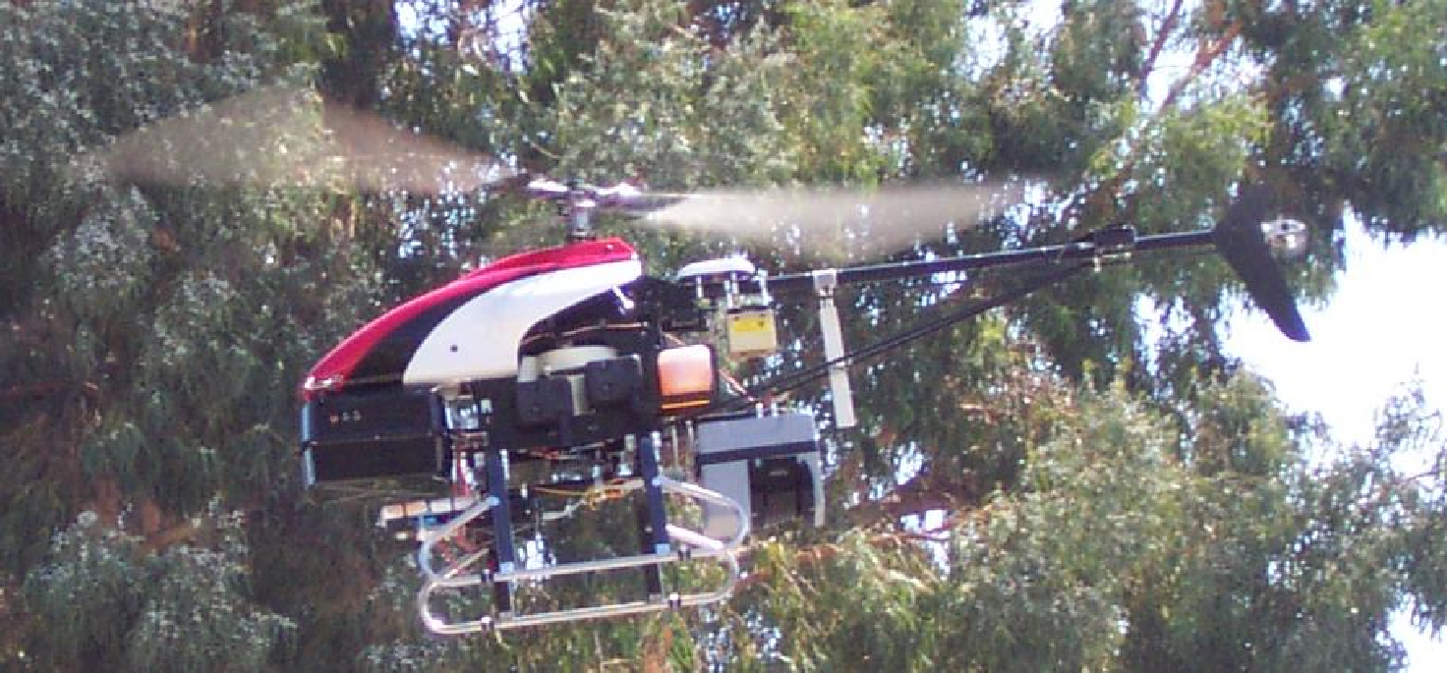
Inverse Reinforcement Learning
Learn policy from user demonstrations
Stanford Autonomous Helicopter http://heli.stanford.edu/ https://www.youtube.com/watch?v=VCdxqn0fcnE

Slide 32
Framing a Learning Problem

Slide 33






Designing a Learning System
Choose the training experience
Choose exactly what is to be learned
– i.e. the target function
Choose how to represent the target function
Choose a learning algorithm to infer the target function from the experience
Training data
Learner
Environment/ Experience
Knowledge
Testing data
Performance Element
41
Based on slide by Ray Mooney

Slide 34
Training vs. Test Distribution
We generally assume that the training and test examples are independently drawn from the same overall distribution of data
– We call this “i.i.d” which stands for “independent and identically distributed”
If examples are not independent, requires
collective classification
If test distribution is different, requires
transfer learning
Slide credit: Ray Mooney
42

Slide 35
The Learning Process

Slide 36
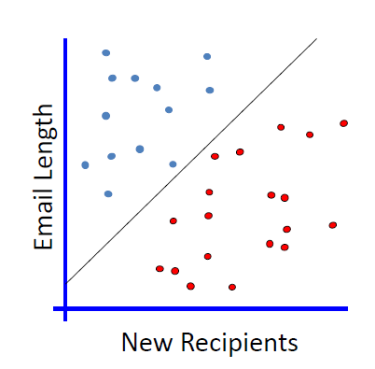
Linear Classifier
A simplified spam filtering problem

Slide 37
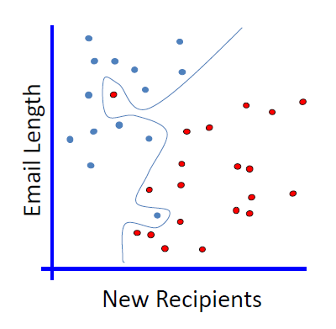
Non-linear Classifier
A simplified spam filtering problem
No Linear Classifier can cover all
instances

Slide 38
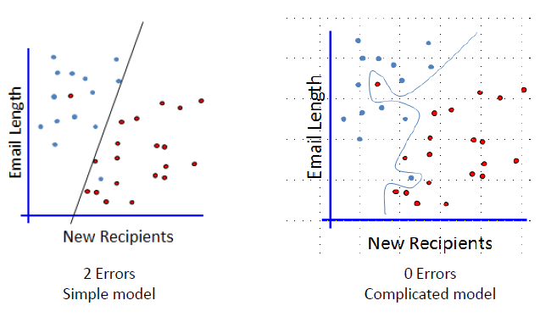
Generalization
Which one is better?

Slide 39
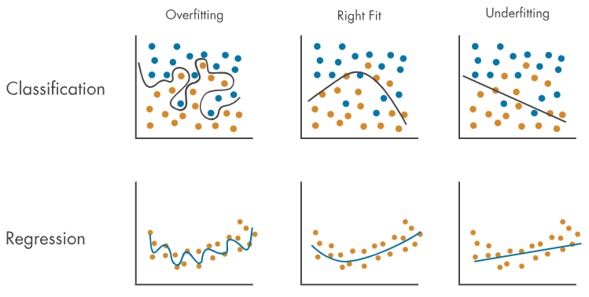
Overfitting & Underfitting
Overfitting
- Model too complex
- Performs excellent on training data, but poorly on test data
Underfitting
- Model too simple
- Performs poorly on both training and test data

Slide 40
ML in a Nutshell
Tens of thousands of machine learning algorithms
Hundreds new every year
Every ML algorithm has three components:
Representation
Optimization
Evaluation
43
Slide credit: Pedro Domingos

Slide 41
Various Function Representations
Numerical functions
Linear regression
Neural networks
Support vector machines
Symbolic functions
Decision trees
Rules in propositional logic
Rules in first-order predicate logic
Instance-based functions
Nearest-neighbor
Case-based
Probabilistic Graphical Models
Naïve Bayes
Bayesian networks
Hidden-Markov Models (HMMs)
Probabilistic Context Free Grammars (PCFGs)
Markov networks
Slide credit: Ray Mooney

Slide 42
Various Search/Optimization Algorithms
Gradient descent
Perceptron
Backpropagation
Dynamic Programming
HMM Learning
PCFG Learning
Divide and Conquer
Decision tree induction
Rule learning
Evolutionary Computation
Genetic Algorithms (GAs)
Genetic Programming (GP)
Neuro-evolution
Slide credit: Ray Mooney

Slide 43
Evaluation
Accuracy
Precision and recall
Squared error
Likelihood
Posterior probability
Cost / Utility
Margin
Entropy
K-L divergence
etc.
47
Slide credit: Pedro Domingos

Slide 44


ML in Practice
Understand domain, prior knowledge, and goals
Data integration, selection, cleaning, pre-processing, etc.
Learn models
Interpret results
Consolidate and deploy discovered knowledge
Loop
48
Based on a slide by Pedro Domingos

Slide 45
Lessons Learned about Learning
Learning can be viewed as using direct or indirect experience to approximate a chosen target function.
Function approximation can be viewed as a search through a space of hypotheses (representations of functions) for one that best fits a set of training data.
Different learning methods assume different hypothesis spaces (representation languages) and/or employ different search techniques.
49
Slide credit: Ray Mooney

