Slide 1
Numeric Operations Library
Submitted by: Salsabila Zaman
BSSE Roll:1443
Supervised by:
Abdus Satter Assistant Professor,
Institue Of Information Technology

Slide 2
What is Numeric Operations Library?
Limited-scale system implemented using number theory algorithms
User-friendly tools for mathematicians, researchers, and students.
Provides wide scope of functionalities, including prime numbers, factorization, modular arithmetic, digit manipulations, divisors, GCD, LCM, Fibonacci sequences, and matrix operations.

Slide 3
Why Numeric Operations Library?
Inspires people to pursue their interests in
Cryptography
Hash Functions
Computer Arithmetic
Educational resource for students
Enhancing computational capabilities
Research tool for exploring number theory concepts

Slide 4

List of Operations-
Prime Numbers(Prime Checker ,Prime generator)
Prime Factorization
Digit Manipulations
Palindrome Check
Greatest Common Divisor (GCD)
Least Common Multiple (LCM)
Fibonacci Sequence generator
Modular Arithmetic
Divisors
Specialization (Matrix Manipulation)-
Matrix Addition
Matrix Multiplication
Matrix Determinant
Matrix Inversion
Matrix Power Calculation
Matrix Transposition
Matrix eigenvalues and eigenvectors
Check Matrix Types
Matrix Rank

Slide 5

Primary Objective
Provide wide scope of functionalities from simple prime number tests to complex matrix manipulations
Saves Time and Effort through using pre-implemented algorithms from this toolbox eliminating the need to manually code or develop these functions from start.

Slide 6
Prime Number Generation
Prime Factorization
These are fundamental concepts in number theory. Prime numbers play a crucial role in modern encryption algorithms, such as RSA encryption. Generating large prime numbers and prime factorization are essential for creating secure encryption keys and several encryption algorithms.
Here I implemented Sieve Of Eratosthenes algorithm. But there remains some constraints ,like this algorithm can run for numbers till 1000000(10^7). To handle larger numbers, I’m currently trying to implement Primality Test and Pollard Rho’s algorithm in my system.

Slide 7
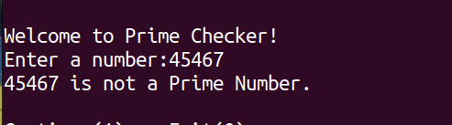
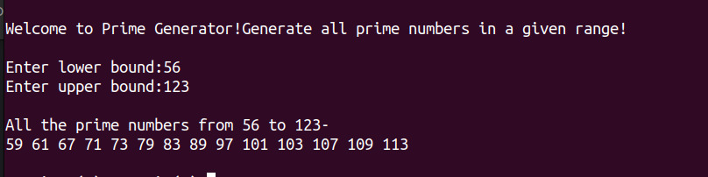

Slide 8
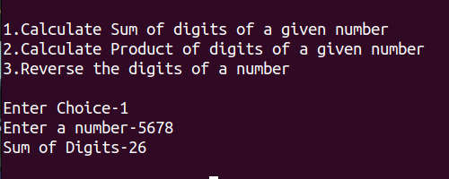
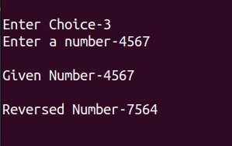
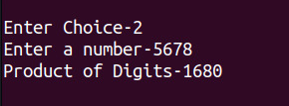
Results in summation /product /reversal of digits in a given number.
Digit Manipulations

Slide 9
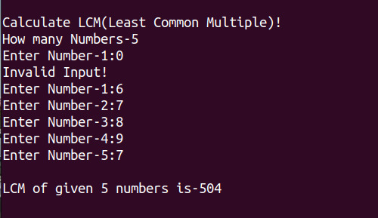
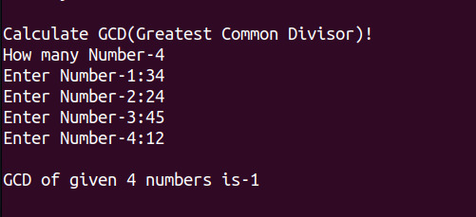
GCD and LCM: Calculating the greatest common divisor (GCD) and least common multiple (LCM) is essential in a variety of mathematical tasks, including fractional simplification, equation solving, and algorithm optimization.

Slide 10
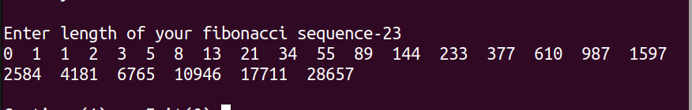
Fibonacci Sequence
Can serve as a resource for guiding students about recursion and dynamic programming

Slide 11
Matrix Manipulations
Matrix operations, which are vital in linear algebra, scientific computing, engineering, and data processing, are a special addition in this library. It makes activities like matrix addition, multiplication, and determinant calculation easier.

Slide 12
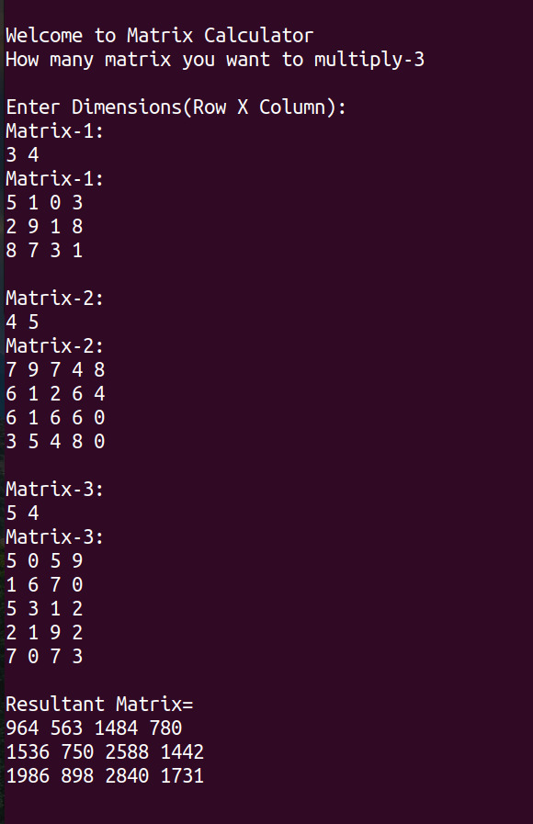
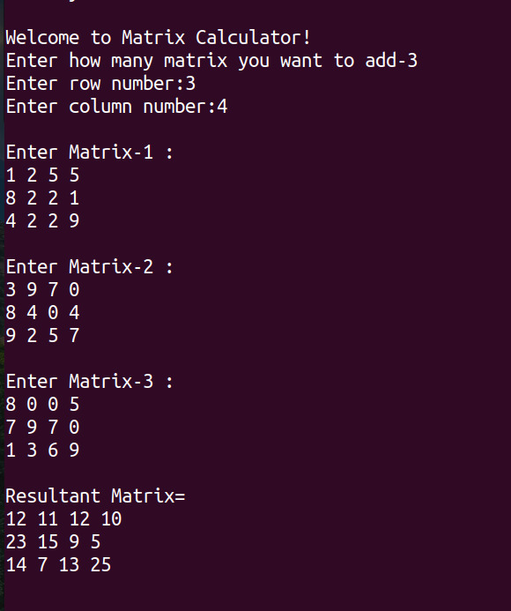

Slide 13

Thank You!

