Slide 1
Machine Learning-Based Detection of Phishing Web Pages Using URL Features
Saleh Alsaheb
Ismael Alhindi
20220045
20220379
sal20220045@std.psut.edu.jo
ism20220379@std.psut.edu.jo
Networks and Information Security Engineering · Princess Sumaya University for Technology (PSUT)
Artificial Intelligence · Final Project · 2026

Slide 2
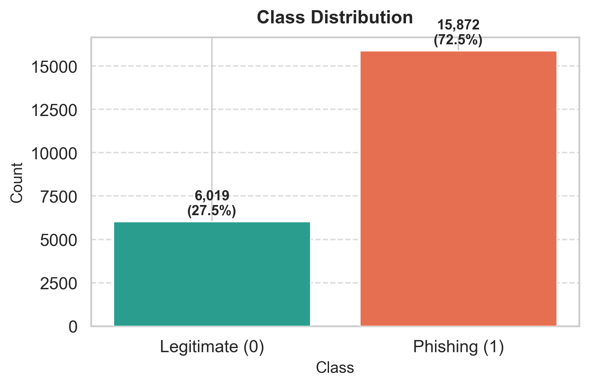
The Problem
Phishing pages impersonate trusted sites to steal credentials, passwords, and financial data.
Static rule lists and manual review cannot scale to millions of new URLs per day.
Automated, lightweight URL-based ML detection provides a fast first line of defense.
Goal: Classify URLs as phishing or legitimate using supervised ML on lexical features only.

Slide 3
Dataset
100,077
21,891
19
72.5%
Kaggle
Raw Rows
Unique Rows (after dedup)
URL Features
Phishing Class Share
Source
Kaggle Web Page Phishing Dataset · 19 numerical URL-derived features · Binary target: phishing (1) / legitimate (0)
url_length · n_dots · n_hypens · n_slash · n_questionmark · n_redirection · n_at · n_percent · n_equal · n_dollar · …+9 more

Slide 4
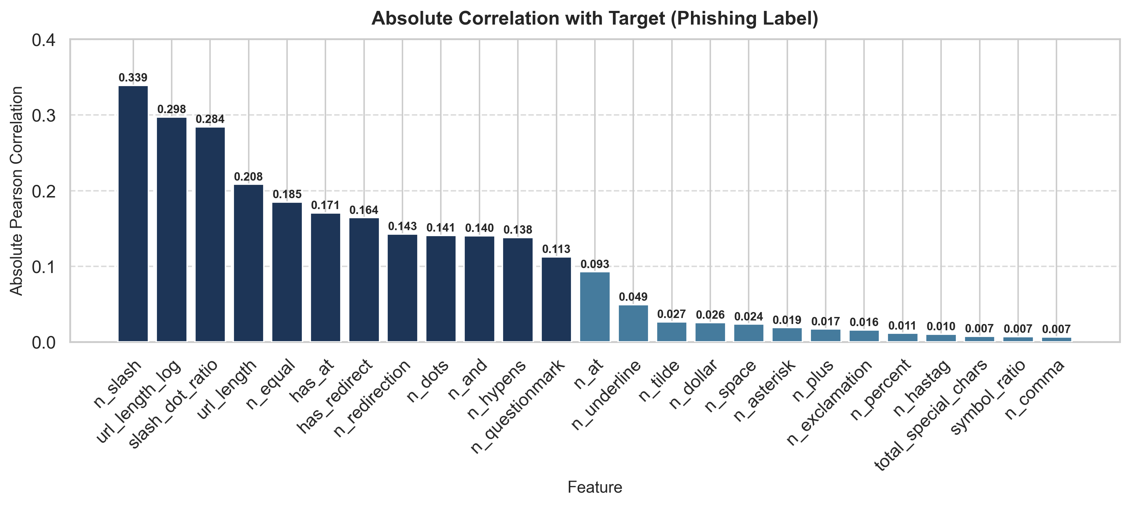
Feature Engineering
Original Features (19)
Engineered Features (+6)
· url_length
· n_dots
· n_hypens
· n_underline
· n_slash
· n_questionmark
· n_equal
· n_at
· n_and
· n_exclamation
· n_space
· n_tilde
· n_comma
· n_plus
· n_asterisk
· n_hastag
· n_dollar
· n_percent
· n_redirection
total_special_chars
Sum of all special character counts
symbol_ratio
total_special_chars / (url_length + 1)
has_redirect
Binary: 1 if n_redirection > 0
has_at
Binary: 1 if n_at > 0
slash_dot_ratio
n_slash / (n_dots + 1)
url_length_log
log(url_length + 1)

Slide 5
ML Pipeline
1
2
3
4
5
6
7
Load
Clean
Engineer
Split
Scale
CV+Tune
Evaluate
CSV → DataFrame
Drop 78K dupes
+6 features
80/20 stratified
StandardScaler (LR only)
GridSearchCV 5-fold
Test metrics
All four models tuned independently via GridSearchCV · 5-fold stratified CV scored on F1
21,891
5-fold
80 / 20
4
unique records
cross-validation
train / test split
models evaluated

Slide 6
Machine Learning Models
Linear
Tree
Logistic Regression
Decision Tree
Linear decision boundary via log-odds. Fast baseline, requires feature scaling.
Greedy axis-aligned splits. Interpretable, no scaling needed.
Best: C=0.01, solver=lbfgs
Best: max_depth=10, min_leaf=1
Acc: 0.7753
F1: 0.8533
Acc: 0.8022
F1: 0.8667
Ensemble · Bagging
Ensemble · Boosting ★ BEST
Random Forest
Gradient Boosting
200 decorrelated trees. Averages predictions to reduce variance.
Sequentially corrects residuals. Best balance of precision and recall.
Best: n_est=200, max_depth=15
Best: lr=0.1, depth=4, n_est=200
Acc: 0.8102
F1: 0.8740
Acc: 0.8198
F1: 0.8801

Slide 7
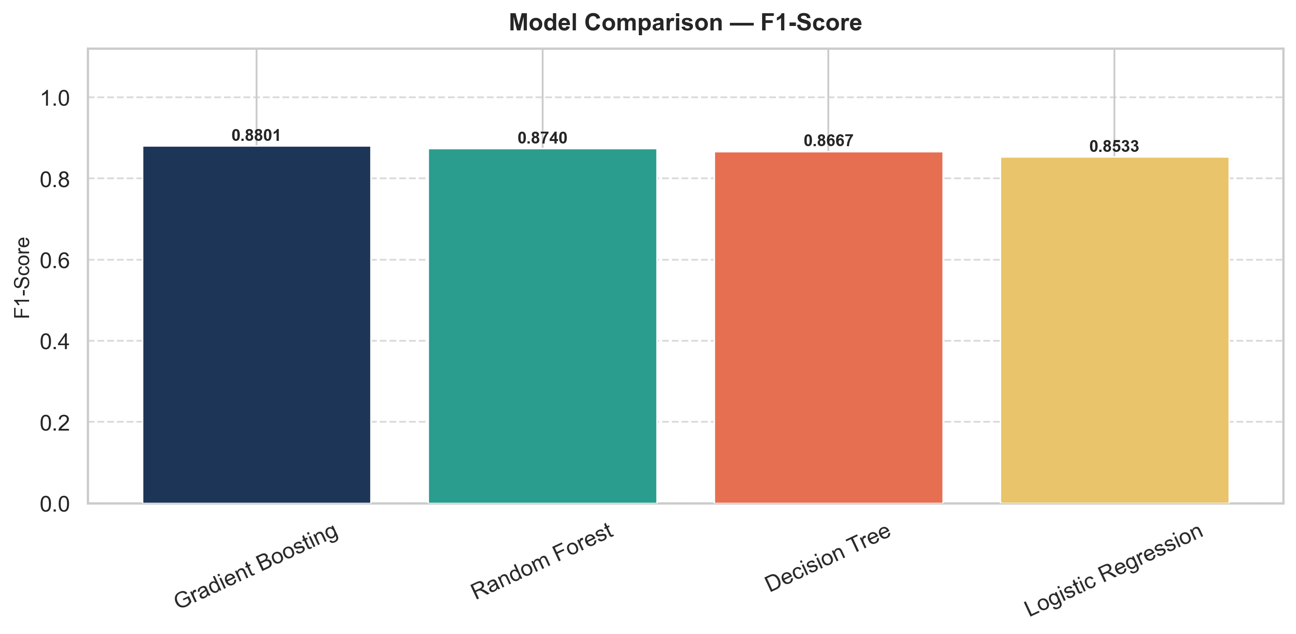
Results — All Models
Model | Accuracy | Precision | Recall | F1-Score | ROC-AUC
Gradient Boosting | 0.8198 | 0.8505 | 0.9118 | 0.8801 | 0.8873
Random Forest | 0.8102 | 0.8429 | 0.9074 | 0.8740 | 0.8793
Decision Tree | 0.8022 | 0.8476 | 0.8866 | 0.8667 | 0.8478
Logistic Regression | 0.7753 | 0.8101 | 0.9014 | 0.8533 | 0.8329
★ Gradient Boosting: highest accuracy, F1, and AUC across all four models
Recall is the primary metric — a missed phishing page is more dangerous than a false alarm. All four models achieve recall above 0.886, demonstrating strong detection capability.

Slide 8
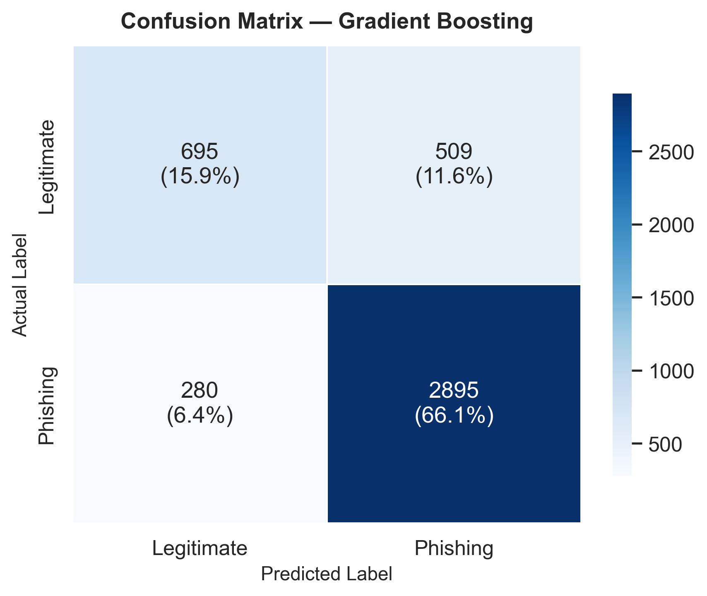
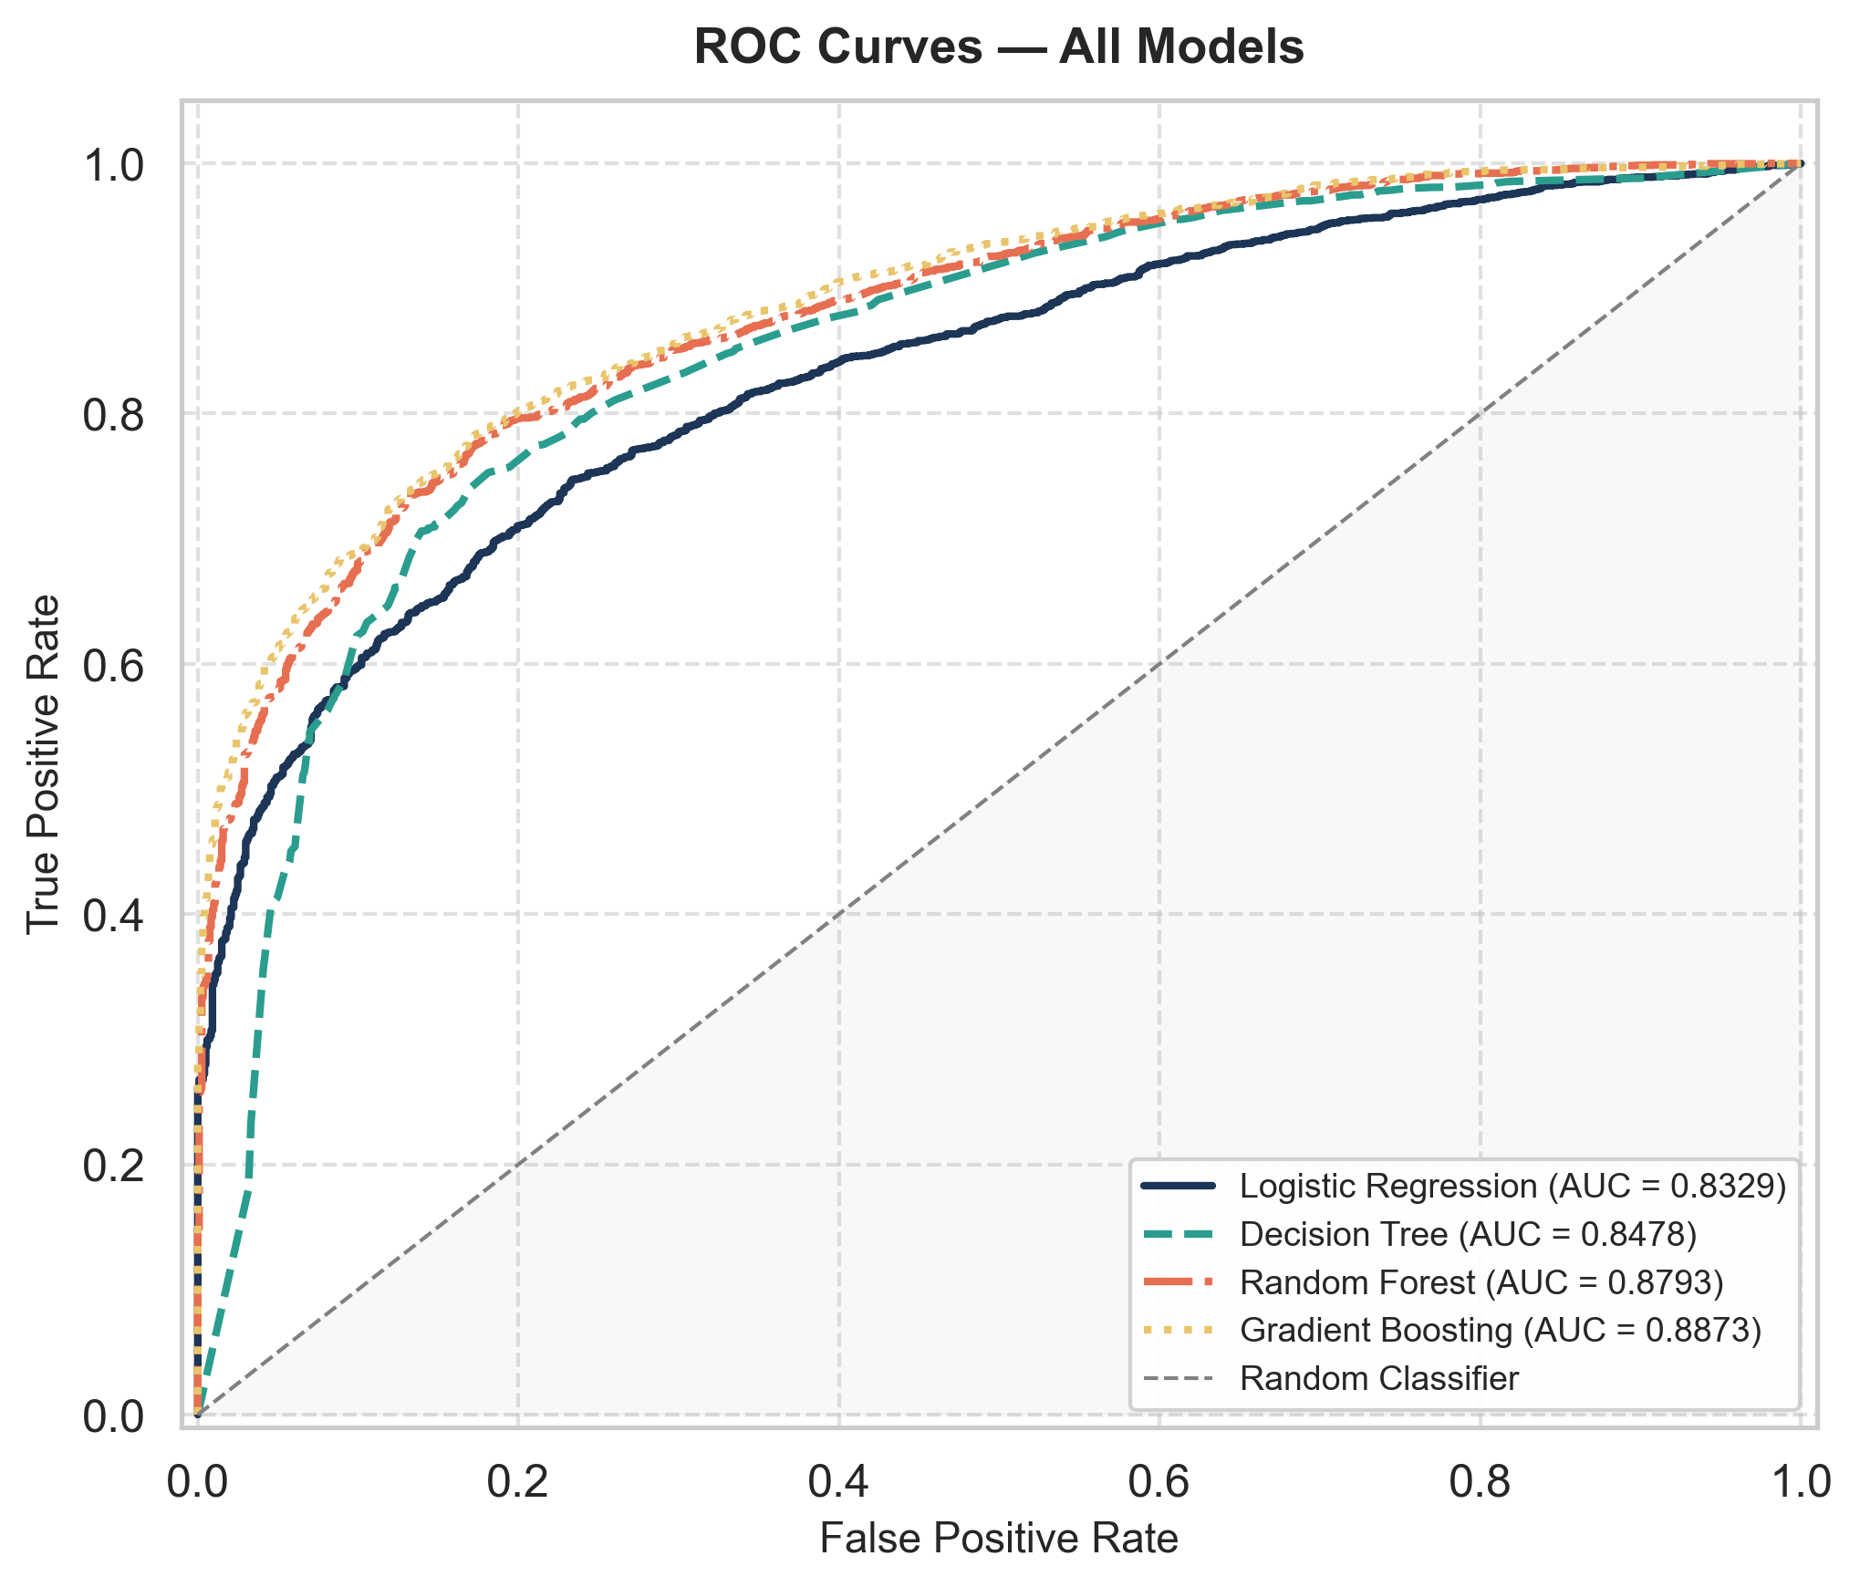
Best Model — Gradient Boosting
0.8801
0.9118
0.8873
F1-Score
Recall
ROC-AUC

Slide 9
Comparison with Prior Work
Study | Features | Best Model | Top Acc.
Blum et al. [2] (2010) | Lexical URL (count-based) | Online learner | N/A
Sahingoz et al. [3] (2019) | NLP + hybrid URL | Random Forest | 97.98%
Awasthi & Goel [4] (2022) | 30 URL-structural | Decision Tree | 95.92%
Alnemari et al. [5] (2023) | 30 URL-structural | Random Forest | 97.30%
This Work | 19 lexical + 6 engineered | Gradient Boosting | 81.98% *
* Different datasets and feature sets — not a direct benchmark comparison. Our method uses URL-only lexical features: lighter, no content scraping required. F1-Score = 0.880 and Recall = 0.912 remain competitive for URL-only approaches.

Slide 10
Conclusion
Key Takeaways
› Gradient Boosting achieved the best results: F1=0.880, Recall=0.912, AUC=0.887.
› All four models competitive (F1: 0.853–0.880); hyperparameter tuning lifted Decision Tree F1 from 0.791 to 0.867.
› URL lexical features + 6 engineered indicators provide effective, lightweight phishing detection.
Limitations
› URL-only features miss sophisticated phishing with clean-looking URLs.
› Static dataset — 78K of 100K rows were duplicates; model may not generalise to fresh data.
Future Work
› Expand features with host-based, DNS, SSL, and content signals; validate on live phishing feeds.
Thank You

