Slide 1
Data Tool Demo: Looker
Salt City Data Community

Slide 2
Overview of Looker
Data management and exploration
Interactive dashboards and reports
Data modeling
Business-oriented
More Information: Why Use Looker

Slide 3
Resources
Main Looker Website: Looker
Documentation: Looker Documentation
14-Day Trial: Looker Free Trial
Note: Contact with multiple representatives from Google Cloud initiates the process of actually getting a trial. Currently there is not an easily accessible sandbox environment without displayed business interest.

Slide 4
Basics in Looker
Operates in-database; source data cannot be brought into Looker on its own.
Search function for data fields
Terminology
Dimensions: Customized groups within data
Example: Bins of data
Measures: Calculations for groups of data
Examples: Average, count, totals
Source: Looker introduction

Slide 5
LookerML
Lightweight data modeling language
SQL-based, reusable, and version-controlled
More compact than statements in SQL
SQL Runner is also available as an option
LookML
View: customer {
dimension: full_name {
sql: CONCAT(${first_name}, {${last_name}) ;;
html: {{ first_name.value | capitalize }}
{{ last_name._value | capitalize }} ;;
}
SQL
SELECT
CONCAT(
UCASE(LEFT(customer.first_name, SUBSTRING(customer.first_name, 2),
UCASE(LEFT(customer.last_name, 1)), SUBSTRING(customer.last_name, 2)
) AS full_name;
Source: Intro to LookML

Slide 6
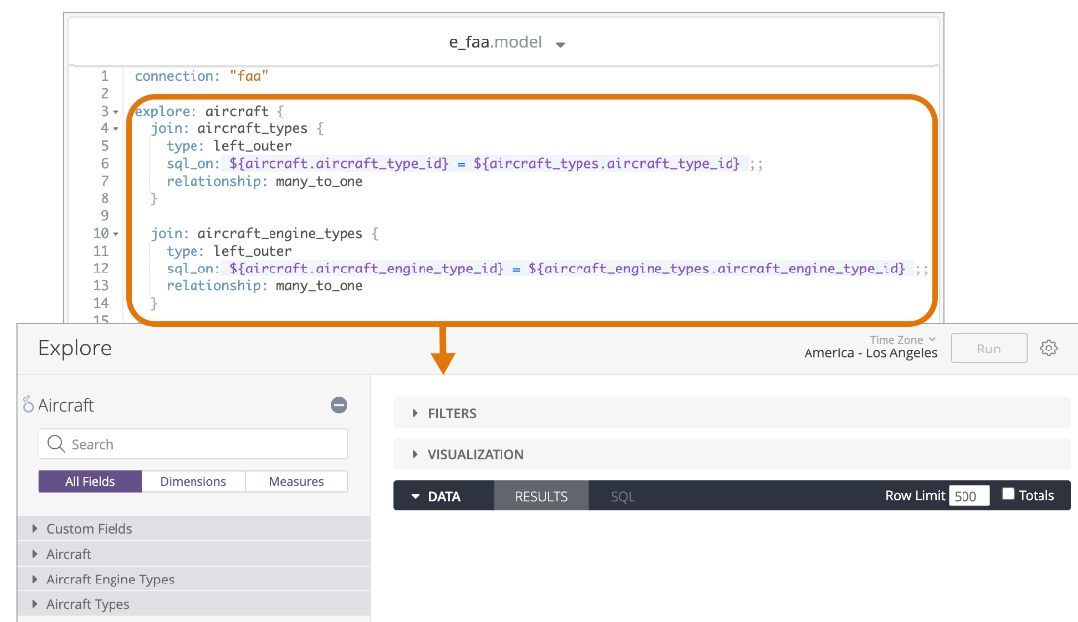
Project and Model Terminology
Explore: Specified set of data fields
Projects: Combination of LookML files controlling connection to database, queries involved, and implemented controls
Models: Database connection and Explores that use the connection
Sources: Model Development and LookML quick reference

Slide 7
Database Connections
Examples:
BigQuery
MySQL
Snowflake
PostgreSQL
Amazon Redshift
Amazon Aurora
Google Cloud PostgreSQL
Microsoft Azure PostgreSQL
Use Case: With BigQuery, machine learning models like regression and clustering can be called from a LookML model
Source: Connecting Looker to your database

Slide 8
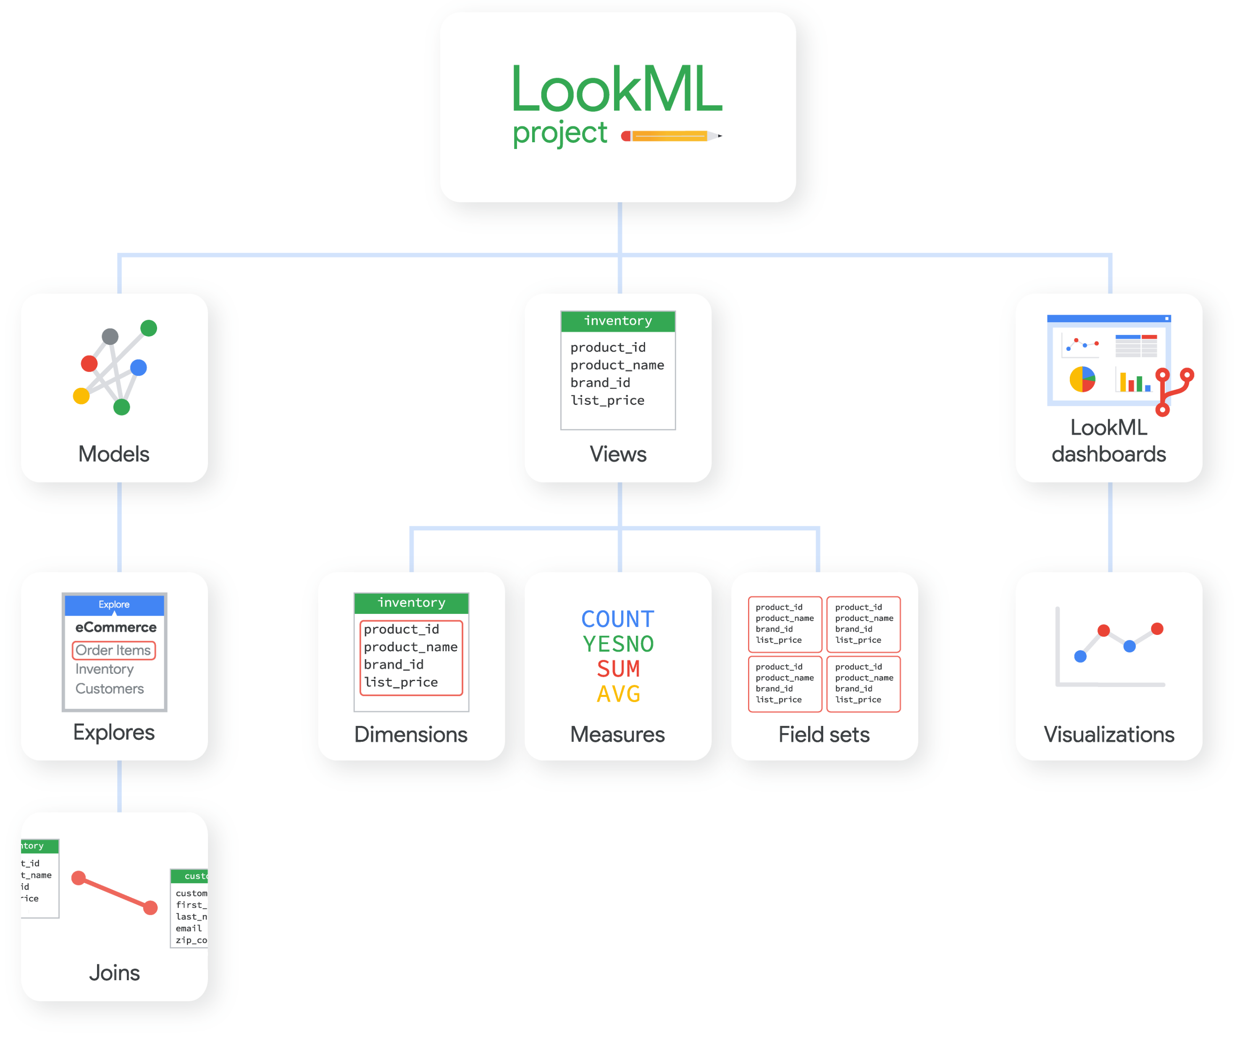
LookML Project Elements
Source: What is LookML?

Slide 9
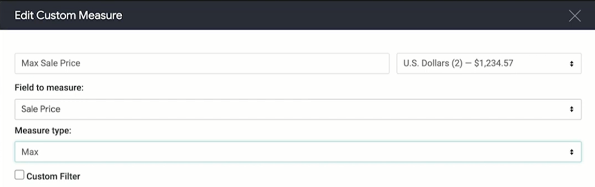
Customizing Features
Table Calculations
Can give users ability to create calculations when viewing data
Custom Fields
Can be created from table calculations
Measures and dimensions
Custom Filters
Limiting data displays
Performance considerations for dashboard use
Sources: Using table calculations and Adding custom fields and Filtering and Limiting

Slide 10
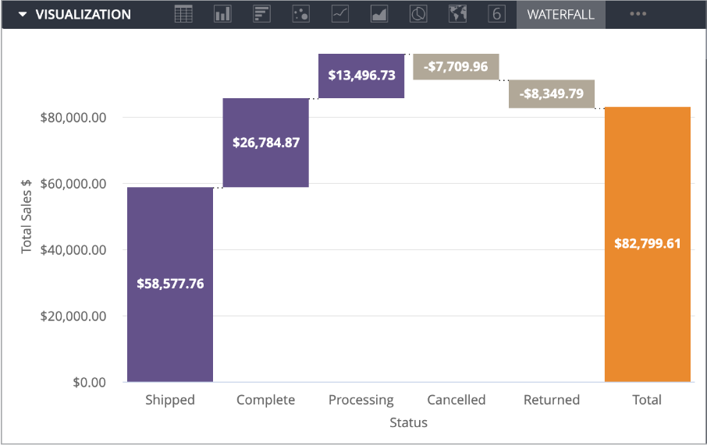
Types of Visualizations
Charts
Column, Bar, Scatterplot, Line, Area, Pie, Donut, Progression, Boxplot
Text and Tables
Single Values or Records, Tables, and Word Clouds
Maps
Example for Customization Options: Boxplot
Sources: Visualization Types and Creating Visualizations and Graphs

Slide 11
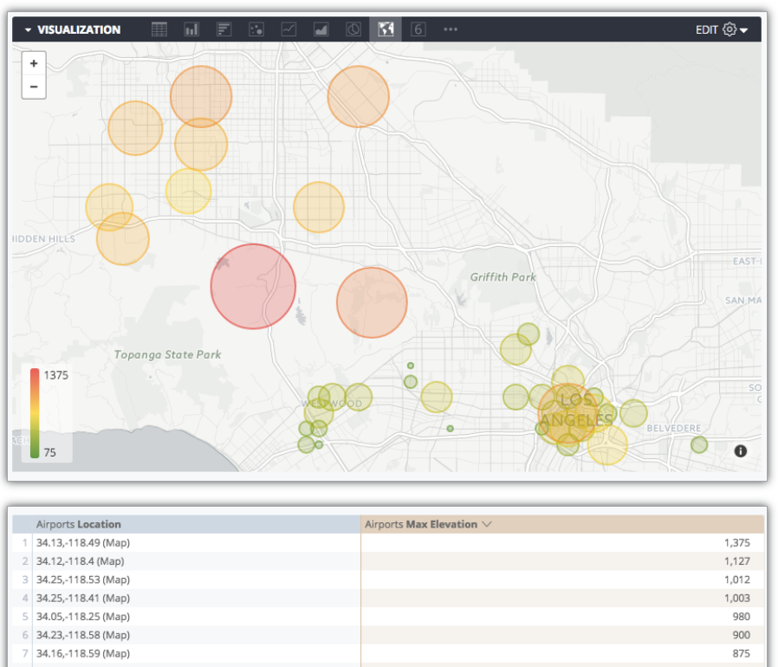
Types of Visualizations
More on Maps
Geospatial data can be turned into points on a map, heatmaps, and connecting lines and areas.
Integration between BigQueryGIS can help create polygons from points data for splits like state and zipcode
Source: Interactive Map Options

Slide 12
Collaboration and Sharing
Options to share data privately once or on reoccurring basis with Looker Scheduler
Shareable URLs and option for public URL that can be embedded on webpage
Schedule deliveries for dashboards
Alert options for when thresholds are met
Notifications to email or Slack
Export data from a Look or Explore in the following formats:
TXT, Excel spreadsheet, CSV, JSON, HTML, Markdown, PNG
Sources: Sharing Data and Building LookML Dashboards

Slide 13
Looker API
Run queries, generating reports on schedules, and administrative tasks
API Explorer gives interactive documentation via a builder for methods available and their categories
Examples: Alerts, Authentication, and Dashboard actions
Source: Getting started with the Looker API

