Slide 1
Recommender Systems based on click events
Submitted by:
Team : Gravel Team No:16
Abhinav Anand (2018201037)
Nishant Goyal (2018201038)
Abhijeet Panda (2018201044)
Shubham Rawat (2018201098)
Project Github Link : https://github.com/abnvanand/smai-proj

Slide 2
Objective
RecSys Challenge 2015 is about predicting the items a user will buy in a given click session.
In this challenge, YOOCHOOSE is providing a collection of sequences of click events; click sessions.
For some of the sessions, there are also buying events.
The goal is hence to predict whether the user (a session) is going to buy something or not, and if he is buying, what would be the items he is going to buy.

Slide 3
Why Recommender Systems
One of the most important applications of recommender systems.
35% of Amazon.com’s revenue is generated by its recommendation engine. (source: https://www.mckinsey.com/industries/retail/our-insights/how-retailers-can-keep-up-with-consumers)
The Netflix Prize was an open competition for the best algorithm for Recommender Systems with a prize money of US$1,000,000

Slide 4
The Task
Given a sequence of click events performed by some user during a typical session in an e-commerce website, the goal is to predict whether the user is going to buy something or not, and if he is buying, what would be the items he is going to buy. The task could therefore be divided into two sub goals:
Is the user going to buy items in this session? Yes | No
If yes, what are the items that are going to be bought?

Slide 5
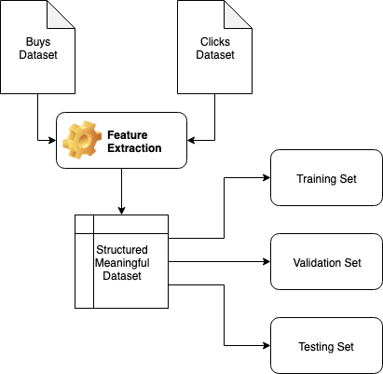
Our Approach

Slide 6
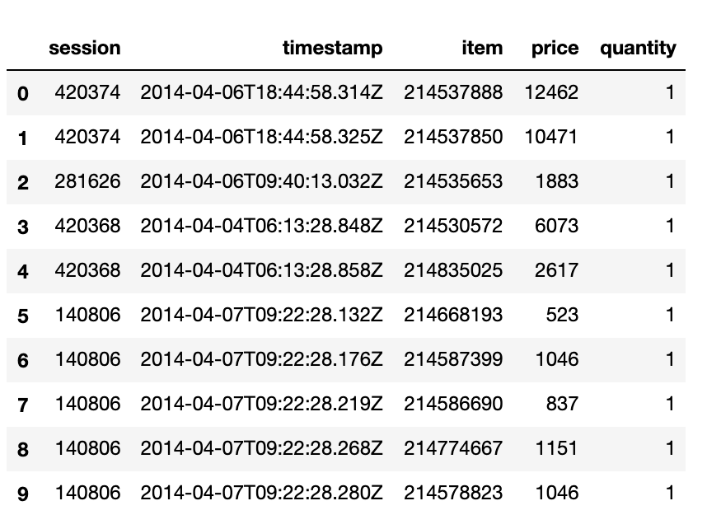
Data : Buys Dataset

Slide 7
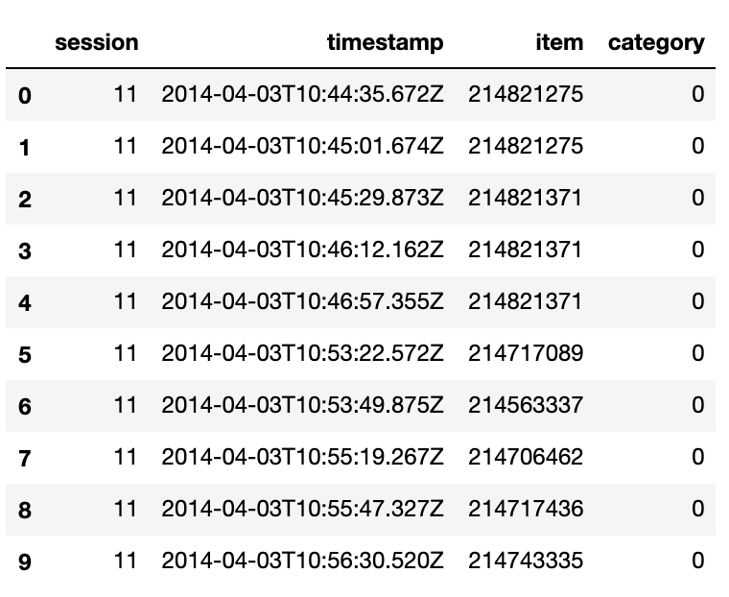
Data : Clicks Dataset

Slide 8
Features
Session Level Features
Item Level Features
Session-Item related features

Slide 9
Features Extracted
Feature | Type | Description
session | Integer | Session ID
item | Integer | Item ID
total_time | Integer | Total time spent on a session
avg.time_clicks | Integer | Average time between the clicks
max_time | Integer | Maximum time between the clicks
n_clicks | Integer | Number of clicks in this session
avg_pop_score | Integer | Average popularity Score of all items in this session
no_of_categories | Integer | Number of unique categories in this session

Slide 10
Features Extracted
Feature | Type | Description
item_time | Integer | time spent on this item in this session
dow_first | Integer | Day of week of the first click on this item in this session
dow_last | Integer | Day of week of the last click on this item in this session
duration_f_l | Integer | Duration between the first click and the last click on this item in this session
f_click | Bool | Is this item the first click in this session
l_click | Bool | Is this item the last click in this session
item_pop | Real | popularity score of this item
purchased | Bool | whether this item is Purchased in this session

Slide 11
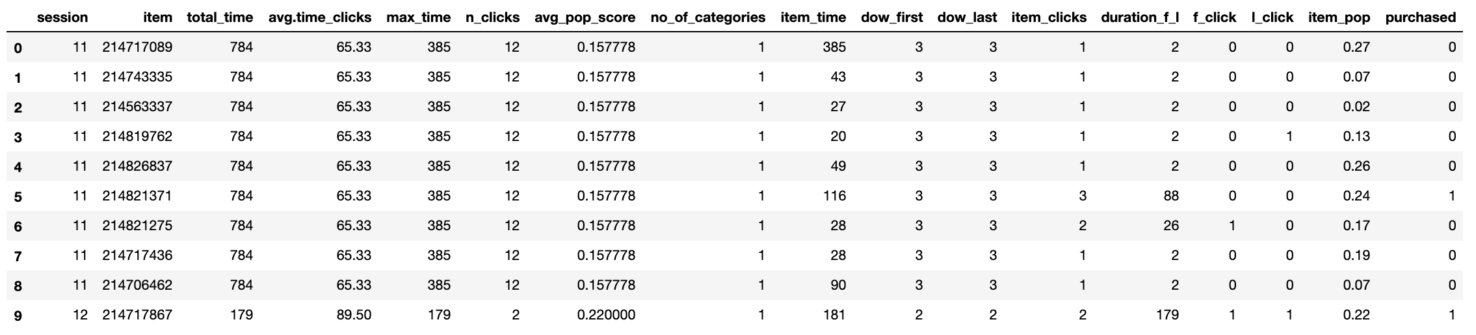
Final Dataset

Slide 12
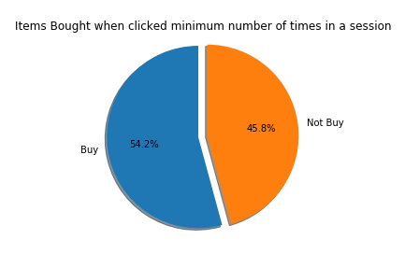
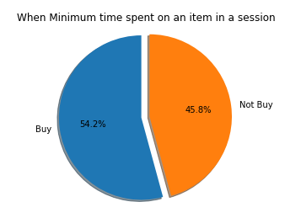
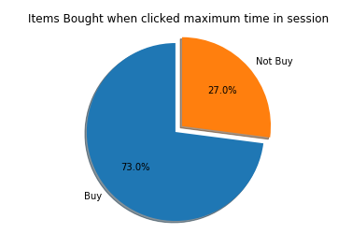
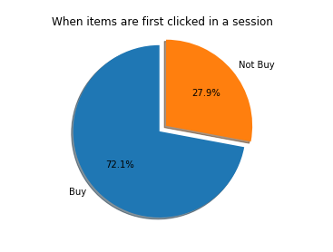
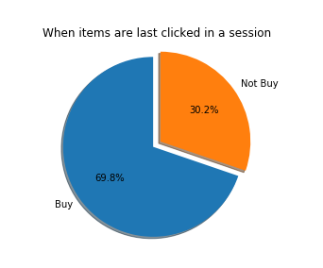
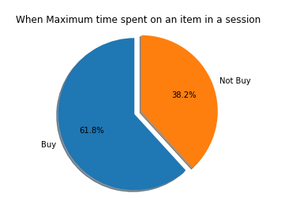
Analysis

Slide 13
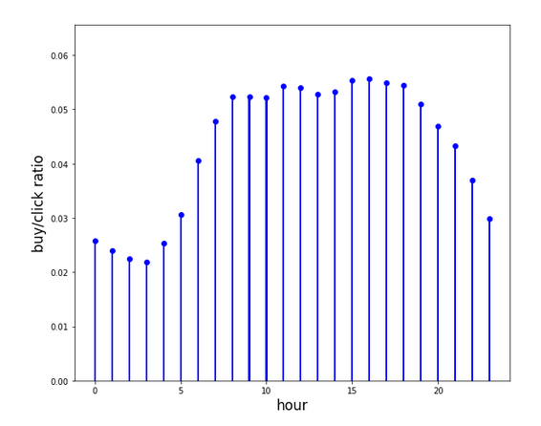
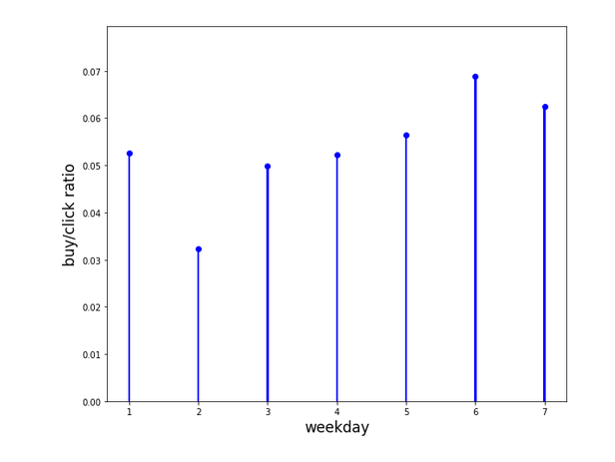
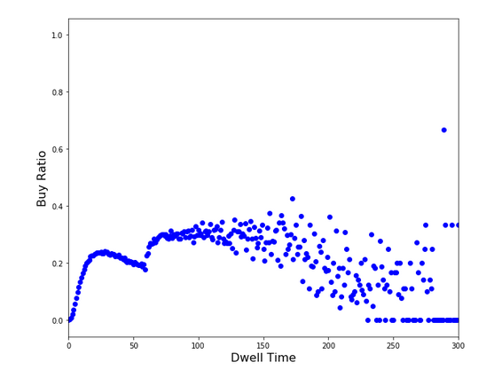
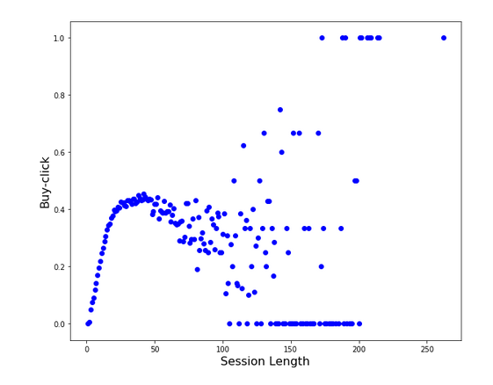
Analysis

Slide 14
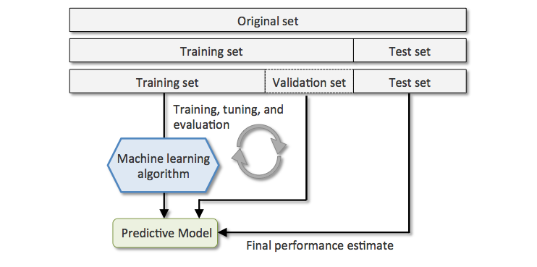
Methodology

Slide 15
Models Trained
Random Forest Classifier
K-Nearest Neighbor Classifier
Naive Bayes Classifier
Gradient Boosting Classifier

Slide 16
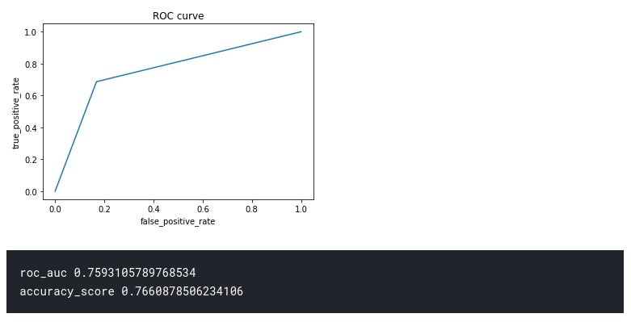
Random Forest

Slide 17
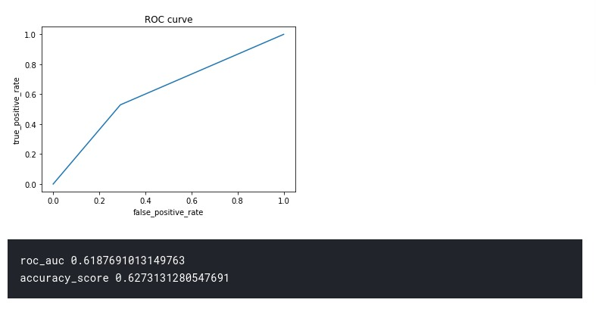
K-Nearest Neighbor

Slide 18
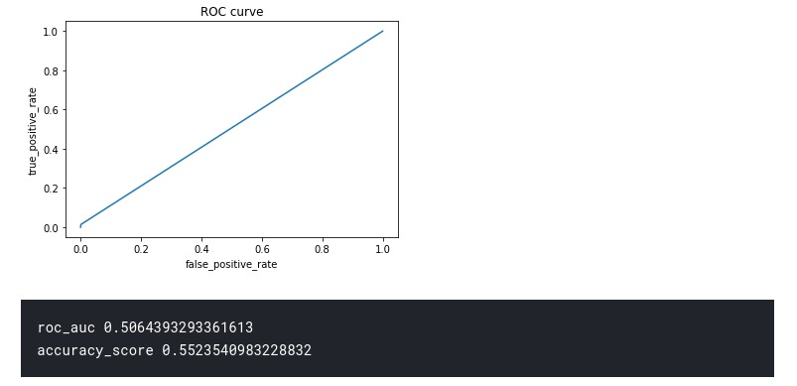
Naive Bayes

Slide 19
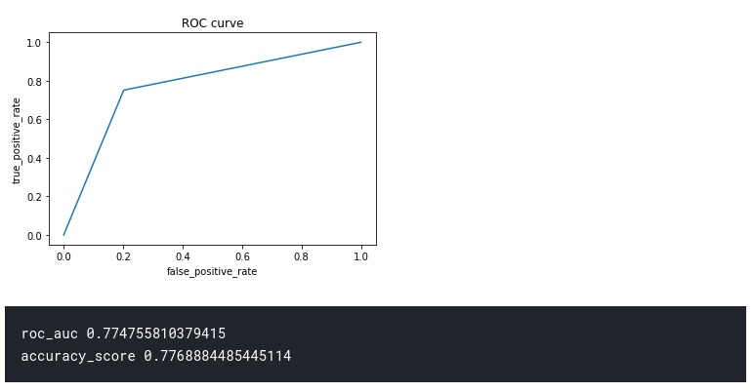
Gradient Boosting

Slide 20
Challenges
Data not directly usable: needed to extract new features in order to get noticeable accuracy.
Huge Datasets made Analysis extremely slow
Feature Extraction is not limited, Many more features could be extracted for further improving the performance.
Class Imbalance Problem

Slide 21
Thank You

