Slide 1
Personality prediction system through CV analysis
Shapkhatova S
Temirbay M

Slide 2
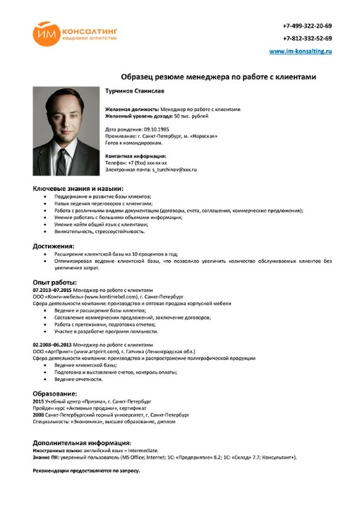
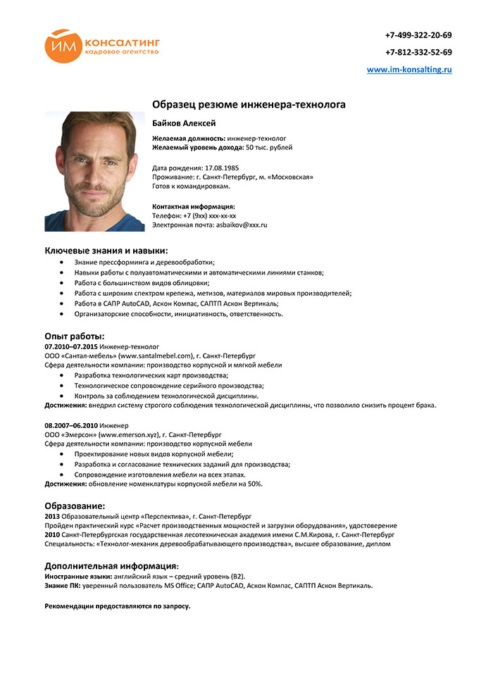
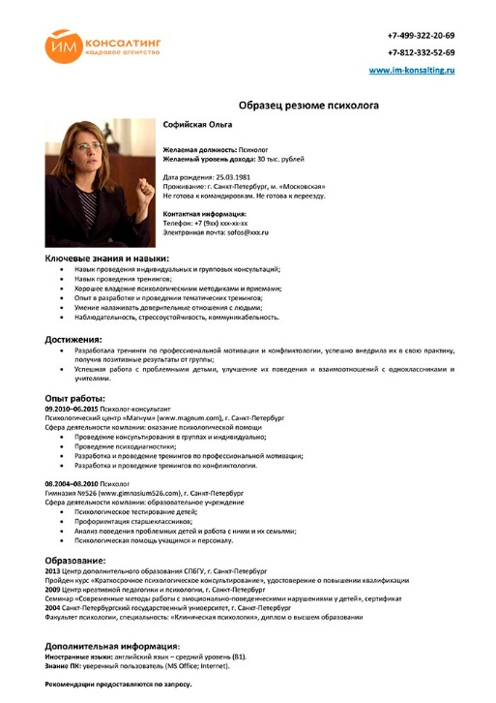

Slide 3
Problem
Too large amount of applicants.
So, it may be hard sometimes to select only few candidates in the hundreds of them. This issue is close to big companies and corporations

Slide 4
Solution that we offer
Personality prediction system through CV analysis

Slide 5
The system will rank the CV’s based on the experience and other key skills which are required for particular job profile.

Slide 6
This system will help the HR department to easily shortlist the candidate based on the CV ranking policy.

Slide 7
This system will focus not only in qualification and experience but also focuses on other important aspects which are required for particular job position. This system will help the human resource department to select right candidate for particular job profile which in turn provide expert workforce for the organization.

Slide 8
Dataset and tools
Various CVs written by particular template
C#

