Slide 1
Neural Cloud Storage: Innovative Cloud Storage Solution for Cold Video
Jinyeong Lim, Juncheol Ye, Jaehong Kim, Hwijoon Lim, Hyunho Yeo, Dongsu Han KAIST

Slide 2
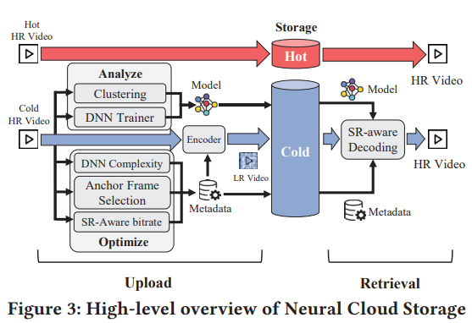
Overview
Cloud storage providers offer different pricing tiers based on the access frequency of stored data
For those are less frequently accessed videos, there is no need to store them in full quality.
Super-resolution could be used to infer these “cold videos” and restore full quality while accessing.
The whole system is built around the core idea above.
It aims to build a ML super-resolution (SR) based archival system.

Slide 3
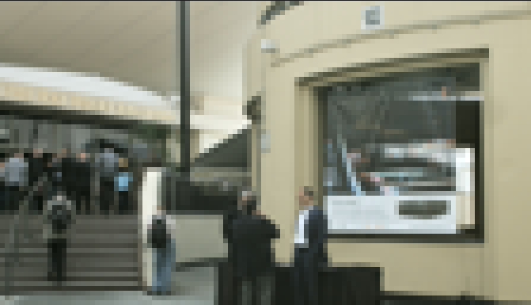
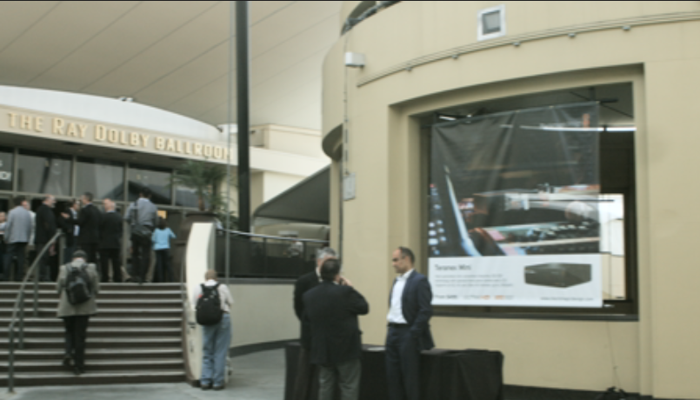
Background
Super-resolution (SR) refers to a set of techniques that can enhance the resolution of an image or video beyond its original captured/stored resolution.
ML-based super-resolution is one the prevailing methods. Experiments conducted in this paper are based on modified EDSR [1].
Bicubic interpolation is an example of non-ML-based method.
Notes:
They use this model because they think this model is the best-performing model in terms of restoration quality given the same computation power budget. Under 100KB, a version smaller than typical.

Slide 4
Background
Cloud storage is the storage method chosen. AWS’s multi-tiered service is used specifically.
Cold videos are the main focus of this paper. According to [2], video popularity is highly skewed, with 1% of the videos accounting for over 80% of the watch time. This observation indicates the existence of “cold videos”, which are videos not frequently accessed.
Their work attempts to use ML-based super-resolution methods to make the video archival more efficient.
Notes:
Emphasis their system is focusing on cloud storage not local storage. They are not buying hardwires like GPU and hard drives.
For cold videos, the data source is not explicitly shown, but it could be from Facebook directly, since Wyatt Lloyd is affiliated with FB.

Slide 5
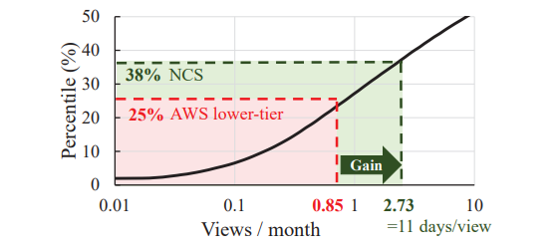
Overall results
According to the preliminary cost-benefit analysis in this paper, Neural Cloud Storage (NCS) system cover 13% more cold videos that can benefit from the multi-tiered service.
Total cost of ownership (TCO) used in the analysis consists of only the storage cost and the retrieval cost.
Notes:
Put overall results here to give a brief view of performance, because Professor Han, during his visit, delivered a point that they have given up on this method based on this paper.
Cost: costs like training cost and part of the optimization costs (will be introduced later), are either considered negliable or ignored with assumptions

Slide 6
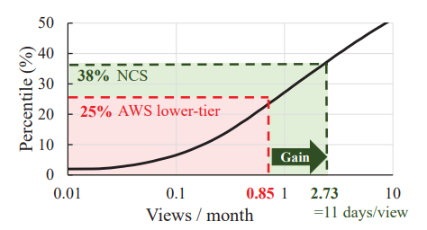
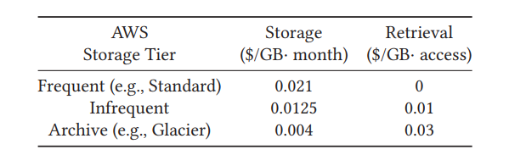
Overall results
This graph is made based on their own video dataset consists of 50k videos crawled with YTB data API.
And based on the pricing table of multi-tiered AWS storage.
However, their final conclusion is it is not worthy to use ML-based super-resolution for video archival since retrieval cost largely offsets the reduction in storage cost
Notes:
This graph is to show that the current multi-tiered service does not cover the majority of cold video. For example, the “Infrequent Access” tier of AWS S3 provides cost-saving over the “Standard” tier, when a video is viewed 0.85 or fewer times per month.

Slide 7
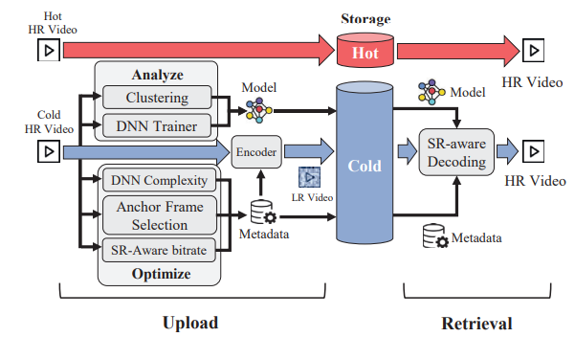
Components of NCS
There are 3 processes in the workflow of NCS: Profiling, Optimization, and Restoration.
Profiling: Process of Clustering videos.
Content-aware super-resolution: train a model for each content.
Notes:
Why profiling? Content-aware SR would be too expensive if a user want to train a model for every video. To amortize the training cost, they choose to utilize the redundancy of similar videos. Profiling is the process of dividing videos into groups (find similar videos).
They proposed in this paper to use metadata of the videos or Neural Network based image classification method in this process, but no detail is explicitly elaborate.

Slide 8
Case Studies
Optimization is elaborated with case studies, which use a dataset of 9 videos randomly collected from YouTube.
Three main optimization approaches: Optimizing DNN complexity, Anchor Frame Selection and SR-Aware bitrate.
Two aspects: maximizing the storage saving and reducing the additional retrieval cost

Slide 9
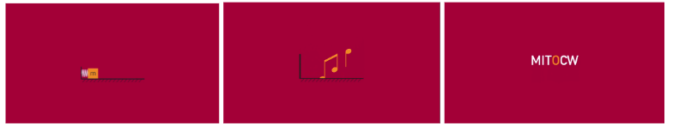
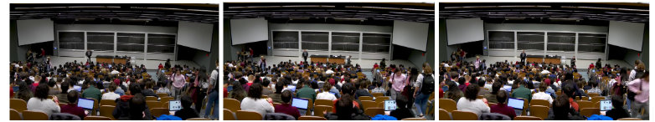
Case Studies
Approach 1: SR-aware video encoding for maximizing the storage saving.
Traditional video encoder is focused on optimizing visual quality rather than SR quality.
The effect of increasing in a video is heterogenous, as each frame has its unique contents.
For example:
Notes:
In their observation, the some frames are more sensitive to bitrate increase, others are not. They want to find the most suitable bitrate for each frame in terms of SR quality, that is SR-aware video encoding

Slide 10
Case Studies
Encode the frames that are not sensitive to bitrates in low bitrates to save storage.
They first obtain the SR quality results of each frame in a video at varying bitrates and use Group of Pictures (GOP) as the smallest unit to allocate bitrates.
Use greedy algorithm that selects the choice that yields the highest quality improvement at the same bitrate increase.
For example:
GOP
GOP
GOP
……
GOP
GOP
GOP
Video 1, 500kbps, LR
2 dB
GOP
GOP
GOP
……
GOP
GOP
GOP
Video 1, 1Mbps, LR
+3 dB
GOP
GOP
GOP
……
GOP
GOP
GOP
Video 1, 1.5Mbps, LR
5 dB
……
……
……
+2 dB
GOP
GOP
GOP
……
GOP
GOP
GOP
Video 1, 500kbps, HR
7 dB
GOP
GOP
GOP
……
GOP
GOP
GOP
Video 1, 1Mbps, HR
GOP
GOP
GOP
……
GOP
GOP
GOP
Video 1, 1Mbps, HR
Notes:
These results are utilized to identify the most suitable GOP bitrate to optimize storage while maintaining the same SR quality.
Didn’t say what bitrate interval is used (500kbps in example), and how to choose one.
The search space would be huge to find a global optimal. (don’t say if not asked)

Slide 11
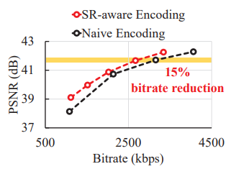
Case Studies
An SR-aware encoded video could be:
As a result, SR-aware encoding achieves up to 15% bitrate saving while maintaining the same SR. A comparation based on bitrates is:
GOP
GOP
GOP
……
GOP
GOP
GOP
Video 1, varying bitrates, LR
Notes:
No detailed explanation of this graph, an educated guess is the PSNR values are the average value among all GOPs of that bitrate.

Slide 12
Case Studies
Approach 2: Optimizing DNN complexity for reducing the retrieval cost.
Based on the observation that different frames have different DNN complexity sensitivity.
Similarly, they utilize the results of applying varying DNN of different complexities to determine which frames (presumed GOPs) have higher sensitivity.
Similarly, A greedy search algorithm is used since it’s computational expensive to find the global optimal.
GOP
GOP
GOP
……
GOP
GOP
GOP
Video 1, LR, infer with complexity 1
2 dB
+3 dB
GOP
GOP
GOP
……
GOP
GOP
GOP
Video 1, LR, infer with complexity 2
5 dB
GOP
GOP
GOP
……
GOP
GOP
GOP
Video 1, LR. Infer with complexity 3
+2 dB
GOP
GOP
GOP
……
GOP
GOP
GOP
Video 1, HR
7 dB
GOP
GOP
GOP
……
GOP
GOP
GOP
Video 1, HR
GOP
GOP
GOP
……
GOP
GOP
GOP
Video 1, HR
Notes:
A little bit vague here.
Based on a similar observation that the sensitivity of DNN complexity and SR quality varies from frame to frame, they “choose to use SR-aware optimal DNN complexity of each frame by assigning a higher DNN complexity to the frames that have higher SR quality improvement”.

Slide 13
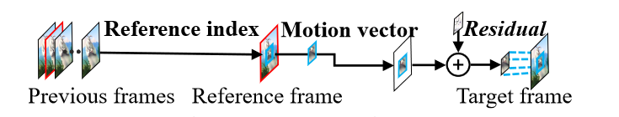
Case Studies
Approach 1: Anchor frame selection for reducing the retrieval cost.
According to [3], the frames that has high residual could be selected for inference and the other frames are up-scaled by a cache of retrieved selected frames and the SR-integrated decoder.
Notes:
This is another paper from this group, and what they found is that during inference, some frames are more efficient to be used than others, called anchor frames.
Together with other components in that system, they could make the inference faster (aiming for neural enhanced live-streaming)
Codec level information are involved.

Slide 14
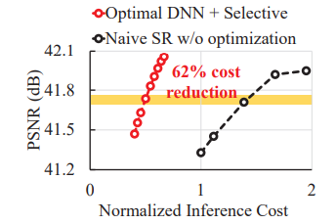
Case studies
Optimization: Optimizing DNN complexity and Anchor frame selection for reducing the retrieval cost.
Combined the two methods, the results show a reduction of inference cost of 62%.
Notes:
They combine this method by applying DNN complexity optimization only to selected anchor frames.

Slide 15
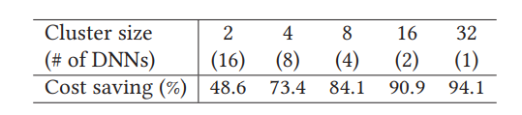
Cost-benefit Analysis
AWS’s multi-tiered cloud storage and AWS g5dn.xlarge spot instance ($0.302/hour) are used.
As for model training, they assumed a amortized training cost for content-aware super-resolution of group of videos is negligible.
They show this by demonstrating how the cost could be amortized by applying one content-aware model to a video cluster containing multiple videos. Specifically, the group is Twitch videos tagged as “Valorant”.
Additionally, they assume that the video’s view pattern is predicted and cost of profiling for optimization are negligible too.
Therefore, only inference and storage cost are considered in this analysis.
Notes:
Like previously mentioned, only inference and storage cost are considered.

Slide 16
Cost-benefit analysis
The analysis is set up by generating low-resolution videos from high-resolution videos and use them for comparison.
First, NCS determines the SR-aware bitrate by using a DNN with arbitrary complexity and then compresses the video in LR.
Next, NCS identifies anchor frames by the residual of the compressed video and subsequently determines the optimal SR-aware DNN complexity only for those frames.
Notes:
Refer back to previous slide 14 (combination of the two methods)

Slide 17
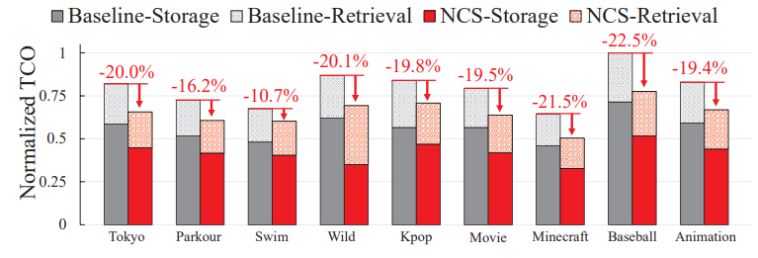
Cost-benefit analysis
In comparison, the baseline is storing the original resolution encoded video in the cheapest storage among AWS multi-tier storage with a considering of access interval of 60 days.
The evaluation shows a TCO saving up to 22.5%
Notes:
From this graph, the NCS-retrieval cost is not much more expensive than Baseline-retrieval. One possible explanation is the normalized size of the video is around 10GB and the inference time is less than 1 hour.

Slide 18
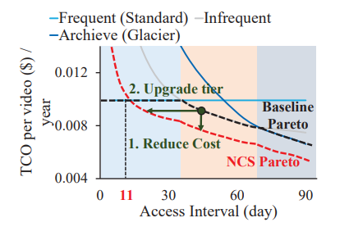
Cost-benefit analysis
The Baseline pareto versus NCS pareto shows a 14% reduction of all 50k videos
Notes:
They don’t list the detailed steps of the calculation getting the number 14. Possibly a estimated value because doing experiment on all 50k videos could be expensive (15000$ if the inference time of videos are about 1 hour)

Slide 19
Discussion
Future work mentioned in the paper:
Optimization profiling: a possible method to predict the SR results without direct inference.
Joint optimization: consider all methods as a complete system and the mutual dependency between them.
Video clustering: metadata-based and DNN-based methods have their own limitations.
Cold video prediction
Image downscaling: Use DNN-based method instead of bicubic interpolation to reduce loss of information.
Notes:
There are already papers trying to solve this (optimization profiling)

Slide 20
References
[1] Neural Cloud Storage: Innovative Cloud Storage Solution for Cold Video.
[2] Popularity Prediction of Facebook Videos for Higher Quality Streaming
[3] NeuroScaler: Neural Video Enhancement at Scale.

