Slide 1
Cryptographic Randomness on a CC2538:
A Case Study
25 October 2016
Yan YAN, Elisabeth OSWALD, Theo TRYFONAS

Slide 2
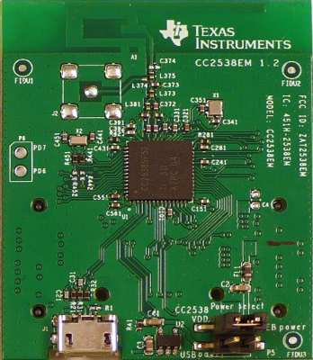
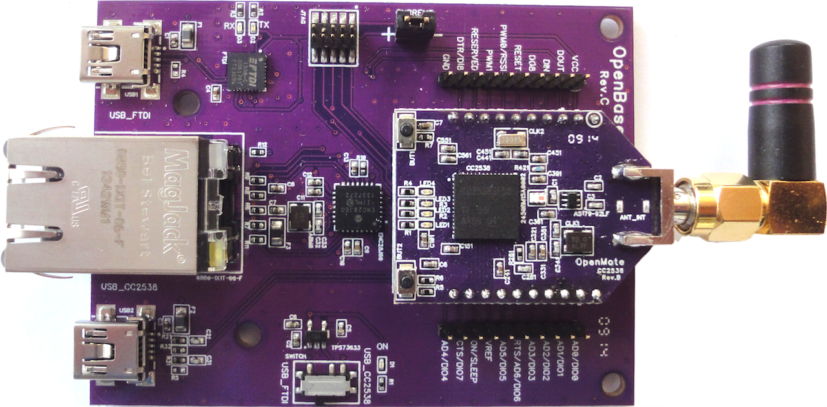
CC2538
(http://www.ti.com/product/CC2538)
25 October 2016
ARM® Cortex®-M3
512KB, 256KB or 128KB Programmable Flash
2.4-GHz IEEE 802.15.4 Compliant RF
Security Hardware Acceleration
Low Power
Zigbee/6LoWPAN Support

Slide 3
Random Number Generators (RNGs)
True RNG (TRNG)
  Samples entropy in physical source
Pseudo RNG (PRNG)
  Seeded by TRNG
  Efficient
Cryptographic Usage:
  Key Generation, etc

Slide 4
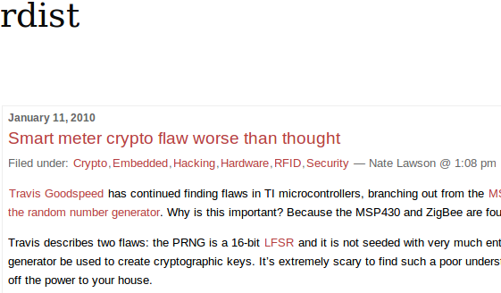
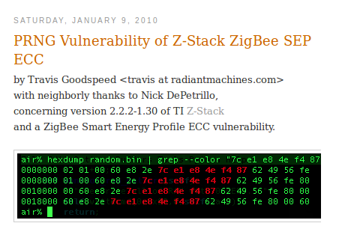
Sad Stories...

Slide 5
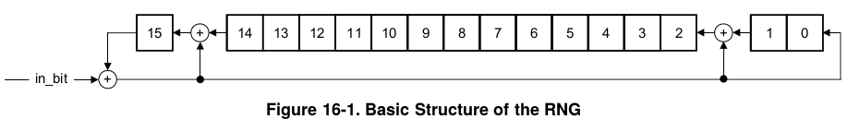
CC2538 PRNG
Coding Issues in Contiki driver
16 bit LFSR (CRC16) as PRNG
Far NOT ENOUGH for cryptographic security!

Slide 6
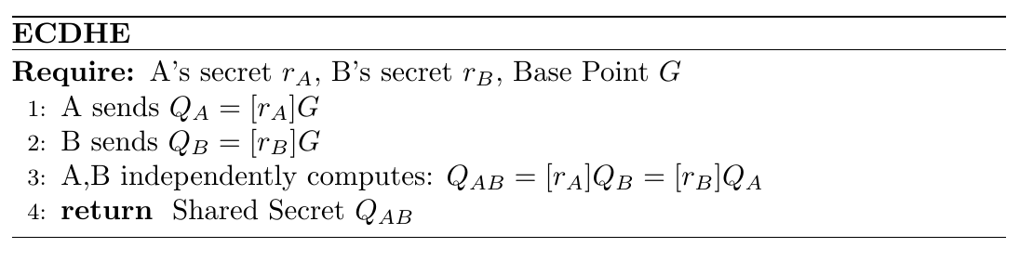
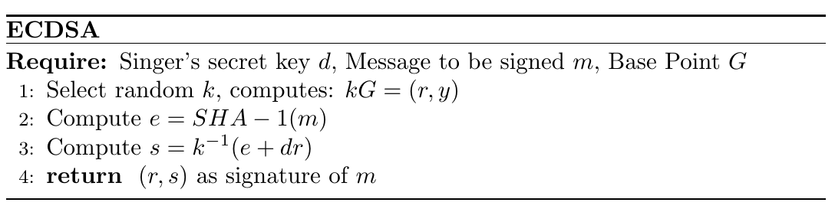
e.g.: Broken ECDHE/ECDSA in DTLS (tinydtls)
Build Key Pair lookup table: 65536 entries
Revert r_A from Q_A and r_B from Q_B.
Compute Q_{AB}.
Revert k from r.
Extract d given (s,k,e,r).

