Slide 1
First Year Review
Information Leakage in Sensor Network Traffic
Yan Yan

Slide 2
Review
May 2014 – Decmber 2014
  Background of sensor network
    Contiki
    6lowPAN, CoAP, DTLS
    tinyDTLS
  Existing attacks:
    Content length fingerprinting
      Generally applicable
      Application specific
      Affected by dynamic contents like ads
    Mutual Information analysis
      Good coverage over multiple observable variables
      Computational heavy

Slide 3
Review
  More existing attacks:
    Compression ratio attack: BREACH, CRIME
      Efficient
      Practically harmful
      Prevented by disabling compression
    Padding Oracle and Lucky 13
      Efficient
      Fixed in latest TLS (Padding Oracle)
      Requires specific setup (Lucky 13)
      Latency sensitive (Lucky 13)

Slide 4
Review(cont)
Reflection
  Applications are mostly experimental
  Not much security took into concern
Plan
  Start with some simple applications
  Demonstrate the potential of similar attacks

Slide 5
Recent Work
January 2015 -
  Developed two toy applications:
    Odd or Even
    Leaky Coffee
Traffic analysis
  Timestamp*
  Fields
  Length

Slide 6
Environment
Ubuntu 14.04
Locallink
Tinydtls-0.8.1
  Pre-shared key
  TLS_ECDHE_ECDSA_WITH_AES_128_CCM_8
    There is no padding!
    Plaintext Length = DTLS length field - 17

Slide 7
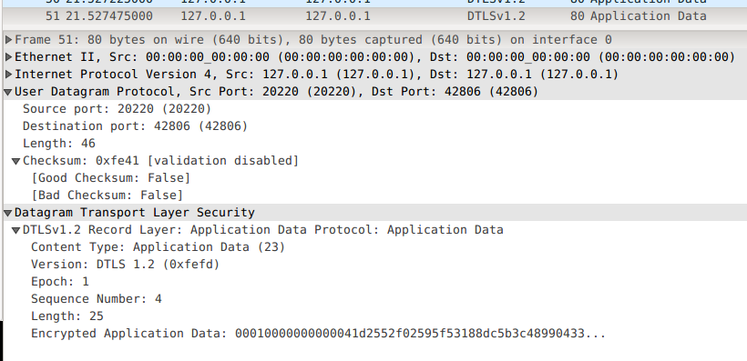
Packet

Slide 8
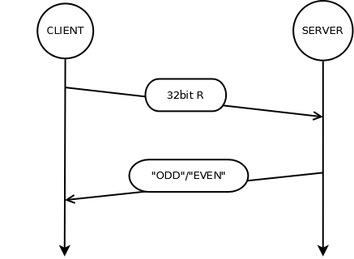
Odd or Even

Slide 9
Odd or Even
No padding,
“EVEN” is 1 byte longer than “ODD”
Plaintext revealed by length!
But all other fields seemingly leaks nothing...

Slide 10
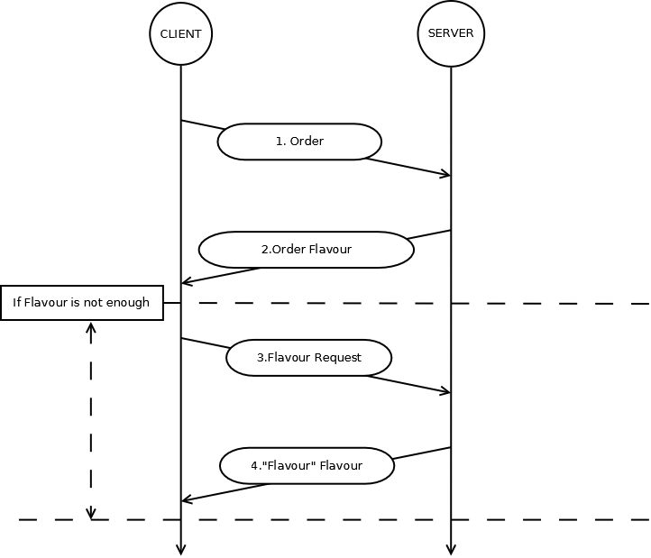
Leaky Coffee

Slide 11
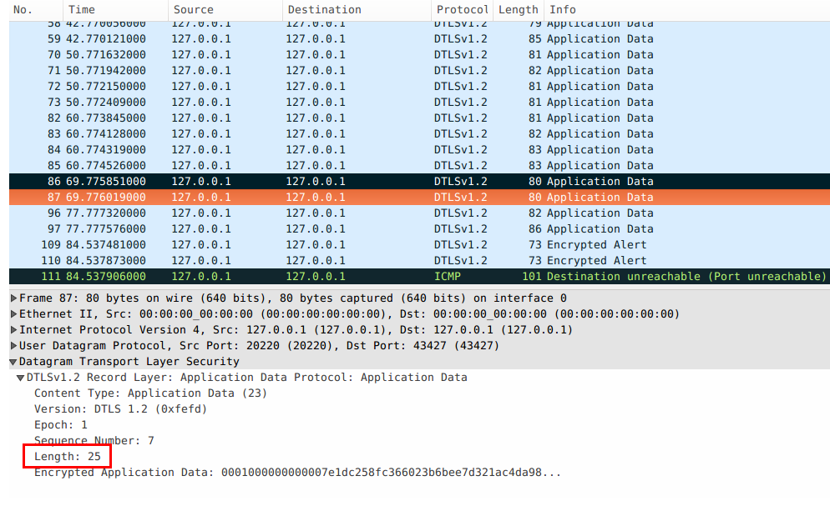
Leaky Coffee

Slide 12
Leaky Coffee
Existence of a packet:
  A session taking place
Timestamp:
  Segmenting packets by session
Length:
  Constructing a channel to “decode” plaintext

Slide 13
Leaky Coffee
W(Length|Order) | 5 bytes | 8 bytes | 9 bytes | Prob(Order)
“AMERICANO” |  |  | 1 | 1/4
“CAPPUCINO” |  |  | 1 | 1/4
“MOCHA” | 1 |  |  | 1/4
“ESPRESSO” |  | 1 |  | 1/4
Plaintext-Length channel for Order
  Prob(Order) is known from the implementation
  Revert it to construct our “decoding” channel!

Slide 14
Leaky Coffee
W(Order|Length) | “AMERICANO” | “CAPPUCINO” | “ESPRESSO” | “MOCHA”
5 bytes |  |  |  | 1
8 bytes |  |  | 1
9 bytes | 1/2 | 1/2
This channel decodes length to Order
The attack can be further improved by analysing packets jointly

Slide 15
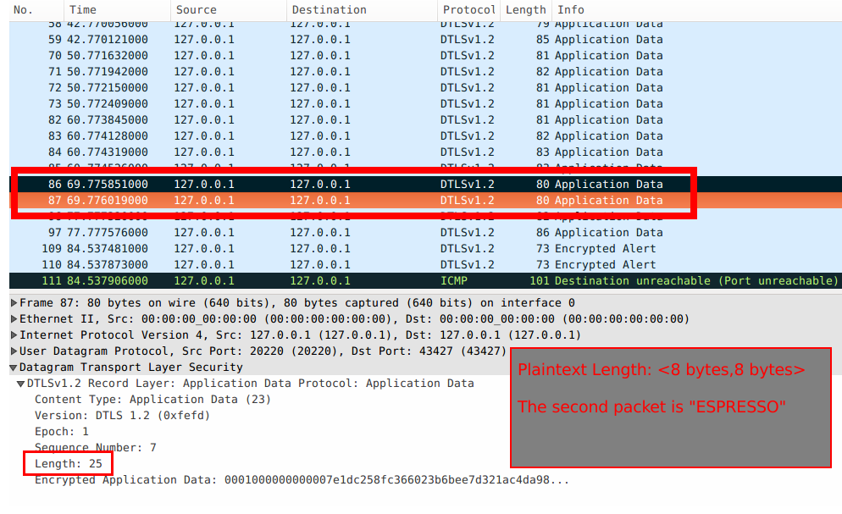
Leaky Coffee

Slide 16
Reflection
Similar to content length fingerprinting
  DTLS instead of TLS
  No noise
Constrains
  Application too simple (low entropy plaintext)
  Some other cipher suites have padding
  Timestamp may be affected by underlying protocols
  Requires pre-knowledge of plaintext distribution

Slide 17
Future Plan
Wrap up the “toys”
  Different pre-knowledge?
  Other types of attack?
  Countermeasure?
Other DTLS implementation
  e.g. PolarSSL (https://tls.mbed.org/)
Apply the attacks on some real world traffic
  (If we can get in touch with any...)

Slide 18
Other Activities
Real World Crypto 2015
  06/01/2015 ~ 09/01/2015

