Slide 1
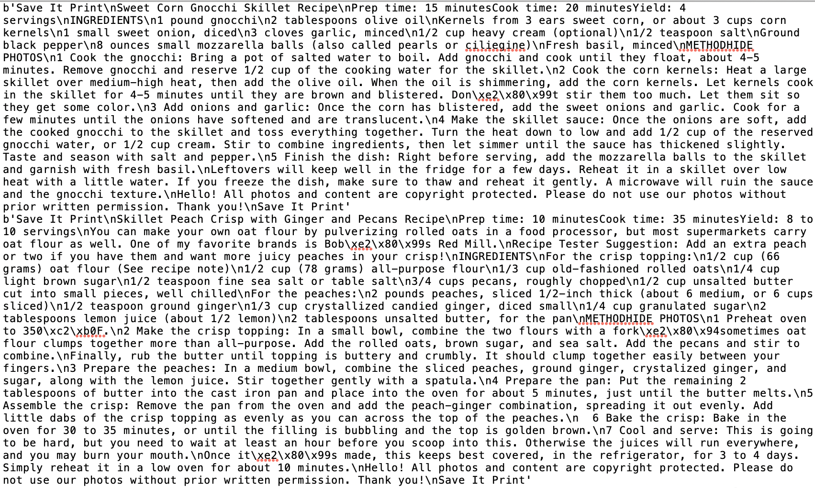
Data Extraction
4,660recipes were scraped from simplyrecipe.com
The data we needed:
Title
Prep time
Cook time
Total time
Ingredients
Number of Ingredient
Method
Number of Cooking Step
Process
Extract the data – python
Create the dataframe – Pandas
Save the data – CSV and JSON format
Upload the data - MongoDB

Slide 2
Analyze Raw Data
Title
Prep time
Cook time
Ingredient
First recipe
Method
Second recipe

Slide 3
Extracting process
Read Text Raw data
Extract Prep time and Cook time
Count Number of Ingredient
Remove incomplete Data
Convert hours to minutes
Extract Method
Separate each recipe
Calculate Total time
Count the Number of Cooking steps
Extract Title
Extract Ingredient
Python was used

Slide 4
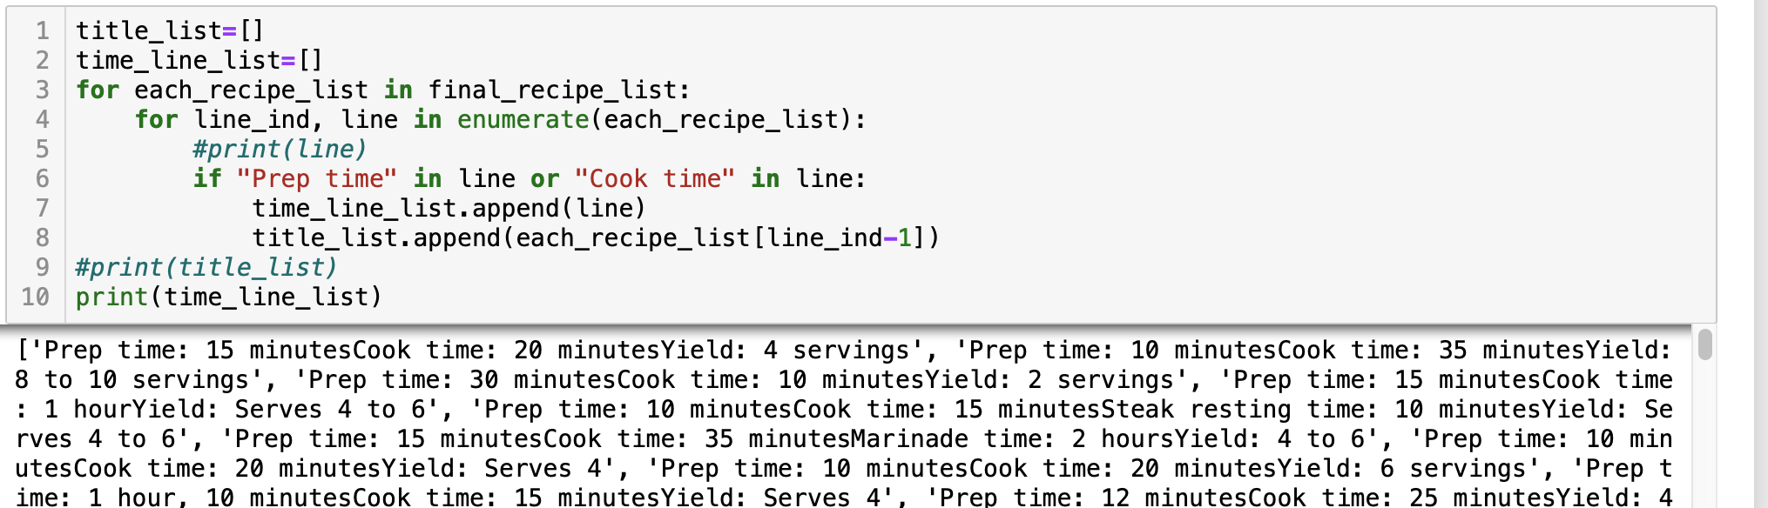
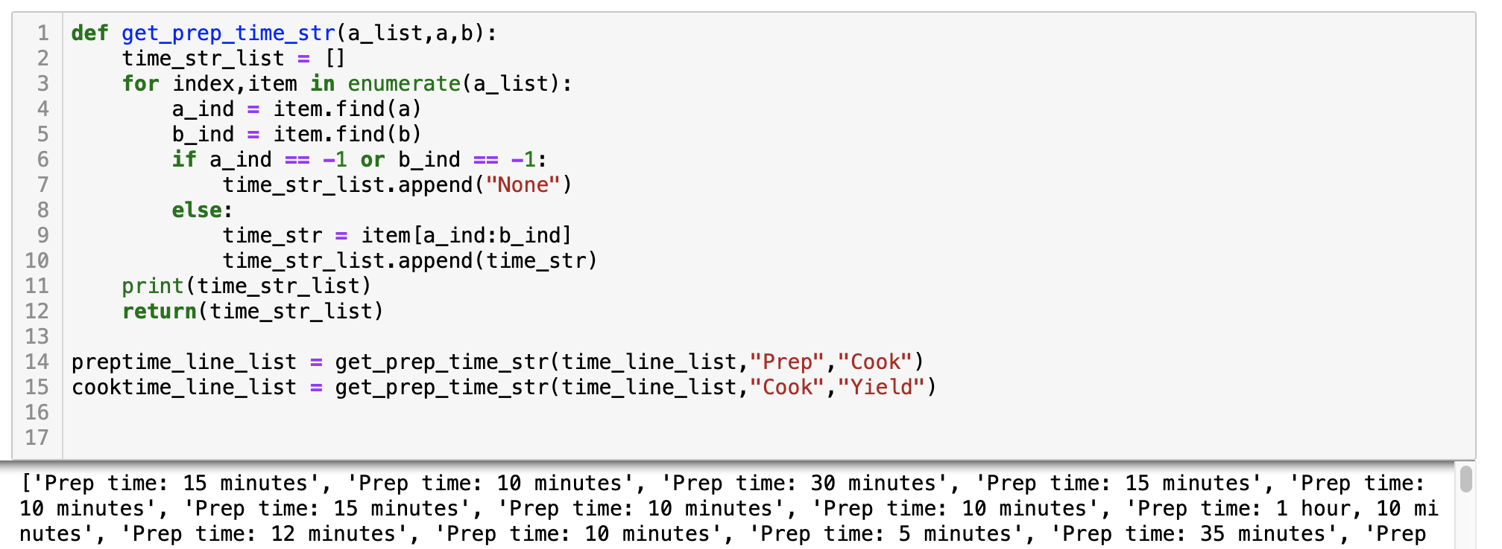
Example Code – Extract Prep time and Cook time

Slide 5
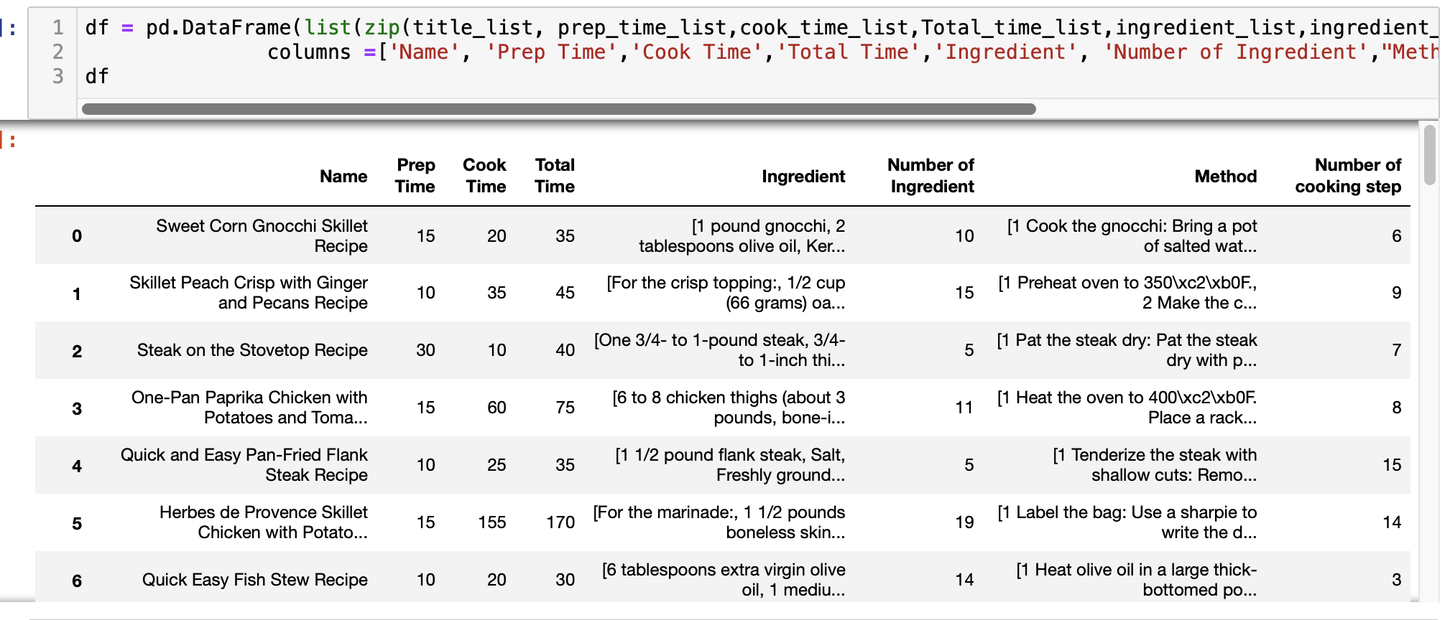
Create DataFrame
Pandas was used.
The dataframe was created from lists made at the previous extraction.

Slide 6
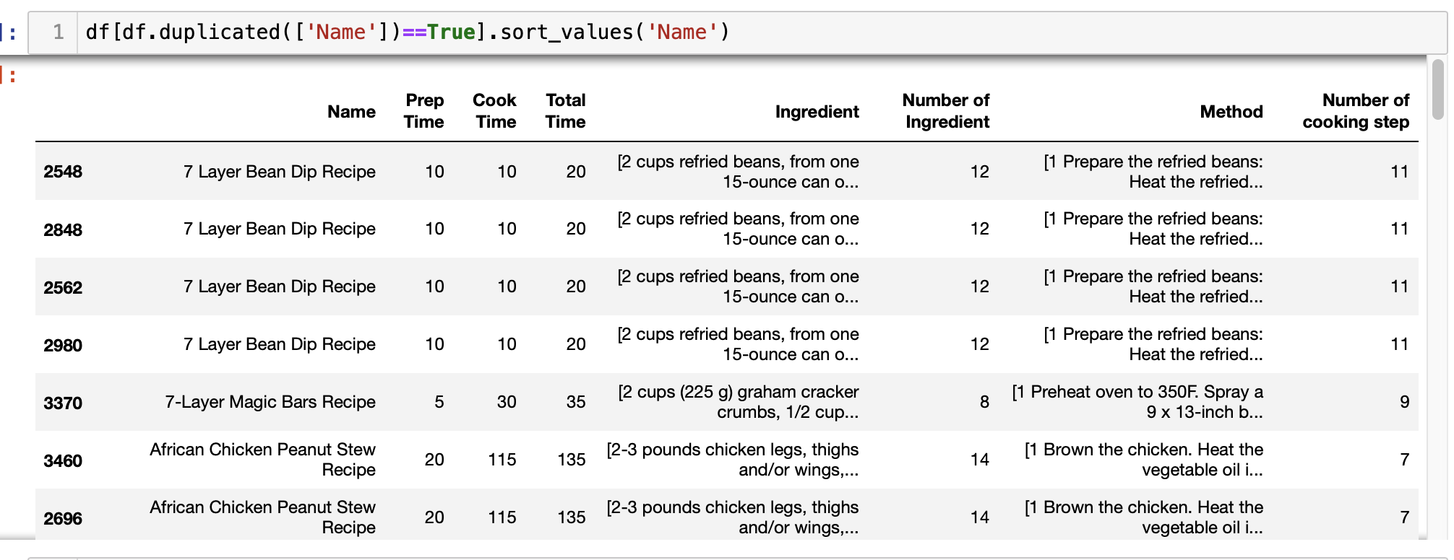
Remove Duplicated Data
Out of 3503 recipes, 1945 duplicated recipes were removed.

Slide 7
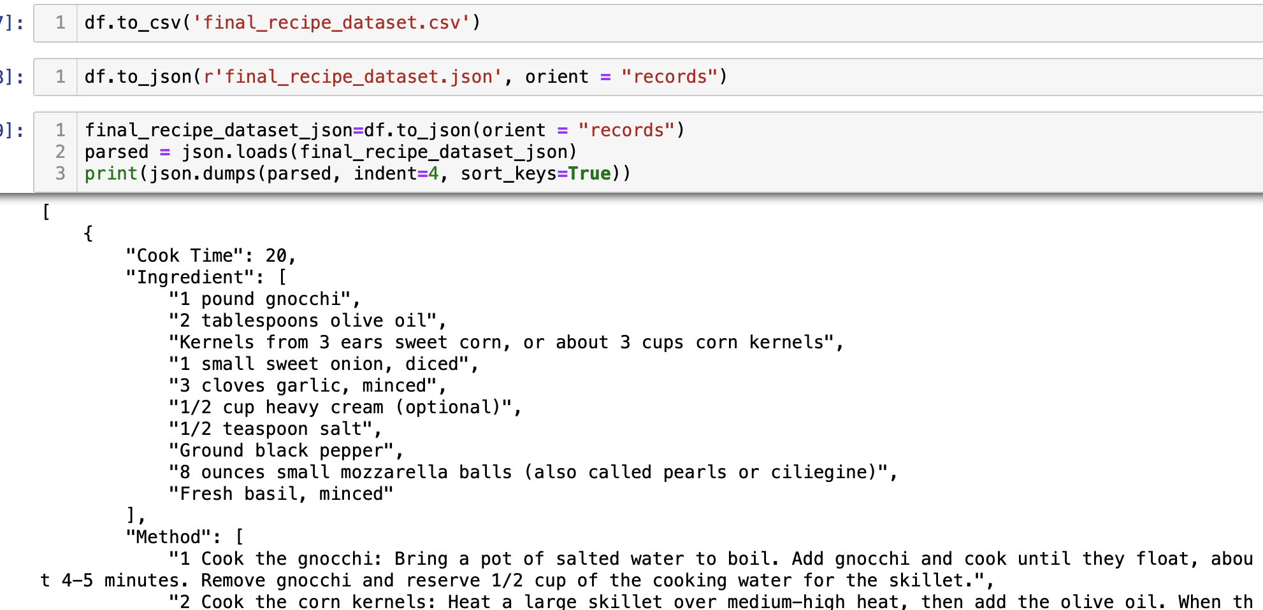
Save the data as CSV and JSON format
Total 1558 recipes were saved as csv and json format

Slide 8
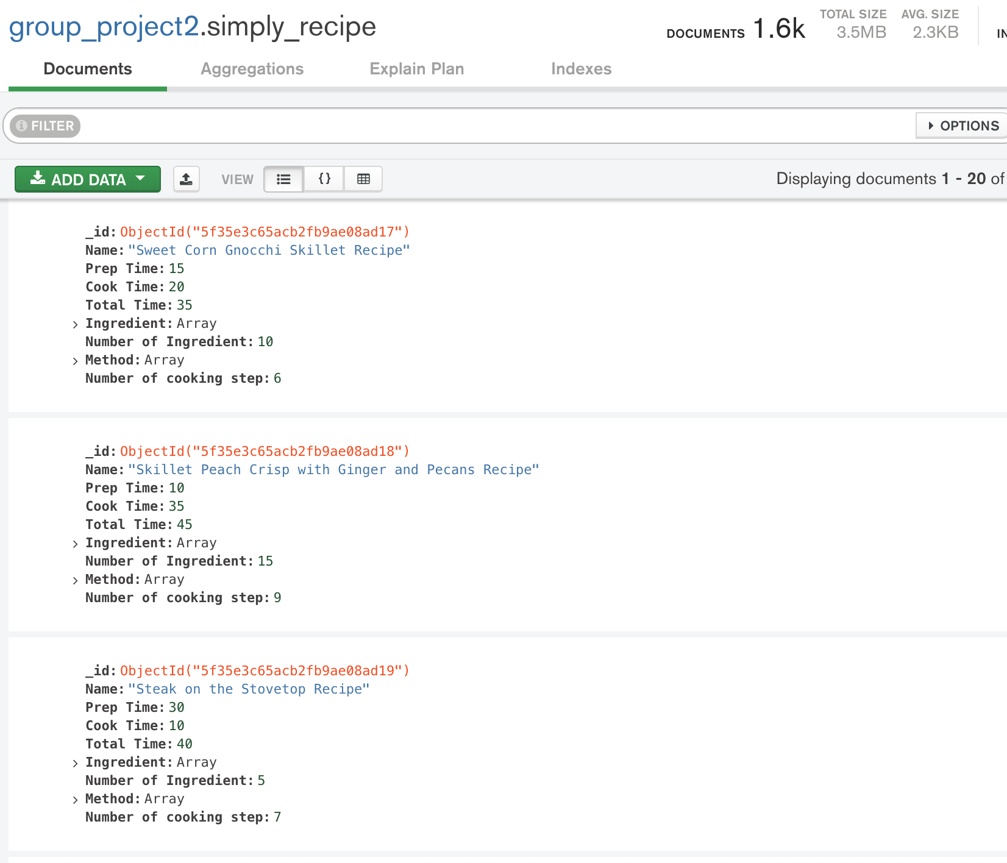
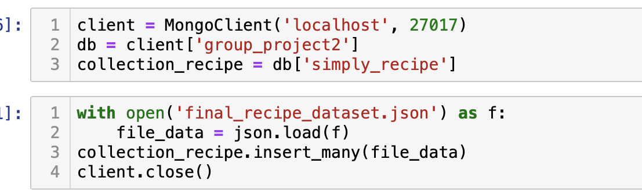
Upload the data to MongoDB
All 1588 data were uploaded
and saved in MongoDB

