Slide 1
Trump Campaign and Artificial Intelligence

Slide 2
Did AI help Trump to win the election?
Deciding factor or merely increased efficiency?
Extent unkown
Machine Learning for optimised ads
Geographical data
Bots?

Slide 3
Cambridge Analytica
Company based in London
Specialised in automatic tracking and analysing social media activities
Optimisation of advertising to match (political) identity
Steve Bannon, former vice president
Funded by Robert Mercer, a friend of Trump
Involvement in Brexit campaign

Slide 4
AI methods in the Trump Campaign
Use of Facebook and E-Commerce data to cluster voters into echo chambers
Target potential Trump supporters to vote
Discourage potential Clinton voters not to vote
Extracted data of 50 million people from Facebook through questionnaires and ‘likes‘

Slide 5
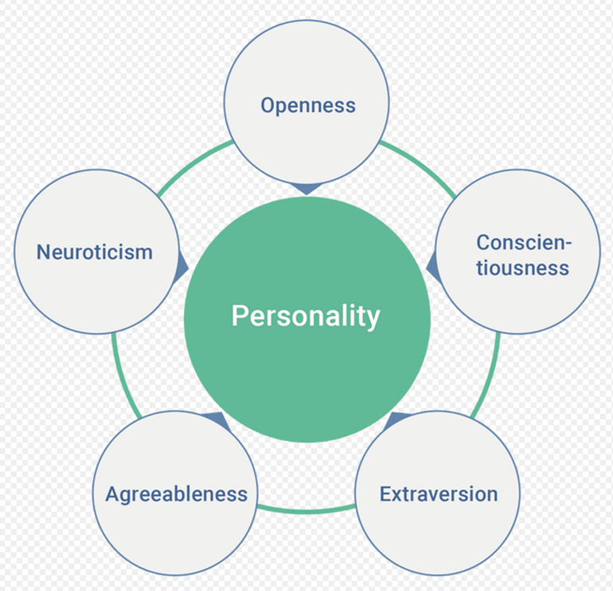
OCEAN SCORE
Notes:
openness to experience (inventive/curious vs. consistent/cautious)
conscientiousness (efficient/organized vs. extravagant/careless)
extraversion (outgoing/energetic vs. solitary/reserved)
agreeableness (friendly/compassionate vs. critical/rational)
neuroticism (sensitive/nervous vs. resilient/confident)^{[4]}

Slide 6
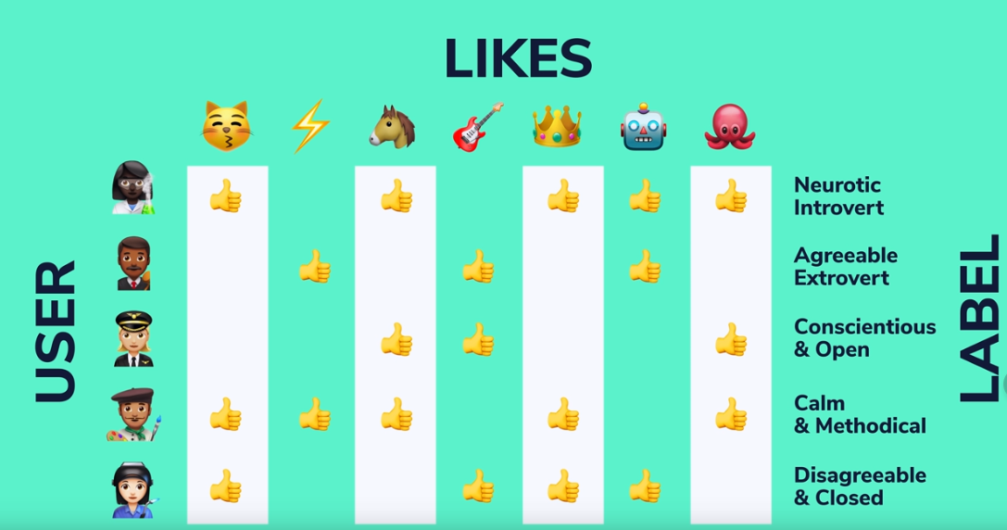

Slide 7
Business vs Politics
Resemblance to customer segmentation, marketing etc.
Classification problem
Business logic applied to politics?

Slide 8
Ethical Considerations
Advertising vs. Manipulation?
Should there be different rules for business and politics?
Opinions?

Slide 9
Think twice before finding out which Disney character you are!

