Slide 1

Credit Card Approval Predicition
A Classification Model
Final Project
Ironhack Data Analytics Bootcamp
Severin Altmeyer

Slide 2
Overview & Goals
Goal 1
Predict approval or decline of credit card application
Identify socioeconomic patterns among people with or without eligibility
Goal 2

Slide 3
Variable to Predict
Credit Card Eligibility
Approval or decline
(Yes/No -- 0/1)
Created by payment record data of varying number of months of credit card history

Slide 4
Socioeconomic Features
Gender
Car
Realty
Children
Income
Income Type
Education
Familiy Status
Housing
Age
Employed (Months)
Work Phone
Phone
Email
Occupation
No. Family Members

Slide 5
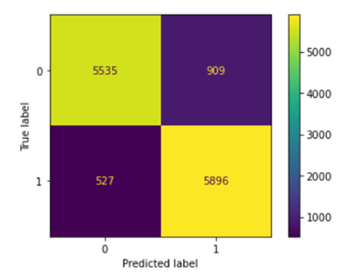
Model Performance
Overall Score: 0.9012
RMSE : 0.3340

Slide 6
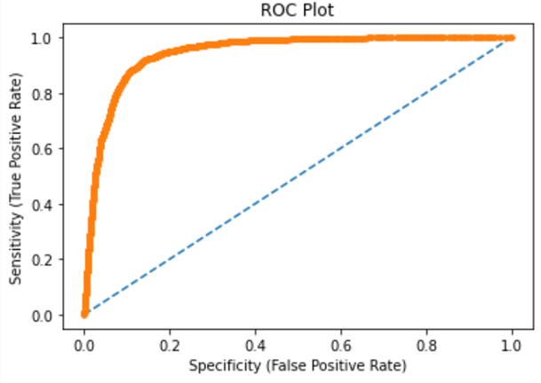
ROC Curve

Slide 7
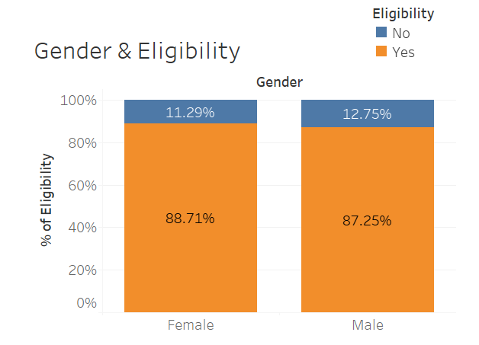
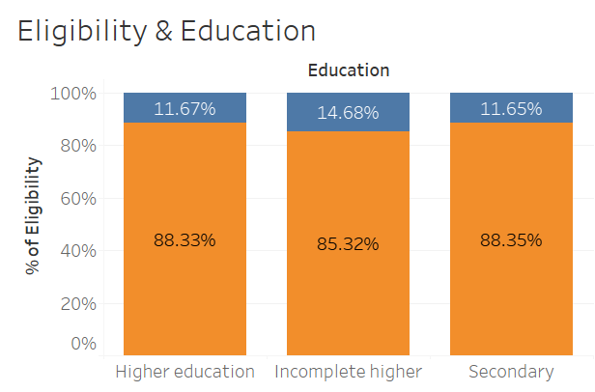
Features - Gender & Education

Slide 8
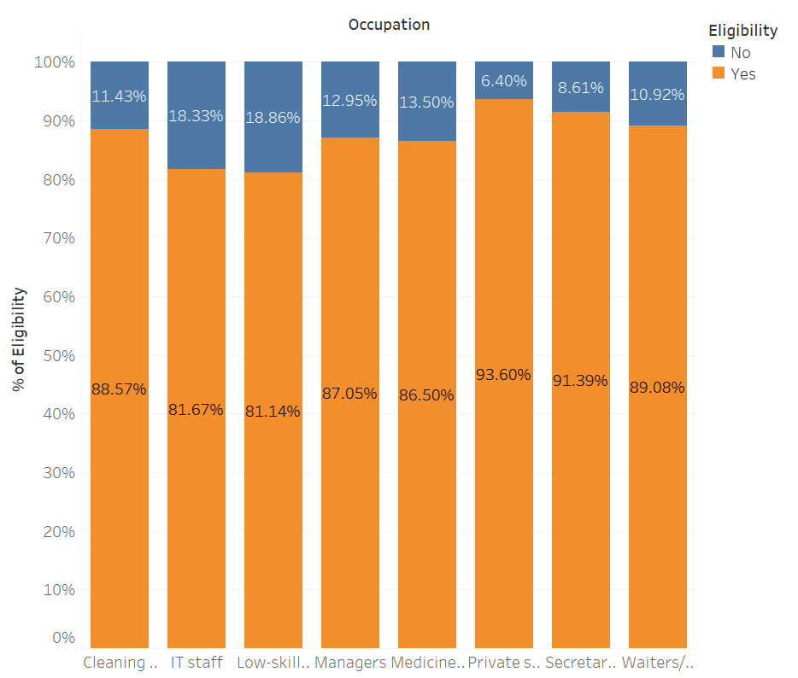
Features - Occupation

Slide 9
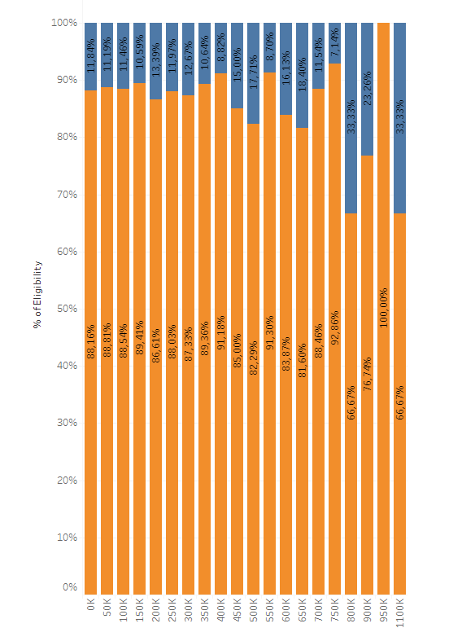
Features – Income

Slide 10
Conclusions
There is more than meets the eye!
Advanced classification models identify patterns 'invisible' at first sight

Slide 11

Business Case
There is a Business Case!
Use model to get first insights and impressions of new customers
Engage potential customers with a negative result in personal meetings
Modelling may reduce some social bias while reducing risk for the bank

Slide 12


