Slide 1
BEAZER HOMES
CALANCE
President's Letter
Scout Integration Vision
The full land acquisition lifecycle — research, comparison,
justification, and AI-generated approval letters,
natively embedded in Scout's LAR.
March 2026
CALANCE × BEAZER HOMES | PRESIDENT'S LETTER | MARCH 2026

Slide 2
THE VISION
Scout: An End-to-End Land Acquisition Platform
Every stage of a deal — from first research to final approval — in a single, connected workflow
01
02
03
04
05
INPUT
LAR CRITERIA
TOP
PROFORMA
PRESIDENT'S LETTER
Research &
Input
Comparison
& Analysis
Triangle of
Potential
Financial
Model
President's
Letter ✦
▶
▶
▶
▶
Site data, community
context, deal details
Market comps,
, resiliency scoring
Land value justification
framework
Returns, absorption,
proforma
AI-generated approval
letter — NEW
What we're building now
CALANCE × BEAZER HOMES | PRESIDENT'S LETTER | MARCH 2026

Slide 3
WHERE WE STARTED
From Standalone Prototype to Native Product
The AI capability is proven — now we embed it directly into the Scout workflow
PROTOTYPE · TODAY
INTEGRATED PRODUCT · TARGET
Files
User manually uploads Excel proforma + prior Word letter examples
Data
AI reads directly from Scout deal data — no uploads needed
AI Model
GPT-4.1 mini
AI Model
Claude Sonnet 4.6 — vision, large context, superior synthesis
Location
Standalone app — lives outside Scout entirely
Location
Native tab in LAR — President's Letter tab alongside Input, TOP, Proforma
▶
Data
Static — only what's in the uploaded files at that moment
Data
Live — always reflects current Scout deal data + supplemental inputs
Output
Draft text returned; no save, no workflow, no version tracking
Output
Draft opens in a full rich-text editor, inline AI assistant for refinement
Approval
No approval workflow — user copies output manually
Approval
Built-in workflow: Draft → In Review → Approved, with full audit trail
CALANCE × BEAZER HOMES | PRESIDENT'S LETTER | MARCH 2026

Slide 4
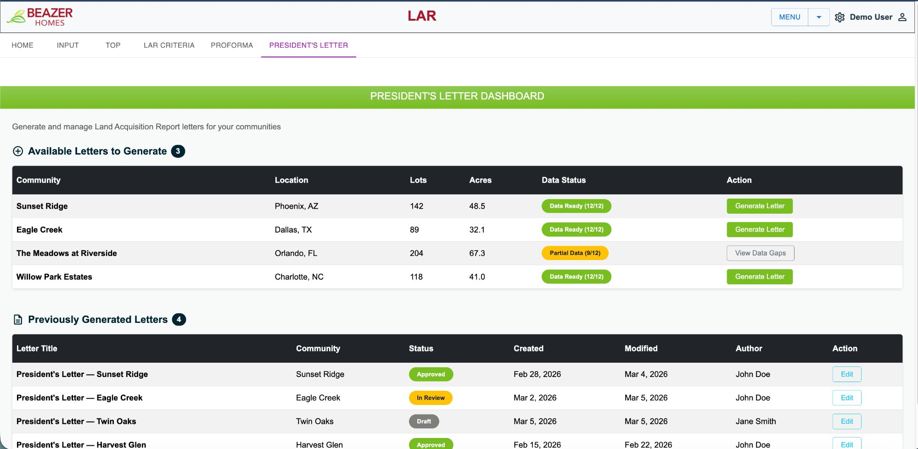
SCREEN 1 / 3
President's
Letter
Dashboard
All deals
in one view
See every community — data readiness, lot count, location — at a glance from a single dashboard
Data Ready
status
Green = all required data points confirmed. Amber = partial data — system blocks generation until resolved
One-click
generation
Click 'Generate Letter' and the AI agent synthesizes all Scout data into a structured draft
Letter
history
Previously generated letters tracked by status: Draft, In Review, or Approved — with author and dates
CALANCE × BEAZER HOMES | PRESIDENT'S LETTER | MARCH 2026

Slide 5
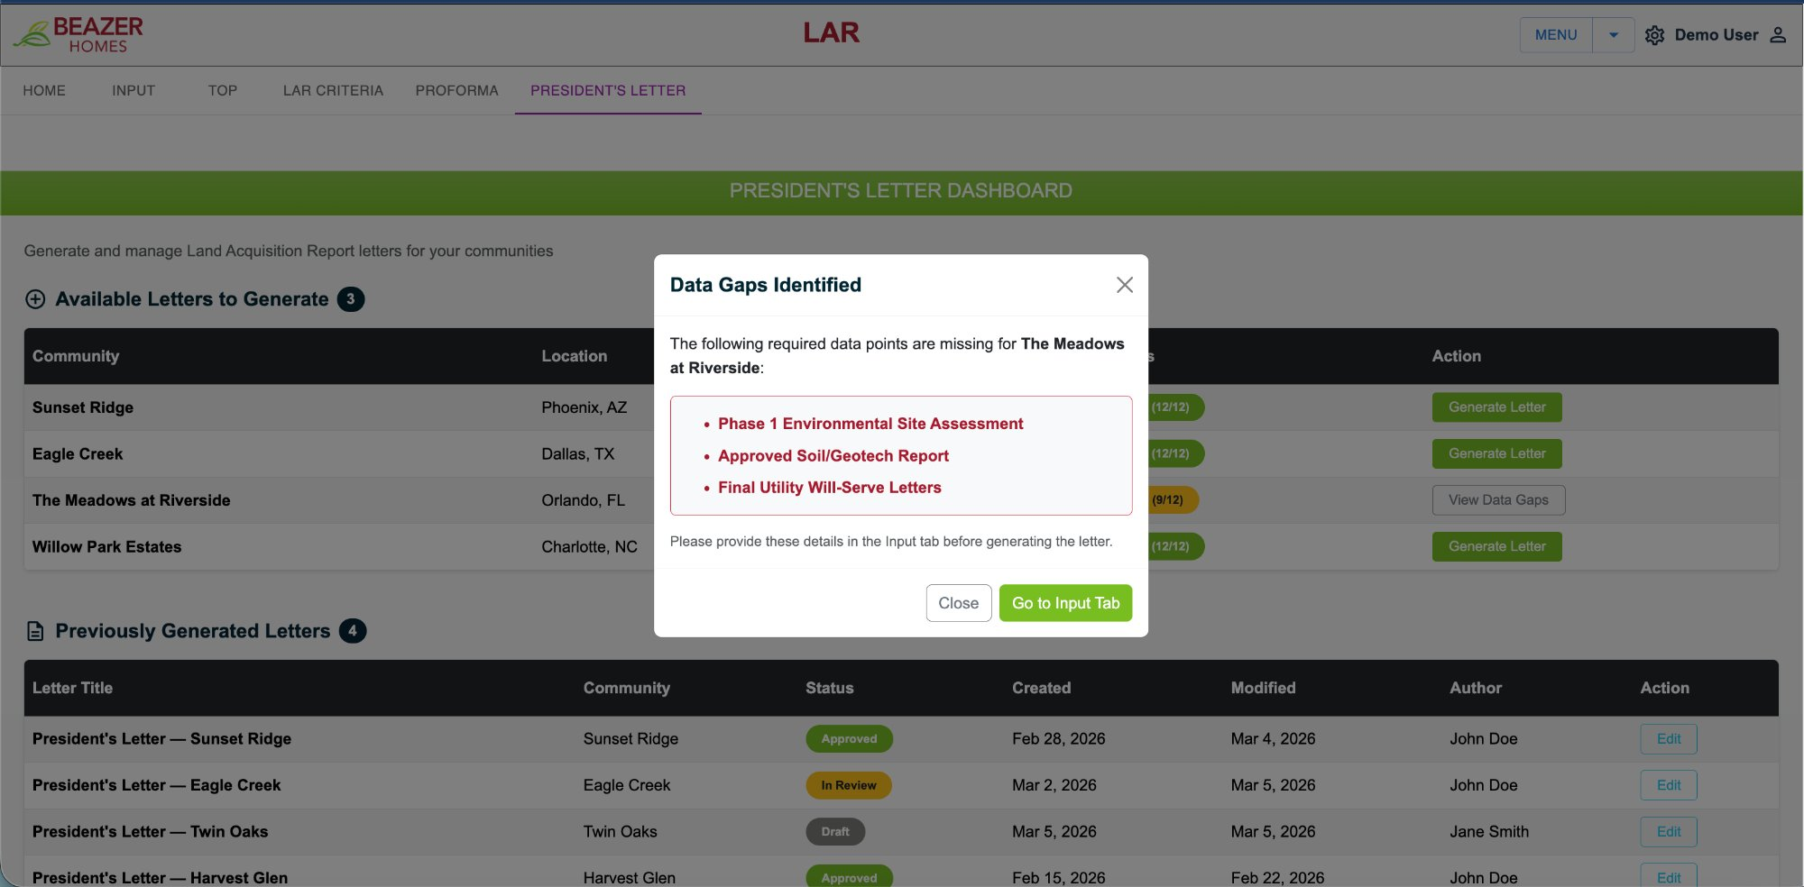
SCREEN 2 / 3
Intelligent
Data Gap
Detection
Knows exactly
what's missing
Before generation, the system validates all required data points against the deal record in Scout
Named fields,
not vague errors
Lists precisely which documents are absent — Phase 1, Soil/Geotech Report, Utility Will-Serve Letters
Guided
resolution
'Go to Input Tab' routes the user directly to the specific field needing attention
Quality
gate
No letter is generated until requirements are satisfied — enforces data completeness before AI runs
CALANCE × BEAZER HOMES | PRESIDENT'S LETTER | MARCH 2026

Slide 6
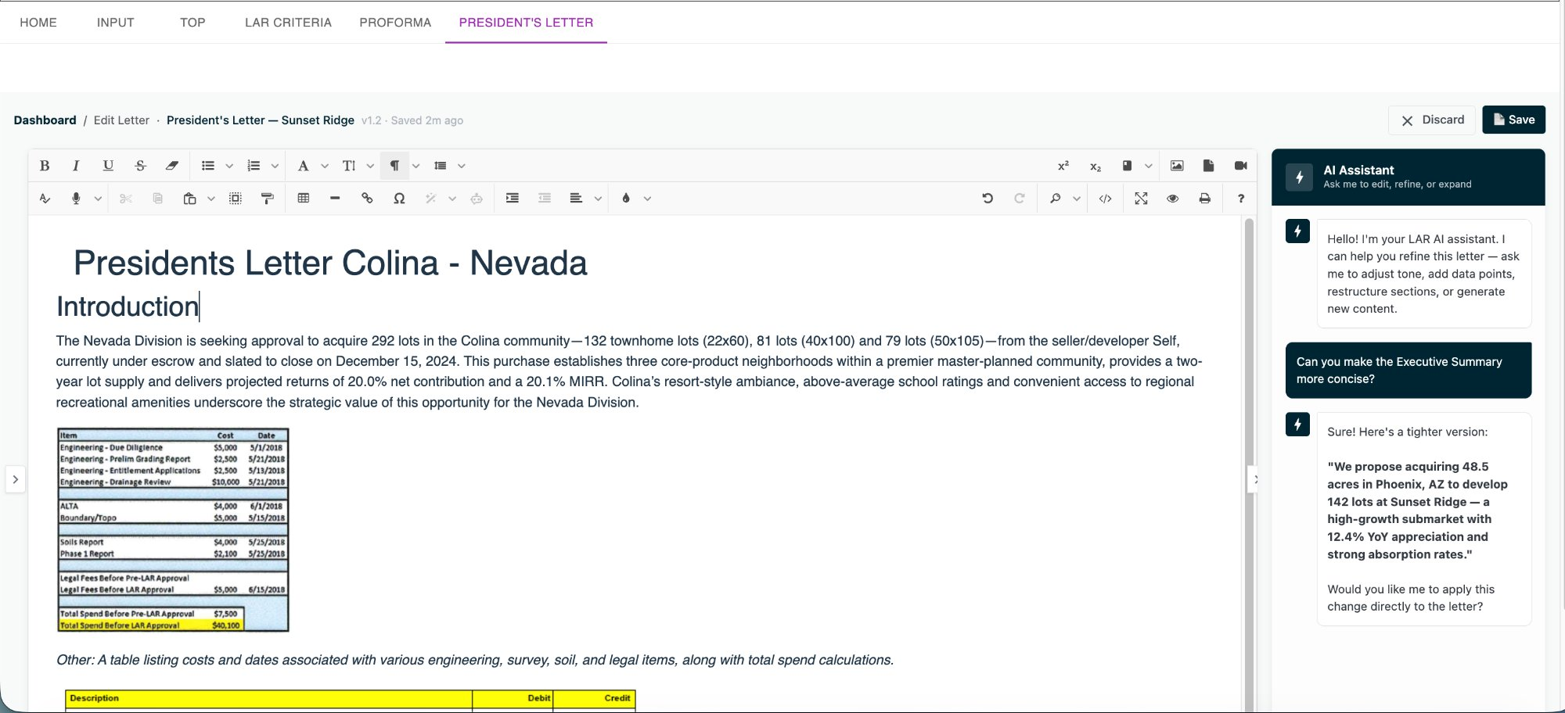
SCREEN 3 / 3
AI Letter
Editor &
Assistant
Generated
in-app
Letter draft opens immediately in a full rich-text editor — no downloading, no copy-paste, no separate tool
Inline AI
assistant
The AI assistant panel knows the deal context — ask it to tighten a section, add a data point, or restructure
Version
history
Every edit saves a version (v1.1, v1.2…) with timestamp and author — full audit trail from day one
Approval
workflow
Status progresses Draft → In Review → Approved, visible to the entire team across communities
CALANCE × BEAZER HOMES | PRESIDENT'S LETTER | MARCH 2026

Slide 7
HOW WE BUILD IT
Technical Approach — Three Guiding Principles
Clean, additive integration that protects the Scout platform you already rely on
01
02
03
🔒 Zero Impact on
Existing Scout
🗄 New Data, Cleanly
Separated
⚡ Claude AI Powers
the Agent
No changes to the .NET backend, no edits to existing database tables, no risk of regression in current workflows.
The President's Letter service sits alongside Scout — reading data via API, not modifying it.
Supplemental inputs not yet in Scout — Phase 1 assessments, utility will-serve letters, site imagery — are stored in new tables linked by deal ID.
Existing schema is untouched.
Upgrading from GPT-4.1 mini to Claude Sonnet 4.6 — a context window large enough for complete 40-page letters, vision capability for maps and imagery, and significantly better narrative output.
CALANCE × BEAZER HOMES | PRESIDENT'S LETTER | MARCH 2026

Slide 8
SCOPE & TIMELINE
Approximately Six Weeks from Green Light to Production
Three parallel work streams — AI agent, backend infrastructure, and UI — built simultaneously
~223 hrs
~6 Weeks
0
Parallel streams mean ~6 weeks calendar time — not 223 hours end-to-end. AI agent, backend, and UI work simultaneously.
Combined effort
across all streams
Calendar time to
production-ready
Changes to existing
Scout .NET code
Week 1
Wk 2–3
Wk 4–5
Week 6
Kickoff &
Data Mapping
Parallel
Build
Integration
& Refinement
QA &
Launch
Align with Jesse & Taylor on letter sections
AI generation pipeline — Scout → Claude → draft
Connect AI agent to live Scout data
End-to-end testing across communities
▶
▶
▶
Map Scout DB to letter data requirements
New DB tables + Azure Functions service
Inline AI assistant + editor integration
UAT with Beazer team
Define schema for supplemental tables
Dashboard UI + letter editor shell
Data gap detection UI + guided resolution
Deployment & go-live
CALANCE × BEAZER HOMES | PRESIDENT'S LETTER | MARCH 2026

Slide 9
What We Need From Beazer
Four decisions that unlock the path from prototype to production
01
Roxanne → Calance
02
Roxanne → Jonathan
Claude API Key Access
Authorization to Engage Taylor & Jesse
Upgrade from GPT-4.1 mini to Claude Sonnet 4.6. Significantly better narrative quality, vision support for maps and site imagery, and context window large enough for complete 40-page letters.
Jesse is the President's Letter subject matter expert. We need his guidance on letter sections and which data points map to Scout vs. supplemental sources before we finalize the build.
03
Beazer Architecture
04
Roxanne → Team
Approval of Additive Database Approach
Priority Direction: Complete BW First
New supplemental tables linked by deal ID — no changes to existing Scout .NET entities or schema. Clean, low-risk separation of the new capability from the existing platform.
Recommendation is to finish Builder Warranty and hand off to Venice, then pivot fully to President's Letter. This eliminates context-switching and allows the team to build with full focus.
CALANCE × BEAZER HOMES | PRESIDENT'S LETTER | MARCH 2026

