Slide 1
Comparing Python and Java for a small-scale app
Xavier Gray

Slide 2
Overview
Introduction
Objectives
Demonstration
Implementation
Analysis
Conclusion
Questions

Slide 3
Why Python?
What are the strengths of Python?
When would you choose Python over another language?

Slide 4
Objectives
Compare the running speeds of a nearly-identical program in Java and Python
Compare amount of code needed in Java and Python
Compare readability of Python and Java code

Slide 5
Java and Python
Java
Python
Strongly typed
Duck Typing

Slide 6
Demo

Slide 7
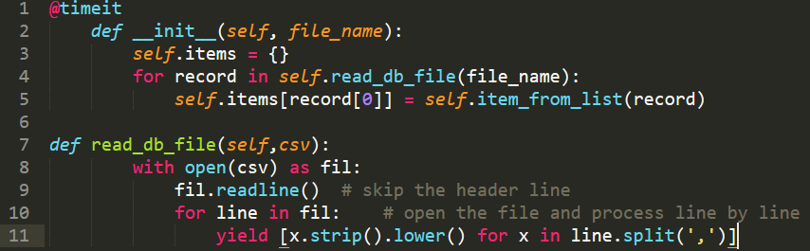
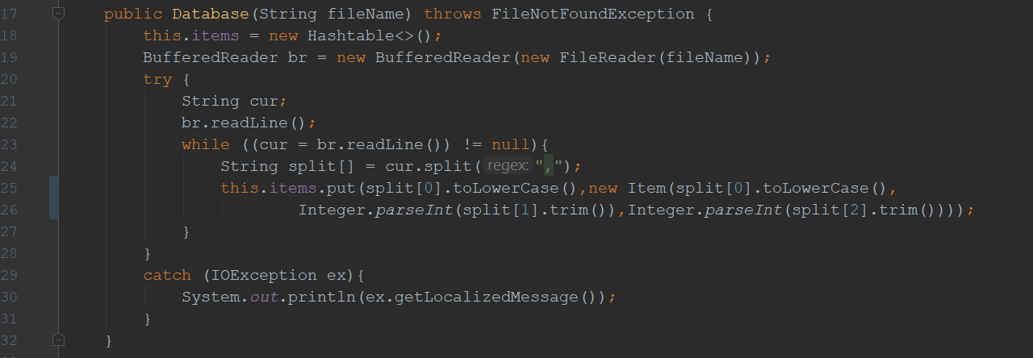
Implementation
Python
Java
Notes:
Python: 11, Java: 14

Slide 8
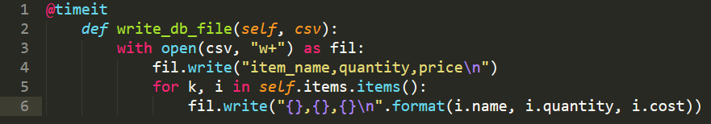
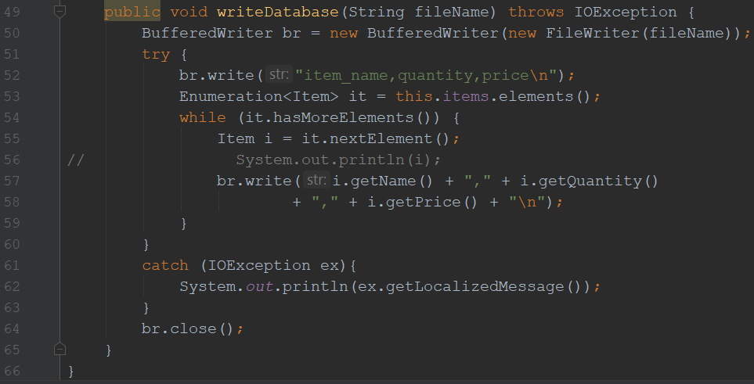
Implementation
Python
Java
Notes:
Python: 6, Java: 15

Slide 9
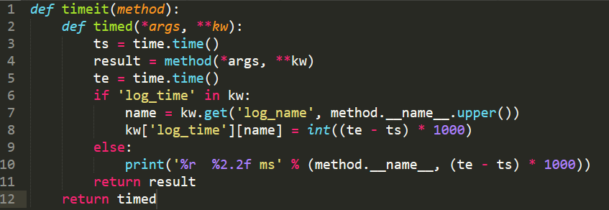
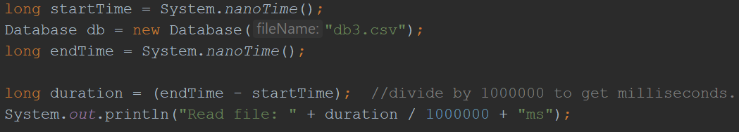
Implementation
Python
Java
Notes:
Python: 12 + 1, Java: 4 x usage

Slide 10
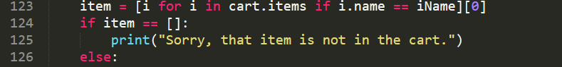
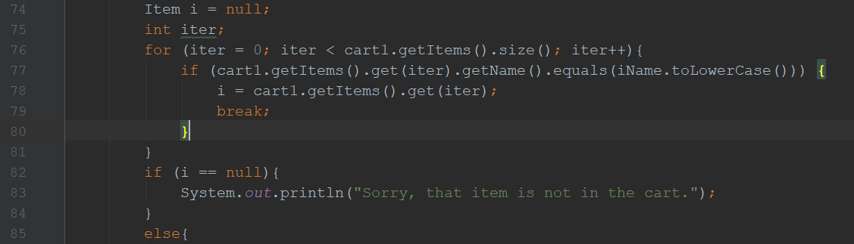
Implementation
Python
Java
Notes:
Python: 4, Java: 10

Slide 11
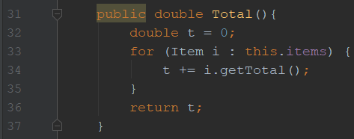

Implementation
Java
Notes:
Java: 10

Slide 12
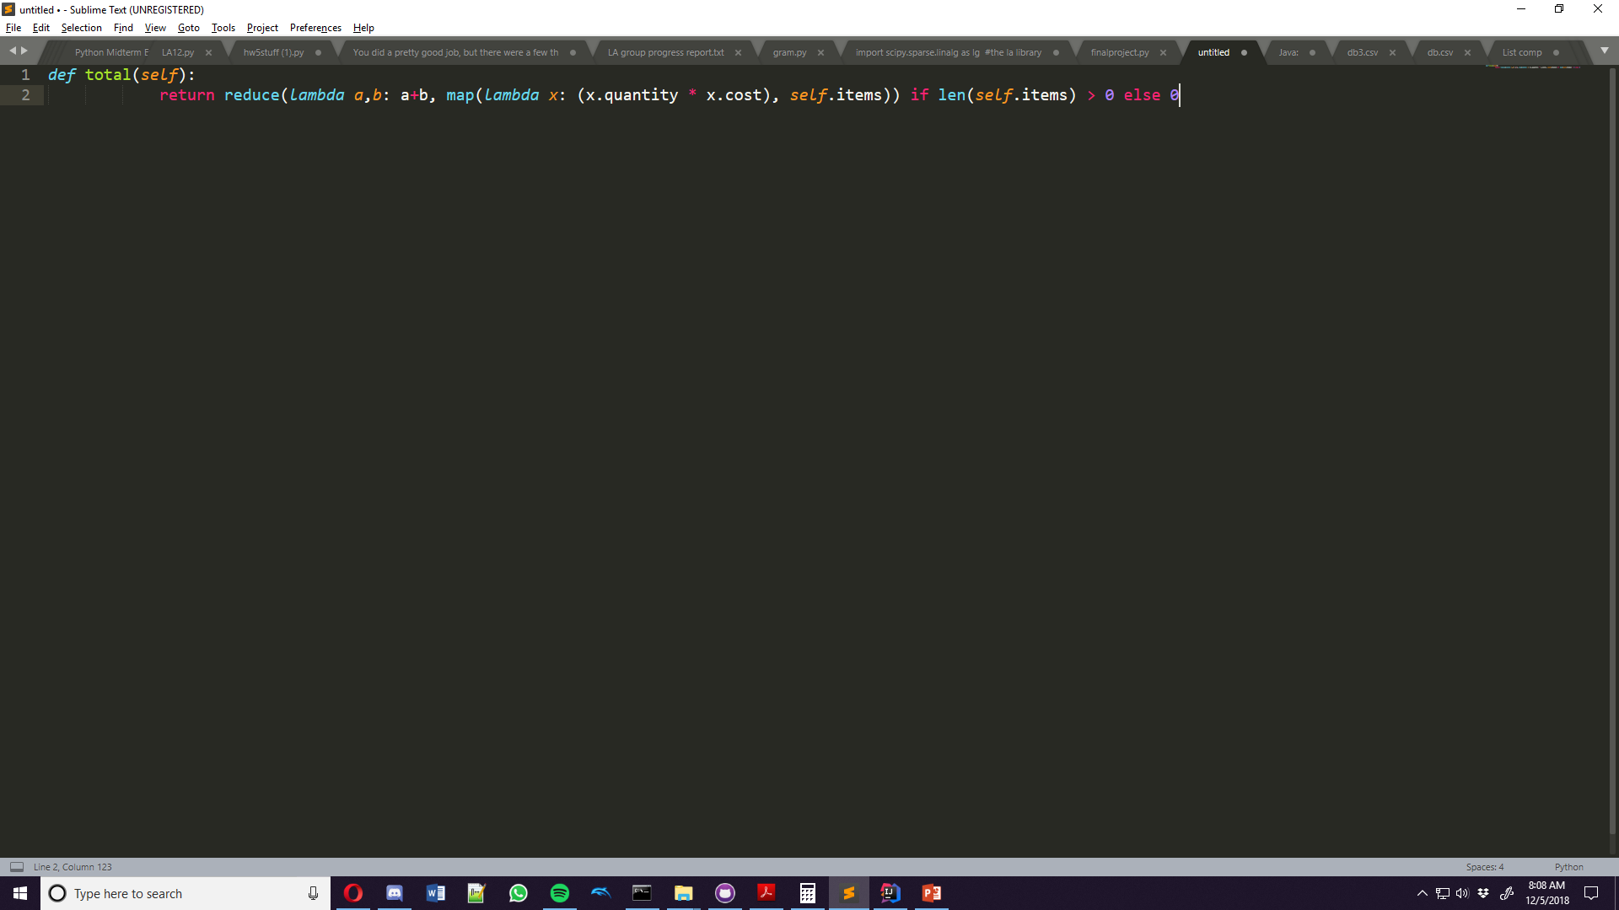
Implementation
Python
Notes:
Python: 2

Slide 13
Observations
Total lines of code:
Python: 171
Java: 278
List comprehensions and lambda + reduce are both very efficient
Decorators made a big difference if used enough
Generators didn’t save much space
Speed difference is negligible for small file IO, but major for large files
Notes:
-Java has 60% more code
-Average Java speeds: 61 ms, 2ms. Python: 240 ms, 2.4ms

Slide 14
Conclusion
Python is great for quick and efficient development
Takes up very little space to do the same work
Not always the fastest
Can be hard to understand

