Slide 1
Comparing Python and Java for a small-scale app
Xavier Gray

Slide 2
Overview
Introduction
Objectives
Demonstration
Implementation
Conclusion
Questions

Slide 3
Why Python?
What are the strengths of Python?
When would you choose Python over another language?

Slide 4
Objectives
Compare the running speeds of a nearly-identical program in Java and Python
Compare amount of code needed in Java and Python
Compare readability of Python and Java code

Slide 5
Java and Python
Java
Python
Strongly typed
Duck Typing

Slide 6
Demo

Slide 7
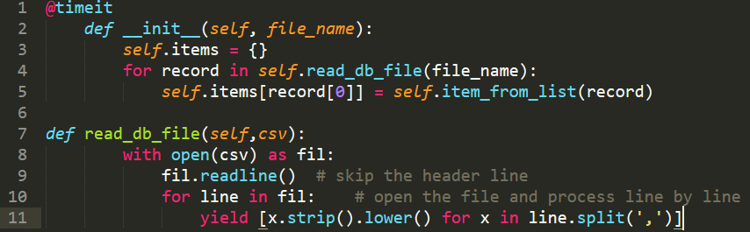
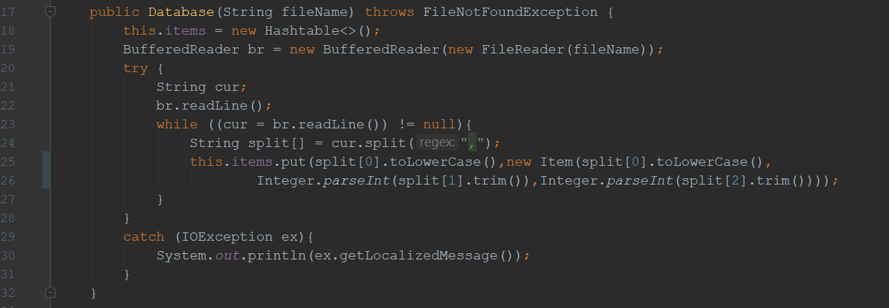
Implementation
Python
Java

Slide 8
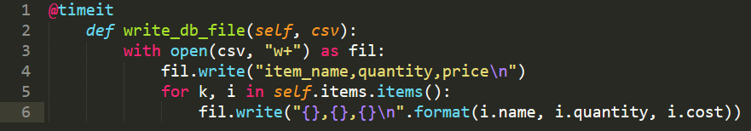
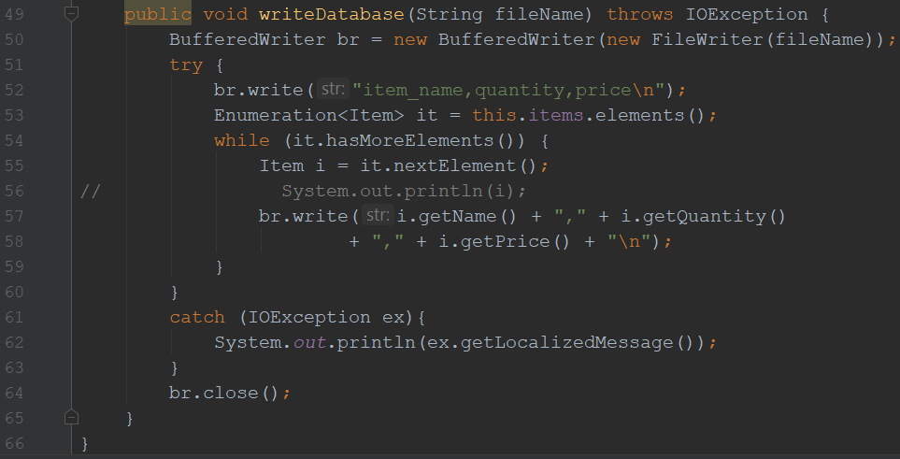
Implementation
Python
Java

Slide 9
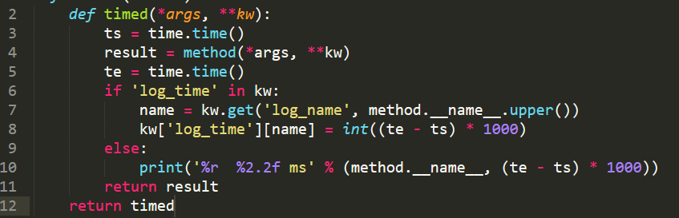
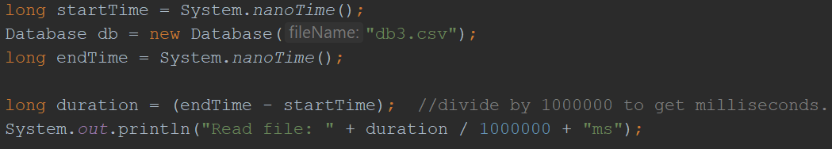
Implementation
Python
Java

Slide 10
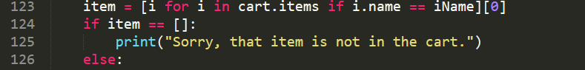
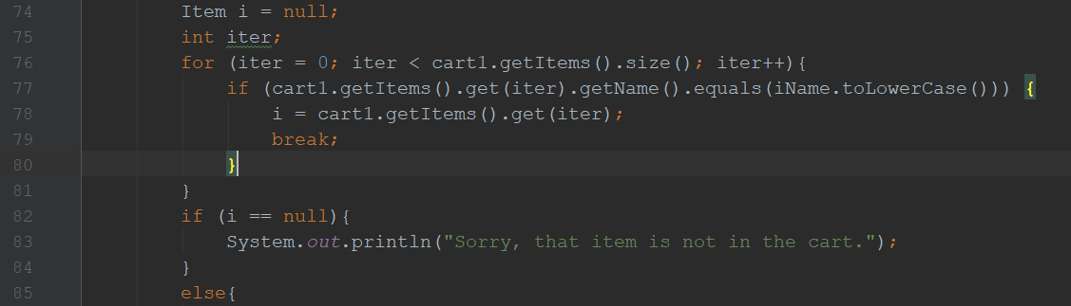
Implementation
Python
Java

Slide 11
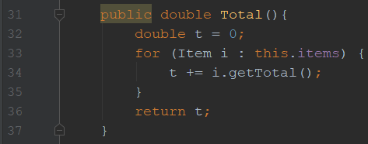

Implementation
Java

Slide 12
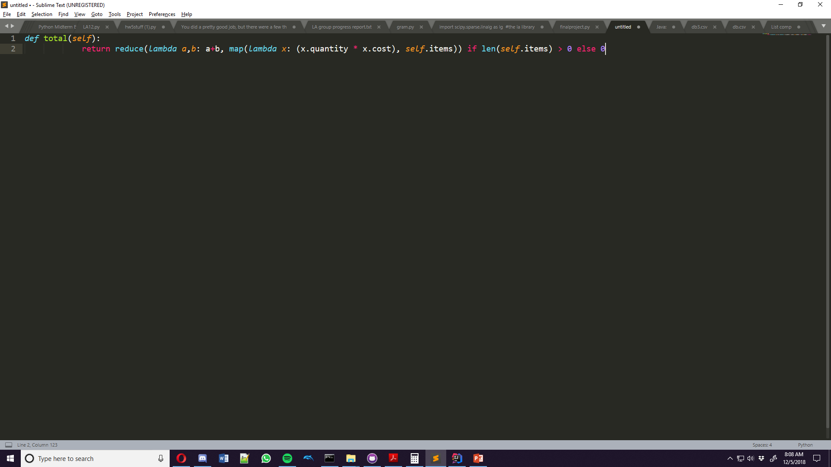
Implementation
Python

Slide 13
Observations
Total lines of code:
Python: 171
Java: 278
List comprehensions and lambda + reduce are both very efficient
Decorators made the biggest difference
Generators don’t help much
Speed difference is negligible for files, but major for large ones
Notes:
-
-Average Java speeds: 61 ms, 2ms. Python: 240 ms, 2.4ms

Slide 14
Conclusion
Python is great for quick and efficient development
Takes up very little space to do the same work
Can be harder to understand at first

