Slide 1
Translation App Concept UI
Group 20
Version 0.4

Slide 2
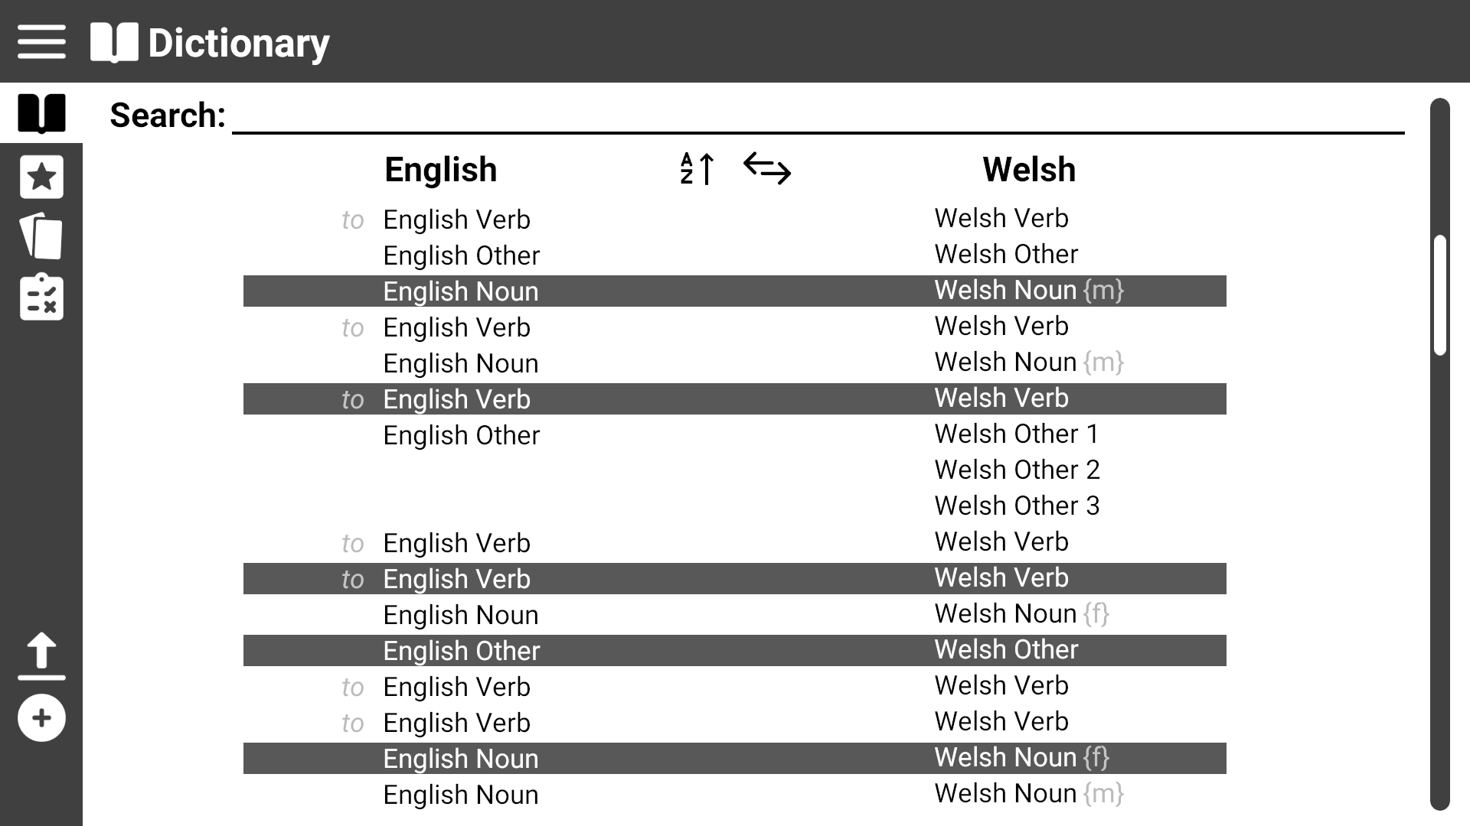
Page Title
This shows the general layout of the program
Expand menu
Scroll bar
Menu Options

Slide 3
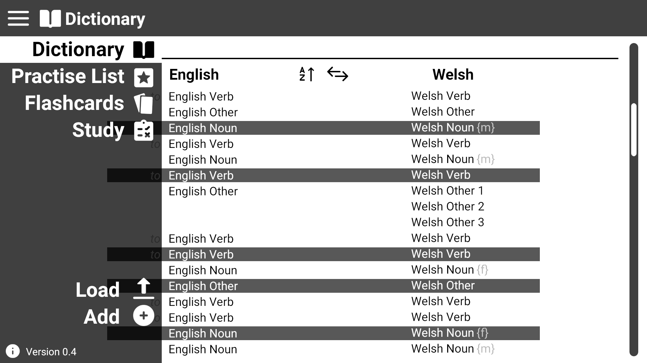
This shows the menu expanded
Current page highlighted
Click here to expand the menu
Click on menu items to switch to their page

Slide 4
This shows the general layout of the program
You can also switch pages by directly clicking on the icon when the menu isn’t expanded

Slide 5
Use Case 1: View dictionary
Click on the Dictionary Icon

Slide 6
Use Case 1: View dictionary
Switch language sorting
User is then presented with the dictionary page
Change ascending/decending
Verb prefixed with “to”
Noting gender for Welsh nouns
Word shown with multiple meanings

Slide 7
Use Case 2: Search for a word
Click on Dictionary or Practise List

Slide 8
Use Case 2: Search for a word
Click on the search textbox and start to type for your word

Slide 9
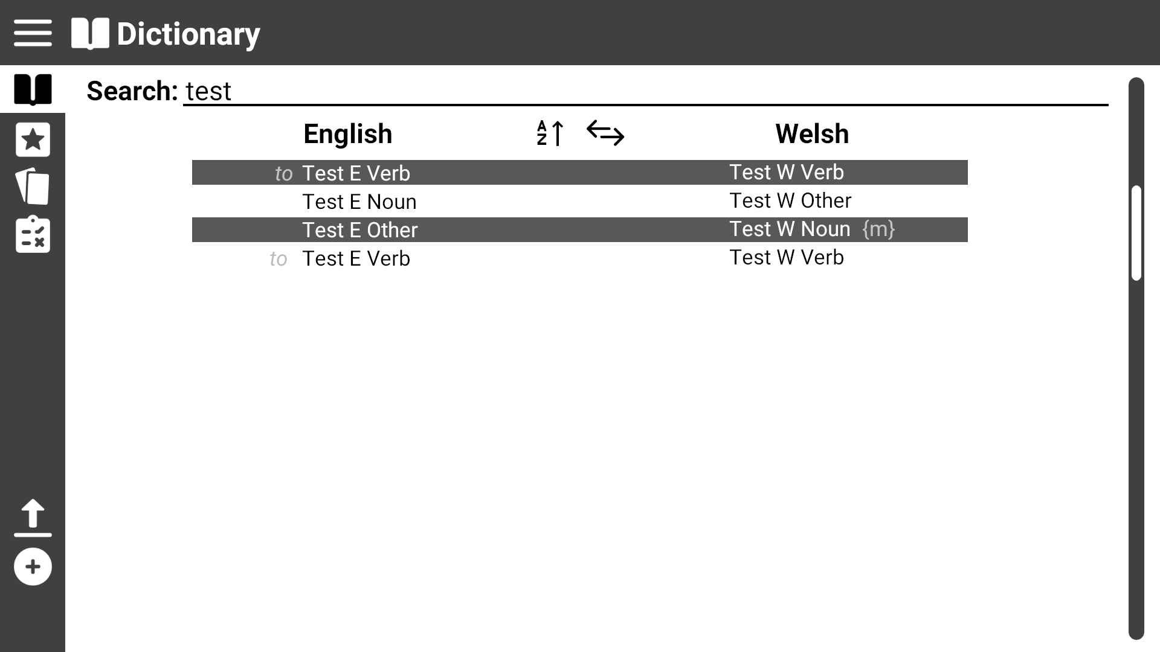
Use Case 2: Search for a word
Results from the search are filtered and displayed in real time (live searching)

Slide 10
Use Case 3: View practise list
Click on the Practise List icon

Slide 11
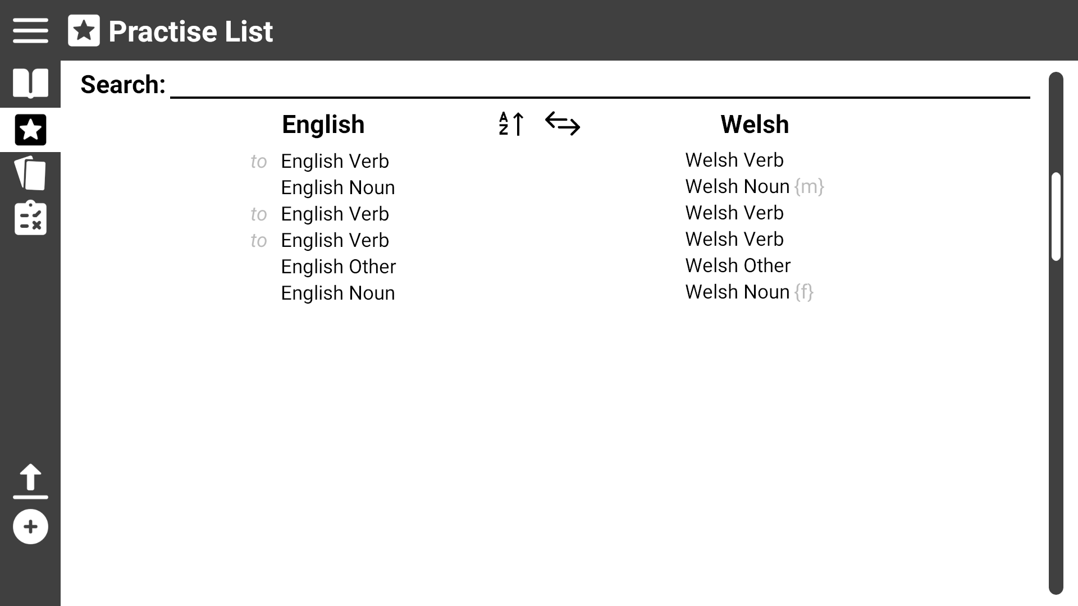
Use Case 3: View practise list
User is presented with the practist list page

Slide 12
Use Case 4: Modify practise list
Click on the ‘Practise List’ page

Slide 13
Use Case 4: Modify practise list
Click on a word to remove it from the practise list
You can only remove practise words from the practise page.

Slide 14
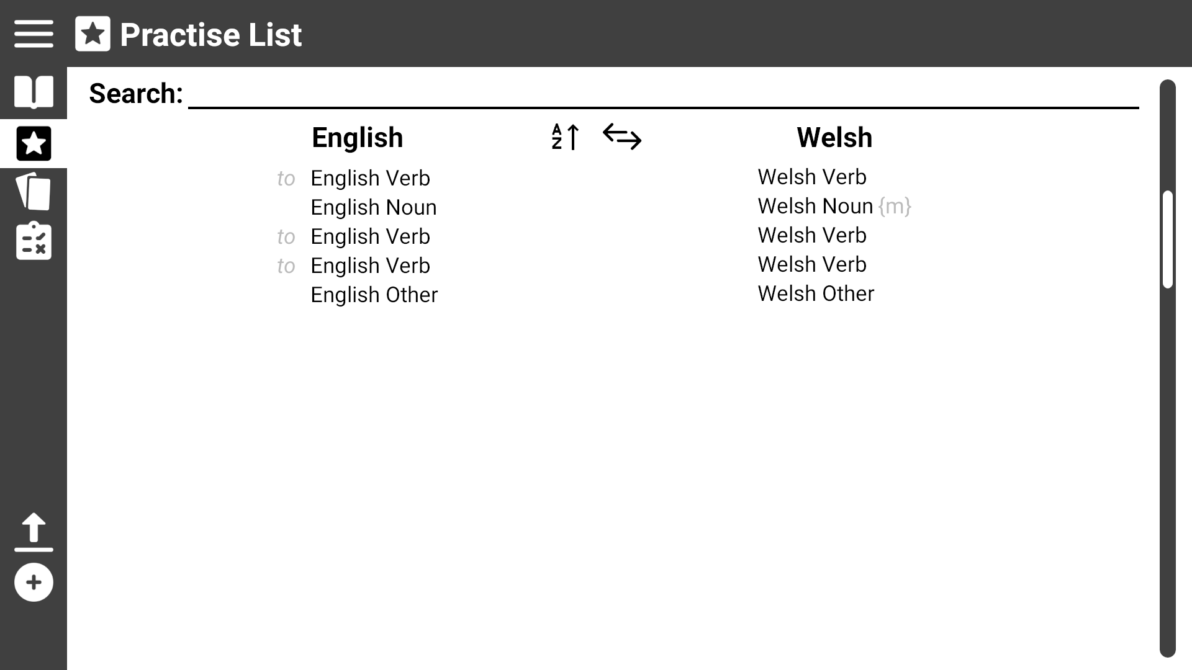
Use Case 4: Modify practise list
Click on the Dictionary icon
To add words to the list need to visit the dictionary page

Slide 15
Use Case 4: Modify practise list
Click on an unmarked word to add it the practise list
Clicking on marked words will remove them from the practise list

Slide 16
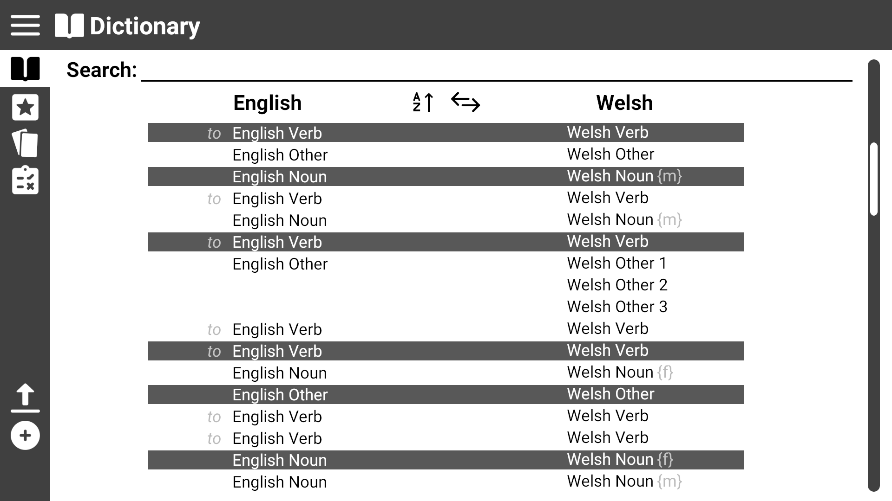
Use Case 4: Modify practise list
Word is now added to practise list

Slide 17
Use Case 5: Start a test
Click on Study icon

Slide 18
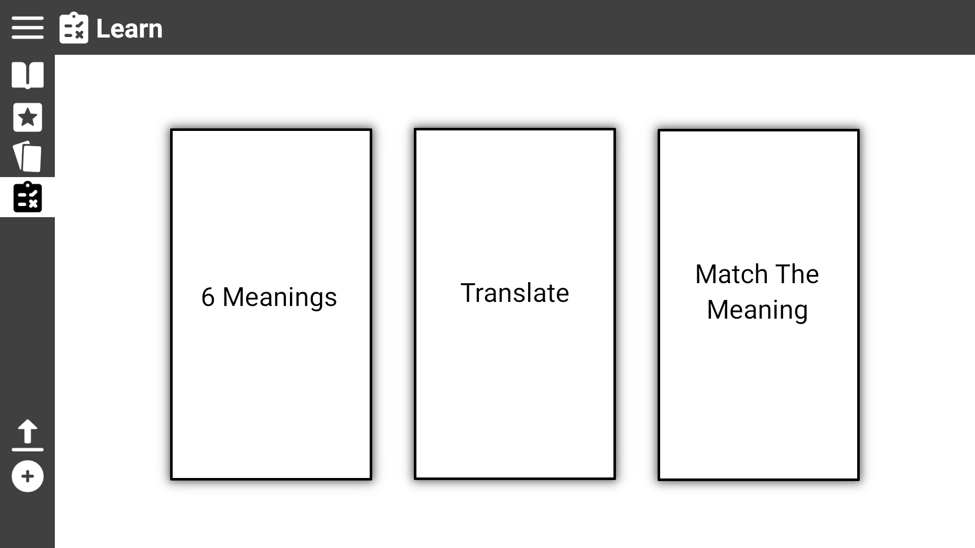
Use Case 5: Start a test
The user is presented with three different types of tests they can click on.

Slide 19
Use Case 5.1: Start ‘Match The Meaning’ test
From the Study page click the ‘Match the Meaning’ box

Slide 20
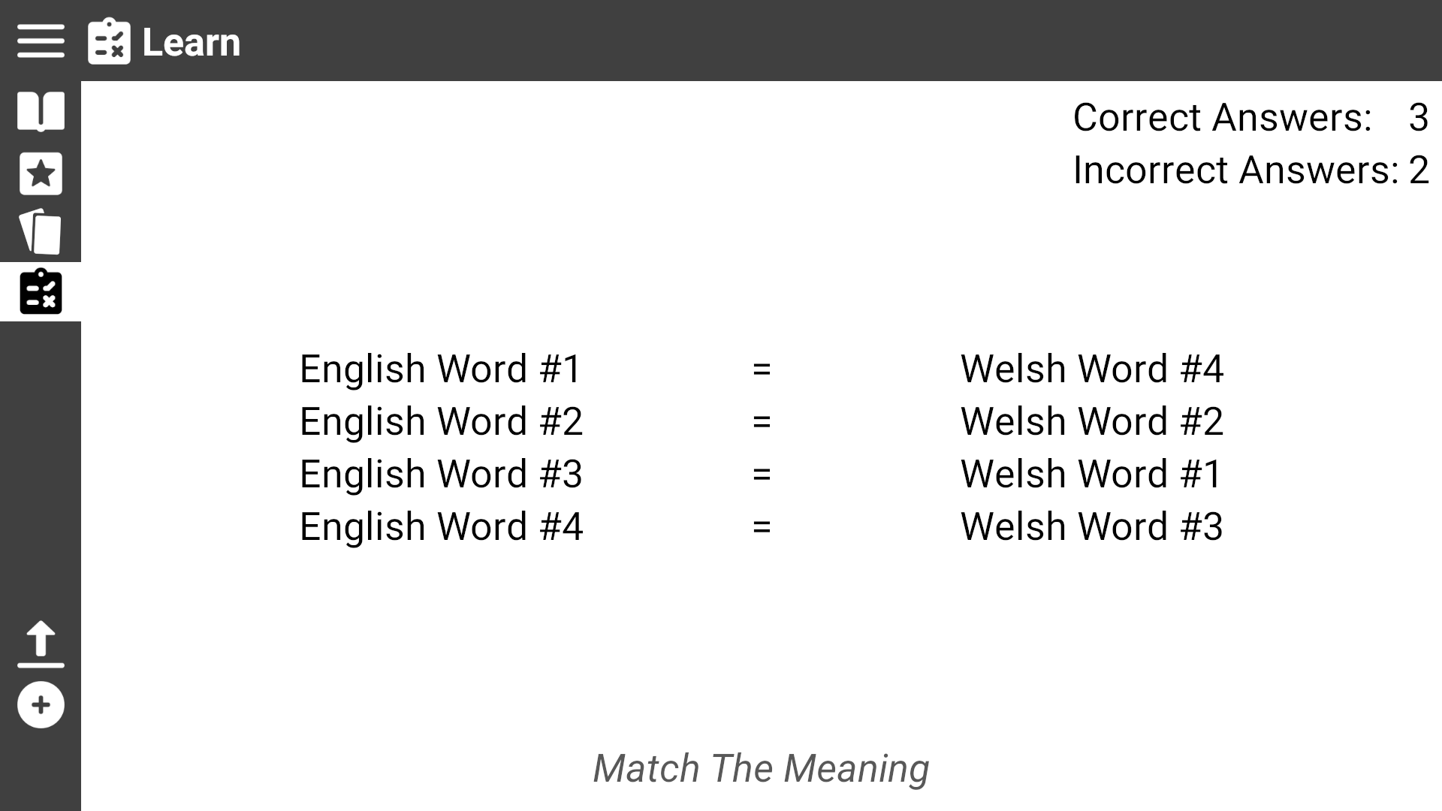
Use Case 5.1: Start ‘Match The Meaning’ test
The user is presented with eight words (four pairs) and must match the word to it’s meaning by dragging it next to the word horizontally
The user is presented with a record of their current score
Name of type of test

Slide 21
Use Case 5.2: Start ‘6 Meanings’ test
Click the Study icon

Slide 22
Use Case 5.2: Start ‘6 Meanings’ test
From the Study page click the ‘6 Meanings’ box

Slide 23
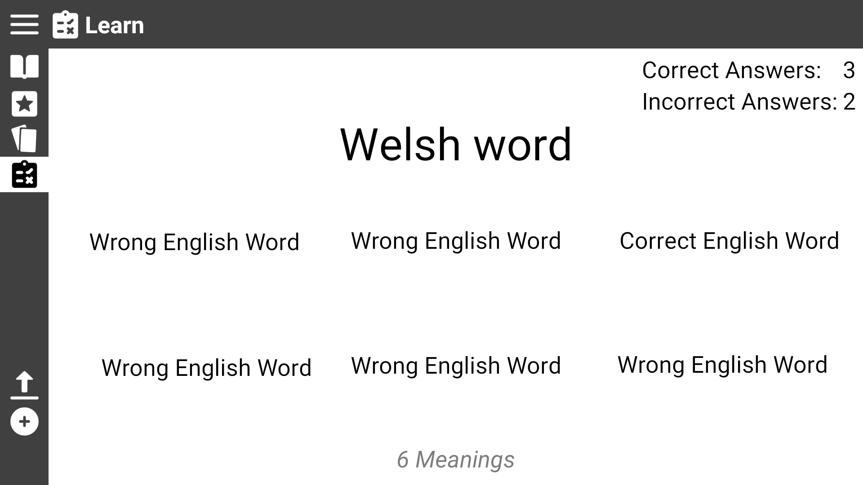
The user is presented with a word in Welsh/English with six words in the other language.
The user must click on the one they believe matches the meaning of the large word
Use Case 5.2: Start ‘6 Meanings’ test
The user is presented with a record of their current score
Name of type of test

Slide 24
Use Case 5.3: Start ‘Translation’ test
Click the Study icon

Slide 25
Use Case 5.3: Start ‘Translation’ test
From the Study page click the ‘Translate’ box

Slide 26
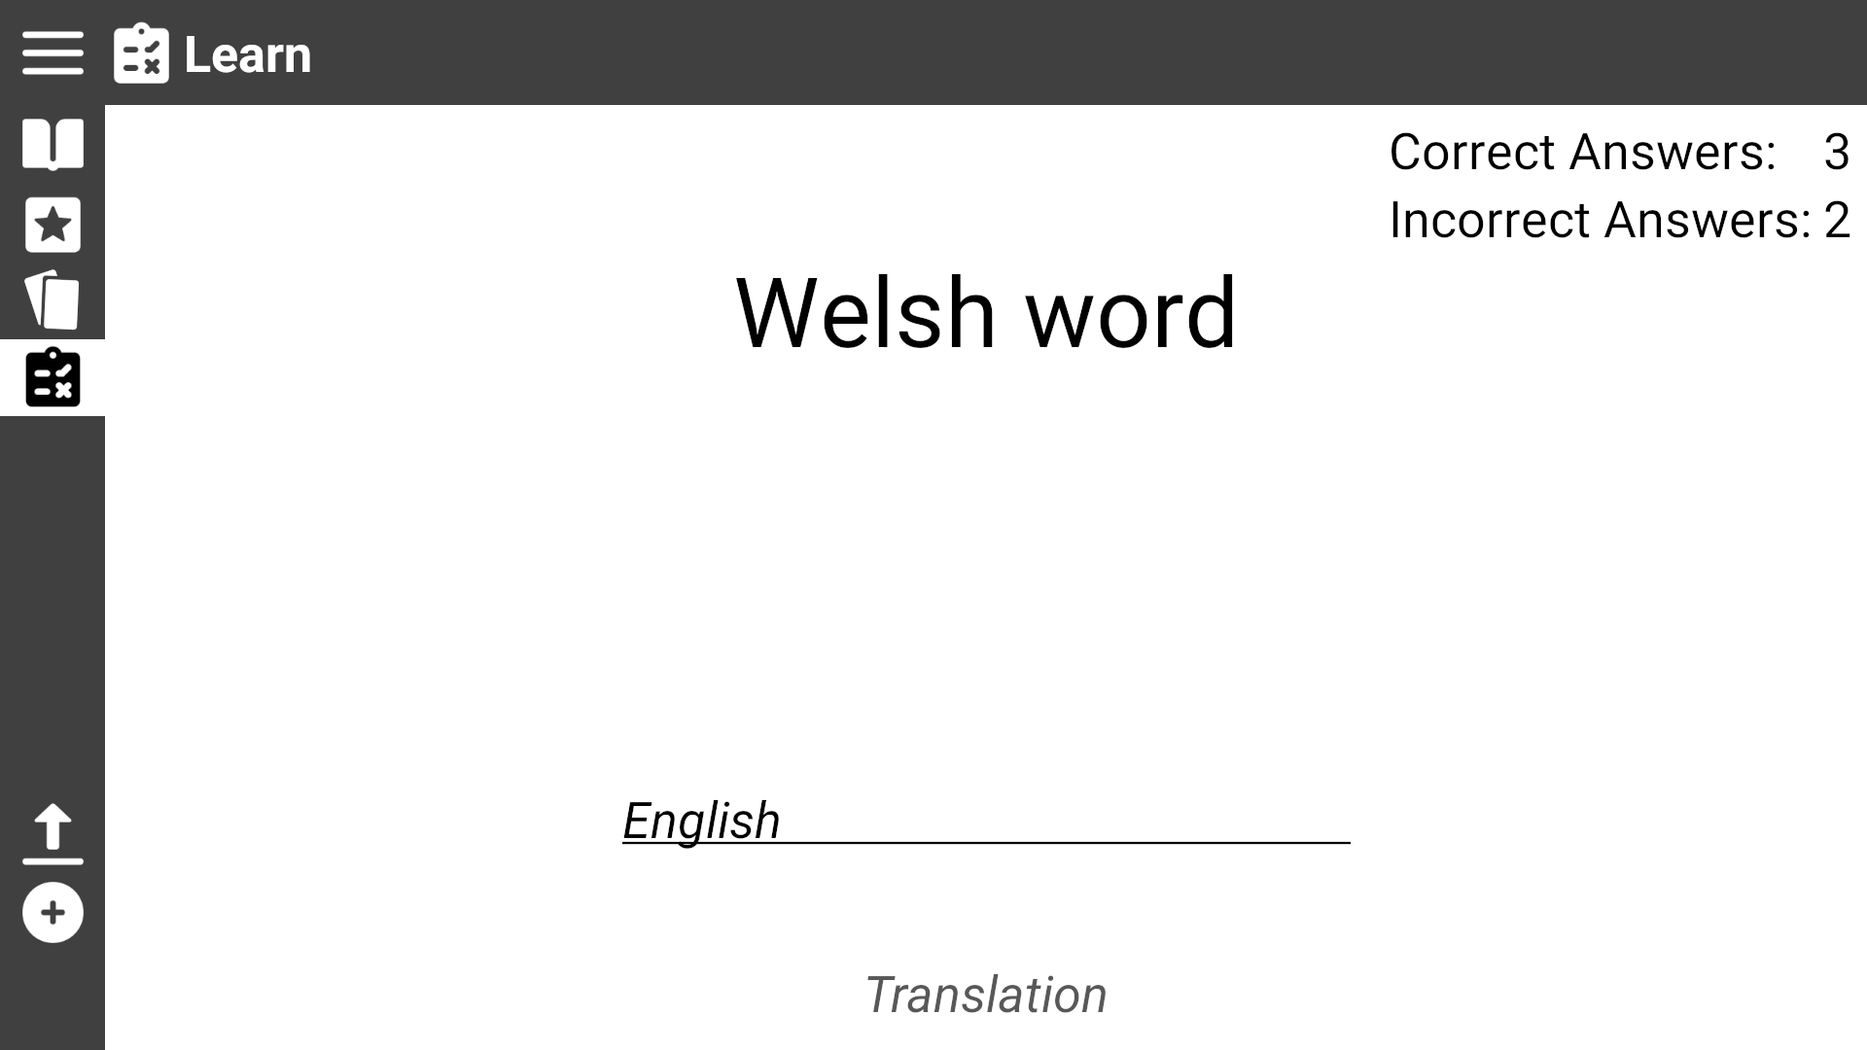
The user is presented with a word in Welsh/English a textbox. The user must type the translation of the word in the textbox
Use Case 5.3: Start ‘Translation’ test
The user is presented with a record of their current score
Name of type of test

Slide 27
Use Case 6: View Flashcards
Click the Flashcards icon

Slide 28
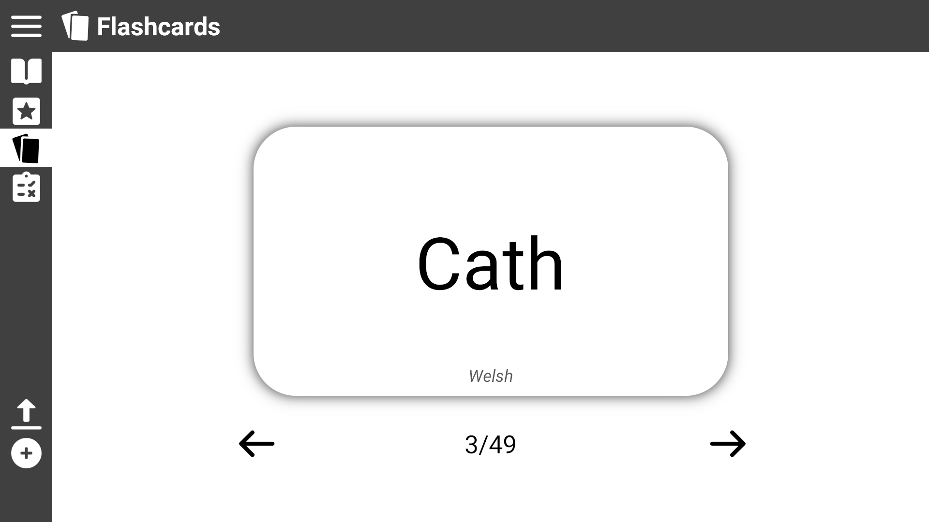
Use Case 6: View Flashcards
The user is presented a flashcard with one of their practise words
The user can click the card to flip it and see the translation
Language is shown at the bottom

Slide 29

Use Case 6: View Flashcards
The user can click the arrows to move to the next or previous card

Slide 30
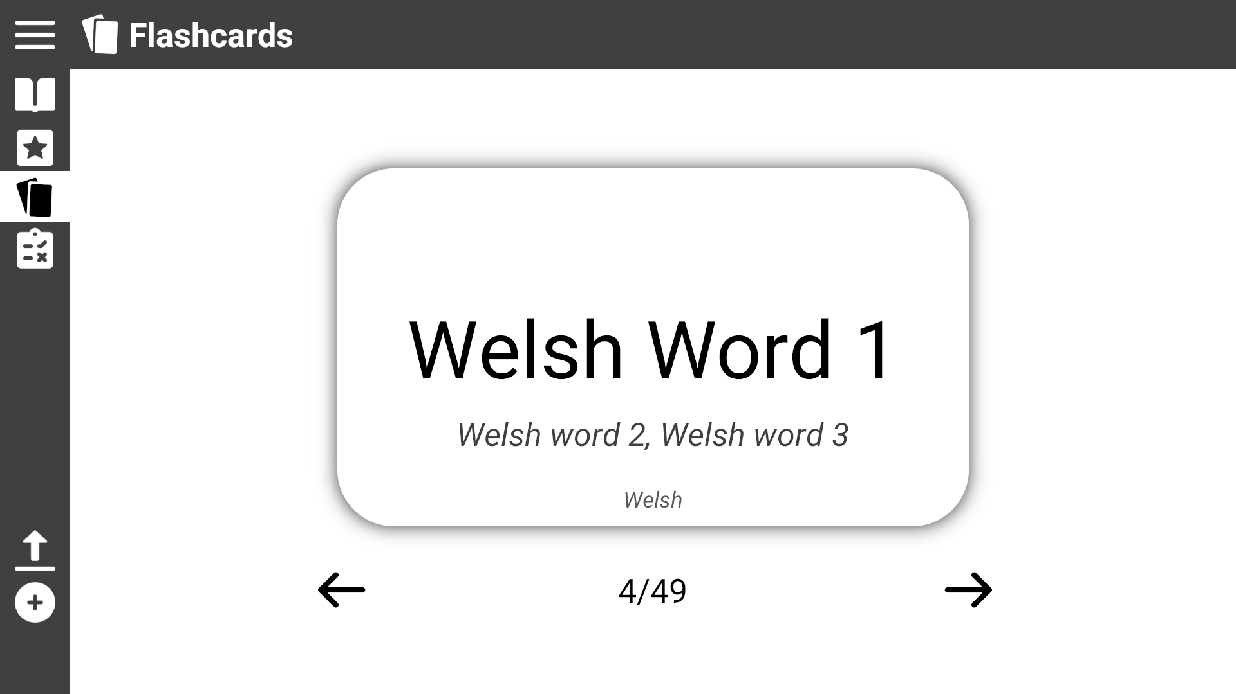
Use Case 6: View Flashcards
If the word on the other side can be translated in different ways the other translations are shown here
The user can click the card to flip it and see the translation

Slide 31
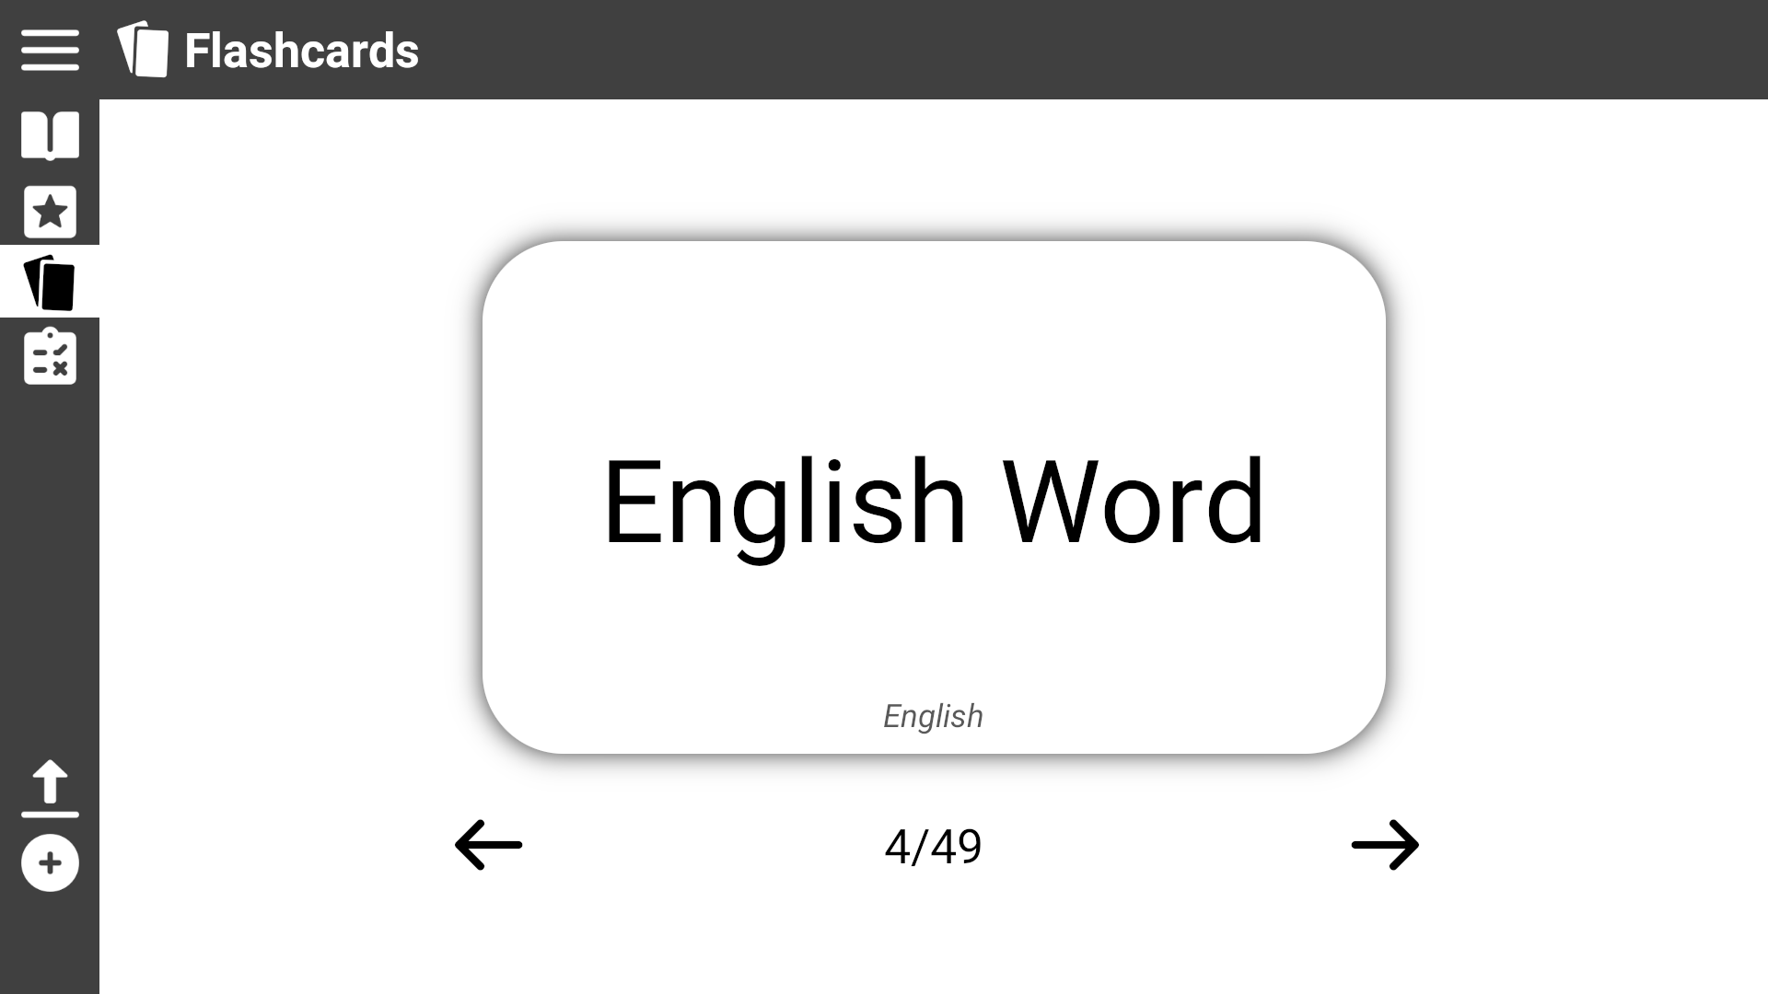
Use Case 6: View Flashcards

Slide 32
Use Case 7: Load a new dictionary
Click the Load icon

Slide 33
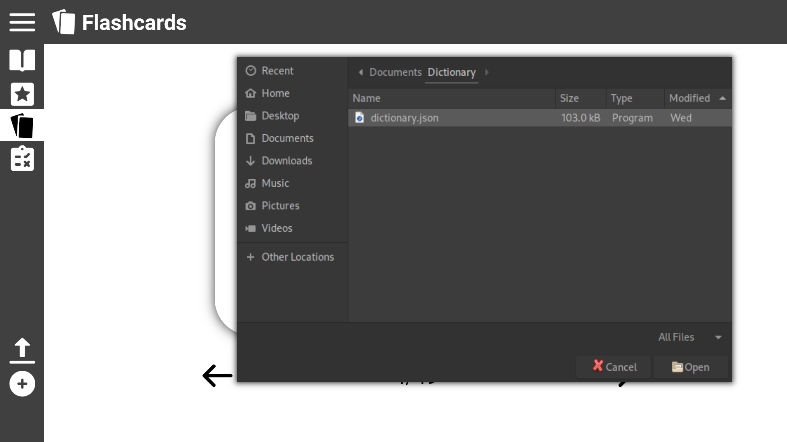
The user is presented with a upload file pop up which allows then to find the file in their local filesystem
Use Case 7: Load a new dictionary
1. Click the file you wish to upload
2. Then click the open icon

Slide 34

Use Case 8: Add a new word
Click the ‘Add’ icon

Slide 35
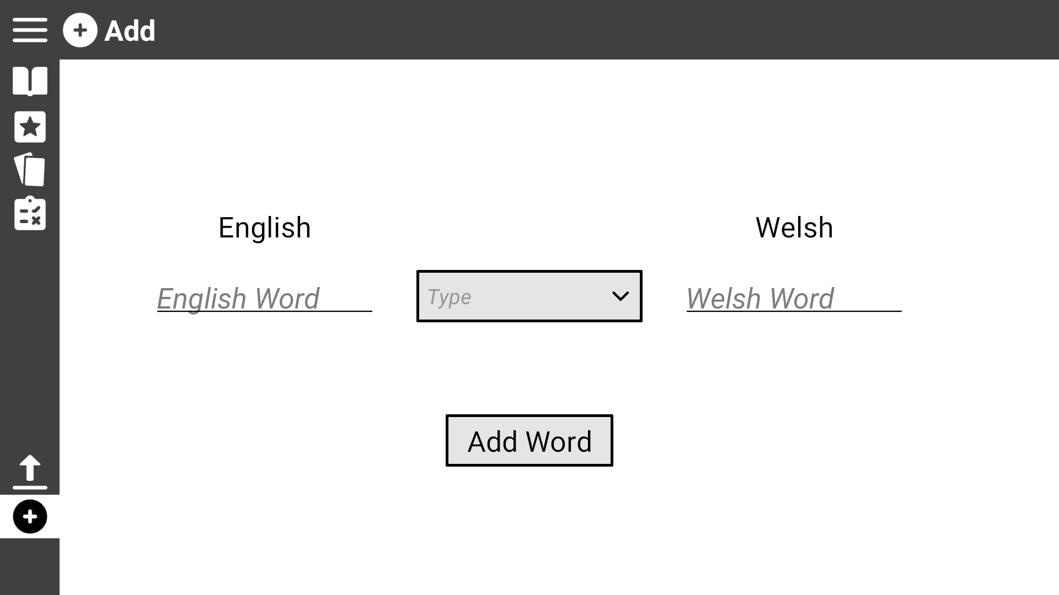

The user is presented with two text boxes one for the English version of the word and one for the Welsh version, a drop down box to select the word type, and an ‘Add Word’ button to add the word to the dictionary
Use Case 8: Add a new word
Menu to use accents
Fill in the meanings in their respected textboxes

Slide 36
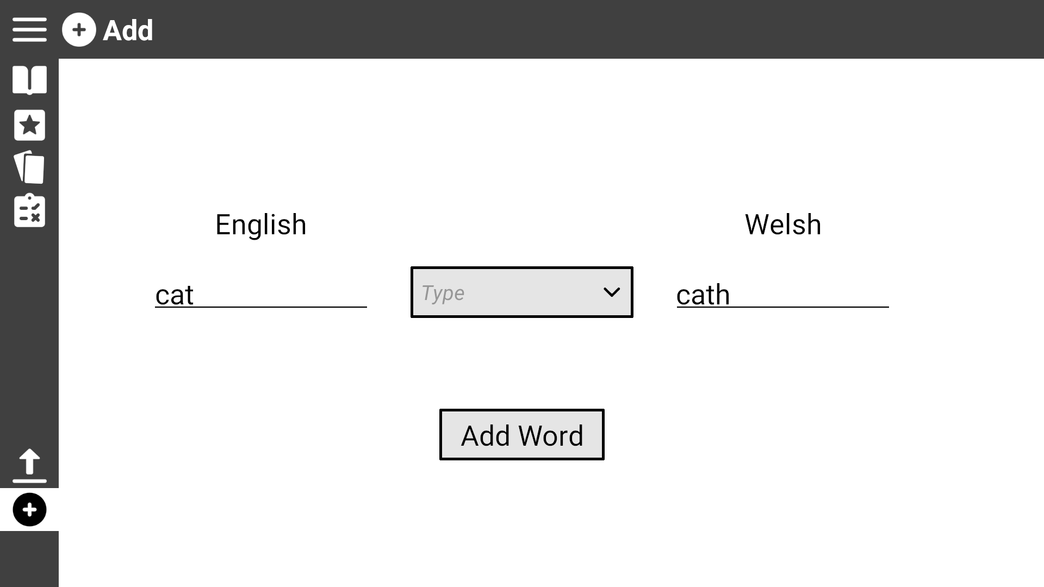
Use Case 8: Add a new word
Click on the drop down box to view the word types

Slide 37
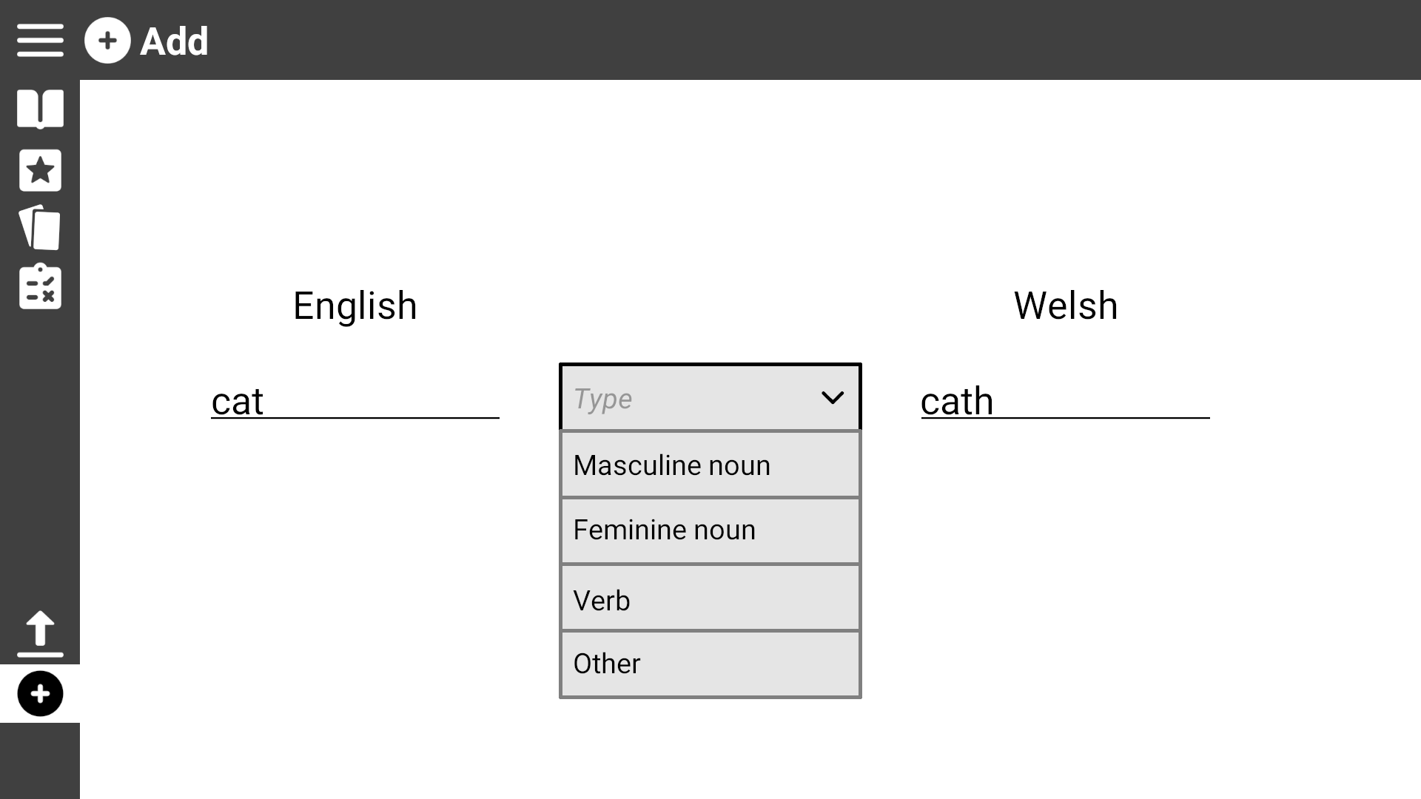
Use Case 8: Add a new word
Click on the drop down box to view the word types

Slide 38
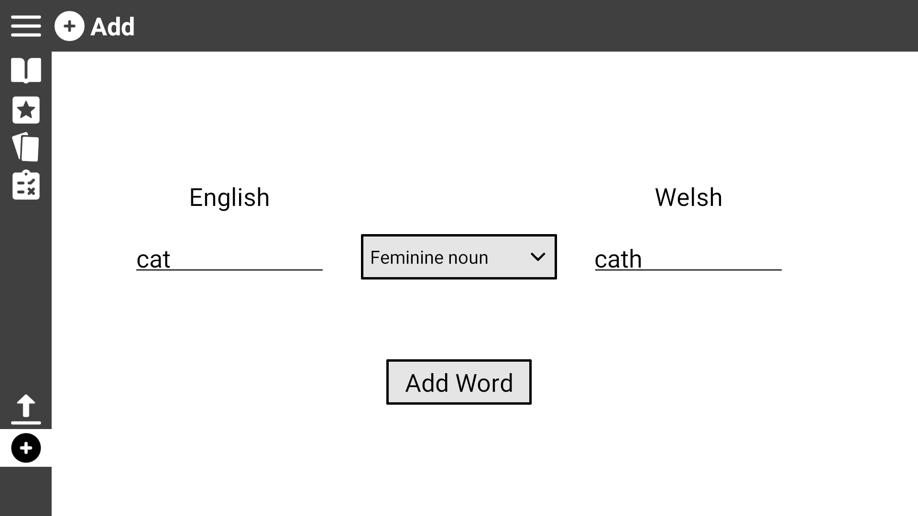
Use Case 8: Add a new word
Once every field is filled, click ‘Add Word’ to add it to the dictionary, it is also automatically added to the practise list

Slide 39
Use Case 9: Change word ordering
If not already, navigate to the Practise List or the Dictionary Page by clicking on their respective icons

Slide 40
Use Case 9: Change word ordering
Click on the ‘Change language order’ icon

Slide 41
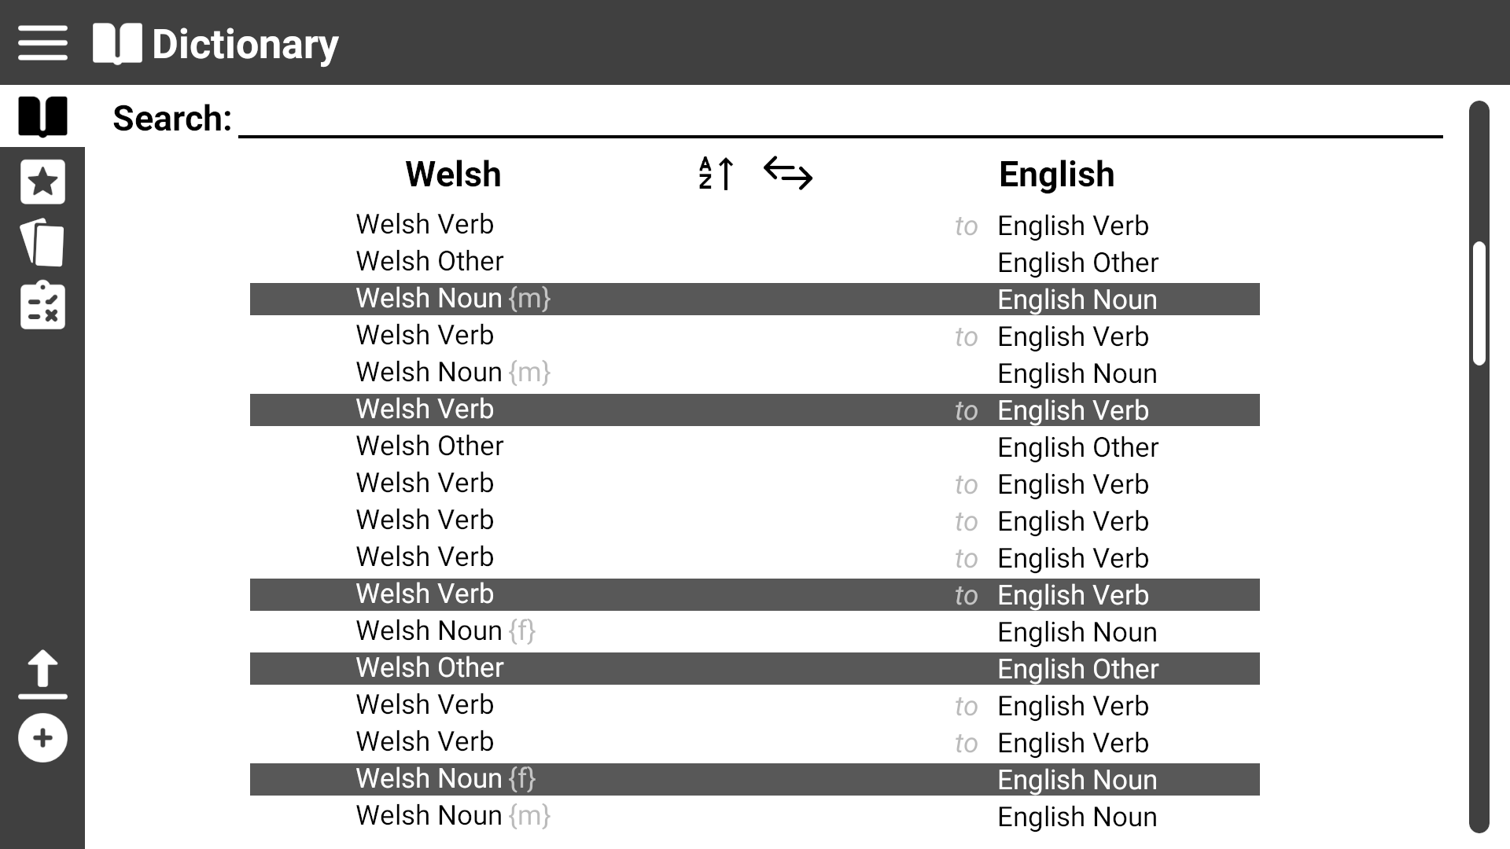
Use Case 9: Change word ordering
Click on the ‘Change language order’ icon to revert back

Slide 42
Use Case 9: Change word ordering
Click on the ‘Change A/Z order’ icon to change to alphabetically ascending or descending

Slide 43

Use Case 9: Change word ordering

