Slide 1
Translation App Concept UI
Group 20
Version 1.1 (Review)

Slide 2

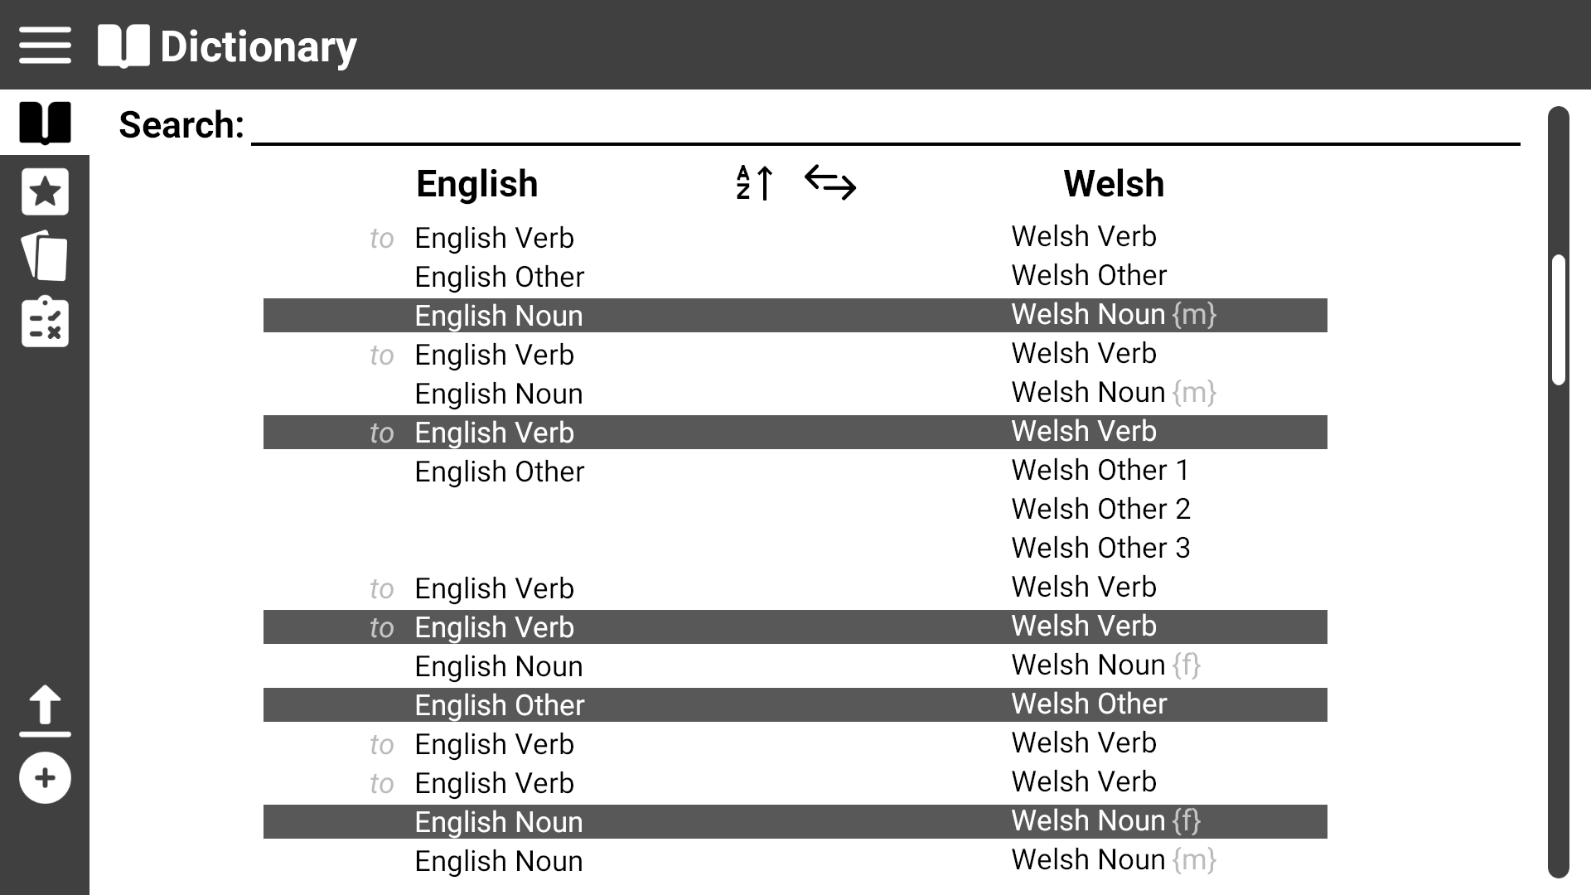
Page title
This shows the general layout of the program
Expand menu
Scroll bar
Menu options

Slide 3
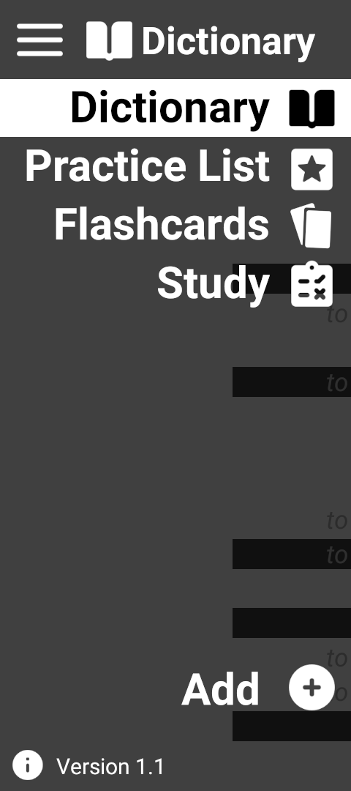
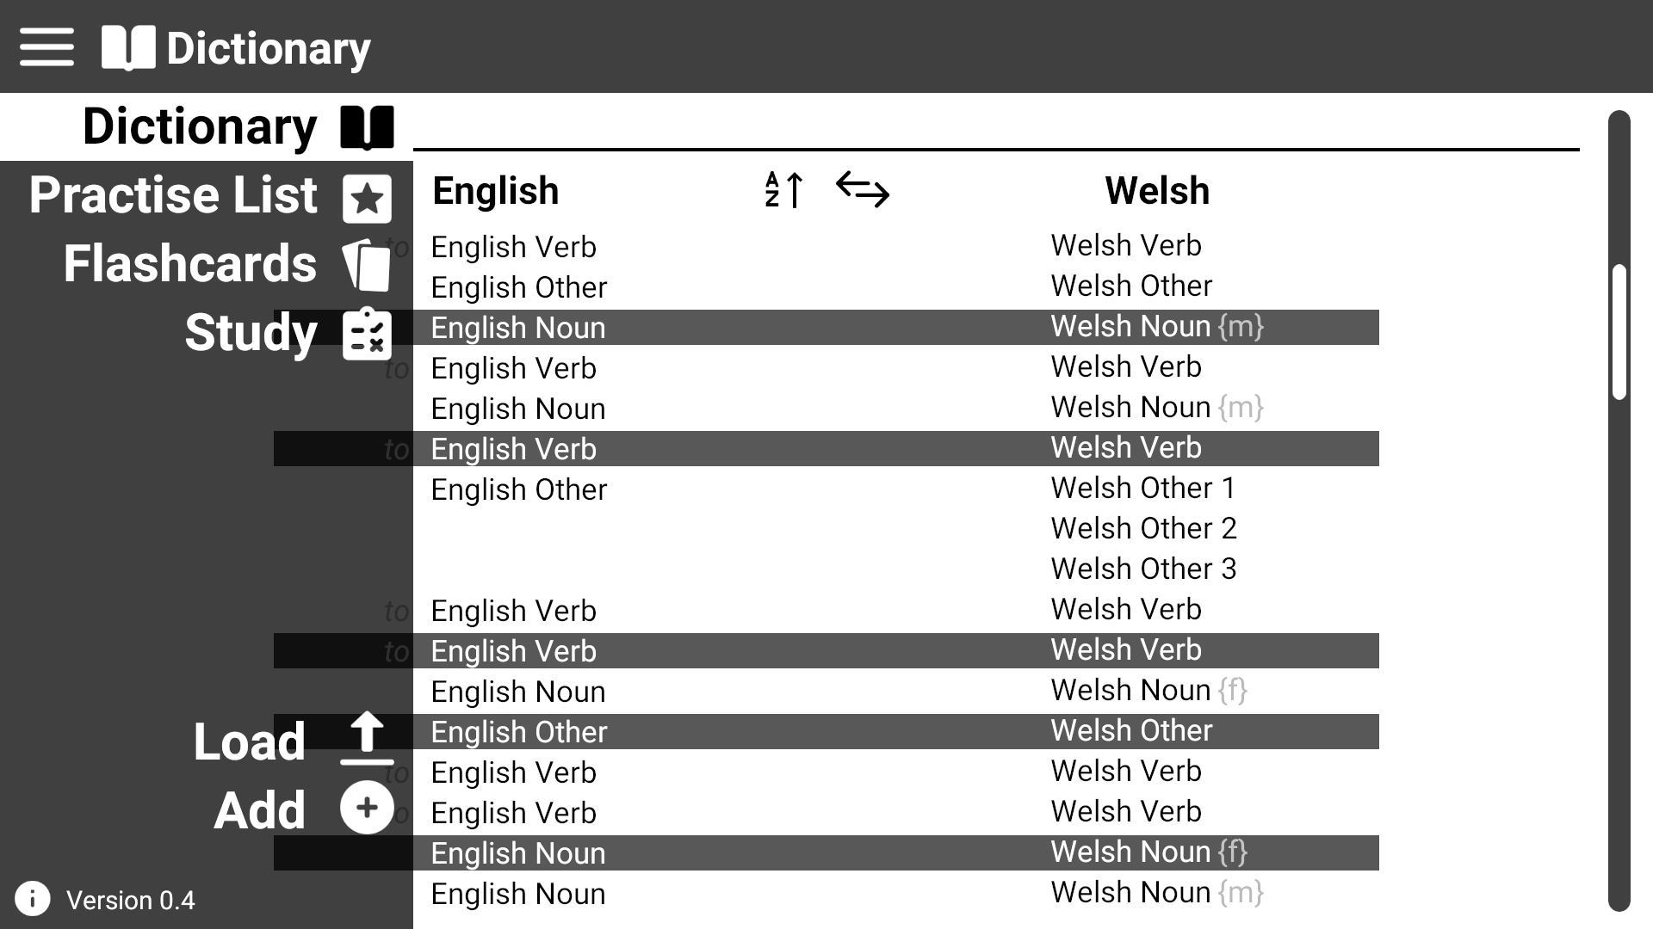
This shows the menu expanded
Current page highlighted
Click here to expand the menu
Click on menu items to switch to their page

Slide 4
This shows the general layout of the program
You can also switch pages by directly clicking on the icon when the menu isn’t expanded

Slide 5
Use Case 1: View dictionary
Click on the ‘Dictionary’ Icon

Slide 6
Use Case 1: View dictionary
Switch language sorting
User is then presented with the ‘Dictionary’ page
Change ascending/decending
Verb prefixed with ‘to’
Noting gender for Welsh nouns
Word shown with multiple meanings

Slide 7
Use Case 2: Search for a word
Click on ‘Dictionary’ or ‘Practice List’

Slide 8
Use Case 2: Search for a word
Click on the search textbox and start to type for your word

Slide 9
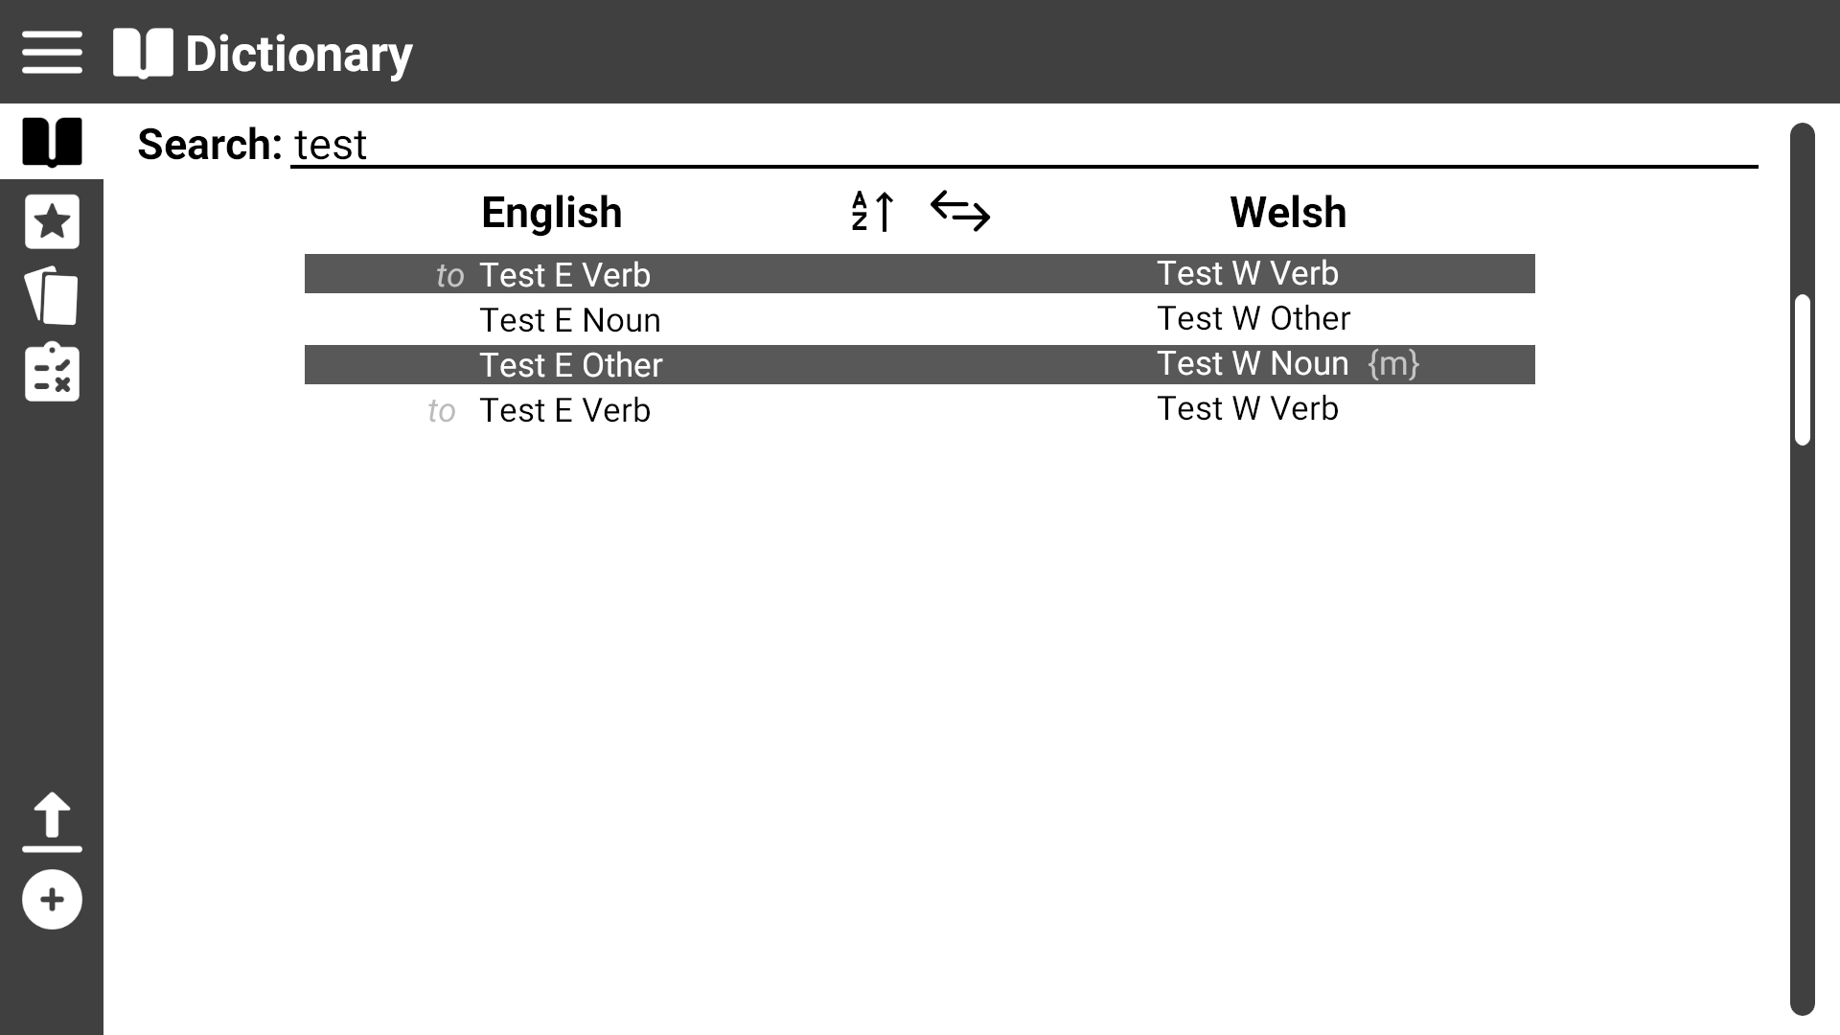
Use Case 2: Search for a word
Results from the search are filtered and displayed in real time (live searching)

Slide 10
Use Case 3: View practice list
Click on the ‘Practice List’ icon

Slide 11

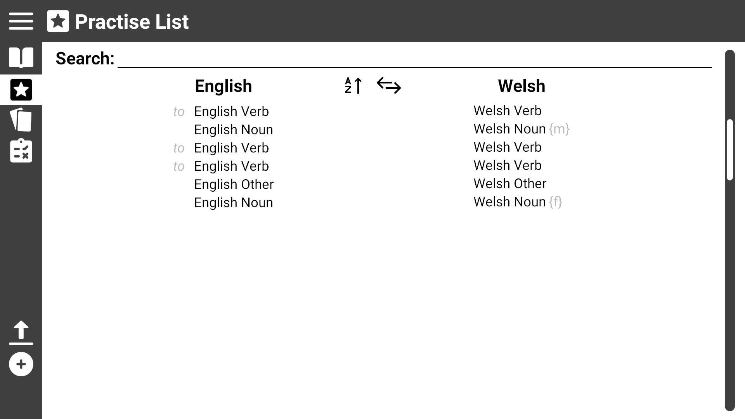
Use Case 3: View practice list
User is presented with the ‘Practice List’ page

Slide 12
Use Case 4: Modify practice list
Click on the ‘Practice List’ page

Slide 13
Use Case 4: Modify practice list
Click on a word to remove it from the practice list
You can only remove practise words from the ‘Practice List’ page.

Slide 14
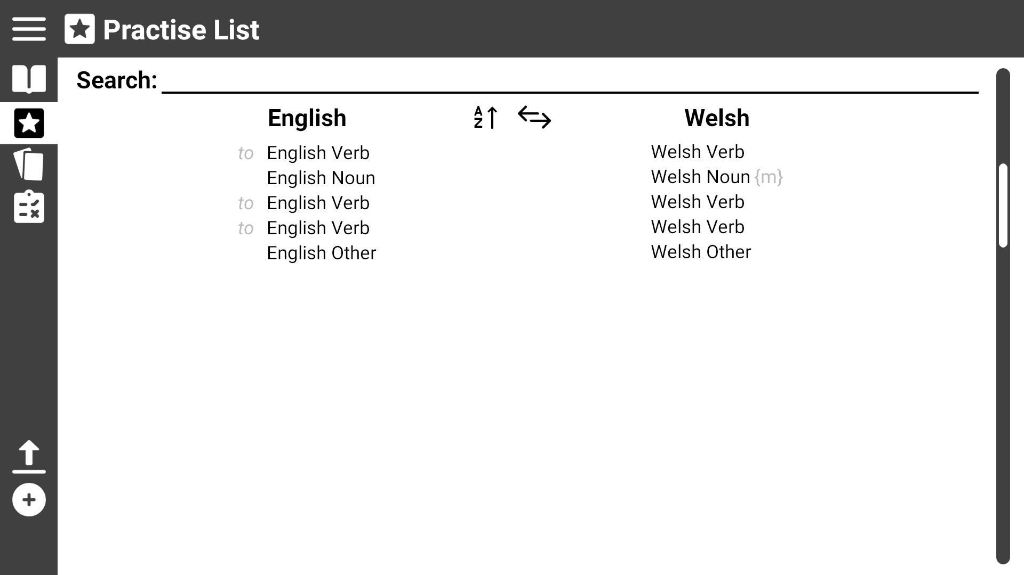
Use Case 4: Modify practice list
Click on the ‘Dictionary’ icon
To add words to the list need to visit the ‘Dictionary’ page

Slide 15
Use Case 5: Start a test
Click on the ‘Study’ icon

Slide 16

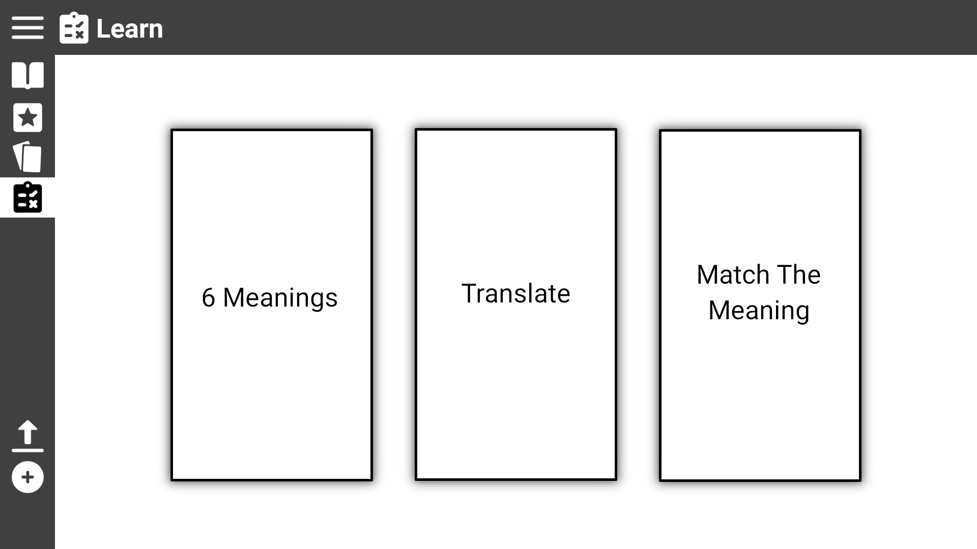
Use Case 5: Start a test
The user is presented with three different types of tests they can click on

Slide 17
Use Case 5.1: Start ‘Match The Meaning’ test
From the ‘Study’ page click the ‘Match the Meaning’ box

Slide 18
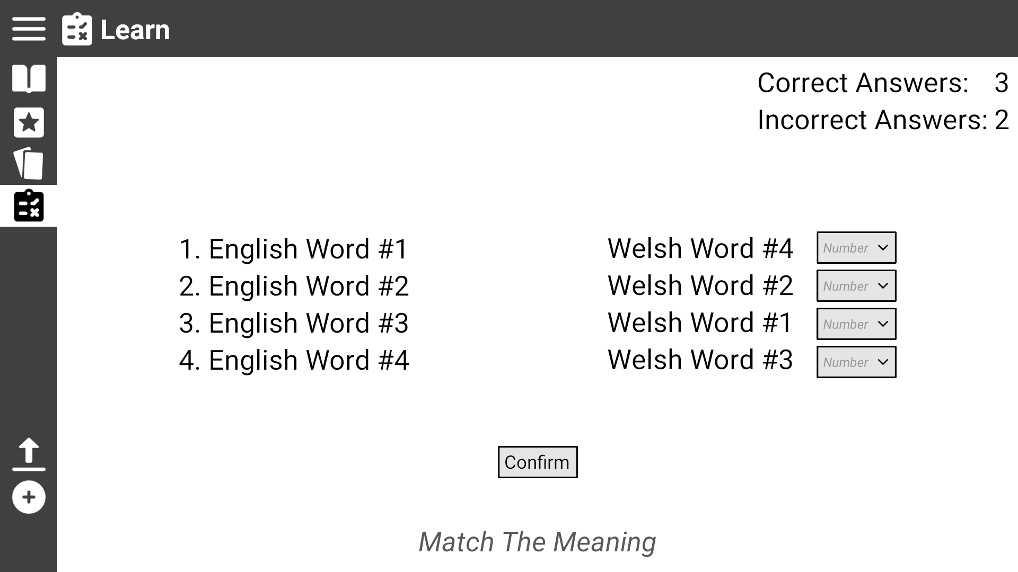
Use Case 5.1: Start ‘Match The Meaning’ test
The user is presented with eight words (four pairs) and must match the word to it’s meaning by dragging it next to the word horizontally
The user is presented with a record of their current score
Name of type of test

Slide 19
Use Case 5.2: Start ‘6 Meanings’ test
Click the ‘Study’ icon

Slide 20
Use Case 5.2: Start ‘6 Meanings’ test
From the ‘Study’ page click the ‘6 Meanings’ box

Slide 21
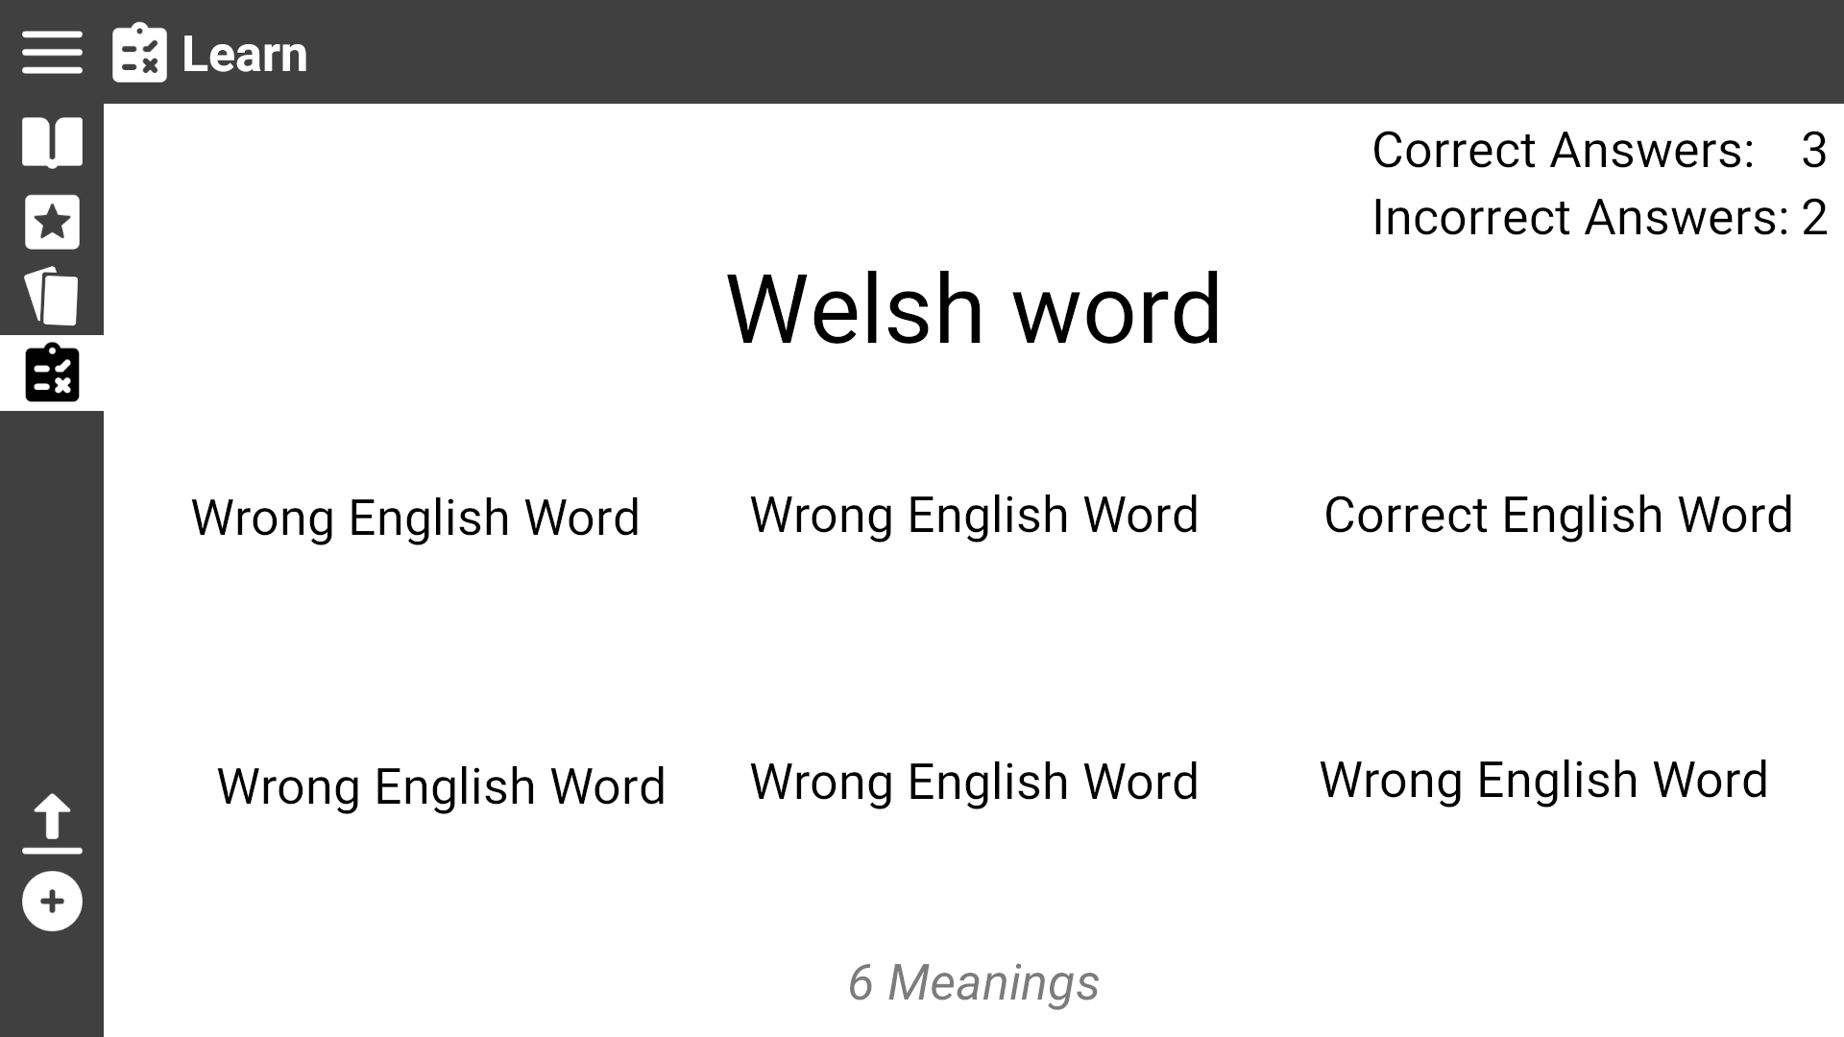
The user is presented with a word in Welsh/English with six words in the other language.
The user must click on the one they believe matches the meaning of the large word
Use Case 5.2: Start ‘6 Meanings’ test
The user is presented with a record of their current score
Name of type of test

Slide 22
Use Case 5.3: Start ‘Translation’ test
Click the ‘Study’ icon

Slide 23
Use Case 5.3: Start ‘Translation’ test
From the Study page click the ‘Translate’ box

Slide 24
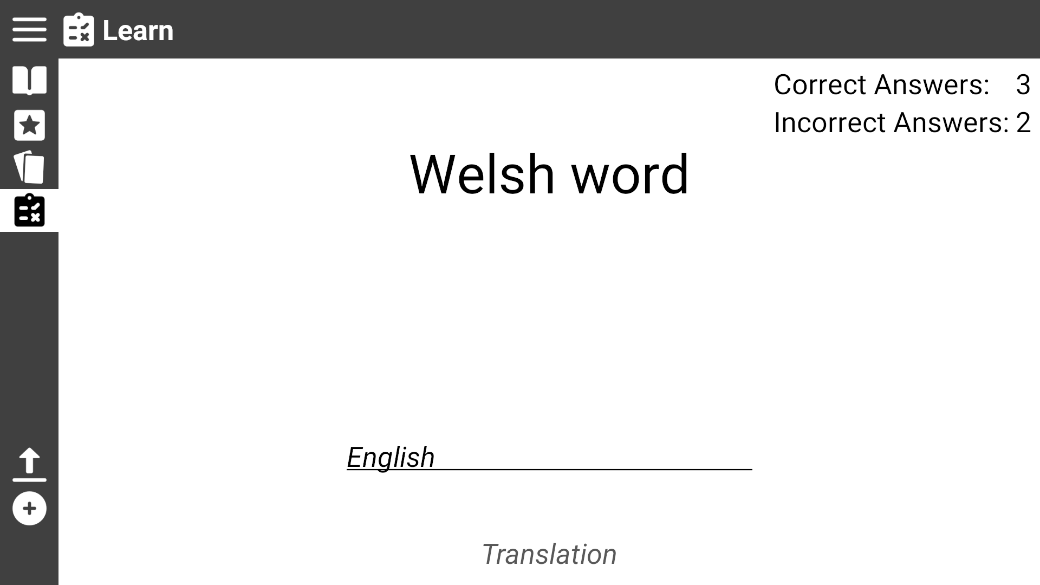
The user is presented with a word in Welsh/English a textbox. The user must type the translation of the word in the textbox
Use Case 5.3: Start ‘Translation’ test
The user is presented with a record of their current score
Name of type of test

Slide 25
Use Case 6: View Flashcards
Click the ‘Flashcards’ icon

Slide 26

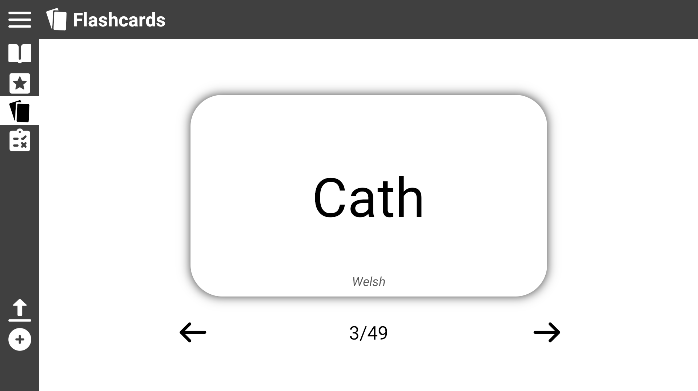
Use Case 6: View Flashcards
The user is presented a flashcard with one of their practise words
The user can click the card to flip it and see the translation
Language is shown at the bottom

Slide 27

Use Case 6: View Flashcards
The user can click the arrows to move to the next or previous card

Slide 28
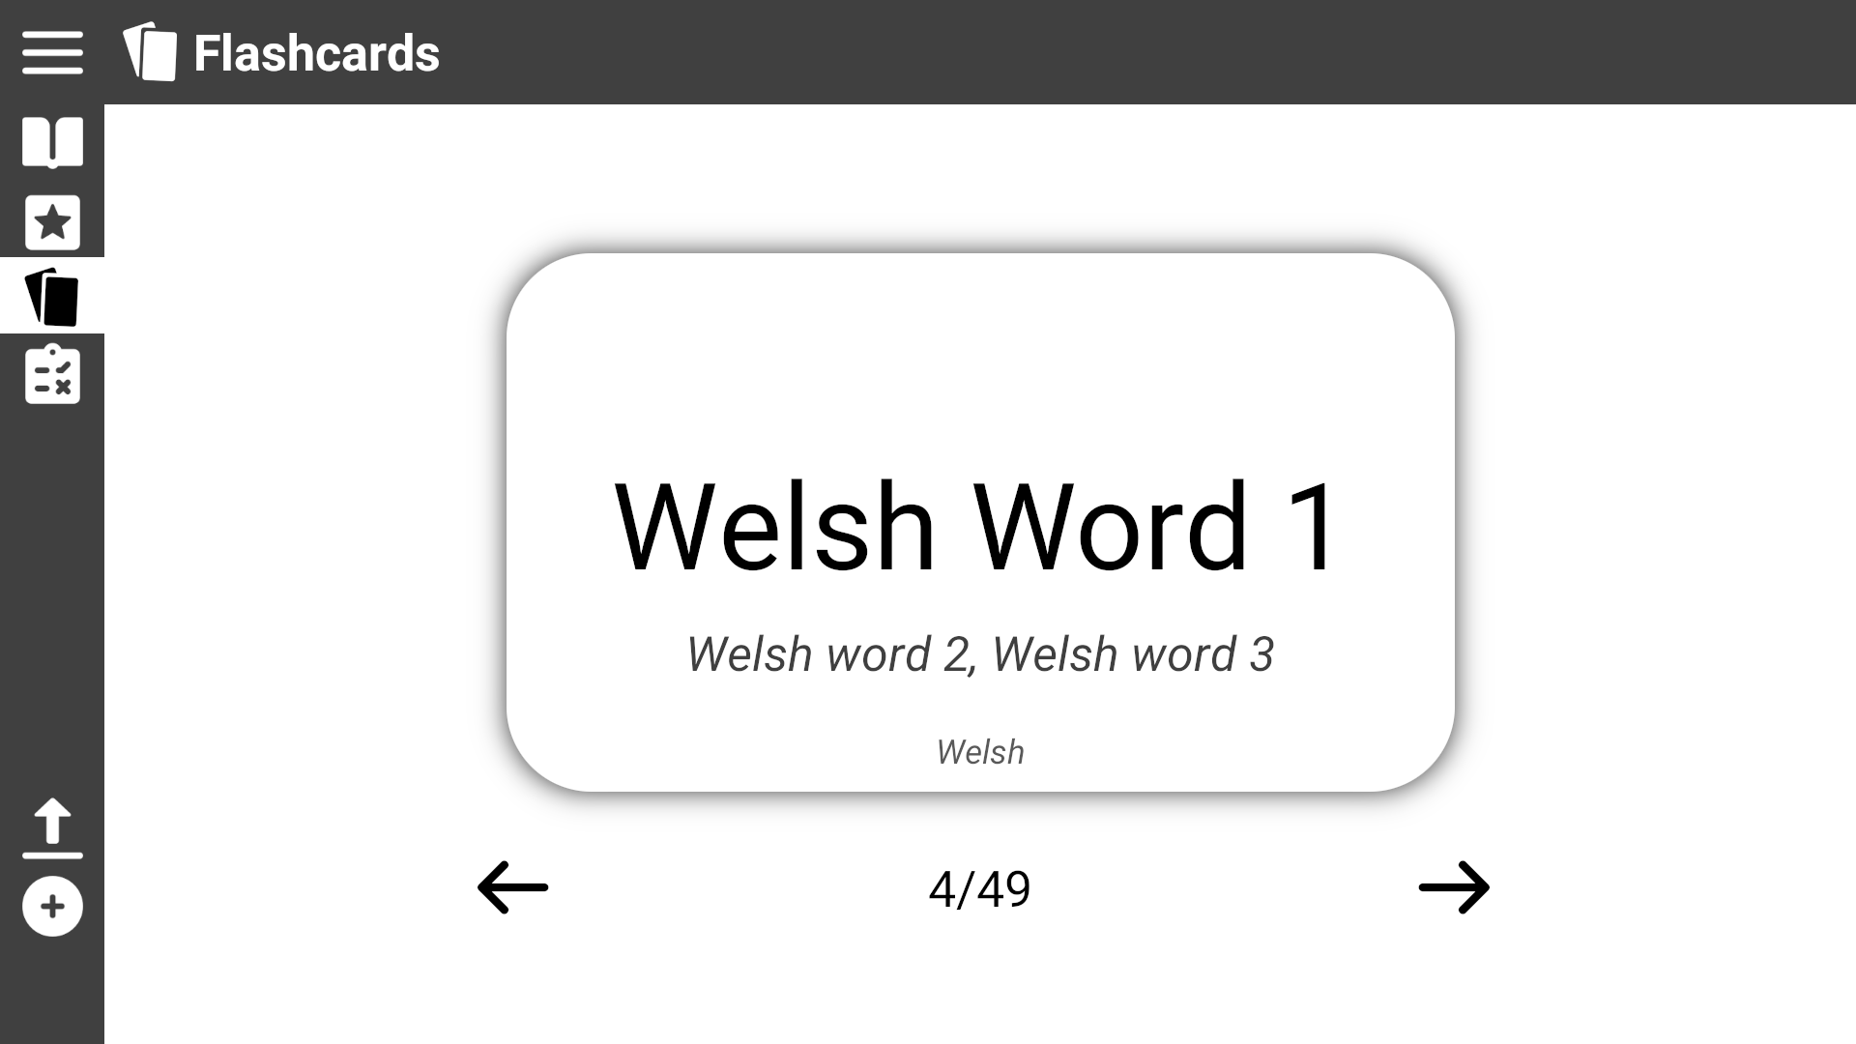
Use Case 6: View Flashcards
If the word on the other side can be translated in different ways the other translations are shown here
The user can click the card to flip it and see the translation

Slide 29
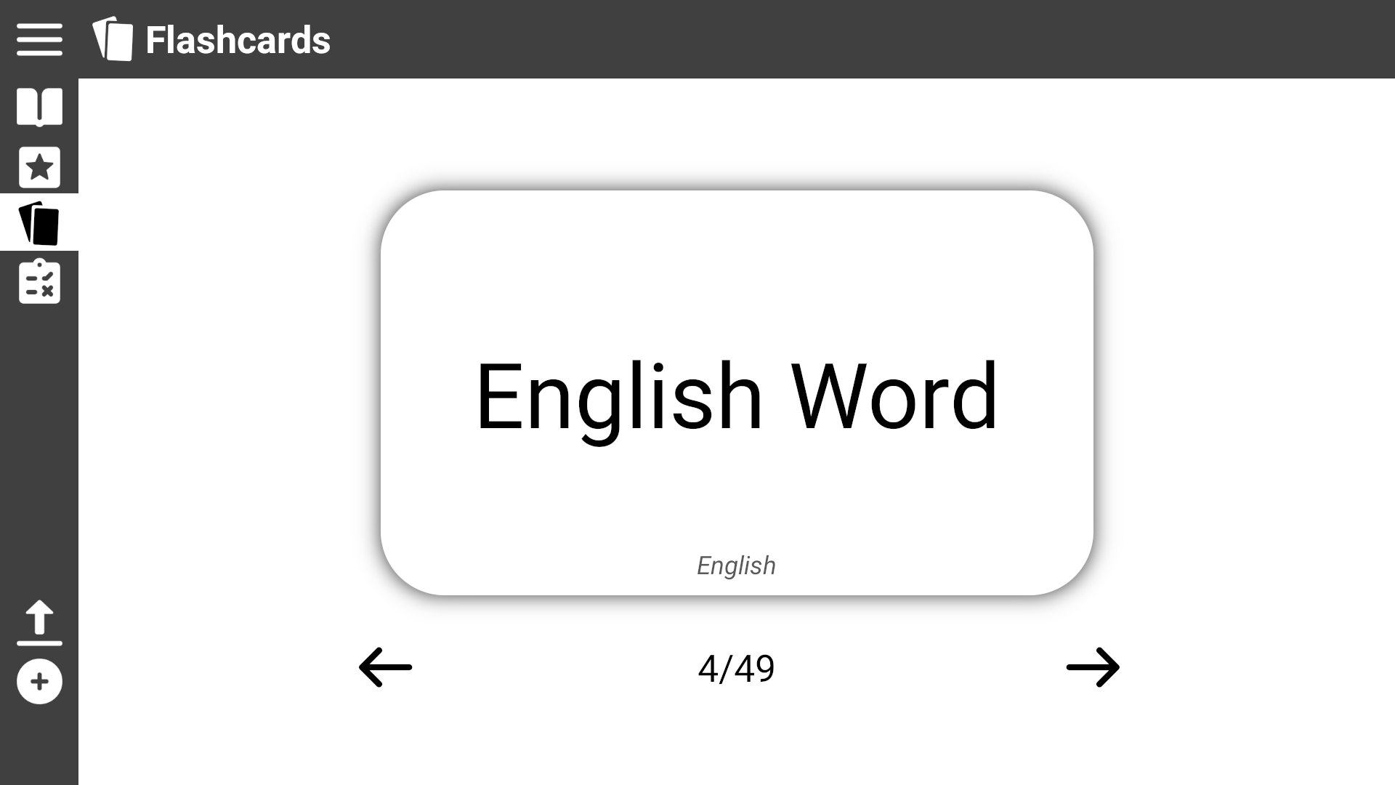
Use Case 6: View Flashcards

Slide 30
Use Case 7: Add a new word
Click the ‘Add’ icon

Slide 31

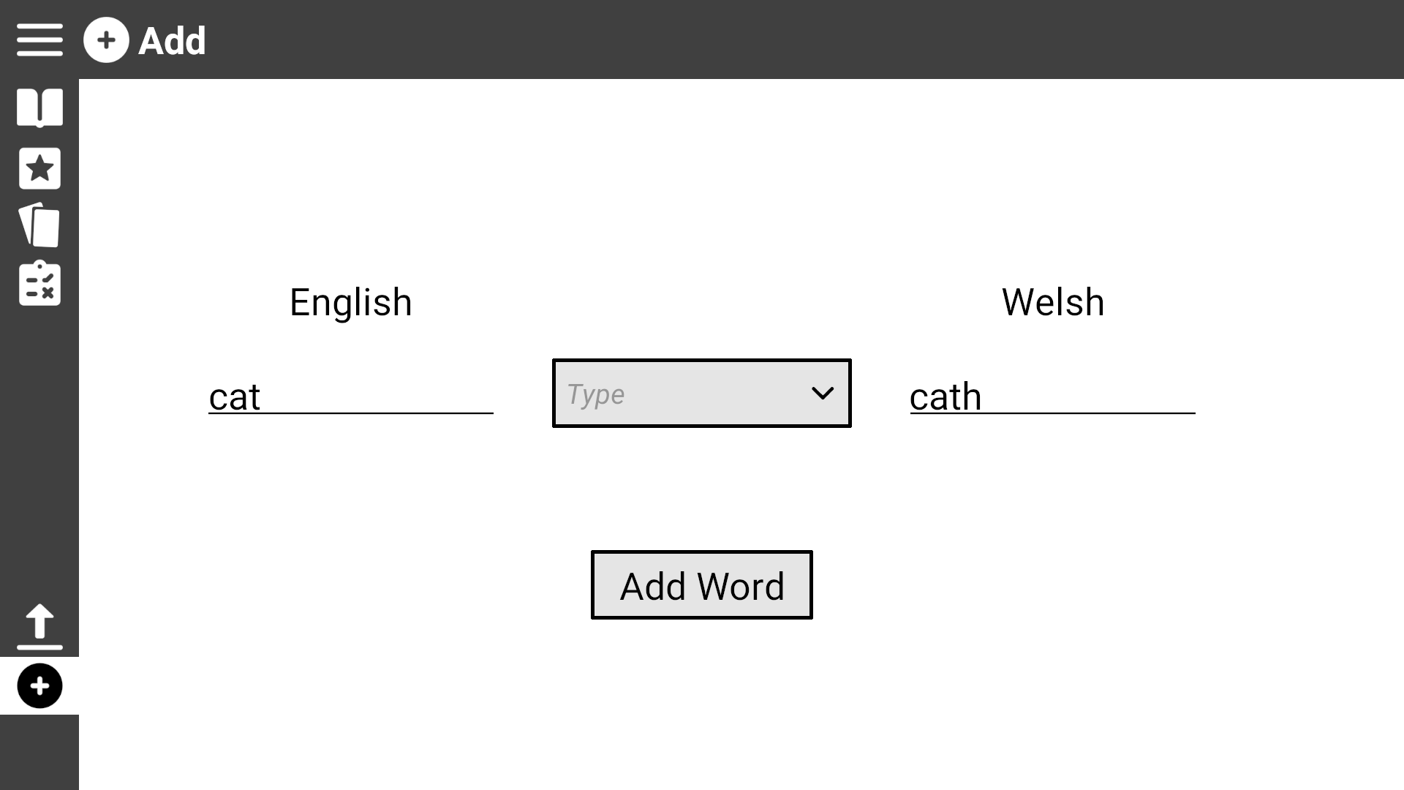

Use Case 7: Add a new word
Click on the drop down box to view the word types

Slide 32
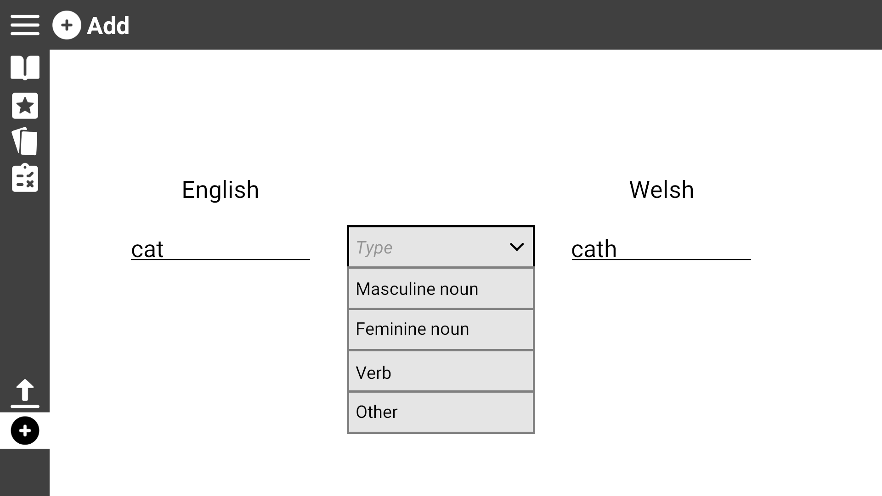
Use Case 7: Add a new word
Click on the drop down box to view the word types

Slide 33
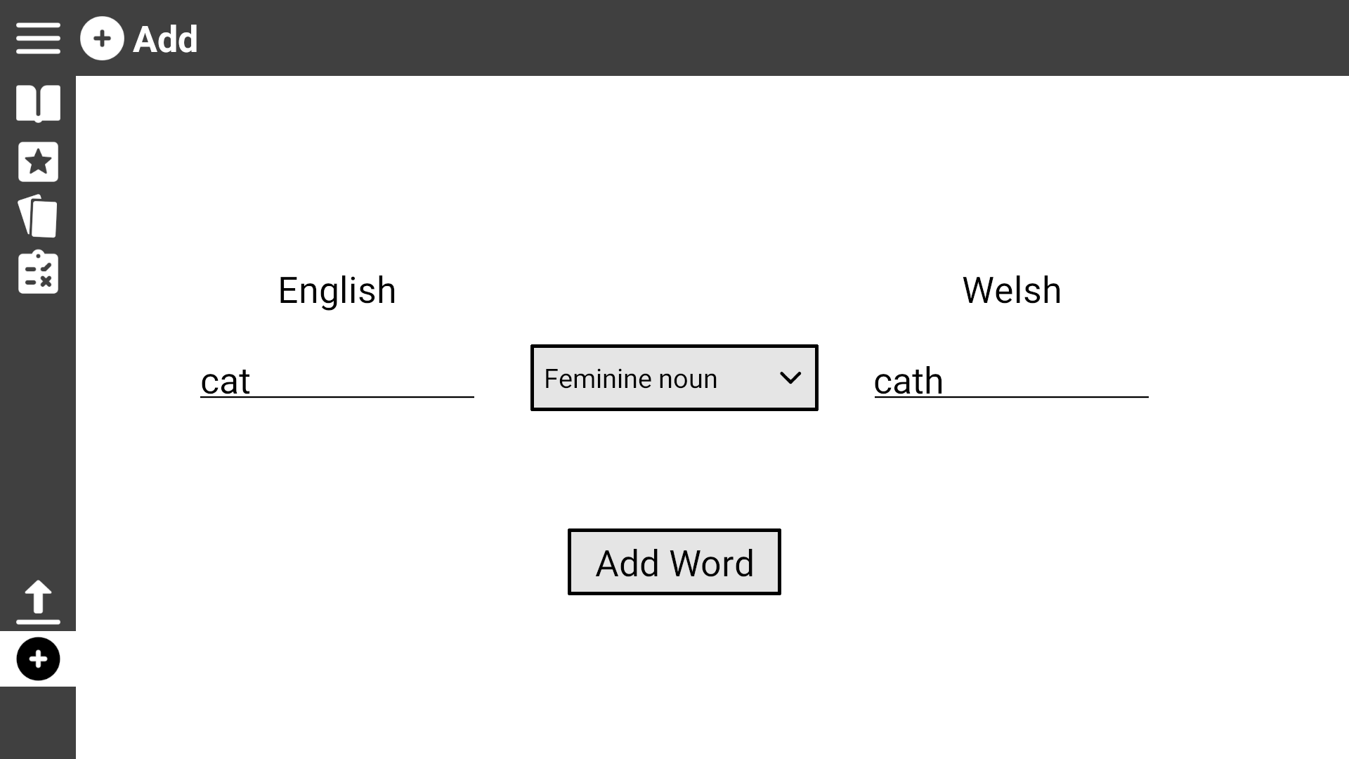
Use Case 7: Add a new word
Once every field is filled, click ‘Add Word’ to add it to the dictionary, it is also automatically added to the practise list

Slide 34
Use Case 8: Change word ordering
If not already, navigate to the ‘Practise List’ or the ‘Dictionary Page’ by clicking on their respective icons

Slide 35
Use Case 8: Change word ordering
Click on the ‘Change Language Order’ icon

Slide 36
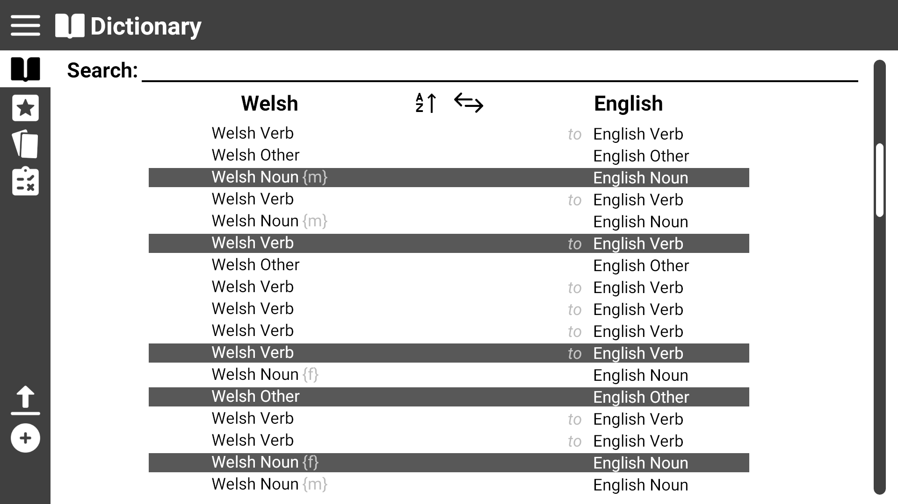
Use Case 8: Change word ordering
Click on the ‘Change Language Order’ icon to revert back

Slide 37
Use Case 8: Change word ordering
Click on the ‘Change A/Z Order’ icon to change to alphabetically ascending or descending

Slide 38

Use Case 8: Change word ordering

