Slide 1
Translation App Concept UI
Group 20
Version 0.1

Slide 2
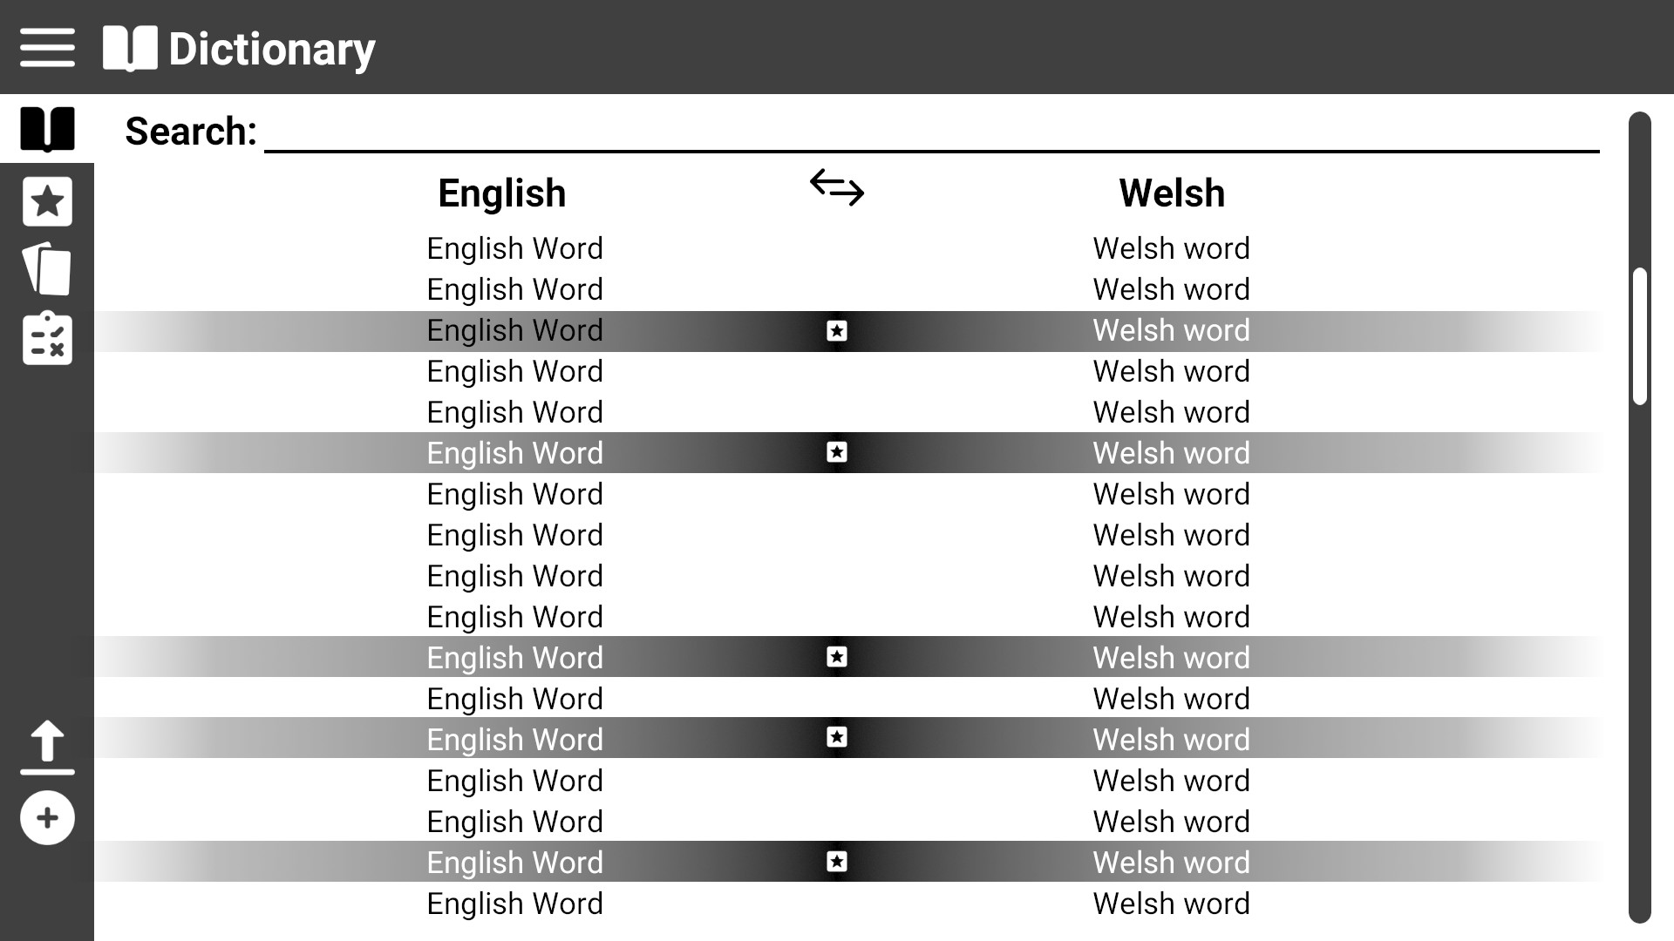
Page Title
This shows the general layout of the program
Expand menu
Scroll bar
Menu Options

Slide 3
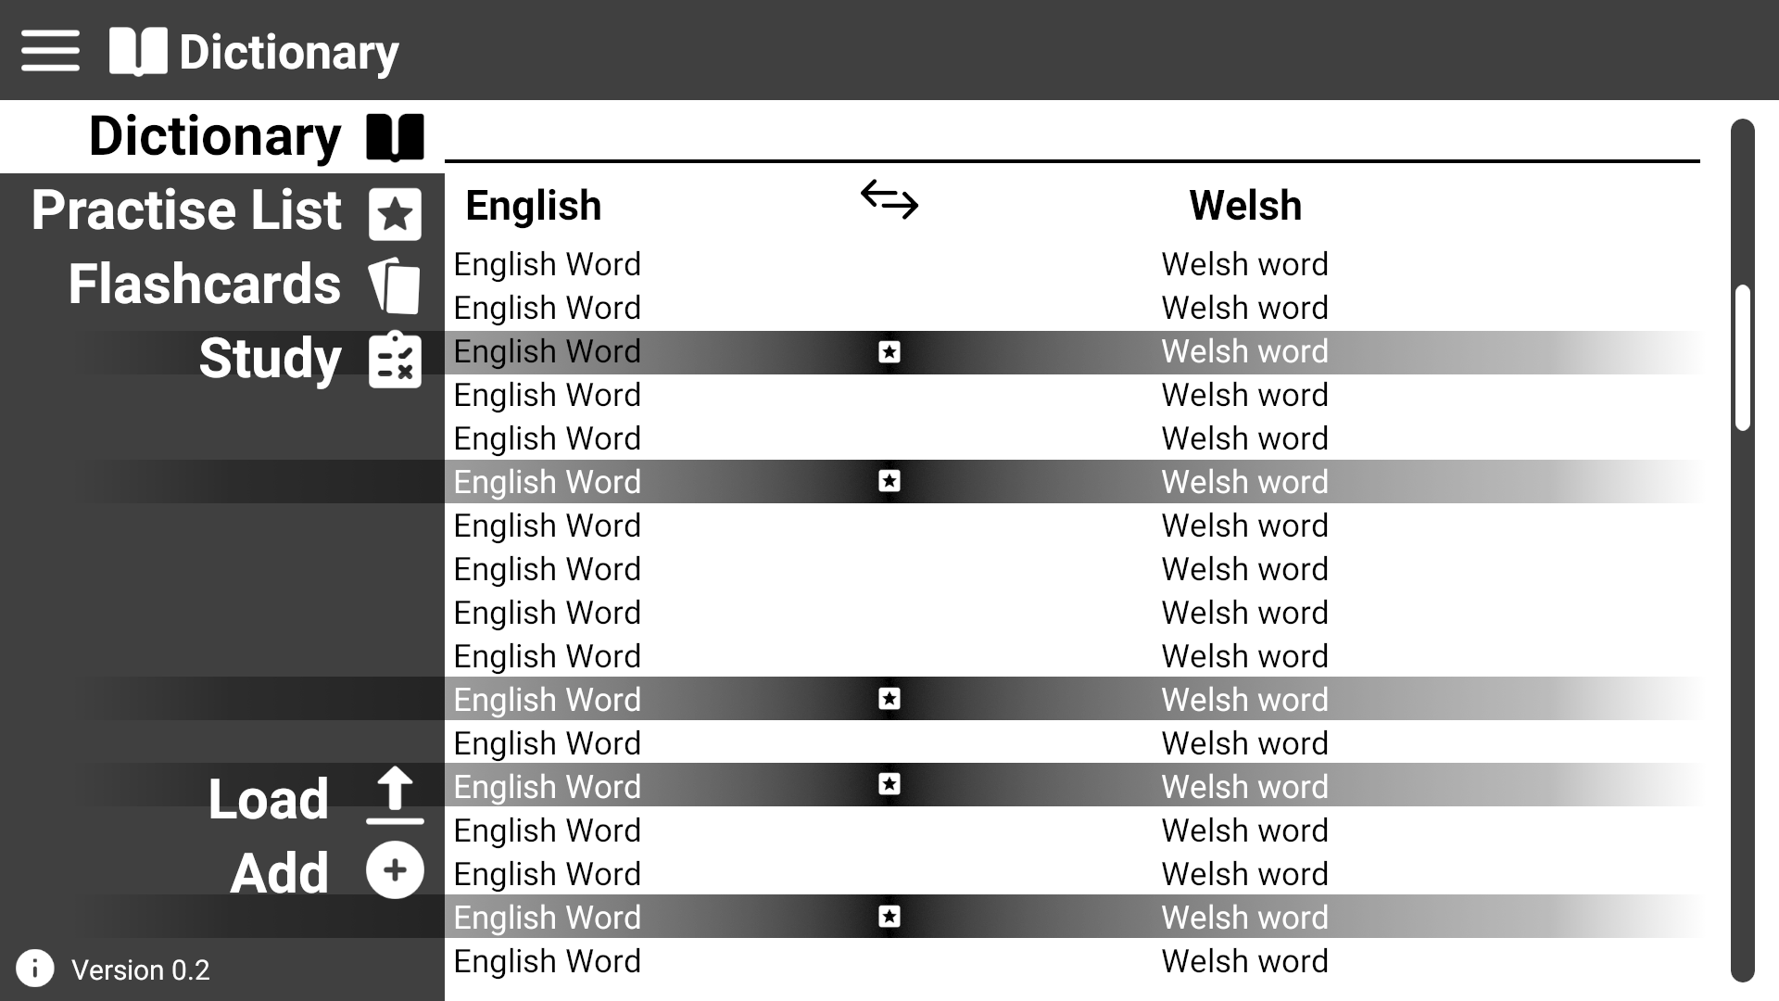
This shows the menu expanded
Current page highlighted
Click here to expand the menu
Click on menu items to switch to their page

Slide 4
This shows the general layout of the program
You can also switch pages by directly clicking on the icon when the menu isn’t expanded

Slide 5
Use Case 1: View dictionary
Click on the Dictionary Icon

Slide 6
Use Case 1: View dictionary
User is then presented with the dictionary page
Click here to change ordering of words
Click on words to add/remove them from the practise list

Slide 7
Use Case 2: Search for a word
Click on Dictionary or Practise List

Slide 8
Use Case 2: Search for a word
Click on the search textbox and start to type for your word

Slide 9
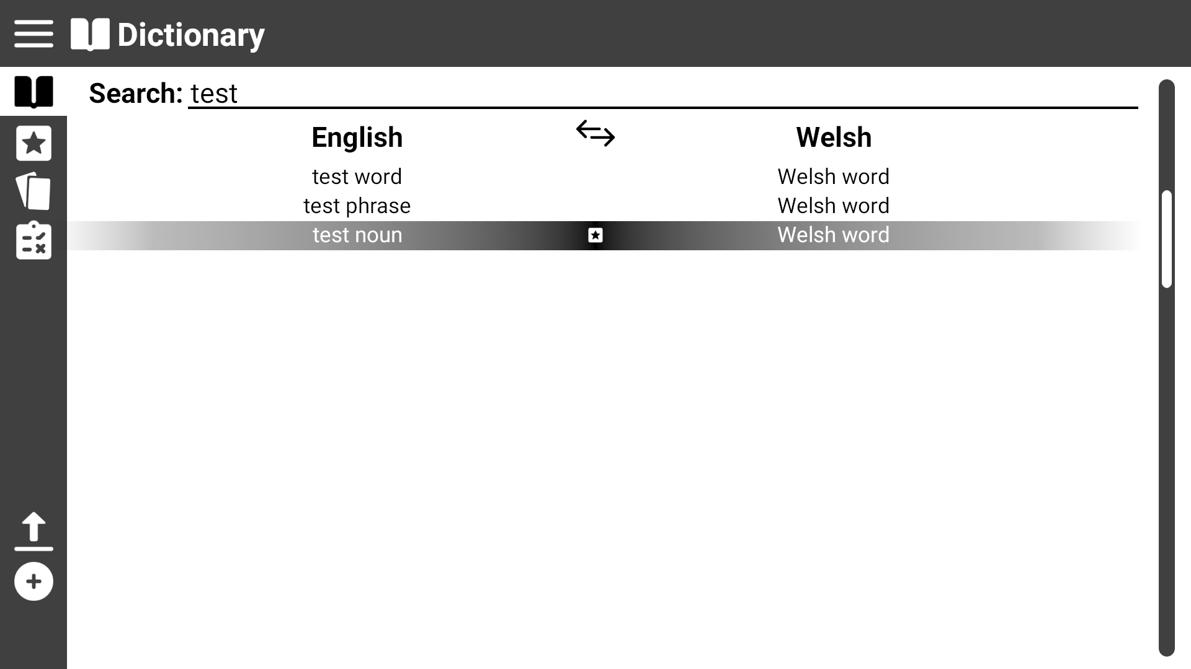
Use Case 2: Search for a word
Results from the search are filtered and displayed in real time

Slide 10

Use Case 3: View practise list
Click on the Practise List icon

Slide 11
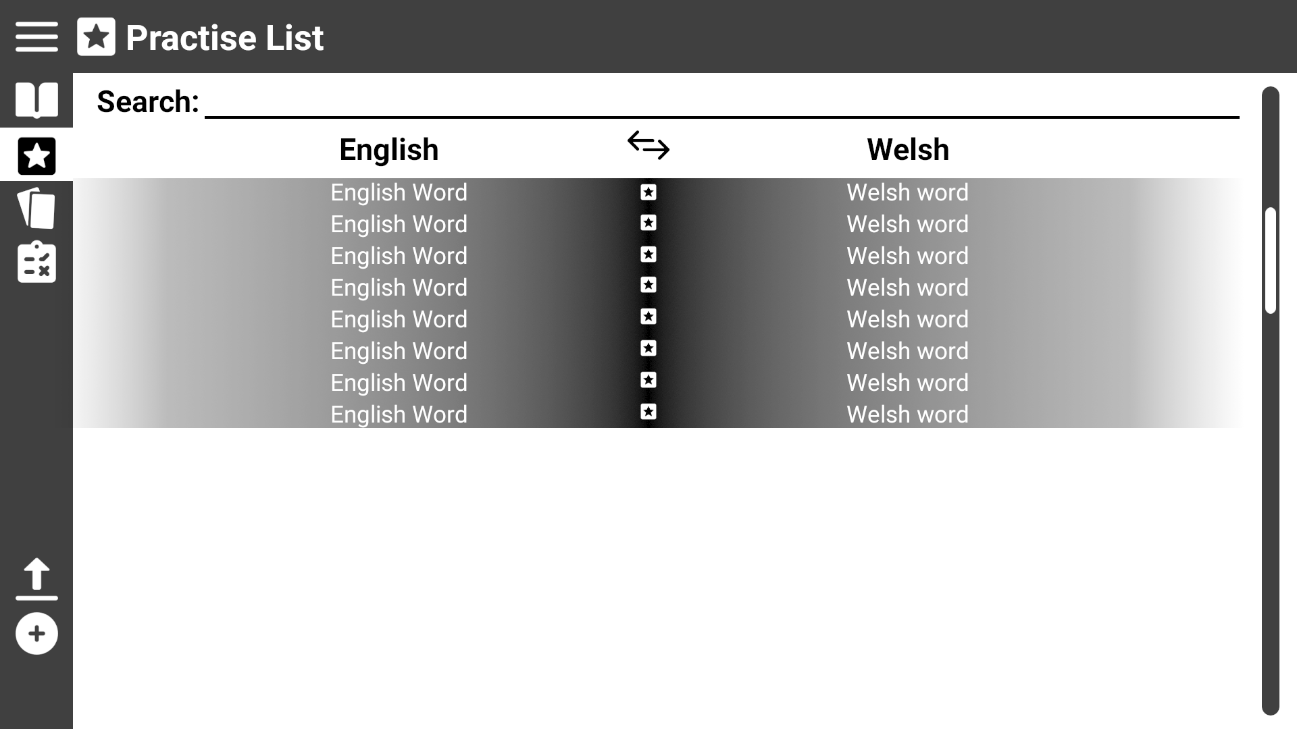
Use Case 3: View practise list
User is presented with the practist list page

Slide 12
Use Case 4: Modify practise list
Click on a word to remove it from the practise list
You can only remove practise words from the practise page.

Slide 13
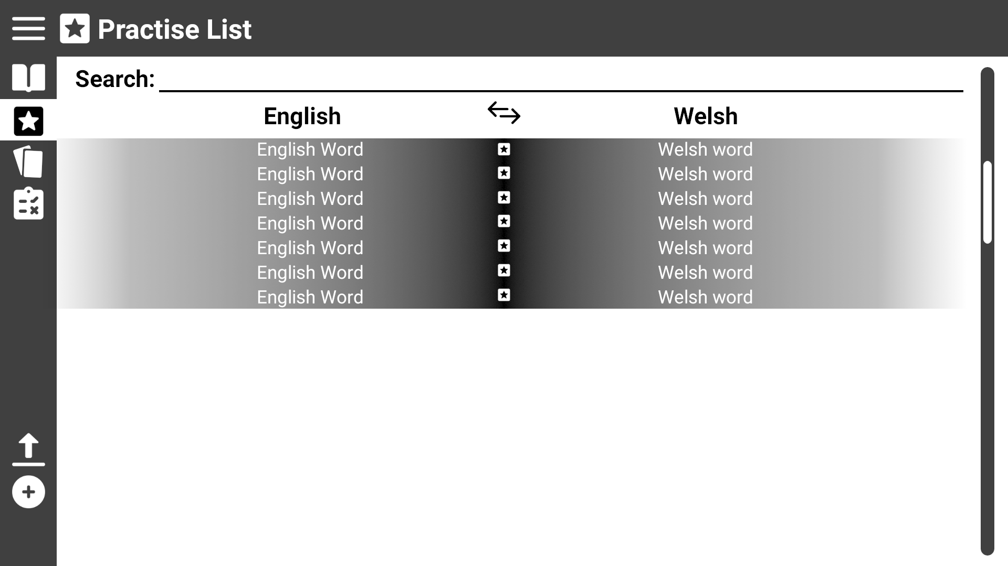
Use Case 4: Modify practise list
Click on the Dictionary icon
To add words to the list need to visit the dictionary page

Slide 14
Use Case 4: Modify practise list
Click on an unmarked word to add it the practise list
Clicking on marked words will remove them from the practise list

Slide 15
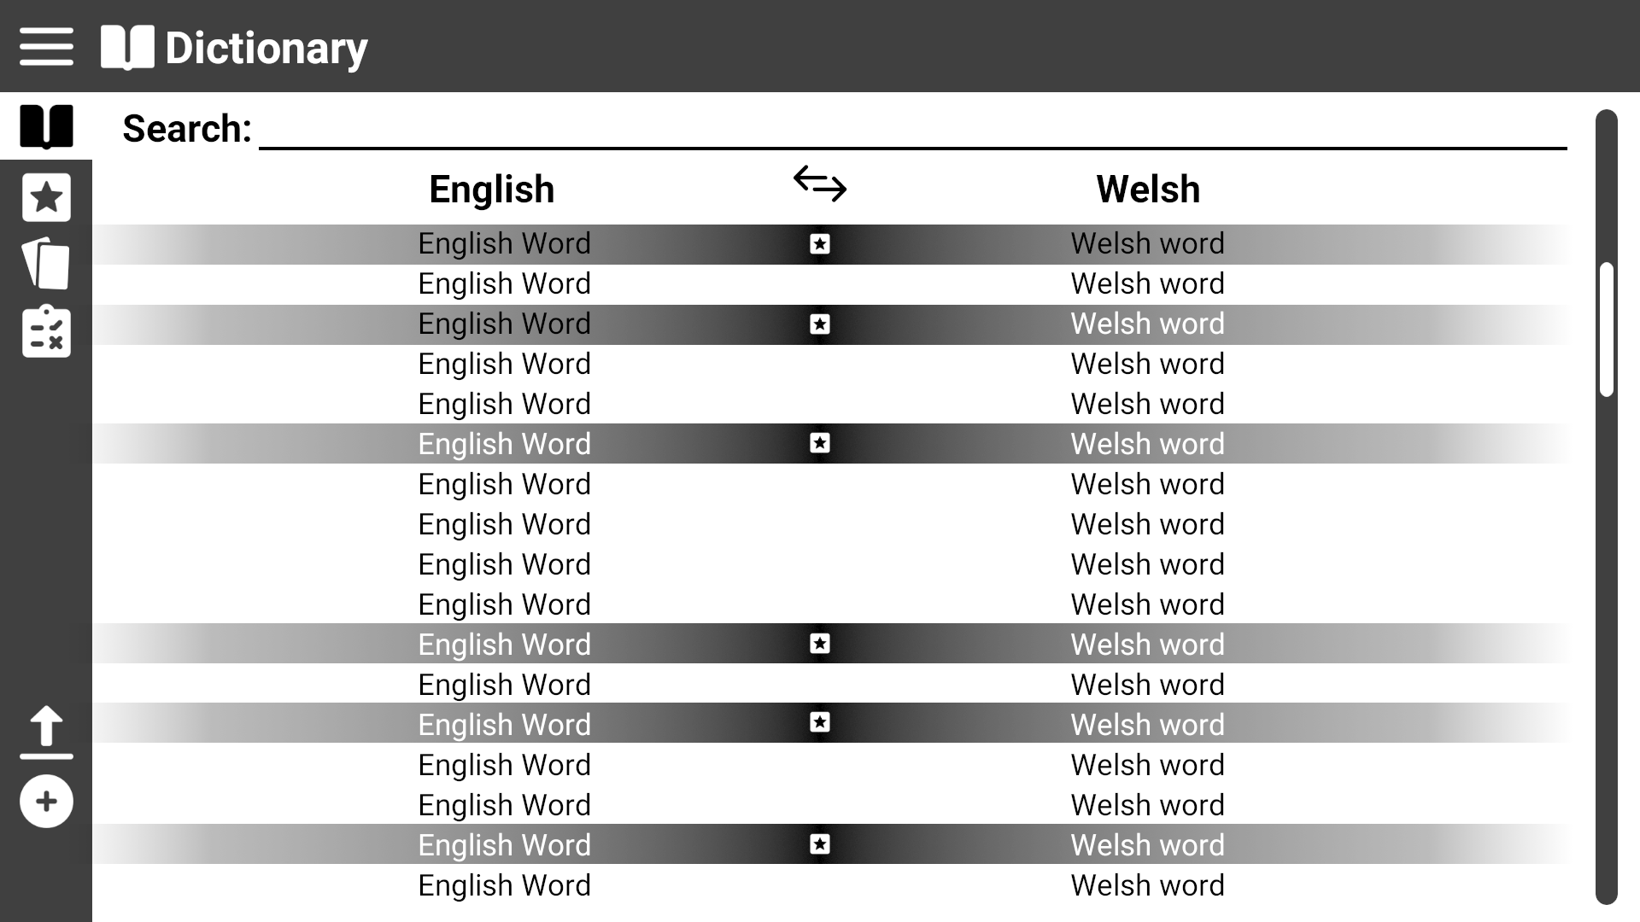
Use Case 4: Modify practise list
Word is now added to practise list

Slide 16
Use Case 5: Start a test
Click on Study icon

Slide 17
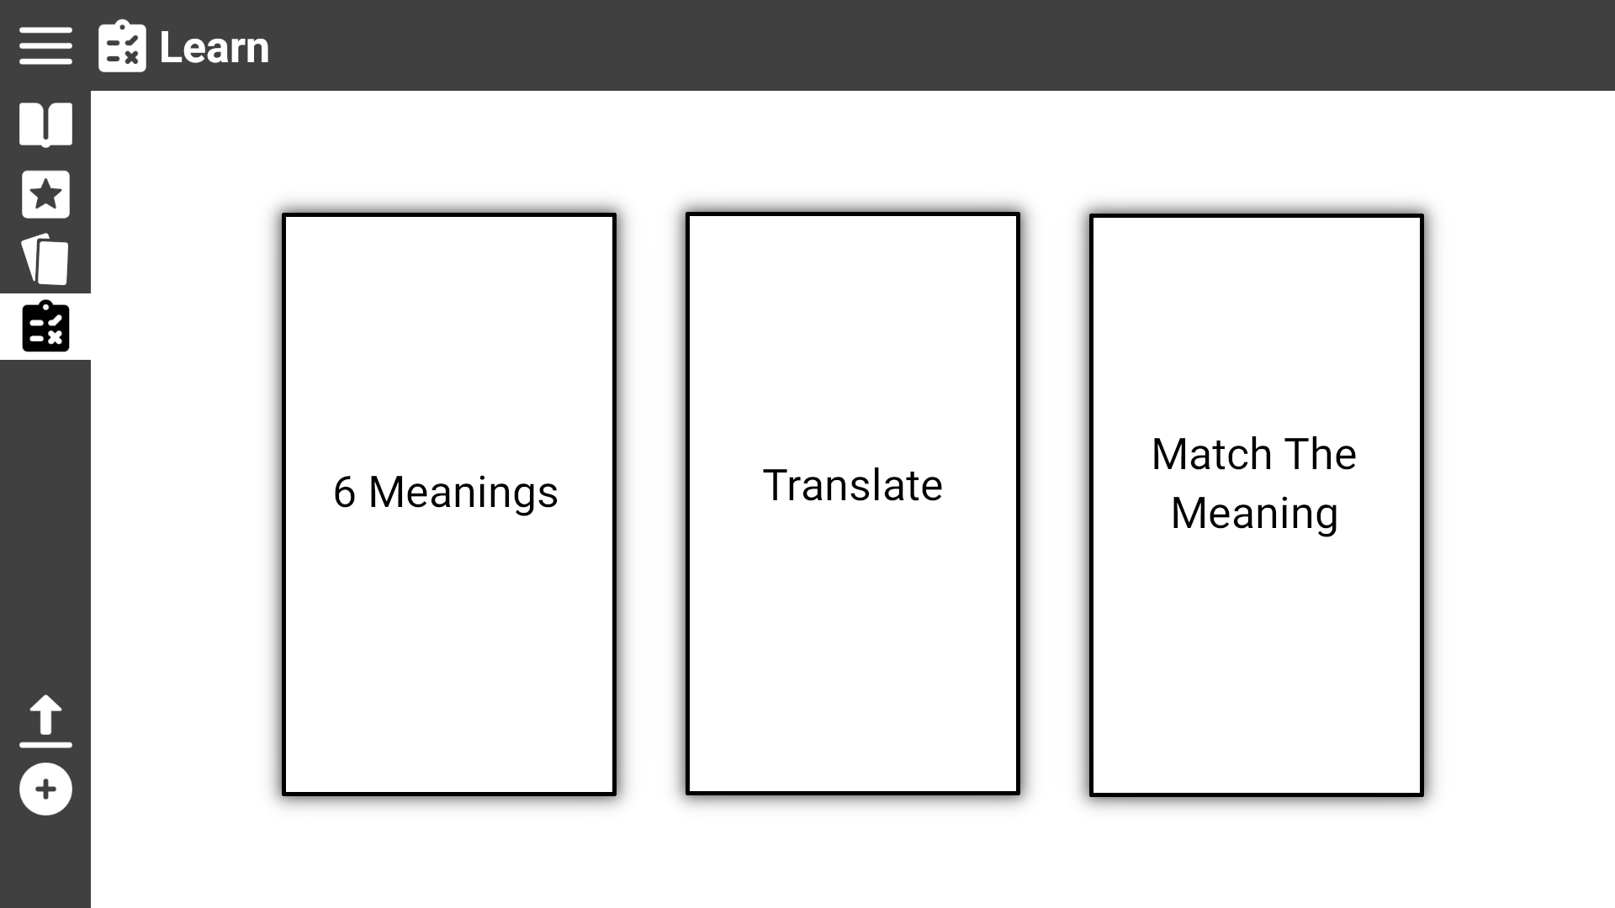
Use Case 5: Start a test
The user is presented with 3 different types of tests they can click on.

Slide 18
Use Case 5.1: Start ‘Match The Meaning’ test
From the Study page click the ‘Match the Meaning’ box

Slide 19
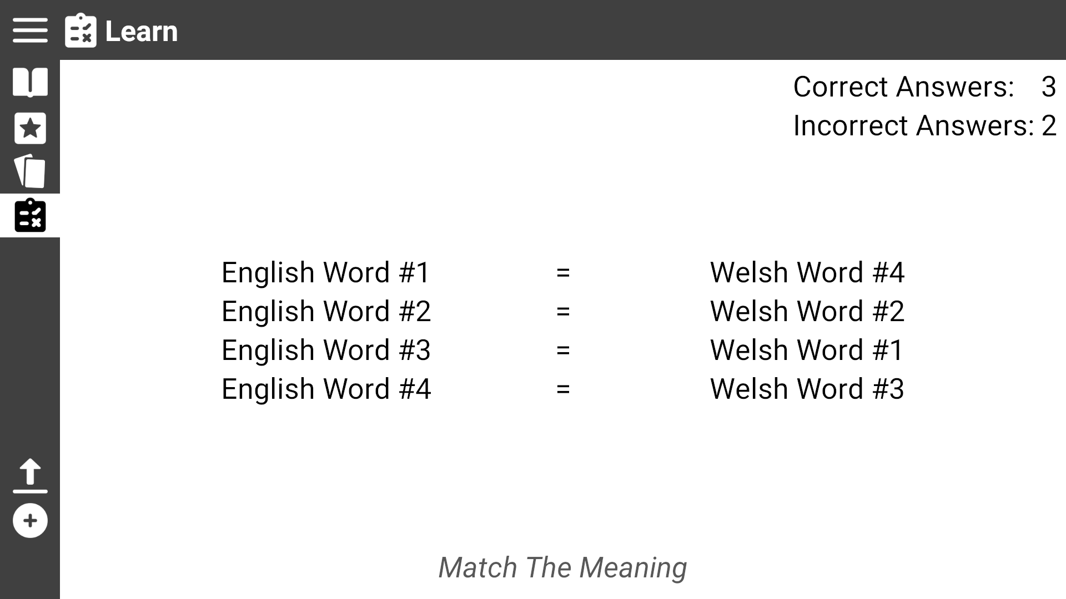
Use Case 5.1: Start ‘Match The Meaning’ test
The user is presented with 8 words (4 pairs) and must match the word to it’s meaning by dragging it next to the word horizontally
The user is also presented with a record of their current score
Name of type of test

Slide 20
Use Case 5.2: Start ‘6 Meanings’ test
Click the Study icon

Slide 21
Use Case 5.2: Start ‘6 Meanings’ test
From the Study page click the ‘6 Meanings’ box

Slide 22
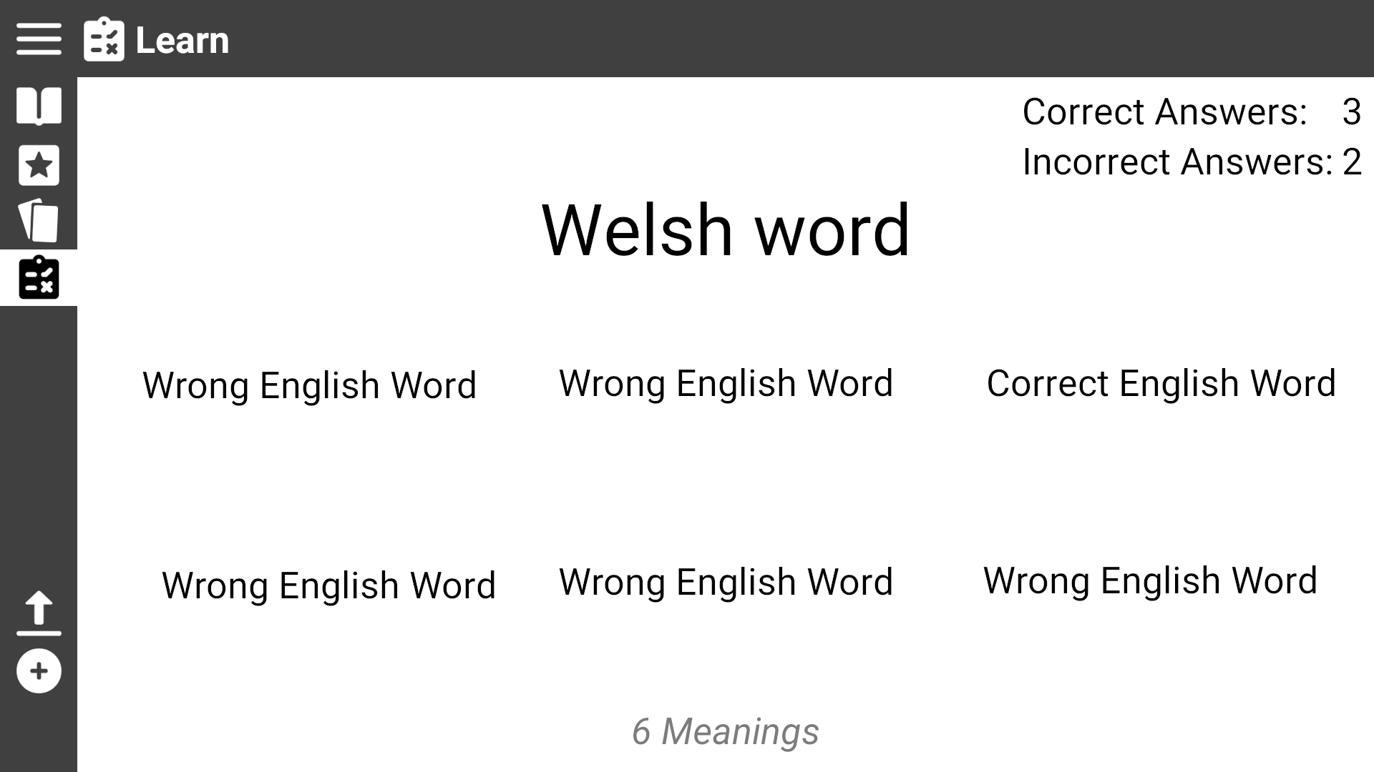
The user is presented with a word in Welsh/English with 6 words in the other language.
The user must click on the one they believe matches the meaning of the large word
Use Case 5.2: Start ‘6 Meanings’ test
The user is also presented with a record of their current score
Name of type of test

Slide 23
Use Case 5.3: Start ‘Translation’ test
Click the Study icon

Slide 24
Use Case 5.3: Start ‘Translation’ test
From the Study page click the ‘Translate’ box

Slide 25
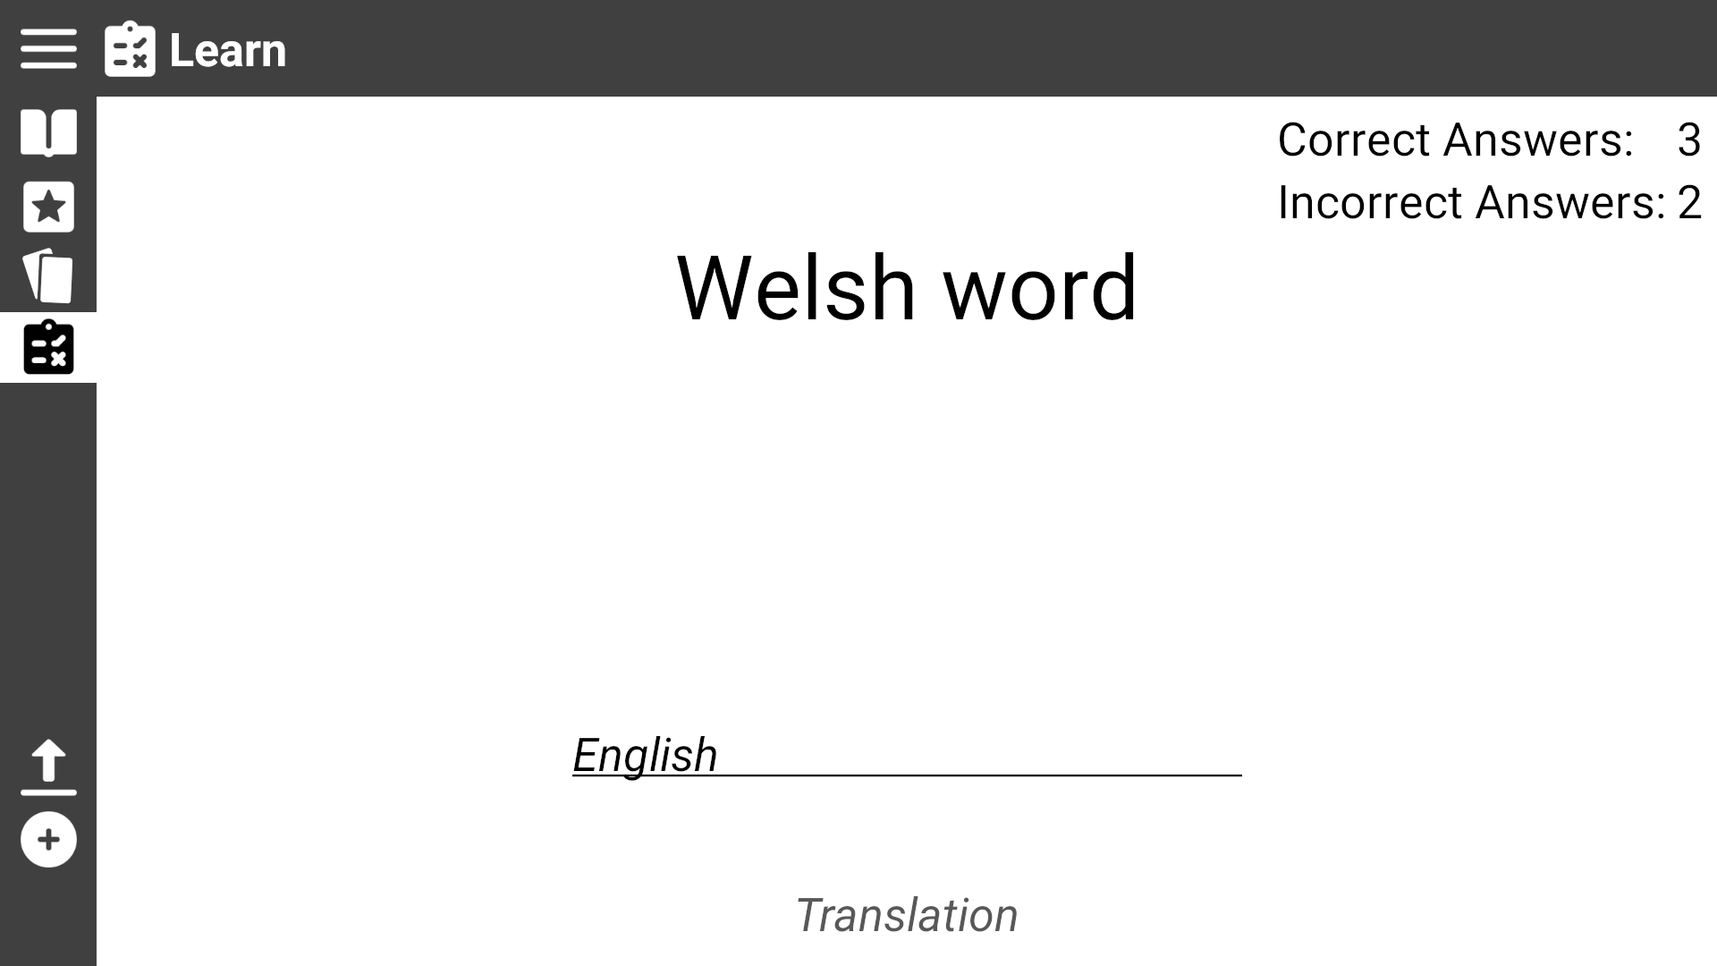
The user is presented with a word in Welsh/English a textbox. The user must type the translation of the word in the textbox
Use Case 5.3: Start ‘Translation’ test
The user is also presented with a record of their current score
Name of type of test

Slide 26
Use Case 6: View Flashcards
Click the Flashcards icon

Slide 27
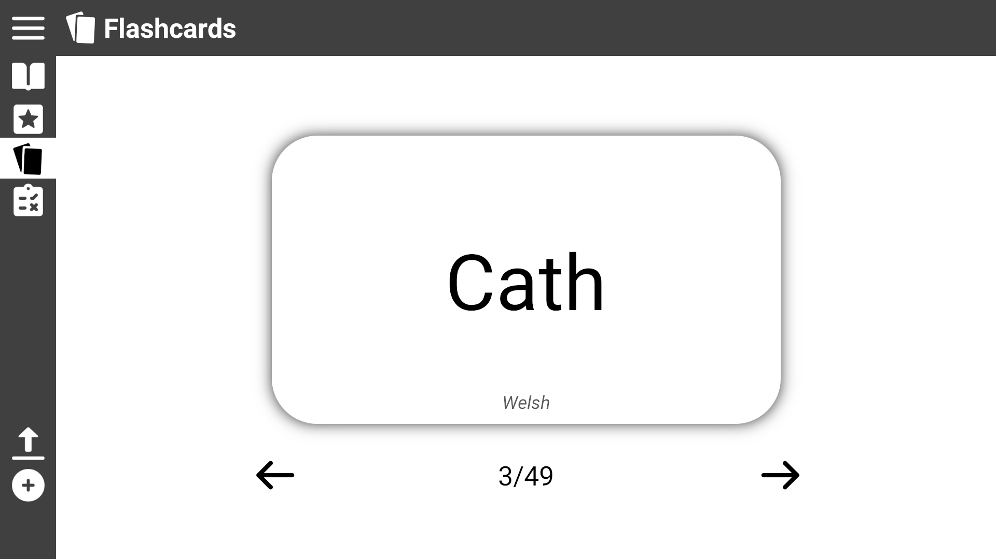
Use Case 6: View Flashcards
The user is presented a flashcard with one of their practise words
The user can click the card to flip it and see the translation

Slide 28

Use Case 6: View Flashcards
The user can click the arrows to move to the next or previous card

Slide 29
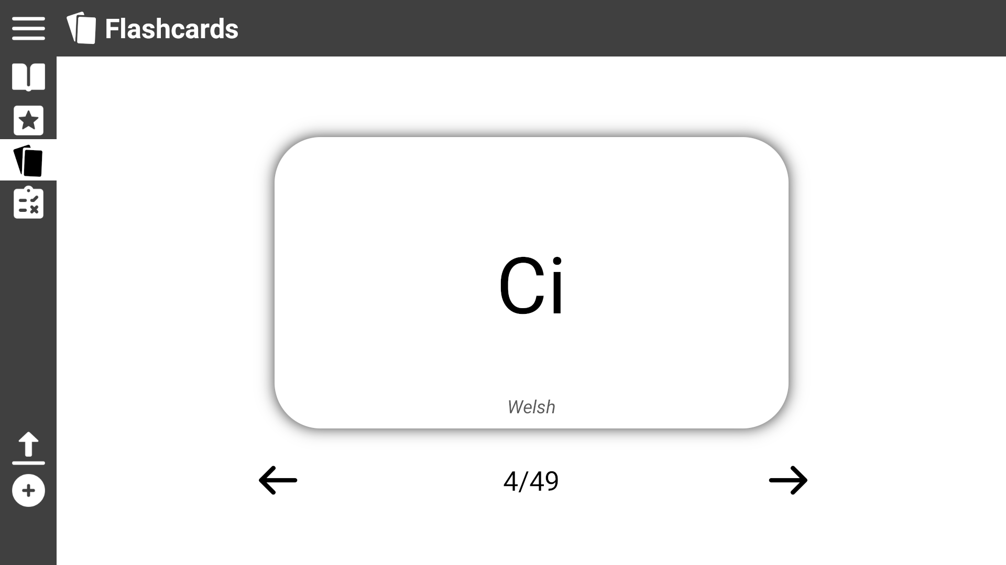
Use Case 6: View Flashcards
The user can click the card to flip it and see the translation

Slide 30

Use Case 6: View Flashcards

Slide 31
Use Case 7: Load a new dictionary
Click the Load icon

Slide 32
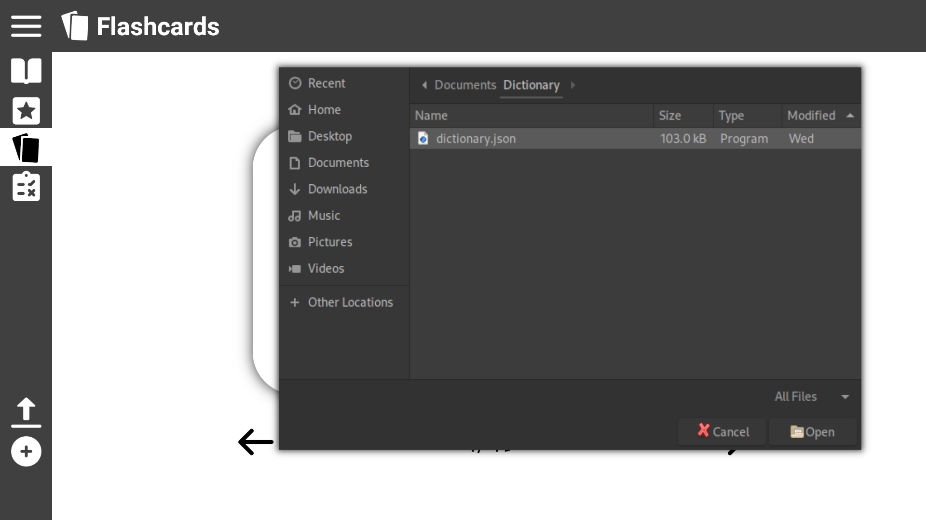
The user is presented with a upload file pop up which allows then to find the file in their local filesystem
Use Case 7: Load a new dictionary
1. Click the file you wish to upload
2. Then click the open icon

Slide 33
Use Case 8: Add a new word
Click the ‘Add’ icon

Slide 34
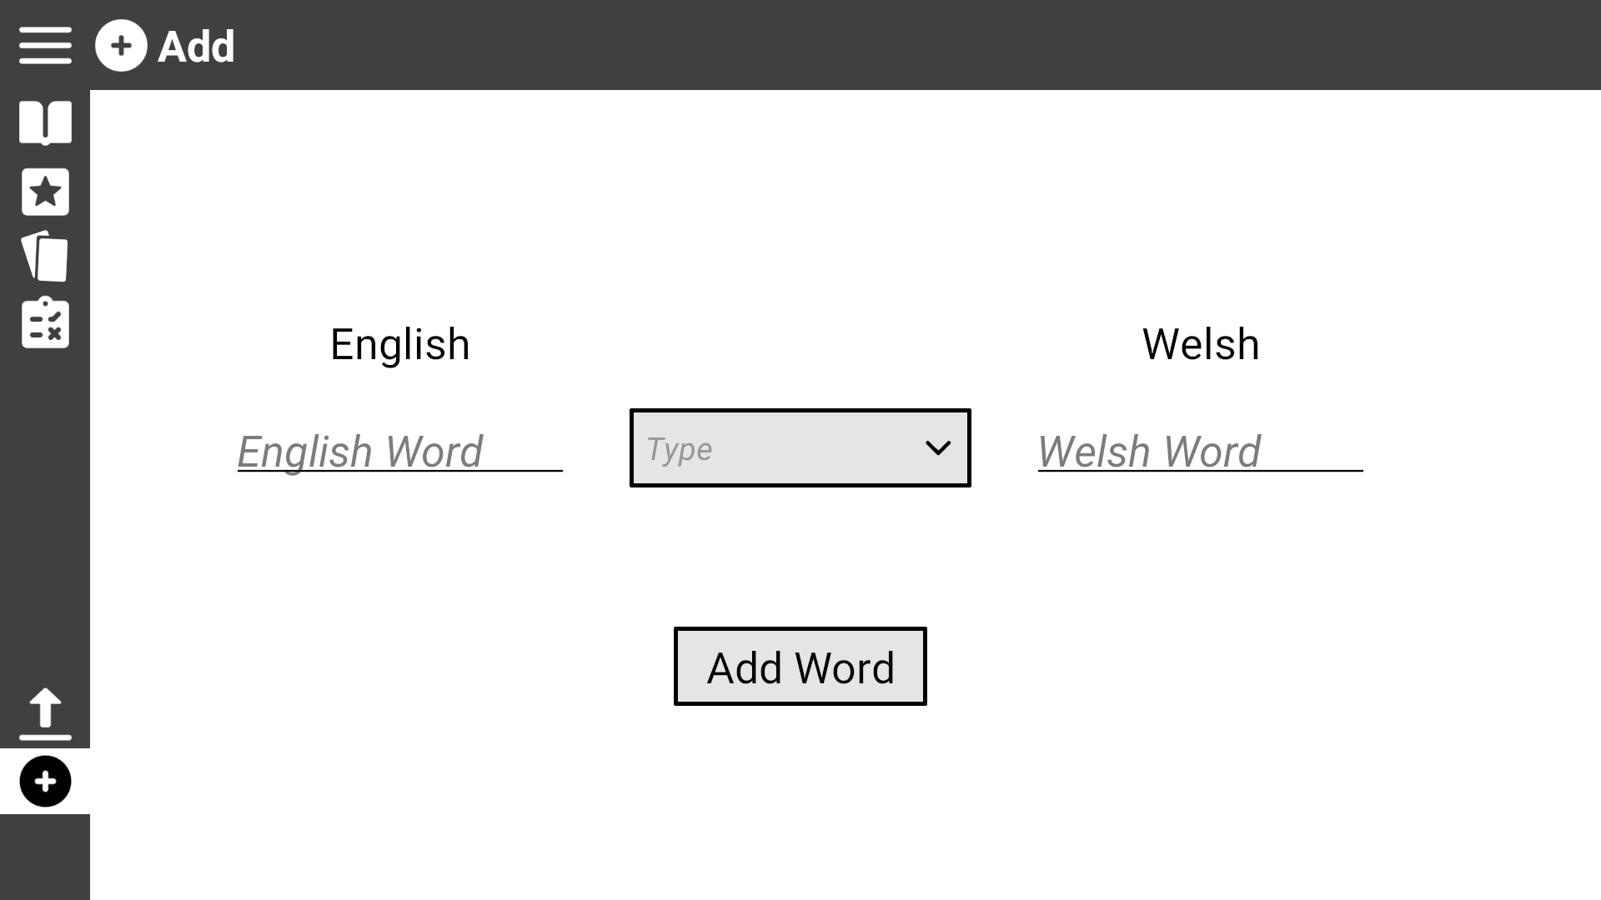
The user is presented with two text boxes one for the English version of the word and one for the Welsh version, a drop down box to select the word type, and an ‘Add Word’ button to add the word to the dictionary
Use Case 8: Add a new word
Fill in the meanings in their respected textboxes

Slide 35
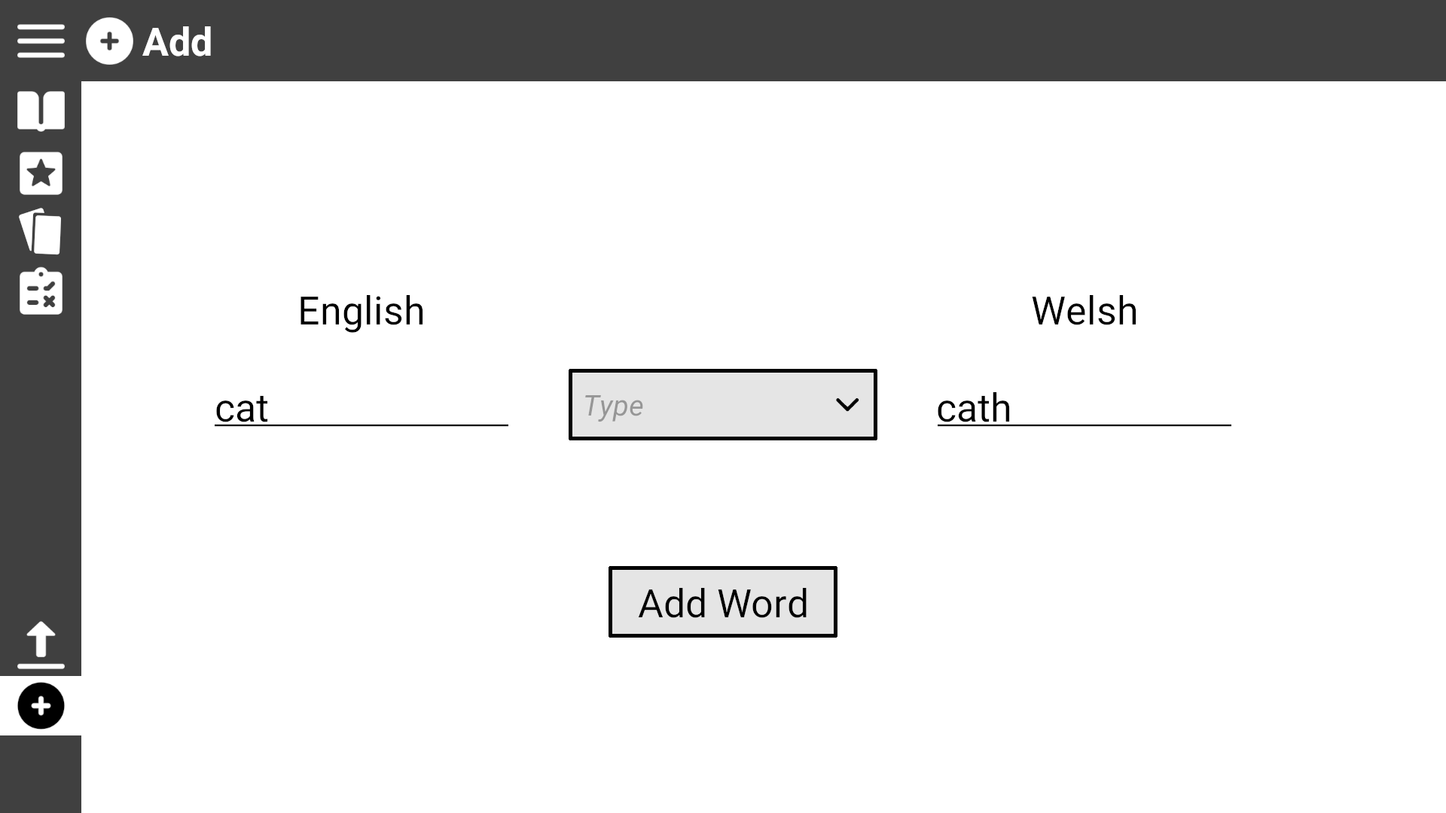
Use Case 8: Add a new word
Click on the drop down box to view the word types

Slide 36
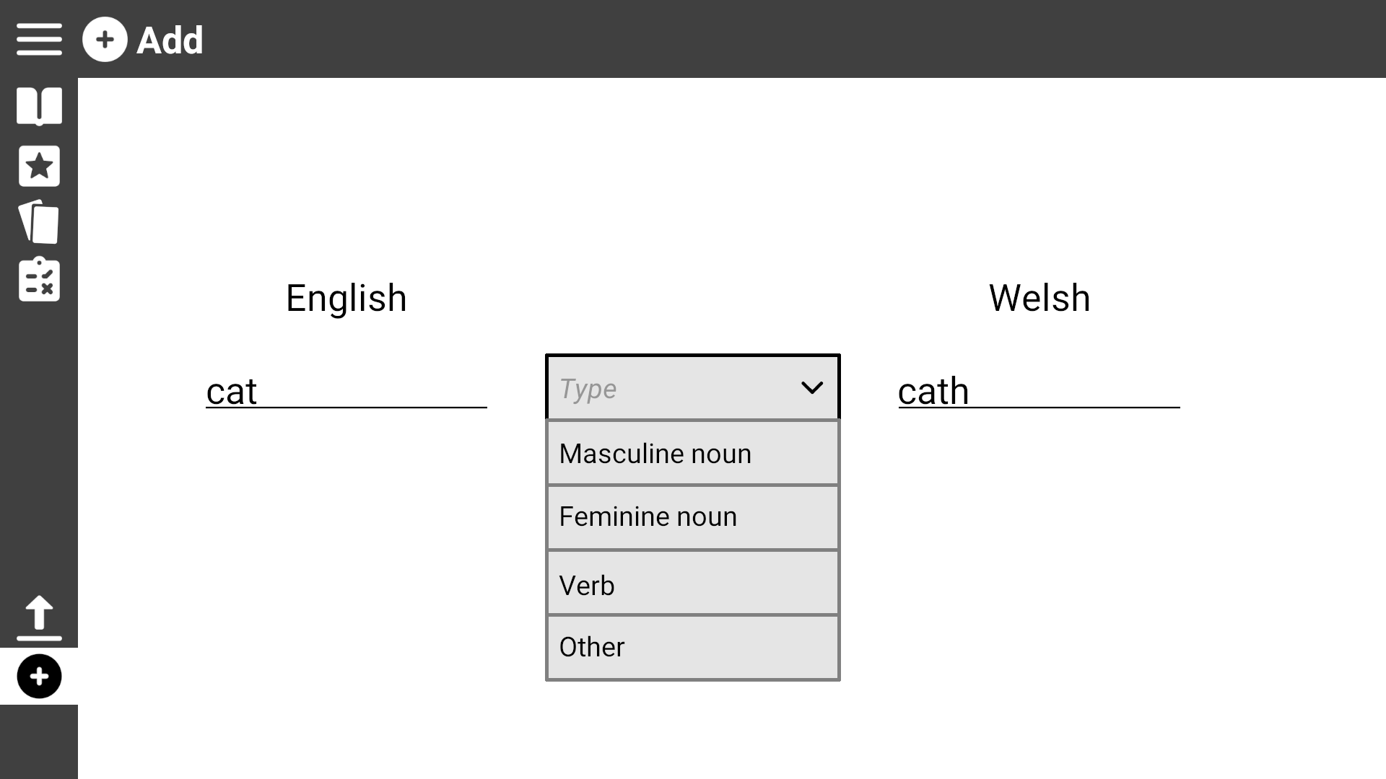
Use Case 8: Add a new word
Click on the drop down box to view the word types

Slide 37
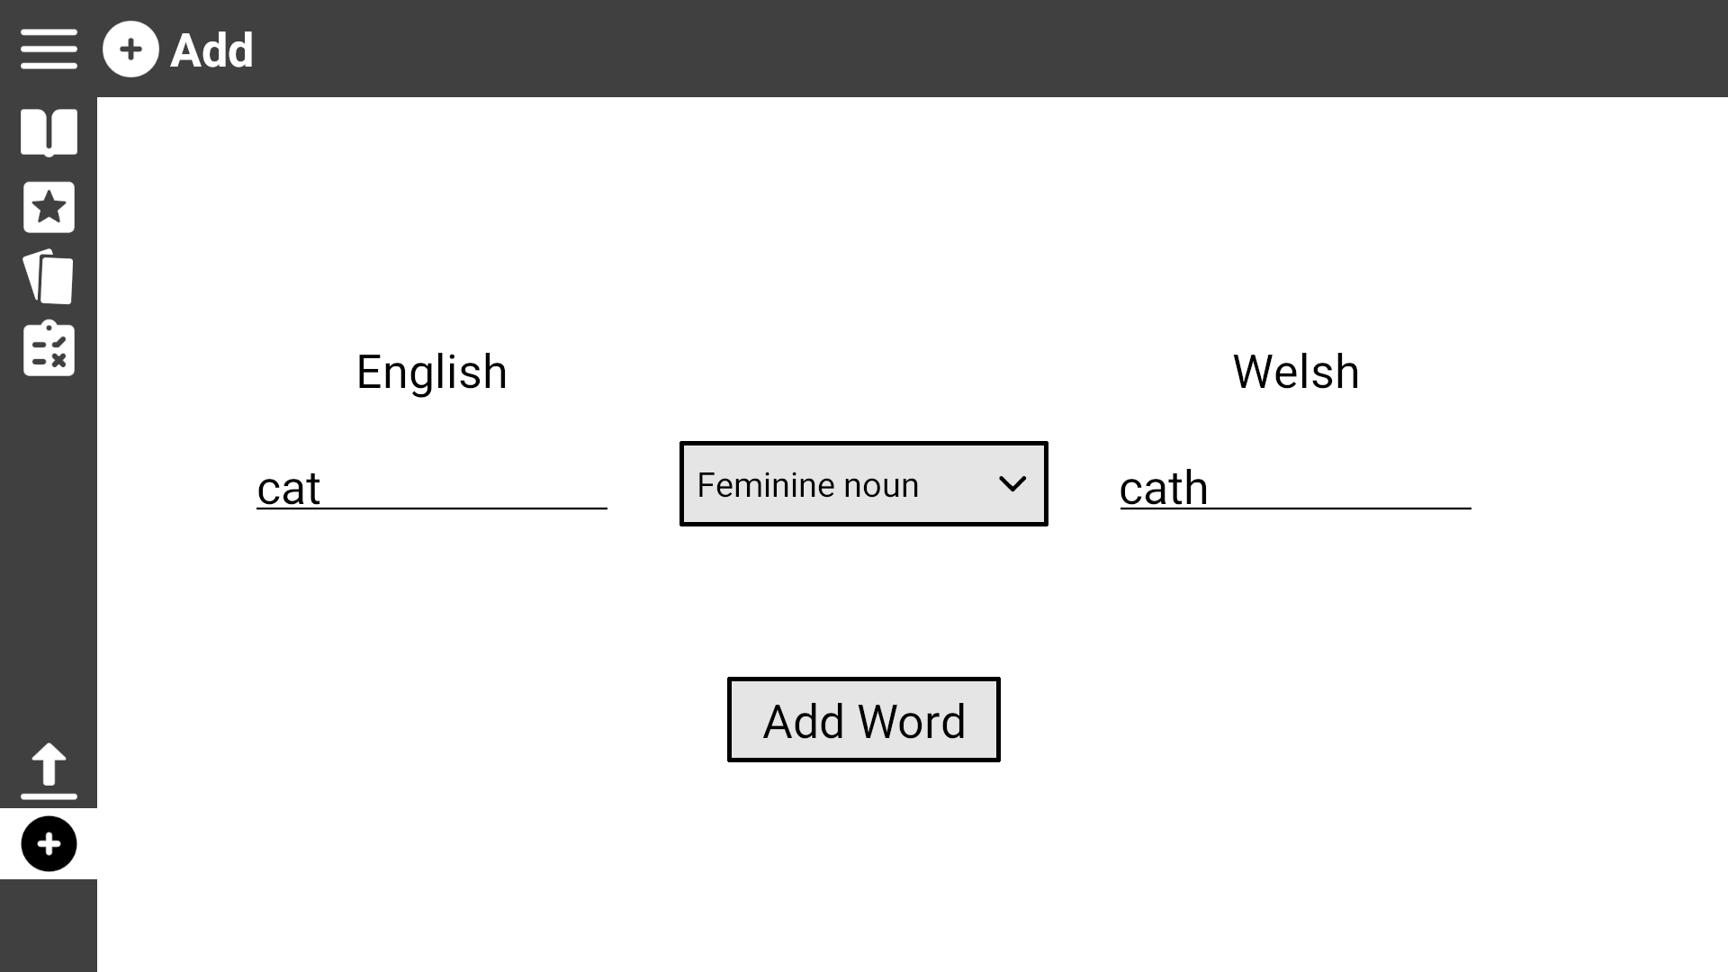
Use Case 8: Add a new word
Once every field is filled, click ‘Add Word’ to add it to the dictionary

