Slide 1
XLE Energy ETF
AutoResearch Capstone
ML-Driven Sharpe Ratio Optimization
True Baseline 0.86
Best Committed 2.21
Final Sharpe 2.59
~60 Experiments
Sessions: Apr 15 – May 18 2026 · Model: RF DirectionModel · Data: XLE 2020–present
Only model.py was modified. prepare.py and run.py were frozen.

Slide 2
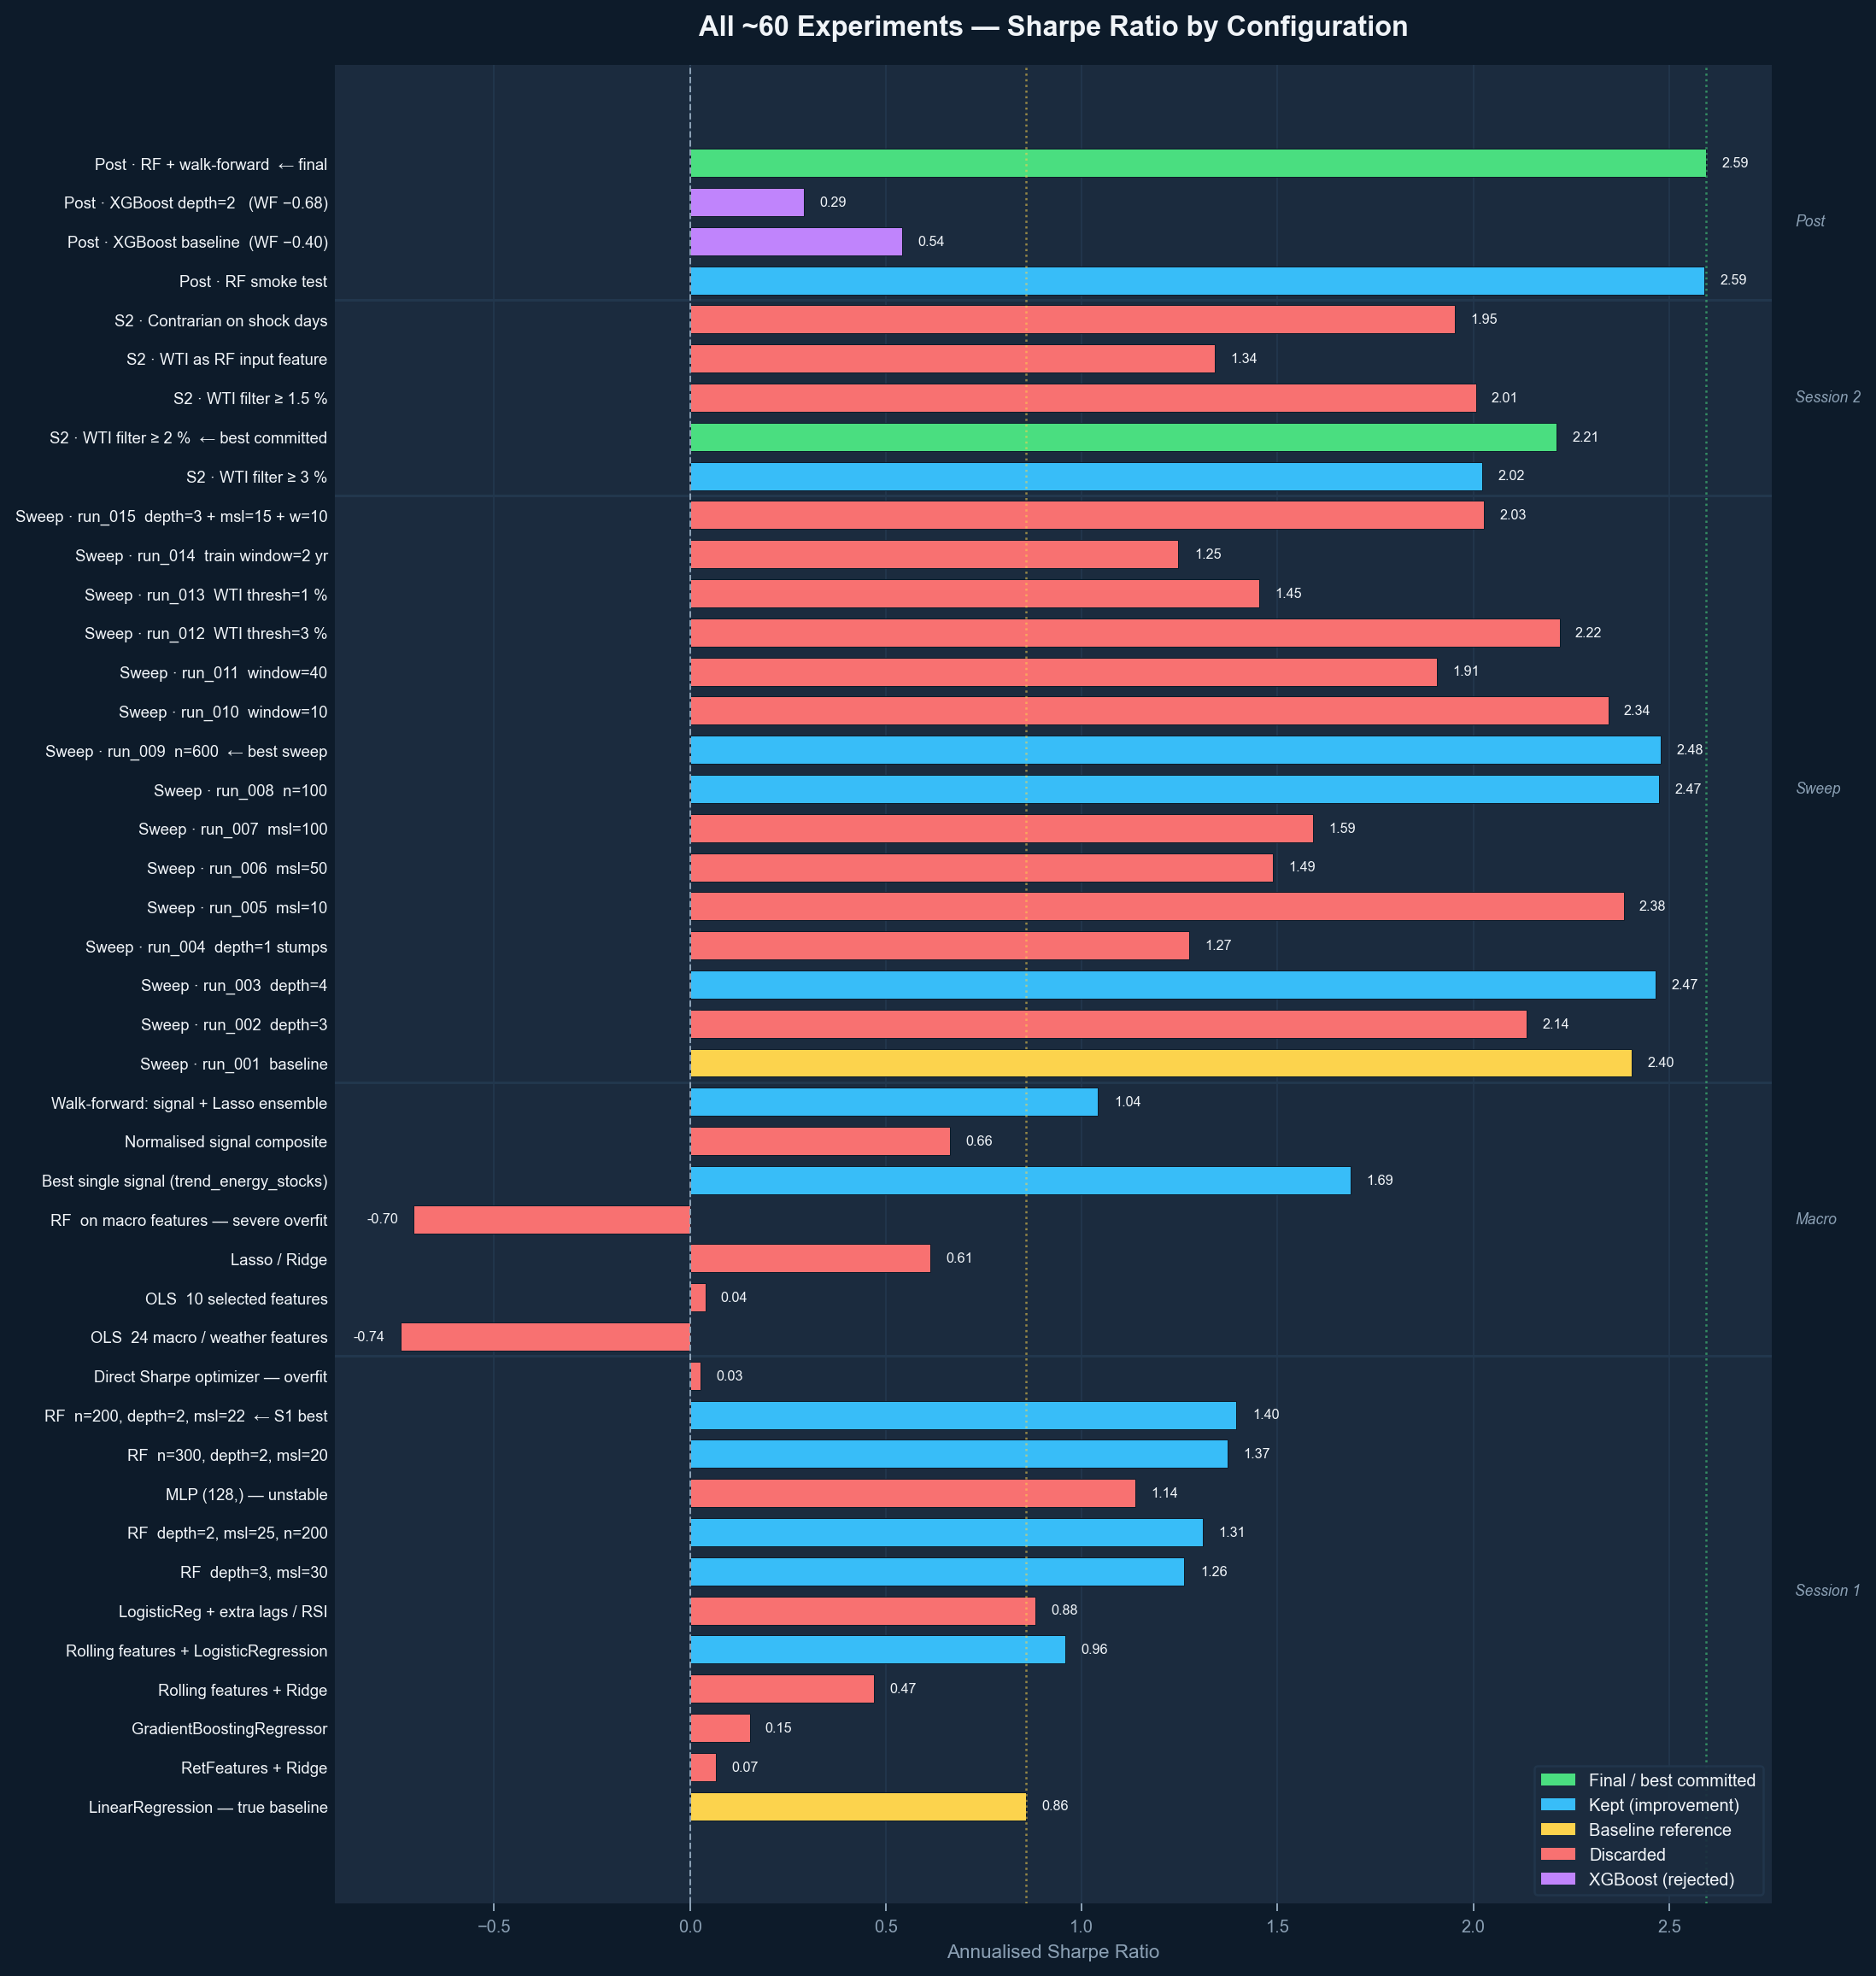
All ~60 Experiments — Sharpe Ratio
Grouped by session · Color = keep / discard / final / XGBoost

Slide 3
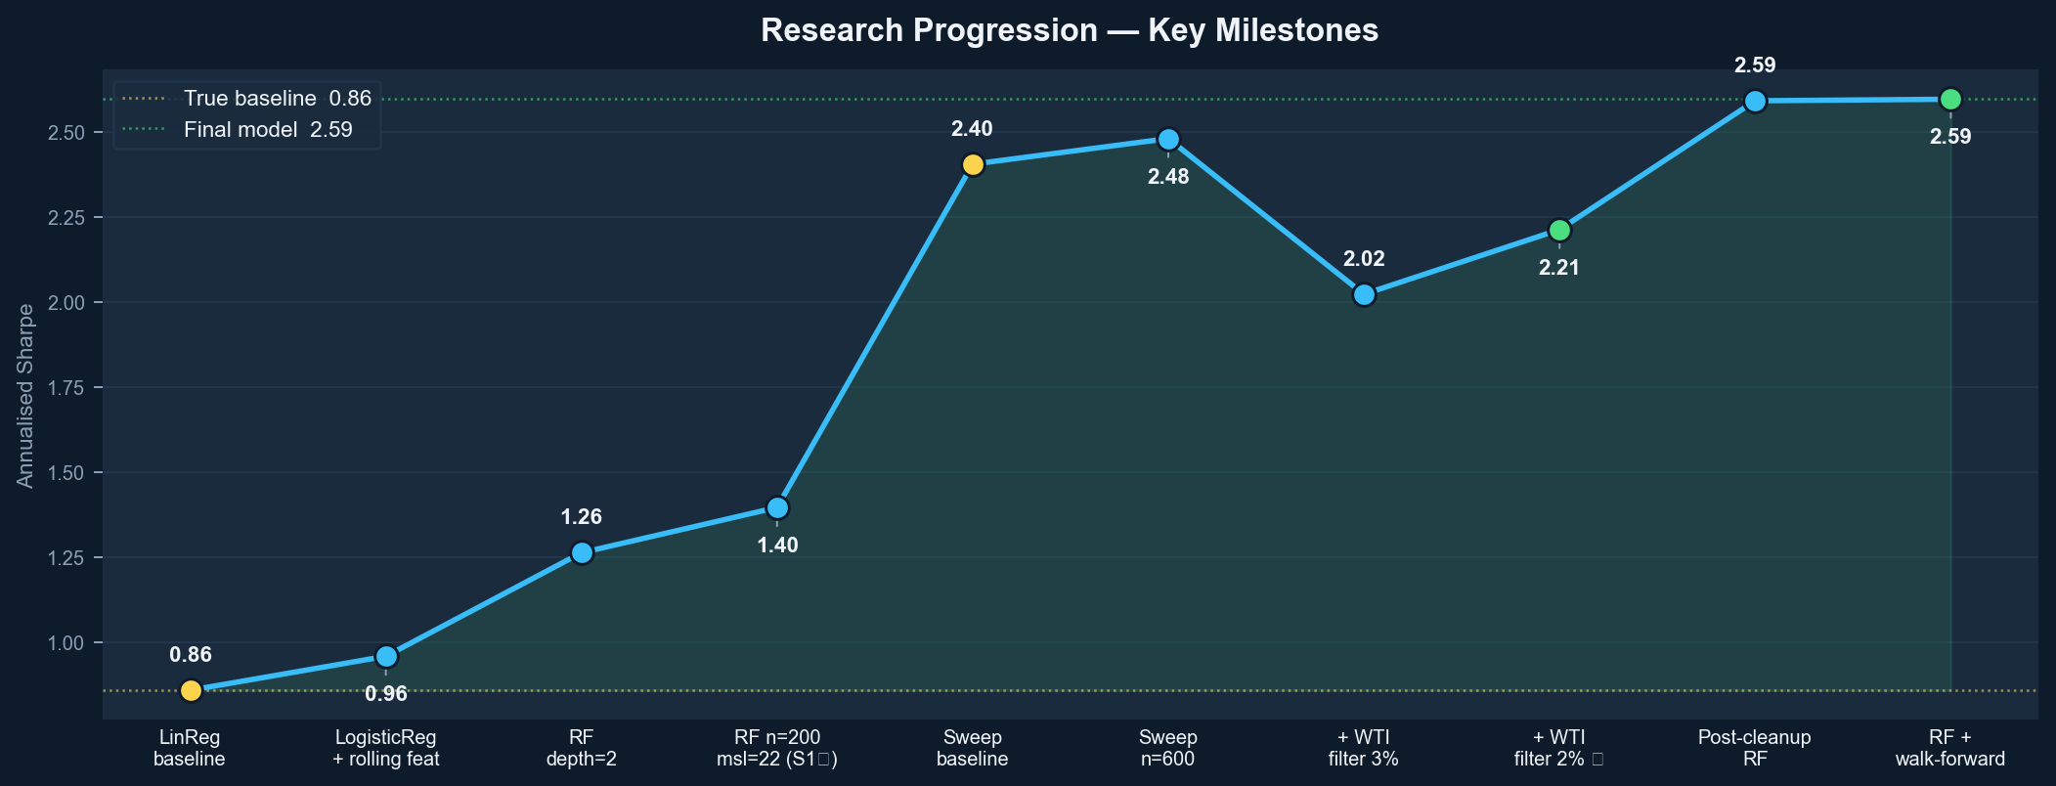
Research Progression — Key Milestones
True baseline 0.86 → best committed 2.21 → post-cleanup 2.59

Slide 4
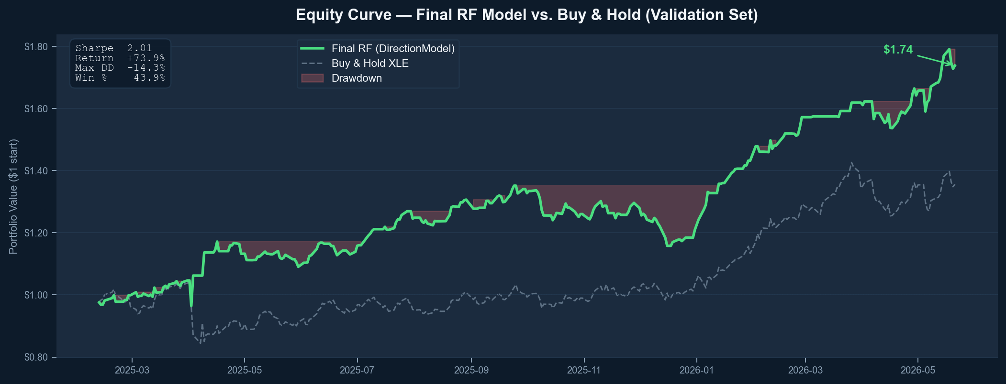
Equity Curve — Final RF Model vs. Buy & Hold
Validation set · Red shading = drawdown periods

Slide 5
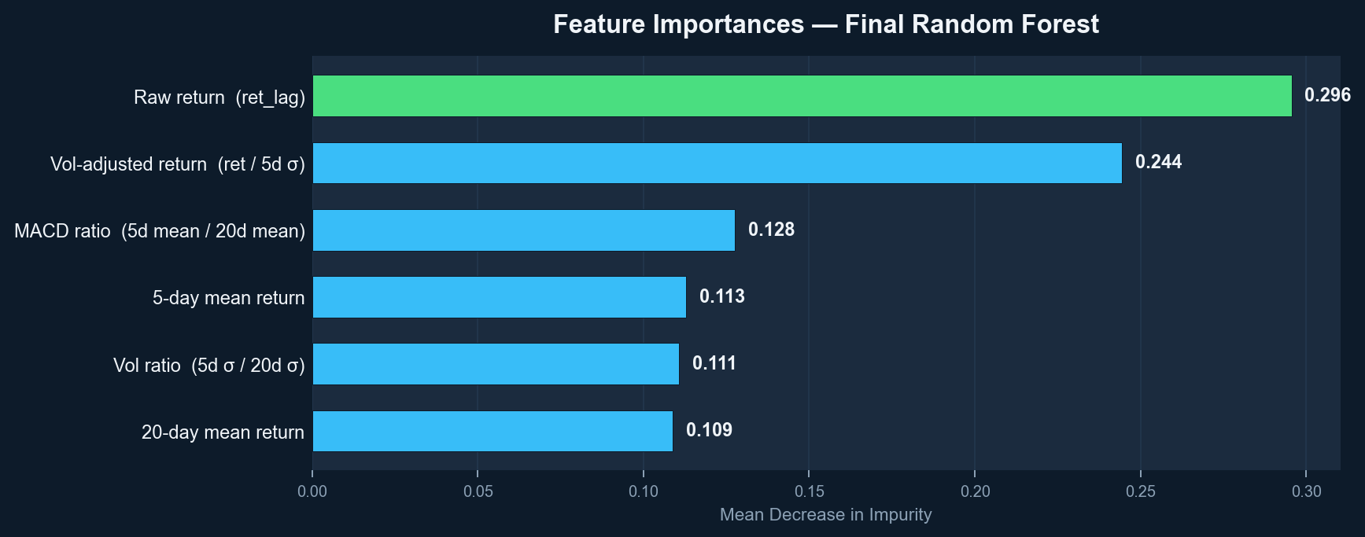
Feature Importances — Final Random Forest
6 rolling momentum / volatility features derived from ret_lag only

Slide 6
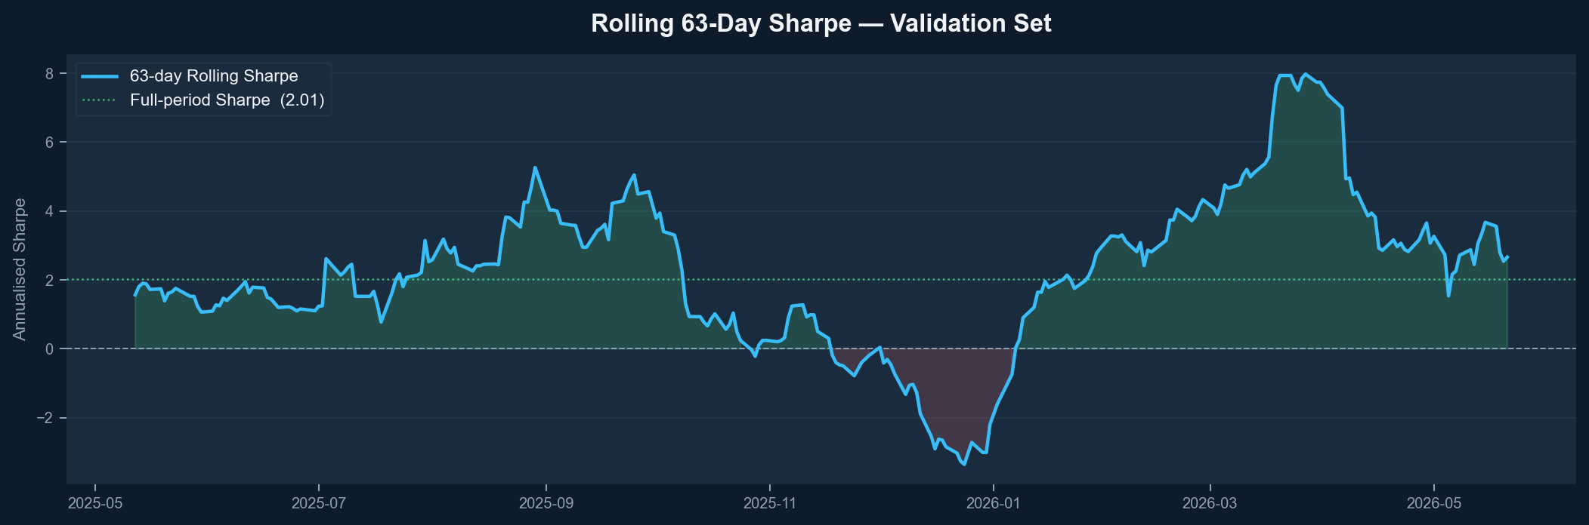
Rolling 63-Day Sharpe — Validation Period
Green fill = positive Sharpe periods · Red fill = negative

Slide 7
What Worked vs. What Failed
✓ 3-year rolling window
✗ Direct Sharpe optimizer
Dropping it to 2yr cost −1.3 Sharpe
Training obj didn't correlate with val (0.03)
✓ WTI shock filter at 2%
✗ Macro / weather features
+0.37 Sharpe; 1.5% and 3% both hurt
OOS −0.74 vs. IS 1.22; too sparse
✓ Direction classification
✗ XGBoost
sign(pred)×ret metric → only direction matters
WF Sharpe −0.40; sequential boosting fits noise
✓ Shallow RF (depth=2)
✗ WTI as RF input
Depth=4 overfit; depth=1 underfit
Works as filter only, not as feature (1.34)
✓ Exponential sample decay
✗ More features (lags/RSI/Bol.)
Upweights recent data within rolling window
Every extra feature reduced val Sharpe

Slide 8
Final Model — DirectionModel (RF)
Classifier
RandomForestClassifier n=600, depth=2, msl=22, max_features='sqrt'
Training window
Rolling 756 days (3 yr) — drops COVID 2020–21 regime
Sample weights
Exponential decay exp(linspace(−0.3, 0, N))[cutoff:]
Features
6 rolling momentum / volatility features derived from ret_lag
Shock filter
Go flat when |WTI log-ret yesterday| > 2 % (EIA cache → yfinance)
Val Sharpe
2.59 (single holdout) · 0.32 mean across 4 walk-forward folds
Val return
+73.9% · Max DD -14.3% · Win rate 43.9%
⚠ Walk-forward Sharpe (0.32) is the conservative estimate. The single-holdout (2.59) reflects favorable 2025–2026 market conditions.

