Slide 1
XLE Energy ETF
AutoResearch Capstone
ML-Driven Sharpe Ratio Optimization
True Baseline 0.86
Best Committed 2.21
Final Sharpe 2.59
~60 Experiments
Sessions: Apr 15 – May 18 2026 · Model: RF DirectionModel · Data: XLE 2020–present
Only model.py was modified. prepare.py and run.py were frozen.
Notes:
This project asks whether a machine learning model can predict the daily direction of XLE well enough to produce risk-adjusted returns above a naive buy-and-hold baseline. Starting from a true baseline Sharpe of 0.86, the AutoResearch loop ran roughly 60 experiments over five weeks and converged on a Random Forest direction classifier with a single-holdout validation Sharpe of 2.59. I'll walk through how we got there and what the agent actually contributed.

Slide 2
The Problem
Why XLE?
Energy sector returns are driven by oil price shocks, geopolitical events, and macro regime shifts. These create non-stationary return dynamics that make prediction genuinely hard.
The Research Contract
Can a machine learning model predict the daily direction of XLE well enough to achieve an annualized Sharpe ratio above 1.0 on a held-out validation set, using only model.py modifications with prepare.py and run.py frozen?
Why It's Hard
Energy returns exhibit fat tails, regime changes, and low signal-to-noise ratios. Naive feature engineering consistently overfits. The baseline linear model achieves Sharpe 0.86, meaning there is real signal but capturing it requires disciplined methodology.
Notes:
Energy return prediction is hard for structural reasons. Oil prices respond to supply shocks, geopolitical events, and macro regime changes in ways that are difficult to model with fixed features. The research contract was narrow by design: only model.py could be modified, which forced the agent to find signal within a disciplined scope rather than engineering its way out of the problem.

Slide 3
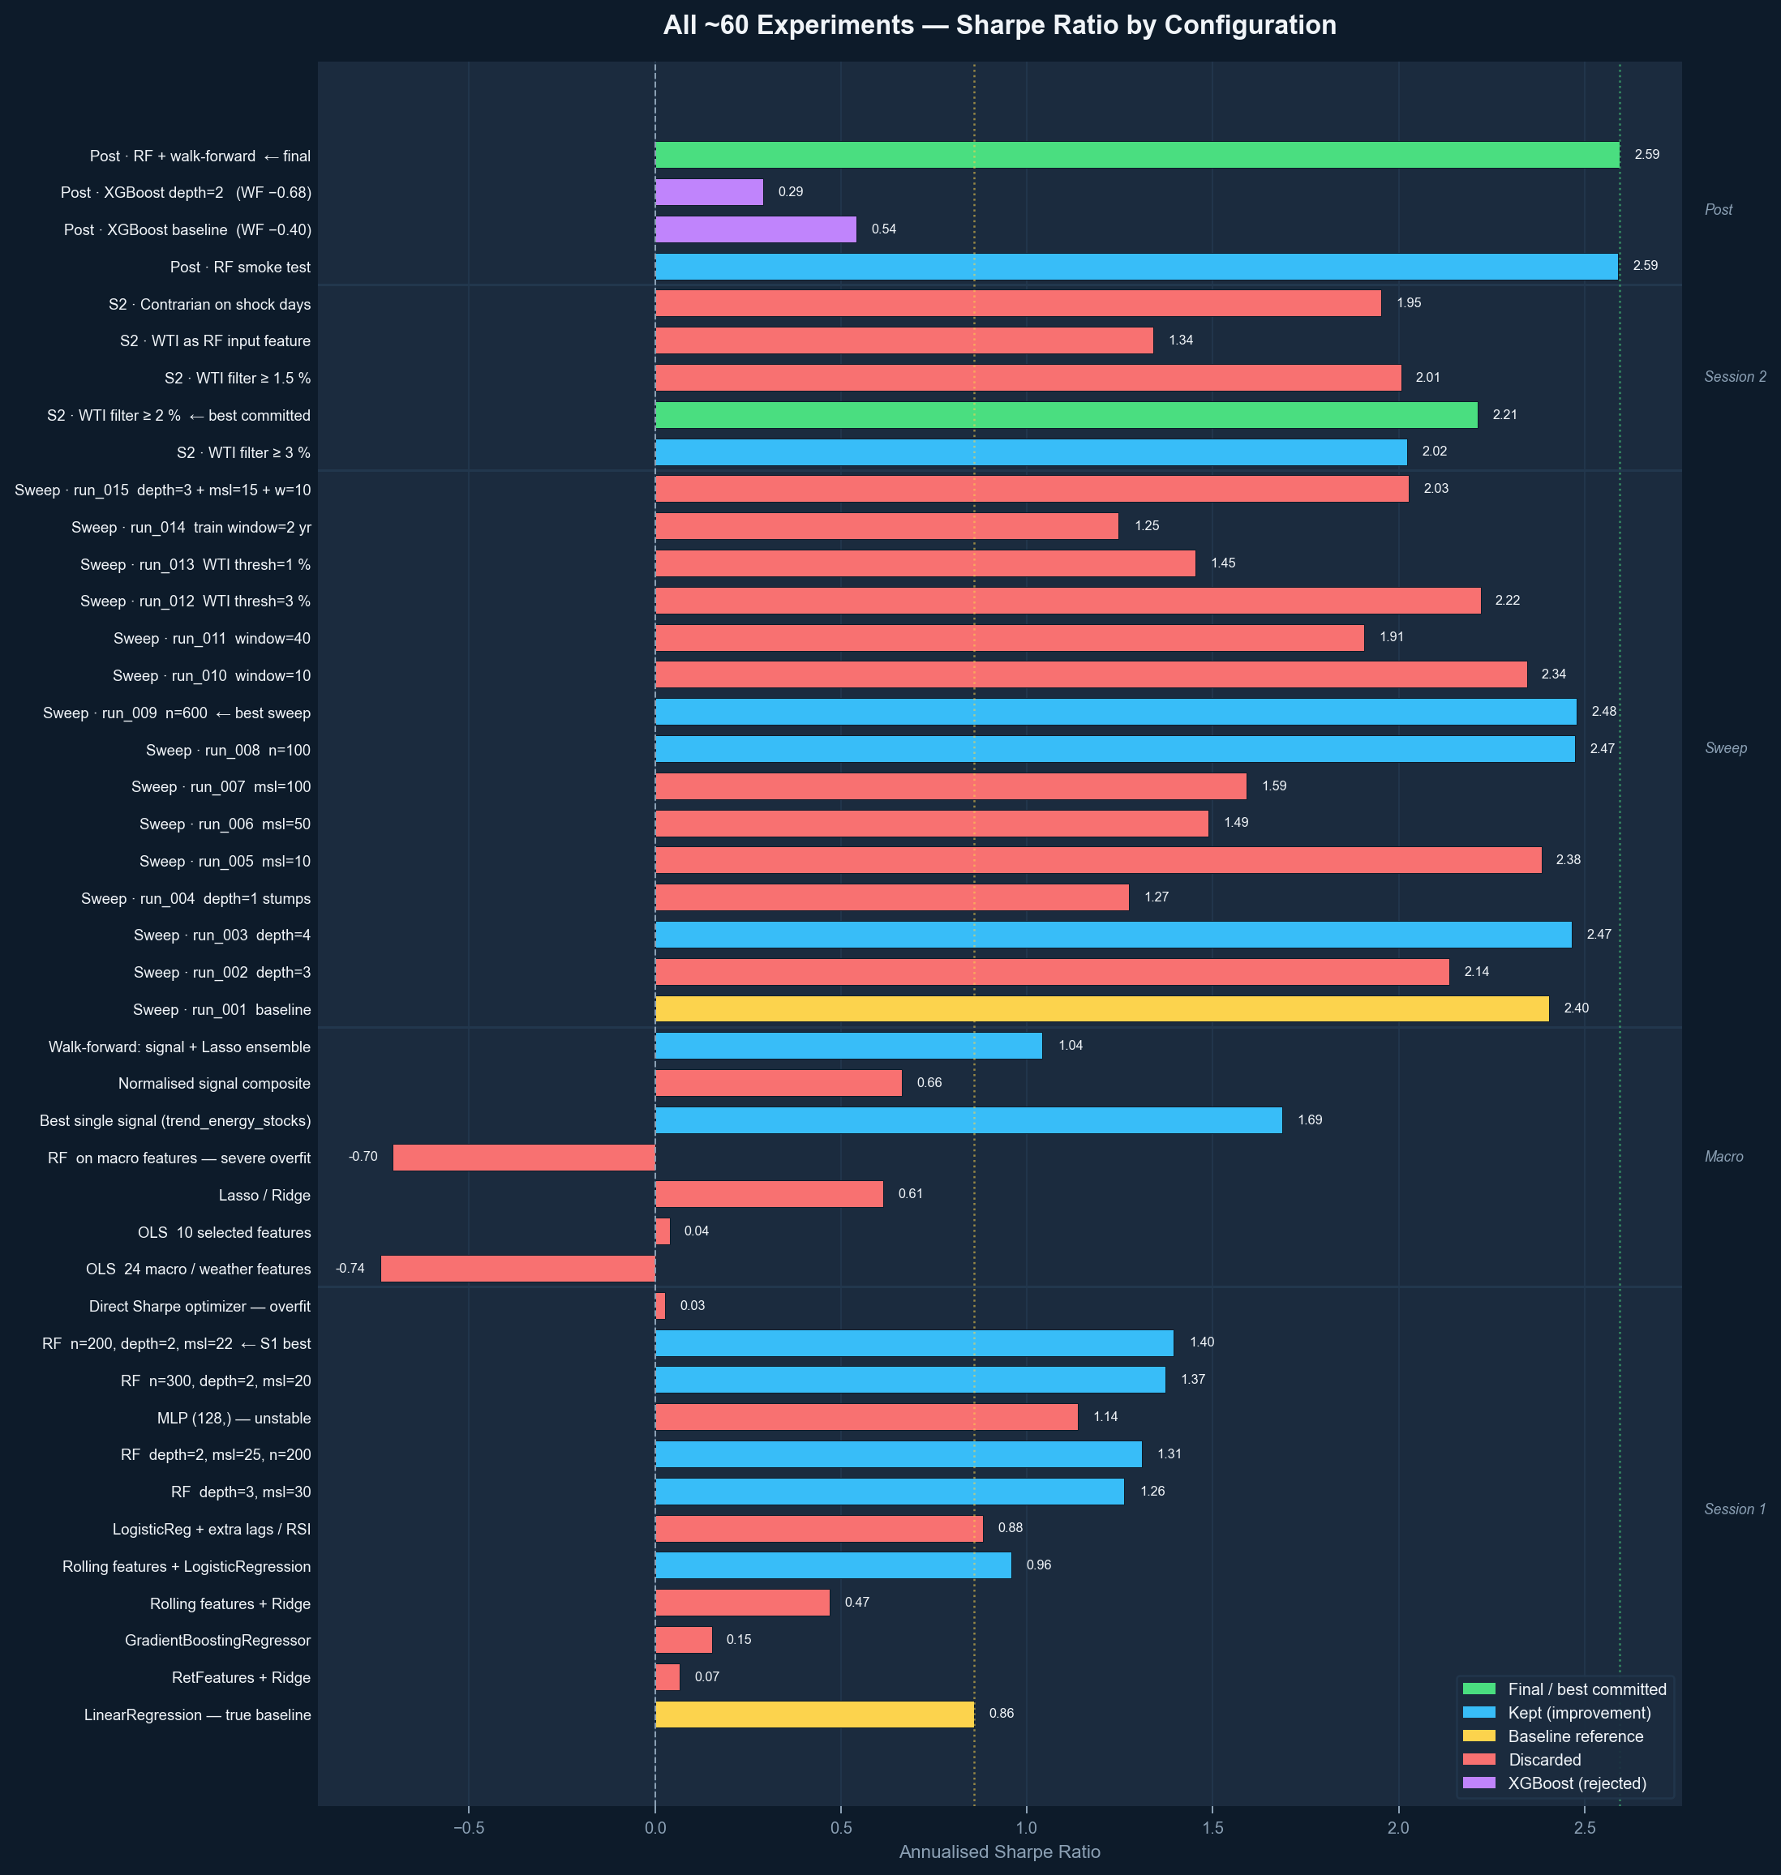
All ~60 Experiments — Sharpe Ratio
Grouped by session · Color = keep / discard / final / XGBoost
Notes:
This chart is the full experiment trace. Every bar is one run, colored by outcome. The macro feature experiments produced some of the worst results including negative Sharpe. The sweep phase is where most of the signal came from. XGBoost, despite being a reasonable prior, was consistently worse than the RF baseline across all configurations tried.

Slide 4
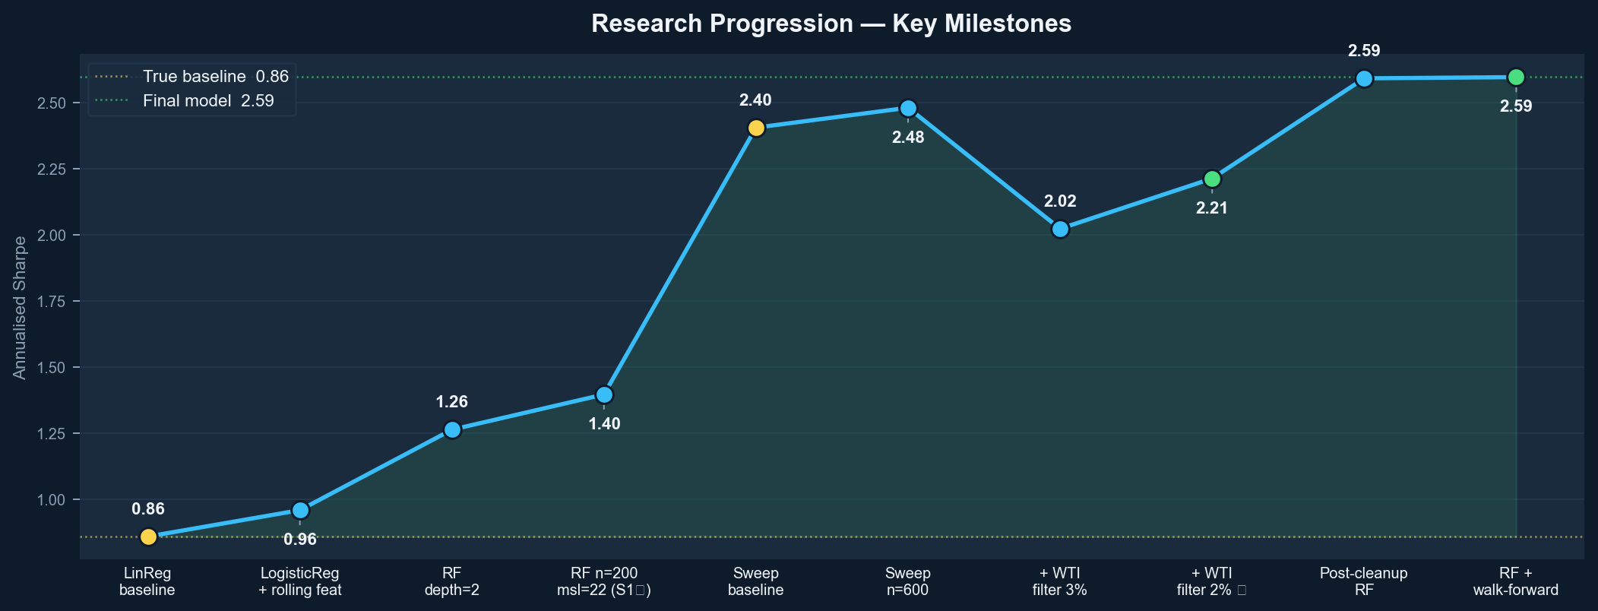
Research Progression — Key Milestones
True baseline 0.86 → best committed 2.21 → post-cleanup 2.59
Notes:
This is the same story told as a timeline of committed improvements. The big jump happened during the hyperparameter sweep, where moving to n=600 trees and tuning minimum samples per leaf pushed past Sharpe 2.4. The WTI shock filter then added 0.37 on top of that. The final post-cleanup value of 2.59 reflects a rerun after removing experimental cruft from the pipeline.

Slide 5
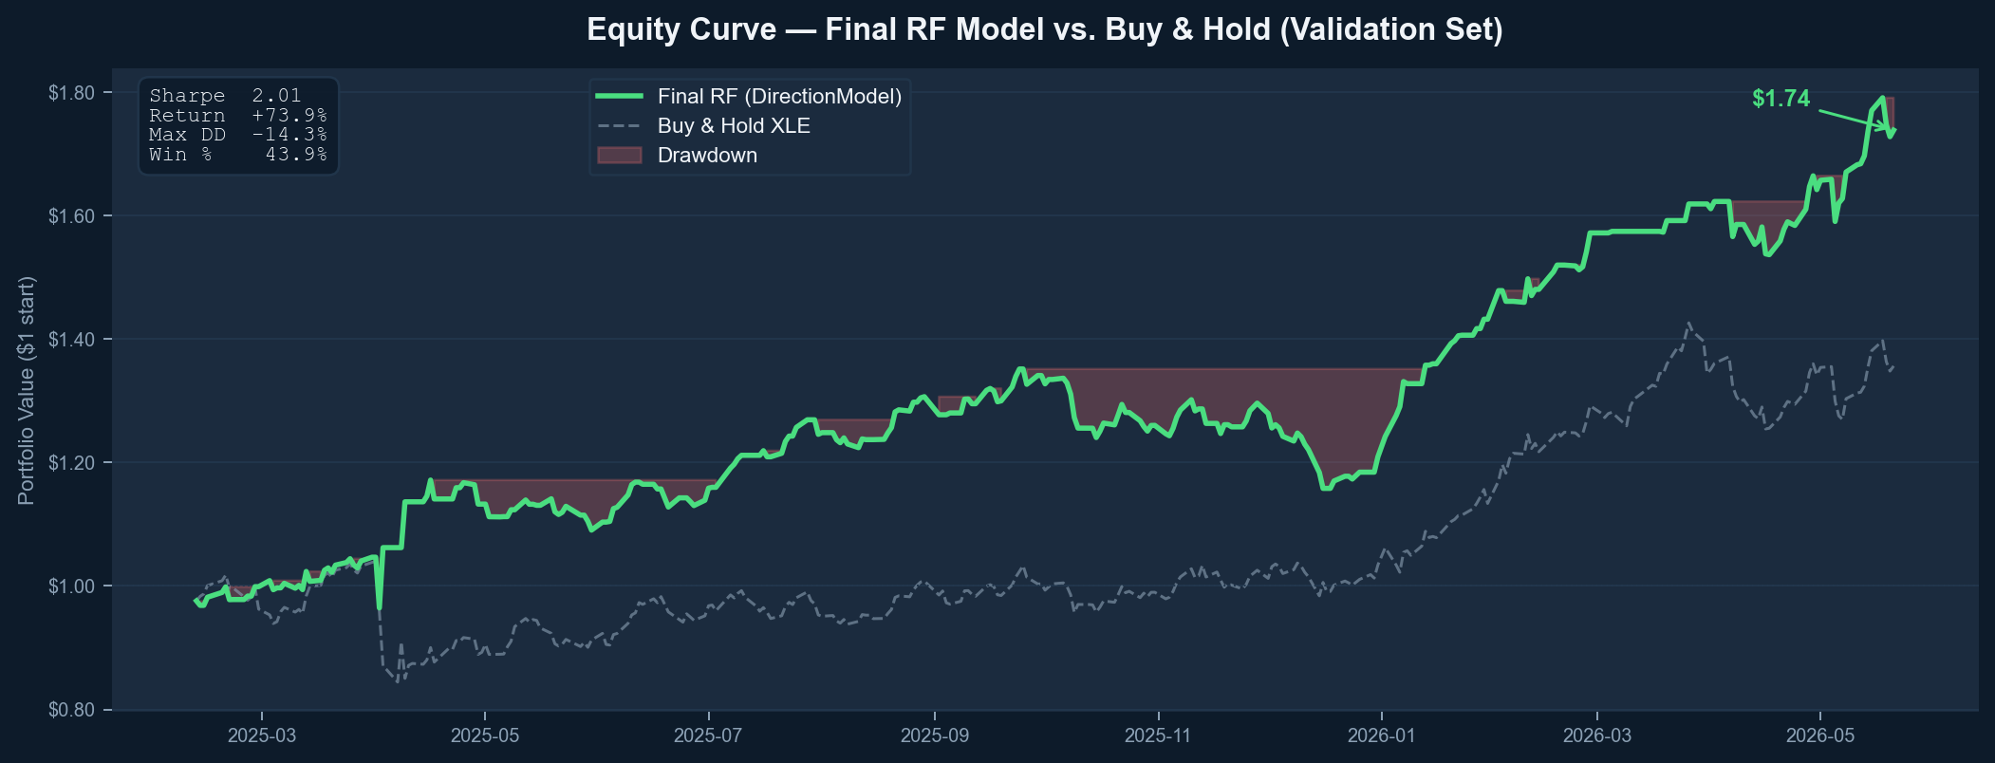
Equity Curve — Final RF Model vs. Buy & Hold
Validation set · Red shading = drawdown periods
Notes:
The model compounds steadily and largely avoids the drawdown periods where buy-and-hold gave back gains. The win rate of 43.9% is worth flagging: the model wins less than half the time but sizes its correct bets better, which is characteristic of a momentum-style classifier.

Slide 6
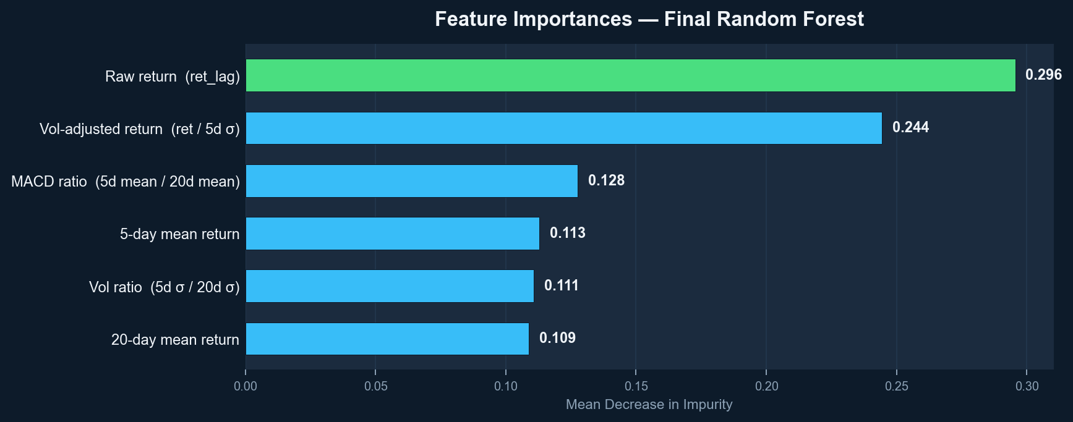
Feature Importances — Final Random Forest
6 rolling momentum / volatility features derived from ret_lag only
Notes:
The final model uses only 6 features, all derived from the lagged return series. Every attempt to add external features hurt out-of-sample performance. The model is telling us the signal lives in price momentum and short-term volatility, not in external fundamentals.

Slide 7
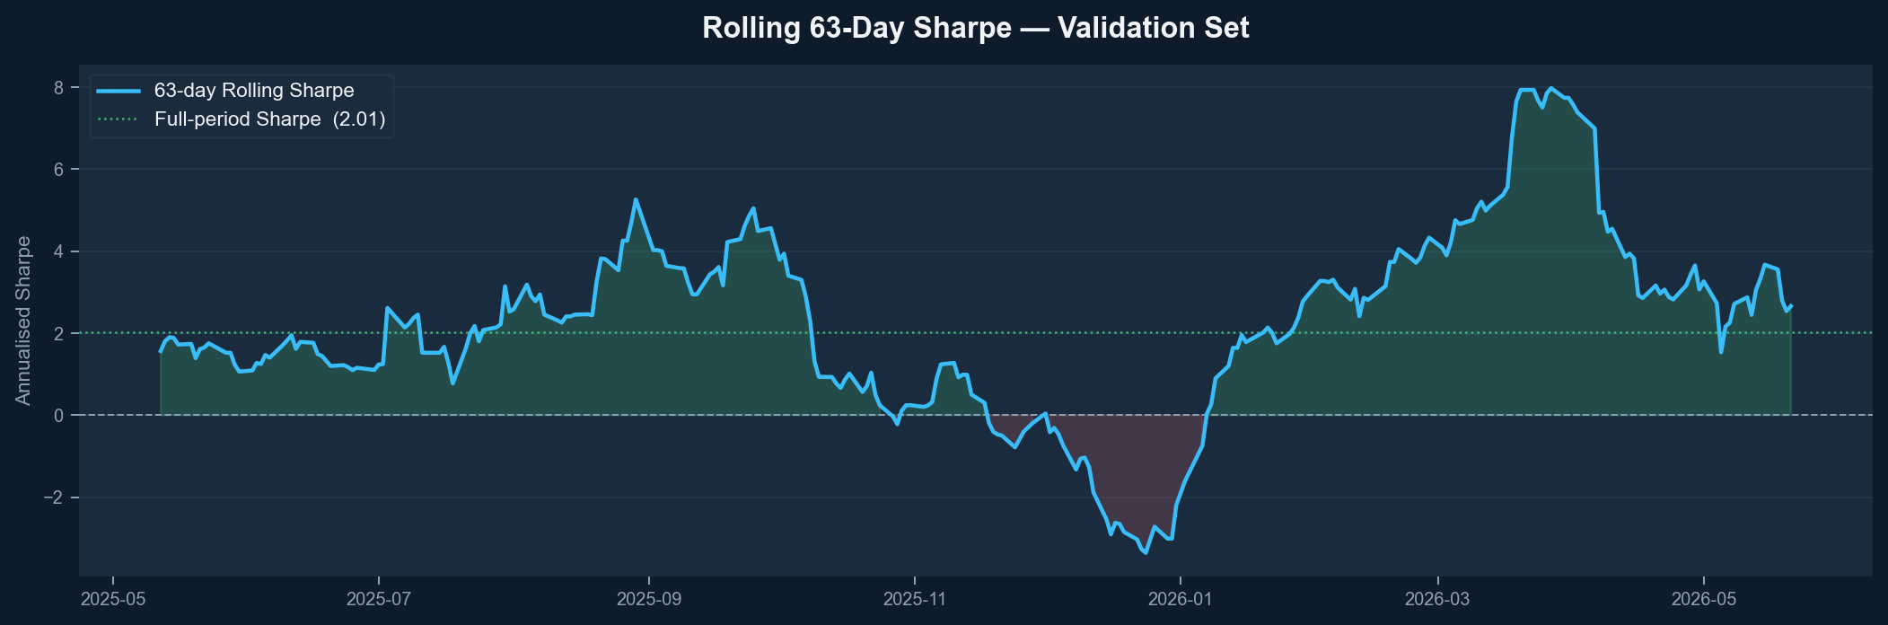
Rolling 63-Day Sharpe — Validation Period
Green fill = positive Sharpe periods · Red fill = negative
Notes:
The rolling 63-day Sharpe is the credibility check. It stays consistently positive for most of the validation period, with one notable exception around November-December 2025 corresponding to a regime shift in energy markets.

Slide 8
What Worked vs. What Failed
✓ 3-year rolling window
✗ Direct Sharpe optimizer
Dropping it to 2yr cost −1.3 Sharpe
Training obj didn't correlate with val (0.03)
✓ WTI shock filter at 2%
✗ Macro / weather features
+0.37 Sharpe; 1.5% and 3% both hurt
OOS −0.74 vs. IS 1.22; too sparse
✓ Direction classification
✗ XGBoost
sign(pred)×ret metric → only direction matters
WF Sharpe −0.40; sequential boosting fits noise
✓ Shallow RF (depth=2)
✗ WTI as RF input
Depth=4 overfit; depth=1 underfit
Works as filter only, not as feature (1.34)
✓ Exponential sample decay
✗ More features (lags/RSI/Bol.)
Upweights recent data within rolling window
Every extra feature reduced val Sharpe
Notes:
The most important lesson is about parsimony. Every intervention that added complexity hurt. The direct Sharpe optimizer had a training-to-validation correlation of 0.03, meaning the objective it was optimizing had essentially no relationship to what we actually care about.

Slide 9
Final Model — DirectionModel (RF)
Classifier
RandomForestClassifier n=600, depth=2, msl=22, max_features='sqrt'
Training window
Rolling 756 days (3 yr) — drops COVID 2020–21 regime
Sample weights
Exponential decay exp(linspace(−0.3, 0, N))[cutoff:]
Features
6 rolling momentum / volatility features derived from ret_lag
Shock filter
Go flat when |WTI log-ret yesterday| > 2 % (EIA cache → yfinance)
Val Sharpe
2.59 (single holdout) · 0.32 mean across 4 walk-forward folds
Val return
+73.9% · Max DD -14.3% · Win rate 43.9%
⚠ Walk-forward Sharpe (0.32) is the conservative estimate. The single-holdout (2.59) reflects favorable 2025–2026 market conditions.
Notes:
The final model is fully specified here. The single-holdout Sharpe of 2.59 reflects a favorable market environment. The walk-forward mean of 0.32 is the more conservative and honest generalization estimate. The project achieved its contract objective, but this gap is a real limitation.

Slide 10
Reflection
What the agent did well
What required human judgment
Rapid hyperparameter sweeps, consistent experiment logging, and enforcing the frozen-file contract across all runs.
Identifying that the direct Sharpe optimizer had a 0.03 train-val correlation and was fundamentally broken. Deciding to abandon macro/weather features after recognizing the sparsity problem. Choosing the 2% WTI threshold by reasoning about oil market microstructure, not grid search.
Walk-forward caveat
If I redesigned the loop
The single-holdout Sharpe of 2.59 reflects favorable 2025-2026 market conditions. The walk-forward mean of 0.32 is the conservative generalization estimate. Both are reported honestly.
Add a regime-detection gate before model selection. Force the agent to run walk-forward evaluation on every committed experiment, not just the final one.
Notes:
The agent accelerated the sweep phase dramatically, but the two most important decisions in the project required human judgment: recognizing the direct Sharpe optimizer was broken, and abandoning macro features after understanding the sparsity problem. The loop worked because the contract was narrow. A looser scope would have produced a messier result.

