Slide 1
FLASHBOOK
Makes you a geek of books
PRESENTED BY :-
RAJ BHARSAKE
YOGESH BORSE
GAURAV SONAWANE
SAURABH SHEWALE
JAY KACHAVE
PRATIKSHA SALKAR
-GUIDED BY
PROF. N.C.BORASE

Slide 2

E-Book
an electronic version of a printed book that can be read on a computer or a specifically designed handheld device. an ebook is defined as the electronic form of the conventional printed paperback, formatted as a file, which is readable with the help of eReader device or on an application.

Slide 3
ADVANTAGES OF EBOOK WEBSITE (FLASHBOOK)
Accessible Everywhere, Anytime 24X7 open
Easy Updates
Shareable Content
Interactive Elements
Environment Friendly
Easy on the Eyes

Slide 4
SOFTWARE & HARDWARE USED :
SOFTWARE SPECIFICATION USED :
OPERATING SYSTEM : WINDOWS 11
FRONTEND SOFTWARE/LANGUAGE : VS CODE(IDLE),HTML,JAVASCRIPT,CSS,PHP,ETC.
BACKEND SOFTWARE : XAMPP / MYSQL
HARDWARE SPECIFICATION USED:
COMPUTER PROCESSOR RYZEN 5 (4000 SERIES)
HDD 1TB SSD 256GB OR RAM 8GB

Slide 5
Benefits of an E-Book
Portability
Accessibility
Suitability
Sustainability

Slide 6
DESCRIPTION :
There are three roles available: Visitor, User and Admin
Visitor can view available products(books).
User can view and read books.
An Admin has some extra privilege including all privilege of visitor and user.
Contact Us page is available to contact Admin for queries.

Slide 7




Feature added in website :
1) QR CODE SCANNER : User can access the specific book by QR Code
2) AUTOFLIP : User can turn on this feature and pages will Fliping next Automatically
3) RESIZABLE: Can adjust the book by Zoom/Zoom Out Tool
4) BOOKMARK: Bookmark Any Page In Book
5) CLEAN QUALITY : We are Providing Clean Quality Book

Slide 8
STRUCTURE OF WEBSITE :
USER MANAGEMENT
BOOK MANAGEMENT
E-BOOK WEBSITE
ADMIN MANAGEMENT
LOGIN MANAGEMENT

Slide 9
LOGIN MANAGEMENT :
REGISTER
USERNAME &
PASSWORD
LOGIN
FORGOT PASSWORD
CHANGE PASSWORD

Slide 10
USER MANAGEMENT :
PHONE
NUMBER
EMAIL
LAST NAME
PASSWORD
USER
CITY
FIRST NAME
ADDRESS

Slide 11
BOOK MANAGEMENT :
PUBLISH
ID
TITLE
AUTHOR
BOOK
VERSION
BOOK NAME
BOOK DESCRIPTION

Slide 12
CATEGORIES :
ENGINEERING
BOOKS
CATEGORIES
DIPLOMA BOOKS

Slide 13
WEBSITE UI :
SIGN UP PAGE
LOGIN PAGE
WESBSITE UI
CATEGORY
BOOK
QUERIES

Slide 14
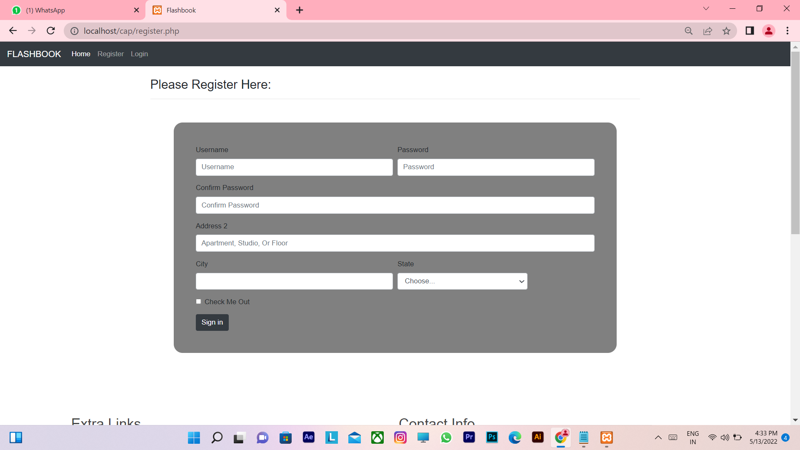
1. SIGN UP PAGE :

Slide 15
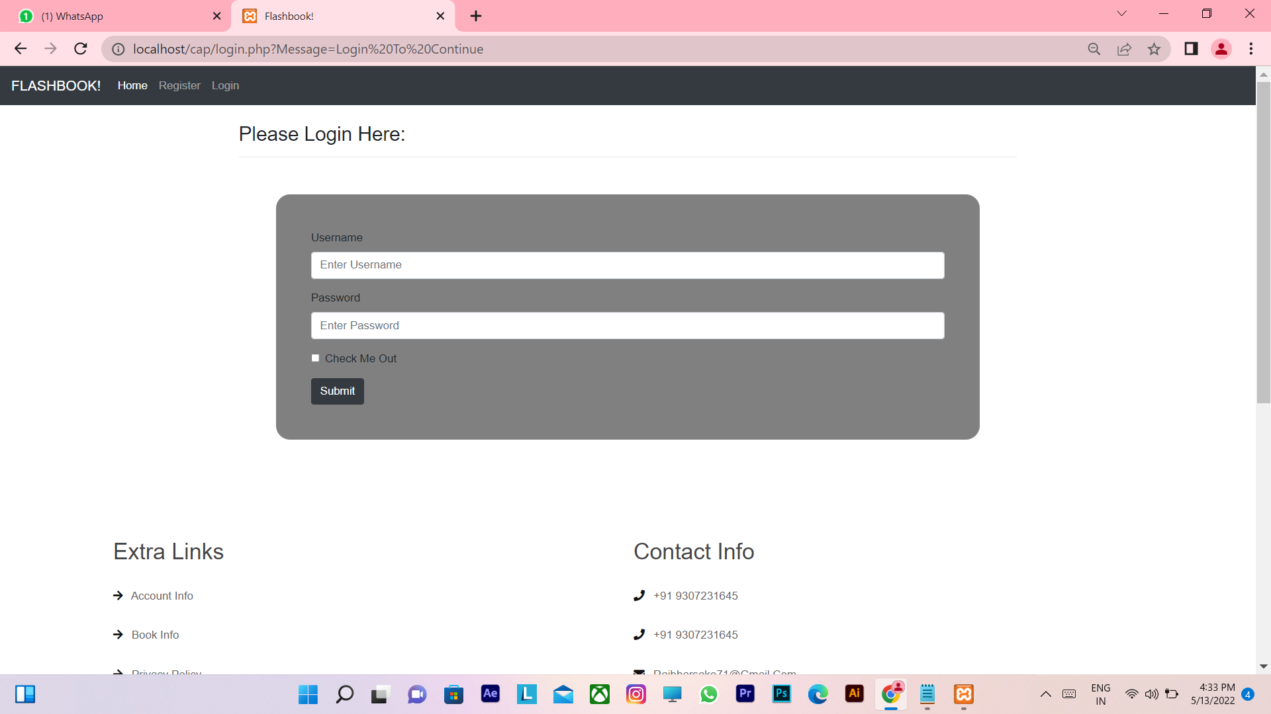
2. LOGIN PAGE :

Slide 16
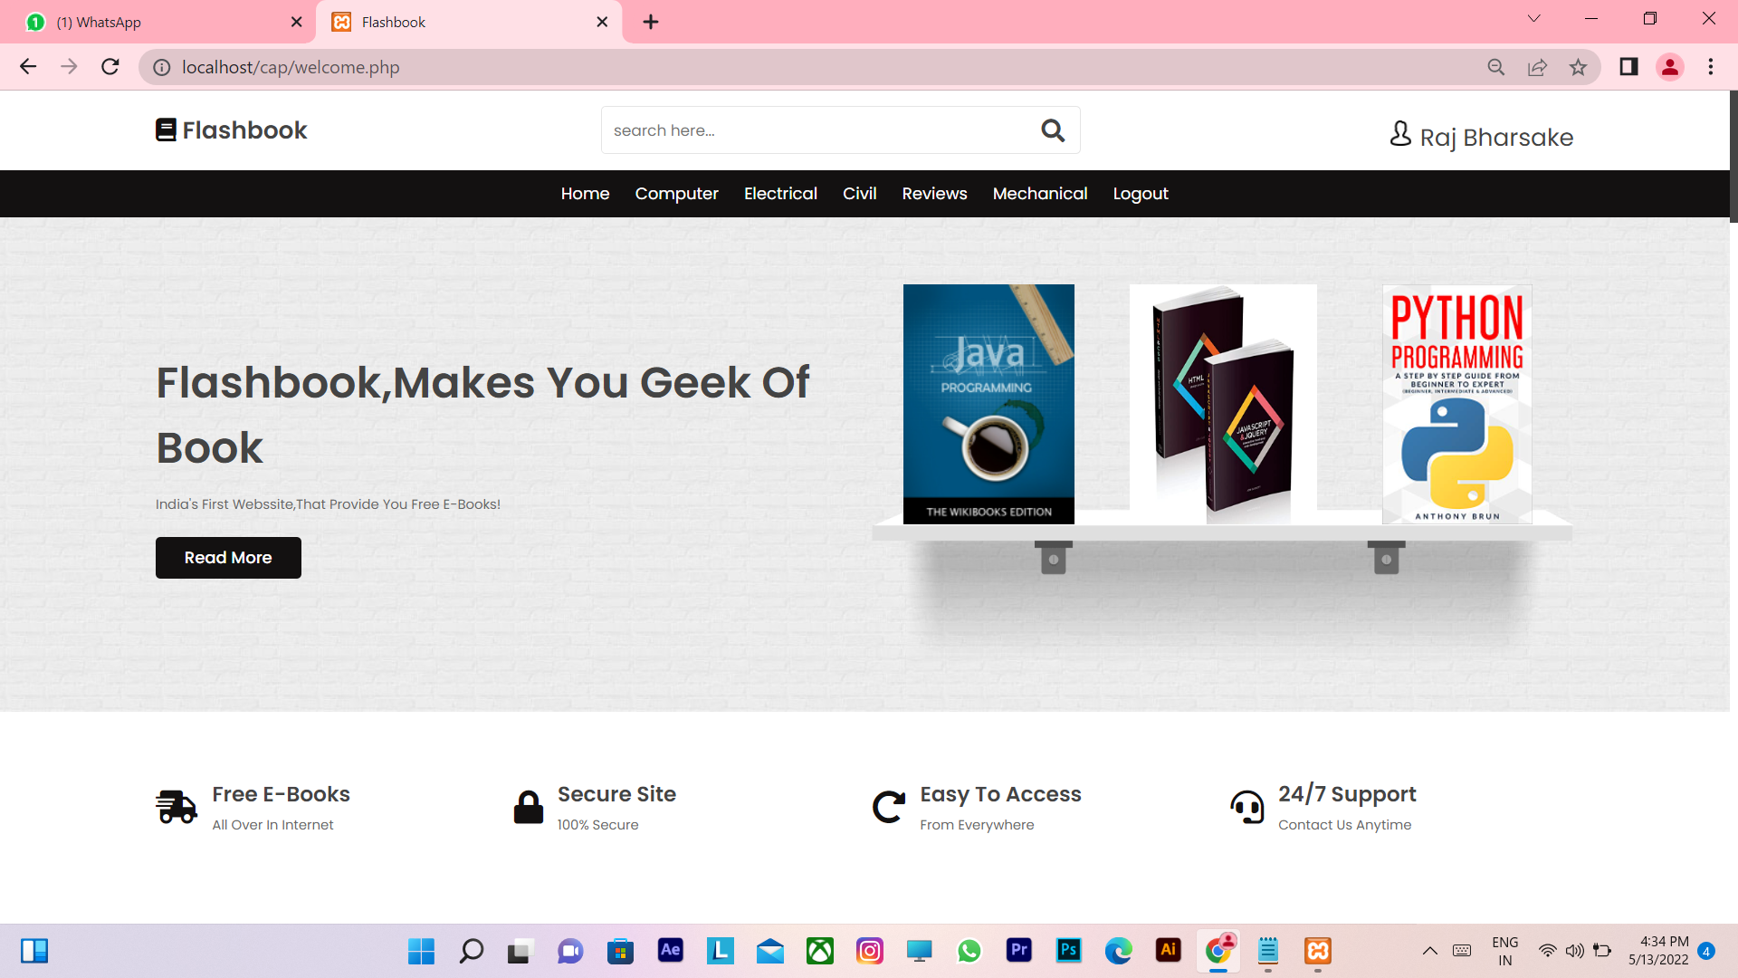
3. WEBSITE UI :

Slide 17
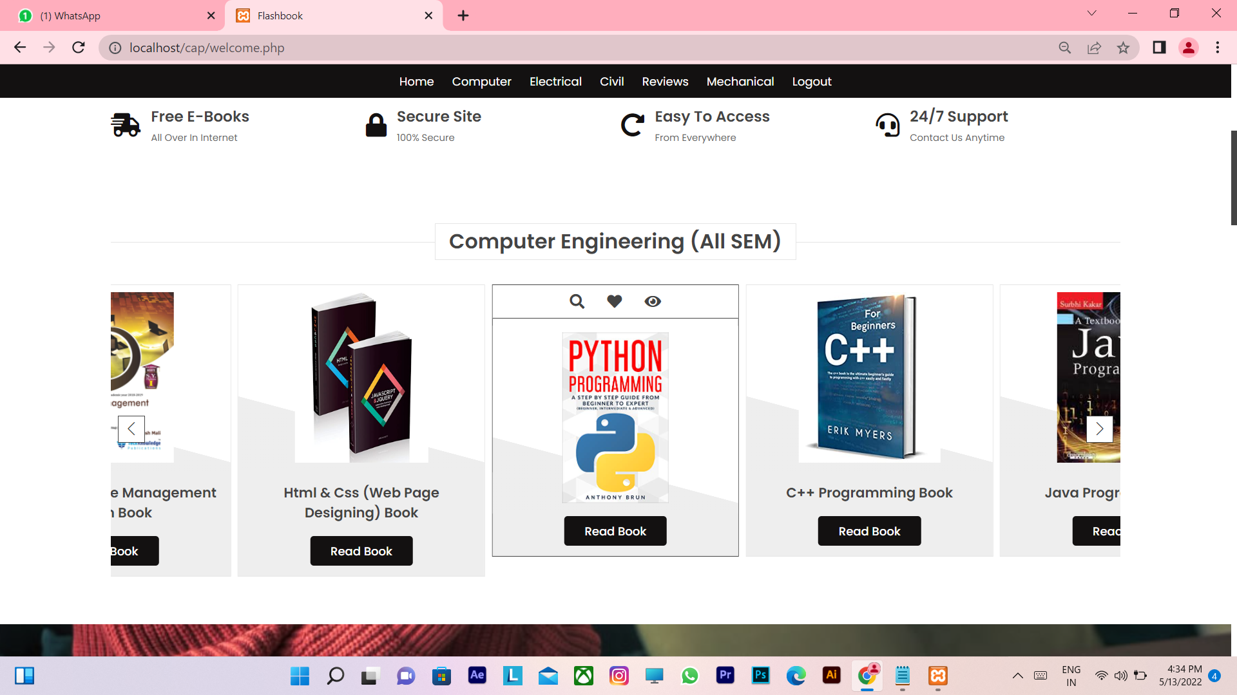
4.CATEGORIES :

Slide 18

6.SUBSCRIPTION FOR UPDATES :

Slide 19
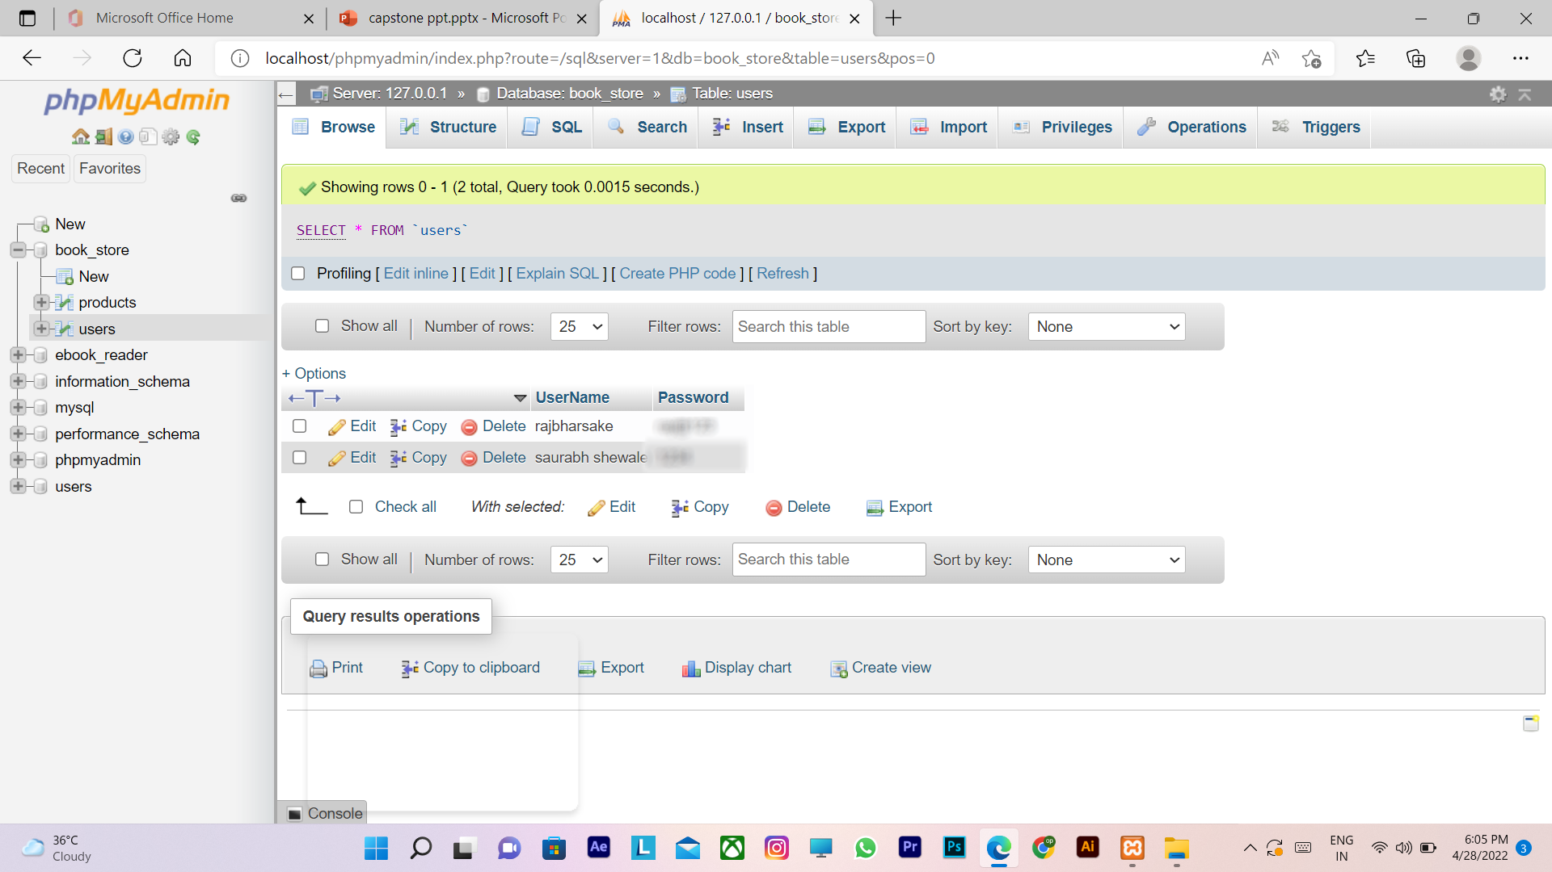
DATABASE TABLES: 1. USER TABLE

Slide 20
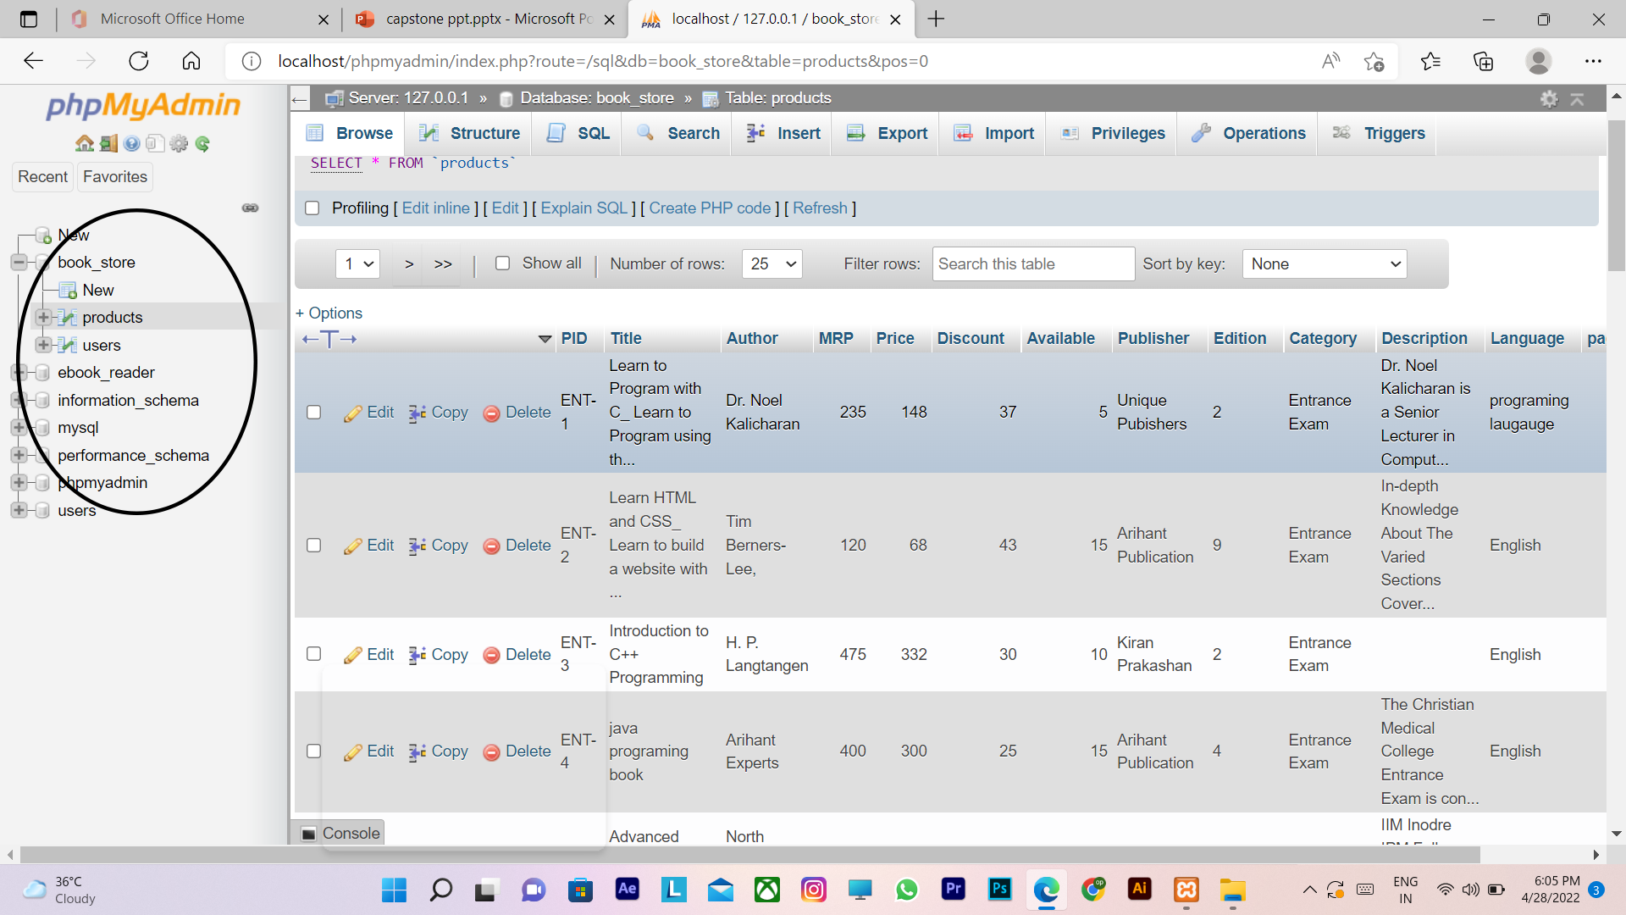
DATABASE TABLES: 2. PRODUCT TABLE

Slide 21
ANY QUERIES
?

Slide 22
THANK YOU

