Slide 1
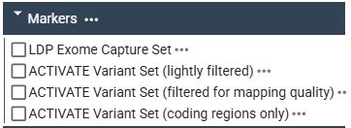



ACTIVATE genetic diversity analysis
JB2:
Structural variants (SVs):
these variants are flagged in the VCF's INFO column with specific structural tags:
SVTYPE = INS,
SVTYPE = DEL,
SVTYPE = DUP,
SVTYPE = INV
Biallelic variants (SNPs):
Coding regions (SNPs):
Emulate an exome capture sequencing to compare the LDP and ACT geno datasets
Pruned Set (SNPs):
SNPs set pruned based on linkage disequilibrium (LD)
ACT + LDP (SNPs):
Common SNPs dataset

Slide 2
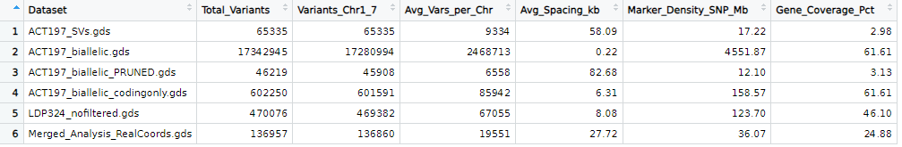
ACTIVATE genetic diversity analysis
We need the geno file to run our association analysis (GWAS + GS).
The file is in a different format accepted by GAPIT and is 12 GB.

Slide 3
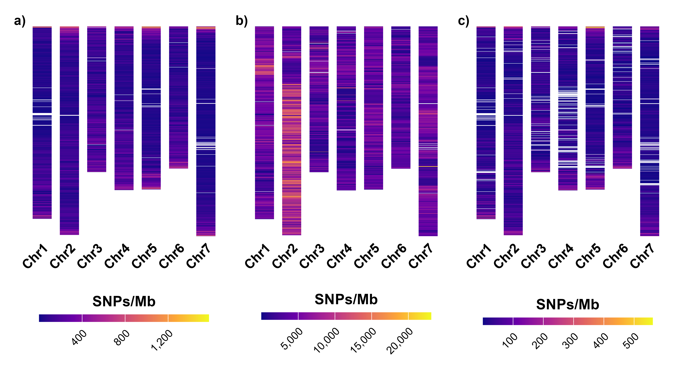
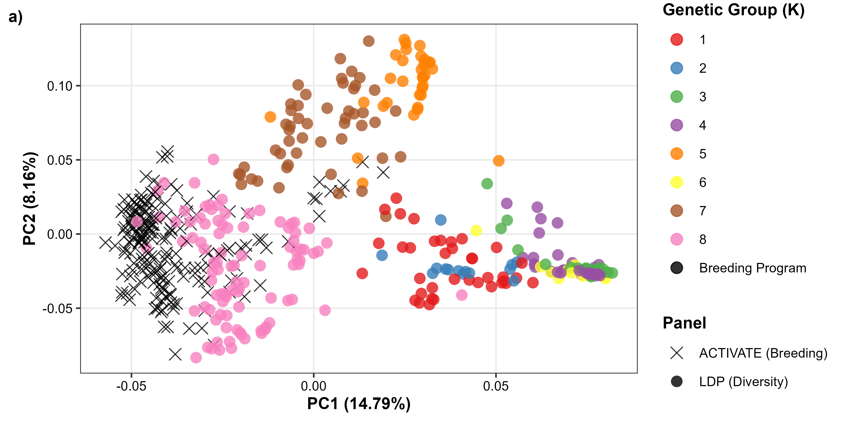
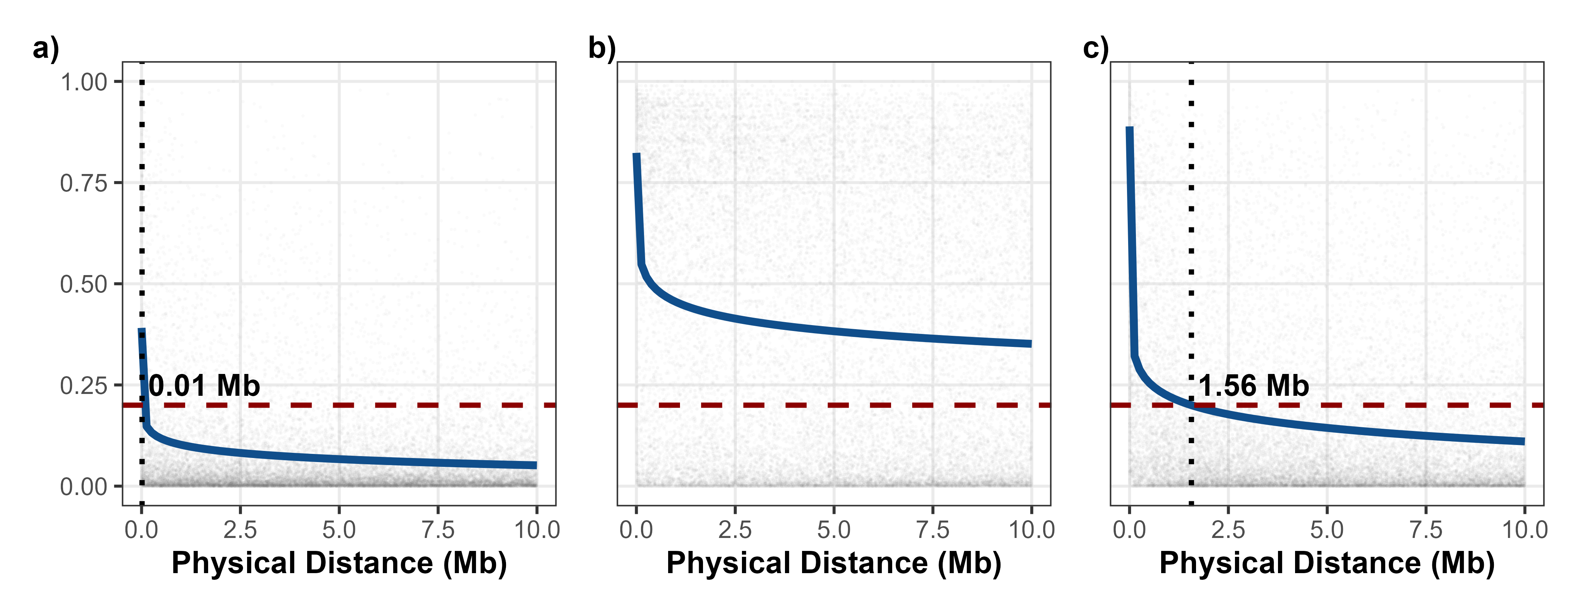
d
d
e
f
g

Slide 4
