Slide 1


Time Series Analysis Using LSTM for Demand Forecasting
By: Salva Samimi

Slide 2

My Background
- Data Science - Lighthouse Labs (2023)
- Education: Aerospace engineering
  Researching and Interpreting Aerodynamic Experiments Data
Git Hub: SalvaSamimi

Slide 3
Goal
Demand Forecasting for TOP4SPORT Company
Demand Forecast Benefits
Improve Inventory Management
Increase Efficiency
Minimize Costs
Reduce Out-of-Stock and Over-Stock Situation

Slide 4
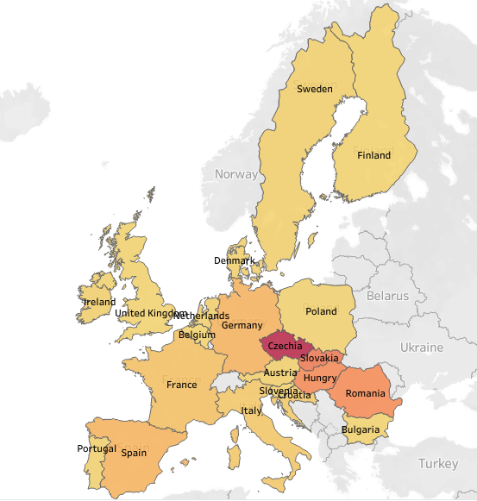

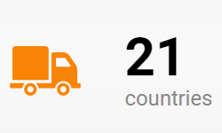
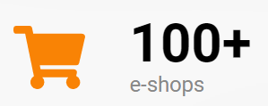
About Top4Sport

Slide 5
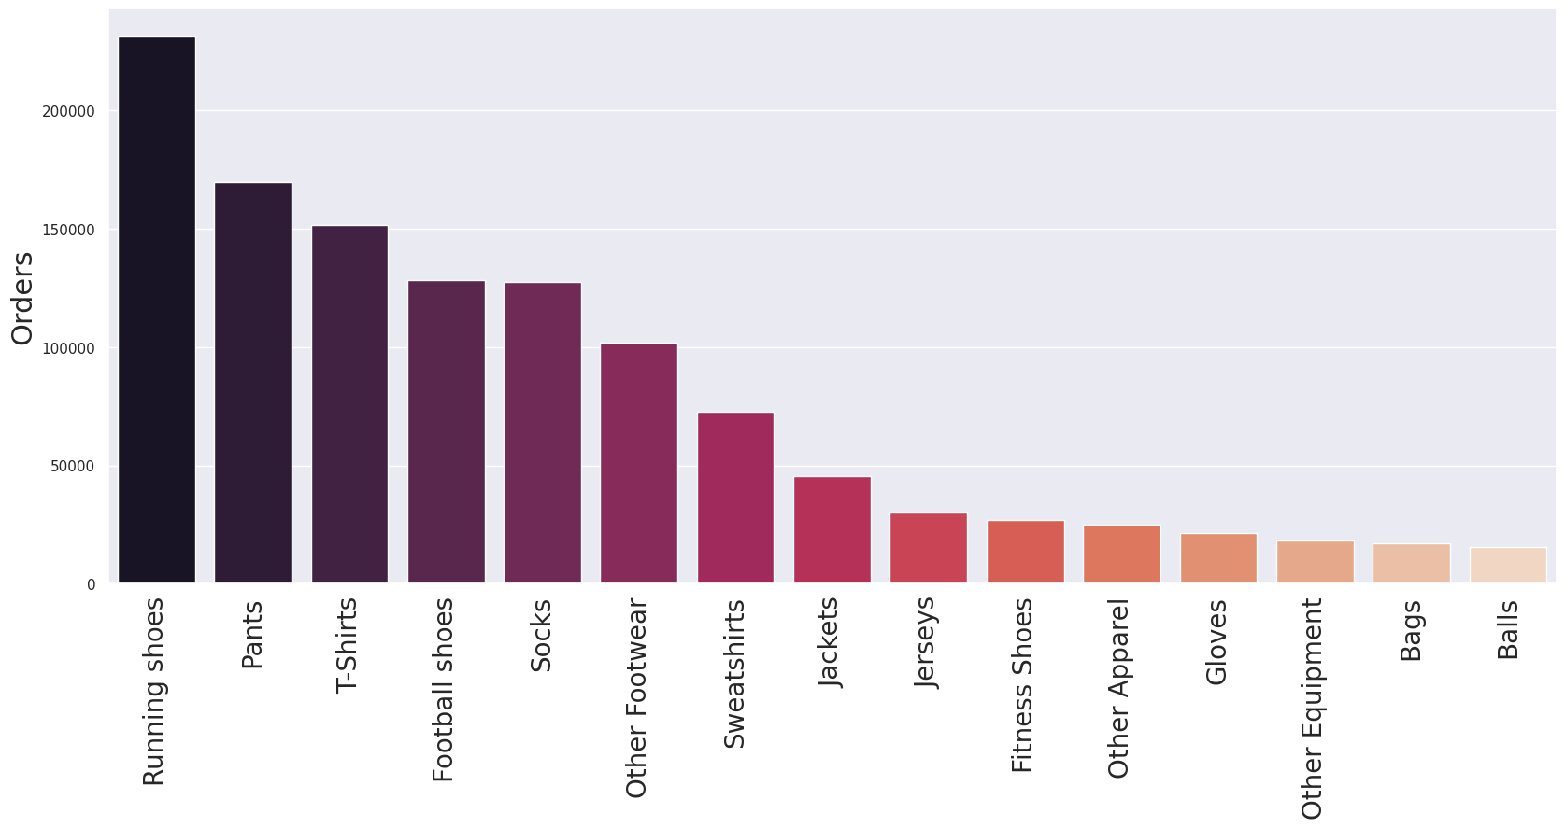
Products Type

Slide 6
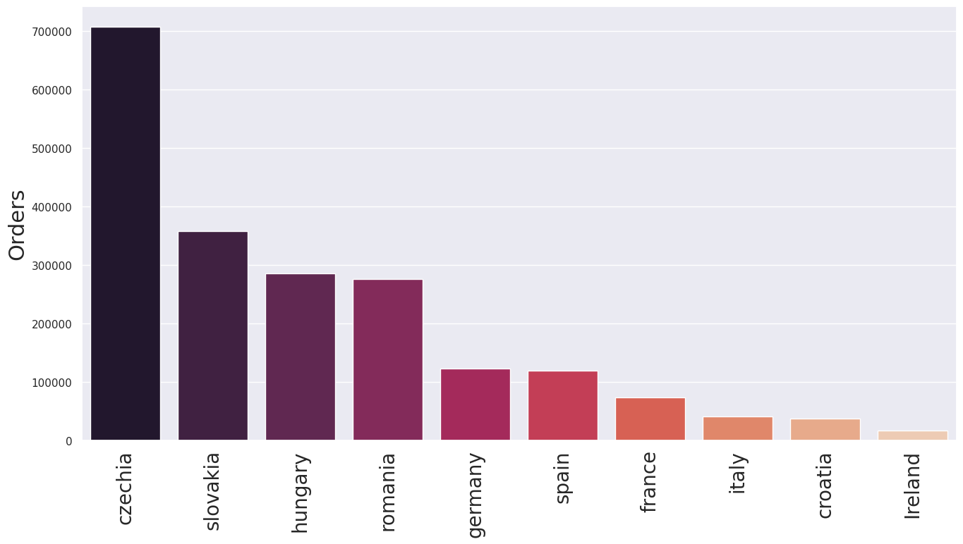
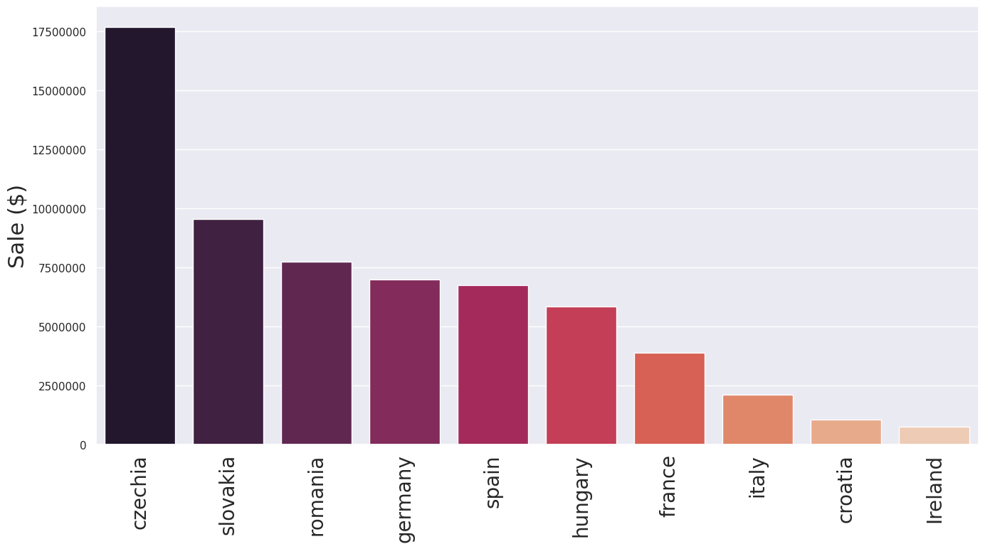
Total Orders vs Total Sale($) for Countries

Slide 7
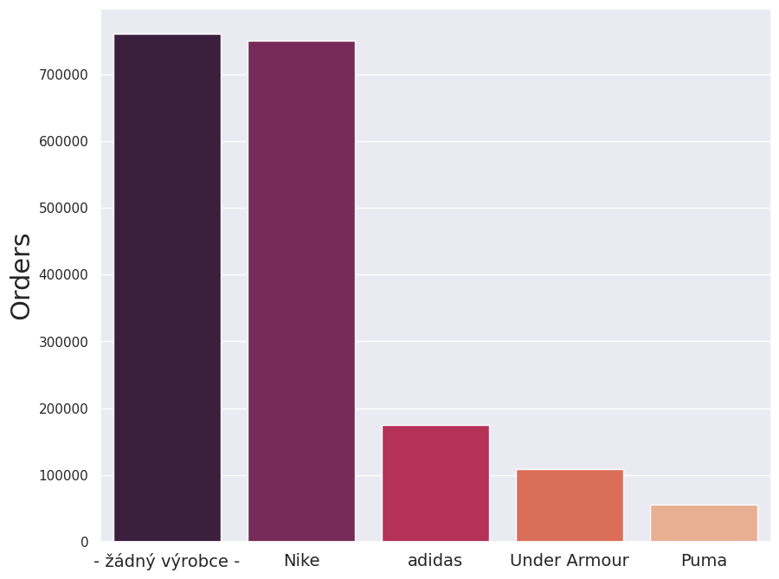
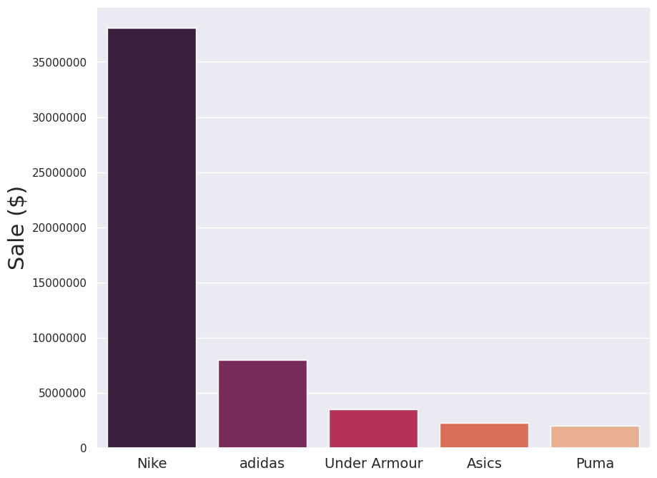
Total Orders vs Total Sale($) for Top5 Brands

Slide 8
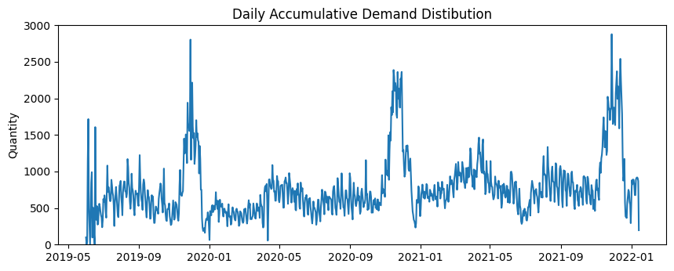
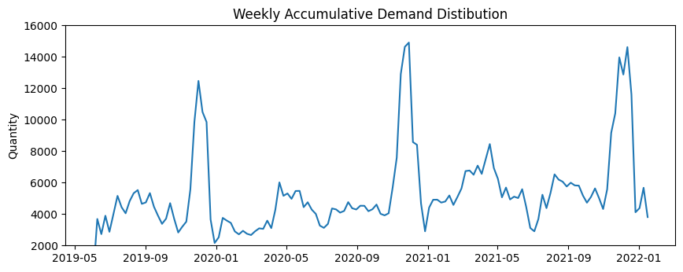
Demand Distribution for Czechia
Notes:
curacy

Slide 9

Features
Sale Information
Lag Features
Weather Temperature
Calendar Features
Model
Supervised Learning
Stacked LSTM
XGBOOST
LightGBM

Slide 10
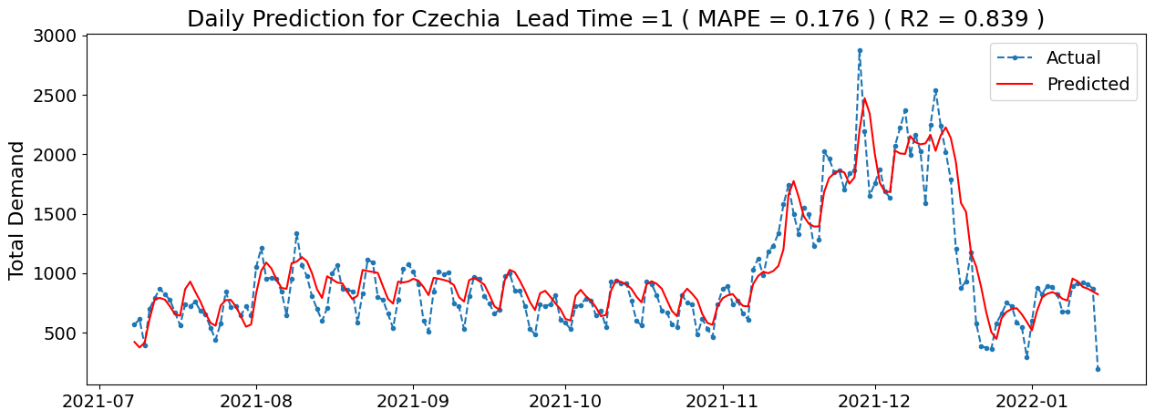
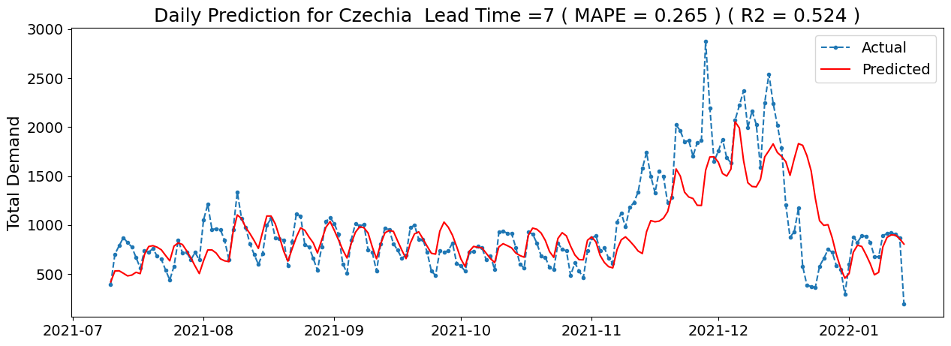
Results for LSTM

Slide 11
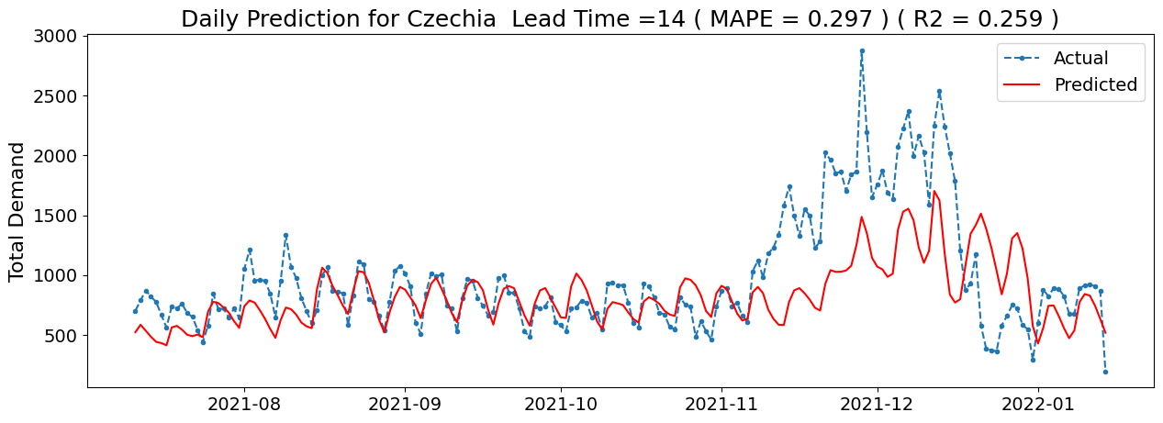
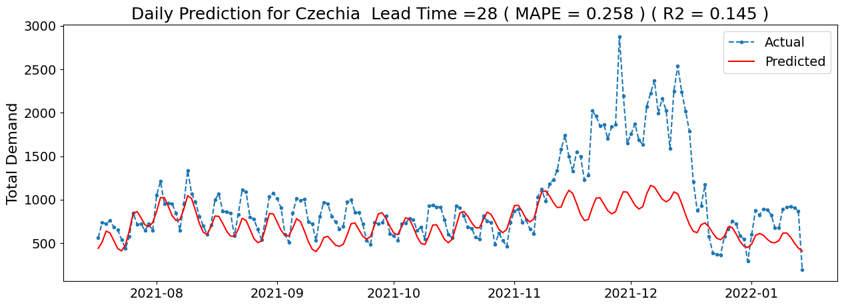
Results for LSTM

Slide 12
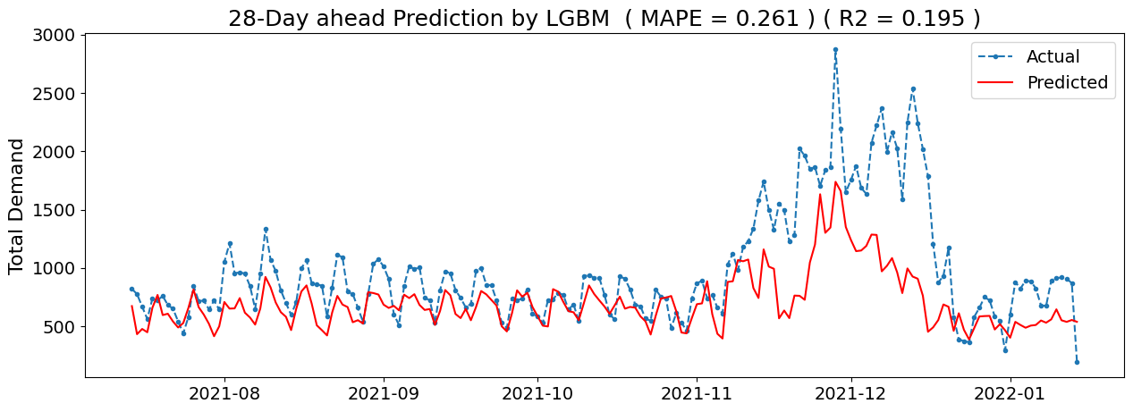
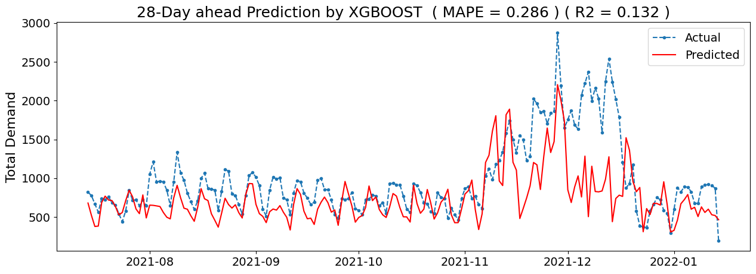
Results for LGBM and XGBOOST

Slide 13
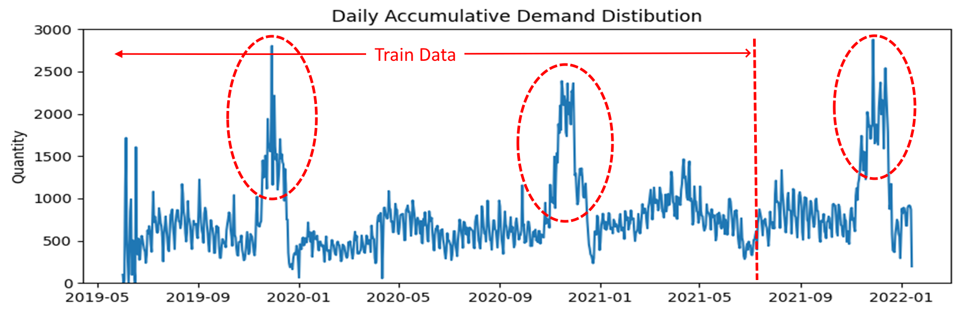
Seasonality in Historical Data

Slide 14
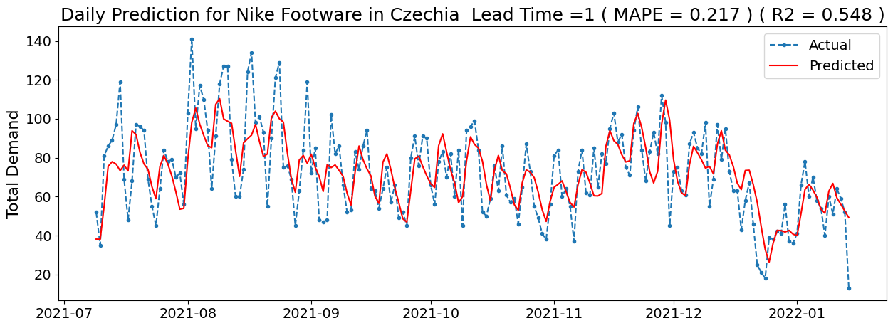
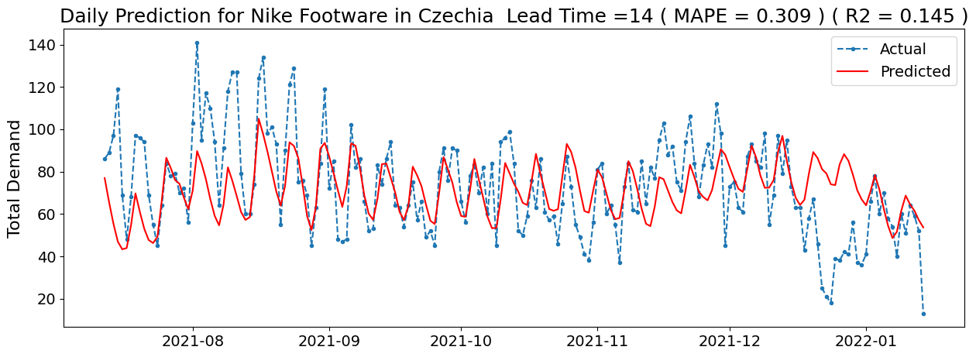
Results for Nike Footwear

Slide 15
Future Goal to Get Better Model Performance
Modeling with Bigger Historical Dataset
Including Holidays in our Prediction
Including Customer Review Analysis

Slide 16
THANK YOU

