Slide 1


Week10– NLP Project
by: Salva

Slide 2
Project Goal
Identify duplicate questions in Qoura website dataset
Project Steps
Data Preparation (text cleaning, preprocesssing)
2) Feature Eextraction
4) Modelling
Challenges
Feature Extraction
BOW

Slide 3
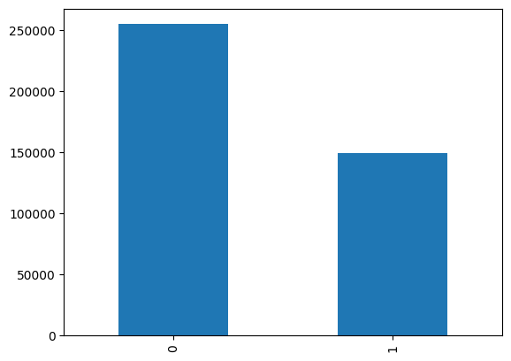
Label Distribution

Slide 4
Cleaning Preprocessing
Tokenize
Remove Punctuation & Nonalphabetic Tokens
Change to Lowercase
Remove Stop Words
Lemmatization

Slide 5
Modling
Logistic Regression (63.1%)
RandomForestClassifier (77.8%)
XGboost Classifier (79.7%)
XGboost Classifier
Best Model

Slide 6
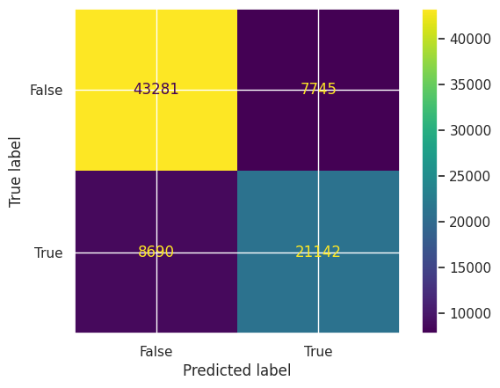
Confusion Matrix Plot for XGBoost
Accuracy : 79.7%
F1 score : 0.78
Notes:
curacy

Slide 7
Results
Number of Unique Question :
Predicted: 537359
Actual: 537929

Slide 8
Feauture Goal
Grid Search cv
Changing Contractions to Original Word
Deployment on AWS

