Slide 1

School of Computer Science and Engineering (SCOPE)
CSI3007 - Advanced Python Programming
Dr. Biji C. L.
Associate Professor, Department of Analytics

Slide 2
Class Vs Objects
Class is the blue print or generalized representation while Objects are specific
Class | Object belonging to the class
1. Person
Gandhiji, Curie, Einstein
Keyur, Sanith, Nandita, Shreyansh, Vaibhav, Aaron
2. Student
3. States of India
Kerala, Tamil Nadu, Delhi
4. Clubs @ VIT
CSI, IEEE, Codechef, Literary

Slide 3
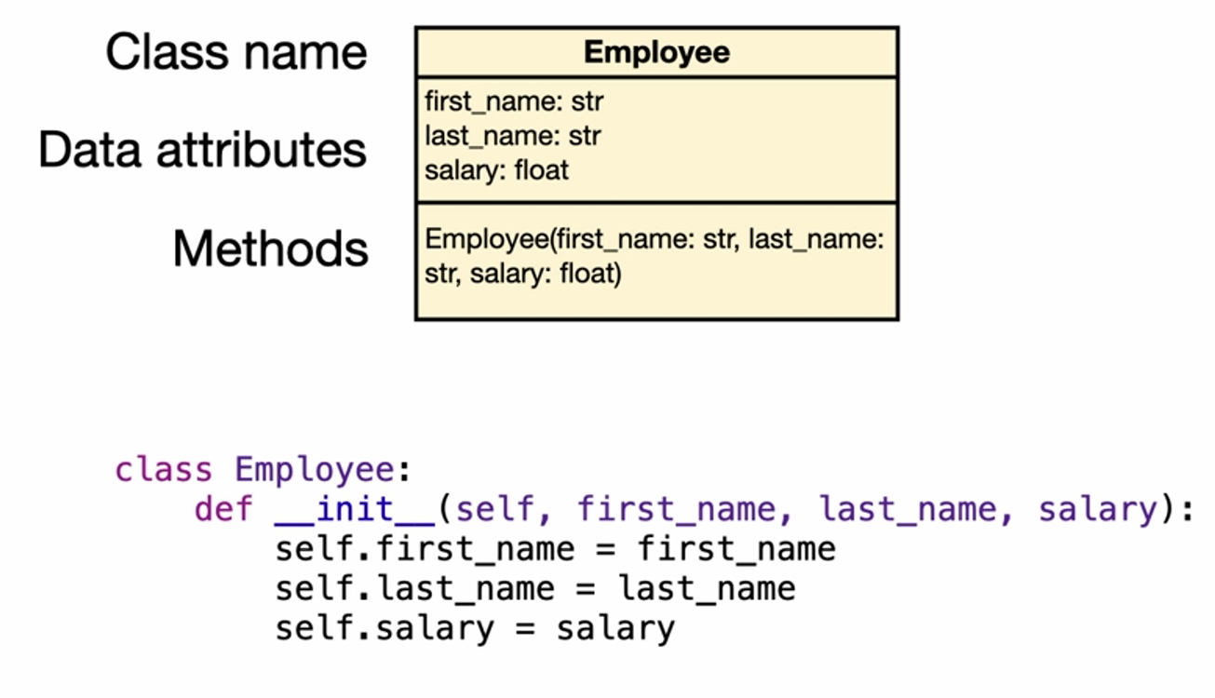
Example

Slide 4
Methods
A method is also a function, but it is bound to a class instance which is an object and may interact with everything in that object. We say that method interact with object state.

Slide 5
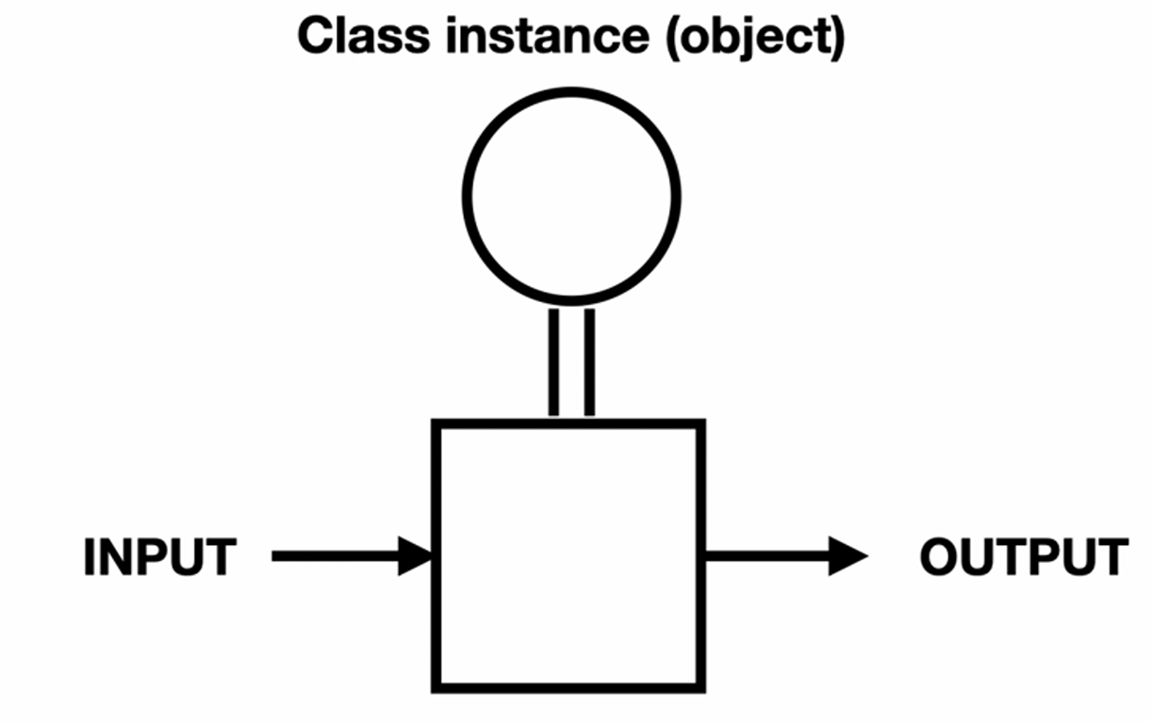
Class Vs Objects

Slide 6
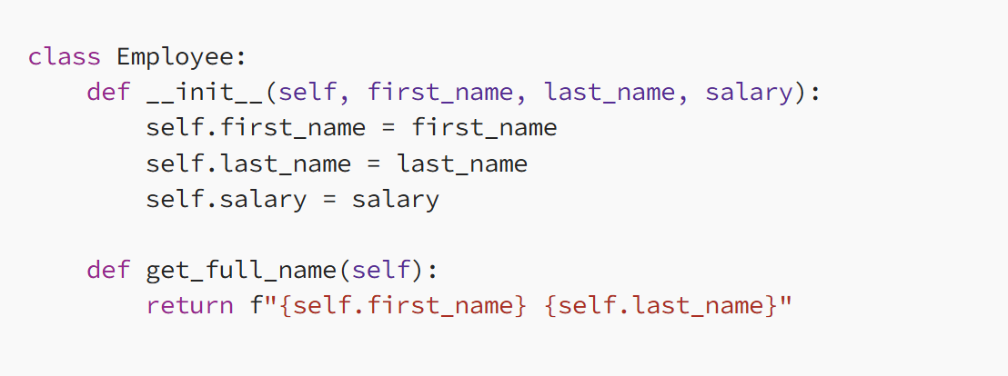
Add a method that returns a full name.

Slide 7
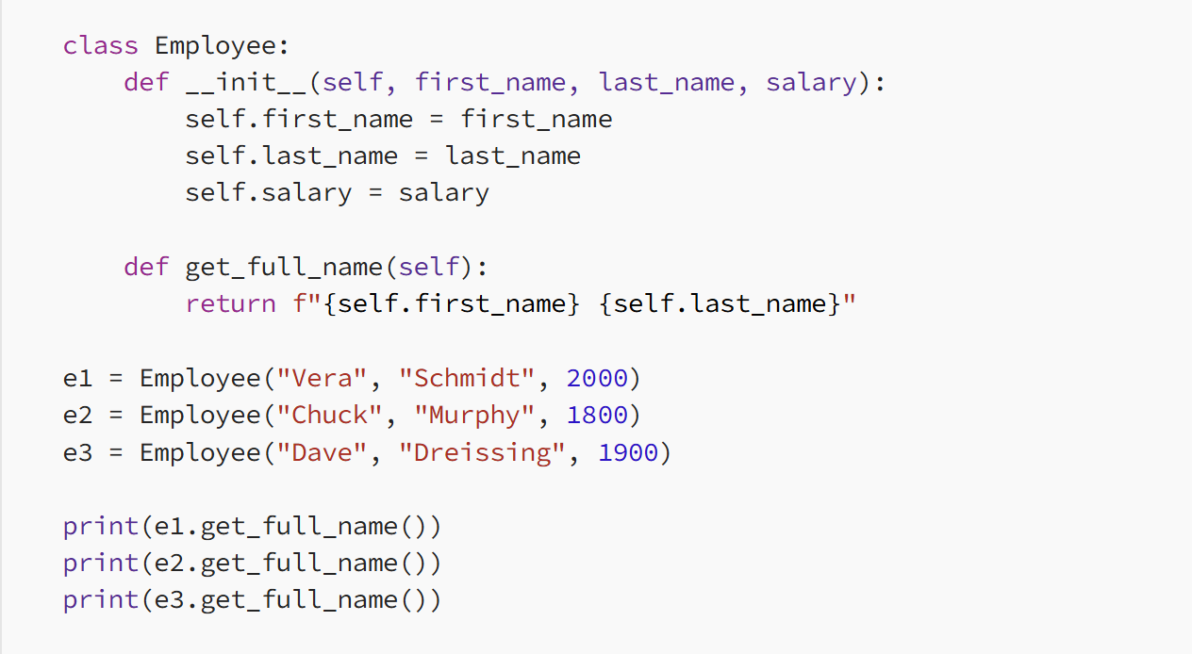
Create Three Employee Objects and print employee name reports

Slide 8
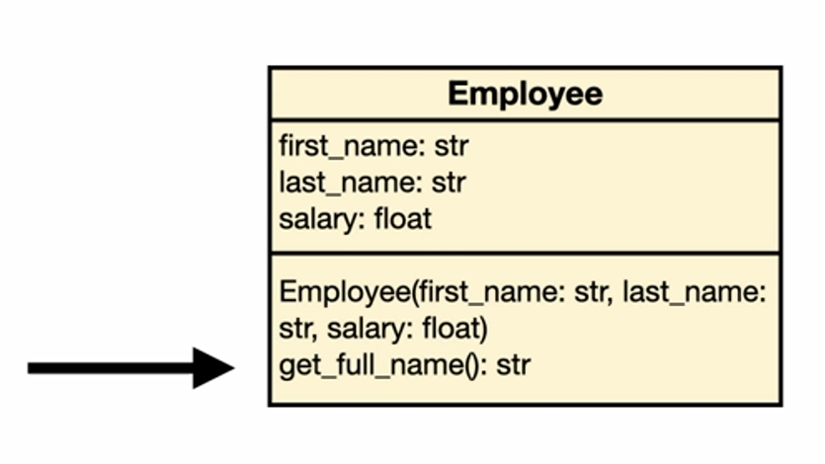
UML Class Diagram

Slide 9
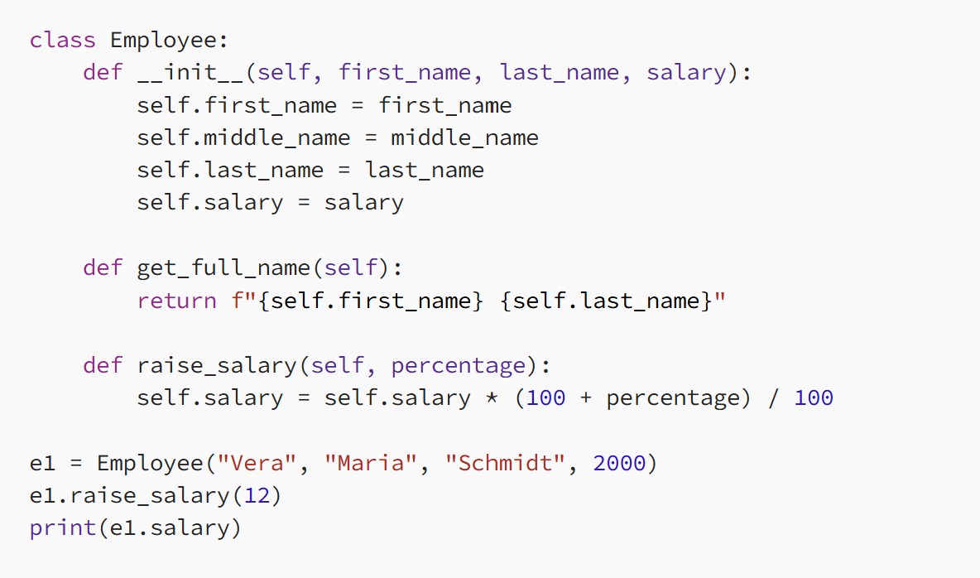
The employee class gets a new method that raises the salary by 12 percentage.

Slide 10
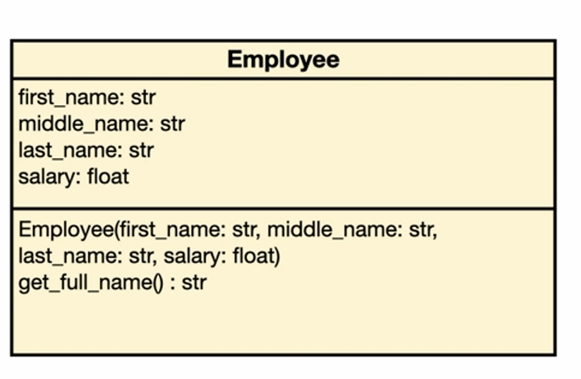
Updated UML

Slide 11
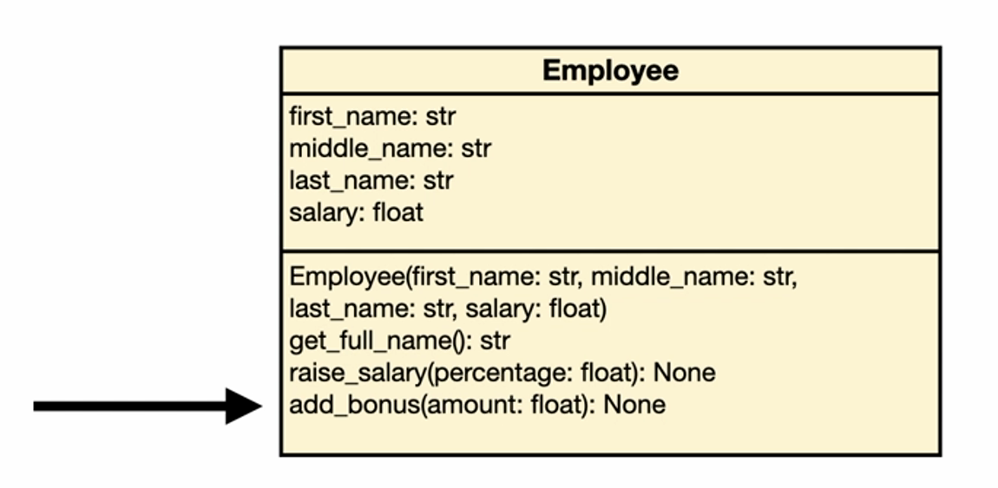
Add method for adding bonus

Slide 12
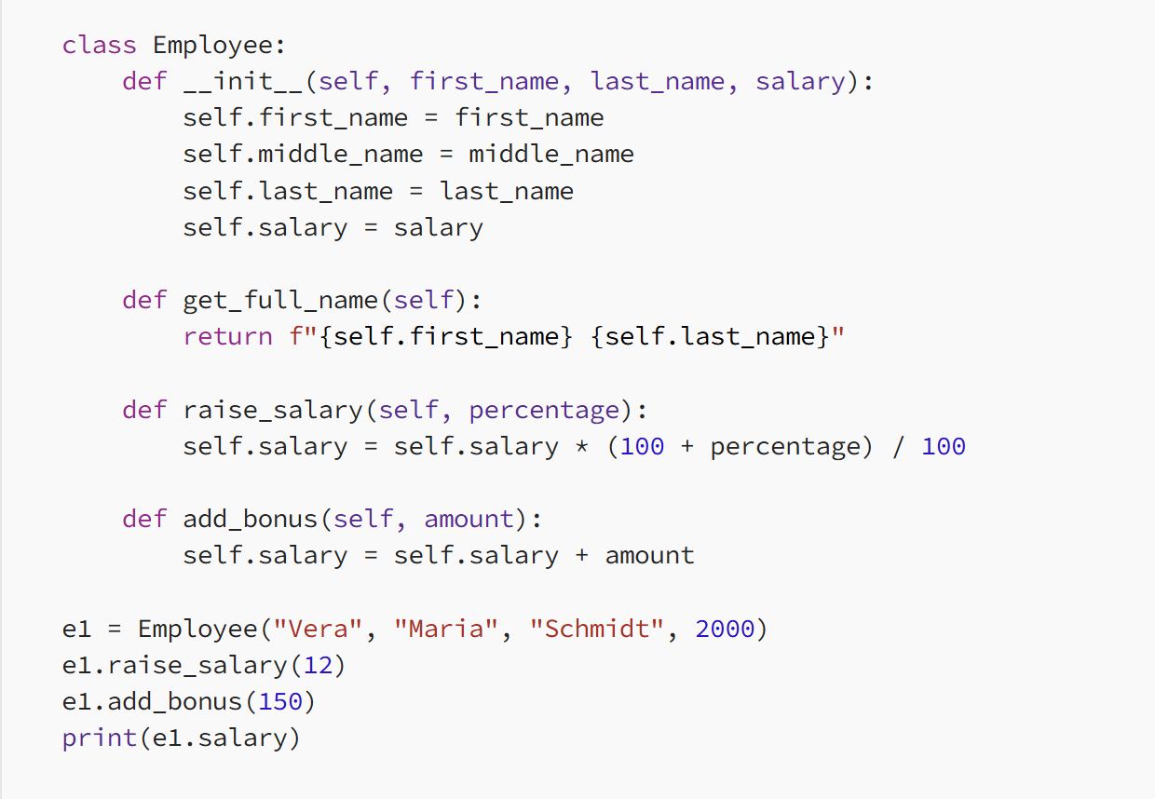

Slide 13
Problem Statement-1
In modern banking applications, customer data security and unique identification are critical. One requirement is to convert a customer’s account balance from its decimal representation into binary format. This binary conversion can serve multiple purposes, such as:
Data encryption: Using binary values as part of secure encoding schemes.
Unique identification: Generating identifiers based on binary balance values for internal tracking.
System compatibility: Supporting systems that require binary inputs for processing.
The challenge is to design a Python class that models a bank account with attributes such as account number, customer name, and balance. The class should provide methods to:
Display the account balance in decimal format.
Convert and return the account balance in binary format.
The solution must demonstrate object-oriented programming principles by creating objects of the class and invoking the methods to show both decimal and binary representations of the balance.

Slide 14
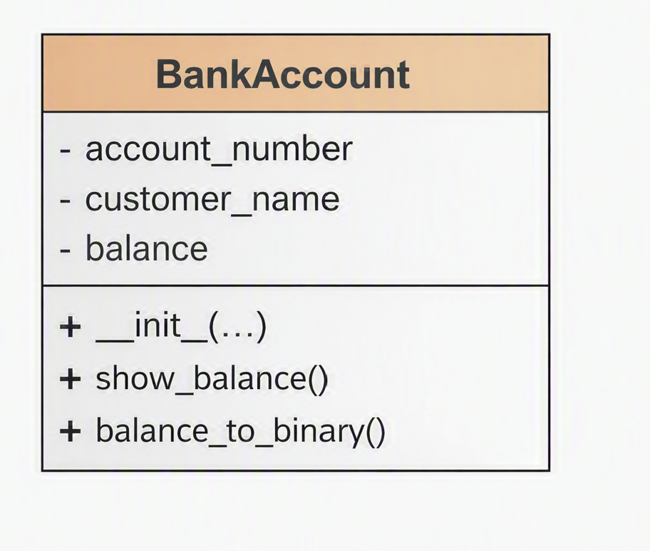
Class Diagram
Class diagram visually represents the structure of the Bank Account class, showing its attributes and methods

Slide 15
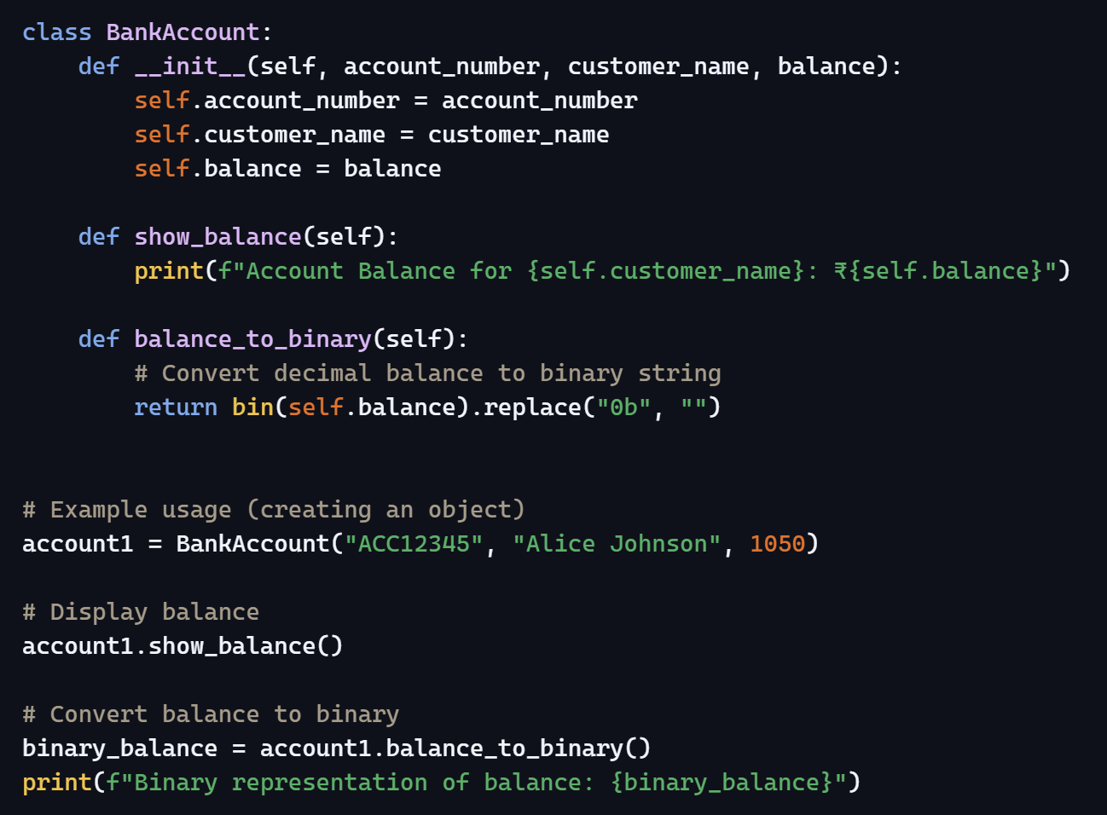

Slide 16

Problem Statement-2
In mathematics, a Strong Number is defined as a number whose sum of the factorial of its digits equals the number itself. For example, $145$is a Strong Number because:
$1!+4!+5!=1+24+120=145$
Strong Numbers are useful in teaching students about factorials, digit manipulation, and number properties.
The task is to develop a Python program that helps students identify Strong Numbers within a given range. The program should be object‑oriented and include:
A class that encapsulates the logic for Strong Number detection.
A constructor to initialize the range of numbers.
Methods to:
  Compute the factorial of digits.
  Check whether a number is Strong.
  Display all Strong Numbers within the specified range.
The program should accept user input for the start and end of the range, create an object of the class, and output all Strong Numbers found in that range.

