Slide 1
InteroperAI-ResQUE
Intelligent Disaster Data Interoperability and Emergency Response Coordination Platform
BY TEAM
Salva Soumya,23MID0061
Gilledi Santhosh,23MID0233
Notes:
Introduce the project: InteroperAI-ResQUE connects disaster data integration (Member 1) with disaster assessment (Member 2). Mention both presenters.

Slide 2



INTRODUCTION
01 • INTRODUCTION
Problem
Solution
Outcome
Disaster datasets use different formats, field names and incomplete records.
Two connected web applications validate, standardize, transfer and assess data.
Traceable transfer, receiver confirmation and ML-assisted review signals.
Core idea: make disaster information easier to exchange and interpret — without treating missing values as known or anomalies as confirmed severity.
Notes:
Problem: disaster datasets differ in format, field names and completeness. Solution: two connected web applications that validate, standardize, transfer and assess data. Outcome: traceable transfer, receiver confirmation and ML-assisted review signals.

Slide 3
Problem statement and objectives
01 • INTRODUCTION
Problem statement
Project objectives
Inconsistent field names can break data exchange.
1
Upload disaster CSV
1
Different schemas make cross-system interpretation difficult.
2
Validate structure
2
3
Map source columns
Missing values can distort assessment if silently treated as zero.
4
Standardize to shared schema
3
5
Send through HTTPS API
Transfer logs should show sender, timestamp and receiver status.
4
6
Assess and log results
Notes:
Left: the problems the project addresses. Right: the six-step objective chain from upload to assessment and logging.

Slide 4
System architecture: data flow
02 • ARCHITECTURE
MEMBER 1 · DATA INTEGRATION
API INTEGRATION
MEMBER 2 · RECEIVING AND ASSESSMENT
1
Member 1 React / Vite frontend
POST /api/receive-file
10
Member 2 React dashboard
Tailwind CSS · CSV upload UI · Vercel
Vite · Tailwind CSS · review UI · Vercel
CSV upload
HTTPS REST API
GET endpoints
Member 1 FastAPI backend · Render
multipart/form-data
Member 2 FastAPI backend · Render
2
Validation
Field: file
9
Activity logs and processed results
Metadata headers
3
Source-column mapping
X-Source-System
X-Client-Id
X-Correlation-Id
8
Isolation Forest anomaly signals
4
Canonical-schema standardization
Backend-to-backend transfer
7
Processing and assessment
Standardized CSV
5
HTTPX-based API request
6
CSV reception and parsing
Receiver response (status) → Member 1
Frontend (Vercel)
Backend step (FastAPI on Render)
Inter-service API call
Frontends: Vercel · FastAPI backends: Render
Notes:
About one minute. Follow the numbers: (1) the Member 1 React frontend uploads a CSV to the Member 1 FastAPI backend, which validates it (2), maps source columns (3) and standardizes to the 20-field canonical schema (4). The backend then sends it with HTTPX (5) using POST /api/receive-file over HTTPS, multipart/form-data, field 'file', with X-Source-System, X-Client-Id and X-Correlation-Id headers. The transfer is backend-to-backend; the frontends do not exchange the file. The Member 2 backend receives and parses the CSV (6), processes and assesses it (7), produces Isolation Forest anomaly signals (8) and stores activity logs and processed results (9), which the Member 2 React dashboard (10) displays. The receiver response returns to Member 1. Frontends are on Vercel; backends on Render.

Slide 5
Python File Execution Flow
03 • IMPLEMENTATION
Logical Python module flow · conceptual execution path
MEMBER 1 · DATA INTEGRATION
MEMBER 2 · RECEIVING AND ASSESSMENT
app/main.py
React dashboard
1
Initializes the FastAPI app and registers routes.
11
Reads results and logs through GET endpoints.
GET endpoints
upload_routes.py
10
Processed results and activity logs
2
Accepts the uploaded CSV and captures upload metadata.
Outputs produced by the assessment pipeline.
9
Evidence-based impact rules
validation_service.py
Applies configured logic to casualty and loss data.
3
Checks required fields and validates the dataset.
8
Isolation Forest anomaly detection
Flags unusual patterns in disaster records.
transformation_service.py
4
Maps source columns to the canonical schema and prepares standardized data.
CSV receiving and parsing
HTTPS REST API
7
Accepts the uploaded file and converts it into records.
POST
/api/receive-file
integration_routes.py
main.py
5
Sends the standardized CSV to Member 2 via HTTPX and records transfer details.
6
Standardized CSV
Hosts the FastAPI app and its API endpoints.
Notes:
Logical Python module flow, not a verified call graph. Member 1: app/main.py initializes FastAPI and registers routes; upload_routes.py accepts the CSV and captures metadata; validation_service.py checks required fields; transformation_service.py maps columns to the canonical schema; integration_routes.py sends the standardized CSV with HTTPX and records transfer details. The transfer is POST /api/receive-file over HTTPS REST. Member 2: main.py hosts the FastAPI app; the CSV is received and parsed, Isolation Forest flags unusual records, evidence-based rules are applied to casualty and loss information, processed results and activity logs are exposed to the React dashboard through GET endpoints. Verify exact function-level calls against the code before presenting this as a call graph.

Slide 6
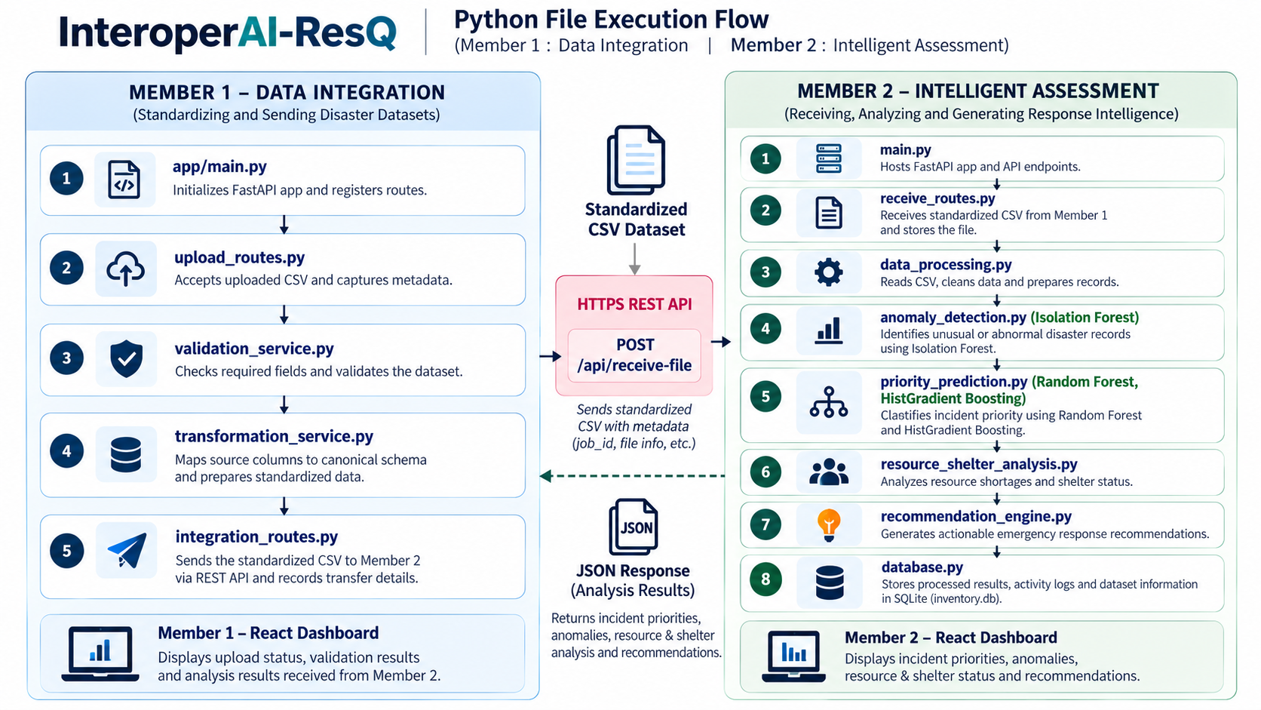

Slide 7
API contract and transfer traceability
03 • IMPLEMENTATION
SENDER
POST /api/receive-file
RECEIVER
Member 1 backend
Member 2 backend
FastAPI · sends via HTTPX
HTTPS · multipart/form-data
FastAPI · receives and parses CSV
HTTP status code and message
Request
Headers
POST /api/receive-file
multipart/form-data
Multipart form field: file (the CSV upload)
X-Source-System
X-Client-Id
X-Correlation-Id
X-Correlation-Id is a unique tag that links the upload to its logs.
1
Send
2
Process
3
Respond
4
Display
Member 1 sends the CSV to the API
Member 2 parses the CSV into stored records
HTTP status code and message returned to Member 1
UI shows confirmation
Notes:
Member 1's backend is the sender (HTTPX client); Member 2's backend is the receiver. The request is POST /api/receive-file with multipart/form-data and a field named file. Three metadata headers travel with it; X-Correlation-Id links the upload to its logs. Member 2 returns an HTTP status code and message, and the Member 1 UI shows the confirmation.

Slide 8
Member 2: receiving and assessment
03 • IMPLEMENTATION
Receives the CSV at POST /api/receive-file as a multipart form upload.
1
Important endpoints
Parses the CSV and stores each accepted record.
GET /api/health
2
Builds processed results for the dashboard.
POST /api/receive-file
3
GET /api/processed-results
Uses Isolation Forest (unsupervised anomaly detection) to flag records with unusual patterns; a flag is a review signal, not proof of severity.
4
GET /api/activity-logs
Applies evidence-based rules to recorded casualties and losses; a missing value stays missing.
GET /api/model-evaluation-report
5
Exposes processed results, activity logs and model evaluation details through GET endpoints.
GET /api/assess
6
Notes:
Member 2 receives the CSV, parses and stores accepted records, builds processed results for the dashboard, flags unusual records with Isolation Forest and applies evidence-based rules. A flag is a review signal, not confirmed severity.

Slide 9
Machine learning in the assessment pipeline
04 • ASSESSMENT AND ML
Assessment pipeline in Member 2
Hybrid assessment
1
Received records
2
Isolation Forest
3
Evidence-based rules
4
Processed results
Parsed and stored by the Member 2 backend after transfer.
Unsupervised anomaly detection: learns typical records and flags unusual ones, with no labels needed.
+
Applied to recorded casualties and losses; a missing value stays missing.
Anomaly signals, assessment outputs and activity logs exposed to the dashboard.
Supervised model comparison: evaluation setup
TARGET
DATA HANDLING
METRICS
Project-defined impact label (not an official NOAA priority).
Pre-event features only; storm episodes kept apart between training and testing; unverifiable labels excluded.
Accuracy and balanced accuracy, which averages results per class.
Notes:
Member 2 combines Isolation Forest anomaly signals with evidence-based rules on recorded casualties and losses to produce processed results for the dashboard. Separately, three supervised classifiers were compared against a project-defined impact label; the results follow on the next slide.

Slide 10
Experimental results: model comparison
04 • ASSESSMENT AND ML
Comparative evaluation of supervised machine-learning models
Corrected group-aware evaluation • 11,495 held-out test records
Model | Test accuracy | Balanced accuracy
Logistic Regression | 77.01% | 73.77%
Random Forest | 76.62% | 74.03%
HistGradientBoosting | 81.57% | 77.00%
81.57%
Highest test accuracy
HistGradientBoosting
77.00%
Highest balanced accuracy
HistGradientBoosting
HistGradientBoosting reports the highest test accuracy and balanced accuracy of the three models compared.
Note: figures are from the supervised comparison and are not an accuracy measure for Isolation Forest.
Notes:
Comparative evaluation of three supervised models on 11,495 held-out test records. HistGradientBoosting reports the highest test accuracy and balanced accuracy of the three. These figures describe the supervised comparison only; they are not an accuracy figure for Isolation Forest.

Slide 11
Interpreting the results
04 • ASSESSMENT AND ML
1
Accuracy
2
Balanced accuracy
3
What the comparison shows
The share of test records predicted correctly (e.g. 81 of 100 is 81%).
Averages the result for each class, so a common class cannot hide weak results on a rare one. It is most informative when classes are imbalanced.
HistGradientBoosting leads on both metrics (81.57% and 77.00%). Balanced accuracy is lower than accuracy for every model, which is why both are reported.
Scope of the evaluation
The target is a project-defined impact label, not an official NOAA emergency-priority label.
Results come from a single held-out test set; further validation on new regions and time periods is planned.
Isolation Forest flags are review signals and are assessed differently from classification accuracy.
Notes:
Explain the two metrics, what the comparison shows, and the scope of the evaluation, then move on to limitations and future work.

Slide 12






Technology stack
05 • ENGINEERING
FRONTEND
BACKEND
DATA PROCESSING
React • Vite • Tailwind CSS
Python • FastAPI
Pandas • NumPy
UI and dashboard
Validation and APIs
CSV processing
INTEGRATION
MACHINE LEARNING
HOSTING
HTTPX • HTTPS REST
scikit-learn • joblib
Vercel • Render
Backend transfer
Anomaly and supervised experiments
Frontends on Vercel; backends on Render
Notes:
Technologies are grouped by role. Everything listed is part of the documented implementation.

Slide 13
Testing and deployment
05 • ENGINEERING
Test areas covered
Backend tests
Integration tests
Frontend build
Validation rules, missing-value handling (kept as missing, not 0), assessment logic and API responses.
File receipt, required headers, correlation IDs and separation of results between uploads.
Production build verifies the React app compiles.
Integration walkthrough demonstrated
Deployment
1
Upload a sample CSV in Member 1.
React frontend on Vercel;
FastAPI backend on Render.
2
Confirm validation and standardized output.
3
Verify Member 2 receives the file and returns a response.
4
Check received data and activity details in Member 2.
Notes:
The original deck lists these test areas and the demonstrated integration walkthrough. It does not report test counts, coverage or benchmarks, so none are shown. Add actual run results here if you have them.

Slide 14
Limitations and future enhancements
06 • CONCLUSION
Current limitations
Future improvements
Some NOAA fields are absent; missing values stay missing, not zero.
Add richer labelled emergency data.
1
1
Anomaly flags need human review; they are not severity scores.
Validate on new regions and time periods.
2
2
Supervised labels are project-defined, not official emergency-priority labels.
Use persistent storage and monitoring.
3
3
Performance may vary across regions.
Improve completeness and uncertainty reporting.
4
4
Notes:
Left: realistic current limitations. Right: planned improvements. The closing line is the project's stance: trustworthy assessment rather than a high accuracy number without validation.

Slide 15




Conclusion
06 • CONCLUSION
InteroperAI-ResQUE connects disaster data integration with assessment in one traceable workflow.
Standardization
Backend-to-backend transfer
Receiver-side assessment
Traceability
Responsible ML use
Member 1 validates, maps and standardizes heterogeneous disaster data.
The standardized dataset is sent through a REST API.
Member 2 receives data and presents assessment results and anomaly signals.
Correlation IDs, activity logs and receiver confirmations link each transfer.
Experimental results are presented transparently, with limitations.
Notes:
Summarise the contribution in five points. Keep the experimental results framed with their limitations.

Slide 16
Thank You
From inconsistent disaster data to traceable, standardized information for assessment.
Notes:
Thank the audience and invite questions. Be ready to explain the architecture (slide 4), the API contract (slide 9) and the distinction between Isolation Forest and the supervised experiment (slides 11–13).

