Slide 1
InsightVault Multimodal RAG System
Dr. Salvador vento asturias (Founder)

Slide 2

Looking for something? Just ask!
Personalized agents at your fingertip.
Overview:
InsightVault is an MVP of a flexible, privacy- focused Retrieval-Augmented Generation (RAG) system. It’s tailored to handle various tools and is designed for future scalability, adapting to customer needs.
Pitch:
"InsightVault bridges the gap between content and fast, contextual insights, securely stored in a local database."
Wasted time searching in intranet by workers:
1.8 hours to 3.6 hours daily
468 hours to 936 hours yearly
Cost per employee for the company:
$11,700 to $23,400 employee/annually
Notes:
Hook: Imagine having a secure, modular system that can rapidly retrieve and analyze video content with the power of AI, all while ensuring data privacy.
Overview: InsightVault is an MVP of a flexible, privacy-focused Retrieval-Augmented Generation (RAG) system that uses LLMs to retrieve or generate transcripts for YouTube videos, playlists, and channels. It’s tailored to handle various tools and is designed for future scalability, adapting to customer needs.
Pitch: "InsightVault bridges the gap between content and fast, contextual insights, securely stored in a local database."

Slide 3
Modular architecture
Gradio deployment
Agent (ReAct)
Llm (GPT4o-mini)
Custom memory
Tools
Retrieval of urls ( single, playlist, channel)
Direct fetch of transcripts
Generation of transcripts (Faster-Whisper)
Storage in ChromaDB
Multiquery retrieval
Core Components:
LLM (GPT-4o mini for MVP)
Tested but require prompt tunning: command R Plus (cohereAI)
To be tested: IBM Granit models
Faster-Whisper for transcription
ChromaDB for storage.
Modular Design:
Each tool serves a specific function and can be swapped or scaled, allowing easy adaptation to customer-specific needs.
Deployment:
Designed to run locally or on cloud platforms, ensuring adaptability and data security.

Slide 4
All you need are Agents-LLMs-Tools
Gradio deployment
Agent (ReAct)
Llm (GPT4o-mini)
Custom memory
Tools
Retrieval of urls ( single, playlist, channel)
Direct fetch of transcripts
Generation of transcripts (Faster-Whisper)
Storage in ChromaDB
Retrieval pipeline
Fetch or generate tool
Multiquery Retrieval
YouTube URL Input:
Accepts video URLs, playlists, or entire channels.
Transcription Handling:
If a transcript is unavailable, Whisper generates it.
Storage in ChromaDB:
Ensures secure, local storage of data for fast retrieval.
LLM Interaction:
Uses a memory-wrapped LLM for consistent and relevant answers across queries.
Customization Potential:
Compatible with other LLMs for expanded use cases, with plans for smaller local models to minimize resource requirements.

Slide 5
The answers you need are within you
Primary Data Source: YouTube
Current data in the database:
Boardgames
Training for climbing
Access Method:
Multiquery retrieval with similarity threshold selecting for highly relevant data
Preprocessing:
Whisper Transcription: Generates transcripts from video content when not directly available from YouTube, ensuring data completeness.
Impact: Preprocessing with Whisper allowes for a higher quality of transcript-based retrieval at the expense of time.

Slide 6
Fully flexible agent
ReAct Agent:
Allows combination of multiple tools in a single workflow.
Easy and simple addition or removal of tools
Dynamic decision making
Upon query, the agent can decide which way is best to proceed
Memory integration
Contextual awareness ( can be tunned)
Multiple parsing possibilities
To be implemented: JSON parser
Flexibility:
Ready for integration with other LLMs as the project scales.
Scalability
Possibility to combine multiple agents if needed

Slide 7
Endless tool possibilities
Vector Database (ChromaDB):
Text splitting into chunks ( easily tunnable)
Stores transcripts as embeddings locally for efficient retrieval, emphasizing privacy and data security.
Video URL Validation and Retrieval:
Capable of handling single videos, playlists, and channel-wide content extraction.
YoutubeLoader:
Eficient retrieval of transcripts
Whisper:
Generates transcripts for videos where transcripts aren’t available, using AI to fill in gaps.
Memory:
Custom memory allows to tune how many interactions are remembered.
Modularity:
Each tool is interchangeable, allowing for easy integration of additional tools, such as image processing or web scraping

Slide 8
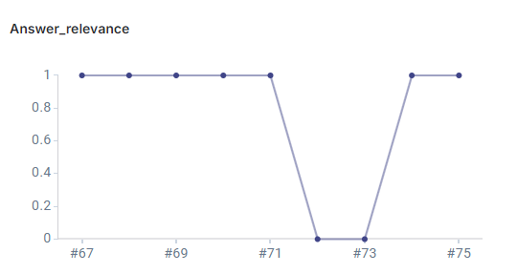
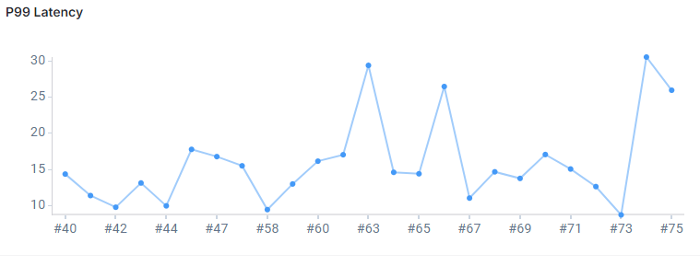
Evaluation
Evaluation Approach: Uses LangSmith for systematic evaluation with a custom dataset.
Relevance and Quality Metrics: Evaluates document relevance and response quality, ensuring the system retrieves useful information.
Latency: measured latency in a database with over 1000 videos stored
Continuous Improvement: Langsmith logging improves ability to adjust and improve transcript quality and LLM relevance.

Slide 9
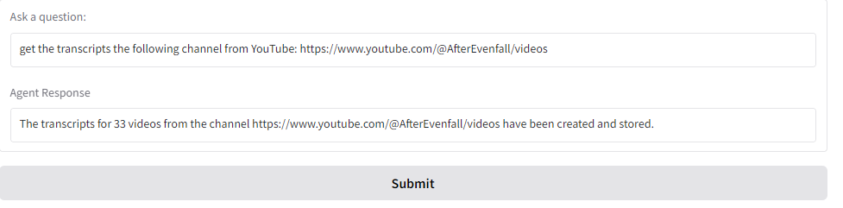
InsightVault -Seamless access to your data-
Gradio deployment
Agent (create_react)
Llm (GPT4o-mini)
Custom memory
Tools
Retrieval of urls ( single, playlist, channel)
Direct fetch of transcripts
Generation of transcripts (Faster-Whisper)
Storage in ChromaDB
Retrieval pipeline
Fetch or generate tool
Multiquery Retrieval
InsightVault has proven its viability as a modular, secure RAG system for video transcripts.
Future Goals:
Integration of smaller models for local-only operation.
Further tool expansion.
Enhanced Q&A accuracy.
“Copy” Alex’s yamel file ☺
Develop improved deployment
InsightVault is a foundational step towards a scalable, adaptable AI-driven system for secure and insightful data retrieval.

Slide 10
Demo time!
InsightVault testing grounds: https://a318aa1269a9ccc3eb.gradio.live

