Slide 1
Outline
Maximum Likelihood
Maximum A-Posteriori (MAP) Estimation
Bayesian Parameter Estimation
Example:The Gaussian Case
Recursive Bayesian Incremental Learning
Problems of Dimensionality
Example: Probability of Sun Rising

Slide 2
Bayes' Decision Rule
(Minimizes the probability of error)
ω₁ : if P(ω₁|x) > P(ω₂|x)
ω₂ : otherwise
or
ω₁ : if P ( x |ω₁) P(ω₁) > P(x|ω₂) P(ω₂)
ω₂ : otherwise
and
P(Error|x) = min [P(ω₁|x) , P(ω₂|x)]

Slide 3
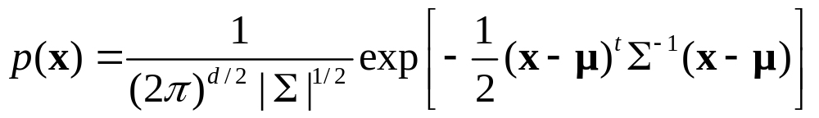
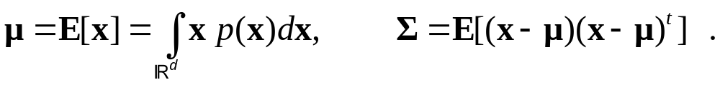
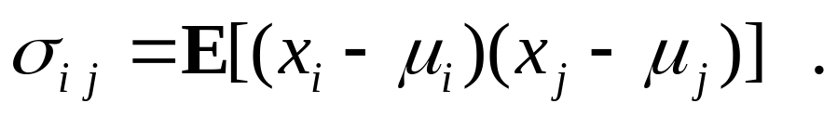
Normal Density - Multivariate Case
The general multivariate normal density (MND) in a d dimensions is written as
It can be shown that:
which means for components

Slide 4
Maximum Likelihood and Bayesian Parameter Estimation
To design an optimal classifier we need P(ω_{i}) and p(x| ω_{i}), but usually we do not know them.
Solution – to use training data to estimate the unknown probabilities. Estimation of class-conditional densities is a difficult task.

Slide 5
Maximum Likelihood and Bayesian Parameter Estimation
Supervised learning: we get to see samples from each of the classes “separately” (called tagged or labeled samples).
Tagged samples are “expensive”. We need to learn the distributions as efficiently as possible.
Two methods: parametric (easier) and non-parametric (harder)

Slide 6




Learning From Observed Data
Hidden
Observed
Unsupervised
Supervised

Slide 7

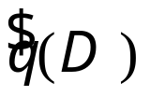

Maximum Likelihood and Bayesian Parameter Estimation
Program for parametric methods:
  Assume specific parametric distributions with parameters
  Estimate parameters from training data
  Replace true value of class-conditional density with approximation and apply the Bayesian framework for decision making.

Slide 8
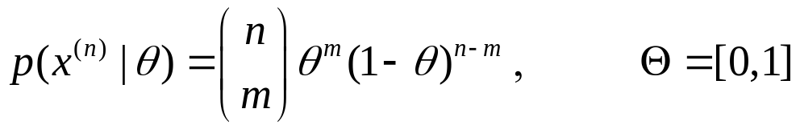
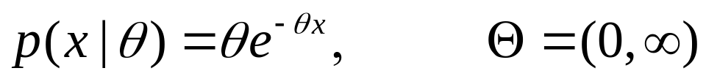
Maximum Likelihood and Bayesian Parameter Estimation
Suppose we can assume that the relevant (class-conditional) densities are of some parametric form. That is,
p(x|ω)=p(x|θ), where
Examples of parameterized densities:
  Binomial: x^{(n)} has m 1’s and n-m 0’s
  Exponential: Each data point x is distributed according to

Slide 9



Maximum Likelihood and Bayesian Parameter Estimation cont.
Two procedures for parameter estimation will be considered:
  Maximum likelihood estimation: choose parameter value that makes the data most probable (i.e., maximizes the probability of obtaining the sample that has actually been observed),
  Bayesian learning: define a prior probability on the model space and compute the posterior Additional samples sharp the posterior density which peaks near the true values of the parameters .

Slide 10







Sampling Model
It is assumed that a sample set with
independently generated samples is available.
The sample set is partitioned into separate sample sets for each class,
A generic sample set will simply be denoted by .
Each class-conditional is assumed to have a known parametric form and is uniquely specified by a parameter (vector) .
Samples in each set are assumed to be independent and identically distributed (i.i.d.) according to some true probability law .

Slide 11



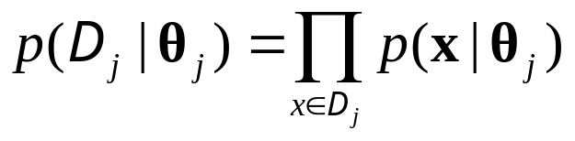

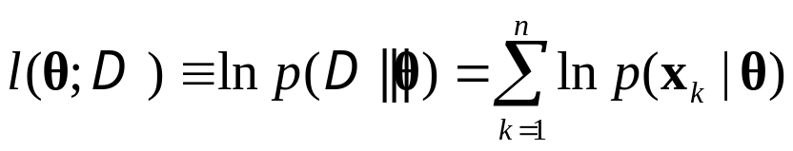

Log-Likelihood function and Score Function
The sample sets are assumed to be functionally independent, i.e., the training set contains no information about for .
The i.i.d. assumption implies that
Let be a generic sample of size .
Log-likelihood function:
The log-likelihood function is identical to the logarithm of the probability density function, but is interpreted as a function over the sample space for given parameter

Slide 12
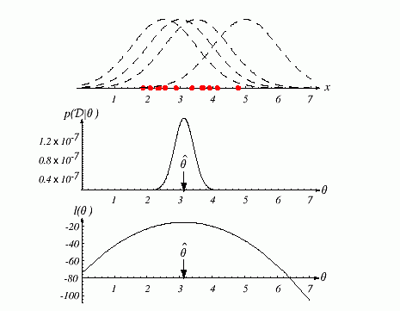
Log-Likelihood Illustration
Assume that all the points in are drawn from some (one-dimensional) normal distribution with some (known) variance and unknown mean.

Slide 13
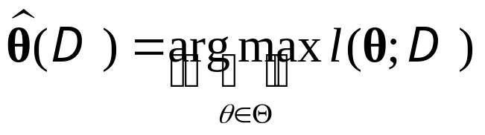
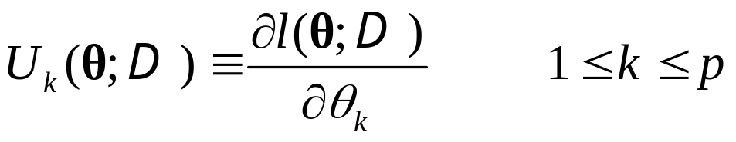



Log-Likelihood function and Score Function cont.
Maximum likelihood estimator (MLE):
(tacitly assuming that such a maximum exists!)
Score function:
and hence
Necessary condition for MLE (if not on border of domain
) :

Slide 14
Maximum A Posteriory
Maximum a posteriory (MAP):
Find the value of θ that maximizes l(θ)p(θ), where p(θ),is a prior probability of different parameter values.A MAP estimator finds the peak or mode of a posterior.
Drawback of MAP: after arbitrary nonlinear transformation of the parameter space, the density will change, and the MAP solution will no longer be correct.

Slide 15
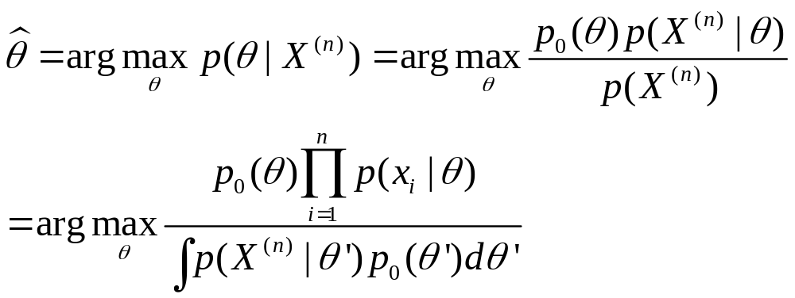
Maximum A-Posteriori (MAP) Estimation
The “most likely value” is given by θ

Slide 16
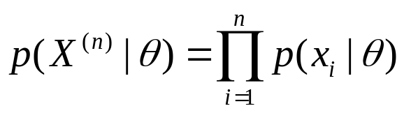

Maximum A-Posteriori (MAP) Estimation
since the data is i.i.d.
We can disregard the normalizing factor when looking for the maximum

Slide 17

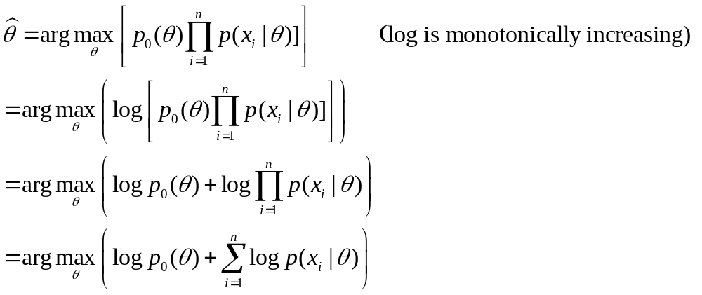
MAP - continued
So, the we are looking for is

Slide 18



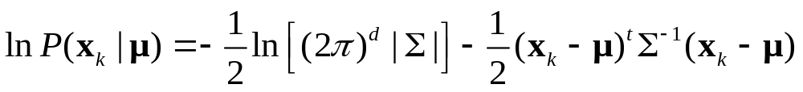
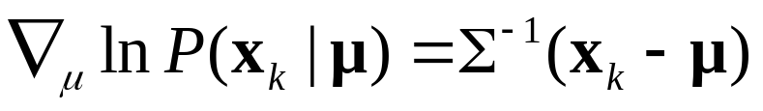

The Gaussian Case: Unknown Mean
Suppose that the samples are drawn from a multivariate normal population with mean , and covariance matrix
.
Consider fist the case where only the mean is unknown
.
For a sample point x_{k} , we have
and
The maximum likelihood estimate for must satisfy

Slide 19
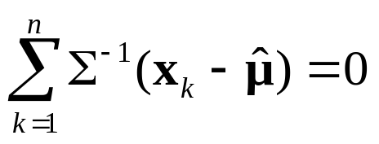
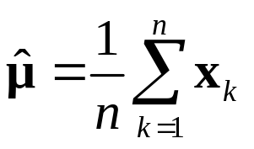
The Gaussian Case: Unknown Mean
Multiplying by , and rearranging, we obtain
The MLE estimate for the unknown population mean is just the arithmetic average of the training samples (sample mean).
Geometrically, if we think of the n samples as a cloud of points, the sample mean is the centroid of the cloud

Slide 20

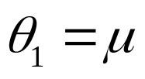
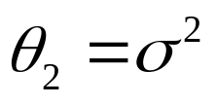
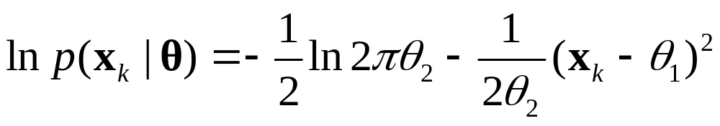
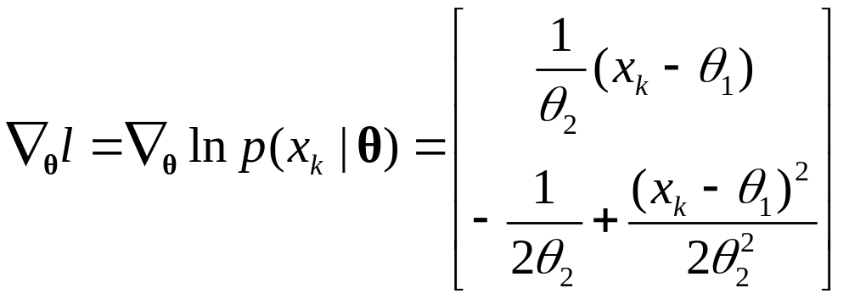
The Gaussian Case: Unknown Mean and Covariance
In the general multivariate normal case, neither the mean nor the covariance matrix is known .
Consider fist the univariate case with and
. The log-likelihood of a single point is
and its derivative is

Slide 21
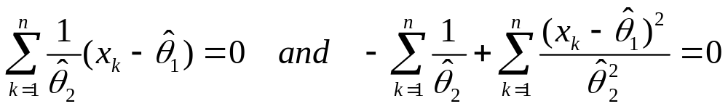




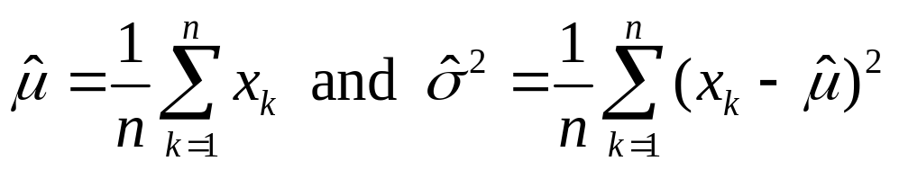
The Gaussian Case: Unknown Mean and Covariance
Setting the gradient to zero, and using all the sample points, we get the following necessary conditions:
where are the MLE estimates for , and respectively.
Solving for , we obtain

Slide 22
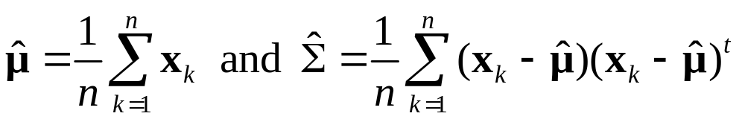
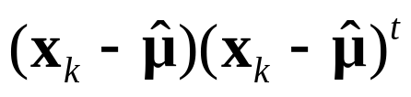

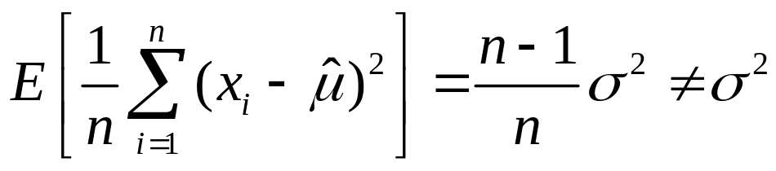
The Gaussian multivariate case
For the multivariate case, it is easy to show that the MLE estimates for are given by
The MLE for the mean vector is the sample mean, and the MLE estimate for the covariance matrix is the arithmetic average of the n matrices
The MLE for is biased (i.e., the expected value over all data sets of size n of the sample variance is not equal to the true variance:

Slide 23


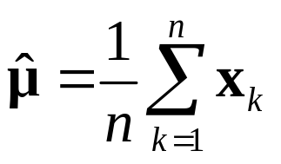
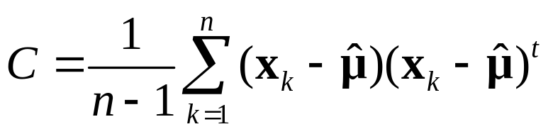

The Gaussian multivariate case
Unbiased estimator for and are given by
and
C is called the sample covariance matrix . C is absolutely unbiased. is asymptotically unbiased.

Slide 24

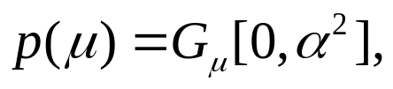

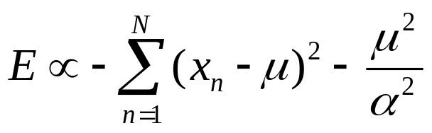
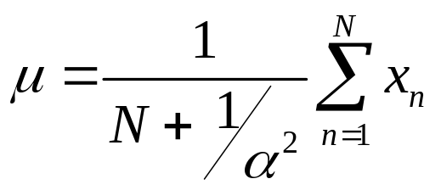
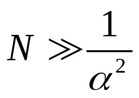
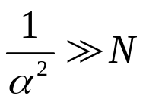
Example (demo-MAP)
We have N points which are generated by one dimensional Gaussian,
Since we think that the mean should not be very big we use as a prior where is a hyperparameter. The total objective function is:
which is maximized to give,
For influence of prior is negligible and result is ML estimate. But for very strong belief in the prior the estimate tends to zero. Thus,
if few data are available, the prior will bias the estimate towards the prior expected value

Slide 25
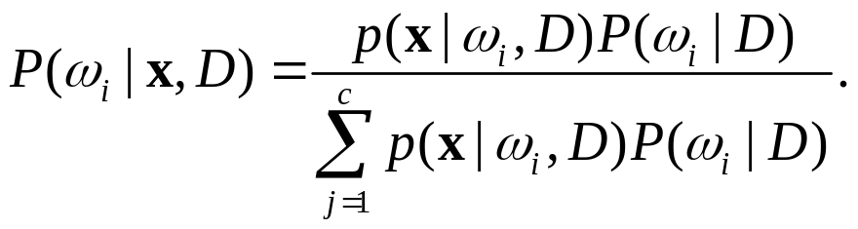
Bayesian Estimation: Class-Conditional Densities
The aim is to find posteriors P(ω_{i}|x) knowing p(x|ω_{i}) and P(ω_{i}), but they are unknown. How to find them?
Given the sample D, we say that the aim is to find P(ω_{i}|x, D)
Bayes formula gives:
We use the information provided by training samples to determine the class conditional densities and the prior probabilities.
Generally used assumptions:
  Priors generally are known or obtainable from a trivial calculations. Thus P(ω_{i})= P(ω_{i}|D).
  The training set can be separated into c subsets: D₁,…,D_{c}
Notes:
P(w,x,D)=p(x|w,D)P(w,D)=p(w|x,D)P(x,D); P(w,D)=p(w|D)P(D);P(x,D)=p(x)P(D)

Slide 26

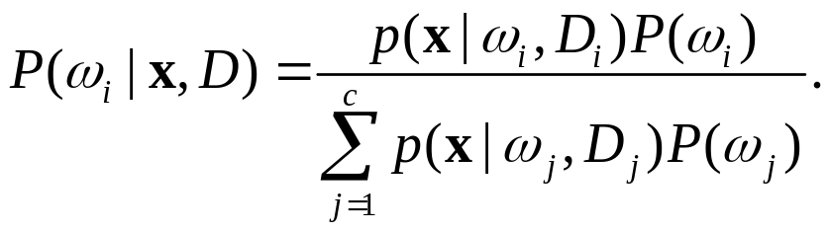
Bayesian Estimation: Class-Conditional Densities
  The samples D_{j} have no influence on p(x|ω_{i,}D_{i} ) if
Thus we can write:
We have c separate problems of the form:
Use a set D of samples drawn independently according to a fixed but unknown probability distribution p(x) to determine p(x|D).
Notes:
P(w,x,D)=p(x|w,D)P(w,D)=p(w|x,D)P(x,D); P(w,D)=p(w|D)P(D);P(x,D)=p(x)P(D)

Slide 27

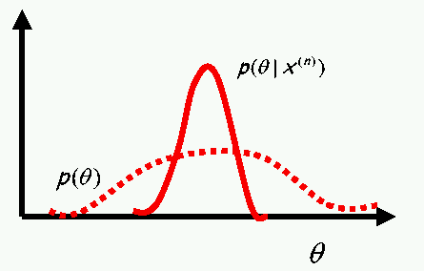
Bayesian Estimation: General Theory
Bayesian leaning considers (the parameter vector to be
estimated) to be a random variable.
Before we observe the data, the parameters are described by a prior p(θ ) which is typically very broad. Once we observed the data, we can make use of Bayes’ formula to find posterior p(θ |D ). Since some values of the parameters are more consistent with the data than others, the posterior is narrower than prior. This is Bayesian learning (see fig.)

Slide 28



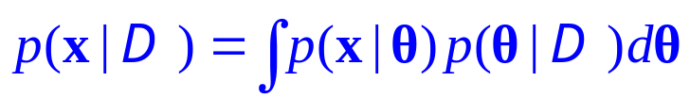




General Theory cont.
Density function for x, given the training data set ,
From the definition of conditional probability densities
The first factor is independent of since it just our assumed form for parameterized density.
Therefore
Instead of choosing a specific value for , the Bayesian approach performs a weighted average over all values of
The weighting factor , which is a posterior of is determined by starting from some assumed prior

Slide 29


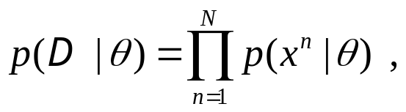

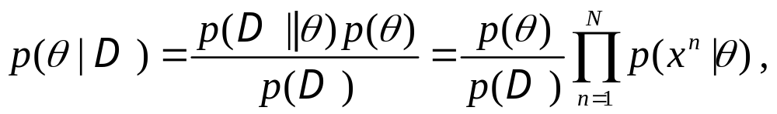
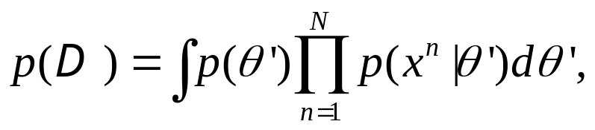
General Theory cont.
Then update it using Bayes’ formula to take account of
data set . Since are drawn independently
which is likelihood function.
Posterior for is
where normalization factor

Slide 30





Bayesian Learning – Univariate Normal Distribution
Let us use the Bayesian estimation technique to calculate a posteriori density and the desired probability density for the case
  Univariate Case:
  Let μ be the only unknown parameter

Slide 31

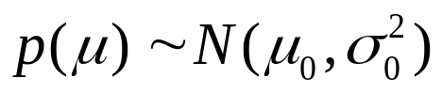

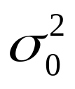

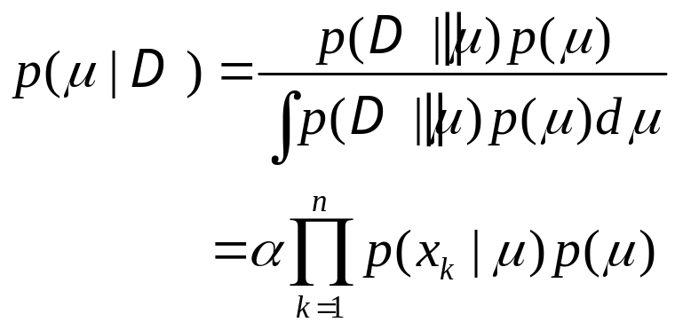
Bayesian Learning – Univariate Normal Distribution
Prior probability: normal distribution over ,
encodes some prior knowledge about the true mean , while measures our prior uncertainty.
If μ is drawn from p(μ) then density for x is completely determined. Letting we use

Slide 32
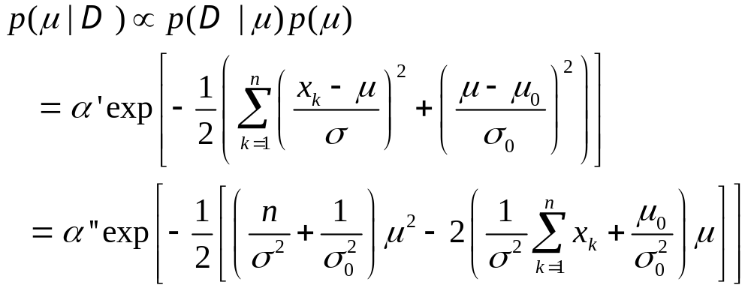
Bayesian Learning – Univariate Normal Distribution
Computing the posterior distribution

Slide 33




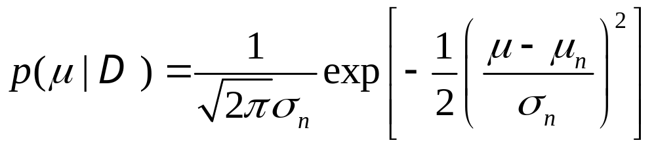
Bayesian Learning – Univariate Normal Distribution
Where factors that do not depend on have been absorbed into the constants and
is an exponential function of a quadratic function of i.e. it is a normal density.
remains normal for any number of training samples.
If we write
then identifying the coefficients, we get

Slide 34
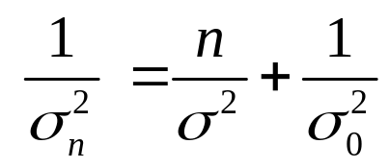
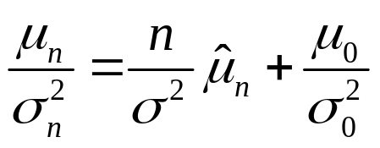
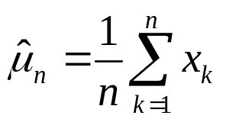


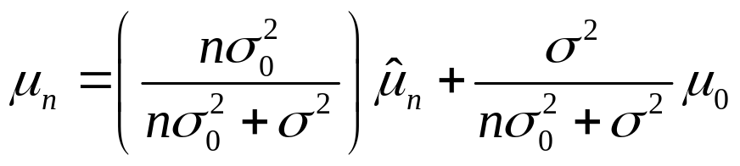





Bayesian Learning – Univariate Normal Distribution
where is the sample mean.
Solving explicitly for and we obtain
and
represents our best guess for after observing
n samples.
measures our uncertainty about this guess.
decreases monotonically with n (approaching
as n approaches infinity)

Slide 35


Bayesian Learning – Univariate Normal Distribution
Each additional observation decreases our uncertainty about the true value of .
As n increases, becomes more and more sharply peaked, approaching a Dirac delta function as n approaches infinity. This behavior is known as Bayesian Learning.

Slide 36










Bayesian Learning – Univariate Normal Distribution
In general, is a linear combination of and , with coefficients that are non-negative and sum to 1.
Thus lies somewhere between and .
If , as
If , our a priori certainty that is so
strong that no number of observations can change our
opinion.
If , a priori guess is very uncertain, and we
take
The ratio is called dogmatism.

Slide 37



Bayesian Learning – Univariate Normal Distribution
The Univariate Case:
where

Slide 38








Bayesian Learning – Univariate Normal Distribution
Since we can write
To obtain the class conditional probability , whose parametric form is known to be we replace by and by
The conditional mean is treated as if it were the true mean, and the known variance is increased to account for the additional uncertainty in x resulting from our lack of exact knowledge of the mean .

Slide 39






Recursive Bayesian Incremental Learning
We have seen that Let us define Then
Substituting into and using Bayes we have:
Finally

Slide 40


Recursive Bayesian Incremental Learning
While repeated use of this eq. produces a sequence
This is called the recursive Bayes approach to the parameter estimation. (Also incremental or on-line learning).
When this sequence of densities converges to a Dirac delta function centered about the true parameter value, we have Bayesian learning.

Slide 41
Maximal Likelihood vs. Bayesian
ML and Bayesian estimations are asymptotically equivalent and “consistent”. They yield the same class-conditional densities when the size of the training data grows to infinity.
ML is typically computationally easier: in ML we need to do (multidimensional) differentiation and in Bayesian (multidimensional) integration.
ML is often easier to interpret: it returns the single best model (parameter) whereas Bayesian gives a weighted average of models.
But for a finite training data (and given a reliable prior) Bayesian is more accurate (uses more of the information).
Bayesian with “flat” prior is essentially ML; with asymmetric and broad priors the methods lead to different solutions.

Slide 42






Problems of Dimensionality:Accuracy, Dimension, and Training Sample Size
Consider two-class multivariate normal distributions
with the same covariance. If priors are equal then Bayesian error rate is given by
where is the squared Mahalanobis distance:
Thus the probability of error decreases as r increases. In the conditionally independent case and

Slide 43


Problems of Dimensionality
While classification accuracy can become better with growing of dimensionality (and an amount of training data),
  beyond a certain point, the inclusion of additional features leads to worse rather then better performance
  computational complexity grows
  the problem of overfitting arises

Slide 44
Occam's Razor
"Pluralitas non est ponenda sine neccesitate" or "plurality should not be posited without necessity." The words are those of the medieval English philosopher and Franciscan monk William of Occam (ca. 1285-1349).
Decisions based on overly complex models often lead to lower accuracy of the classifier.

Slide 45

Example: Prob. of Sun Rising
Question: What is the probability that the sun will rise tomorrow?
Bayesian answer: Assume that each day the sun rises with probability θ (Bernoulli process) and that θ is distributed uniformly in [0,1].Suppose there were n sun rises so far. What is the probability of an (n+1)st rise?
Denote the data set by x^{(n)} =x₁,…,x_{n} , where x_{i}=1 for every i ( the Sun rose till now every day) .

Slide 46



Probability of Sun Rising
We have
Therefore,
This is called : Laplace’s law of succession
Notice that ML gives

