Slide 1
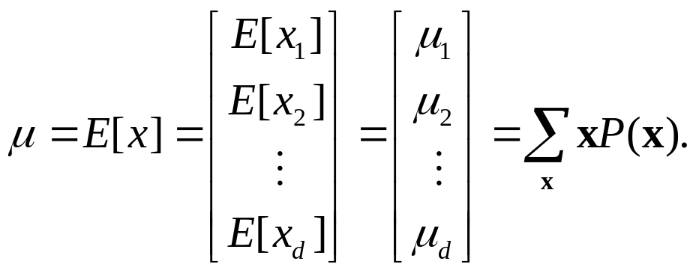

Covariance matrices
The covariance matrix Σ is defined as the square matrix
whose ij^{th} element σ_{ij} is the covariance of x_{i} and x_{j}:

Slide 2
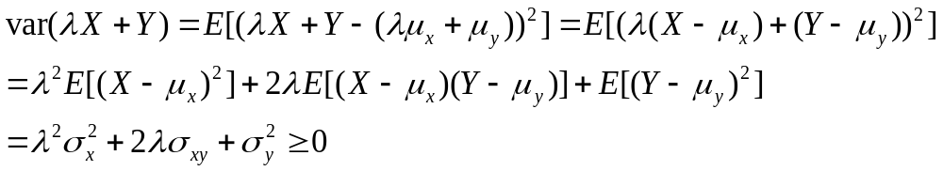
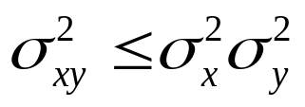





Cauchy-Schwartz inequality
From this we have the Cauchy-Schwartz inequality
The correlation coefficient is normalized covariance
It always . If the variables x
and y are uncorrelated. If y=ax+b and a>0, then
If a<0, then
Question.Prove that if X and Y are independent r.v. then

Slide 3
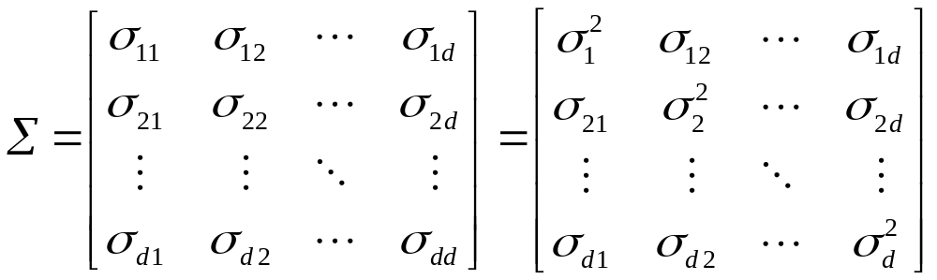

Covariance matrices
If the variables are statistically independent, the covariances are zero, and the covariance matrix is diagonal.
The covariance matrix is positive semi-definite: if w is any d-dimensional vector, then . This is equivalent to the requirement that none of the eigenvalues of Σ can ever be negative.

Slide 4
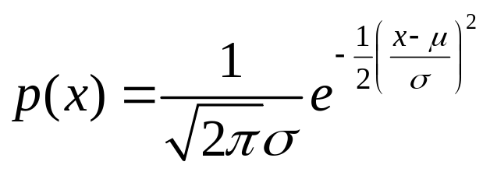
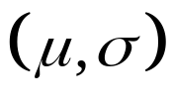
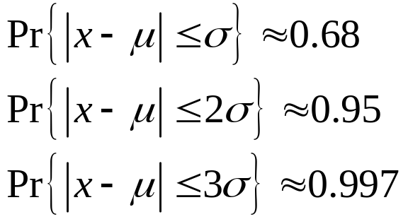
Univariate normal density
The normal or Gaussian probability function is very important. In 1-dimension case, it is defined by probability density function
The normal density is described as a "bell-shaped curve", and it is completely determined by .
The probabilities obey

Slide 5

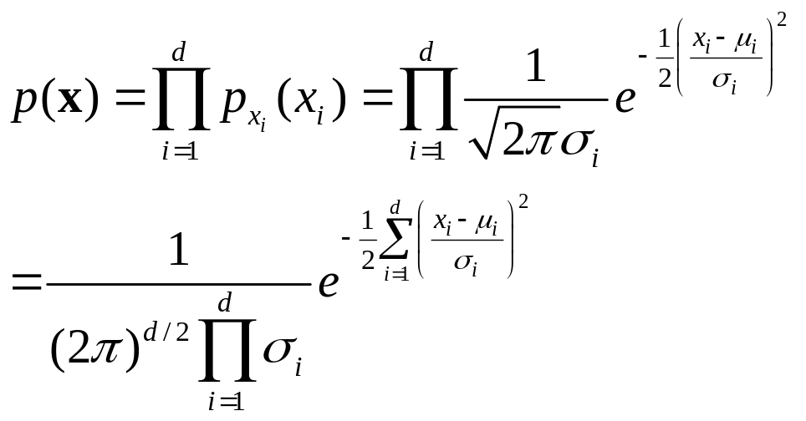
Multivariate Normal densities
Suppose that each of the d random variables x_{i} is normally distributed, each with its own mean and variance:
If these variables are independent, their joint density has the form
This can be written in a compact matrix form if we observe that for this case the covariance matrix is diagonal, i.e.,

Slide 6
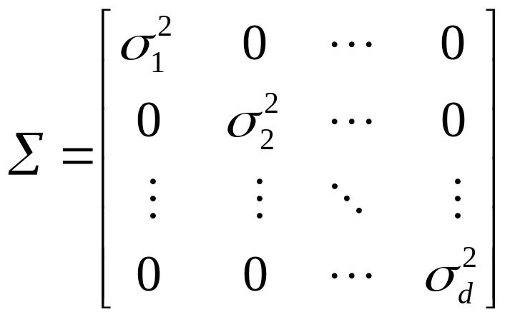
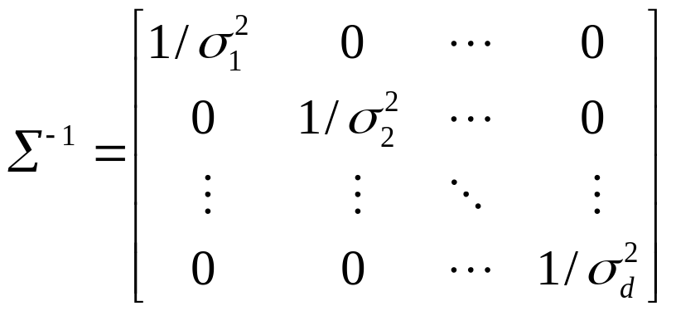
Covariance matrices
and hence the inverse of the covariance matrix is easily written as

Slide 7
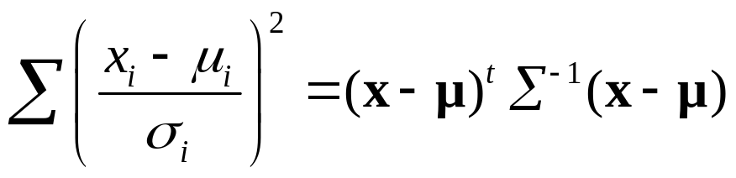
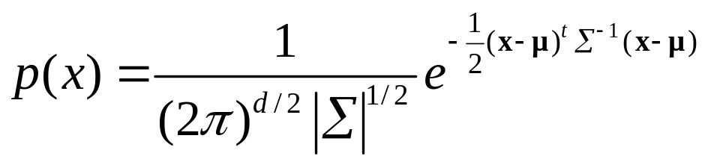
Covariance matrices
and
Finally, by noting that the determinant of Σ is just the product of the variances, we can write the joint density in the form
This is the general form of a multivariate normal density function, where the covariance matrix is no longer required to be diagonal.

Slide 8
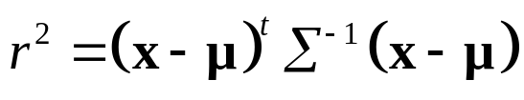
Covariance matrices
The natural measure of the distance from x to the mean μ is provided by the quantity
which is the square of the Mahalanobis distance from x to μ.

Slide 9

Some Geometric Features
The level curves of the 2D Gaussian are ellipses; the principal axes are in the direction of the eigenvectors of Σ, and the different width correspond to the corresponding eigenvalues.
For uncorrelated r.v. ( ρ=0 ) the axes are parallel to the coordinate axes.
For the extreme case of the ellipses collapse into straight lines (in fact there is only one independent r.v.).
Marginal and conditional densities are unidimensional normal.

Slide 10
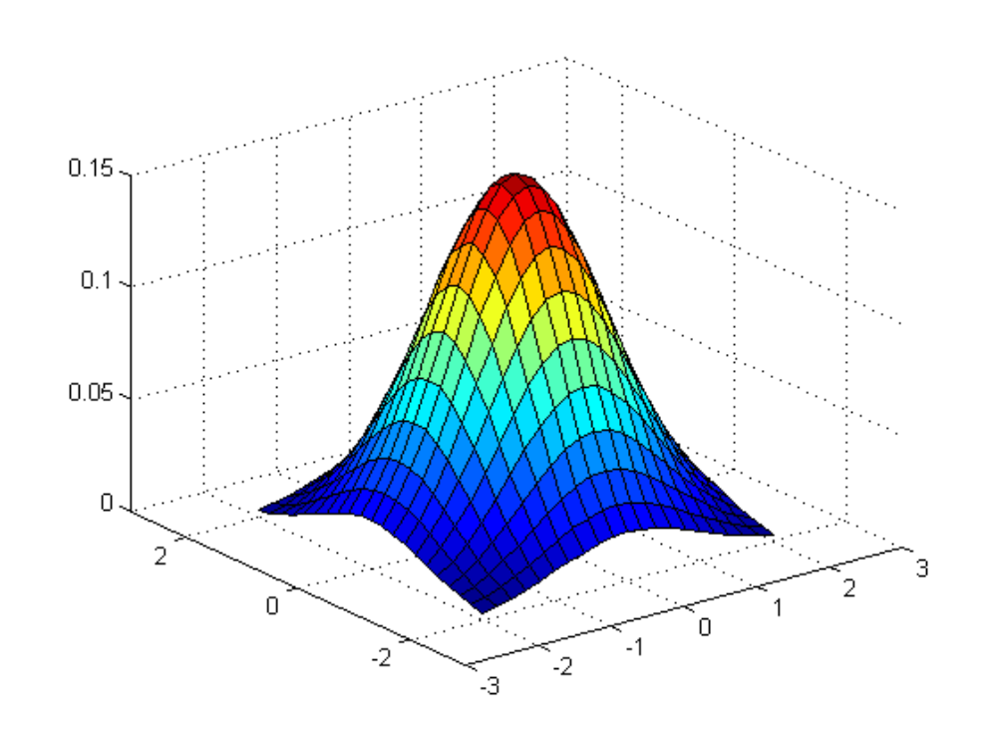
Some Geometric Features

Slide 11
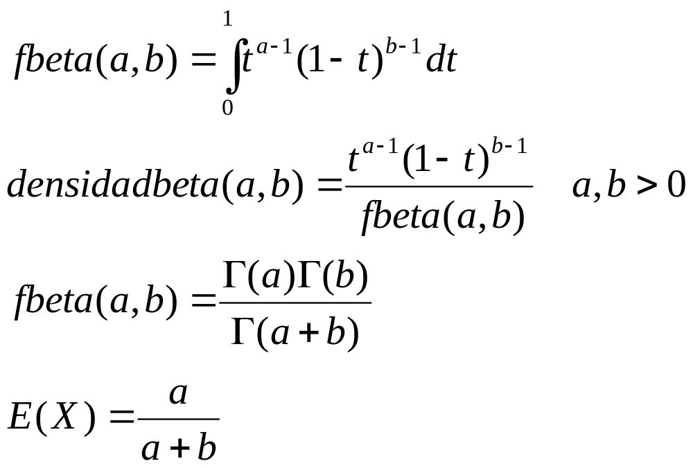
DISTRIBUCIÓN BETA

