Slide 1



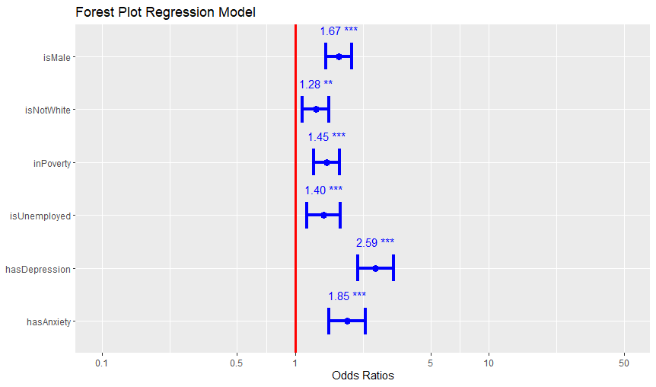
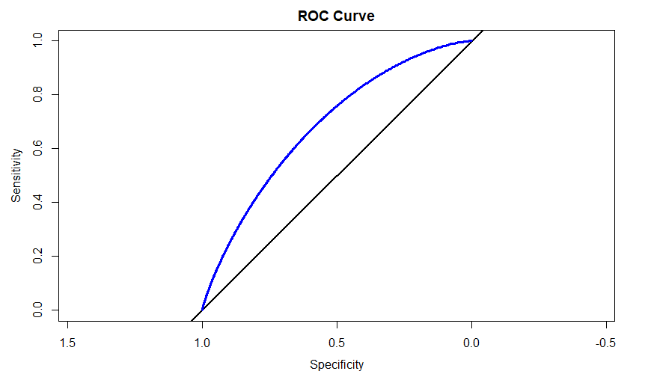
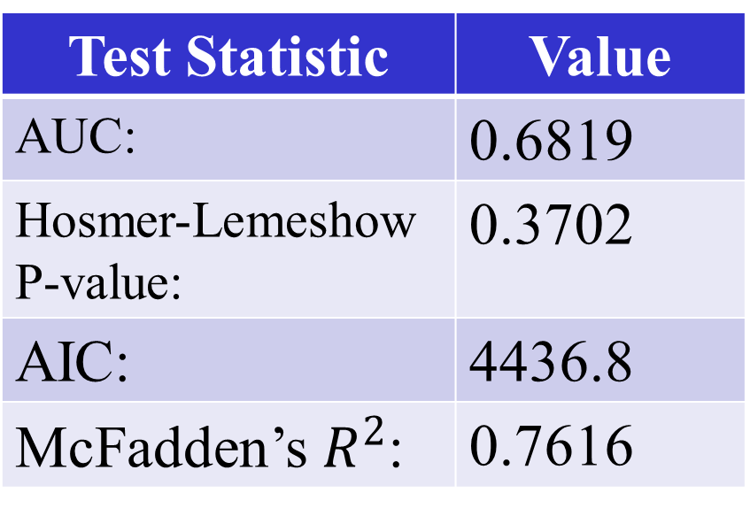
An Analysis of Illicit Drug Use among Those with Physical Disabilities
Sean Waggoner
INTRODUCTION
Faculty Advisor: Dr. Herman Ray
RESULTS
In July of 2022, the Wellstar College of Health and Human Services at KSU conducted a survey among U.S. residents with physical disabilities. The study was headed by Dr. Monica Swahn and Dr. Mark Geil so that they could learn more about the mental health and behavioral needs of those living with physical disabilities. Among the questions asked in the survey were those about mental health, alcohol and drug use, as well as various demographic details.
Using the survey data that they provided, I decided to investigate illicit drug use among those suffering from physical disabilities. A large part of my interest in this topic is due to the opioid epidemic currently gripping different parts of the U.S. I believe that if a correlation is found between suffering from a physical disability and abusing illicit drugs, this could help shed light on a rarely discussed, yet important issue facing a vulnerable subset of our society – and potentially even lead to more research on and investigation into the topic.
Drug Usage by Demographics
Factor | P-value | Relative Impact
Is Male | <0.001
Is White | 0.00385
Is in Poverty | <0.001
Is Unemployed | <0.001
Has College Degree | <0.001
Has Depression | <0.001
Has Anxiety | <0.001
Back Problems by Drug Type
Factor | P-value | Relative Impact
Uses Coca Derivatives | 0.203
Uses Hallucinogens | 0.602
Uses THC Products | 0.143
Uses Painkillers | <0.001
Uses Sedatives | 0.00352
Uses Stimulants | 0.216
Uses Tranquilizers | 0.00661
The following predictors turned out to be very significant to the model:
  “Is Male”, “Is Not White”, “In Poverty”, “Is Unemployed”, “Has Depression”, “Has Anxiety”
Interestingly, the rural/urban distinction did not turn out to be very significant and reduced the model’s overall predictiveness when added.
The c-statistic of this model turned out to be 0.682, showing that the model was predictive overall.
DISCUSSION
Unemployed non-white males with physical disabilities living in poverty and suffering from depression and/or anxiety are at particular risk of abusing illicit drugs.
  These demographic characteristics turned out to be significant to illicit drug use, while the various types of physical disabilities, living in a rural vs. urban location, and other demographic characteristics did not.
If I chose to continue my research on this subject, I would try to obtain access to a larger data set if one exists. The relatively small numbers of illicit drug users compared with the total number of people surveyed in the study is certainly a drawback with the data.
Although much of the national conversation on the opioid epidemic revolves around Fentanyl, the data obtained focused on heroin and painkillers, rather than opioids. Fentanyl was only included under the “Other” category.
Objective
I set out to answer the following research question:
“What is the prevalence and types of illicit drug use among US adults with a physical disability? Is there an association between the type of disability and illicit drug use? Does it vary by demographic characteristics?”
To this end, I decided to use R to look for statistically significant relations between the dependent variable “Uses Drugs” and its potential predictors. Next, I would run a logistic regression in order to find out which variables could be used to predict whether or not someone with a physical disability would abuse illicit drugs.
REFERENCES
METHODS
The Comprehensive R Archive Network. Using the table1 Package to Create HTML Tables of Descriptive Statistics. https://cran.r-project.org/web/packages/table1/vignettes/table1-examples.html
ProjectPro. How to Plot AUC Curve in R. https://www.projectpro.io/recipes/plot-auc-roc-curve-r.
First, I used Excel to start cleaning the survey data, subsequently importing it into R, where I finished cleaning the data and removed unnecessary variables. Next, I used the “table1” function to investigate the significance of different types of physical disabilities, as well as demographic data as they pertain to usage of illicit drugs. After checking my results, I refactorized my predictors so that they would cover sufficiently large numbers of observations in order to ensure significance.
For the regression itself, I chose to focus on demographic characteristics, urban vs. rural counties, and different potentially statistically significant physical disabilities such as back problems. I then checked different regression diagnostics such as ANOVA, Cook’s Distance, VIF’s, standardized residuals, and the ROC Curve in order to refine my model.
Test Statistic | Value
AUC: | 0.6819
Hosmer-Lemeshow P-value: | 0.3702
AIC: | 4436.8
McFadden’s $R^{2}$: | 0.7616
Drug Usage by Disability
Factor | P-value | Relative Impact
Allergies | 0.205
Back Problems | 0.0848
Bone Problems | 0.287
Heart Problems | 0.96
Eye Problems | 0.107
Ear Problems | 0.11
Limb Loss/Impairment | 0.581
Lung Problems | 0.117
Neurological Problems | 0.4
Other Disability | 0.913

