Slide 1
Game-Theoretic Model for Spectrum Sharing in 5G/6G Networks
Power control · Cournot competition · Stackelberg pricing · Nash bargaining
Arnav Anand
Aniket Mohanty
Aneesh Srivastava
Nihit Karanjawala
Shree Ganesh Manikandan
2427030154
2427030143
2427030086
2427030145
2427030121
Project Presentation | October 2026
Notes:
Introduce the team and the project: a game-theoretic framework, implemented in Python, for sharing spectrum among users and operators in 5G and 6G networks.

Slide 2








Agenda
01
02
Background & problem
Objectives
03
04
Why game theory
System model & methodology
05
06
Implementation
Results
07
08
Applications
Conclusion & future scope
Notes:
Walk through the structure of the talk.

Slide 3



Spectrum is scarce, yet often idle
Demand keeps growing
Licensed bands are under-used
Dynamic sharing is the answer
5G NR (n78, 3.3–3.8 GHz; mmWave) and 6G (7–24 GHz, sub-THz) need ever wider channels for eMBB, URLLC and massive IoT.
A band congested downtown at noon can be nearly idle in the suburbs at night: exclusive licences waste capacity.
LTE–NR DSS, CBRS with its Spectrum Access System, Licensed Shared Access and local private-5G licences let many parties share one band.
Notes:
Spectrum is the scarcest resource in mobile networks. Utilisation measurements show licensed spectrum is idle much of the time, so regulators and operators are moving to dynamic spectrum sharing.

Slide 4




Problem statement
How should a limited band and transmit power be shared among self-interested 5G/6G users and operators so the outcome is efficient, fair, profitable and stable, without a central controller that knows everything?
Co-channel interference
Competition for spectrum
Owner pricing
Fair slicing
Small cells on one carrier: what powers emerge, and can a price help?
Operators buying leased bandwidth: how much, and is bidding stable?
What price should the licence holder set as demand grows?
How should eMBB, URLLC and mMTC slices split one band?
Notes:
The general problem, and the four concrete instances we model.

Slide 5
Objectives
1
Model a realistic 5G radio environment (3GPP TR 38.901 UMi, 3.5 GHz)
2
Formulate four games: power control, Cournot, Stackelberg, Nash bargaining
3
Compute equilibria with best response, backward induction and convex optimisation
4
Verify every equilibrium automatically against its definition
5
Evaluate sum rate, energy efficiency, fairness, profit and Price of Anarchy
6
Study learning stability, network density and market size
Notes:
Six objectives, from modelling through verification to evaluation.

Slide 6




Why game theory?
Players
Three families of games
radios, small cells, operators, network slices
Non-cooperative
selfish, distributed decisions (power control, Cournot)
Hierarchical (Stackelberg)
a licence holder moves first, others react
Cooperative (bargaining)
parties agree on a fair, efficient division
Strategies
transmit power, bandwidth requested, price announced
Utilities
throughput or profit minus the cost of power, spectrum or interference
Equilibrium
a stable outcome where nobody gains by deviating alone; it predicts distributed behaviour
Notes:
Spectrum sharing has many decision makers with conflicting goals. Game theory gives us players, strategies, utilities and equilibria. We use one model from each family.

Slide 7
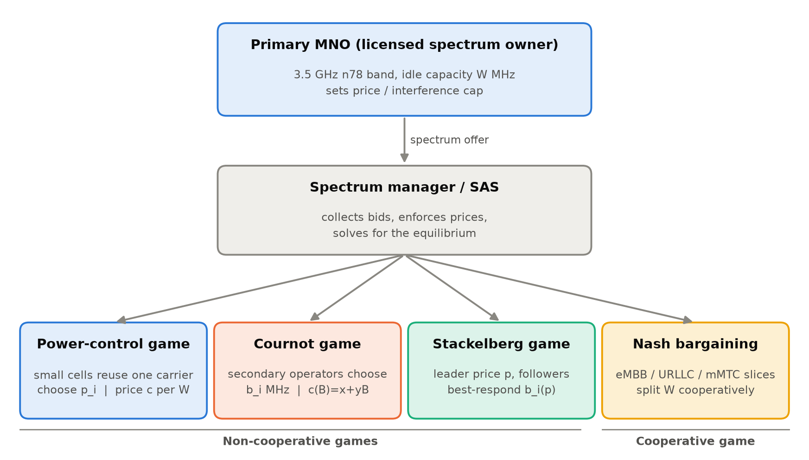
System model
Primary MNO
holds the licensed n78 band and idle capacity W
Spectrum manager / SAS
sets prices and rules, computes equilibria
Four sharing games
three non-cooperative, one cooperative
Notes:
One licensed band, a spectrum manager playing the role of a CBRS SAS, and four sharing situations underneath.

Slide 8
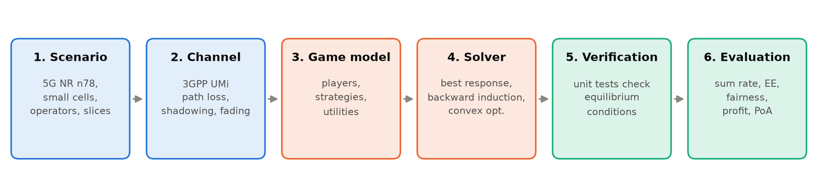
Methodology and channel model
Path loss
Fading
PL = 32.4 + 21 log10(d) + 20 log10(fc) (3GPP UMi)
4 dB log-normal shadowing + Rayleigh
Noise
Spectral efficiency
−174 dBm/Hz + NF 7 dB → −94 dBm over 20 MHz
k = log2(1 + K·SNR), K = 1.5 / ln(0.2/BER)
Notes:
Six-step method. The channel follows 3GPP TR 38.901 Urban Micro at 3.5 GHz, so the numbers are realistic for 5G small cells.

Slide 9

Four game models
A. Power-control game
B. Cournot market
uᵢ = B·log2(1+SINRᵢ) − c·pᵢ
πᵢ = r·kᵢ·bᵢ − bᵢ·(x + y·B)
Best response: water-filling, BRᵢ = [B/(c ln2) − (Iᵢ+N₀)/Gᵢᵢ] clipped to [0, Pmax]. Unique NE (Yates).
Operators buy bᵢ MHz; price rises with total demand. Dynamic bidding bᵢ ← bᵢ + α·bᵢ·∂πᵢ/∂bᵢ.
C. Stackelberg pricing
D. Nash bargaining
Uᵢ = wᵢ ln(1 + gᵢbᵢ) − p·bᵢ
max Σ aᵢ ln(sᵢbᵢ − dᵢ)
Followers: bᵢ* = wᵢ/p − 1/gᵢ. Leader maximises (p − c)·Σbᵢ*(p) s.t. Σbᵢ* ≤ W.
Slices get their minimum dᵢ/sᵢ, then share the surplus in proportion to bargaining power aᵢ.
Notes:
Formulation of each model. A: utility is throughput minus an interference price. B: Cournot with linear inverse demand. C: leader price, follower best responses, backward induction. D: weighted Nash bargaining with minimum-rate guarantees.

Slide 10
Implementation in Python
Python 3.13
Module | Responsibility
channel.py | 3GPP path loss, fading, deployment
power_game.py | best response, Nash solver, social optimum
cournot_game.py | equilibrium, collusion, dynamics, stability
stackelberg_game.py | backward induction with capacity
bargaining.py | closed-form & numerical NBS, baselines
metrics.py | Jain, PoA, energy efficiency
main.py | 6 experiments → figures + summary.json
tests/test_games.py | checks every equilibrium definition
language
NumPy
vectorised SINR & channels
SciPy
L-BFGS-B, SLSQP, Brent
Matplotlib
colour-blind-safe figures
unittest
14 equilibrium tests
Notes:
A modular Python package: one module per game plus channel and metrics, a driver that runs six experiments, and a test suite that checks the equilibrium conditions directly.

Slide 11

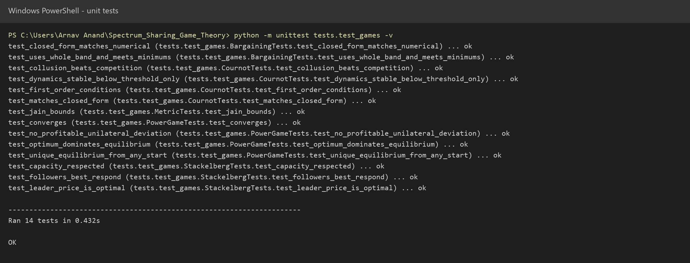
Every equilibrium is verified
Power game
no unilateral deviation helps; same NE from any start
Cournot
matches closed form; stable only below α*
Stackelberg
followers best-respond; leader price optimal
Bargaining
closed form = SLSQP; minimums met
14 / 14 tests pass
Notes:
We do not just check that the code runs: each test checks the mathematical definition of the equilibrium.

Slide 12
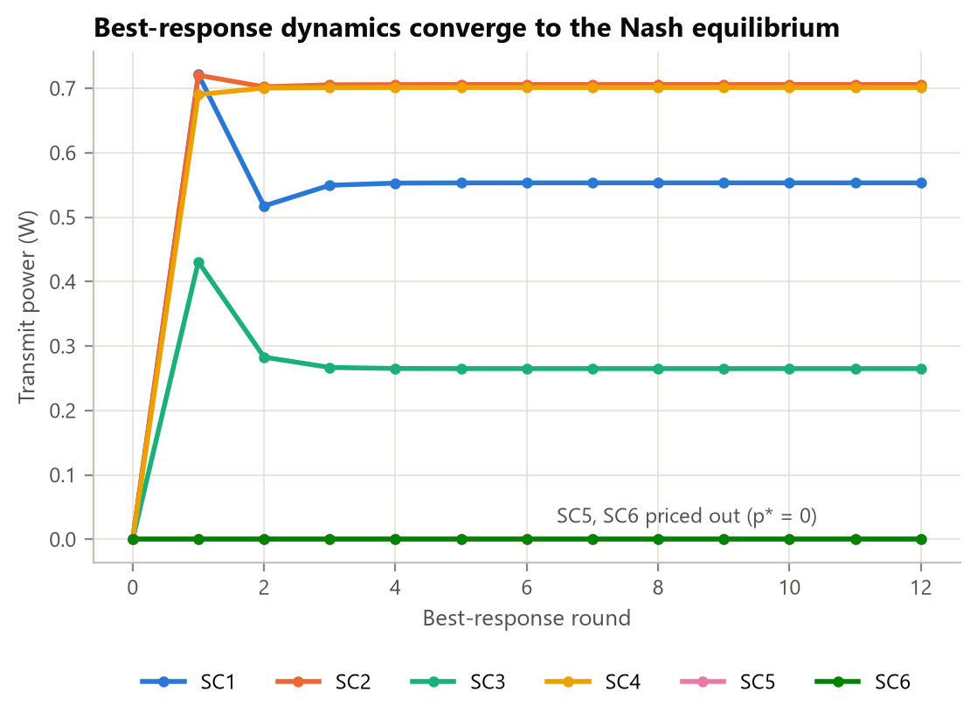
Pricing turns selfish power control into a better network
+28.6%
3.0×
sum rate vs full power
energy efficiency
Best-response dynamics reach the unique Nash equilibrium in 12 rounds; two weak links price themselves out.
Notes:
Six small cells, price 40 Mbps per watt. Pricing gives 28.6 percent more throughput with 63 percent less power. The central optimum is higher still but switches weak links off, so it is the least fair.

Slide 13
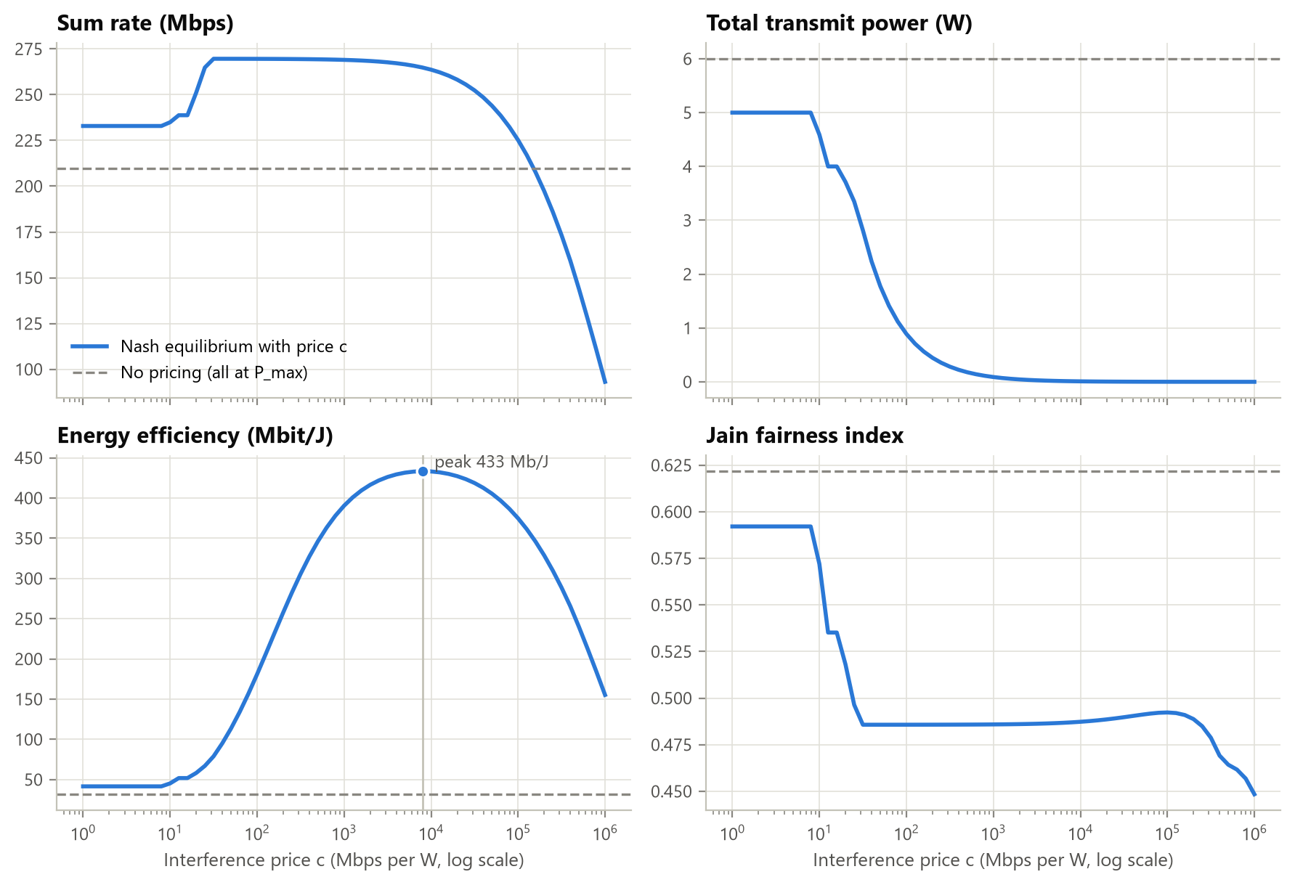
The interference price is a single control knob
c < 10
everyone near full power, like an unpriced network
10 < c < 10⁴
weak links drop out; powers scale down, SINR and sum rate hold
c > 10⁵
signals approach the noise floor and the rate collapses
13.6×
peak energy efficiency vs unpriced, still 264.8 Mbps
Notes:
Sweeping the price from 1 to one million. Because the network is interference-limited, there is a wide range where power falls by orders of magnitude while throughput is unchanged.

Slide 14
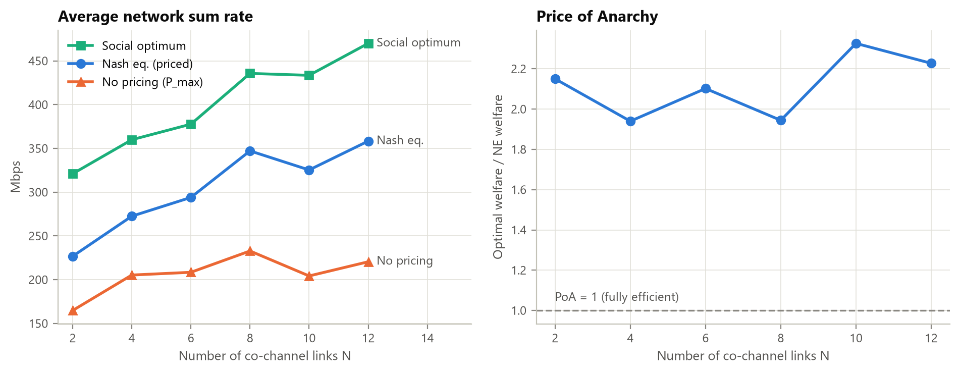
Decentralised play stays close to the optimum
71%–80%
≈ 2
< 26
of the optimal sum rate, reached selfishly
Price of Anarchy, flat as density grows
average best-response rounds to converge
Notes:
40 random networks per size. Full power saturates as interference grows; the priced equilibrium keeps scaling.

Slide 15
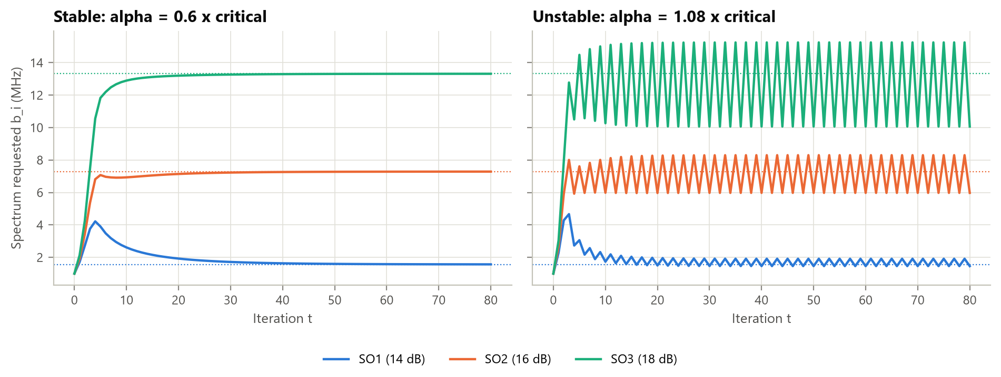
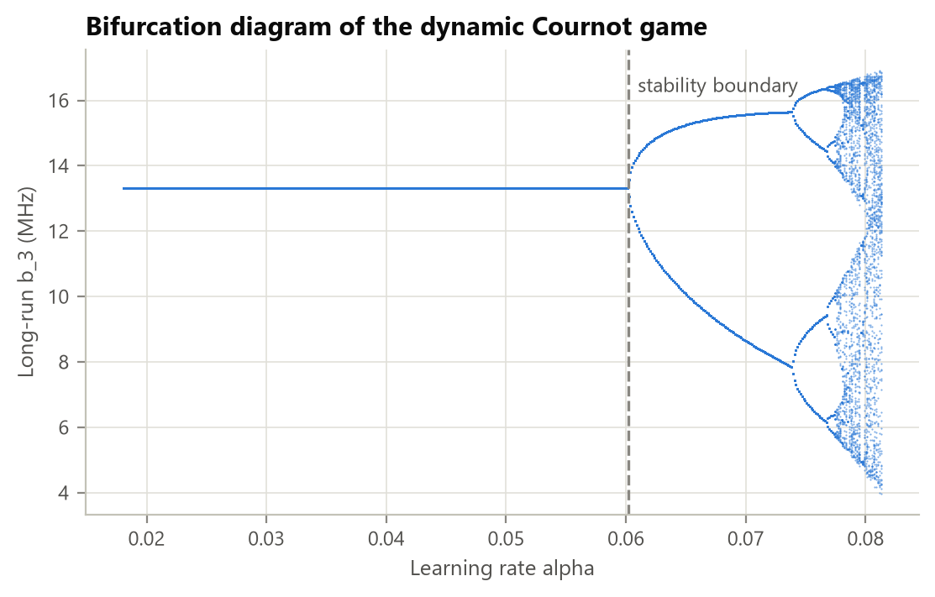
Cournot: competition overbuys, fast learning destabilises
233.0 vs 315.0
total profit: competition vs collusion
α* = 0.060
stability limit for adaptive bidding
Above α*: 2-cycle → period doubling → chaos. AI bidding agents need bounded learning rates.
Notes:
Three secondary operators. Each overbuys because it ignores the price rise it causes for others, so competition is less profitable than collusion. The dynamic game converges only below the stability limit.

Slide 16
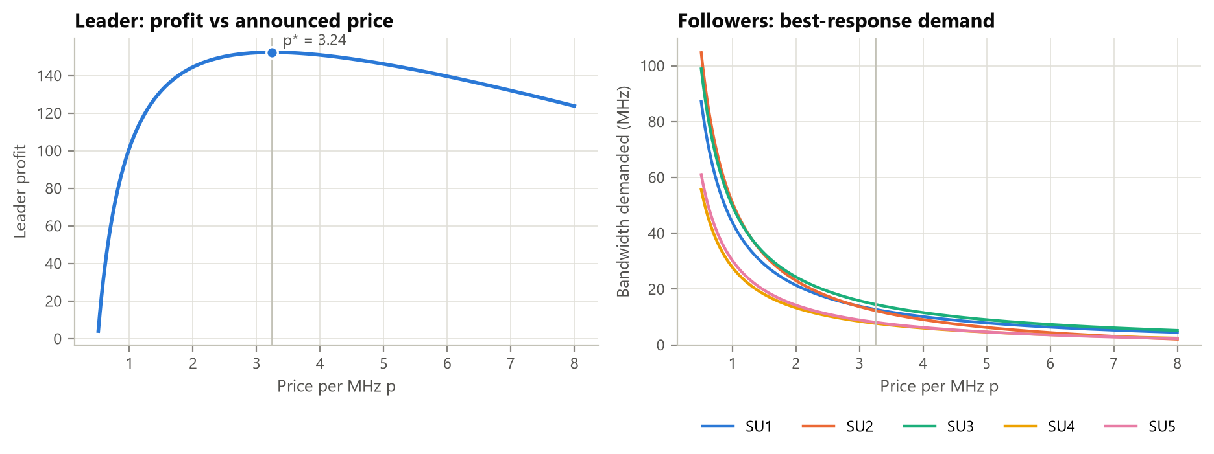
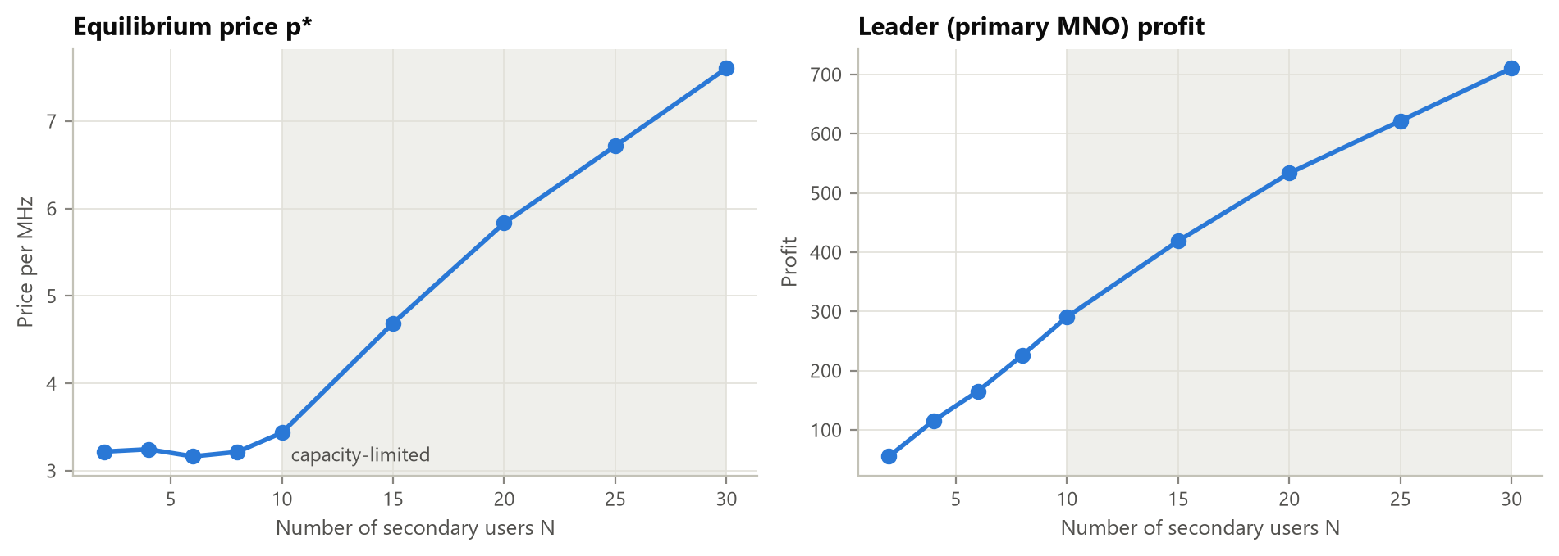
Stackelberg: the owner prices for scarcity
p* = 3.24
optimal price per MHz with 5 followers
55.5 / 100 MHz
leased: the owner withholds capacity
Once demand fills the band (N ≥ 10), price climbs from 3.2 to 7.61 at N = 30.
Notes:
Backward induction. Followers buy where marginal value equals price; the leader picks the profit-maximising price. With few users it withholds capacity; once demand saturates the band, the price rises steeply.

Slide 17
Nash bargaining balances throughput and fairness
Scheme | Sum rate | Jain of gains
Nash bargaining | 369.6 | 0.803
Weighted NBS | 365.5 | 0.822
Equal split | 333.3 | 0.925
Proportional | 405.1 | 0.576
Max sum-rate | 476.7 | 0.333
Max sum-rate starves URLLC and mMTC; equal split wastes eMBB. NBS sits between them and maximises the Nash product.
Notes:
Three slices share 100 megahertz with minimum guarantees. Nash bargaining is the axiomatic compromise. Doubling URLLC's bargaining power shifts about 8 megahertz to it.

Slide 18
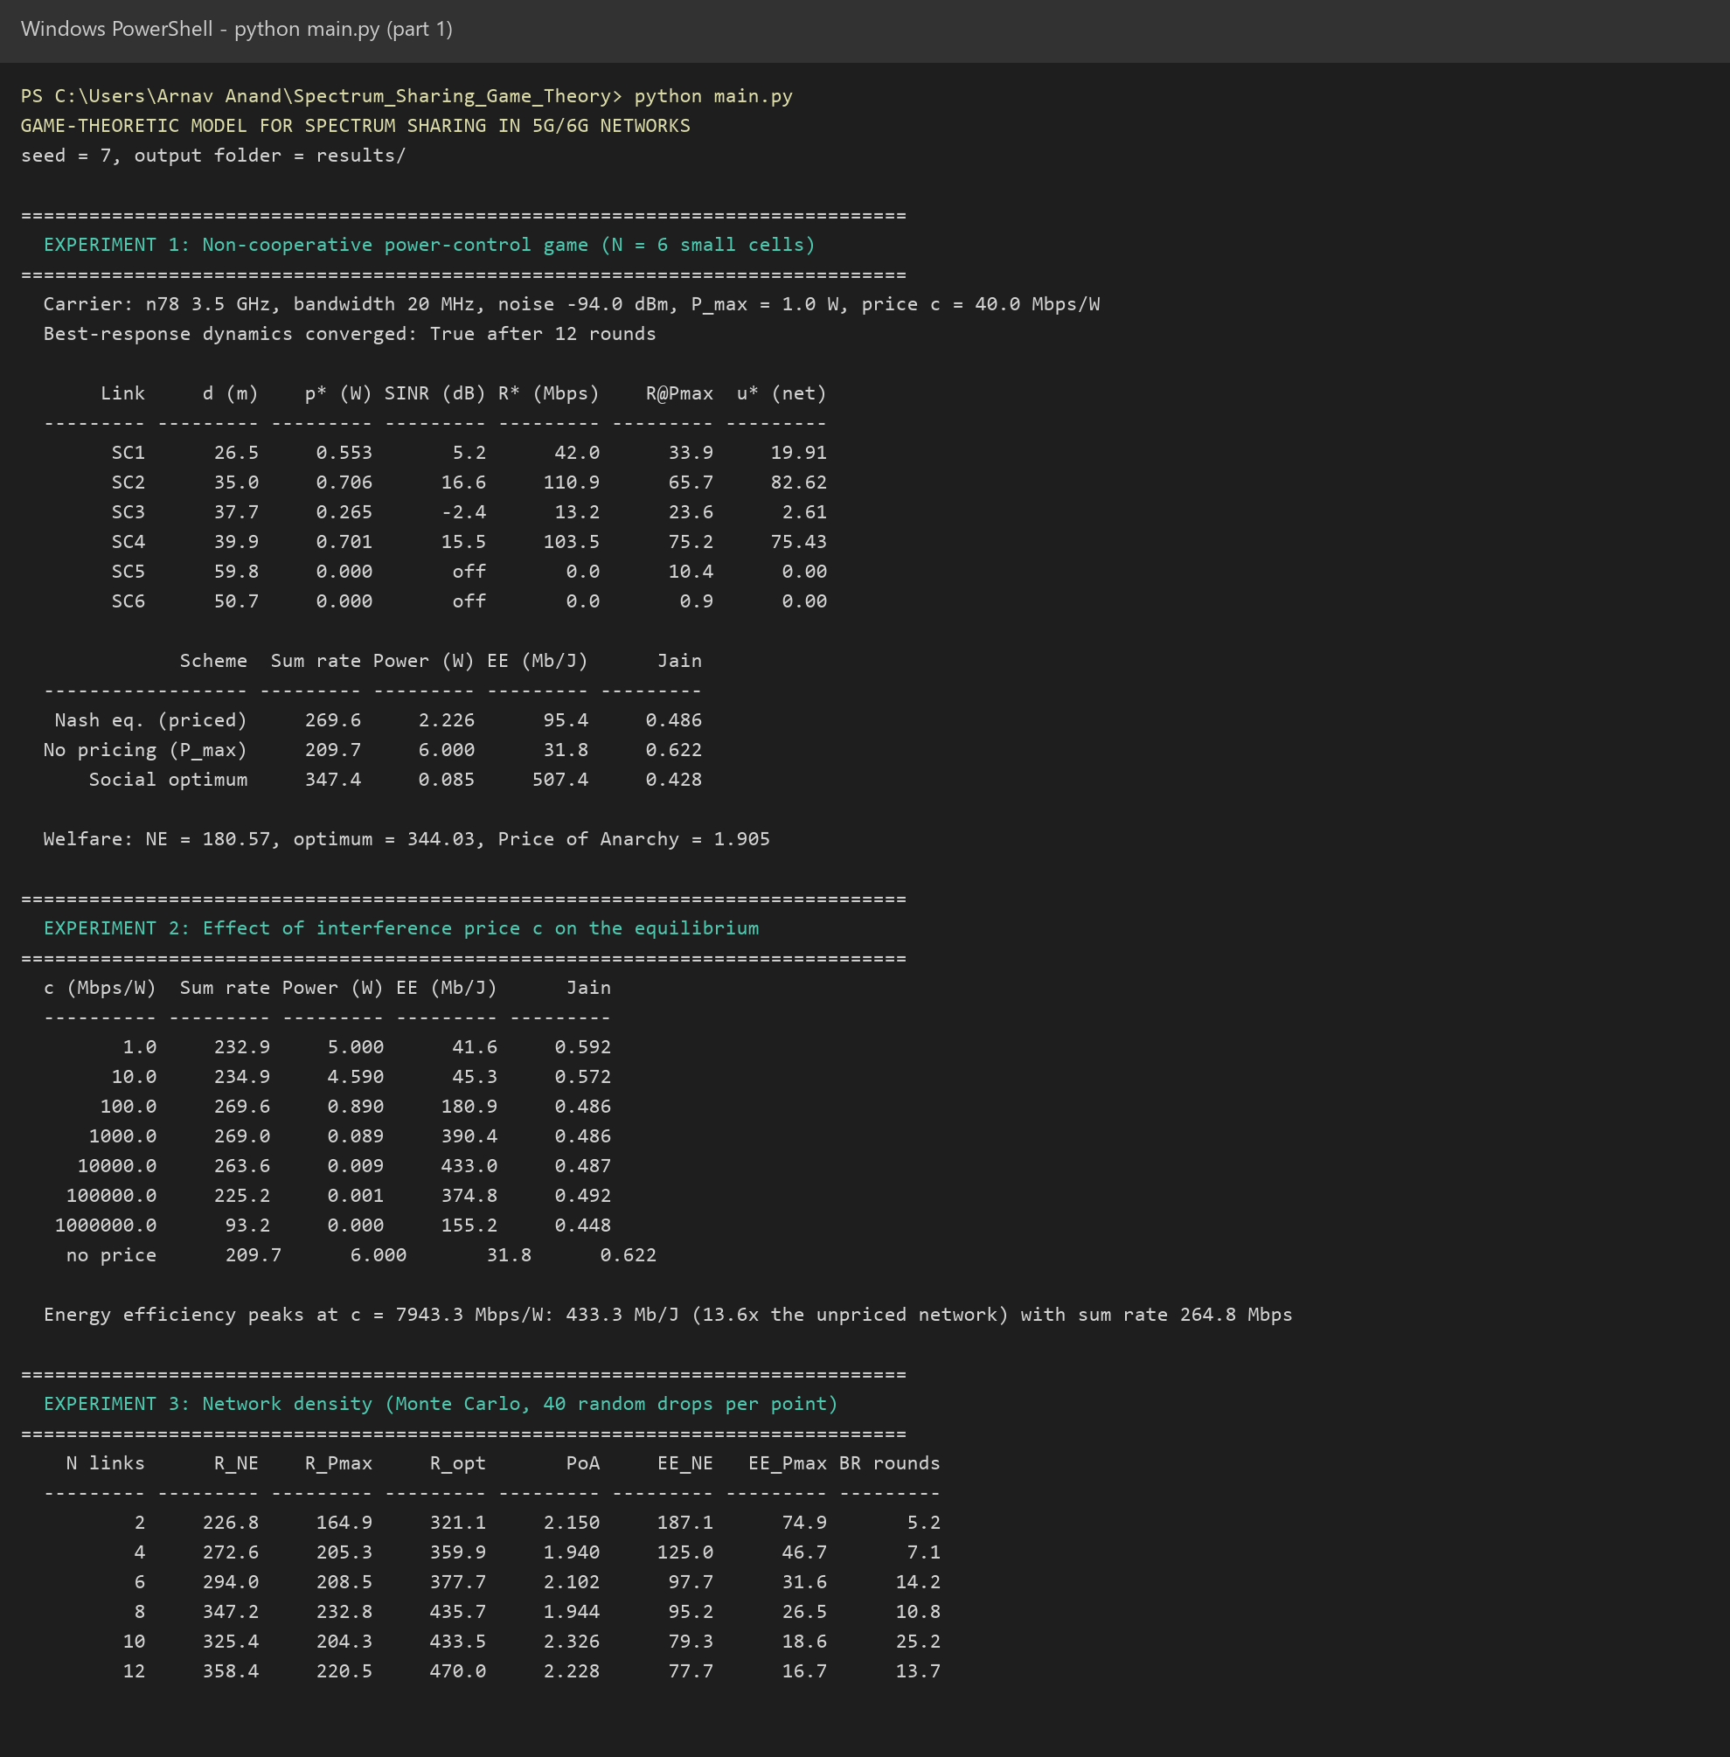
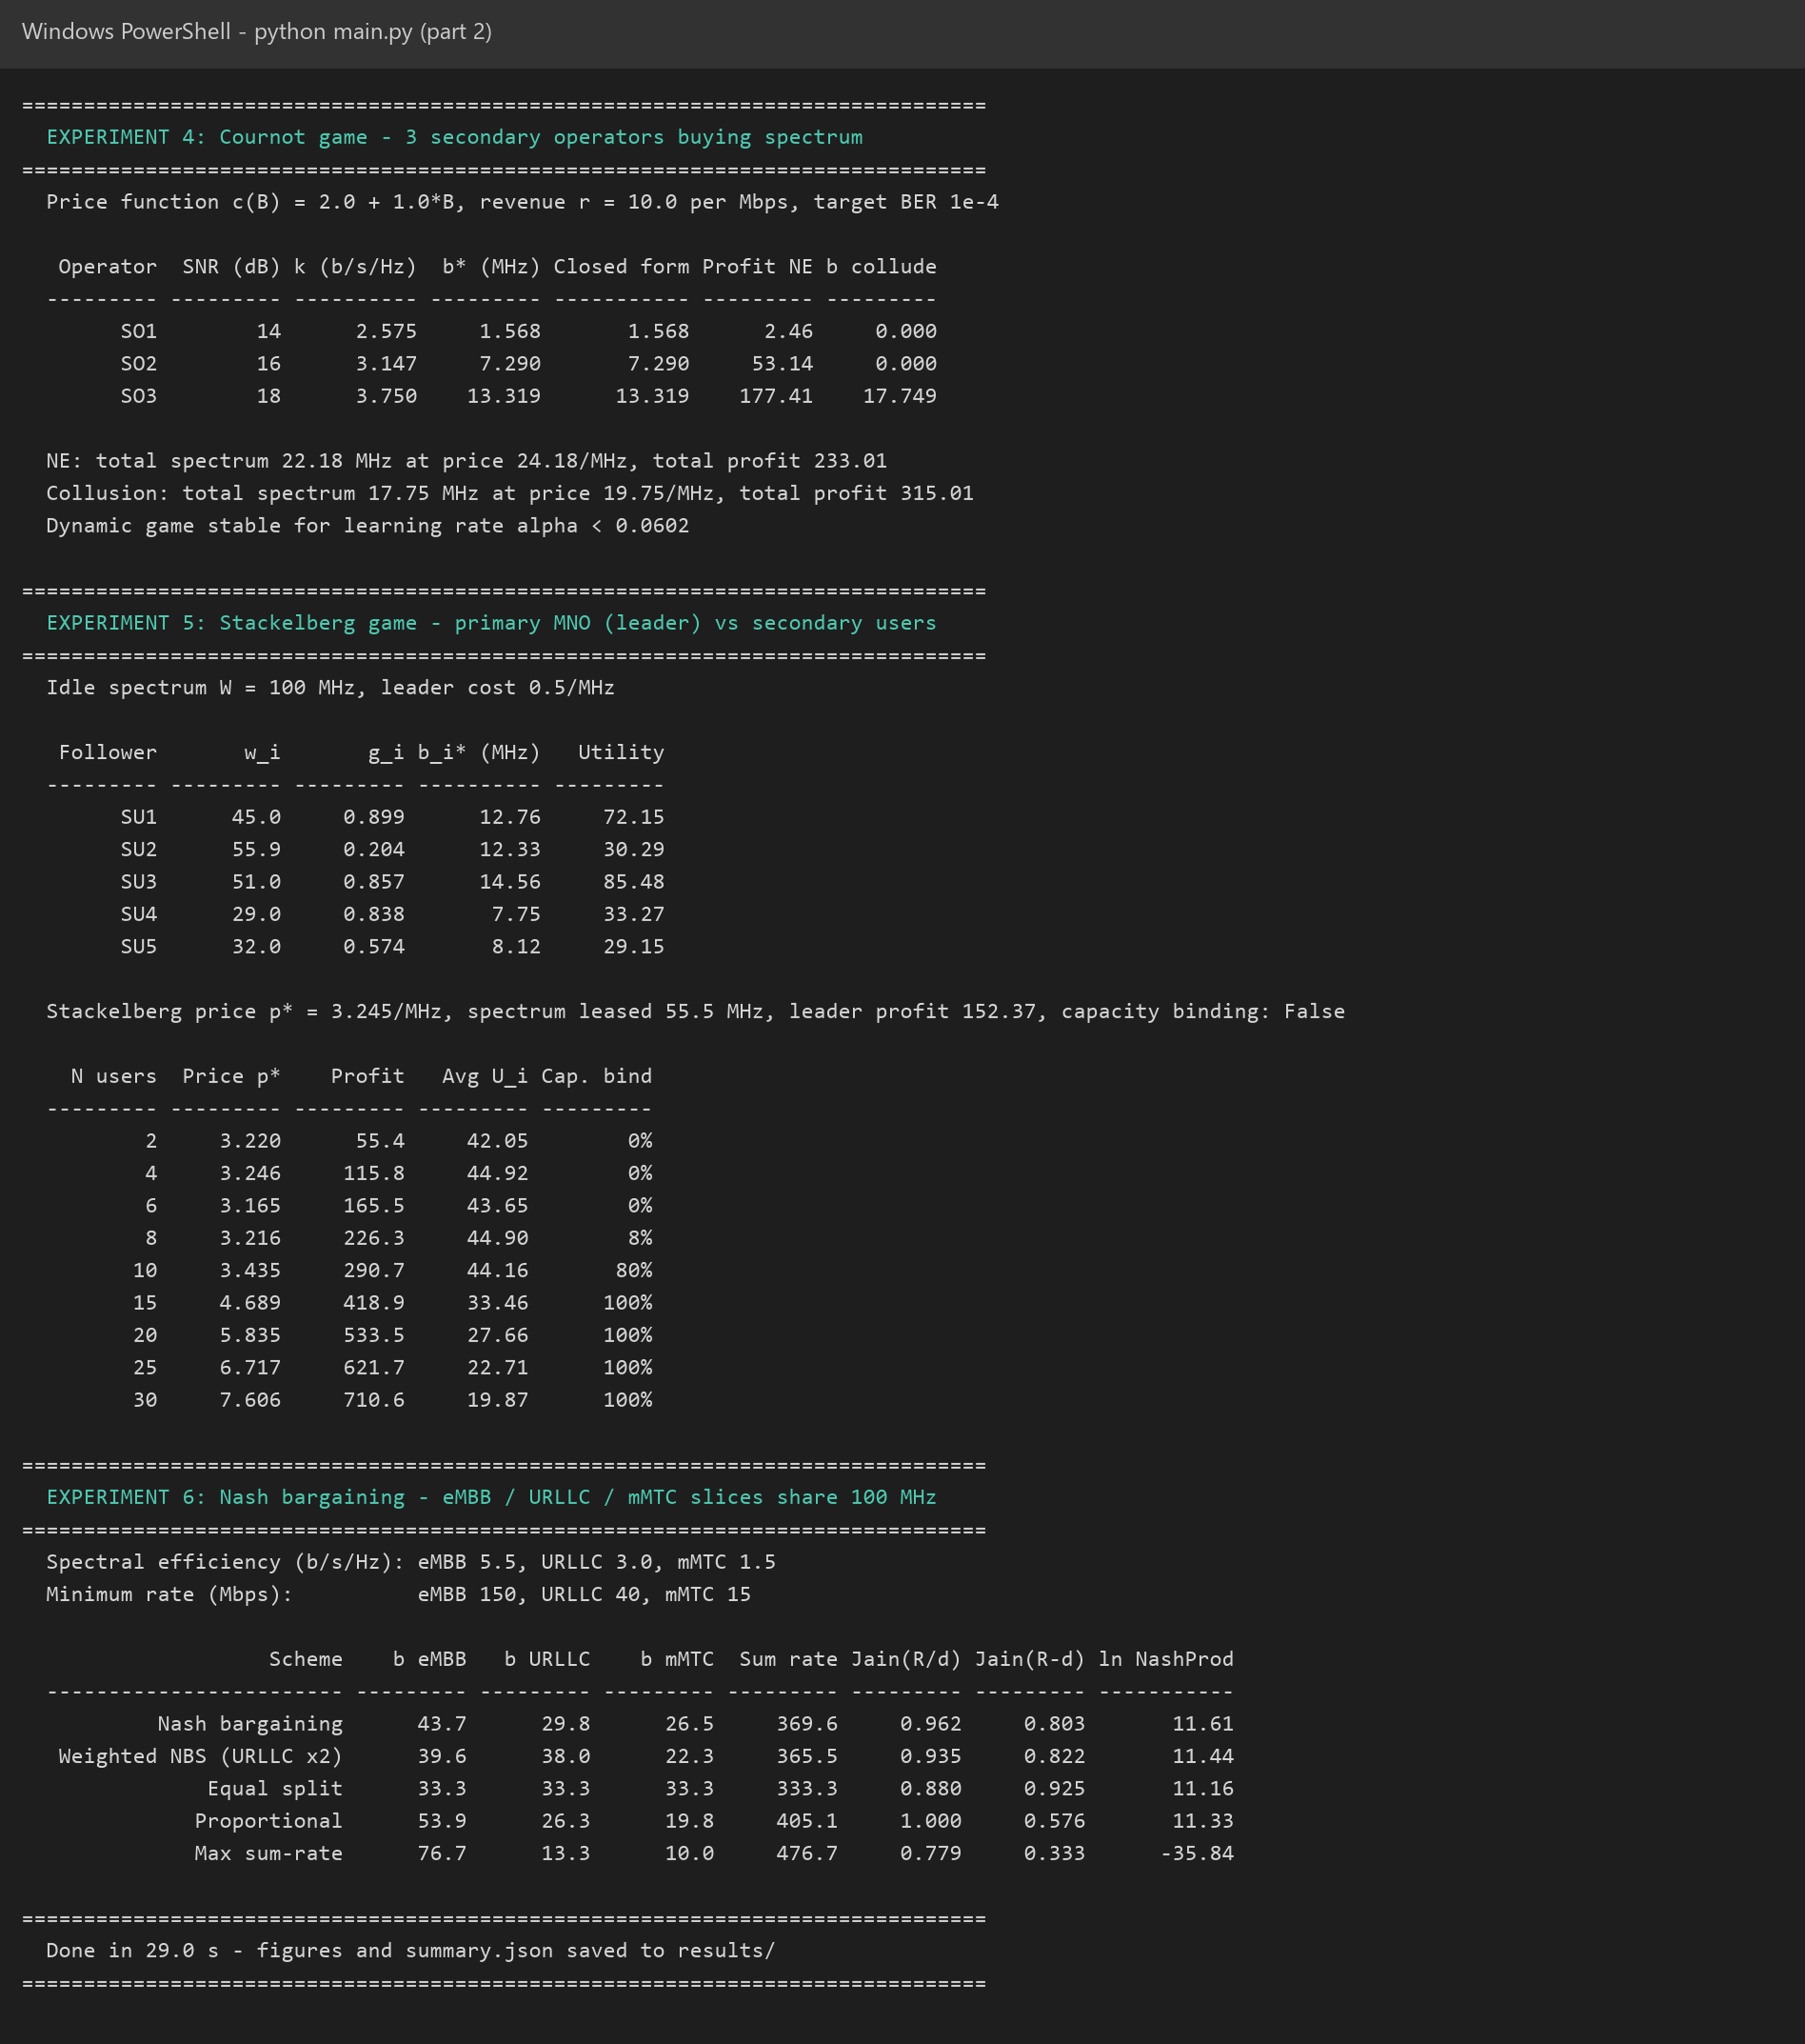
Program output
Notes:
Output of python main.py: every table in the report is printed here. The full run takes about 25 seconds.

Slide 19






Applications
CBRS / SAS
Private 5G
Network slicing
Dense small cells
interference & Stackelberg pricing for 3.5 GHz sharing
factories, ports and campuses leasing local spectrum
fair eMBB / URLLC / mMTC resource split
distributed interference coordination
Spectrum markets
AI-native 6G
NTN sharing
Green networks
price design, collusion risk, trading
rewards & stability limits for multi-agent RL
satellite and terrestrial 6G in one band
trade small throughput loss for big energy gains
Notes:
Where these models apply in practice.

Slide 20
Conclusion and future scope
What we showed
Next steps
A simple interference price gives +29% throughput and 3× energy efficiency
Decentralised equilibria reach 71%–80% of the optimum without a central controller
Markets explain prices, the cost of competition and why fast learning destabilises
Nash bargaining gives slices a fair, tunable split
Multi-agent reinforcement learning
Auctions (VCG, double auctions)
Joint power, bandwidth and beams for mmWave / sub-THz
Bayesian games with hidden costs
O-RAN xApp integration
+28.6%
13.6×
α* = 0.060
14 / 14
throughput from pricing
peak energy efficiency
bidding stability limit
equilibrium tests pass
Notes:
Summarise the findings and the directions for future work.

Slide 21
Thank you
Questions?
Arnav Anand
Aniket Mohanty
Aneesh Srivastava
Nihit Karanjawala
Shree Ganesh Manikandan
2427030154
2427030143
2427030086
2427030145
2427030121
Notes:
Invite questions.

