Slide 1
Automatic Medical Report Generation
Biamonte Salvatore 264177
Di Franco Federico 263678
Visciglia Domenico 263631

Slide 2
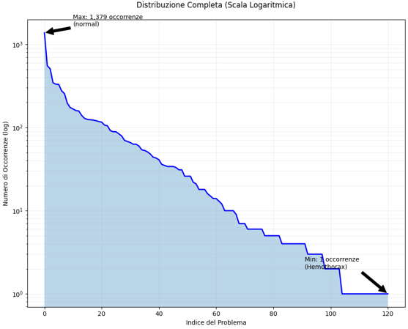
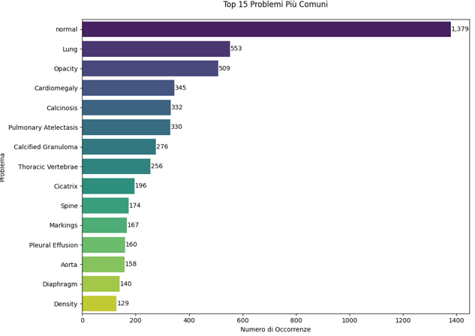
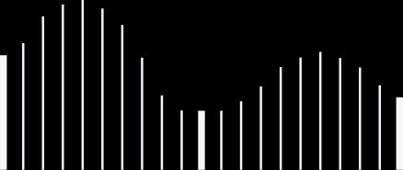
Analysis and Structuring of the Chest X-Ray Dataset
The dataset analyzed contains 3851 rows, with frontal and lateral chest X-rays and associated medical analyses. After cleaning and removing 520 malformed rows, the final dataset includes:
  Selected columns:
    Problems: Medical issues (121 unique labels).
    Findings: Radiologist's analysis.
    Images: Associated chest X-rays.
Distribution:
  Significant imbalance: "normal" dominates (1379 occurrences), intermediate issues like "Lung" (553) and "Opacity" (509), and rare cases (e.g., "Hemothorax" with 1 occurrence).
Challenges:
  Imbalanced and incomplete data (13.5%).
  Ambiguity in labels (e.g., Anatomy vs. Pathology).
Final strategies:
  Data Cleaning: Elimination of problems with few occurrences (20) and removal of rows without all the data
  Binary classification: Sick vs. Not Sick.
  Multi-class classification: Grouped by systems (Pulmonary, Cardiovascular, Musculoskeletal, No Problem).

Slide 3
Using the chest X-ray images, we aim to perform two types of classification through separate image to text models:
  Binary Classification: Predict whether the patient is Sick or Not Sick.
    Not a Standard Binary: Instead of a single-neuron + sigmoid, we use a two-class softmax within a multi-class framework. This ensures a consistent parametric design and streamlines switching between binary and multi-class tasks without performance loss.
  Multi-class Classification: Categorize issues into four regions (Pulmonary, Cardiovascular, Musculoskeletal, or No Problem).
    Different learning rate strategies by grouping the model components based on their roles.
Caption Generation:
Both models generate captions describing the findings. For the multi-class model, we also implemented a version with a Custom Transformer to replace GPT-2 for compare and test the quality of the texts generated by GPT-2.
Key Design Advantages:
  Seamless binary/multi-class switching via final-layer reconfiguration, preserving shared architectures (ResNet, GPT-2, Transformer).
  Flexible label mapping for multi-class anatomical systems.
Custom Loss Functions:
  Modified Focal Loss: Addresses class imbalance with tuned hyperparameters (α, γ) to mitigate dominance of majority classes.
  Medical Caption Loss: Assigns higher penalties to errors in critical medical and anatomical terms using regex-based weighting for key tokens.
This versatile approach ensures robust classification and precise, medically relevant captions.
Objectives and Particularities

Slide 4
  Dataset Splits:
    Train/Test Split: 80% of the dataset for training, 20% for testing.
    Internal Split: The training portion is divided into 70% for actual training and 30% for validation.
    Final distribution: 56% Train, 24% Validation, 20% Test.
  Optimization of Metrics:
  Various values for learning rate, epochs, and other hyperparameters were tested to reach the final configuration, like the number of epochs:
      Binary Model: 8 epochs.
      Multi-class GPT-2: 15 epochs.
      Multi-class Transformer: 15 epochs.
  Early Ideas to Final Solutions:
  Initial Models Tested:
      DenseNet121, EfficientNetB0, DeepLabV3, and custom U-Net, focusing on segmentation and compact networks.
      Custom autoencoder trained on the dataset, but it showed convergence instability and insufficient detail for medical captioning.
  Final ResNet50-Based Architecture:
    Higher Resolution Input (384×384): Improved feature extraction for better classification and captioning.
    Shared Latent Space (4096-dim): Supports both classification and GPT-2 captioning, achieving unified and robust performance.
  The results reported in the presentation are the result of the average of the about ten experiments carried out.
Experiments and Development
During the development phase, various experimental configurations were tested to optimize the performance of our models:

Slide 5
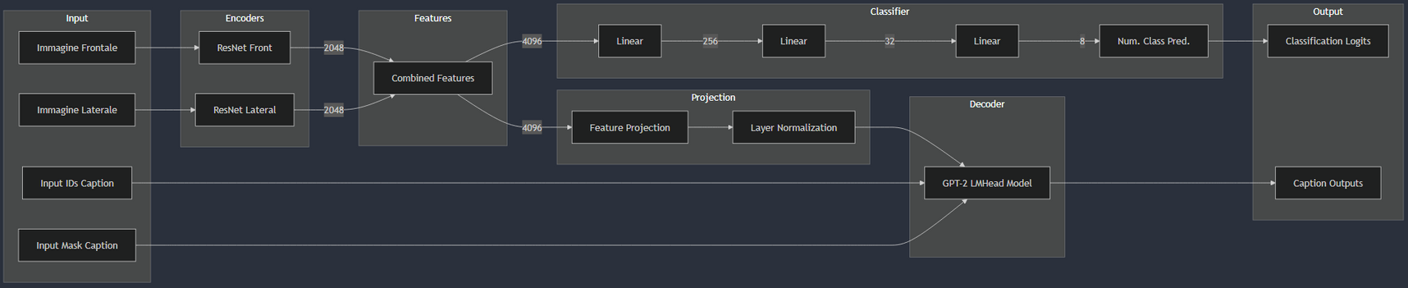
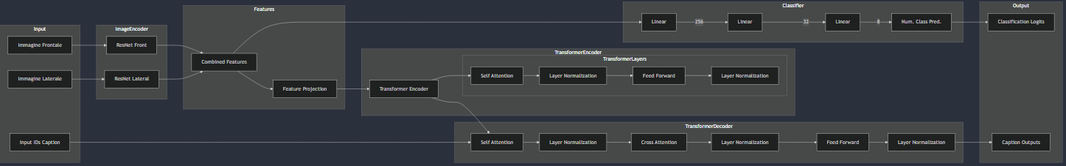
Model Architectures
  Binary Classification (GPT-2):
    Feature Extraction: Two ResNet-50 encoders process frontal and lateral X-rays, producing 2048-dimensional vectors concatenated into a 4096-dimensional representation.
    Binary Classifier: A feed-forward network predicts two logits (Sick/Not Sick).
    Captioning with GPT-2: The 4096 features are projected and passed to GPT-2 for caption generation. Training combines classification loss (binary cross-entropy/Focal Loss) and a custom caption loss.
  Multi-class Classification (GPT-2):
    Same Base Architecture: ResNet-50 encoders and feature concatenation are identical.
    Multi-class Classifier: The classifier outputs four logits for body-system categories (No Problem, Pulmonary, Cardiovascular, Musculoskeletal).
    Captioning with GPT-2: Same pipeline as binary classification, with a four-class loss replacing binary cross-entropy.
  Multi-class with Custom Transformer:
    Feature Extraction: Identical ResNet-50 encoders and multi-class classifier as the GPT-2 model.
    Custom Transformer Encoder: Image features (4096-dim) are projected into "image tokens" and combined with textual embeddings for processing in a TransformerEncoder.
    Custom Transformer Decoder: Generates captions using masked self-attention and cross-attention, trained from scratch with caption loss and classification loss.
Architecture of Models using GPT2
Architecture of Model using Custom Transformer

Slide 6
Results Analysis and Model Comparison
Model Overview:
  Binary (Sick/Not Sick):
    High test accuracy (95% overall).
    GPT-2 generates concise captions describing the presence of pathologies.
  Multi-Class (Body Zones) + GPT-2:
    Focuses on anatomical problem localization.
    High overall accuracy (91%) with fluent radiological text.
  Multi-Class (Body Zones) + Custom Transformer:
    Better classification accuracy (95% overall) but slightly less fluent captioning due to training from scratch.
Conclusion:
The unified pipeline supports flexible switching between binary and multi-class labeling with either GPT-2 or a custom Transformer for captioning. It achieves consistent accuracy and text generation results, balancing performance and versatility without extensive code modifications.
Reference | BLEU-4 | ROUGE-L
State of the Art | 0.177 | 0.372
Binary-GPT2 | 0.140 | 0.163
MultiClass-GPT2 | 0.124 | 0.201
MultiClass-Cust.Trans. | 0.055 | 0.212
Reference | Acc. Class 0 | Acc. Class 1 | Acc. Class 2 | Acc. Class 3 | Acc. Overall
Binary-GPT2 | 97.8% | 93.0% | - | - | 95.4%
MultiClass-GPT2 | 87.0% | 96.1% | 86.3% | 91.4% | 90.9%
MultiClass-Cust.Trans. | 97.2% | 98.2% | 78.9% | 96.5% | 95.6%

