Slide 1
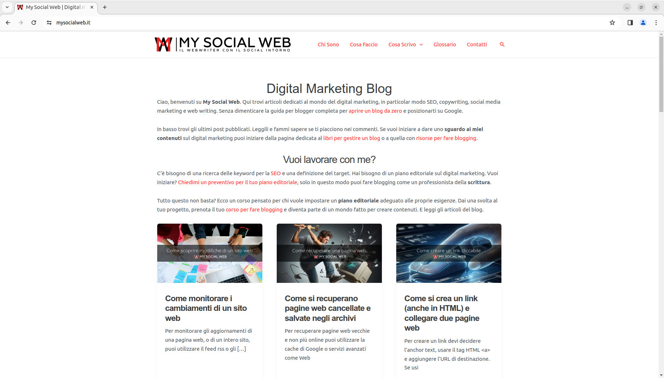

Slide 2
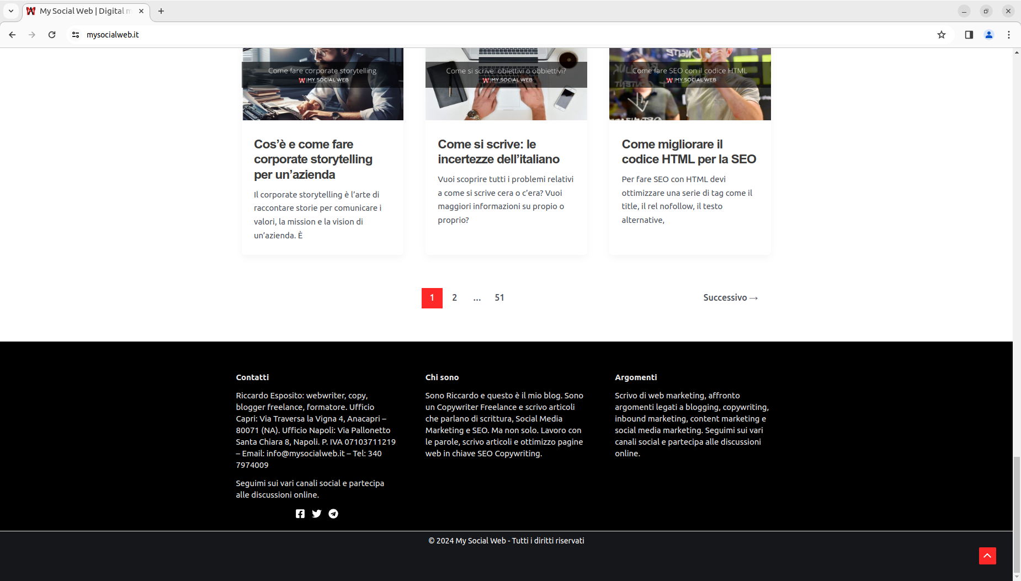

Slide 3
URL: https://www.mysocialweb.it/

